Slide 1
CARBON NANOSTRUCTURES (FULLERENES, CARBON NANOTUBES, GRAPHENE)
lecture for physics and chemistry students
(2017. summer semester – 20. April)
Prof. Jenő Kürti
ELTE Department of Biological Physics
e-mail: kurti@virag.elte.hu www: virag.elte.hu/kurti

Slide 2
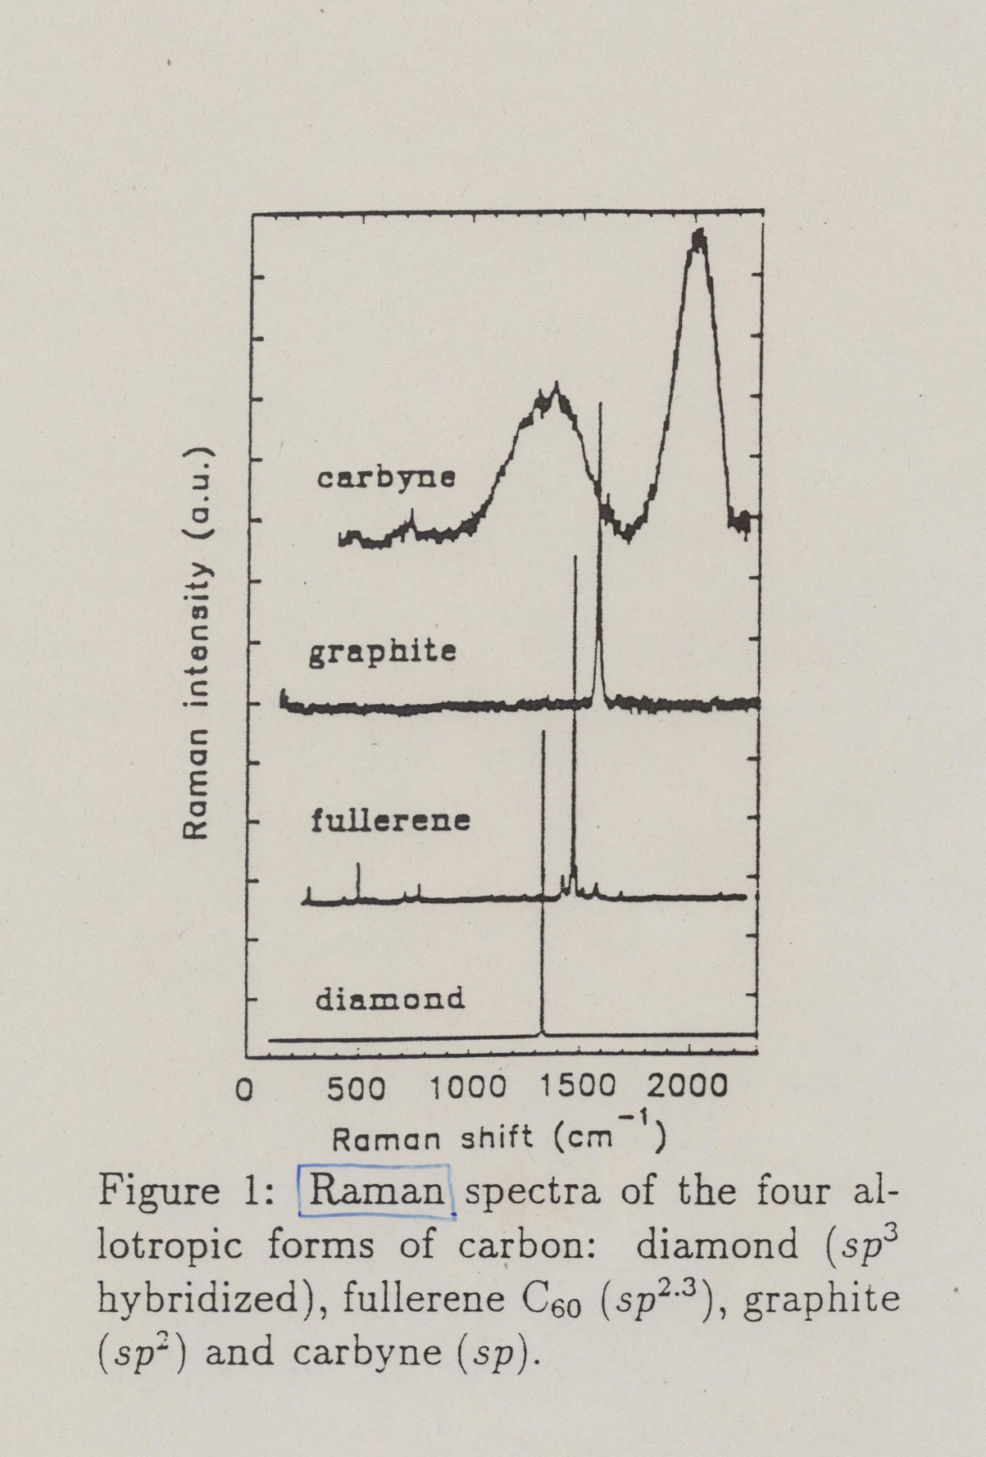
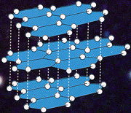
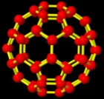
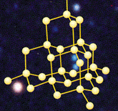
≈2000
sp¹
1580
sp²
1468
sp^{2.3}
1332
sp³
measured in Prof. Hans Kuzmany’s lab,
University of Vienna
Notes:
Effect of hybridization

Slide 3
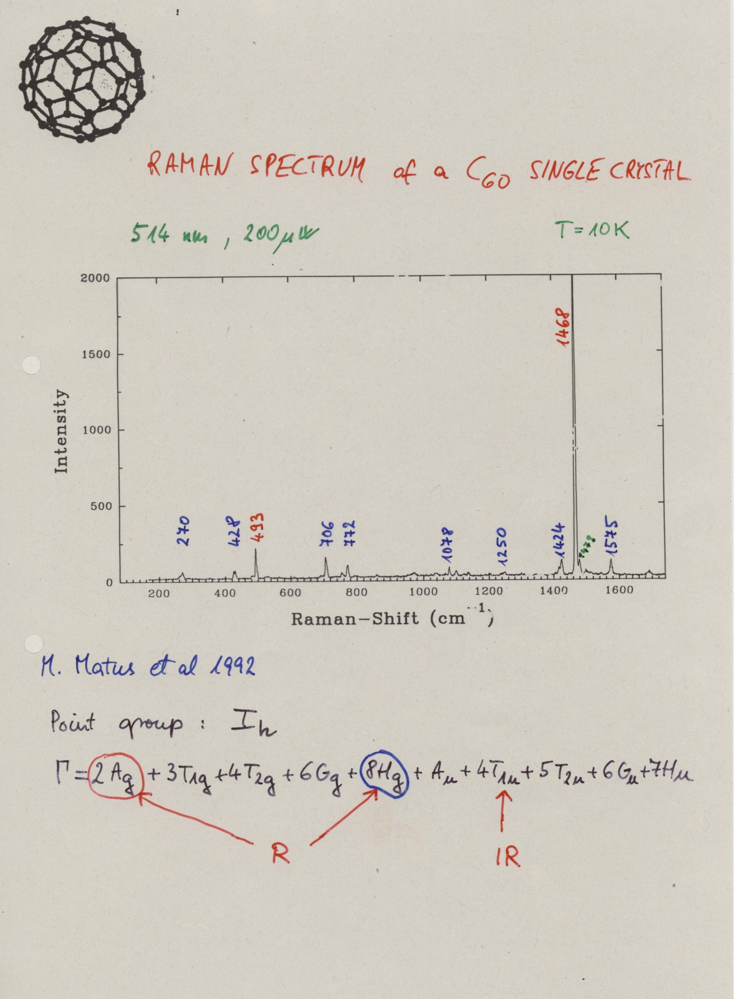
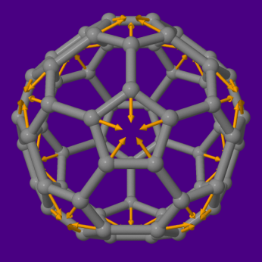
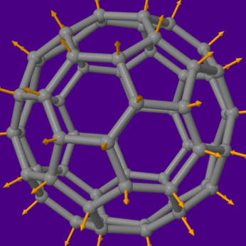

Slide 4
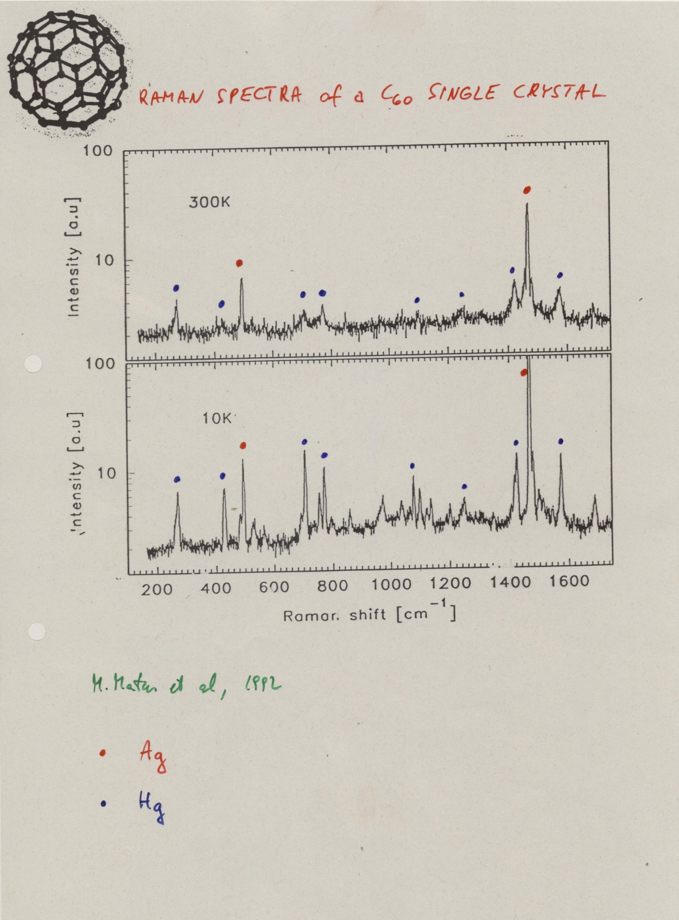

Slide 5
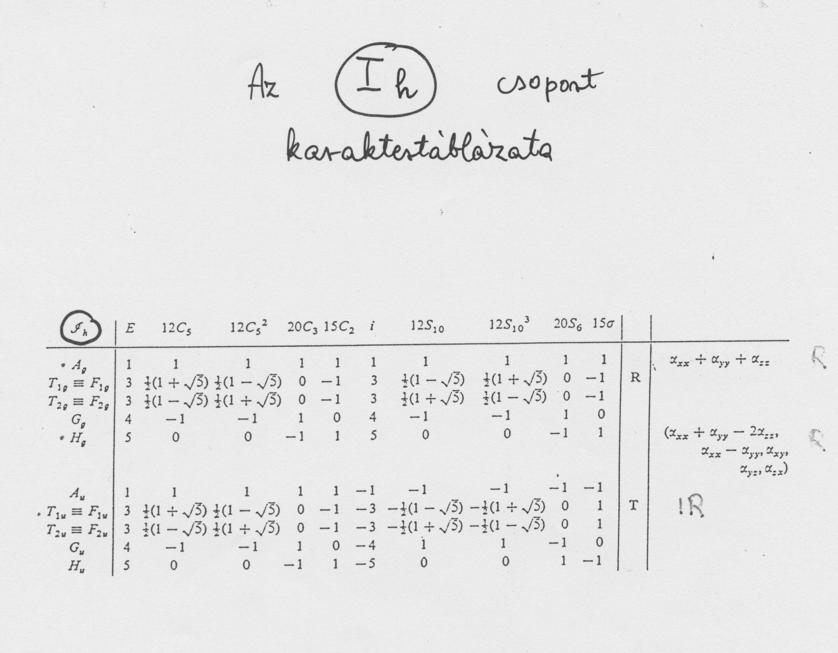
g = 120

Slide 6
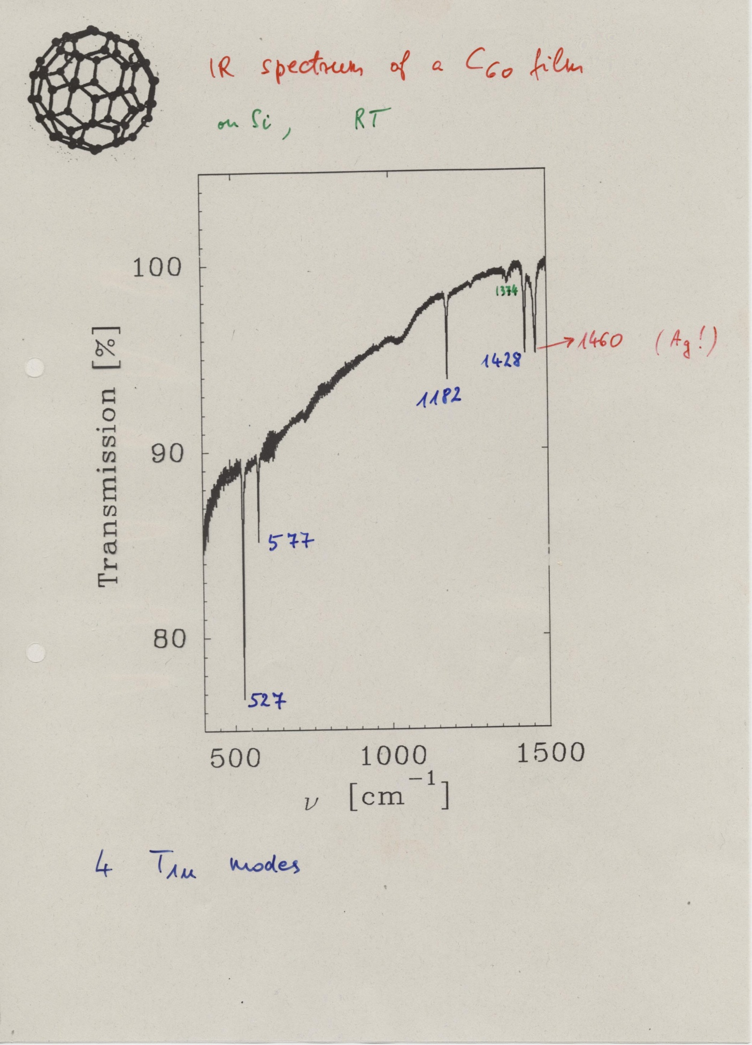

Slide 7
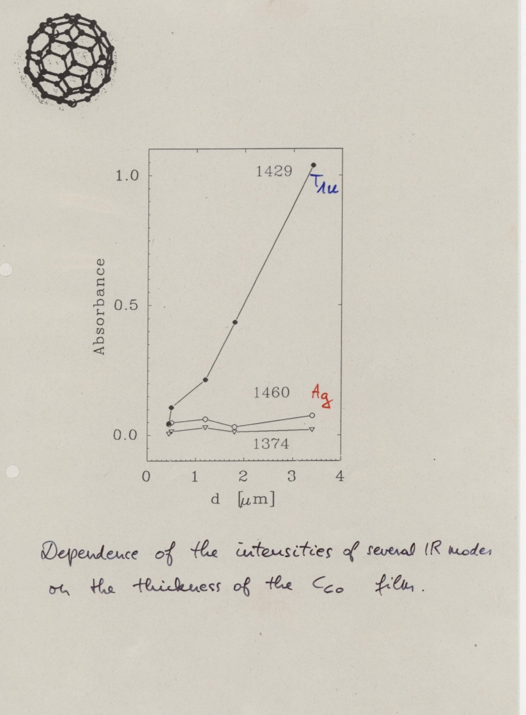

Slide 8
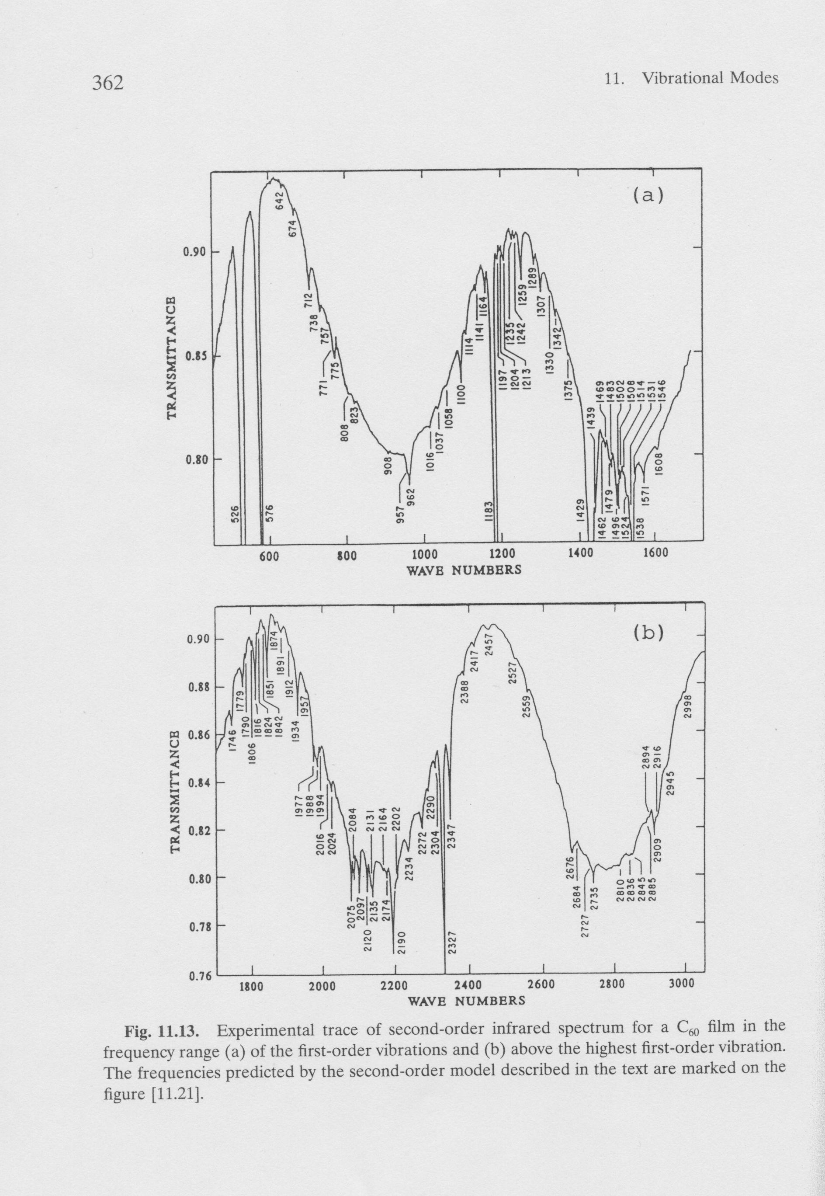
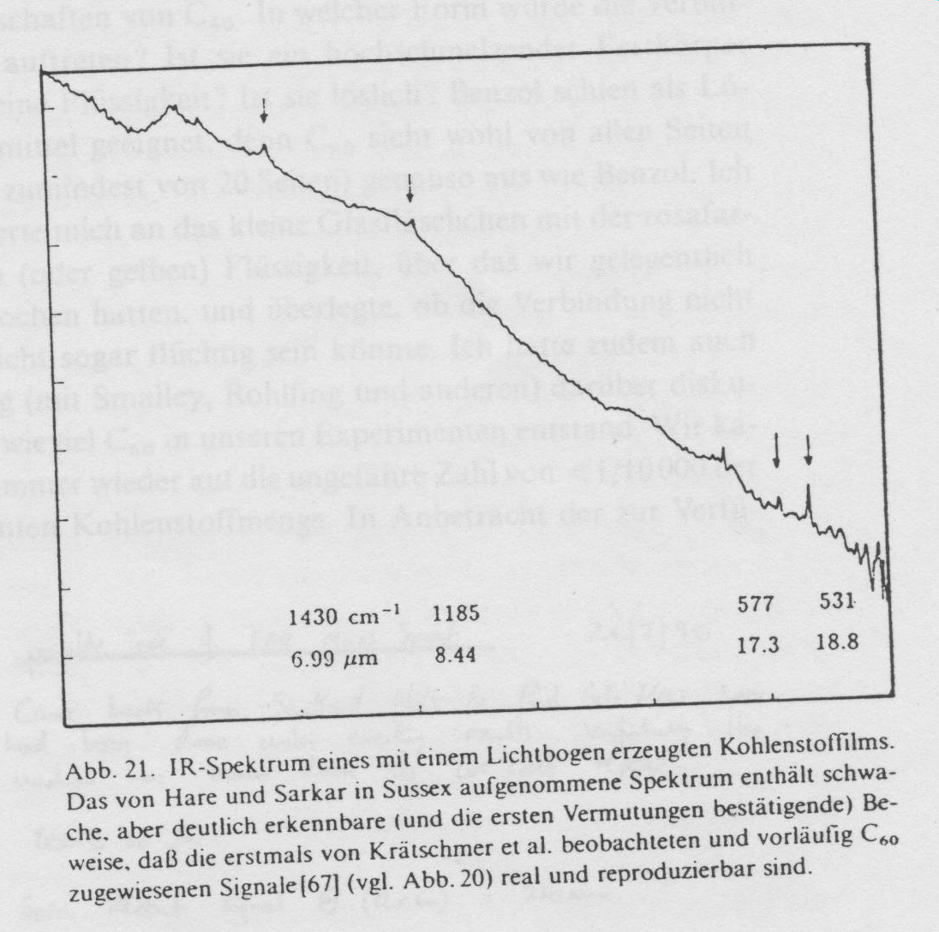
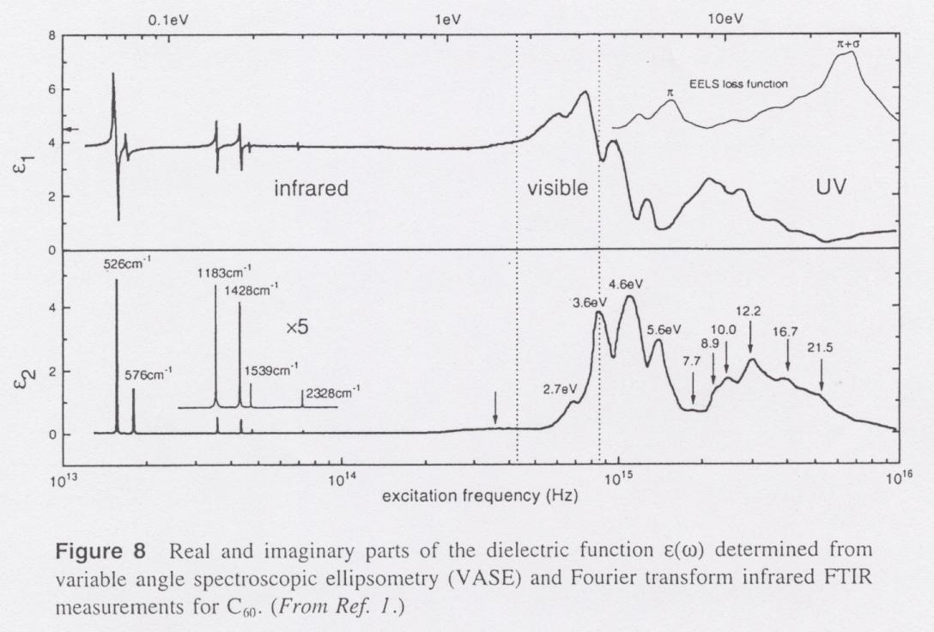

Slide 9
T_{1g} ⊗ T_{1u} = A_{u} + T_{1u} + H_{u}
but for example
G_{g} ⊗ T_{1u} = T_{2u} + G_{u} + H_{u}
In principle 380 combination modes !
>60

Slide 10
cyclic voltammogram

Slide 11
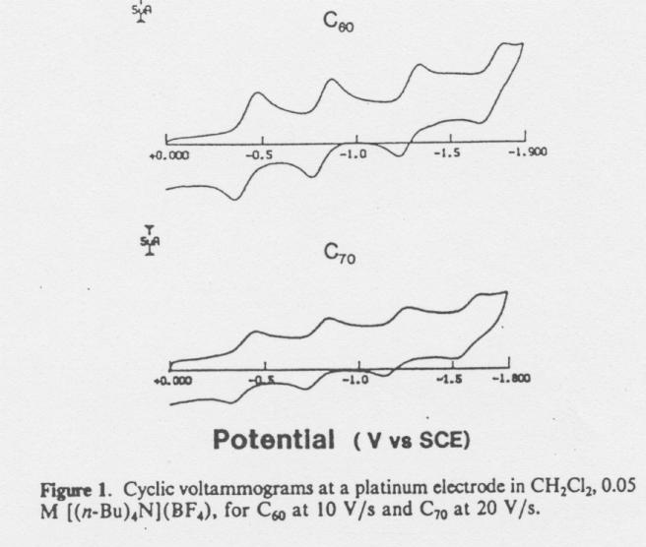

Slide 12
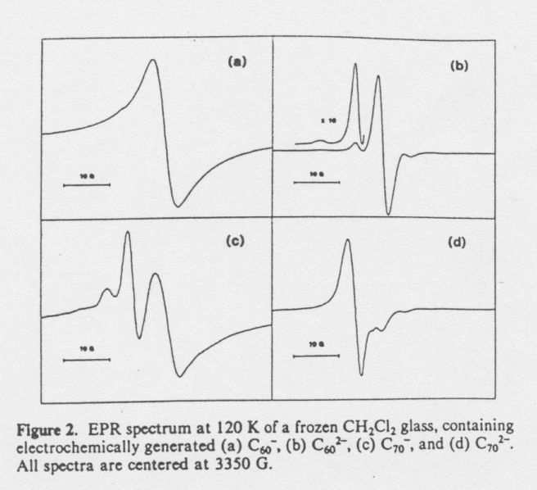

Slide 13
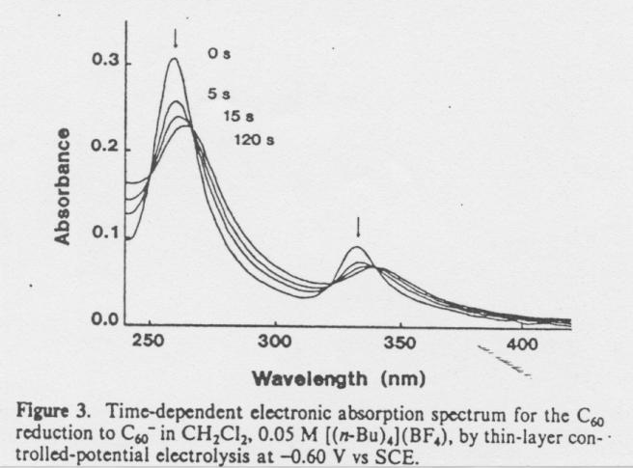

Slide 14
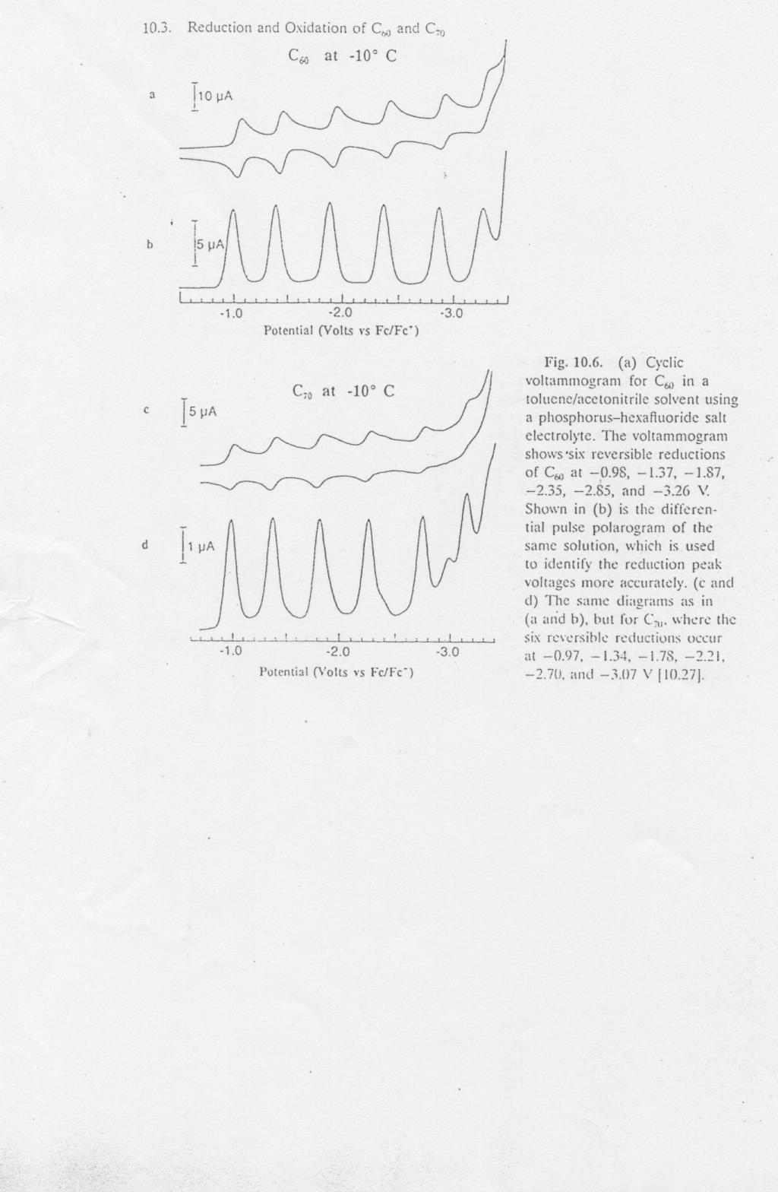

Slide 15
