Slide 1
CARBON NANOSTRUCTURES (FULLERENES, CARBON NANOTUBES, GRAPHENE)
lecture for physics and chemistry students
(2018. summer semester – 23. February)
Prof. Jenő Kürti
ELTE Department of Biological Physics
e-mail: kurti@virag.elte.hu www: virag.elte.hu/kurti

Slide 2
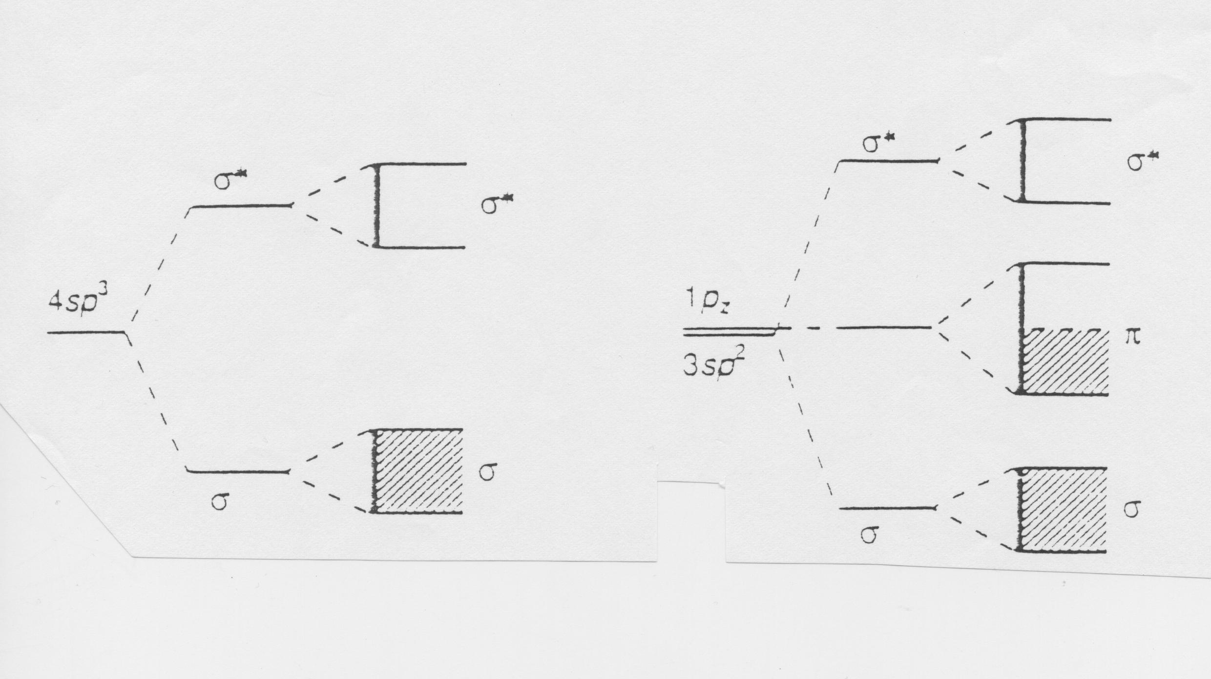
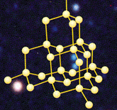
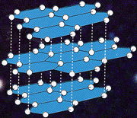
BAND STRUCTURE
-16 meV / carbon atom
≈5.4 eV
≈1.7 eV
diamond sp³ graphite sp²
d_{CC} ≅ 0,154 nm
d_{CC} ≅ 0,142 nm

Slide 3
E_{graphite} < E_{diamond}
E

Slide 4
E_{graphite} < E_{diamond} S_{graphite} > S_{diamond}
E – TS

Slide 5
E_{graphite} < E_{diamond} S_{graphite} > S_{diamond}
E – TS + pV
V_{graphite} > V_{diamond}

Slide 6
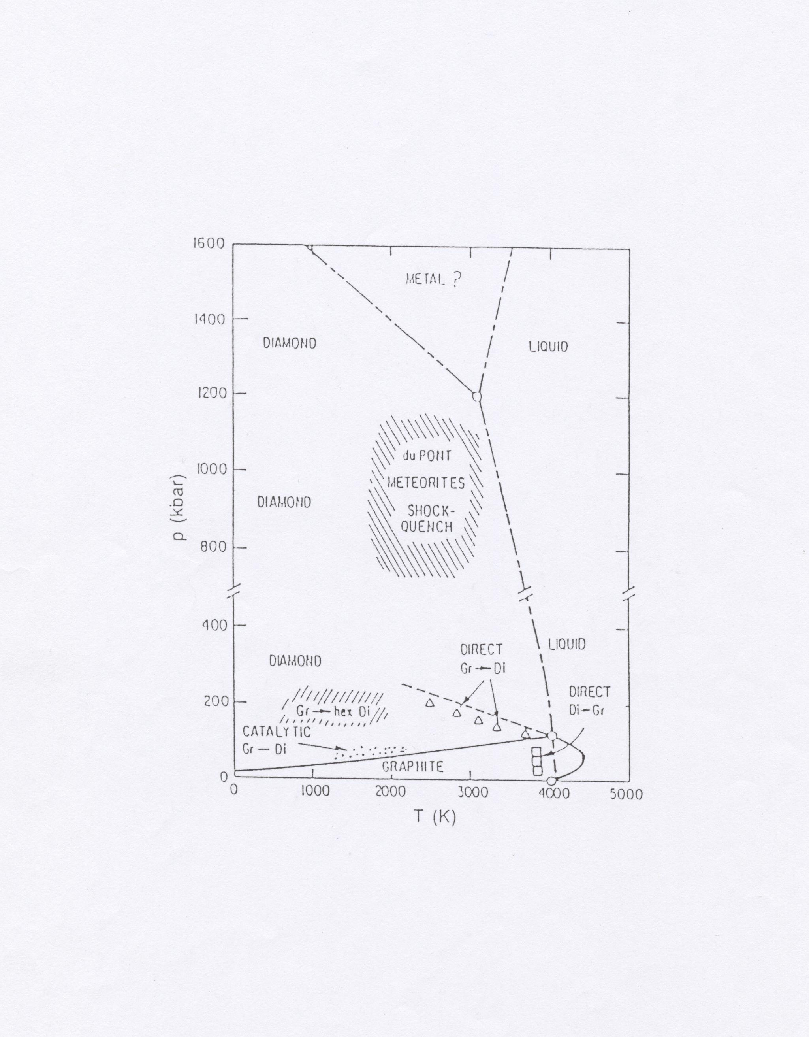

Slide 7
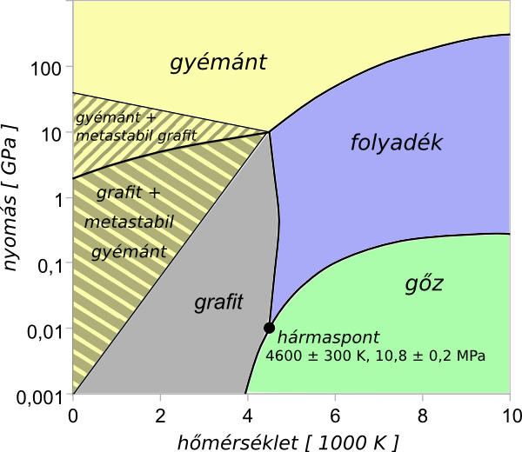

Slide 8
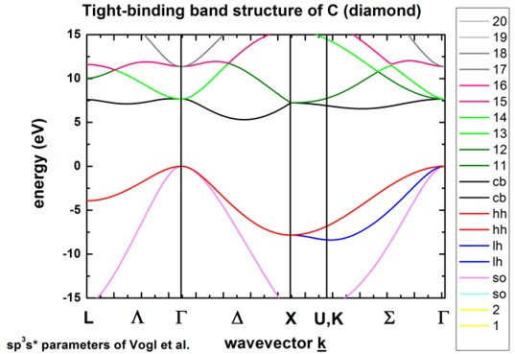
Downloaded from the internet

Slide 9
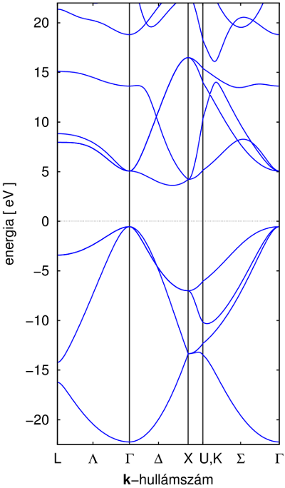
DFT band structure of diamond

Slide 10
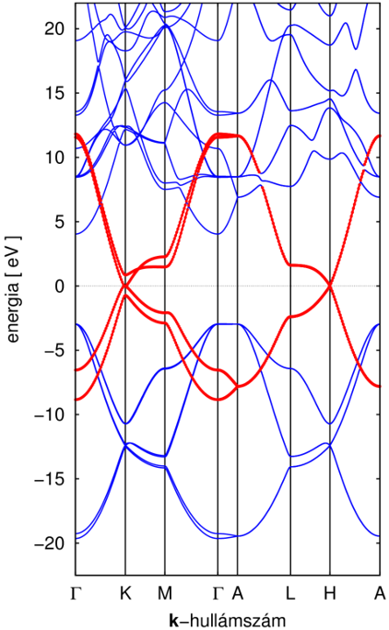
DFT band structure of graphite

Slide 11
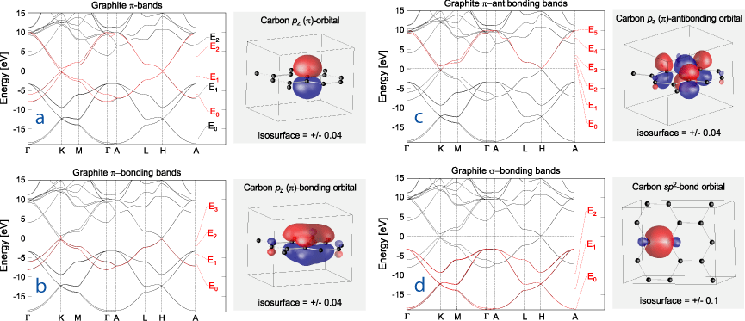
Downloaded from the internet

