Slide 1
CARBON NANOSTRUCTURES (FULLERENES, CARBON NANOTUBES, GRAPHENE)
lecture for physics and chemistry students
(2018. summer semester – 09. March)
Prof. Jenő Kürti
ELTE Department of Biological Physics
e-mail: kurti@virag.elte.hu www: virag.elte.hu/kurti

Slide 2
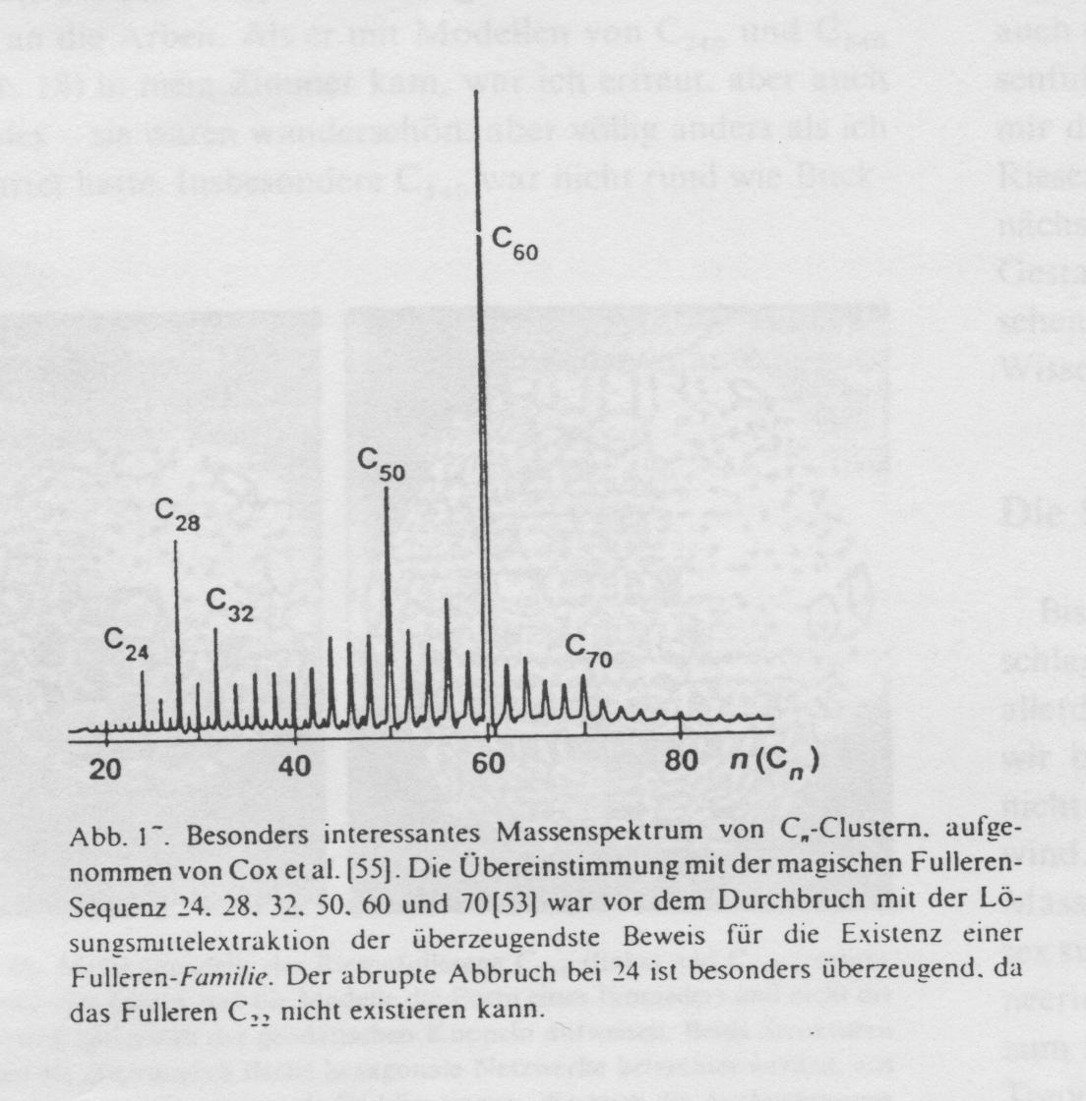
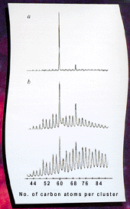

Slide 3
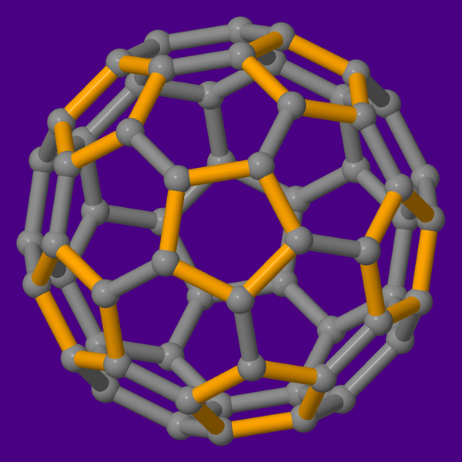
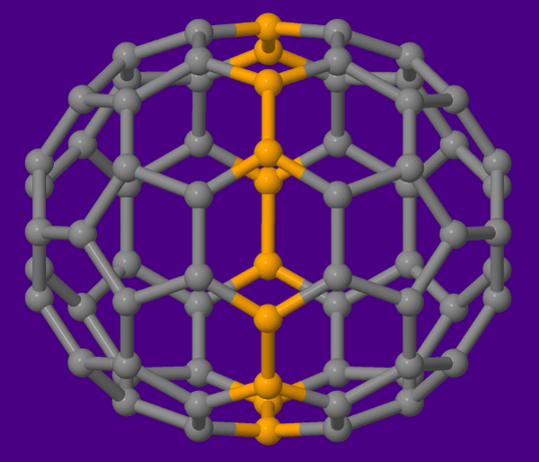
C₇₀
C₆₀

Slide 4
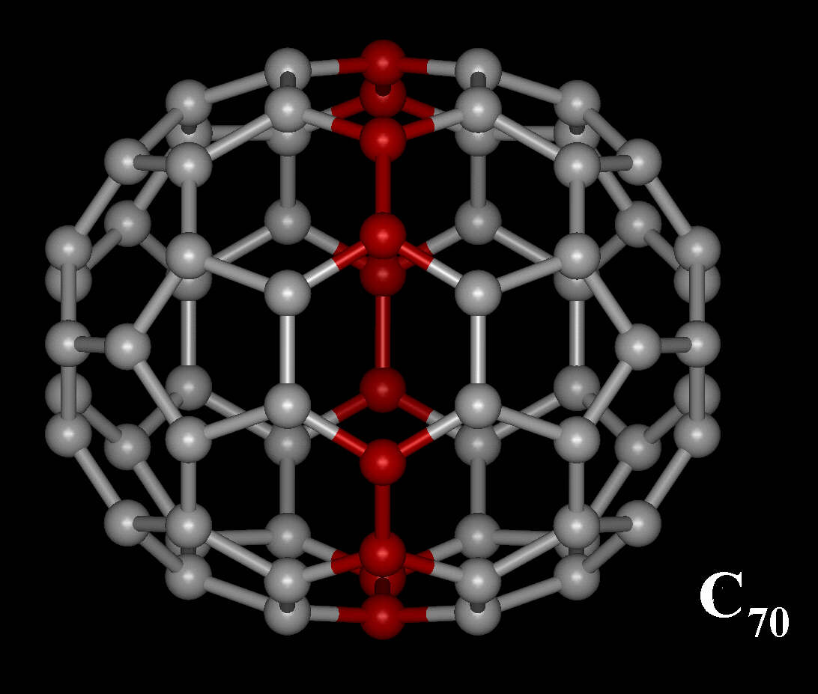

Slide 5
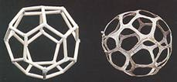
Structure of a C28 fullerene Skeleton of a fungus (Ileodyction cibarium)

Slide 6
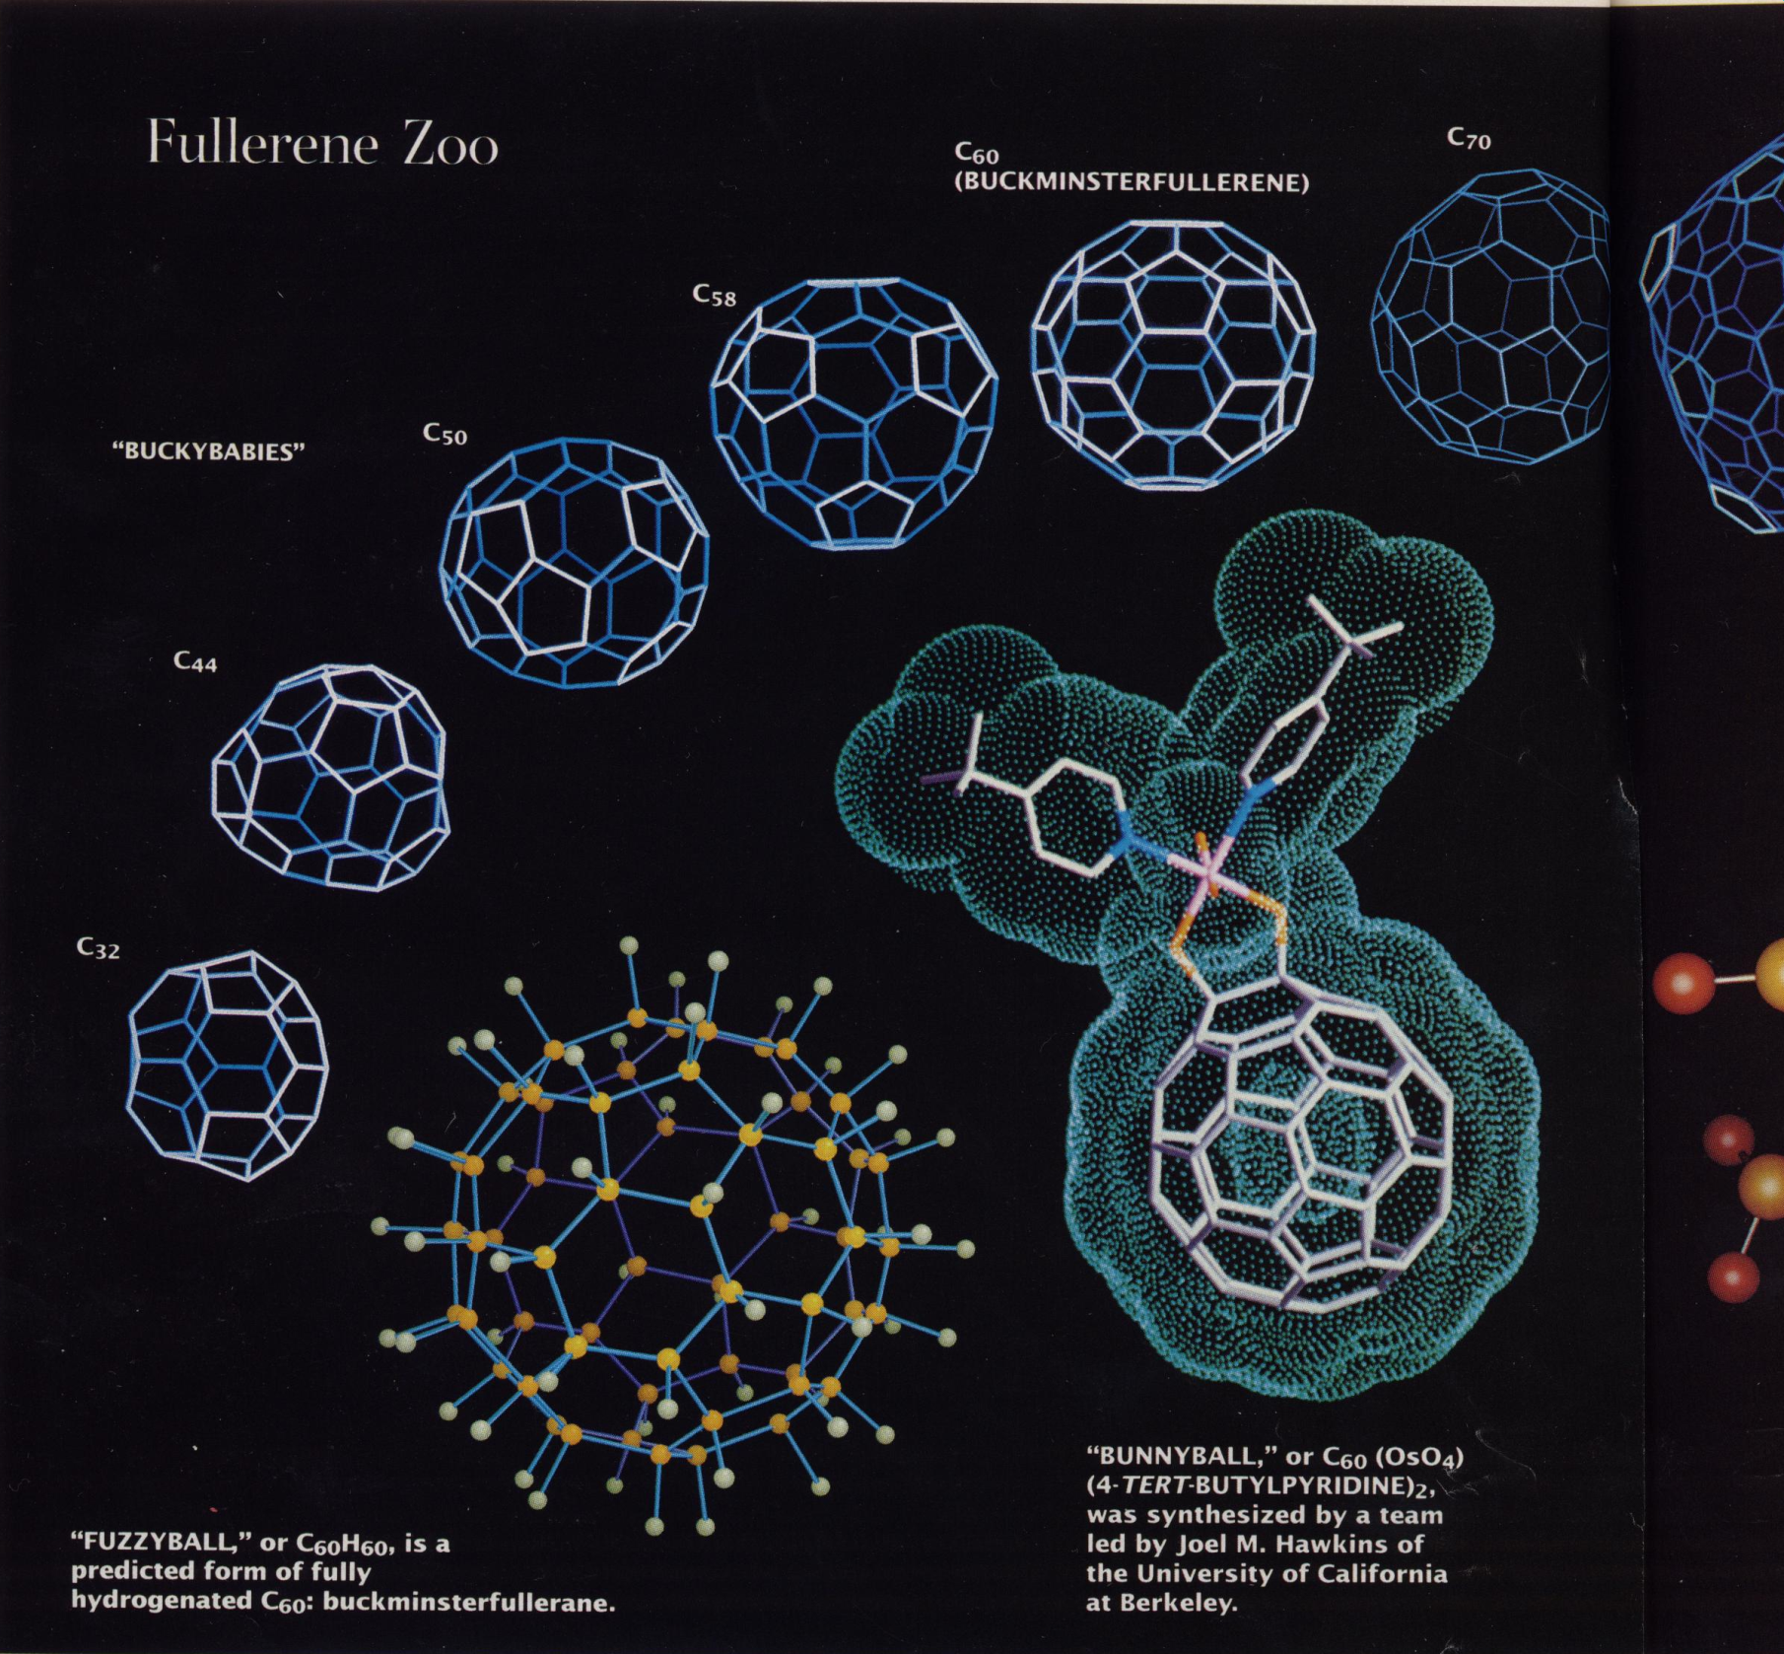

Slide 7
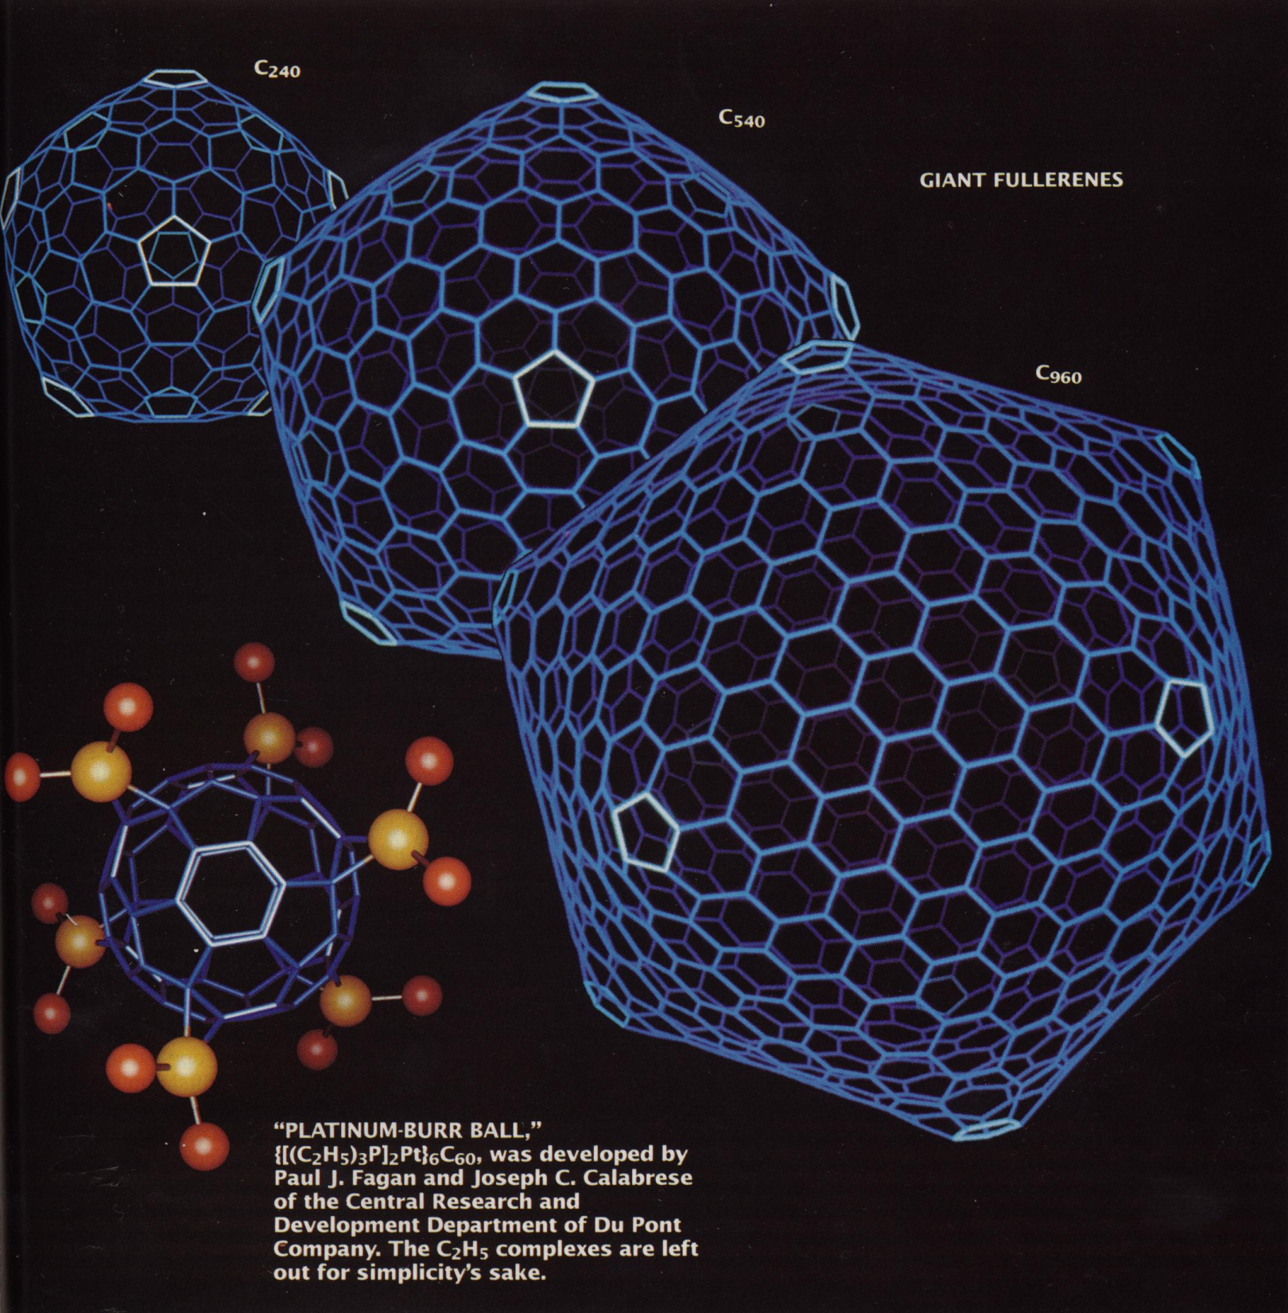

Slide 8
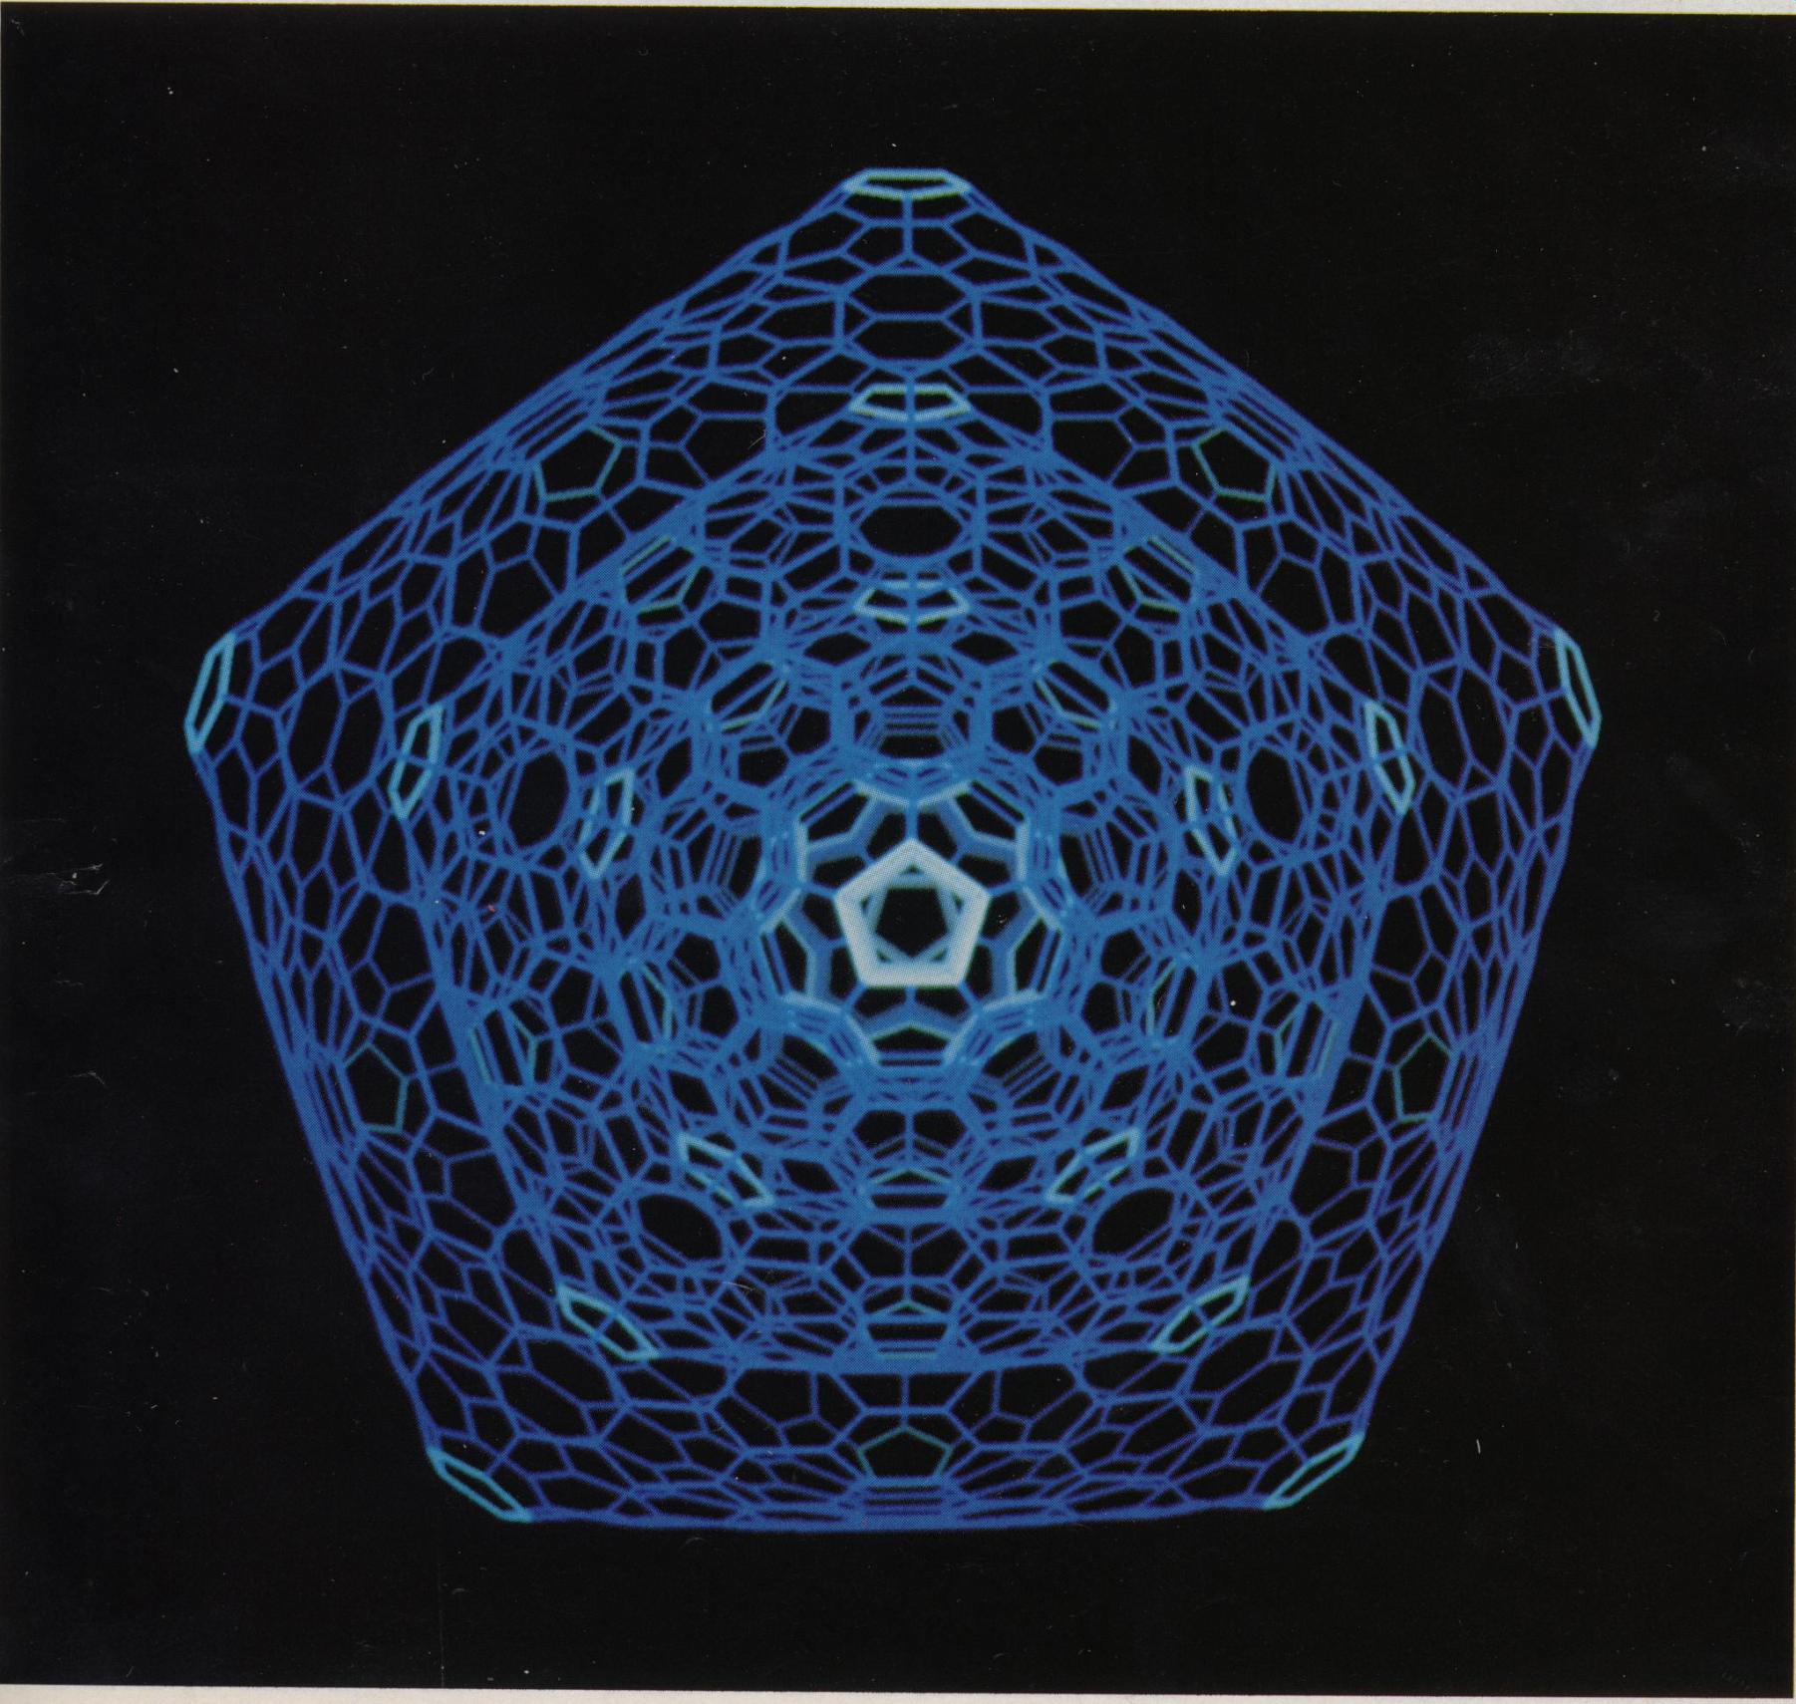

Slide 9
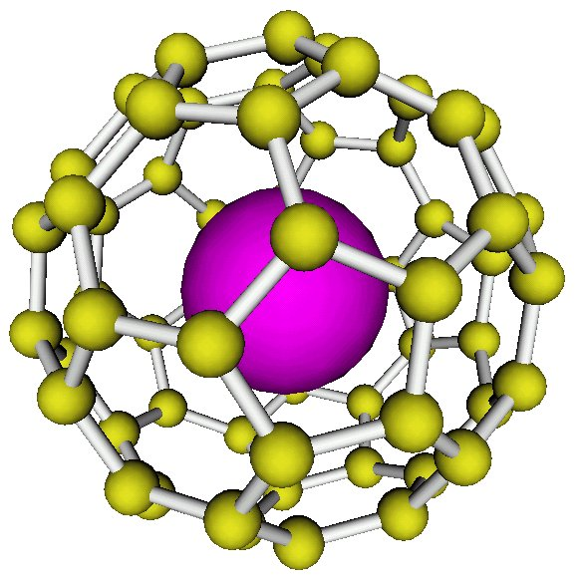
Endohedral fullerenes, e.g. N @ C₆₀

Slide 10
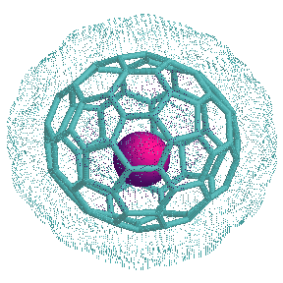
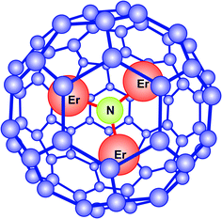
Sc @ C₈₂
Er₃N @ C₈₀

Slide 11
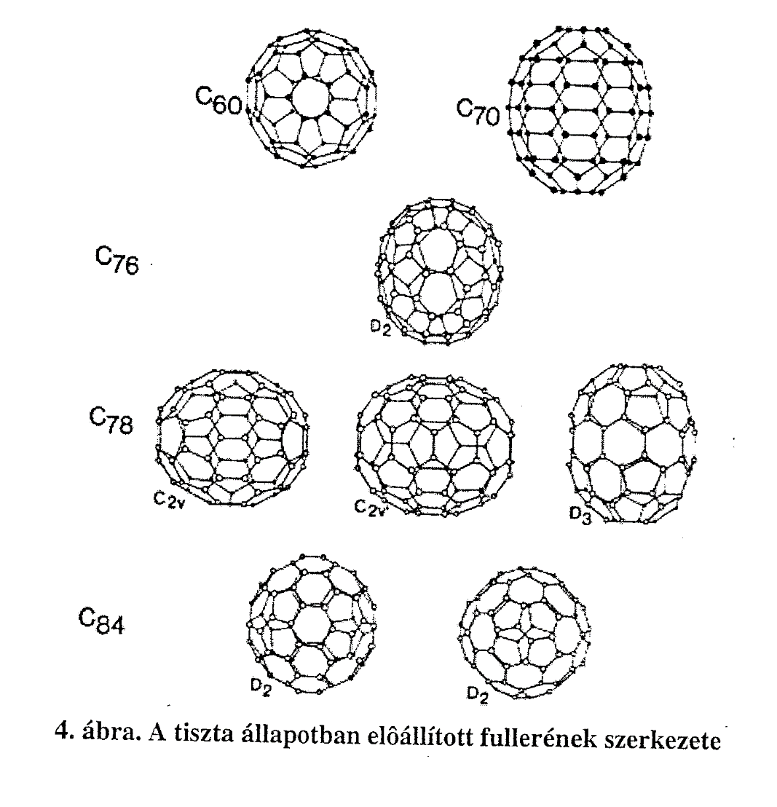
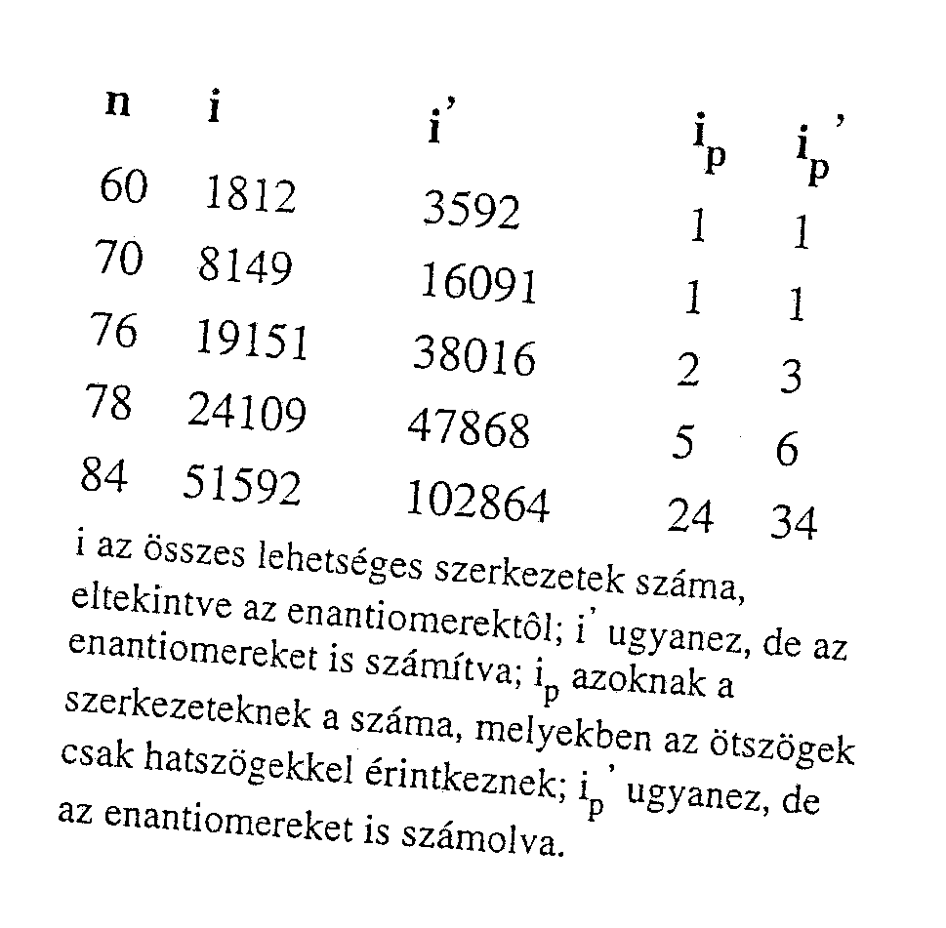
Memo: Euler-rule → n₅ = 12 és n₆ = arbitrary
… !

Slide 12
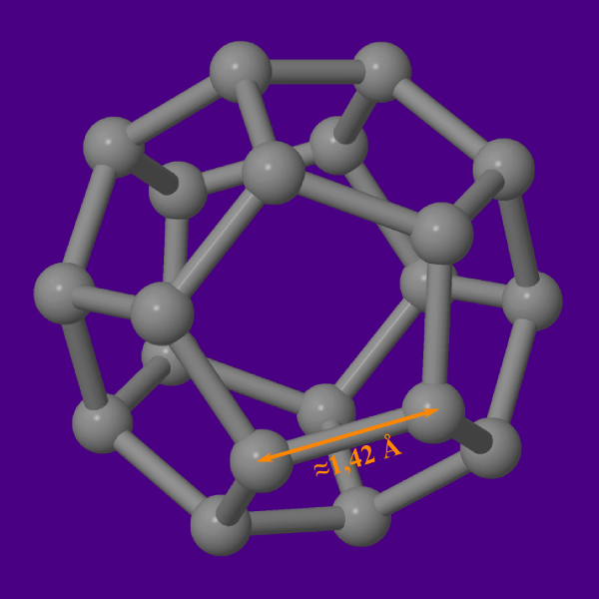
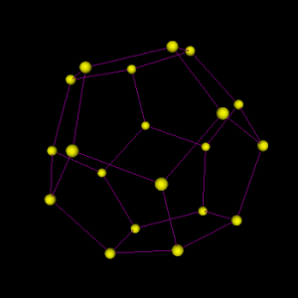
C₂₀

Slide 13
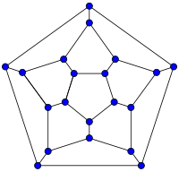
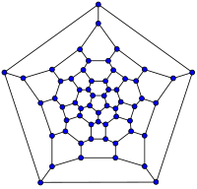
Schlegel diagrams
C₂₀ C₆₀

Slide 17
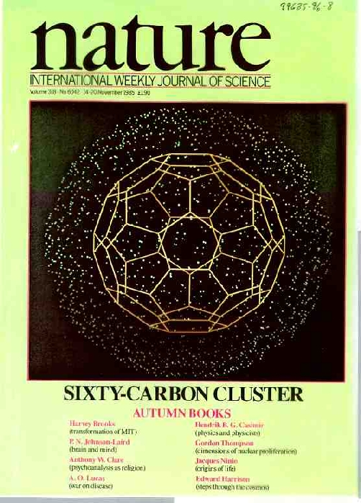
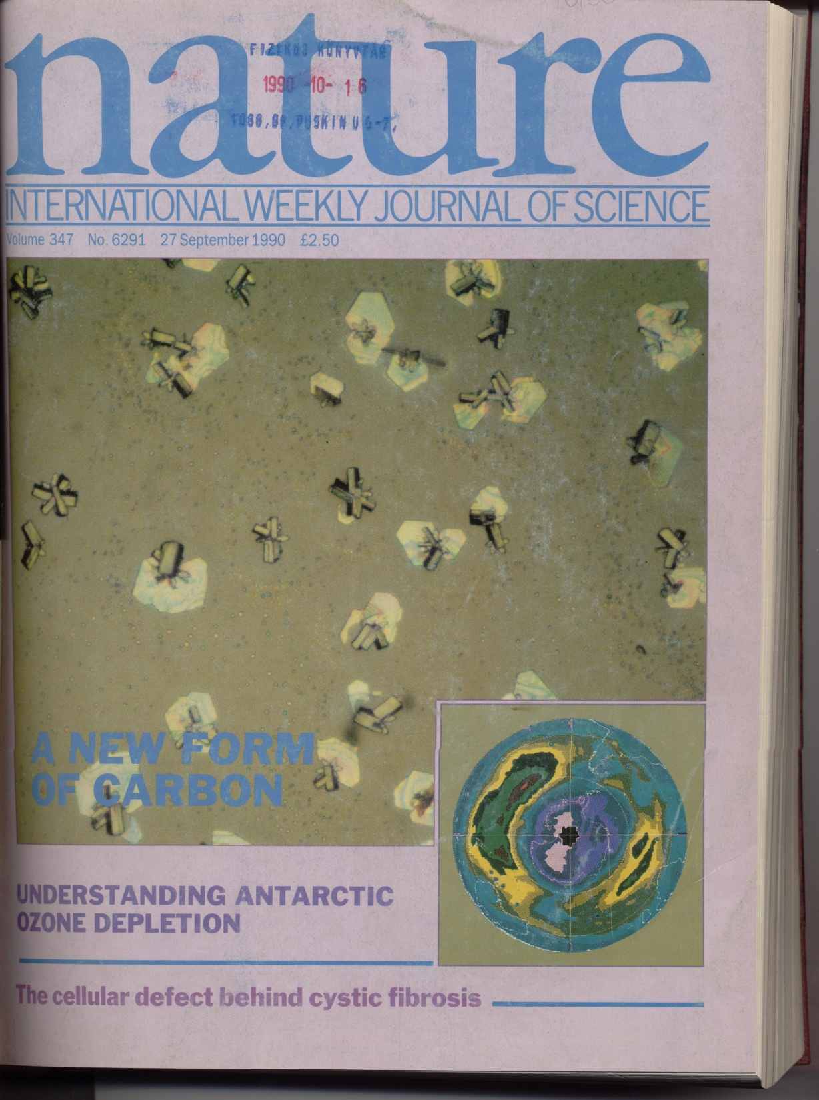

Slide 18
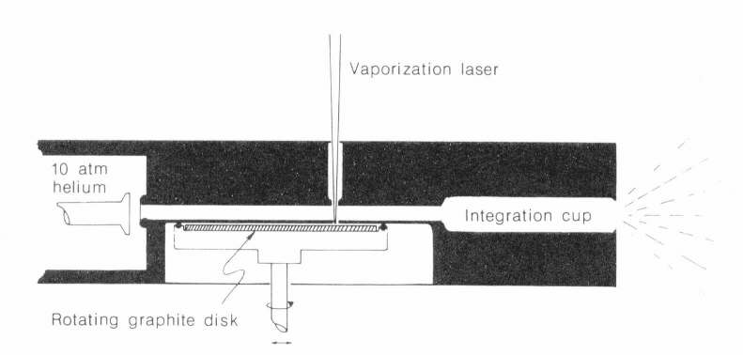
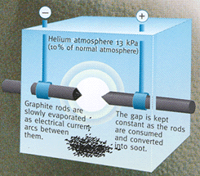
W.Krätschmer, L.D.Lamb, K.Fostiropoulos, D.R.Huffman, „Solid C₆₀: a new form of carbon”, Nature 347, 354 (1990)
C₆₀ in large quantities !

Slide 19
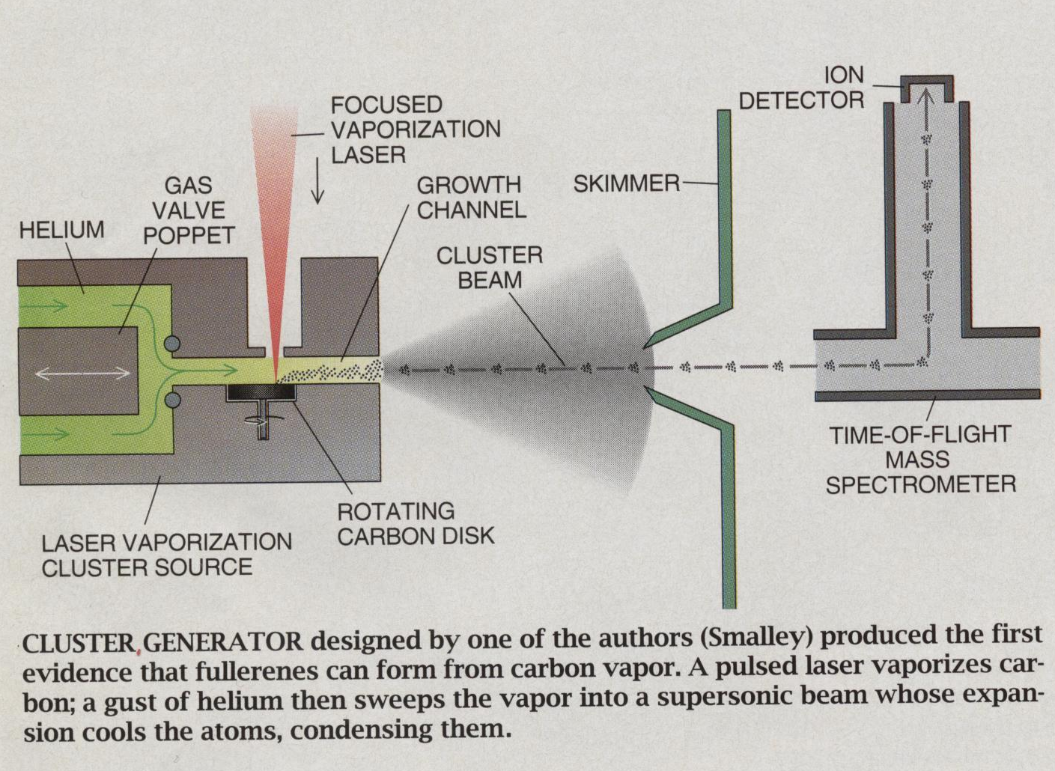

Slide 20
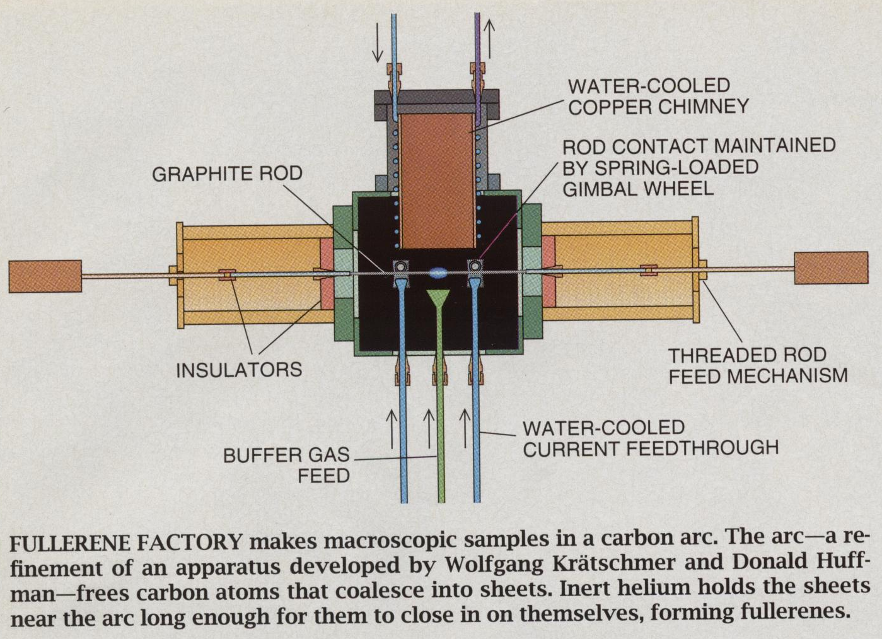

Slide 21
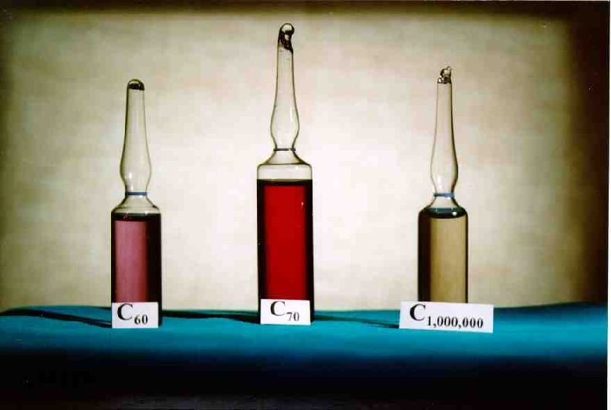
Notes:
C60: bíborvörös, C70: vörös

Slide 22
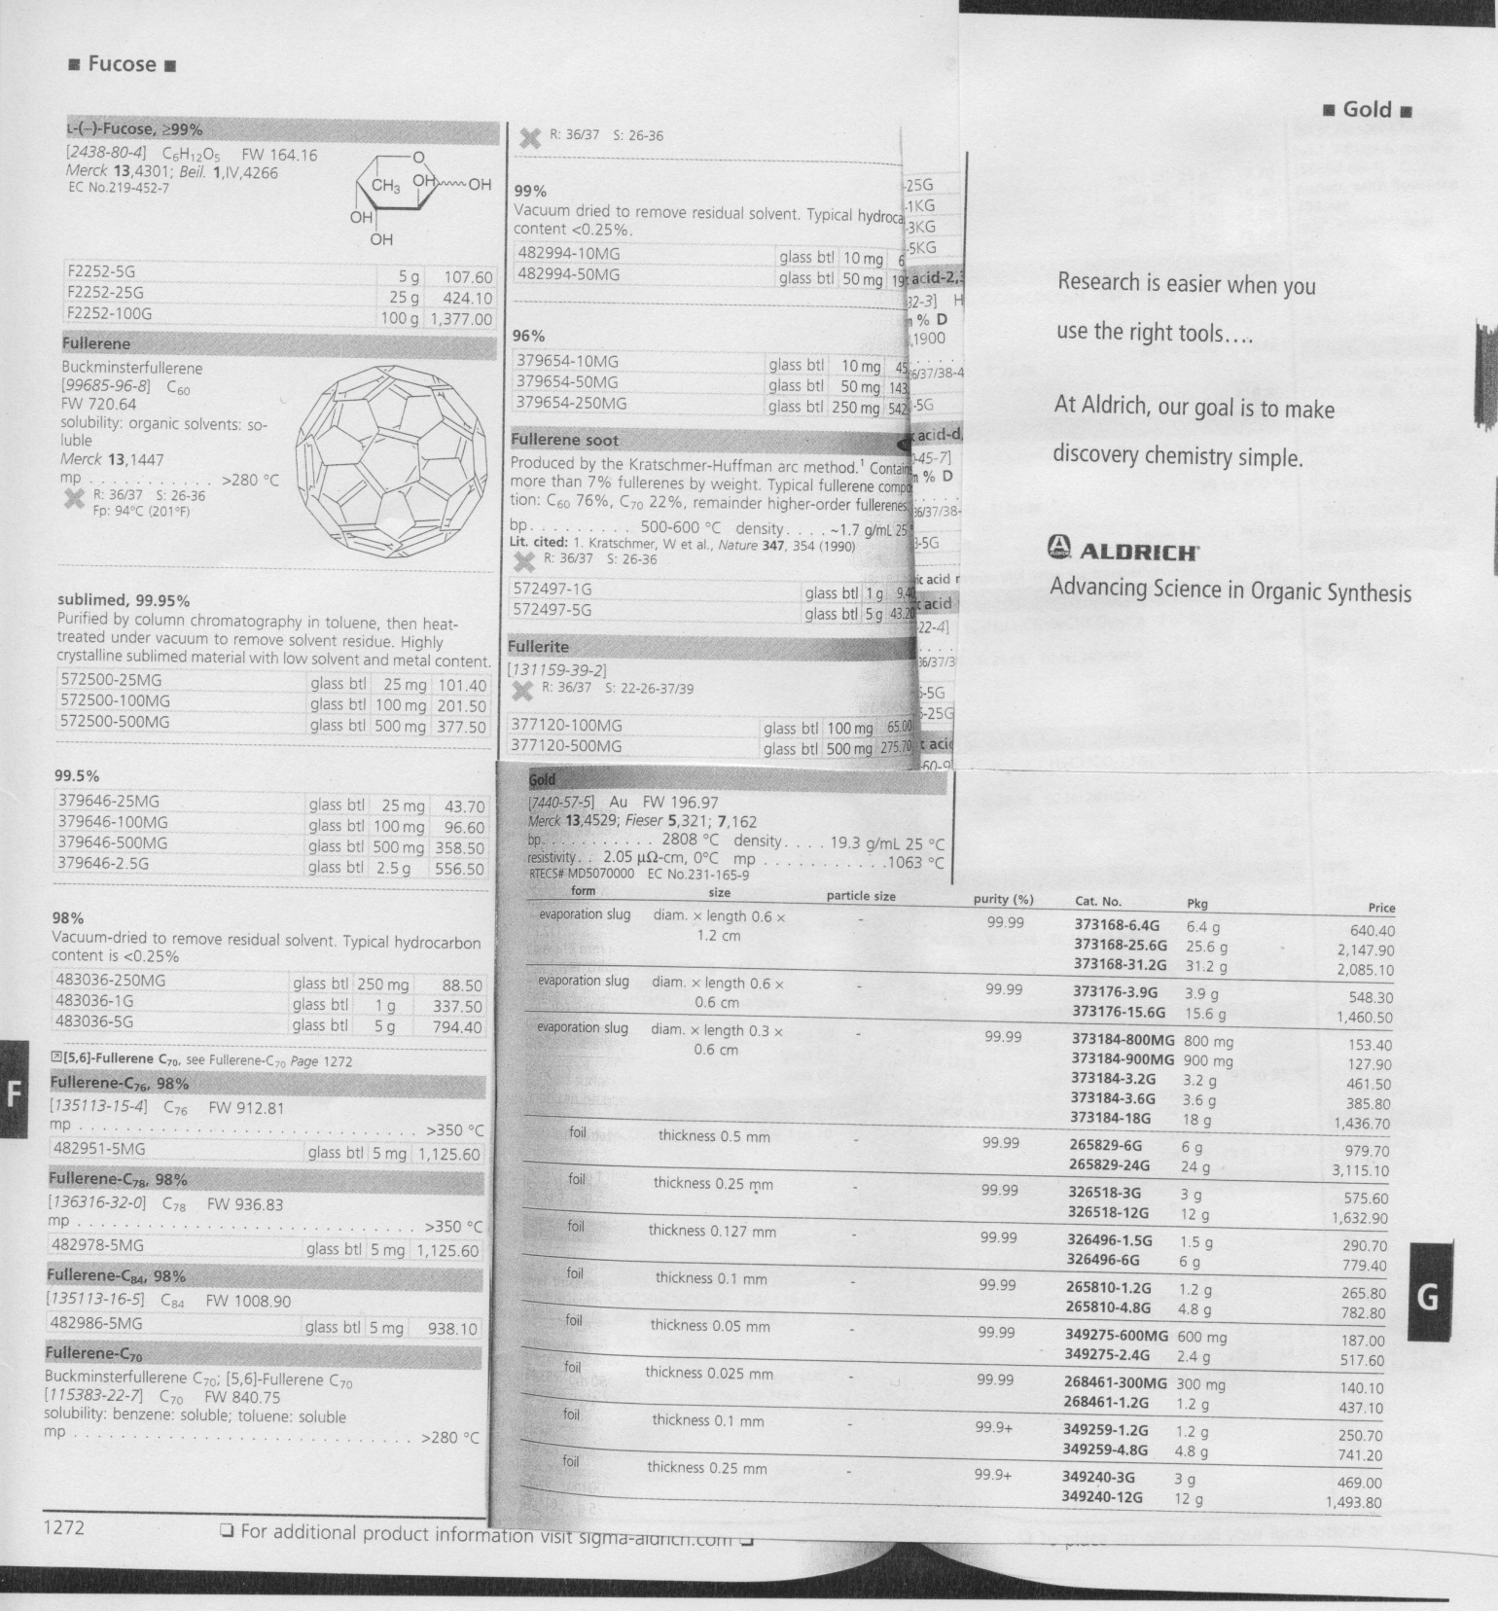

Slide 23
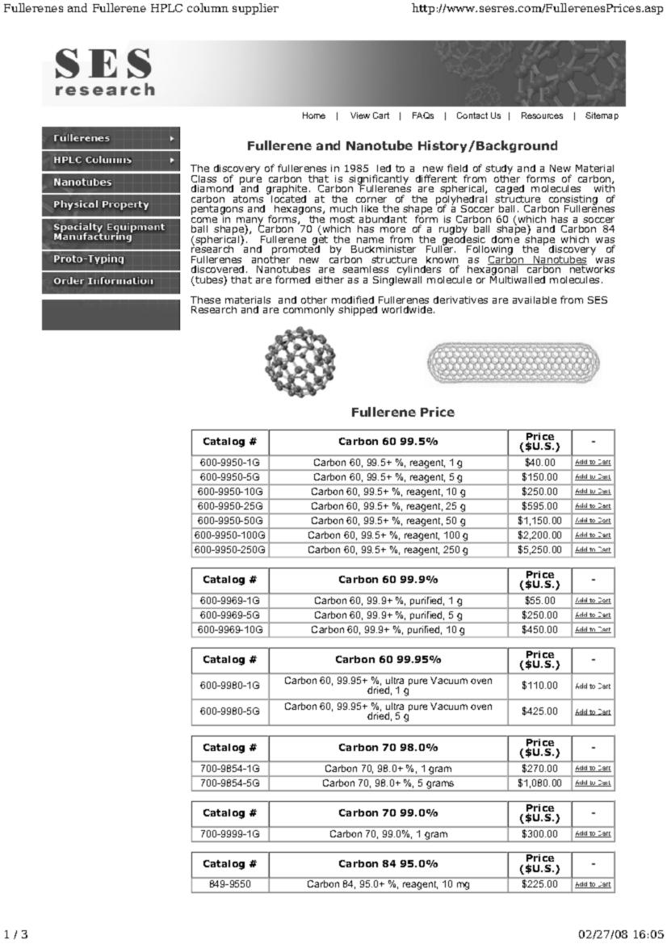
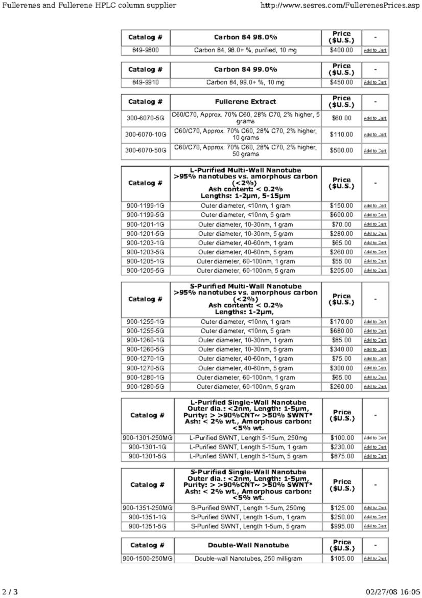

Slide 24
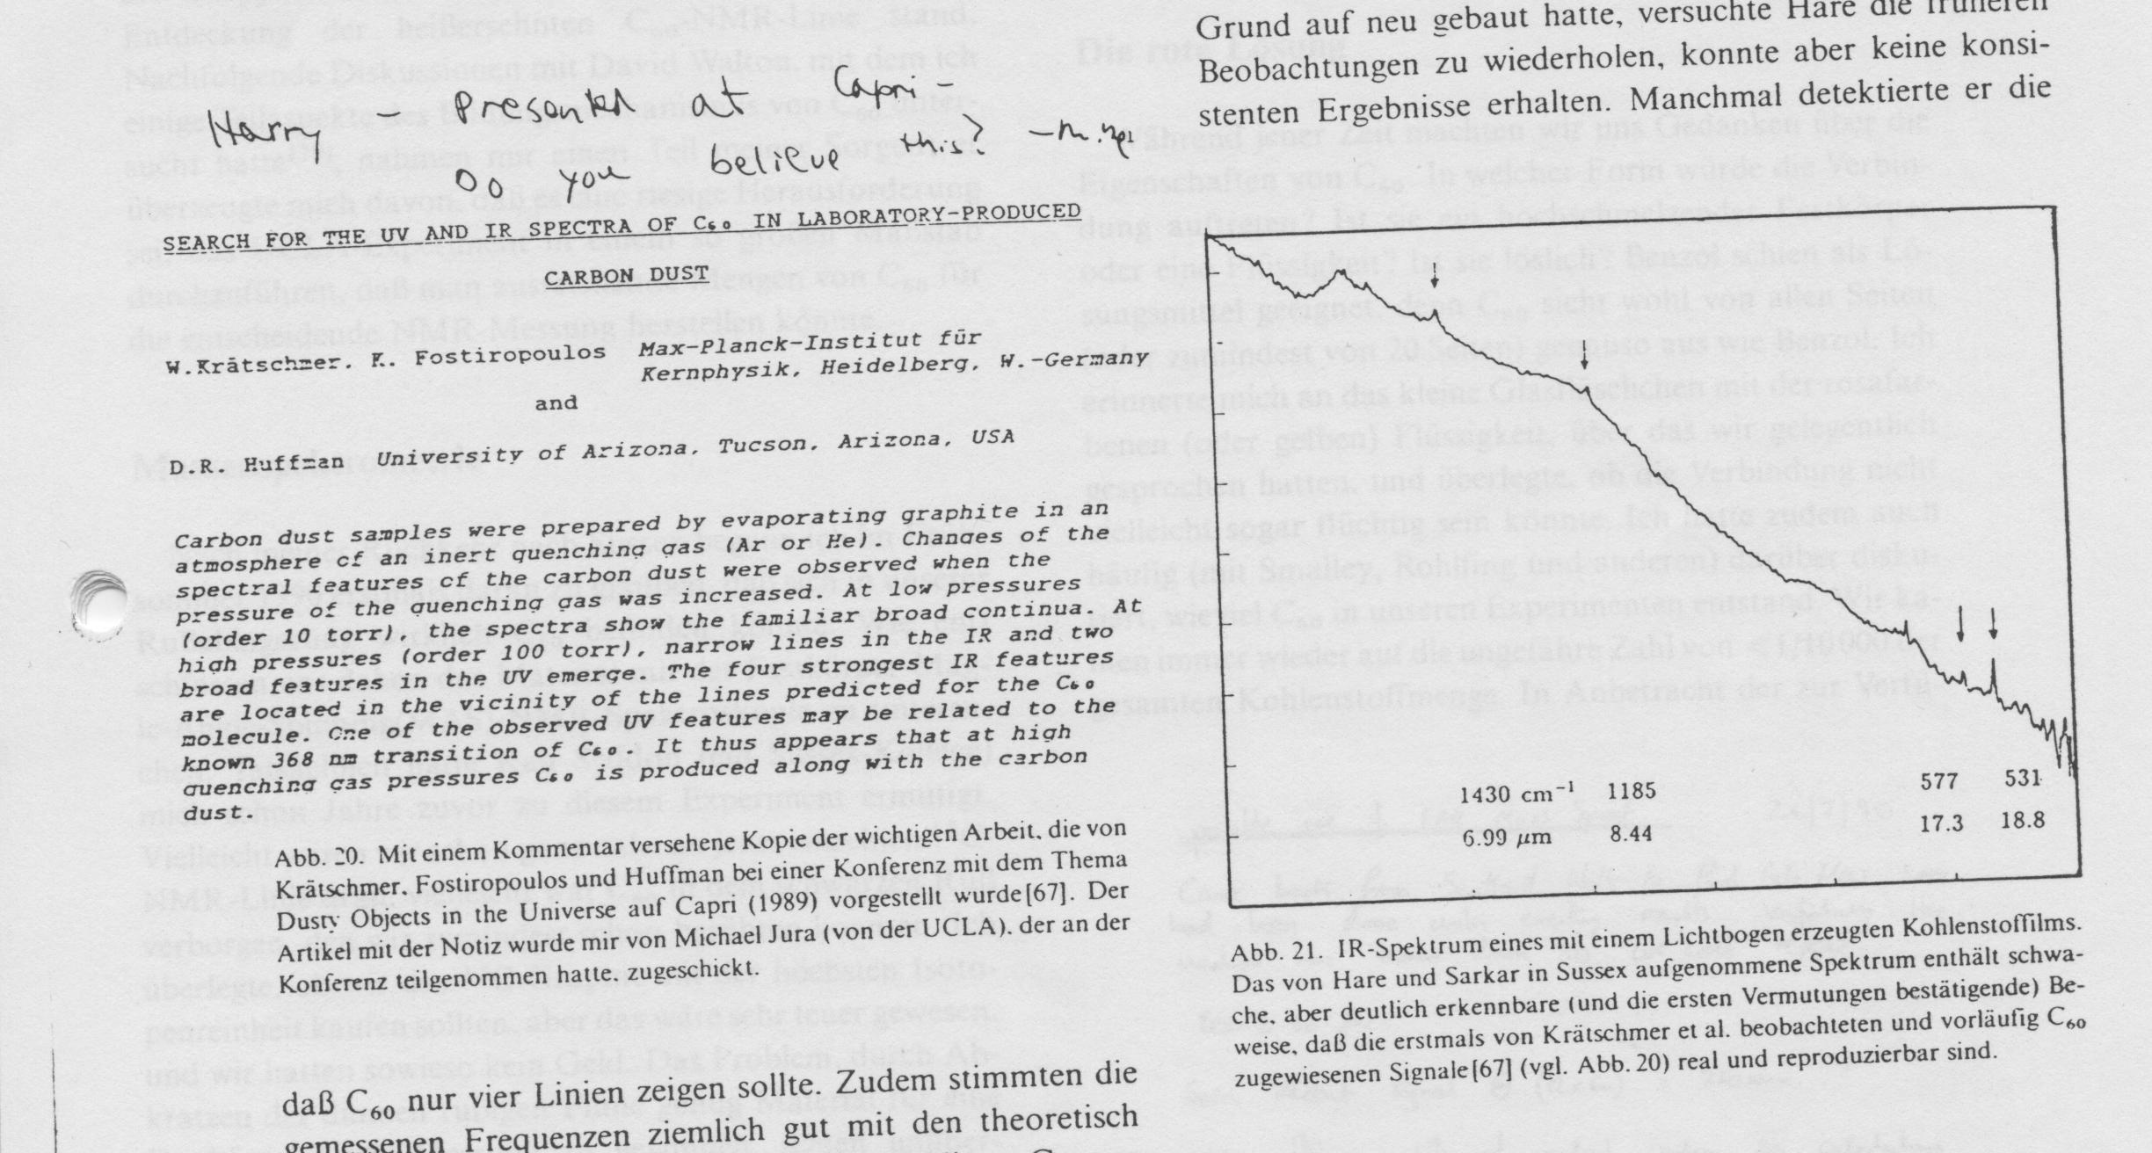

Slide 25
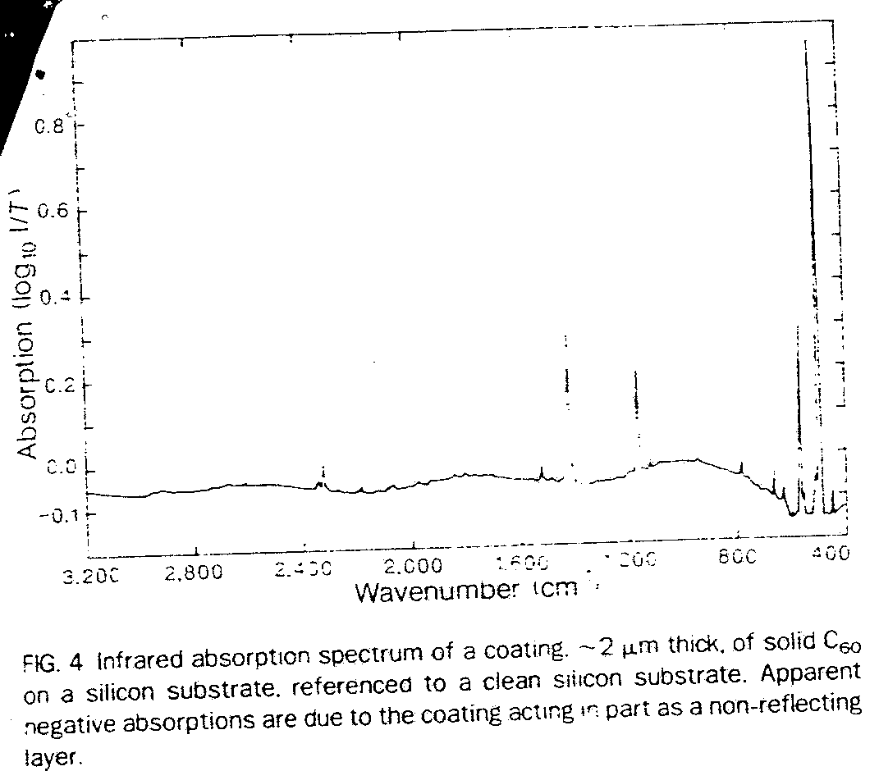

Slide 26
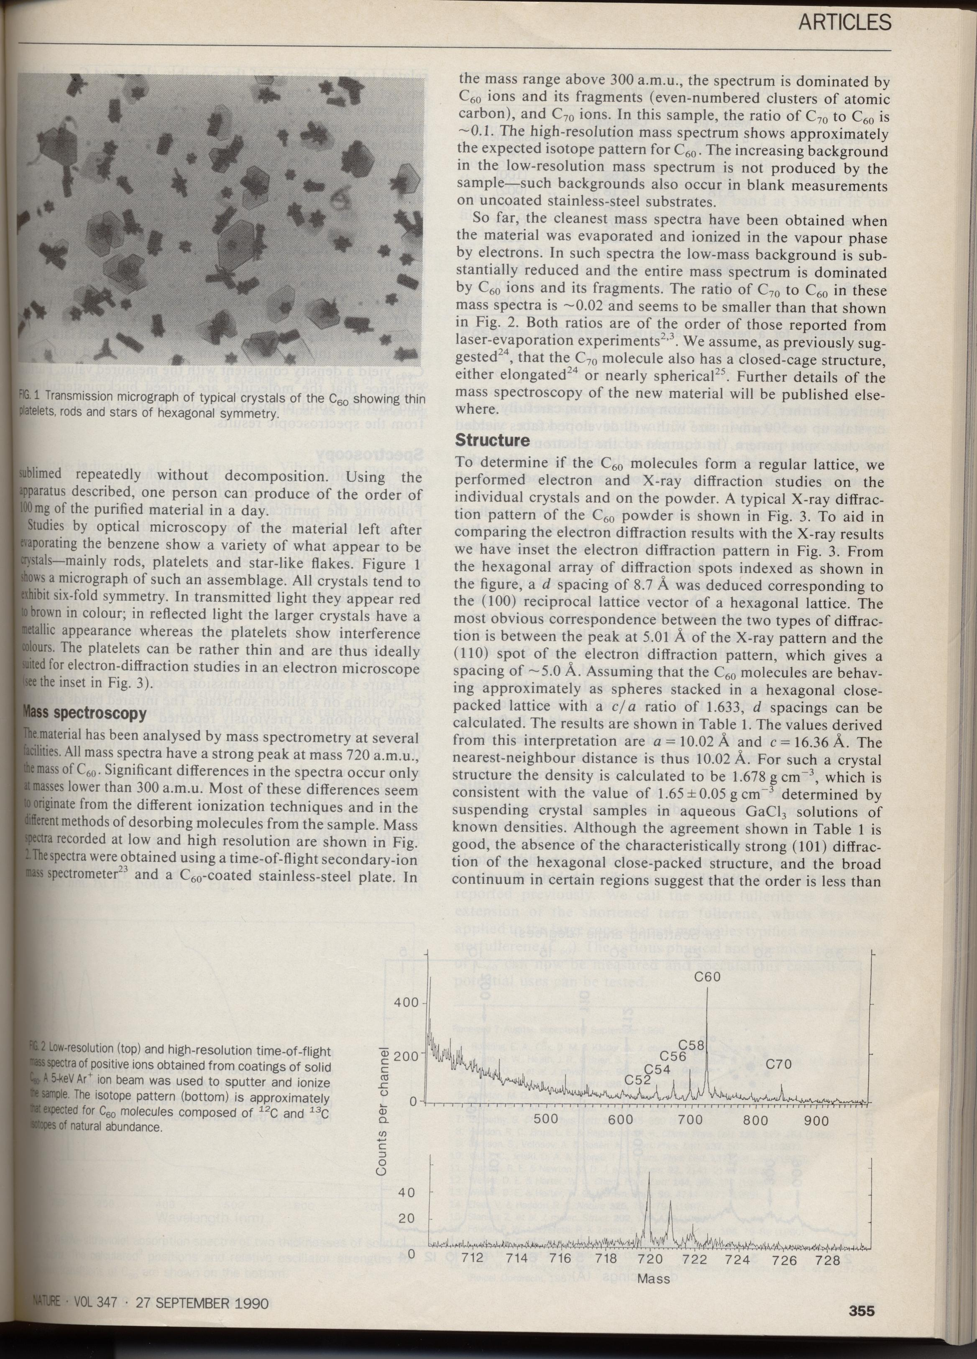

Slide 27
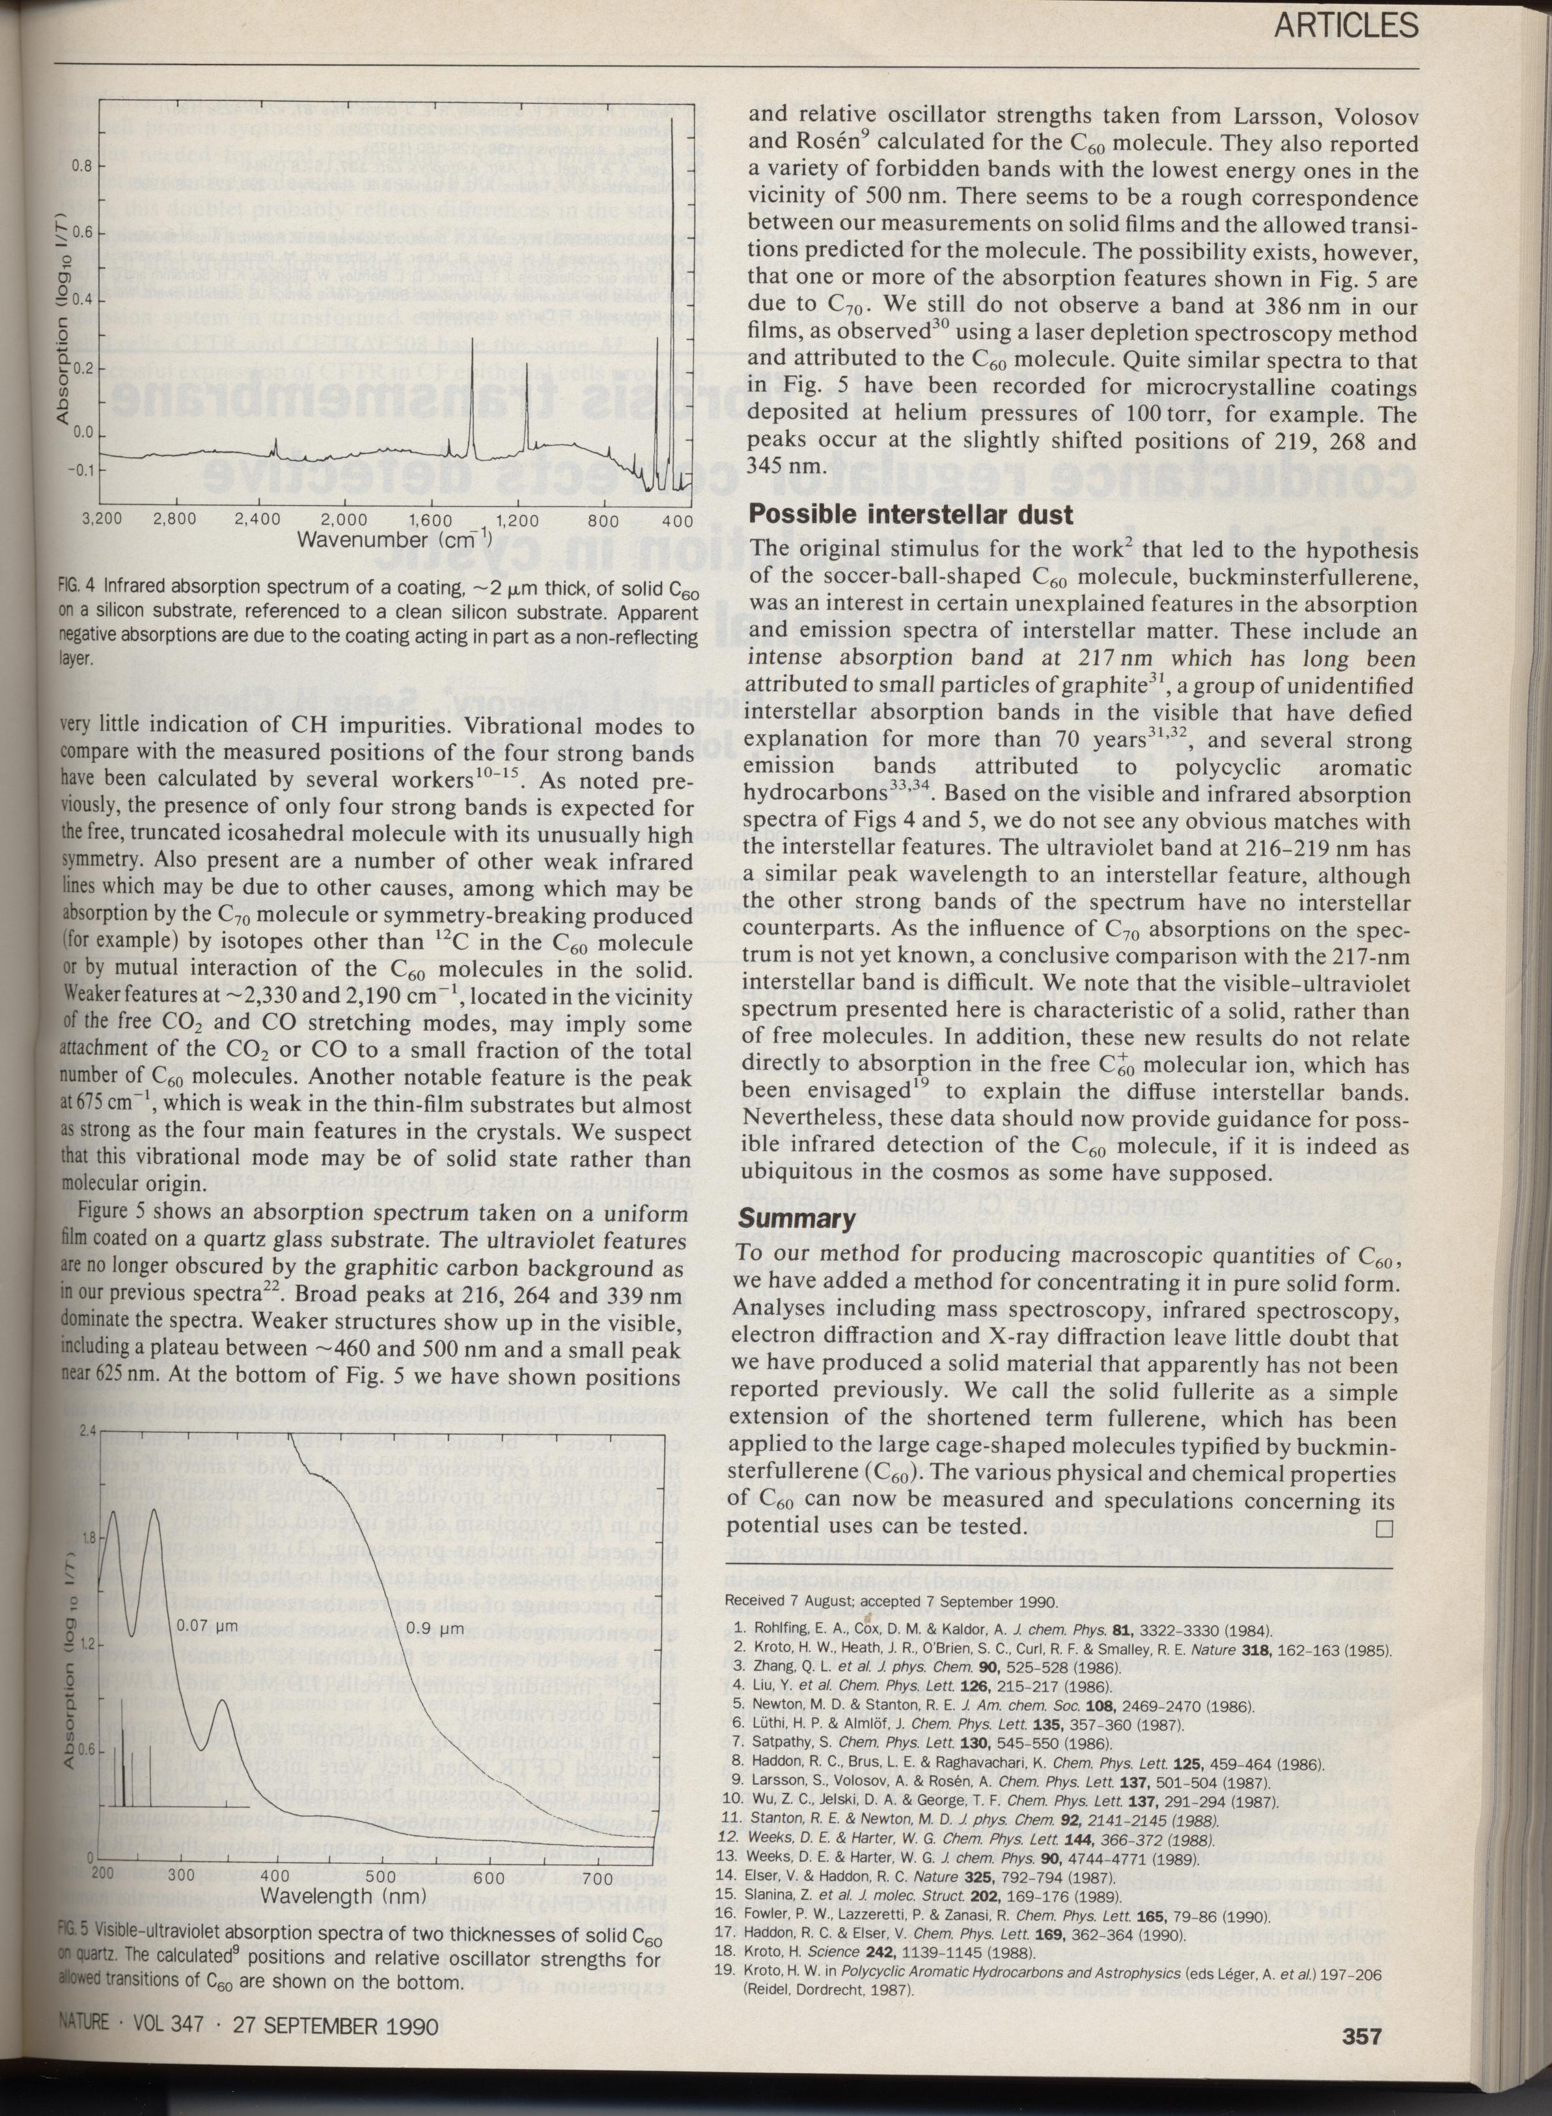
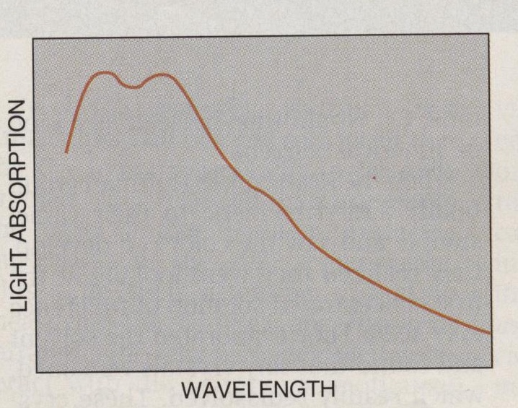

Slide 29
W.Krätschmer, L.D.Lamb, K.Fostiropoulos, D.R.Huffman, „Solid C₆₀: a new form of carbon”, Nature 347, 354 (1990)
C₆₀ in large quantities !

Slide 30
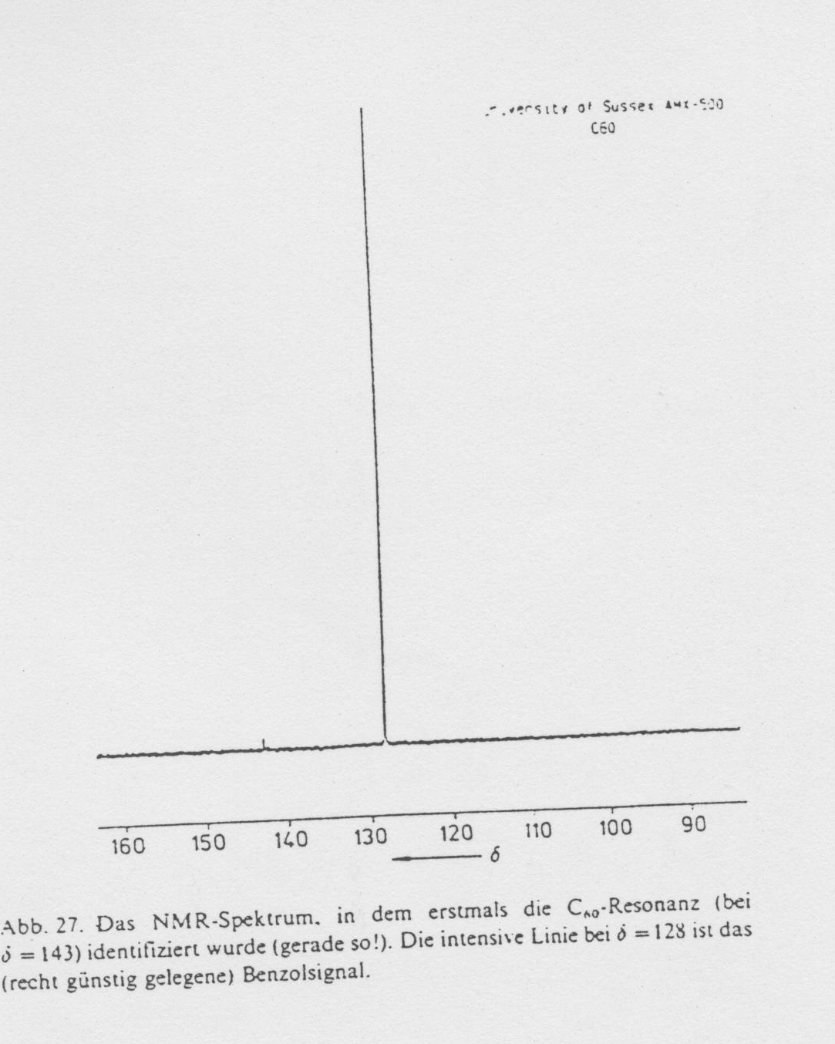

Slide 31
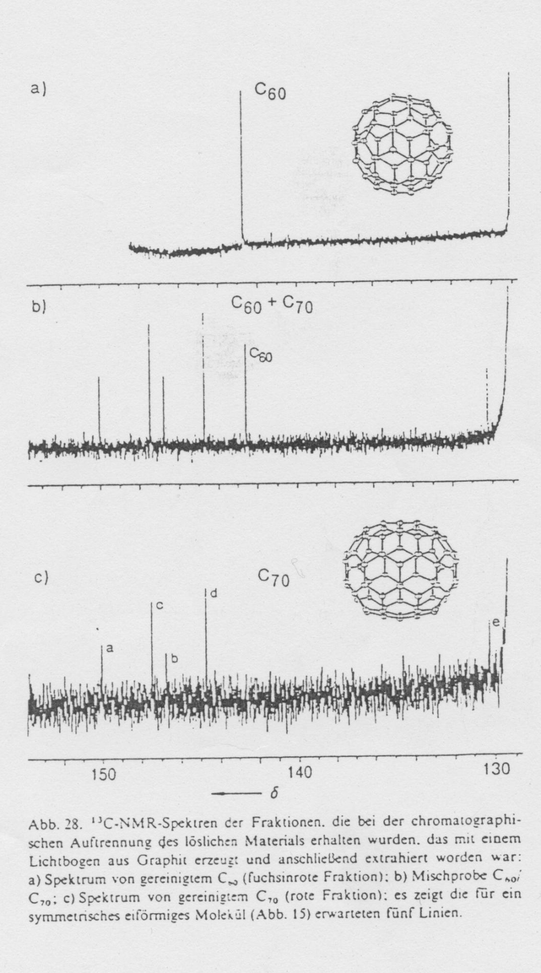
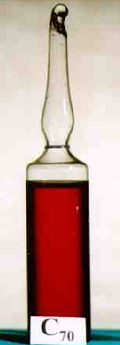

Slide 32
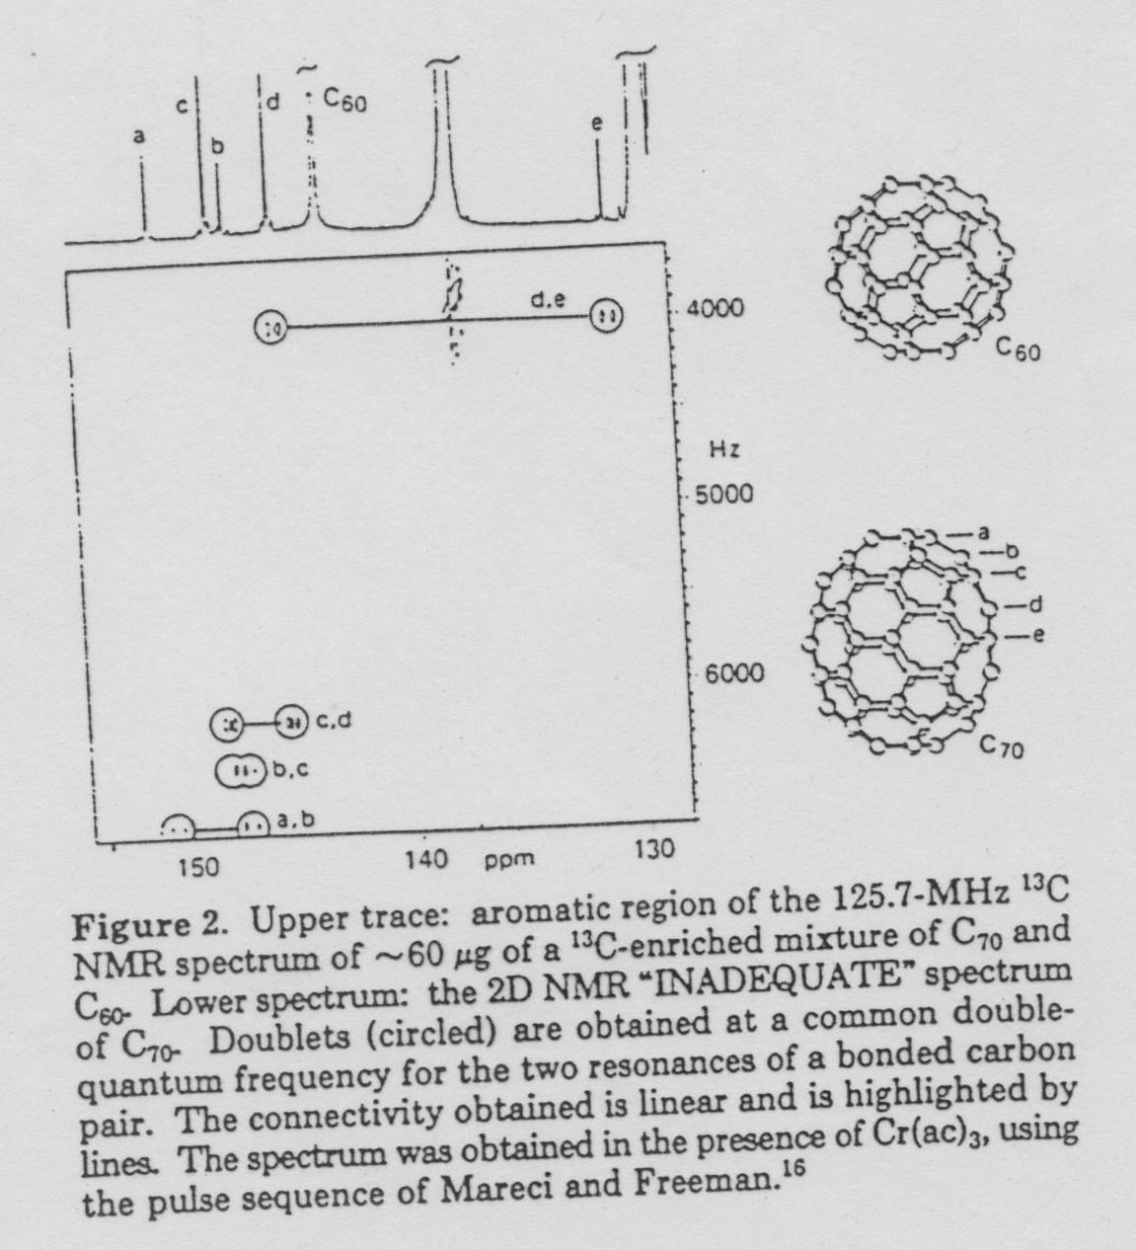

Slide 33
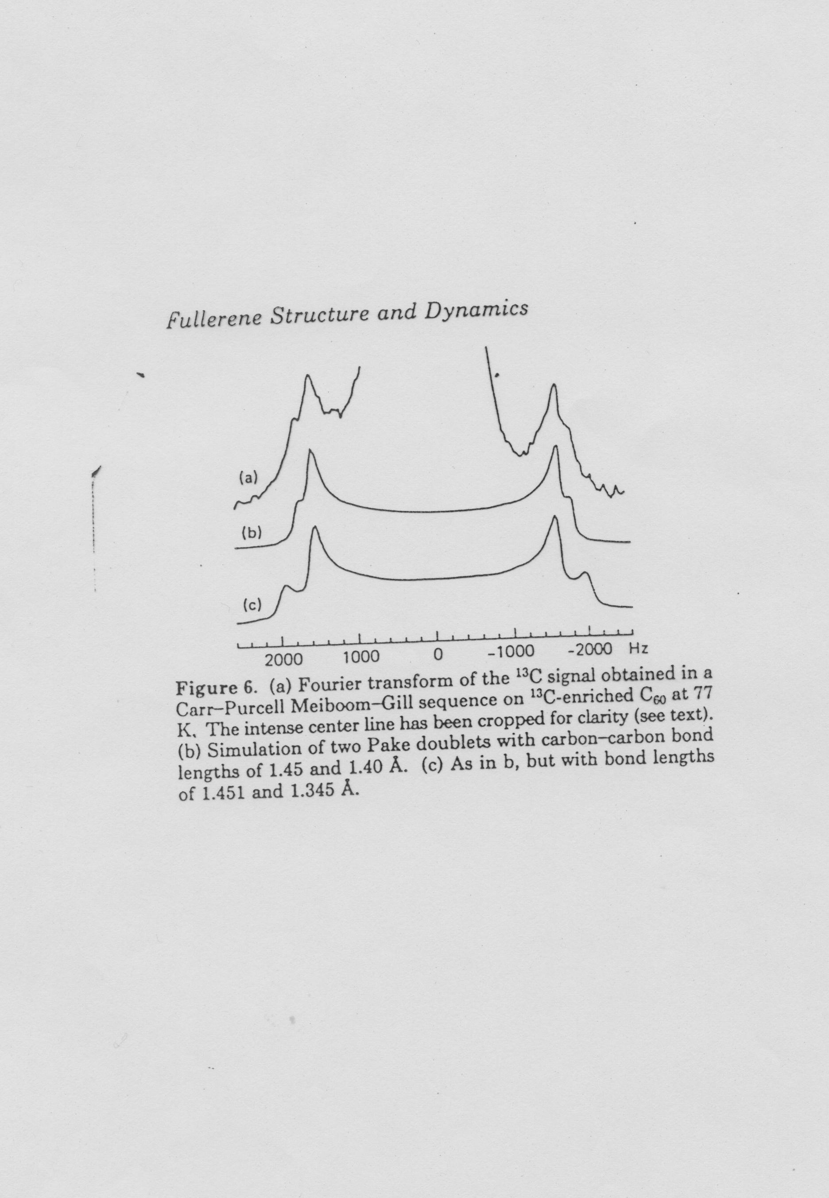

Slide 34
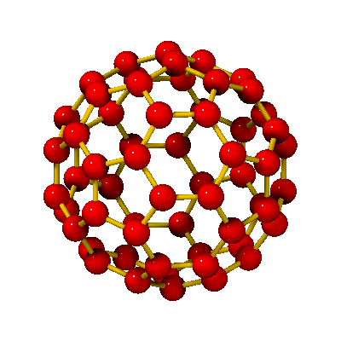
C₆₀
r₆₆
r₅₆
r₆₆ ≈ 140 pm
r₅₆ ≈ 145 pm
d ≈ 0,7 nm

Slide 35
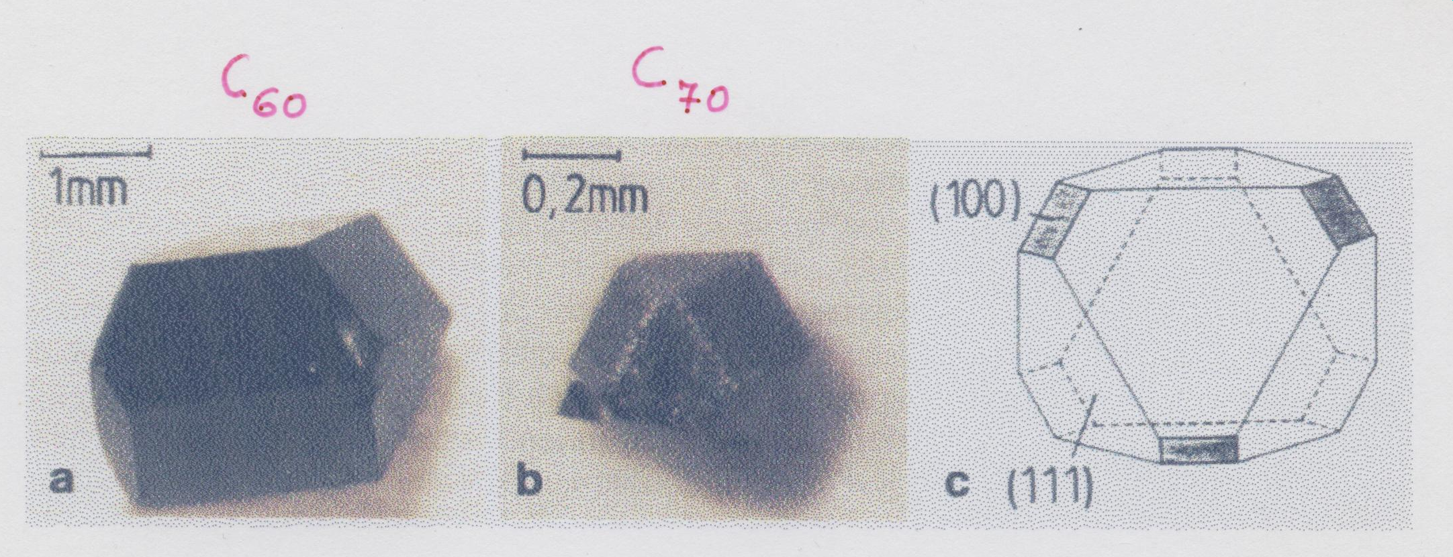

Slide 36
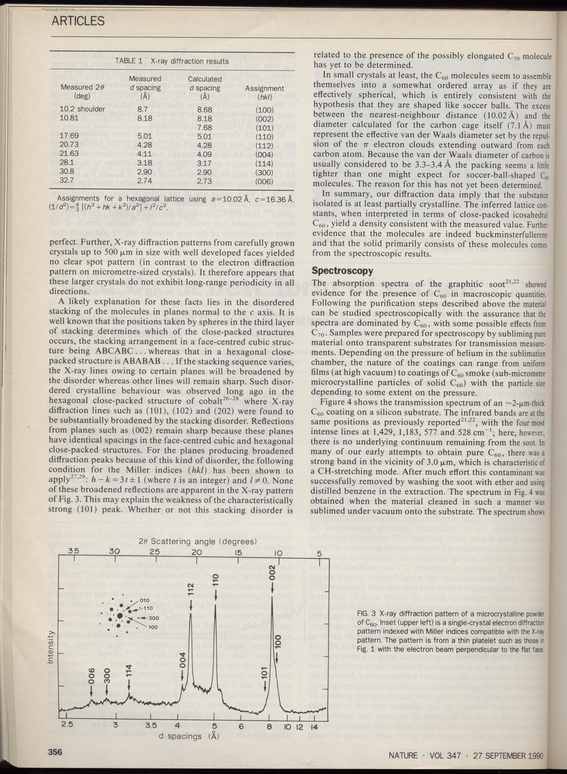

Slide 37
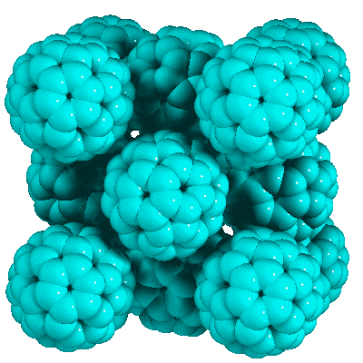
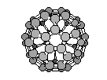
C₆₀ face centered cubic structure (fullerit)
d_{cc} ≈1 nm
d ≈0,7 nm
(T_{room})
a≈1,4 nm

