Slide 1
CARBON NANOSTRUCTURES (FULLERENES, CARBON NANOTUBES, GRAPHENE)
lecture for physics and chemistry students
(2018. summer semester – 23. March)
Prof. Jenő Kürti
ELTE Department of Biological Physics
e-mail: kurti@virag.elte.hu www: virag.elte.hu/kurti

Slide 2
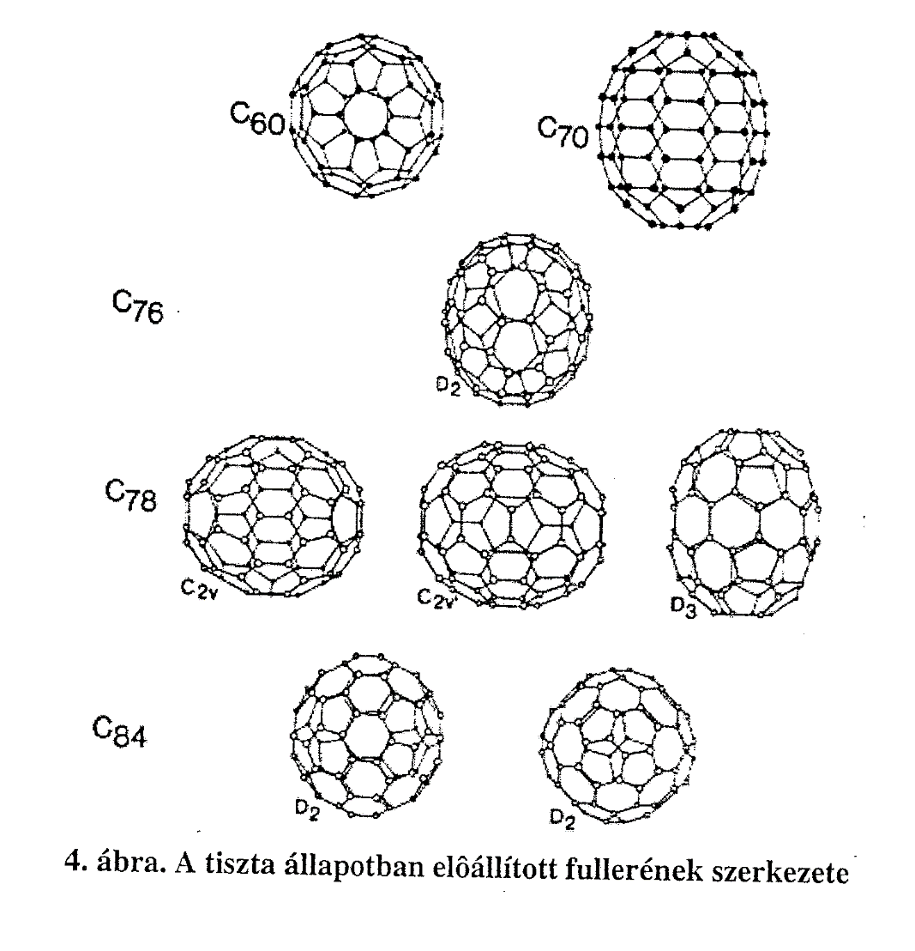
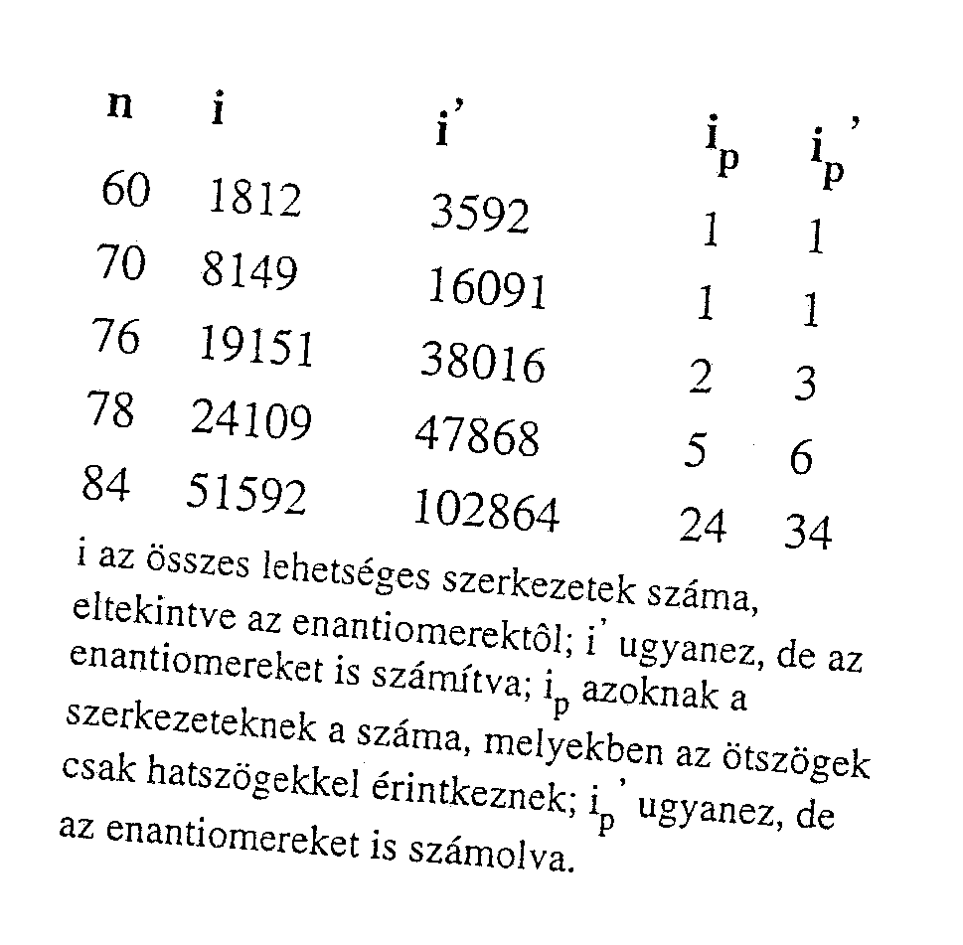
Memo: Euler-rule → n₅ = 12 és n₆ = arbitrary
… !

Slide 4
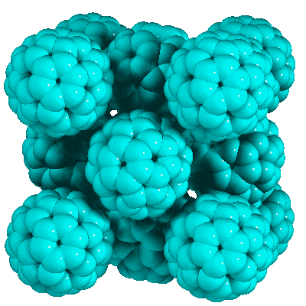
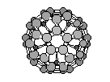
C₆₀ face centered cubic structure (fullerit)
d_{cc} ≈1 nm
d ≈0,7 nm
(T_{room})
a≈1,4 nm

Slide 5
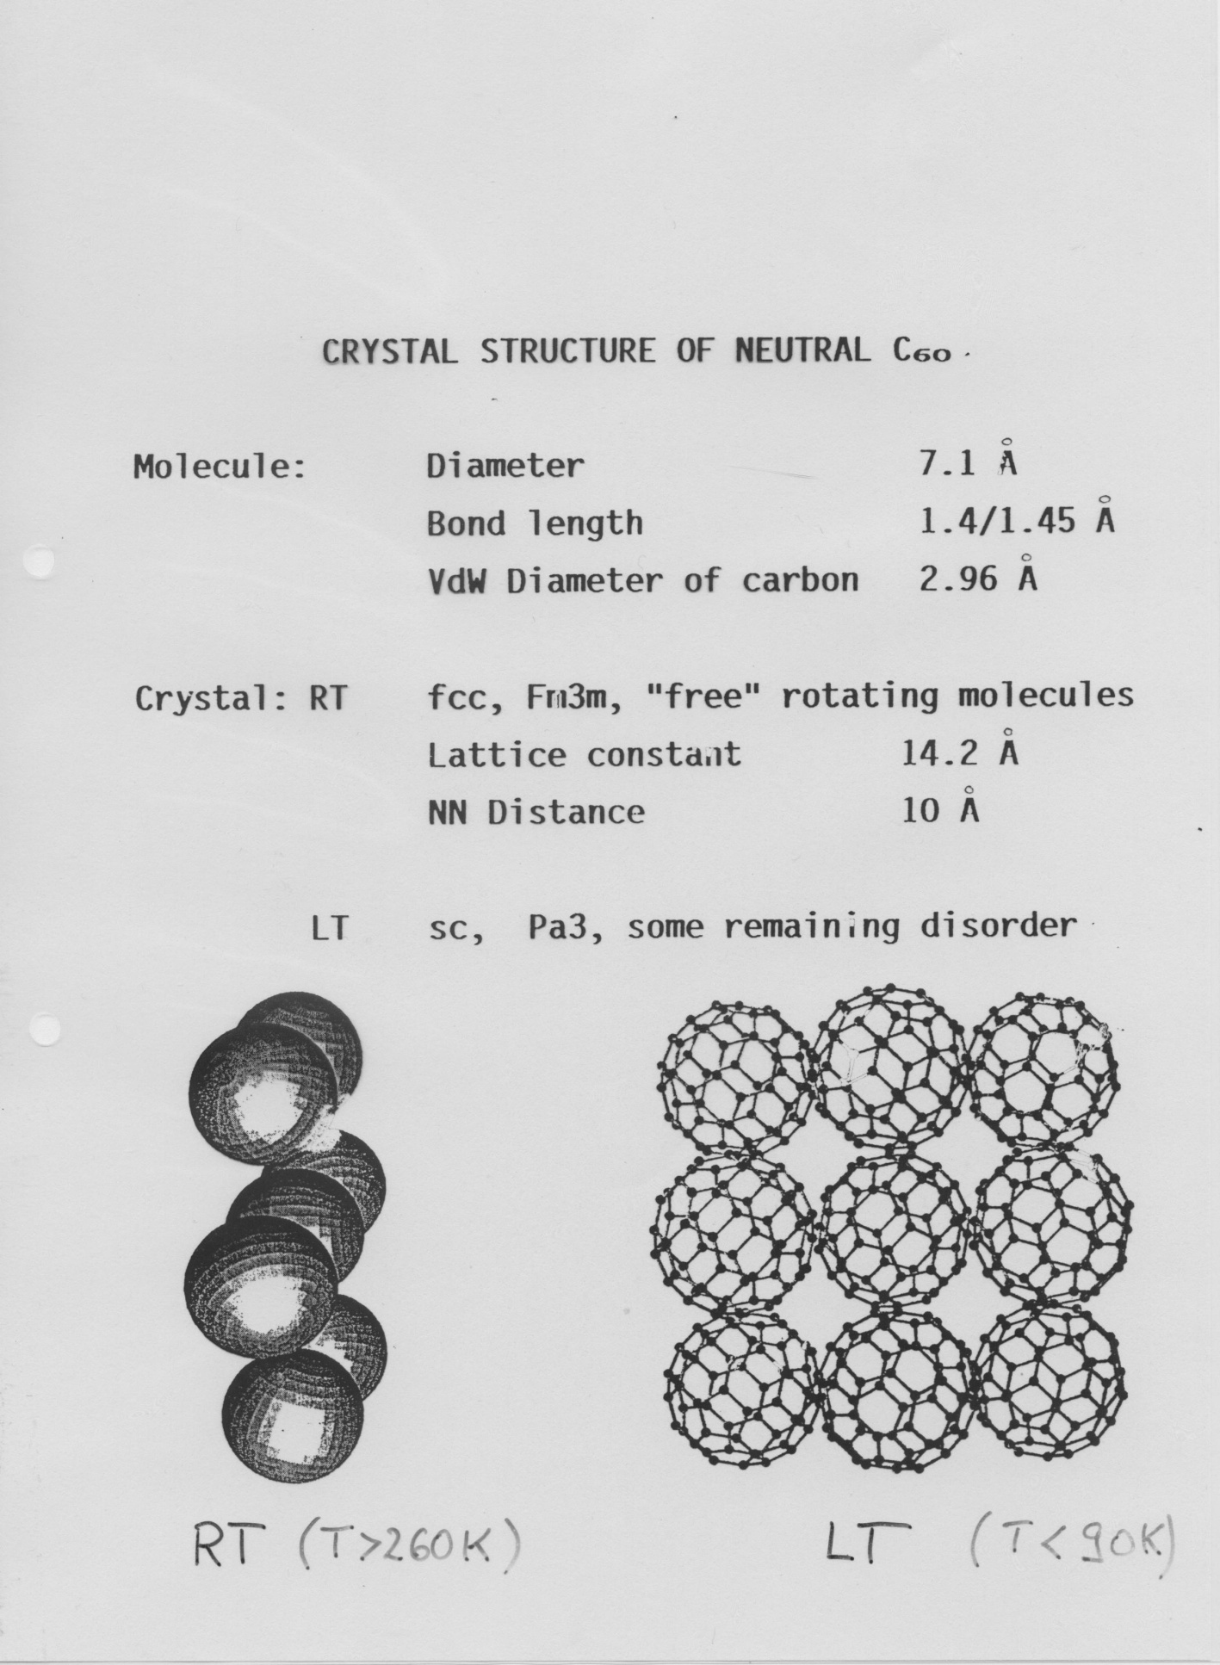

Slide 6
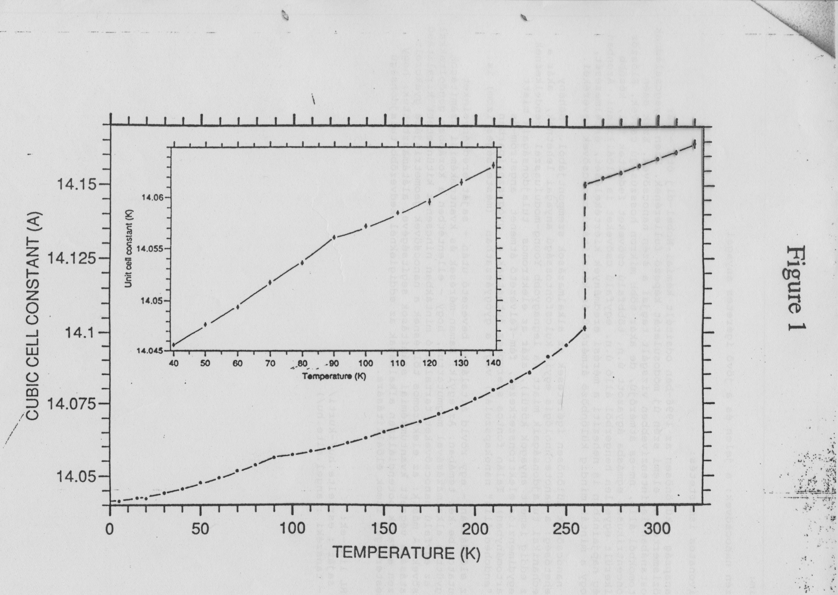
NEUTRON DIFFRACTION

Slide 7
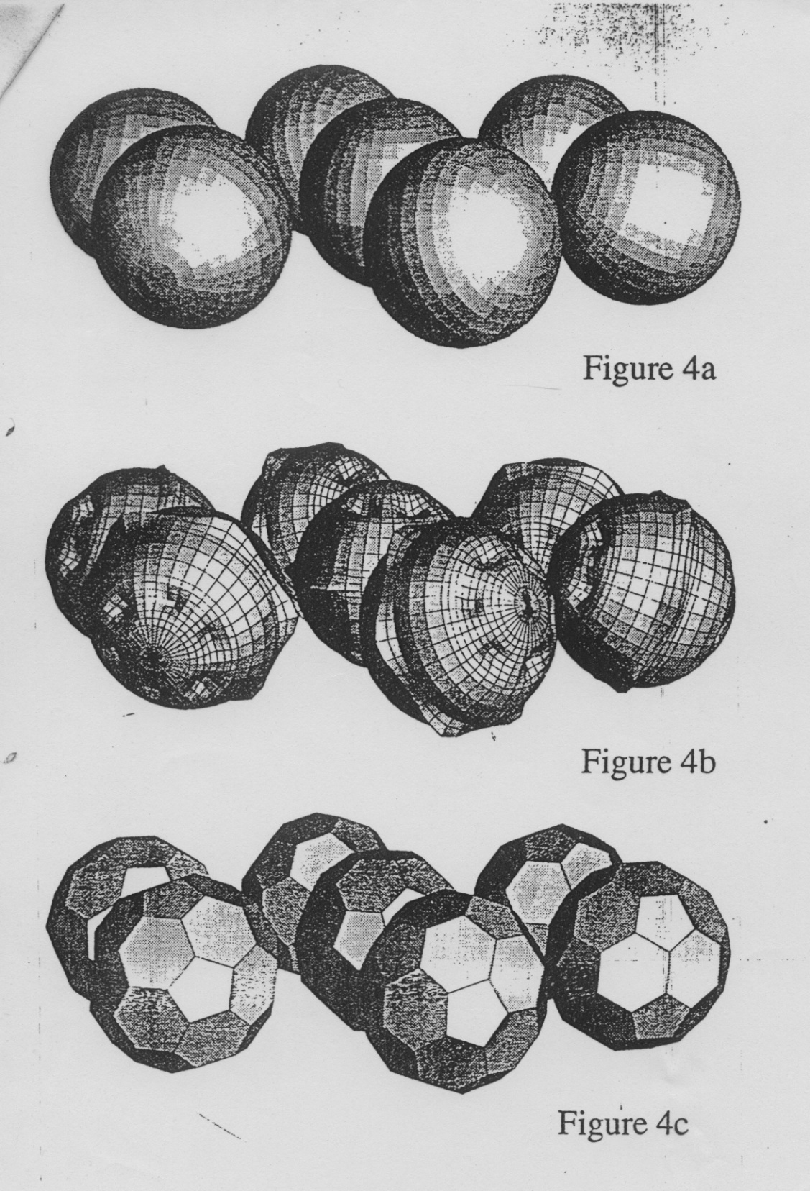
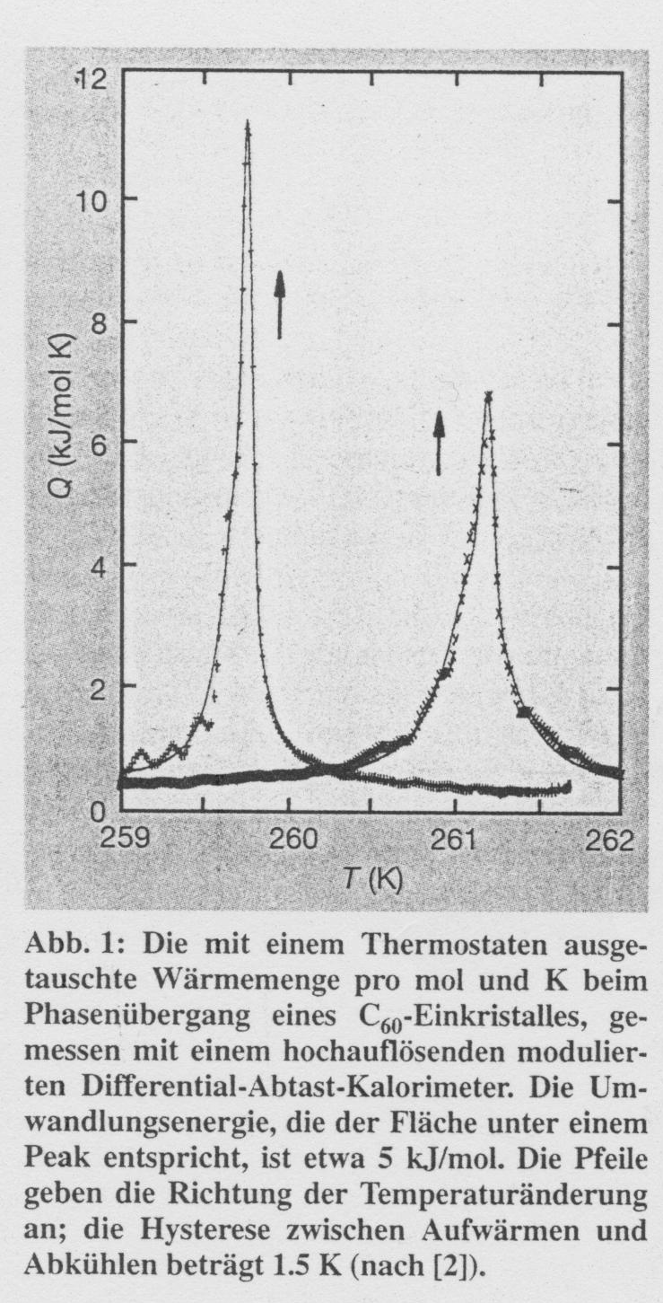
>260 K
< 90 K

Slide 8
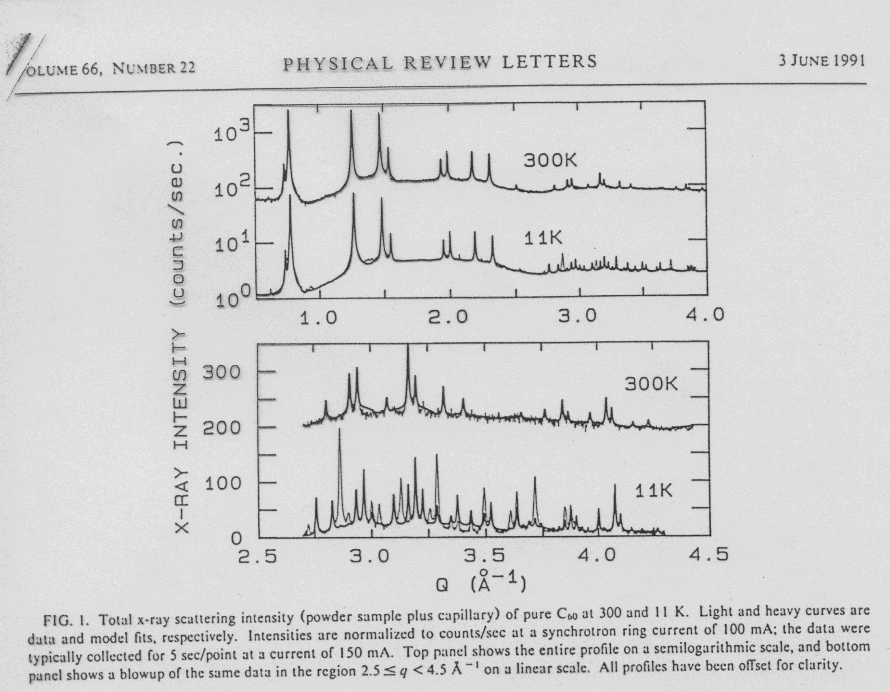

Slide 9
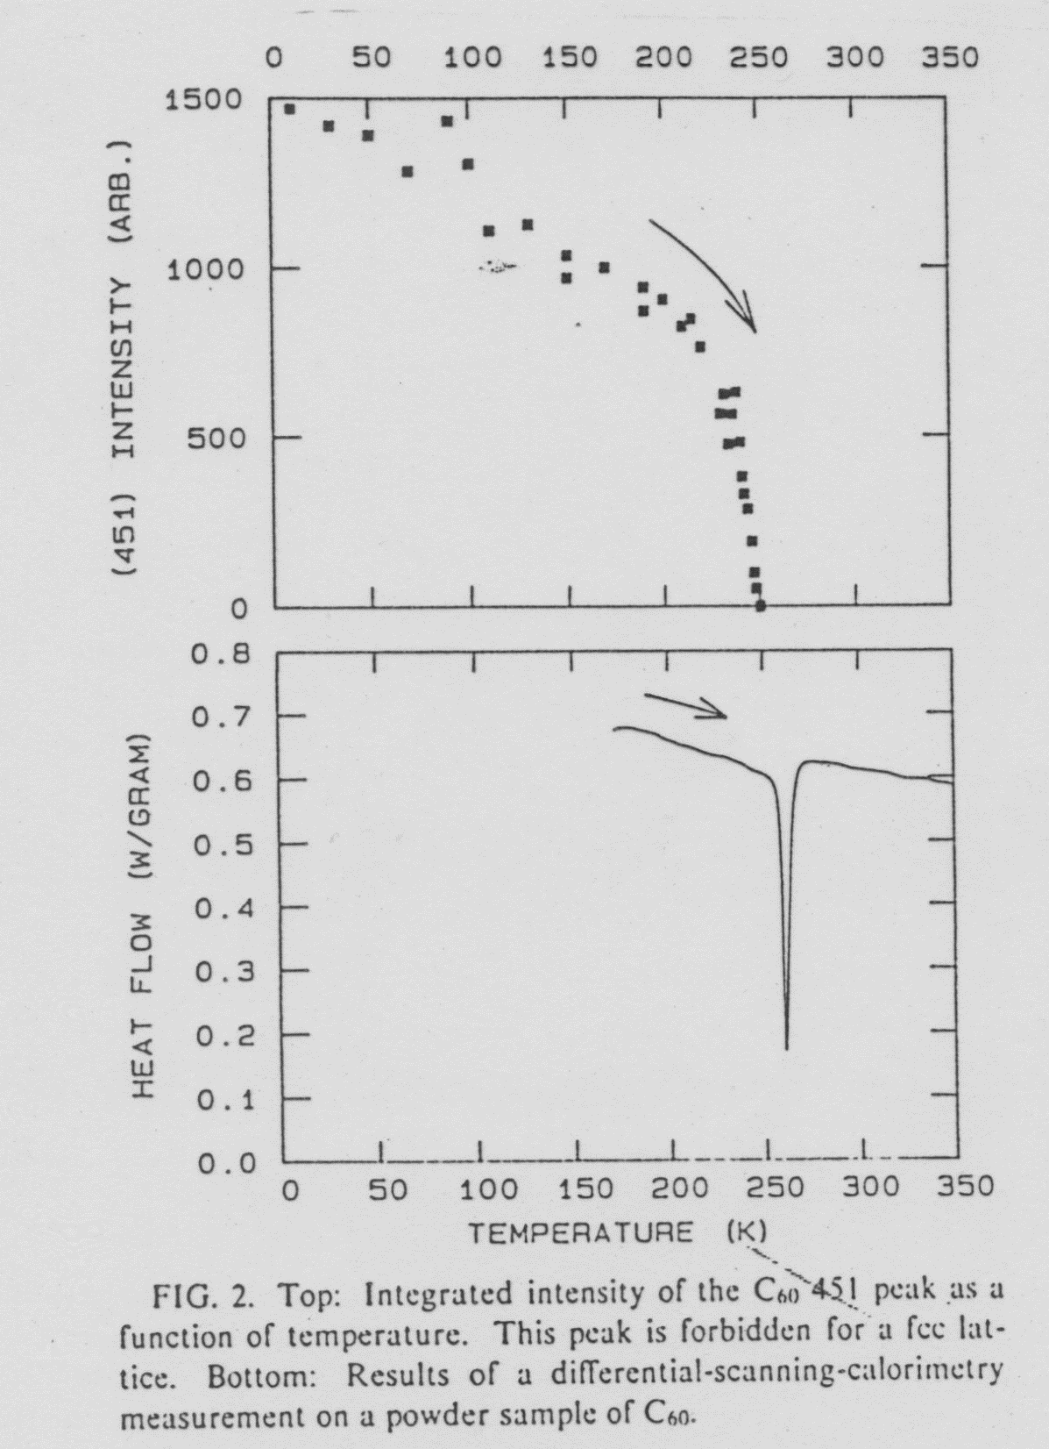

Slide 10
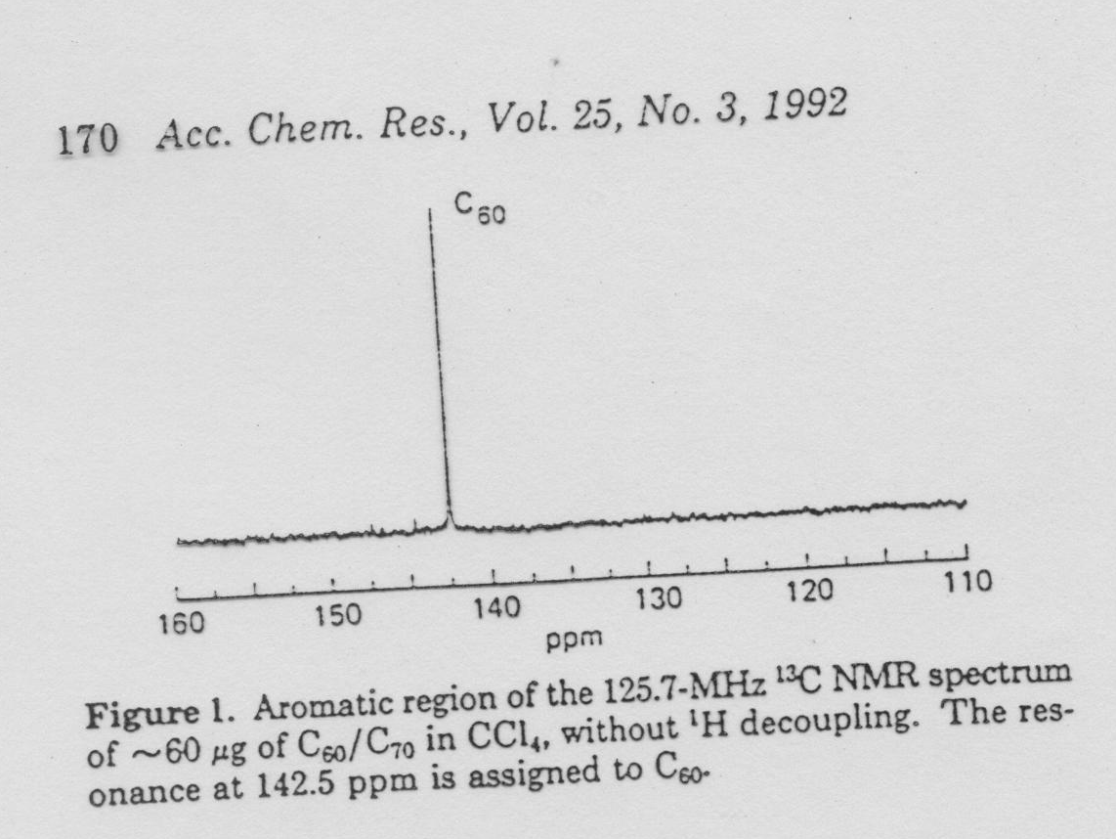

Slide 11
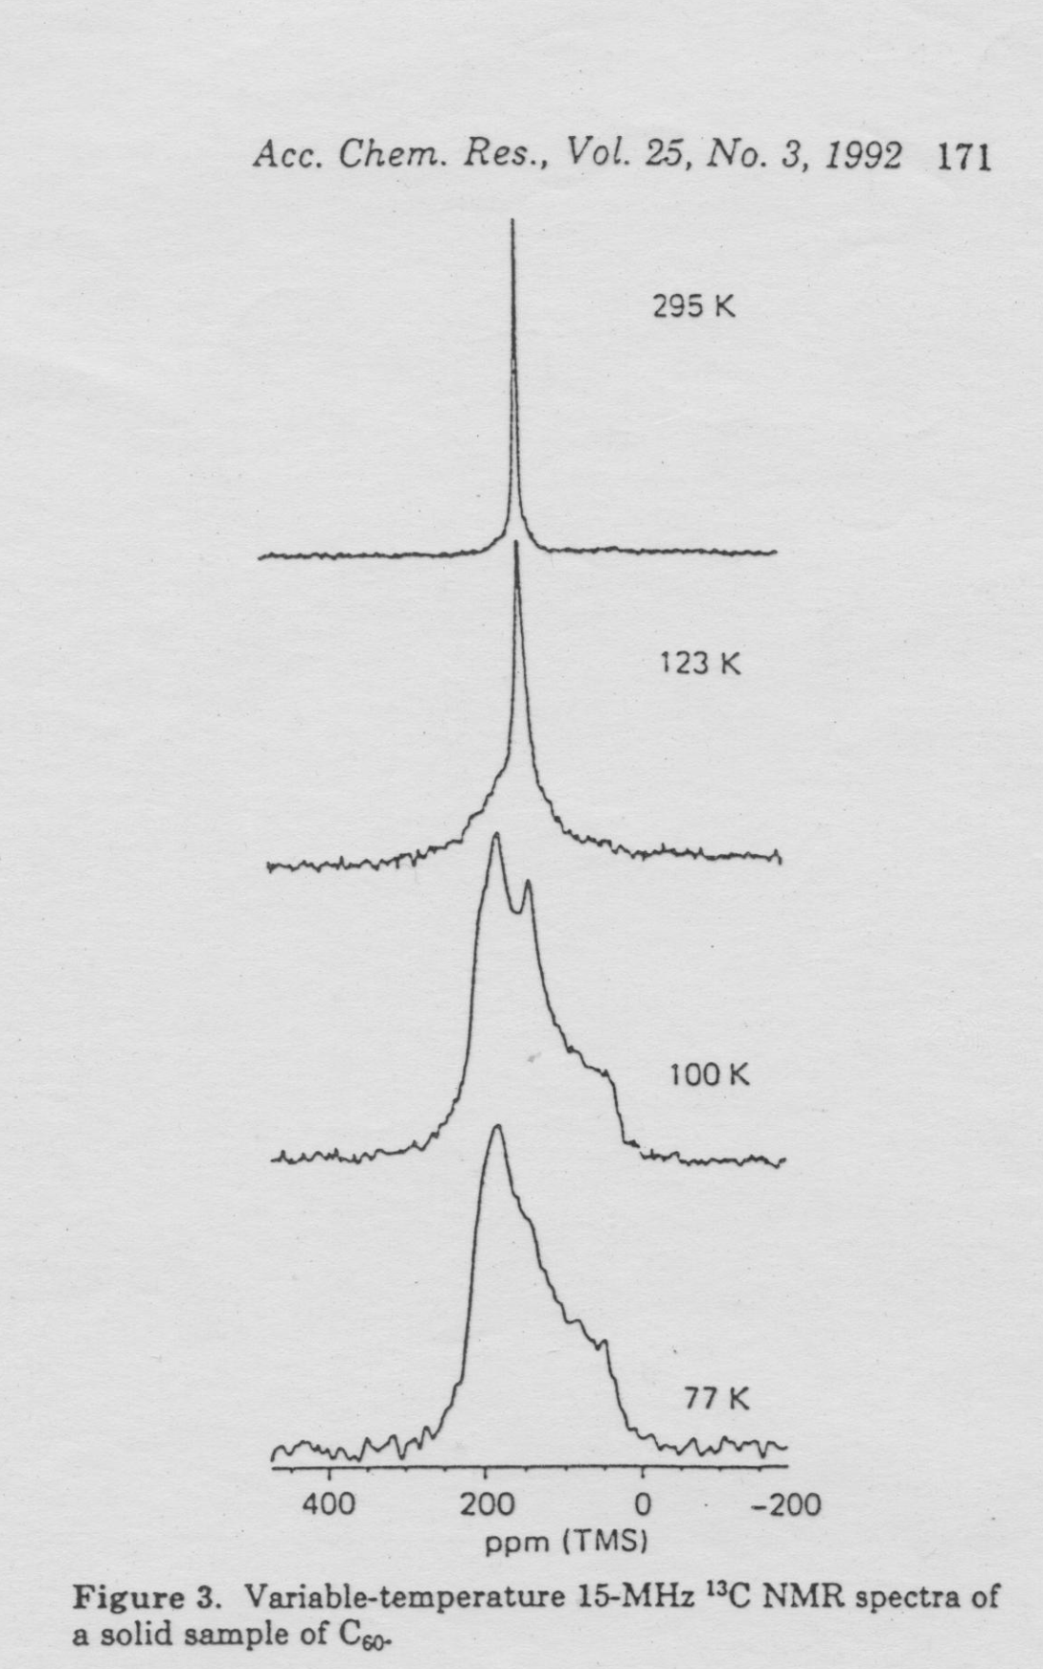

Slide 12
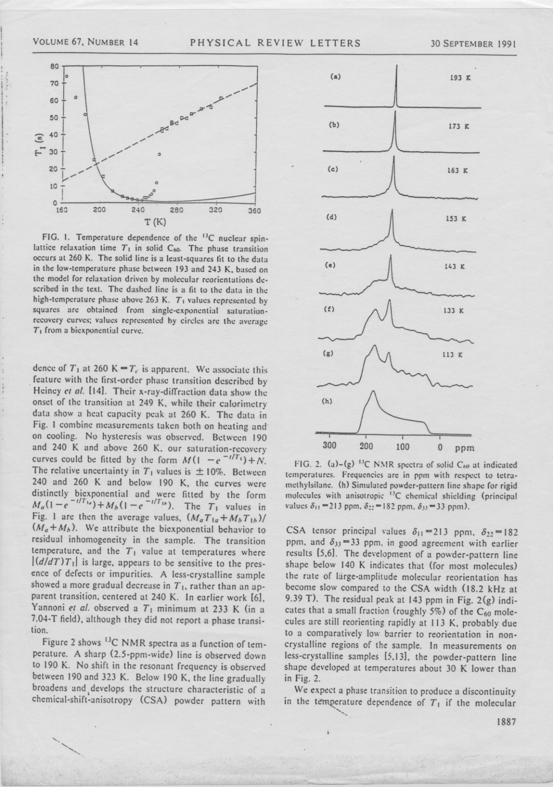

Slide 13
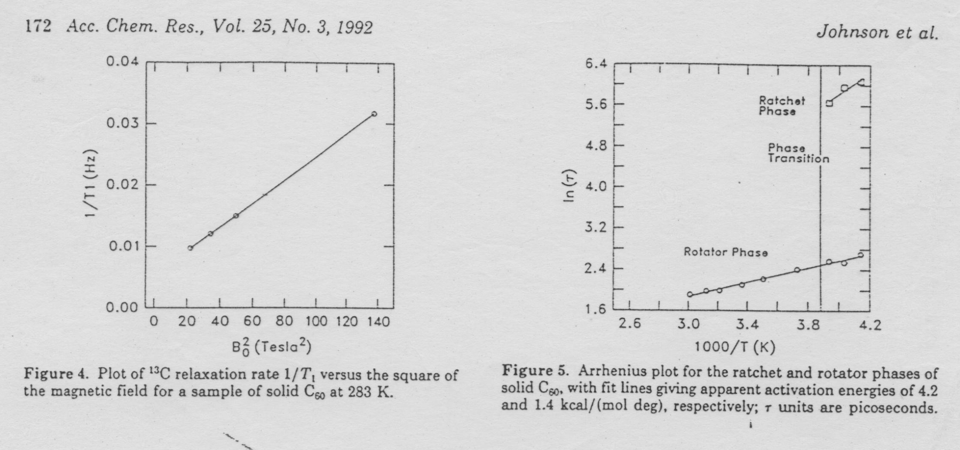
solid: τ=9.2 ps
gas: τ=3.1 ps
liquid: τ=15.5 ps

Slide 14
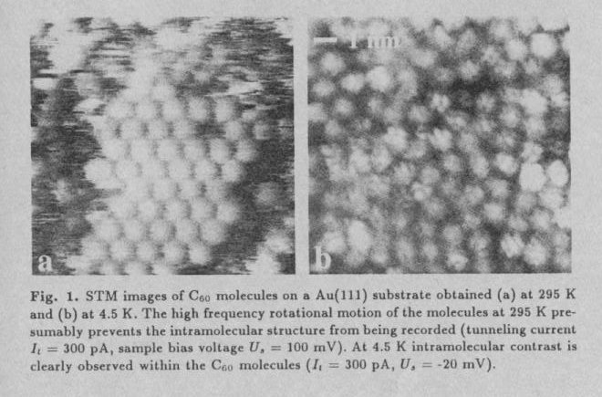

Slide 15
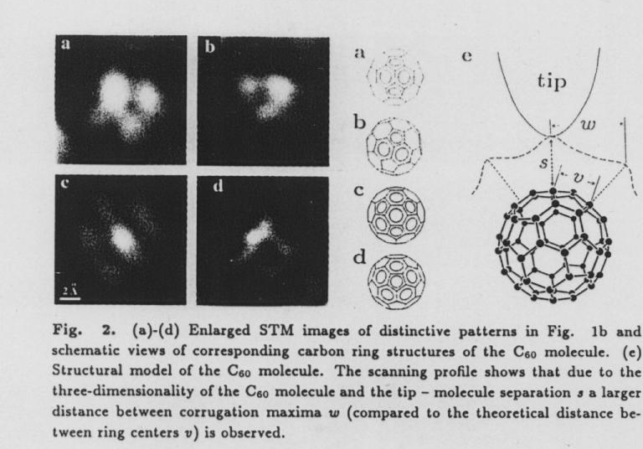

Slide 16
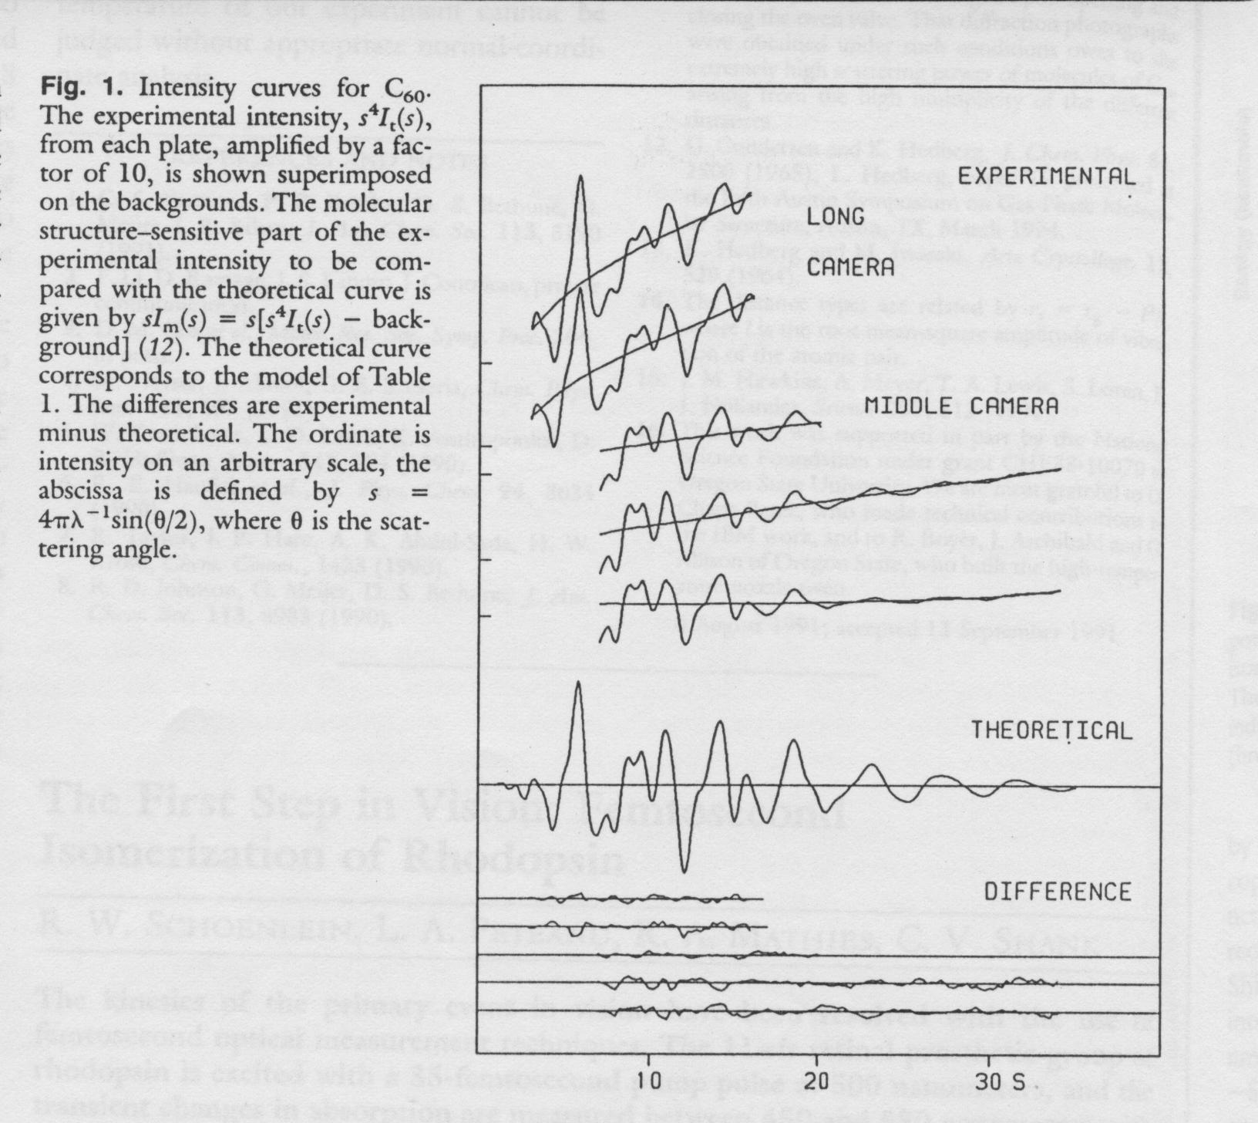
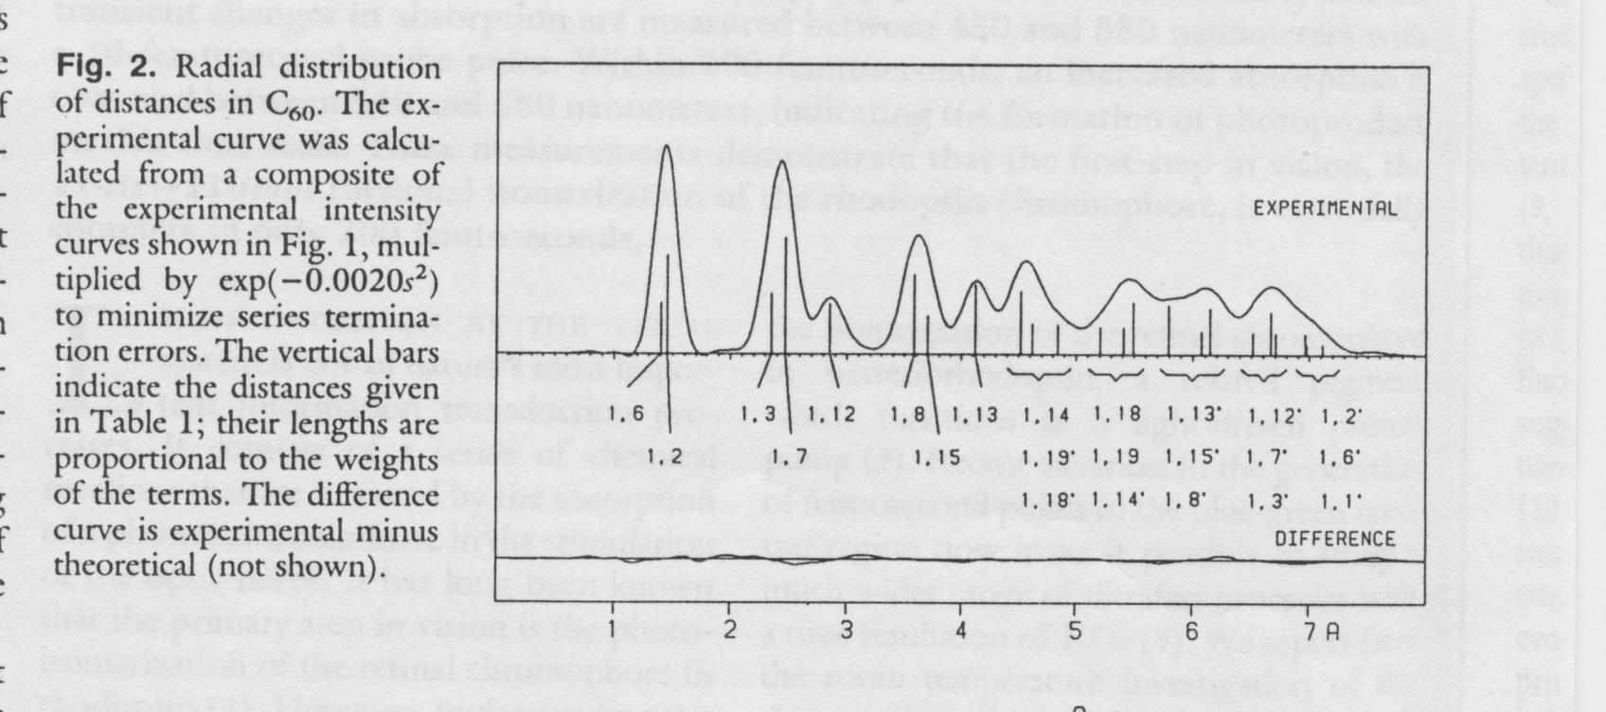
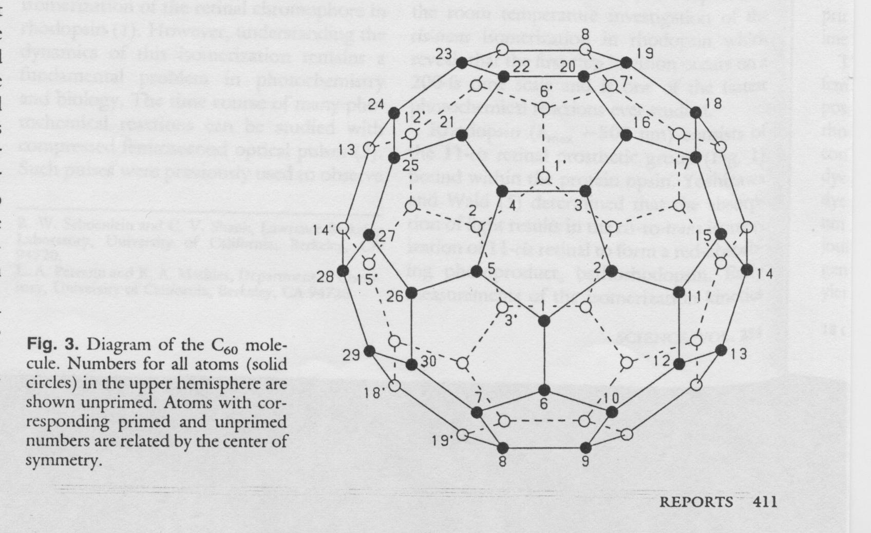

Slide 17
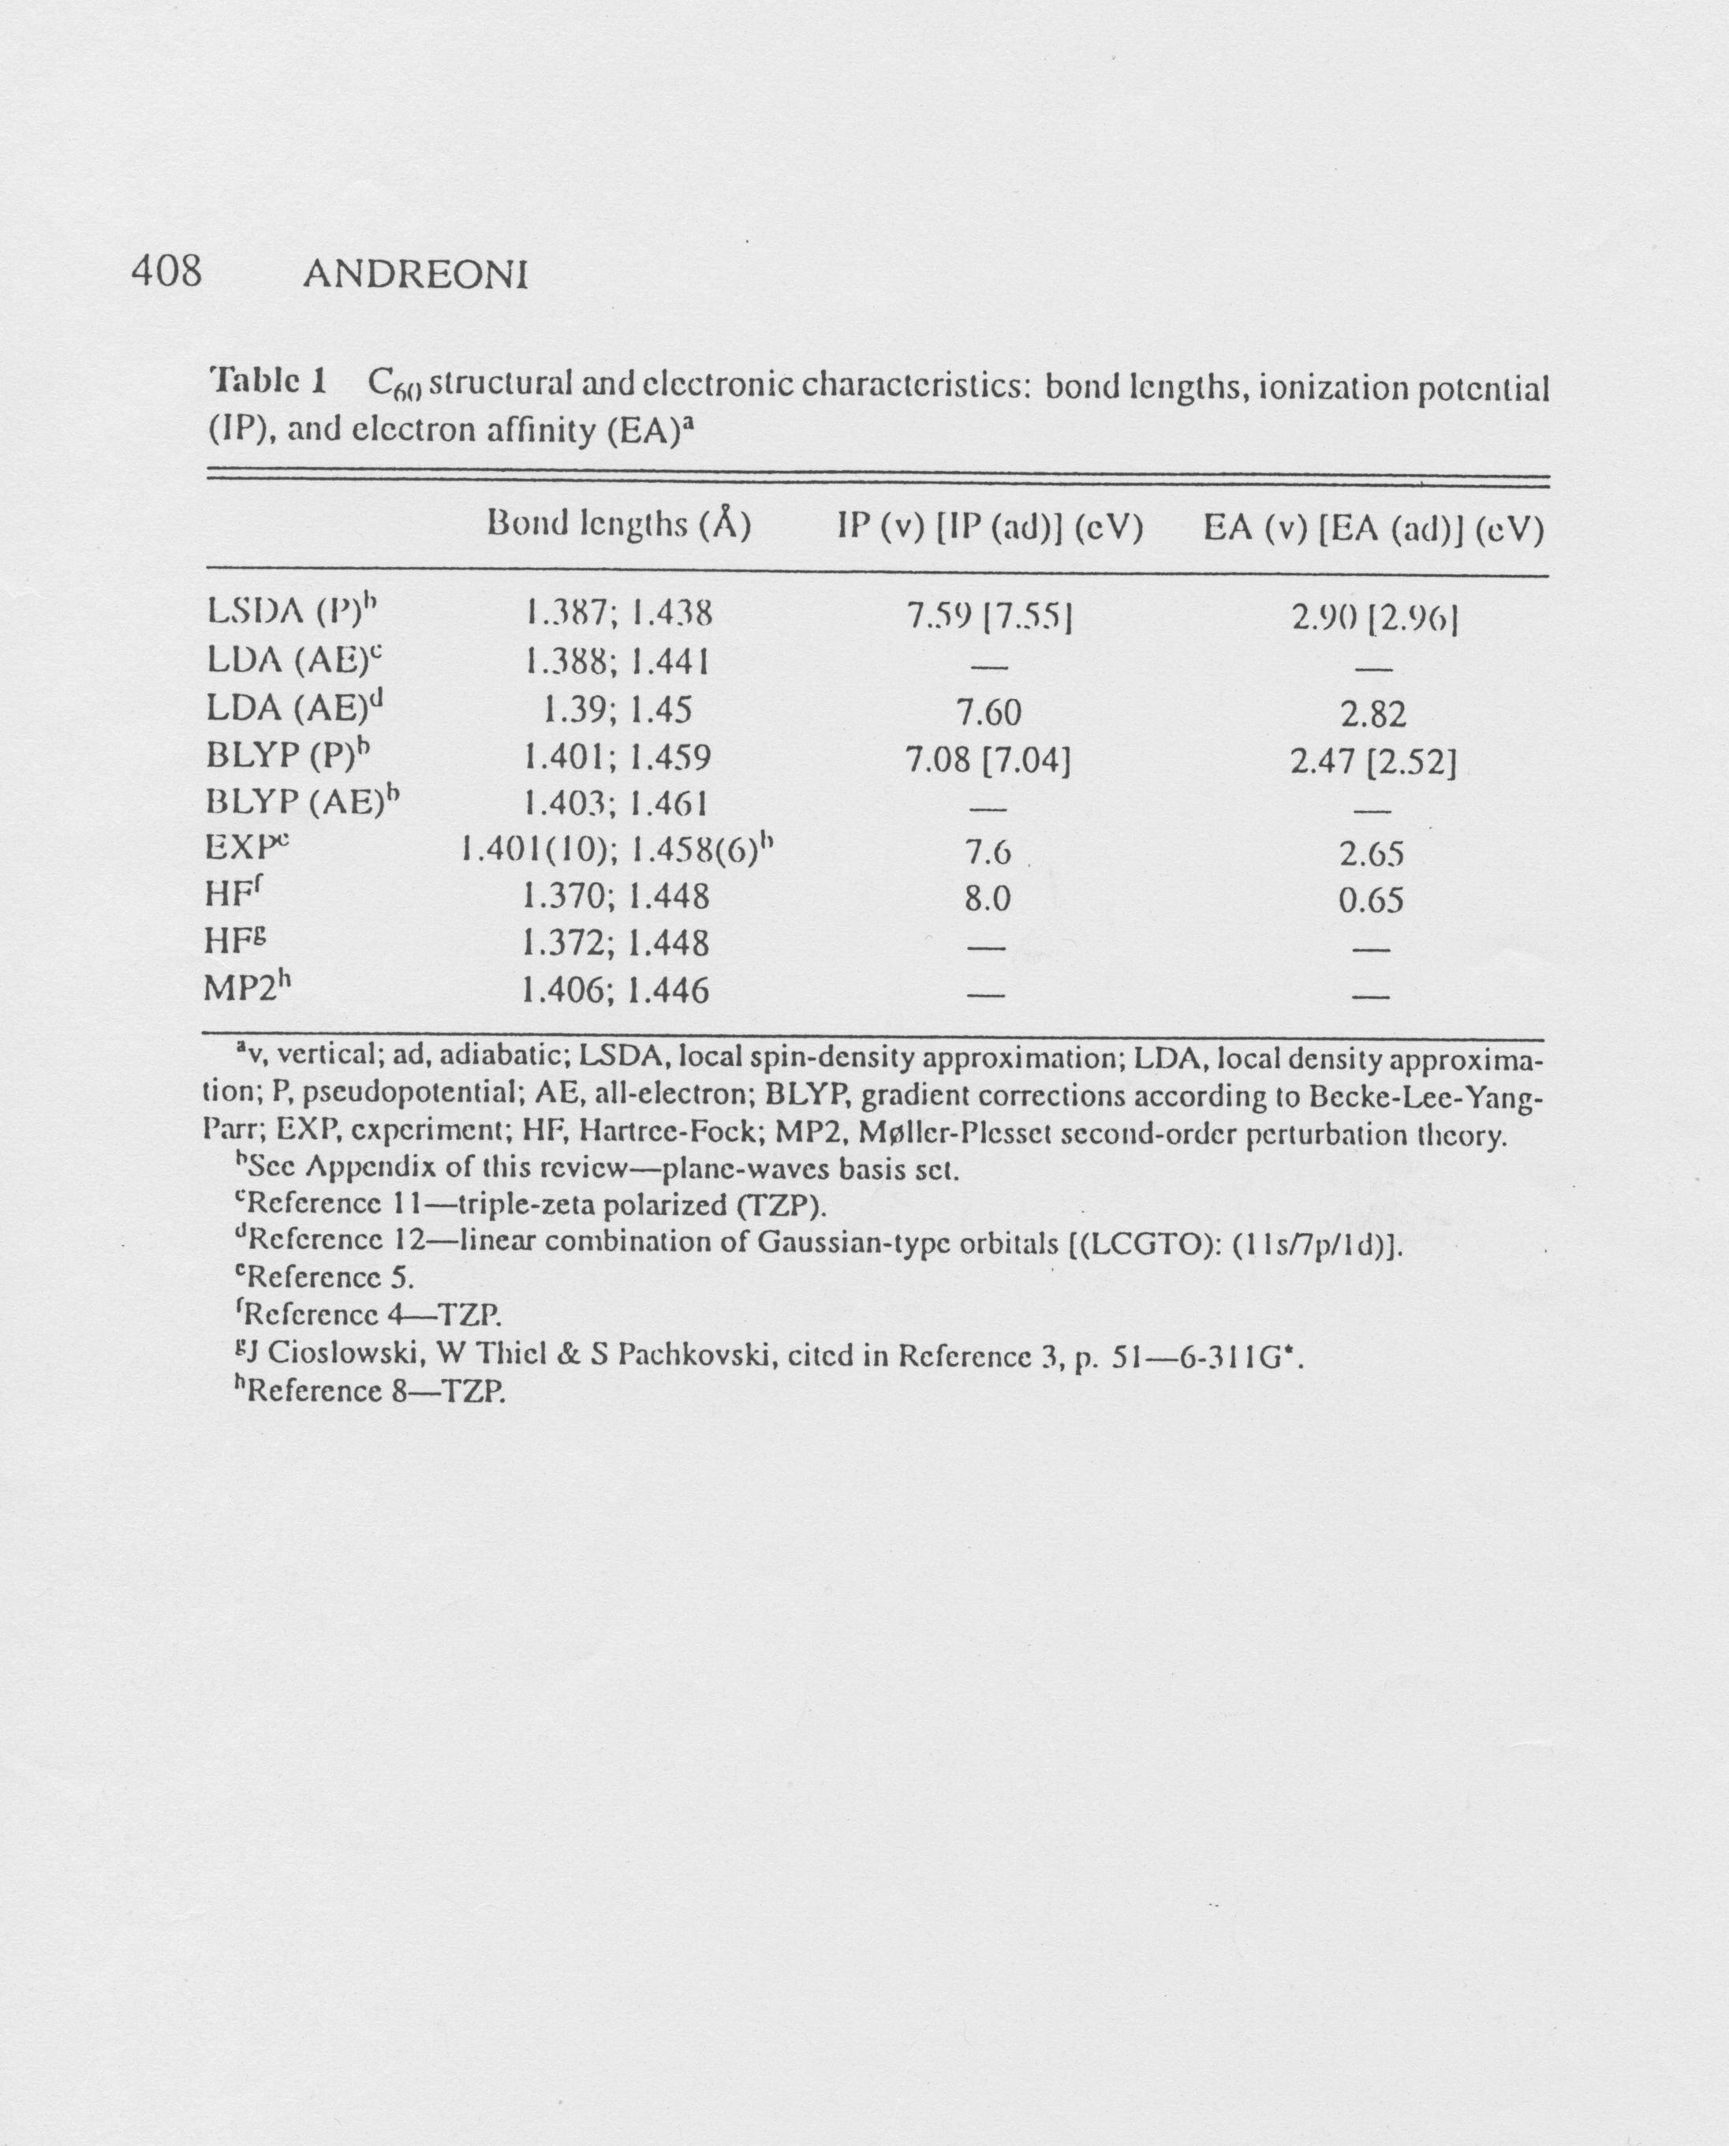
elektron diffraction (gas) 1.401(10) / 1.458 (6)
NMR (liquid) 1.40 (2) / 1.45 (2)
X-ray (110 K) 1.355(9) / 1.467(21)

Slide 19
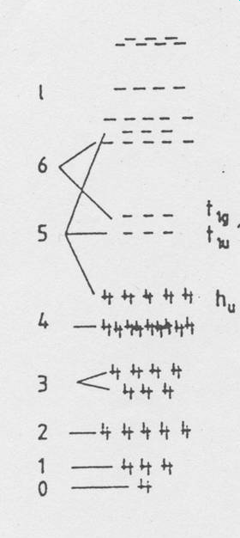

Slide 20
