Slide 1
CARBON NANOSTRUCTURES (FULLERENES, CARBON NANOTUBES, GRAPHENE)
lecture for physics and chemistry students
(2019. summer semester – 14. February)
Prof. Jenő Kürti
ELTE Department of Biological Physics
e-mail: kurti@virag.elte.hu www: regivirag.elte.hu/kurti

Slide 2
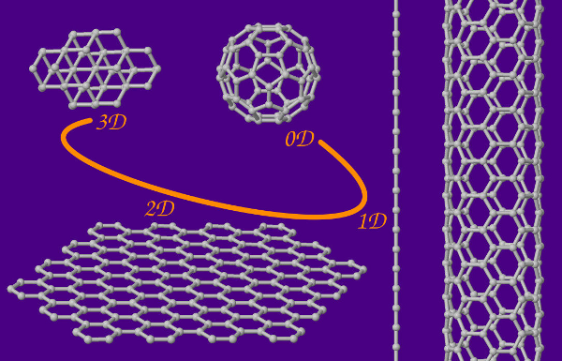

Slide 3
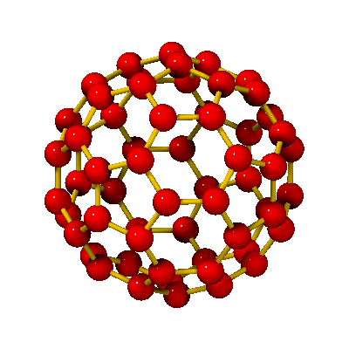
H.W.Kroto, J.R.Heath, S.C.O’Brien, R.F.Curl, R.E.Smalley,
„C₆₀: Buckminsterfullerene”, Nature 318, 162 (14 Nov. 1985)
C₆₀
NOBEL-PRIZE: in 1996
buckminsterfullerene
buckyball
d ≈ 0,7 nm

Slide 4
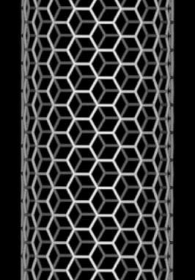
S.Iijima, Nature 354, 56 (1991)
SINGLE WALLED CARBON NANOTUBE: hexagonal lattice of carbon atoms on the surface of a tube
KAVLI-PRIZE:
in 2008
LENGTH ≈1–100 μm
But it can be even several mm long !
≈ 50 000 times thinner than a hair !
DIAMETER ≈1–1,5 nm
Notes:
Hajszál vastagsága kb 50 mikron.

Slide 5
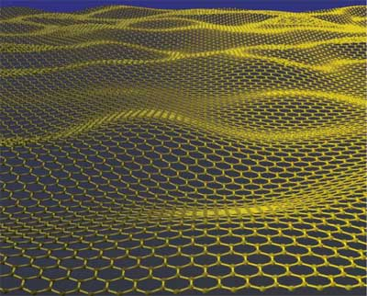
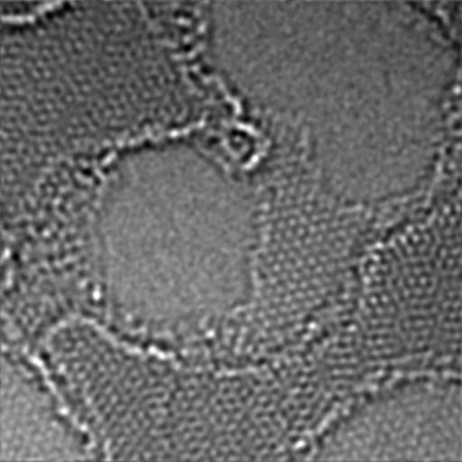
GRAPHENE
Novoselov et al.
2004
NOBEL-PRIZE: in 2010
artistic picture
Visible (200 μ)
AFM (10 μ)
EM

Slide 6
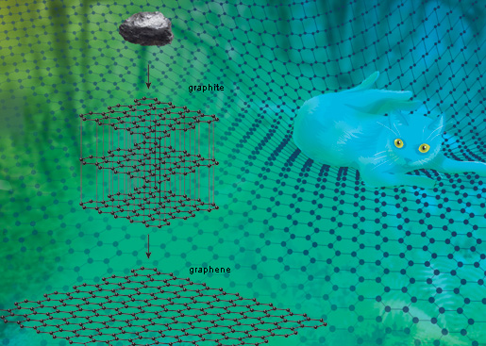

Slide 7
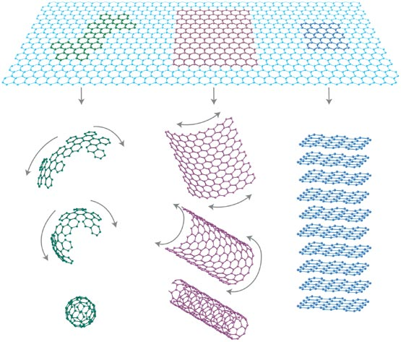
2D
0D
1D
3D

Slide 8
INTRO

Slide 9
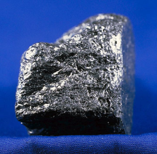
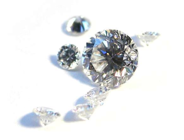
GRAPHITE DIAMOND
soft hard
black transparent
conductor insulator

Slide 10
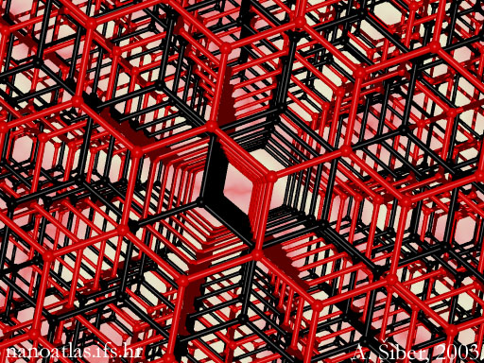
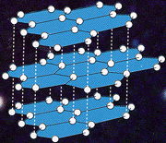
GRAPHITE
d_{ss} ≅ 0,335 nm
d_{CC} ≅ 0,142 nm

Slide 11
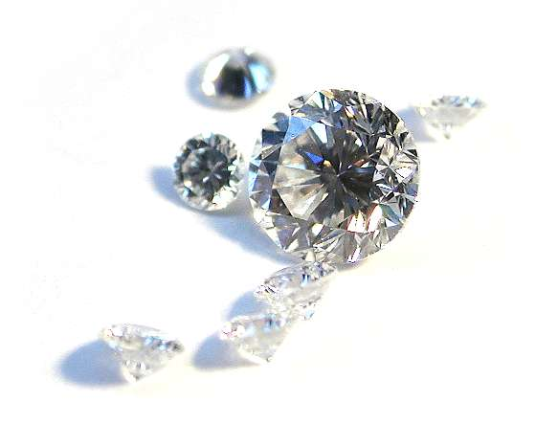
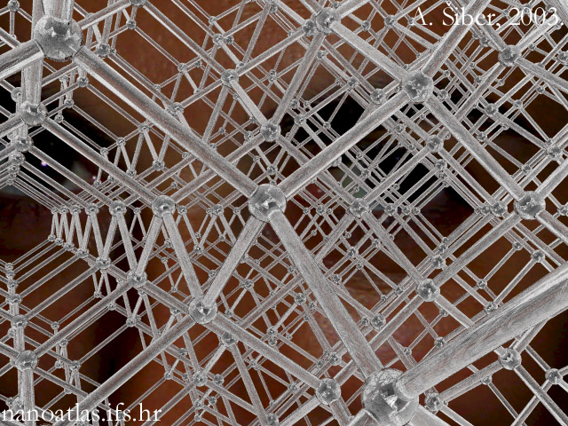
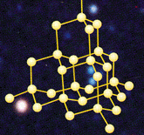
DIAMOND
d_{CC} ≅ 0,154 nm

Slide 12
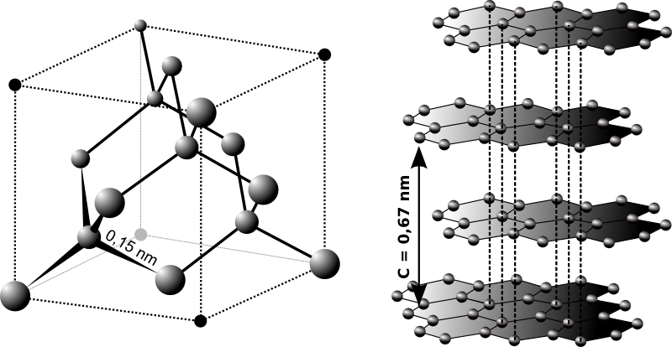
The structure of diamond and graphite

Slide 13
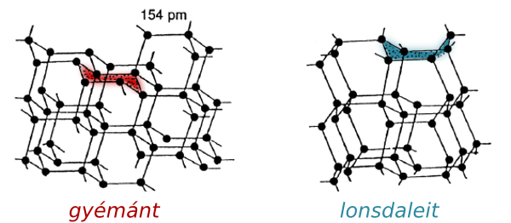
Difference between the structure of cubic diamond and hexagonal diamond (lonsdaleit)

Slide 14
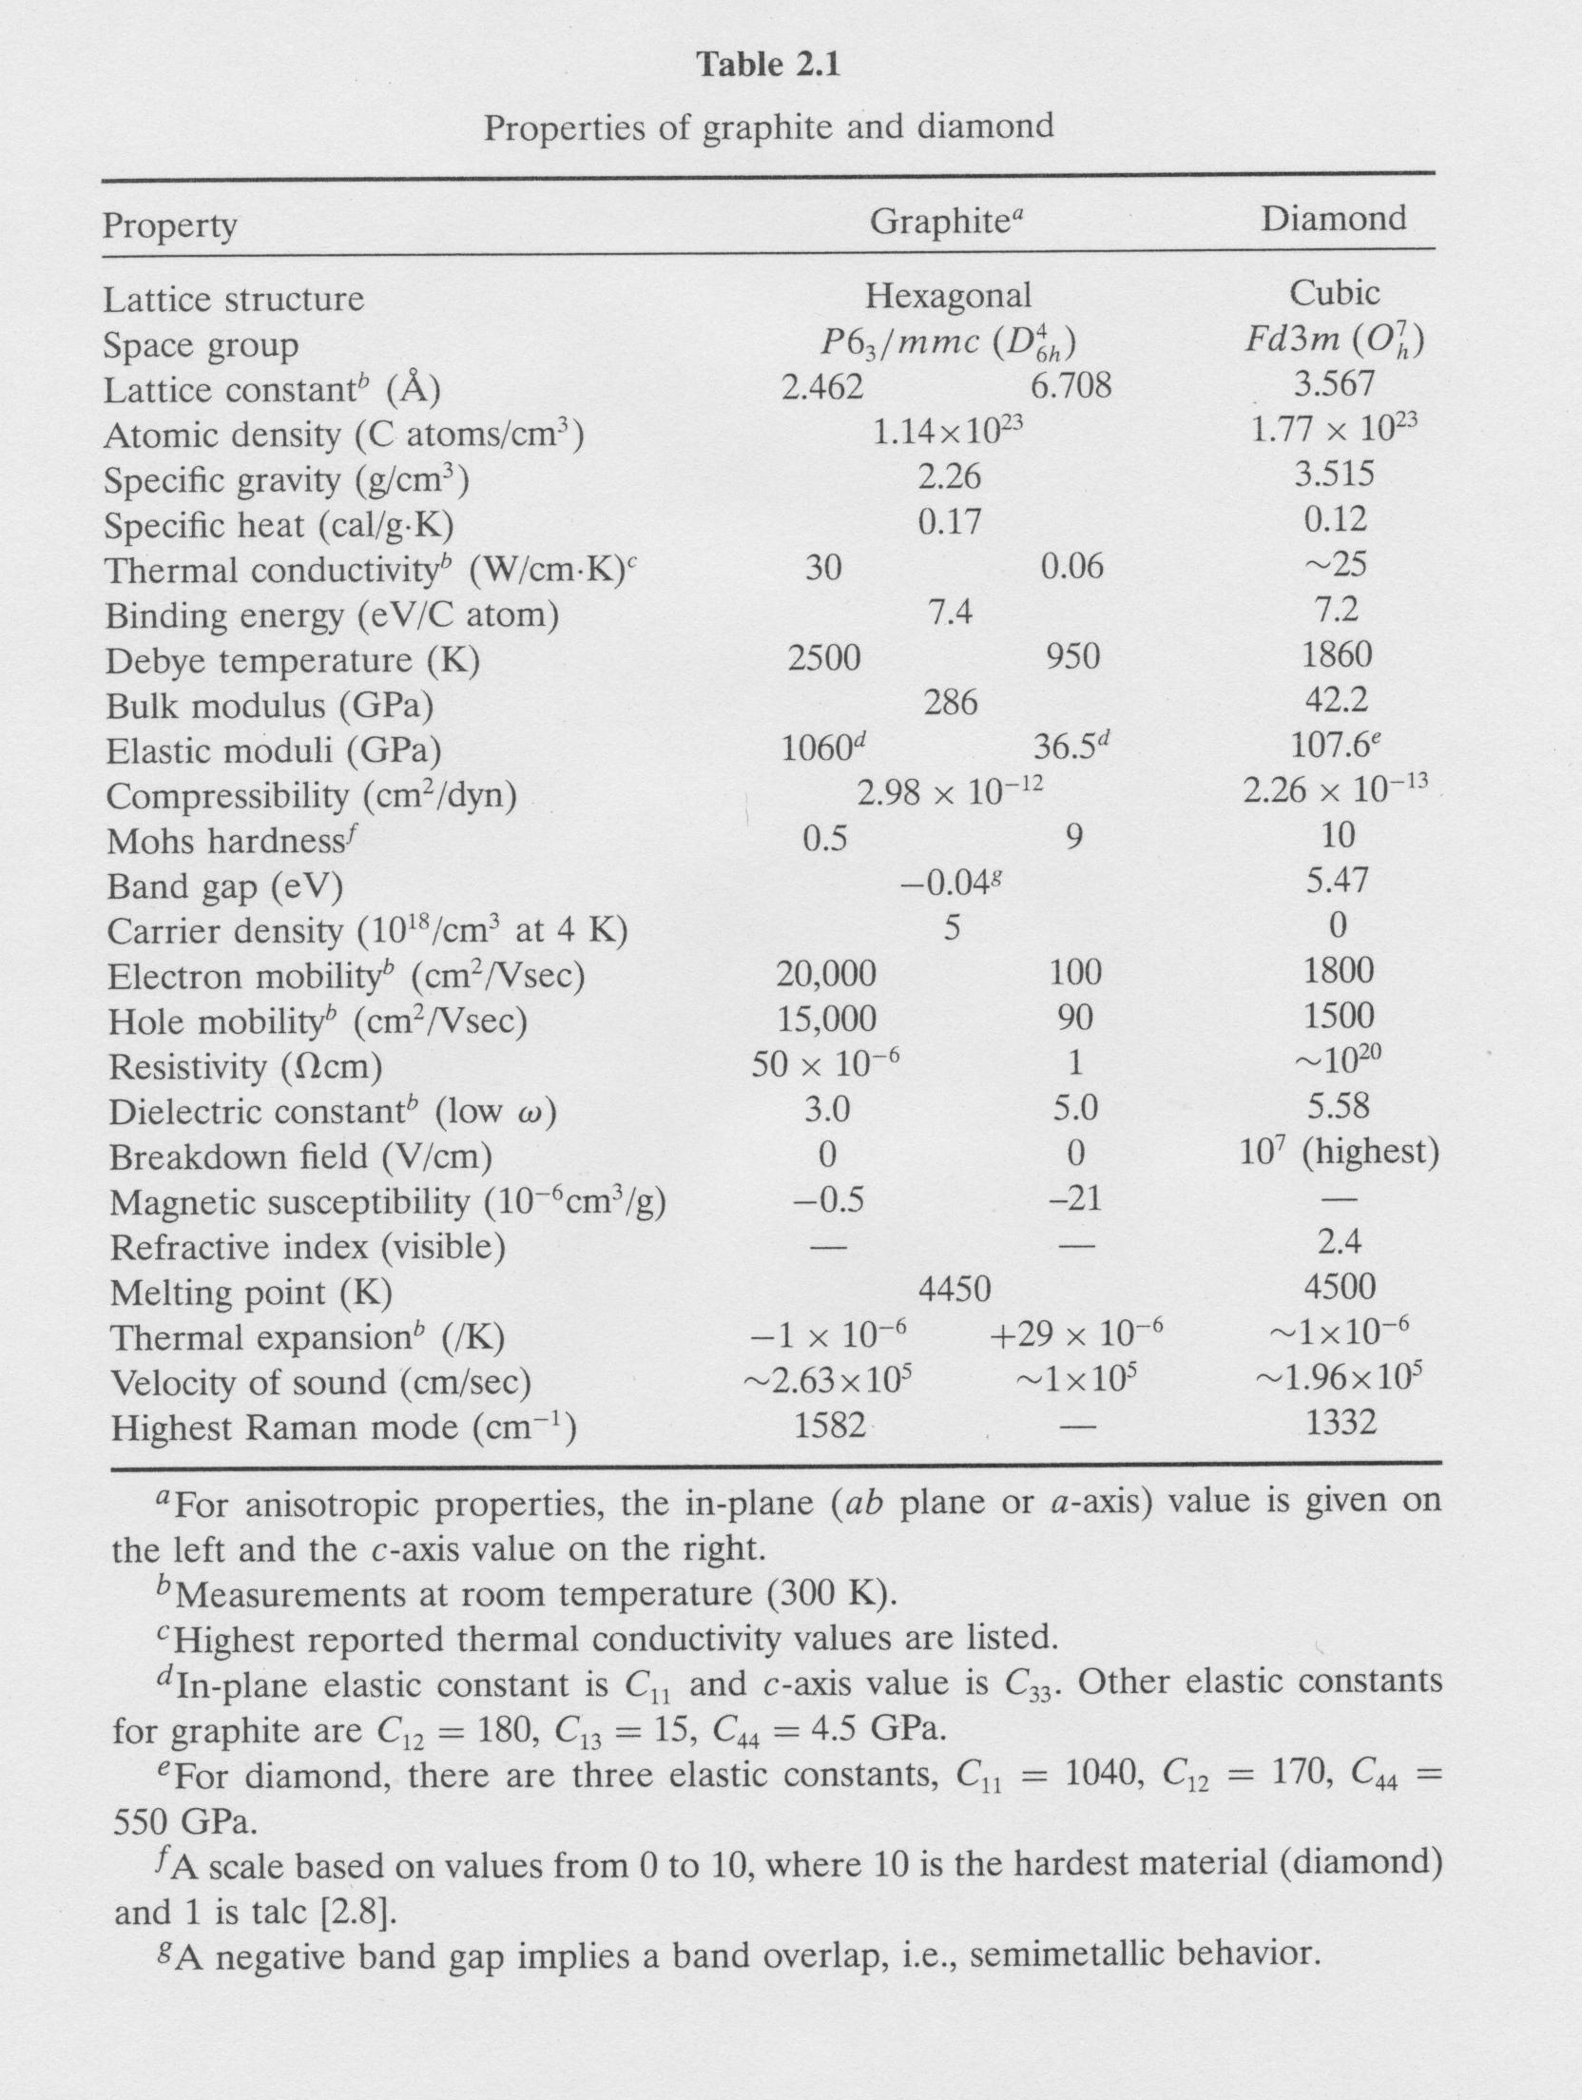

Slide 15
SUPPLEMENT
(hybridization)

Slide 16
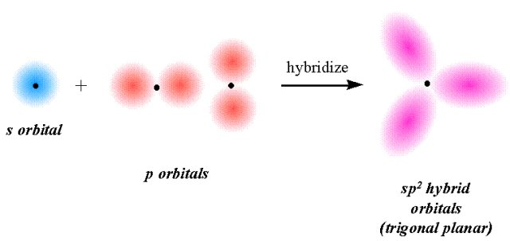
+
+
+
-
+
+
-
+
Downloaded from the internet

Slide 17
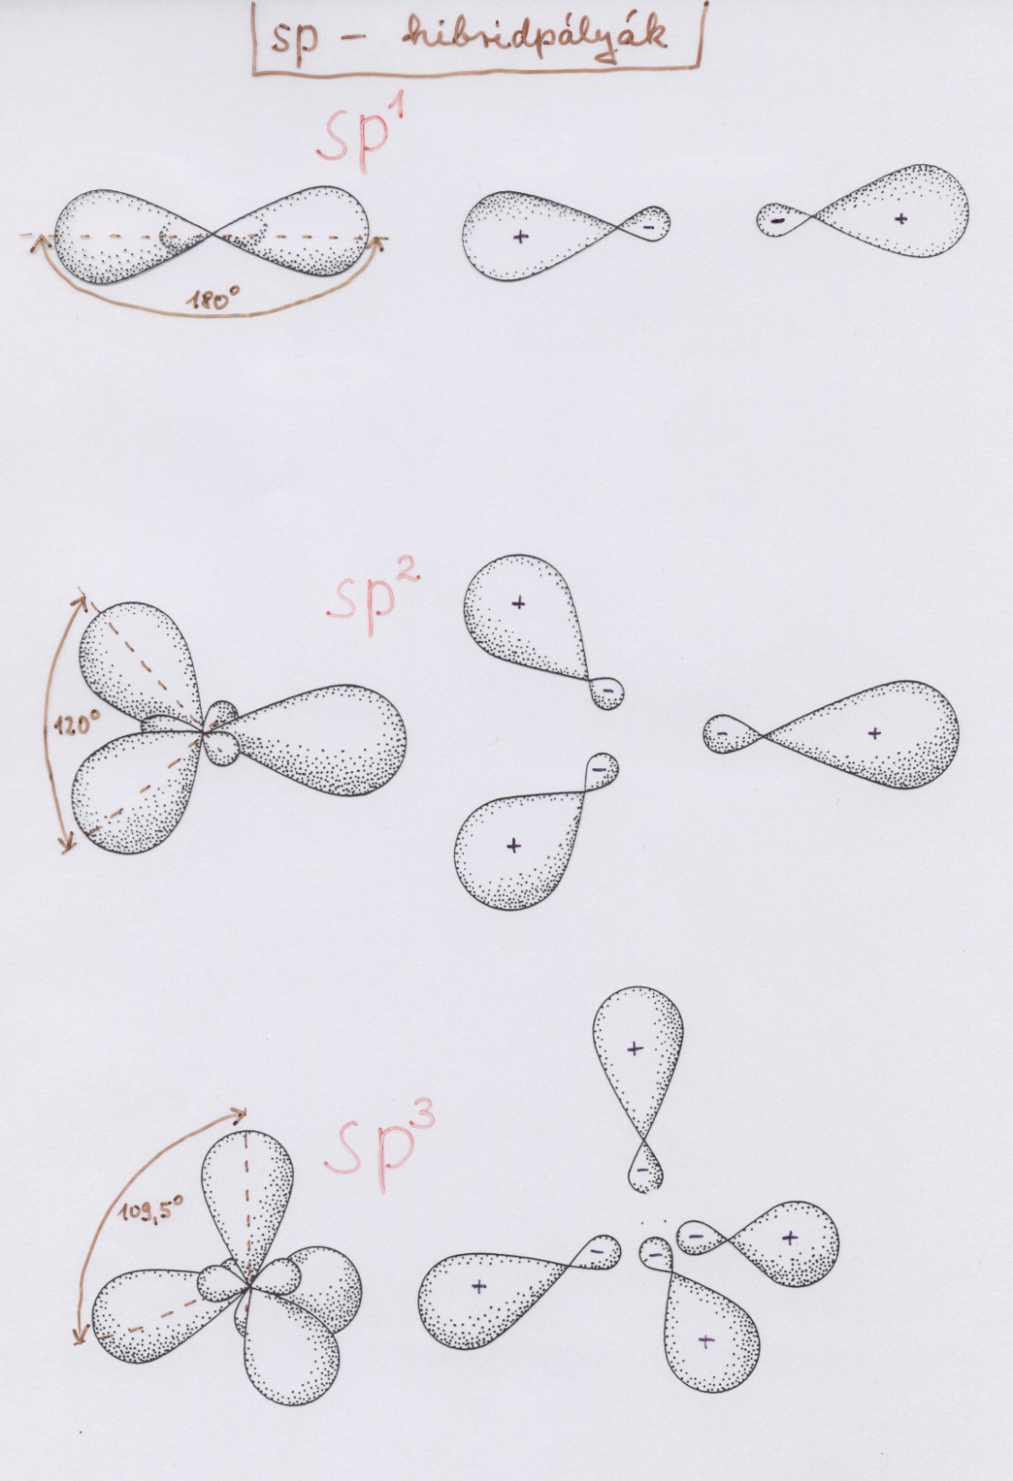

Slide 18
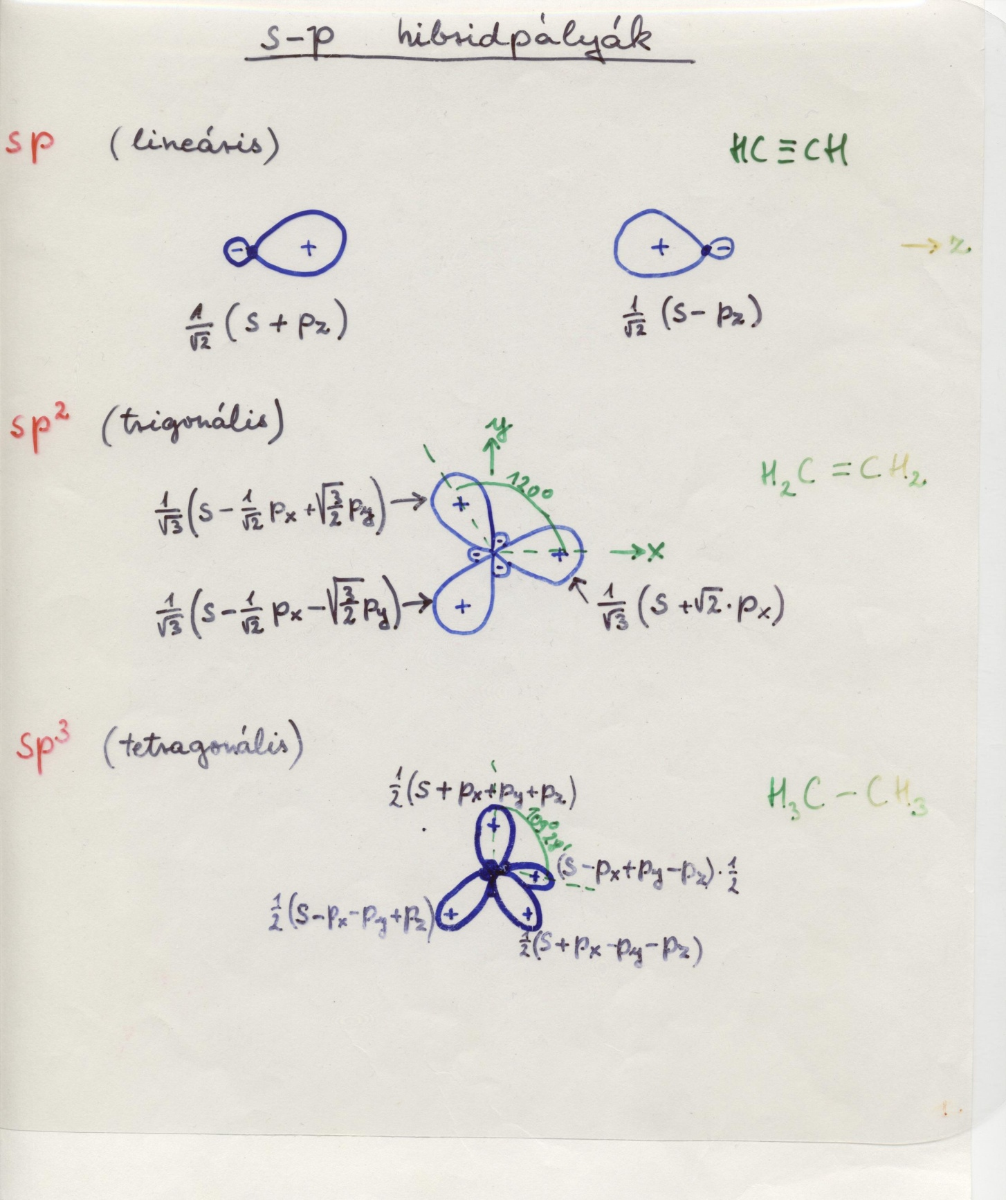

Slide 19
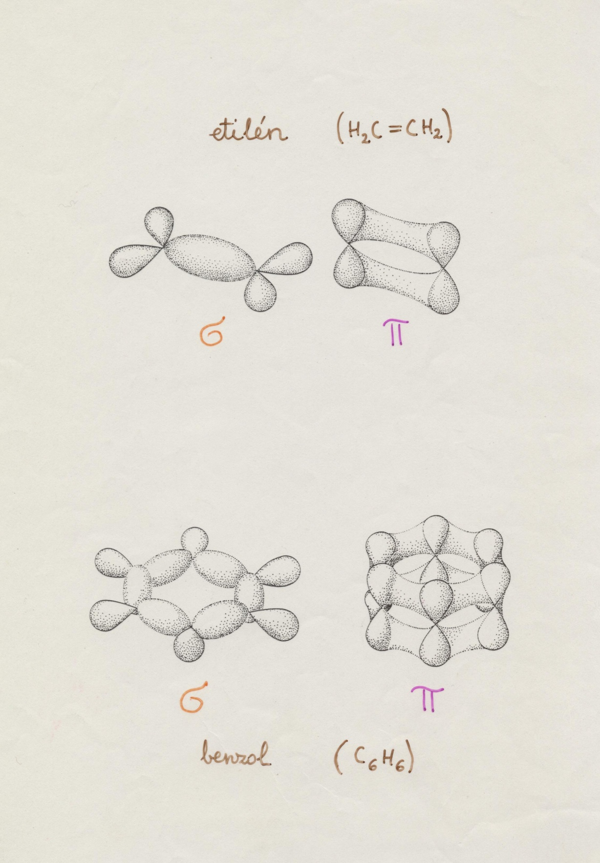
sp²

Slide 20
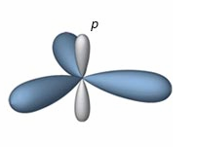
p_{z}
σ
sp²
σ
σ

Slide 21
