Slide 1
CARBON NANOSTRUCTURES (FULLERENES, CARBON NANOTUBES, GRAPHENE)
lecture for physics and chemistry students
(2019. summer semester – 18. February)
Prof. Jenő Kürti
ELTE Department of Biological Physics
e-mail: kurti@virag.elte.hu www: regivirag.elte.hu/kurti

Slide 2
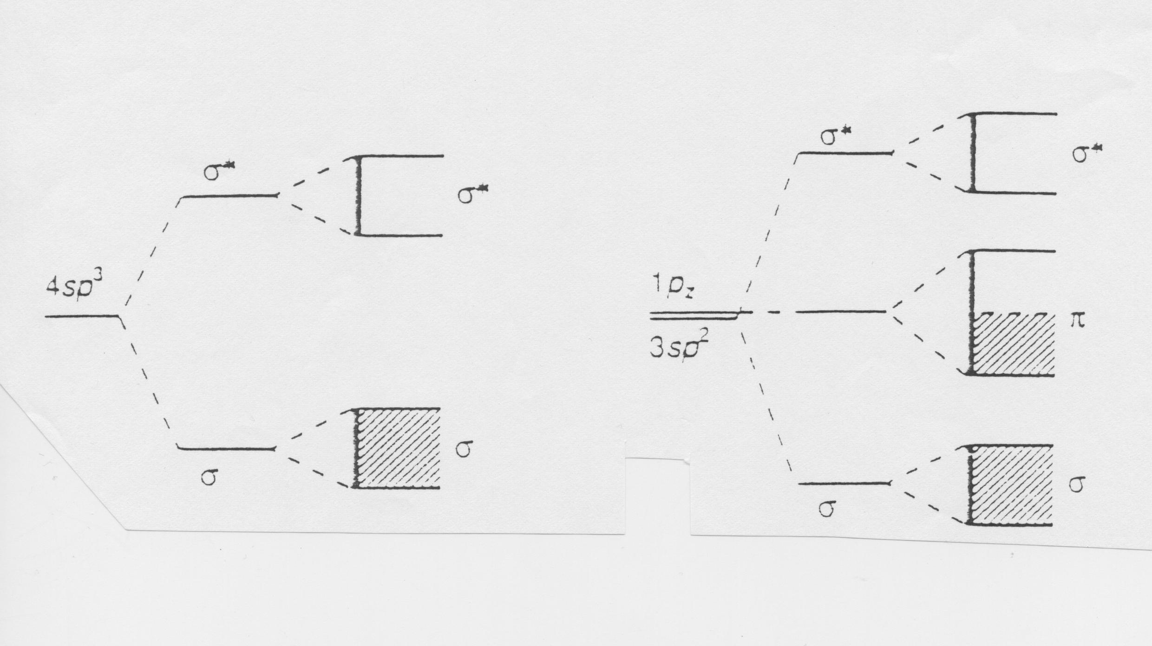
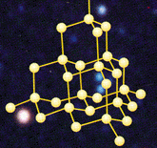
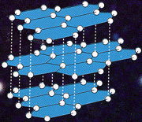
BAND STRUCTURE
-16 meV / carbon atom
≈5.4 eV
≈1.7 eV
diamond sp³ graphite sp²
d_{CC} ≅ 0,154 nm
d_{CC} ≅ 0,142 nm

Slide 3
E_{graphite} < E_{diamond}
E

Slide 4
E_{graphite} < E_{diamond} S_{graphite} > S_{diamond}
E – TS

Slide 5
E_{graphite} < E_{diamond} S_{graphite} > S_{diamond}
E – TS + pV
V_{graphite} > V_{diamond}

Slide 6
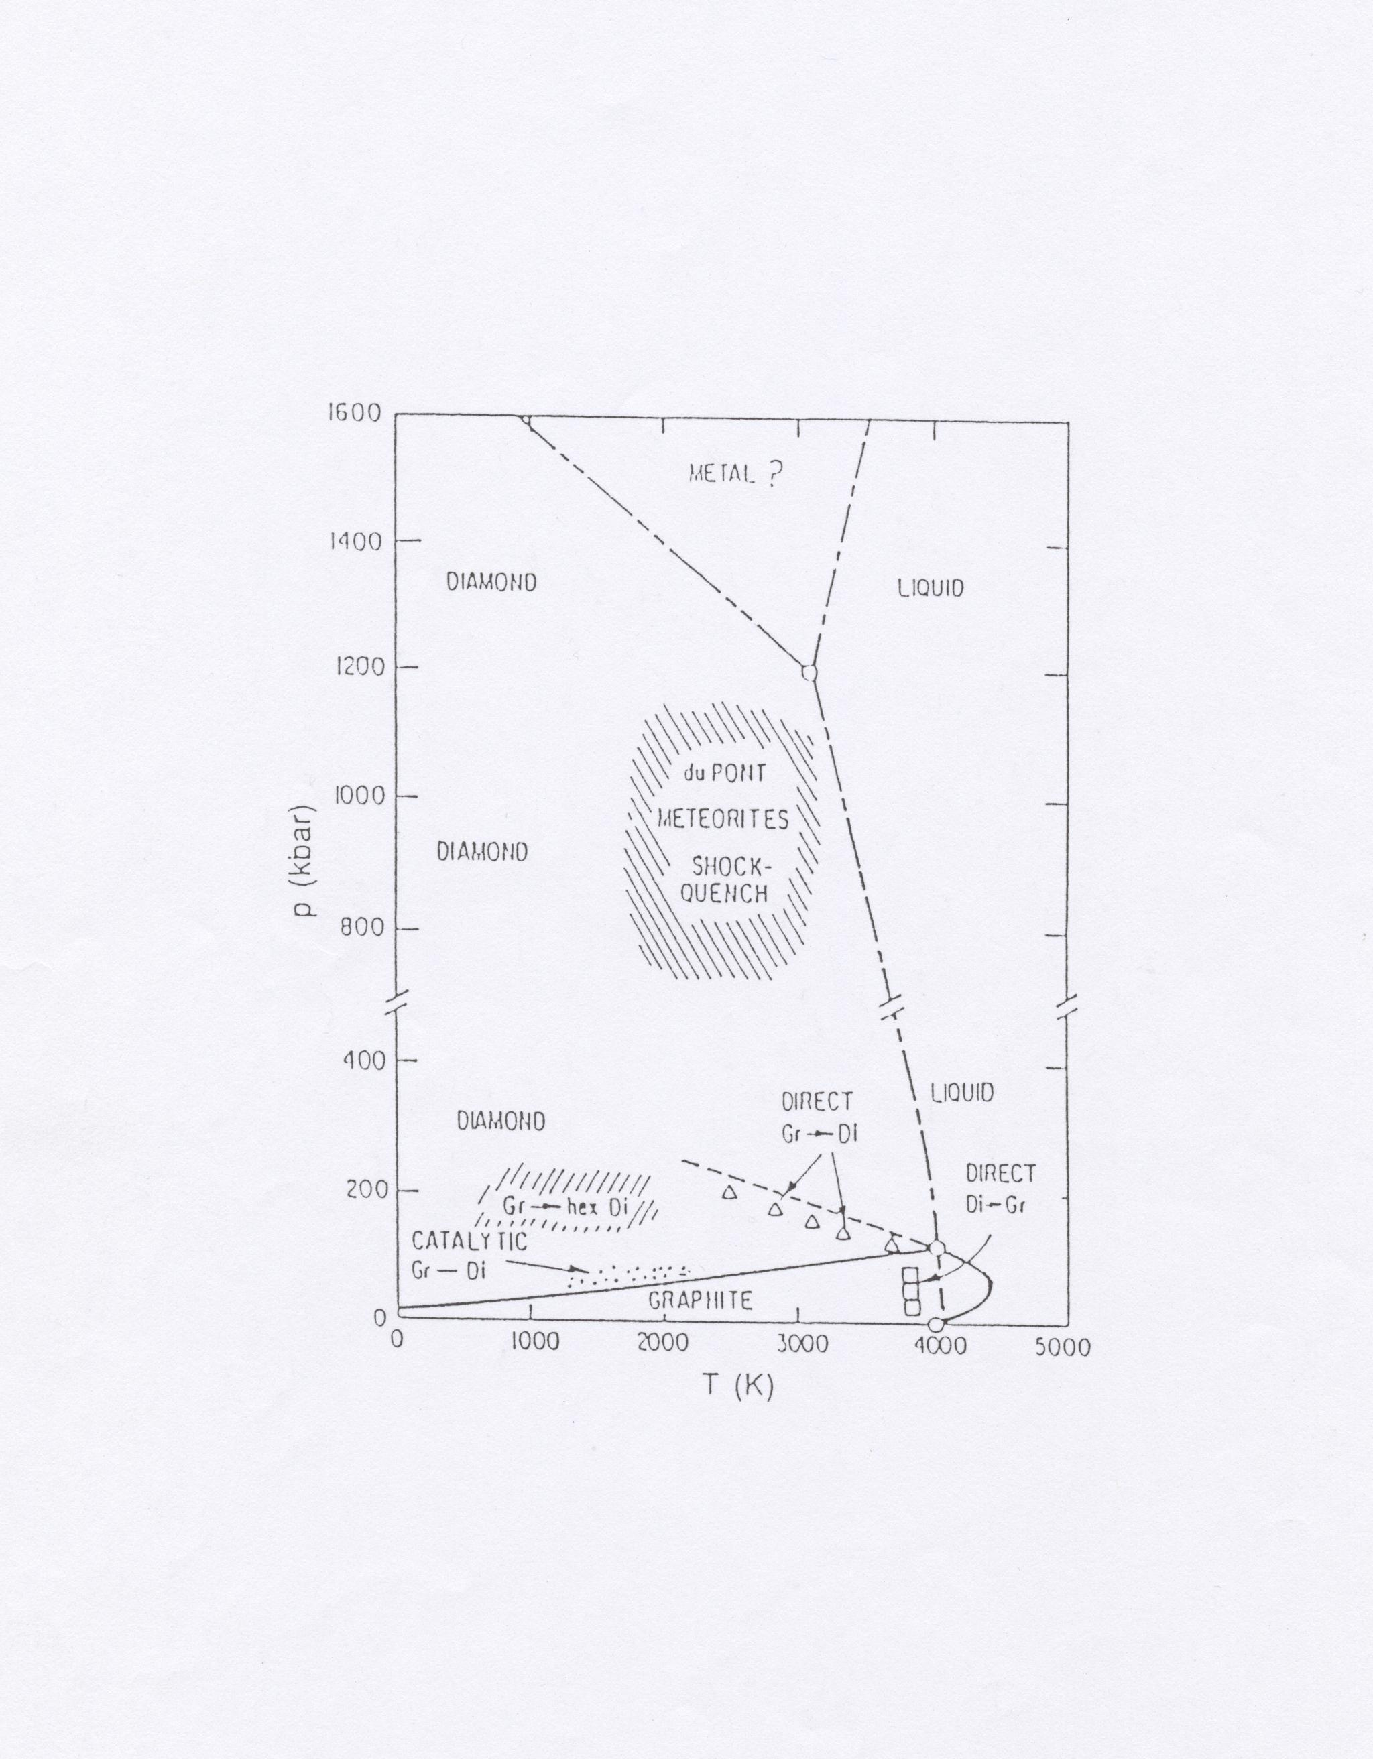

Slide 7
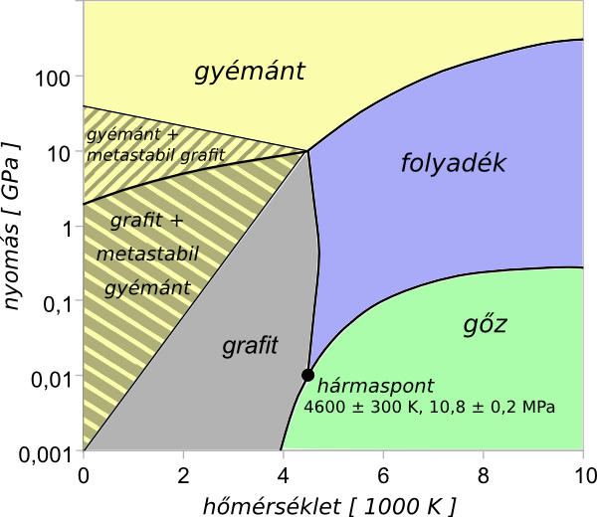

Slide 8
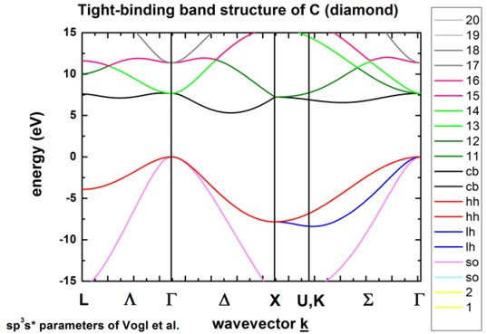
Downloaded from the internet

Slide 9
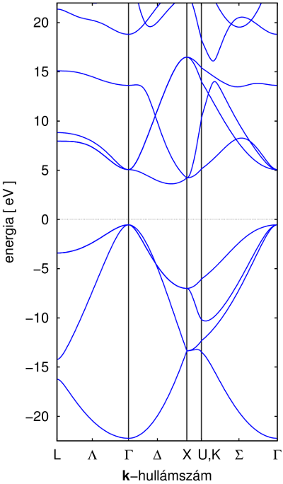
DFT band structure of diamond

Slide 10
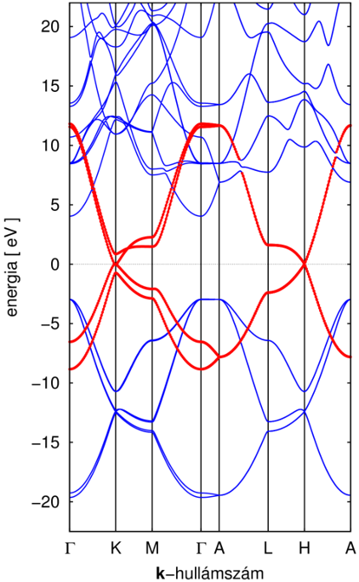
DFT band structure of graphite

Slide 11
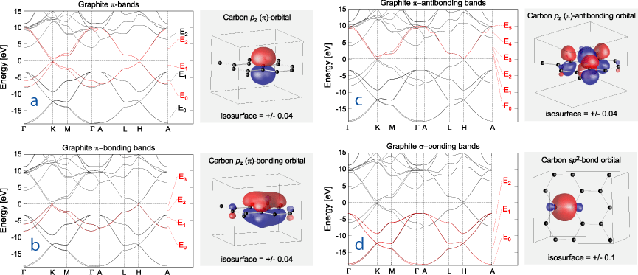
Downloaded from the internet

Slide 13
UNEXPECTED DISCOVERY in 1985
H.W.Kroto, J.R.Heath, S.C.O’Brien, R.F.Curl, R.E.Smalley,
„C₆₀: Buckminsterfullerene”, Nature 318, 162 (14 Nov. 1985)
NOBEL-PRIZE: in 1996

Slide 14
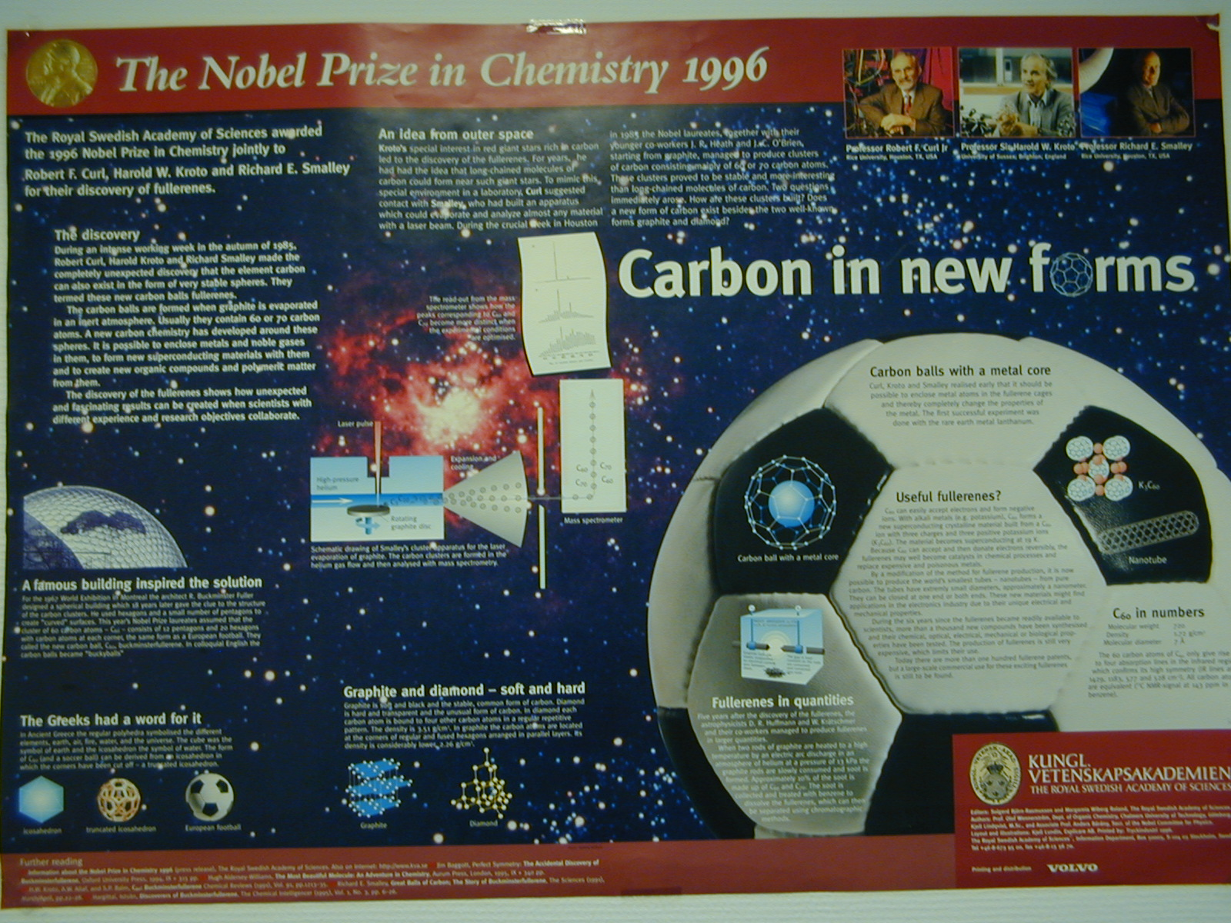
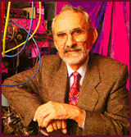
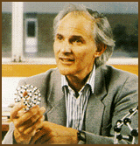
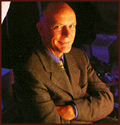

Slide 15
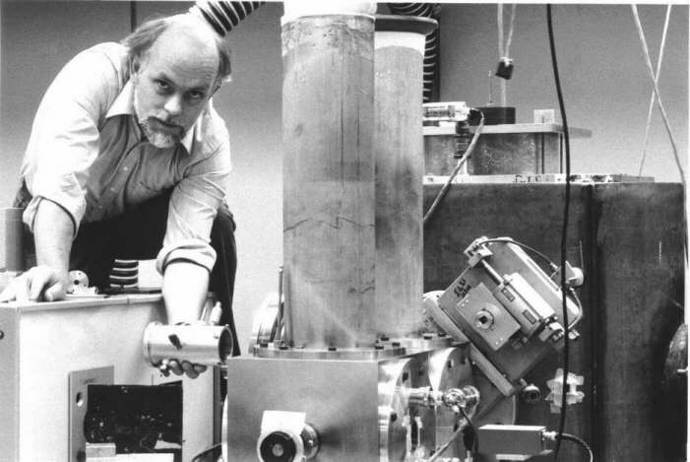

Slide 16
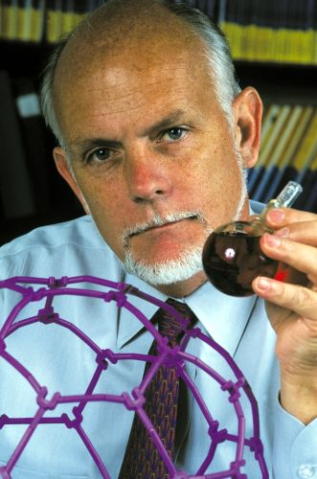
Richard E. Smalley (1943 – 2005)

Slide 17
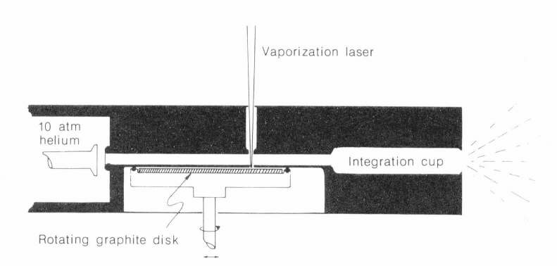

Slide 18
