Slide 1
CARBON NANOSTRUCTURES (FULLERENES, CARBON NANOTUBES, GRAPHENE)
lecture for physics and chemistry students
(2019. summer semester – 04. March)
Prof. Jenő Kürti
ELTE Department of Biological Physics
e-mail: kurti@virag.elte.hu www: regivirag.elte.hu/kurti

Slide 2
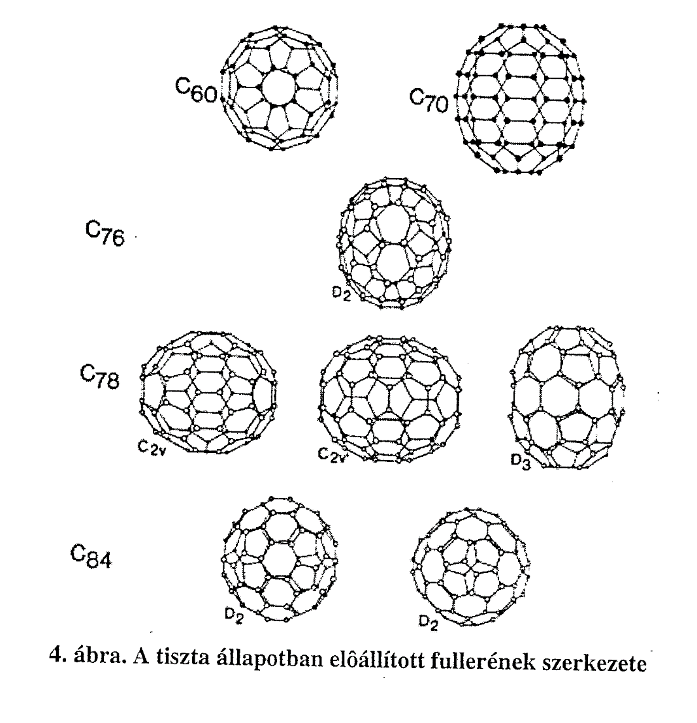
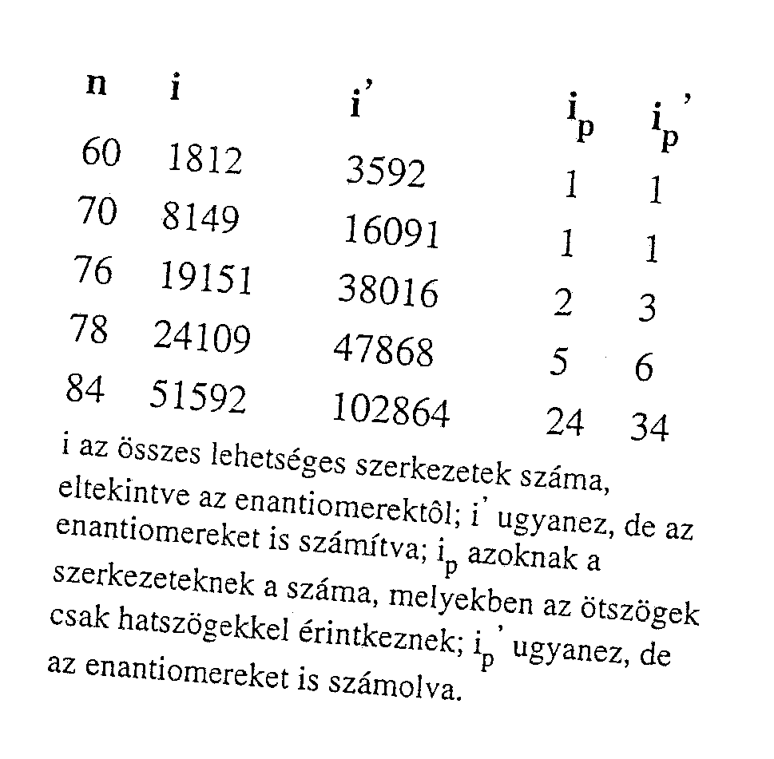
Memo: Euler’s rule → n₅ = 12 és n₆ = arbitrary
… !

Slide 3
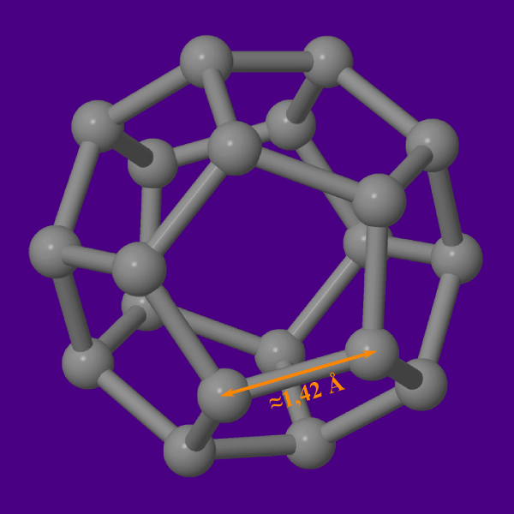
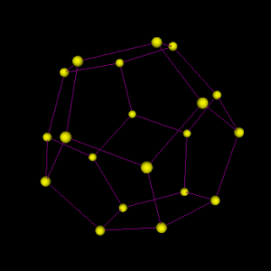
C₂₀

Slide 4
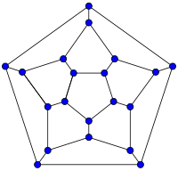
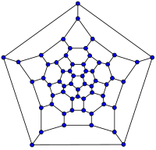
Schlegel diagrams
C₂₀ C₆₀

Slide 7
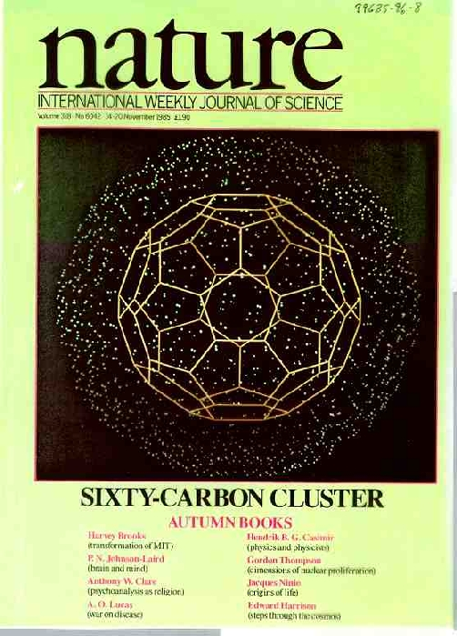
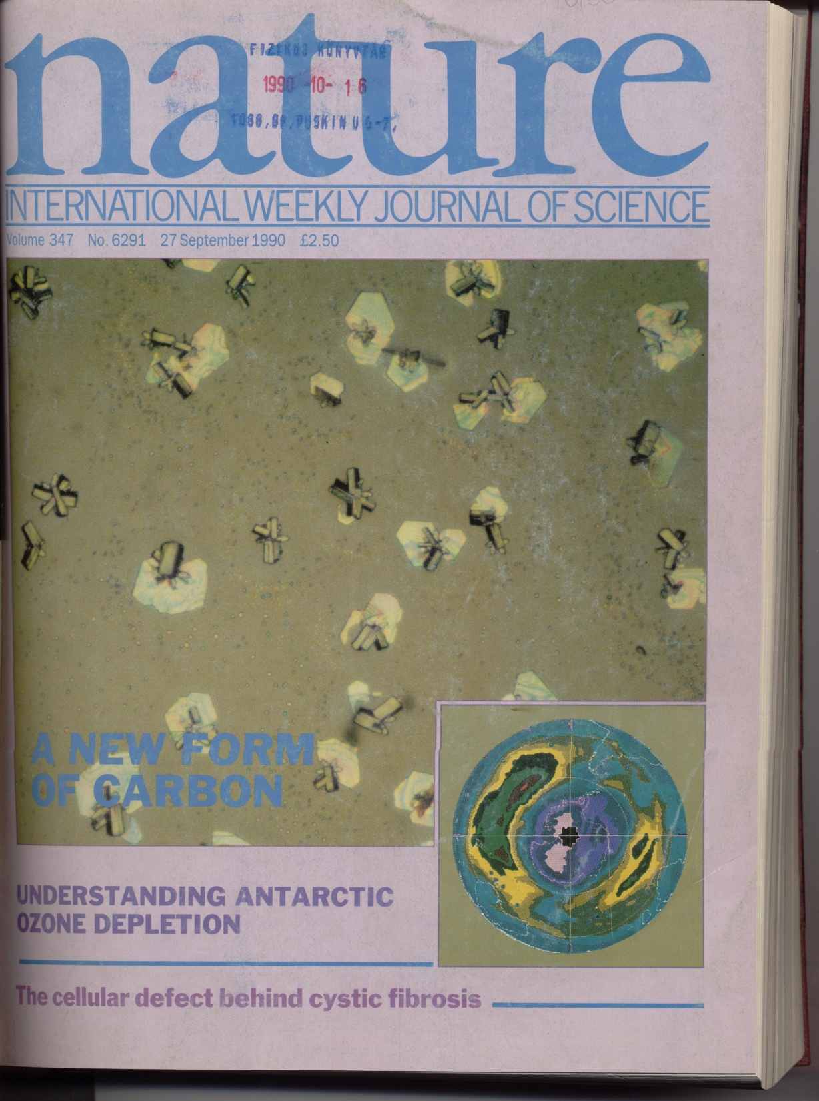

Slide 8
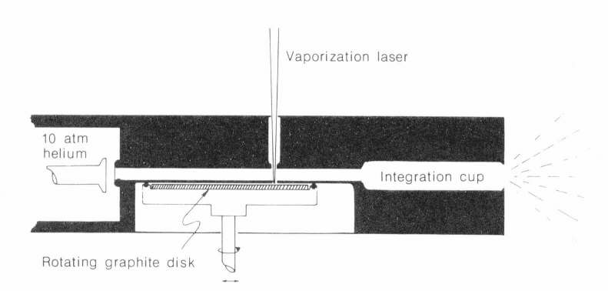
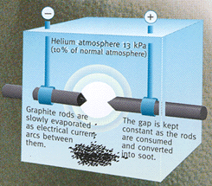
W.Krätschmer, L.D.Lamb, K.Fostiropoulos, D.R.Huffman, „Solid C₆₀: a new form of carbon”, Nature 347, 354 (1990)
C₆₀ in large quantities !

Slide 9
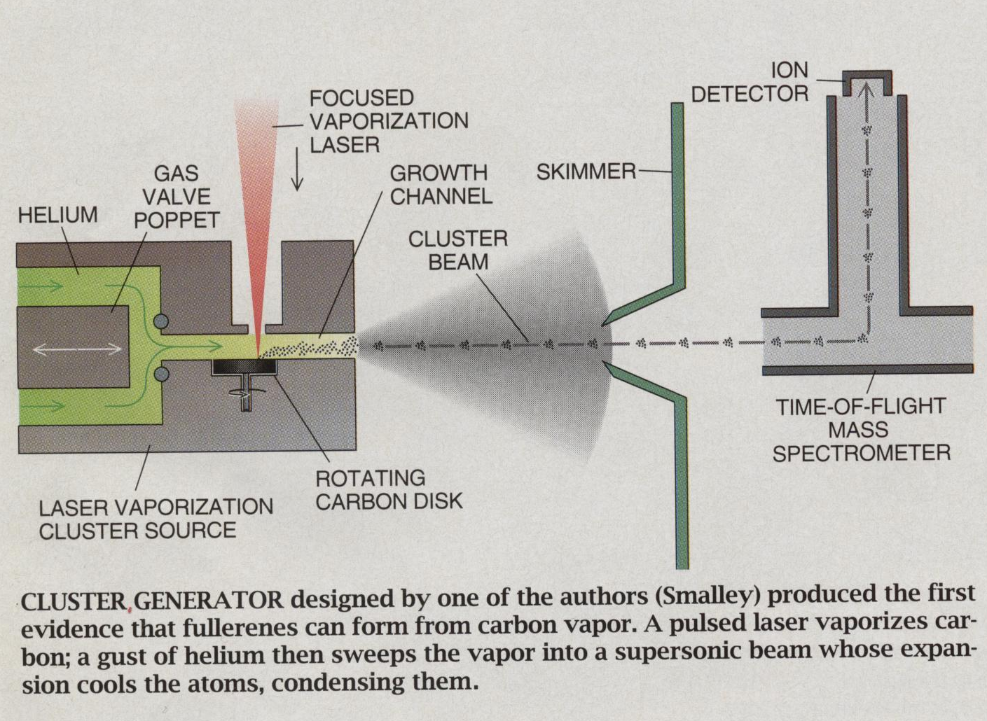

Slide 10
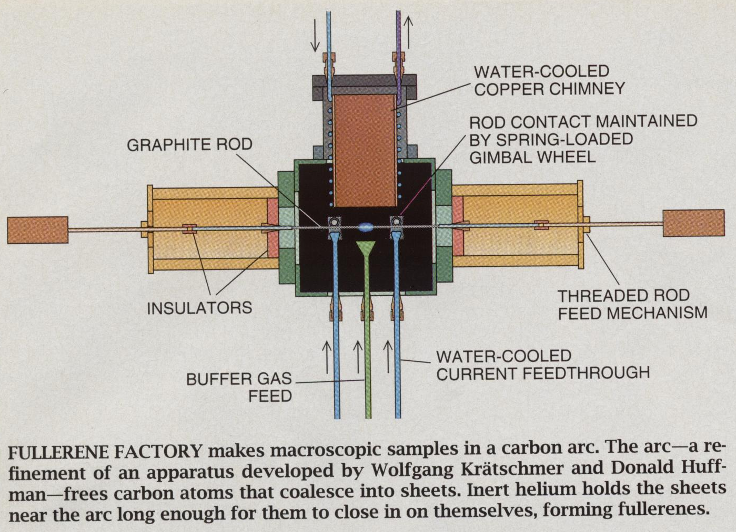

Slide 11
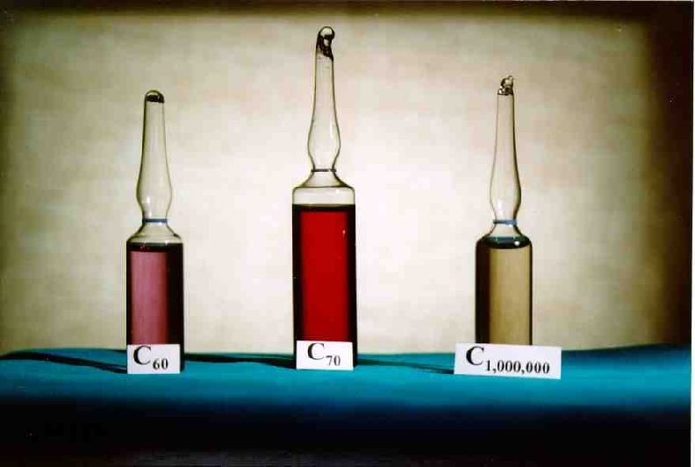
Notes:
C60: bíborvörös, C70: vörös

Slide 12
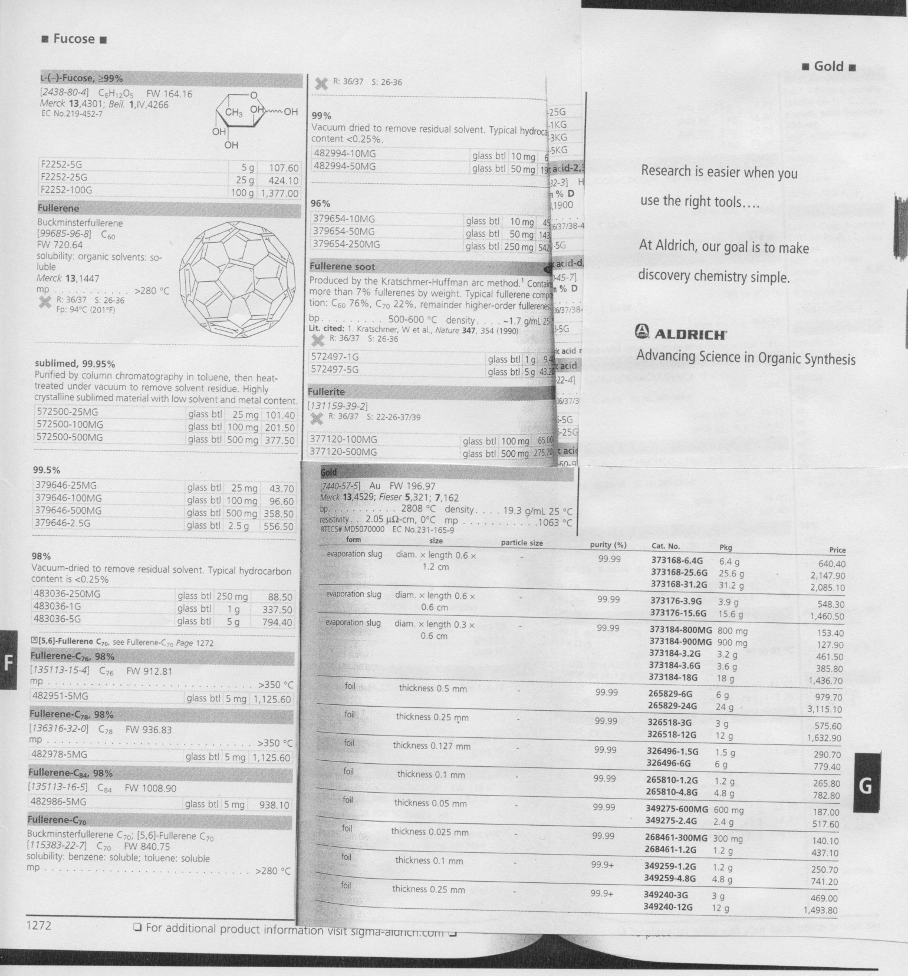

Slide 13
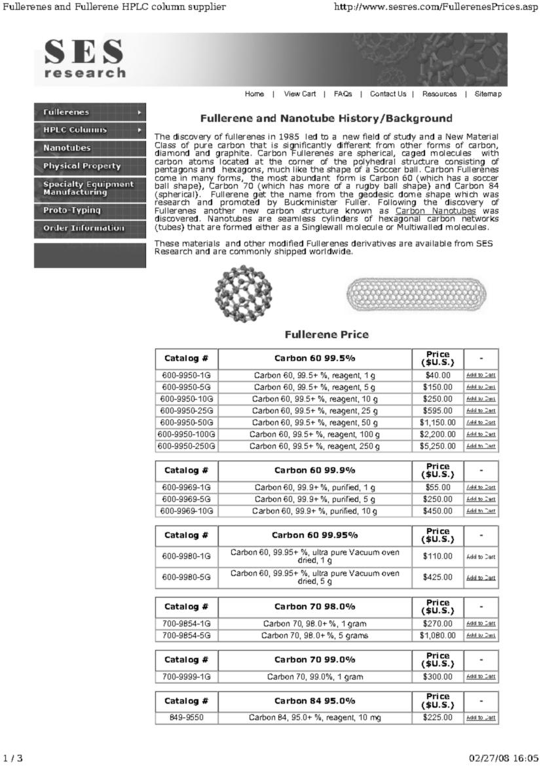
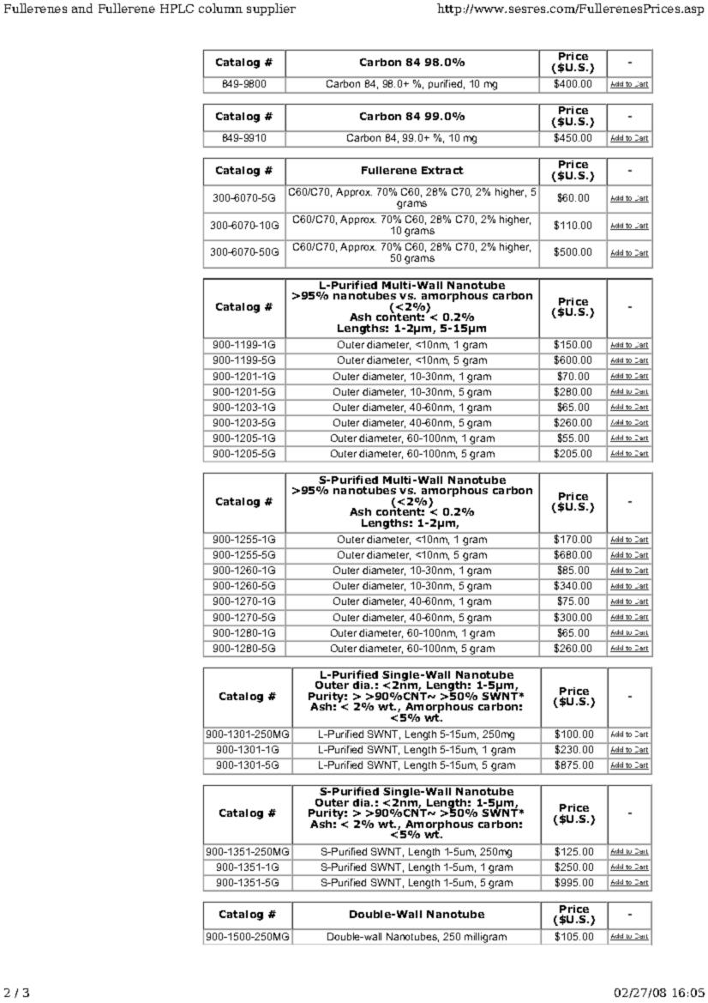

Slide 14
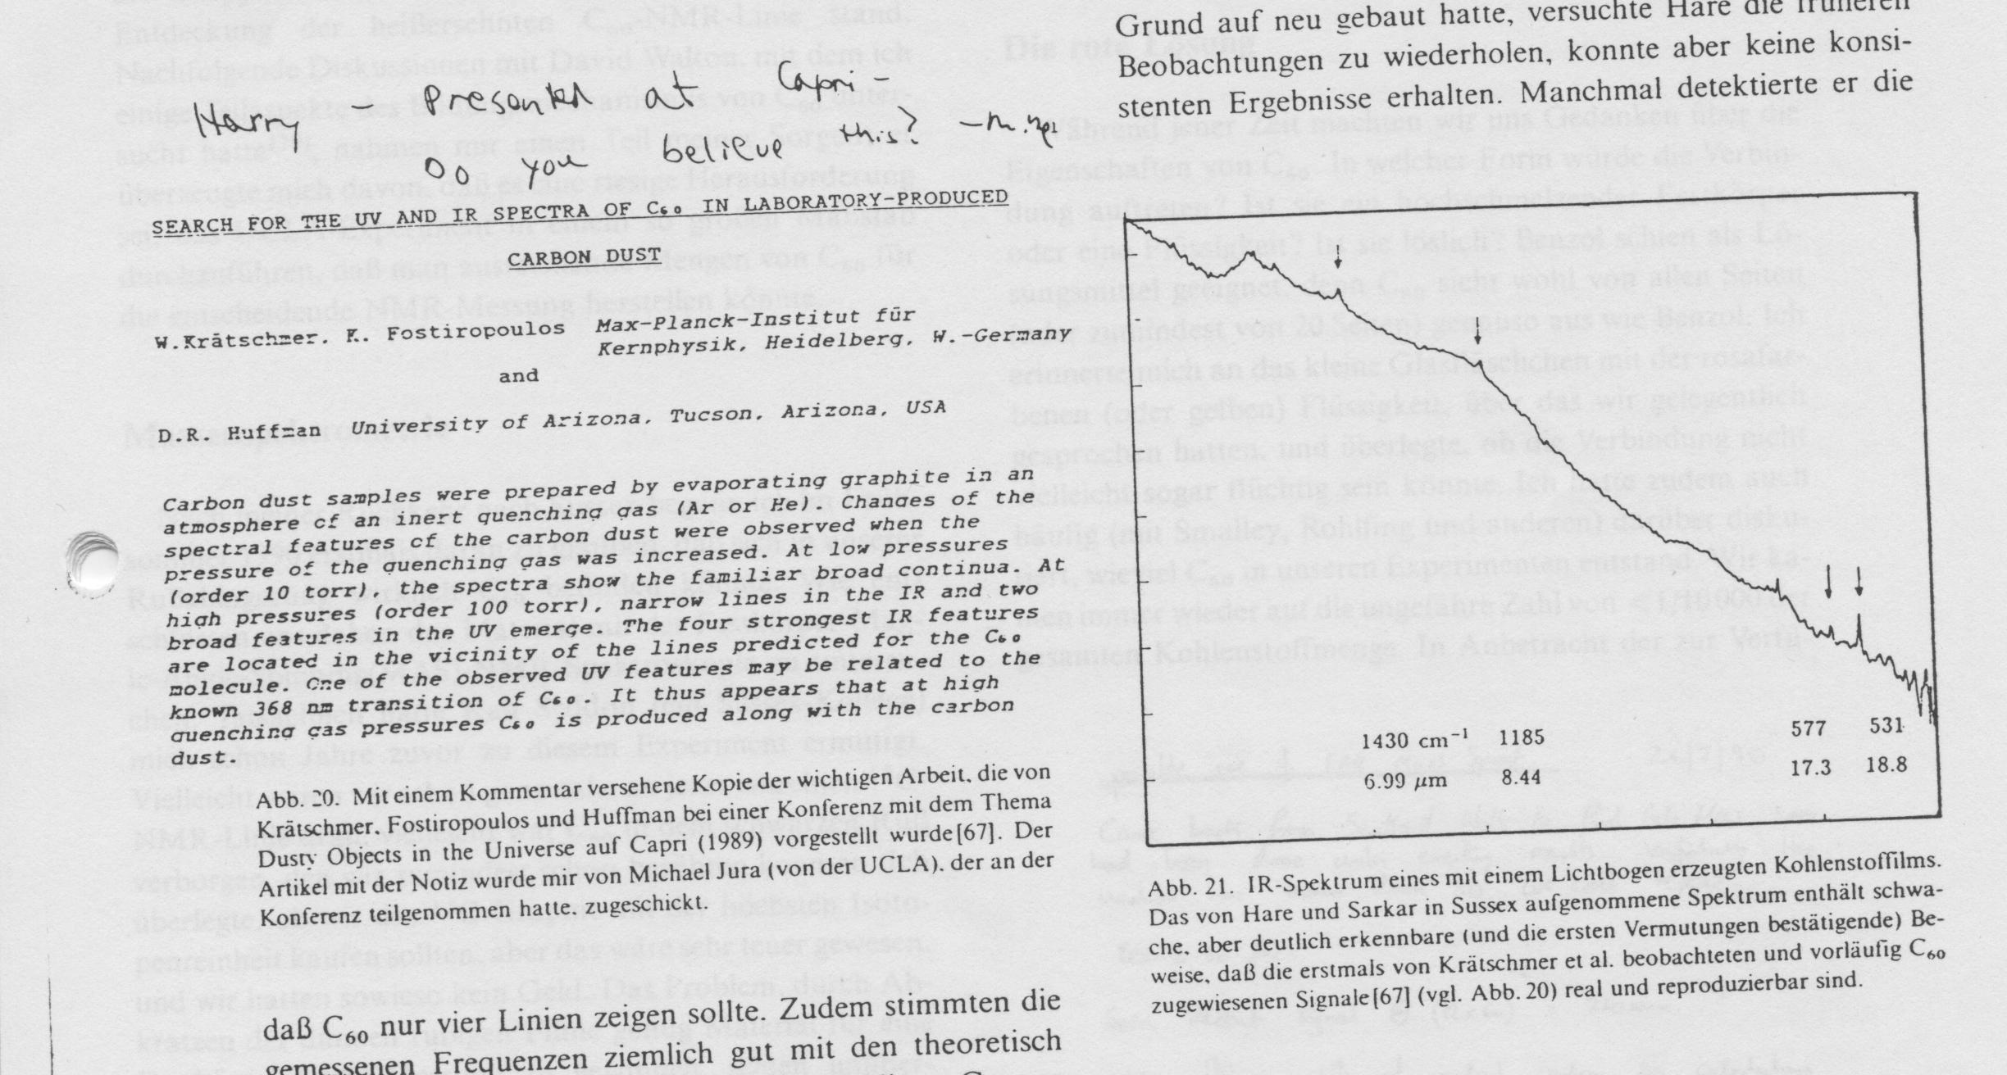

Slide 15
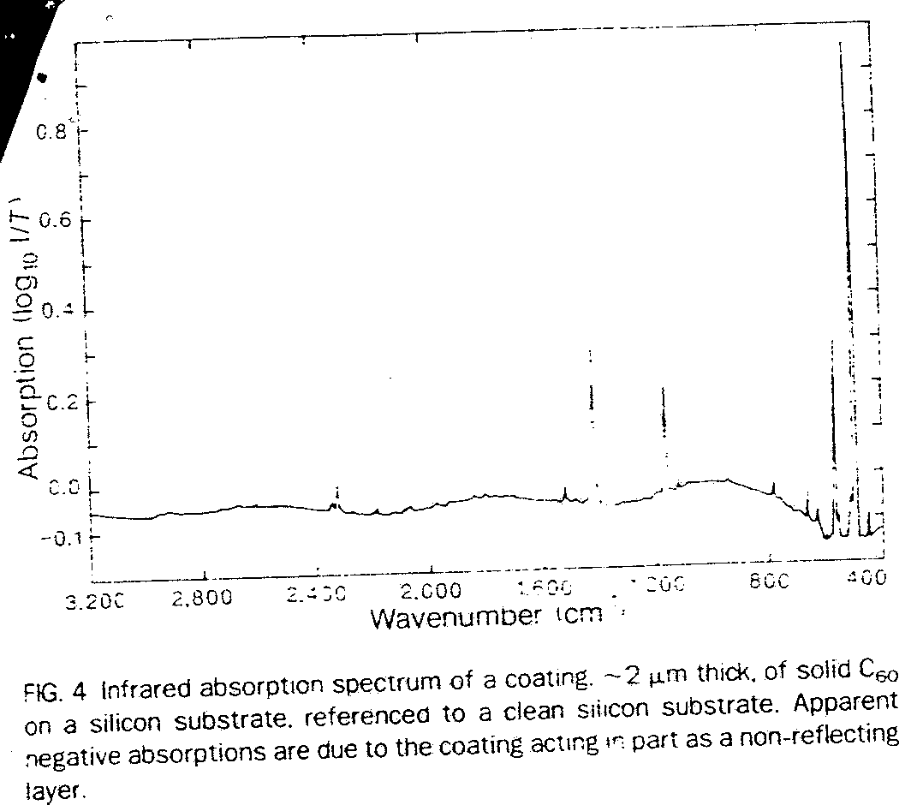

Slide 16
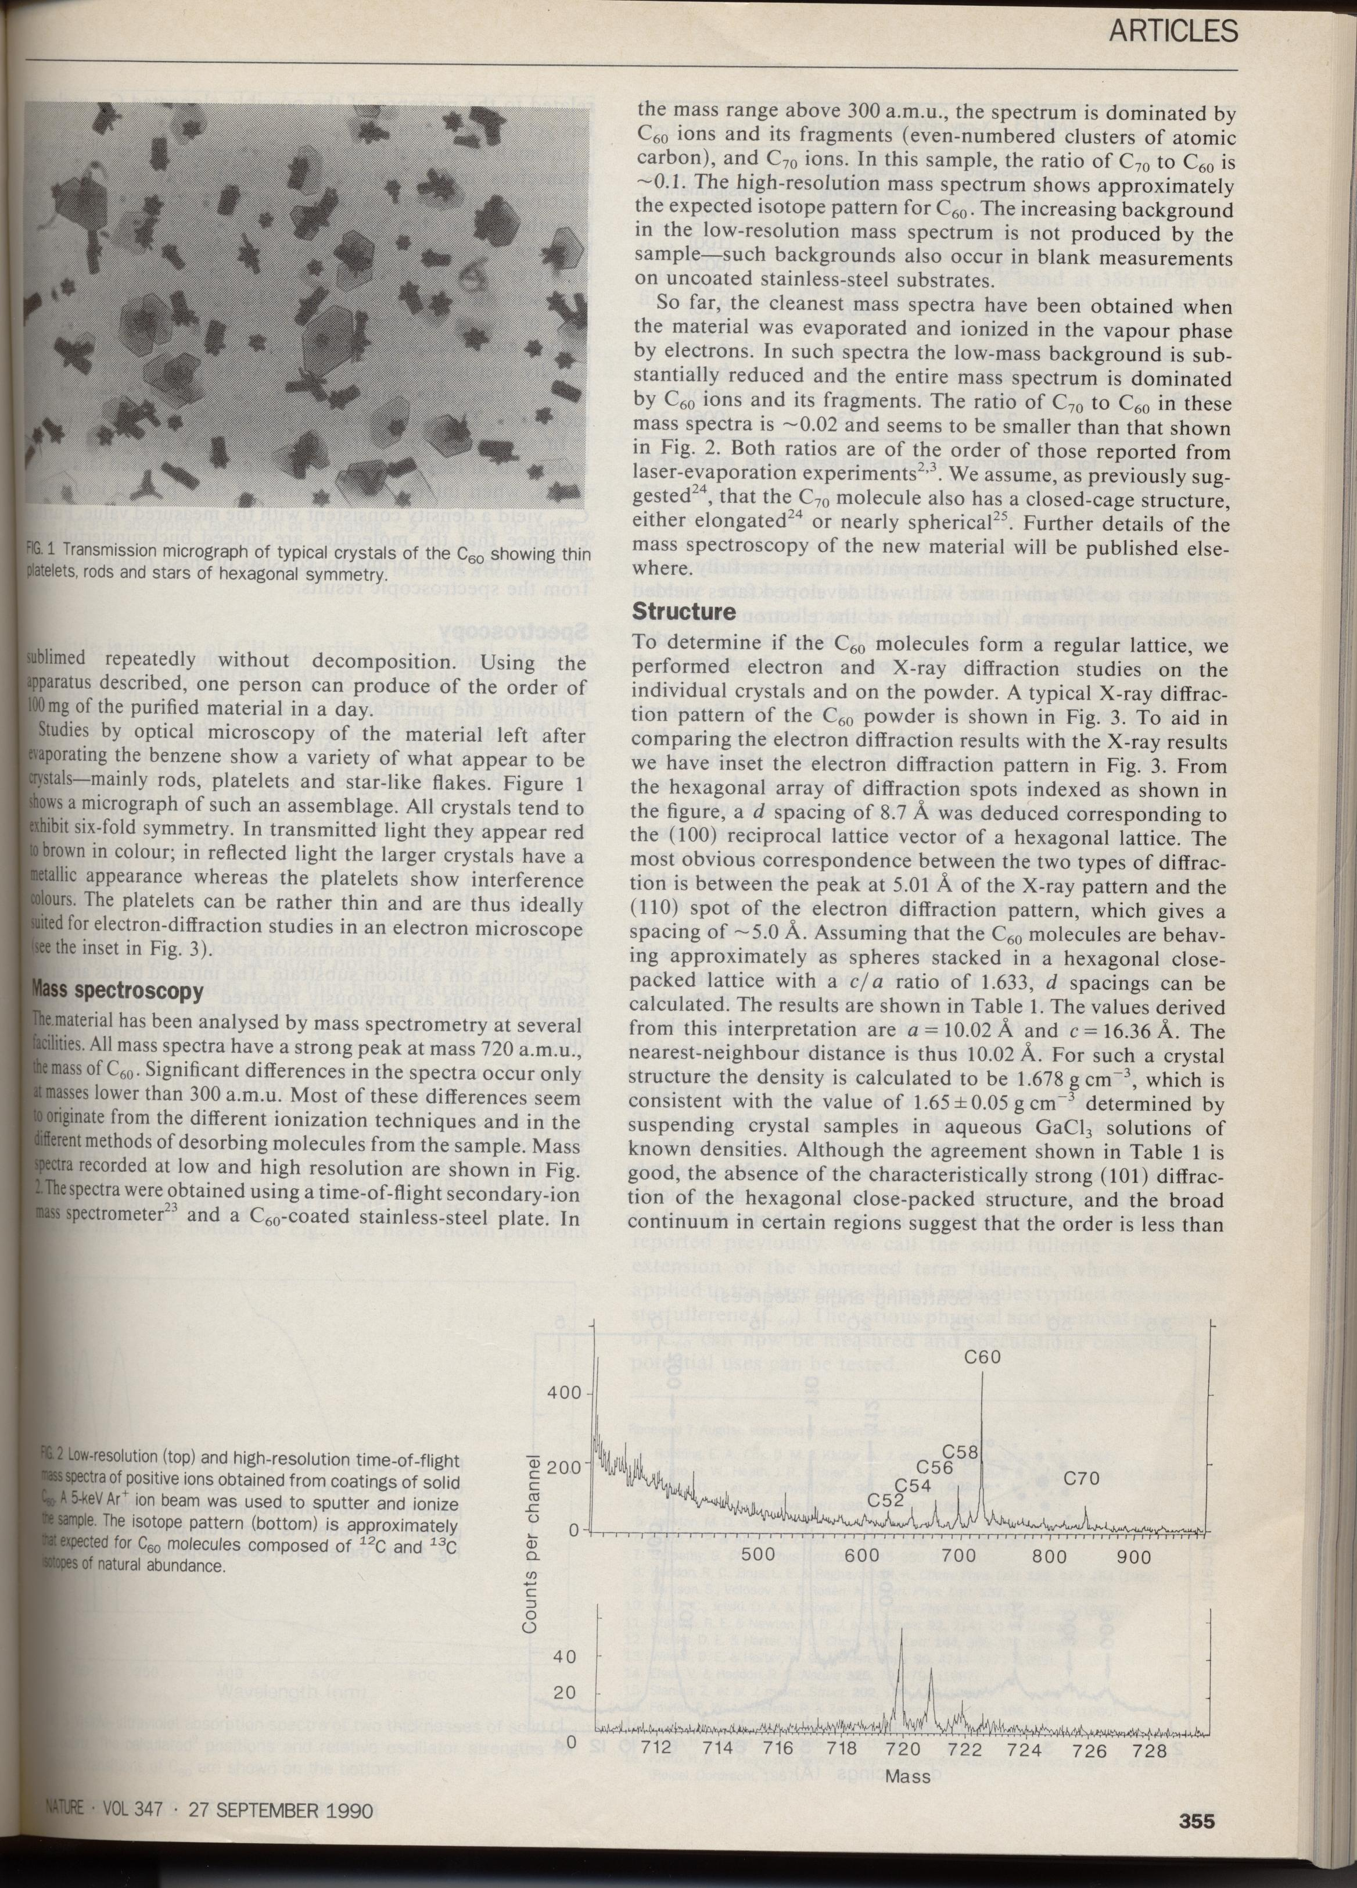

Slide 17
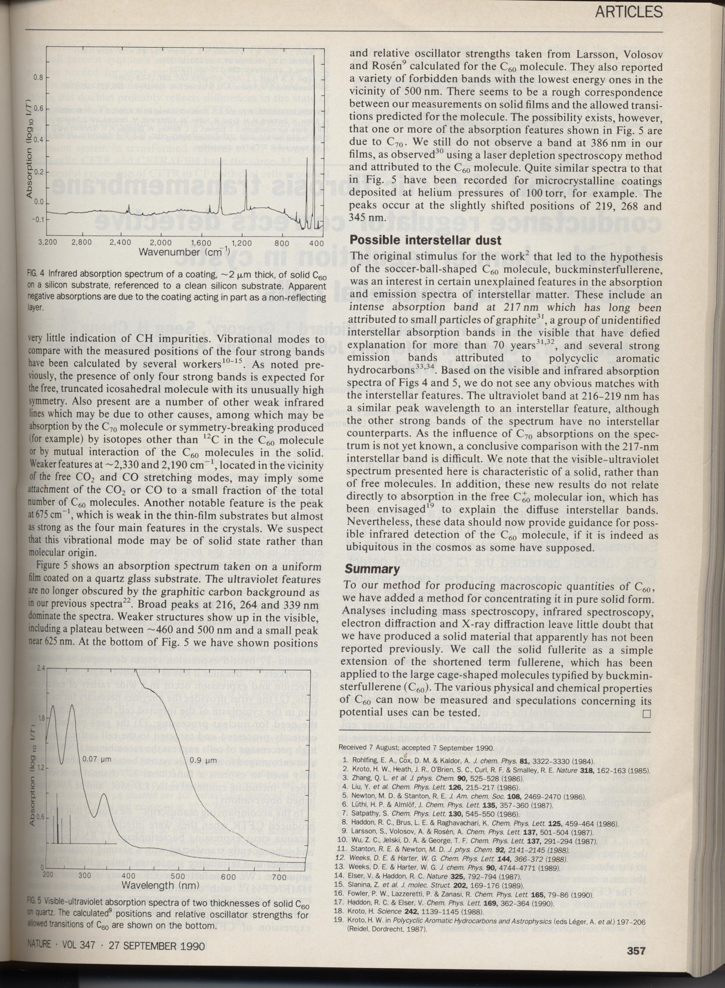
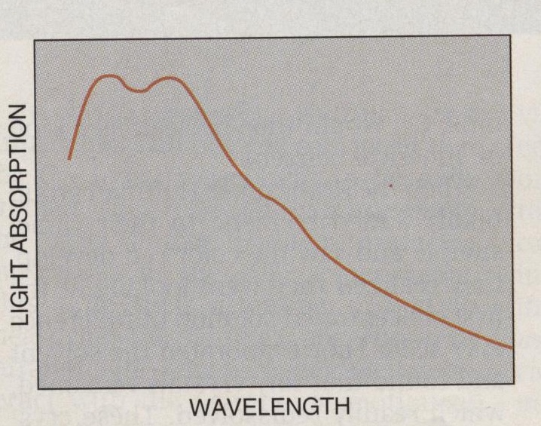

Slide 19
W.Krätschmer, L.D.Lamb, K.Fostiropoulos, D.R.Huffman, „Solid C₆₀: a new form of carbon”, Nature 347, 354 (1990)
C₆₀ in large quantities !

Slide 20
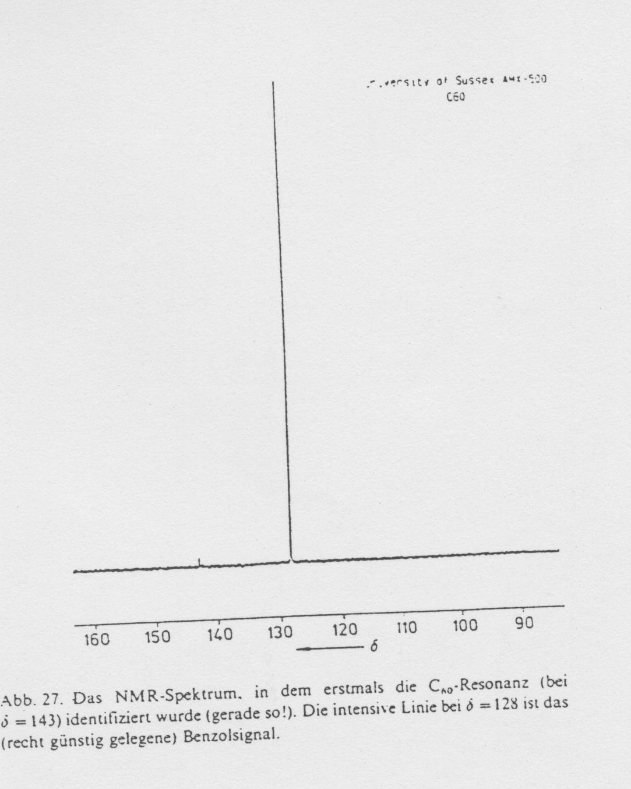

Slide 21
