Slide 1
CARBON NANOSTRUCTURES (FULLERENES, CARBON NANOTUBES, GRAPHENE)
lecture for physics and chemistry students
(2019. summer semester – 11. March)
Prof. Jenő Kürti
ELTE Department of Biological Physics
e-mail: kurti@virag.elte.hu www: regivirag.elte.hu/kurti

Slide 2
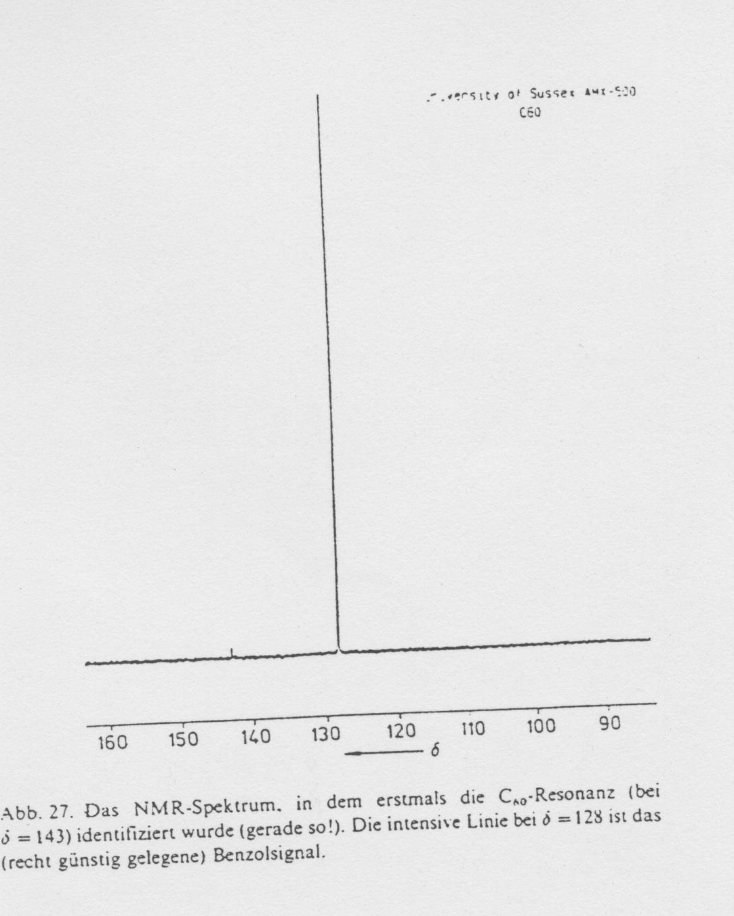

Slide 3
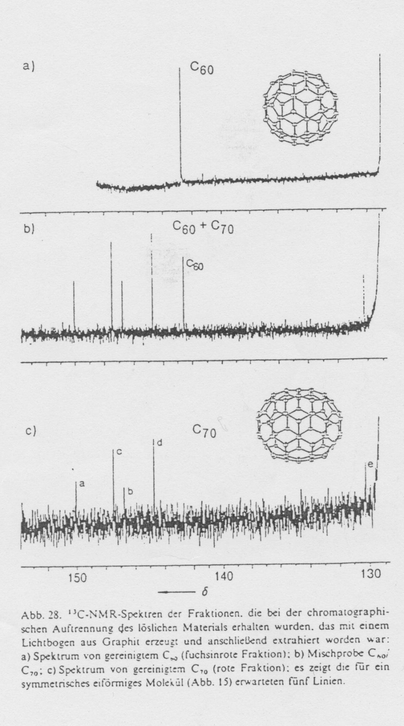
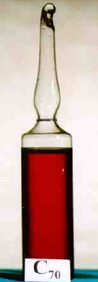

Slide 4
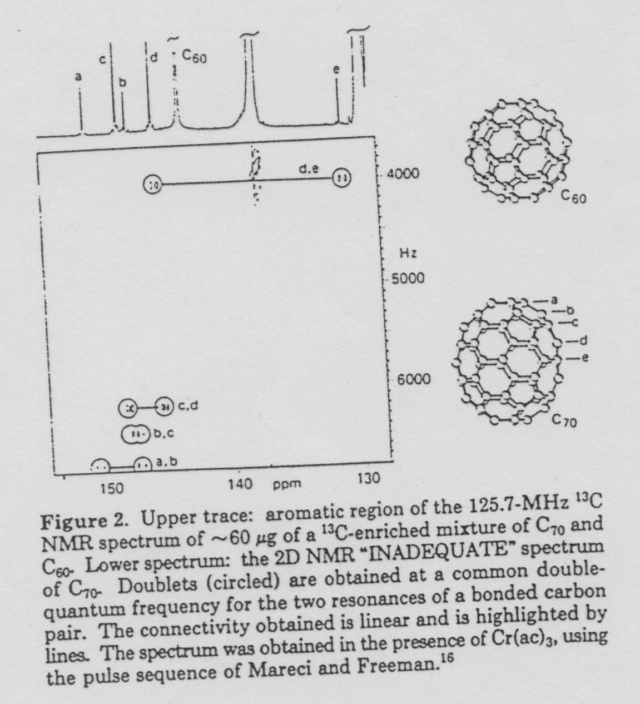

Slide 5
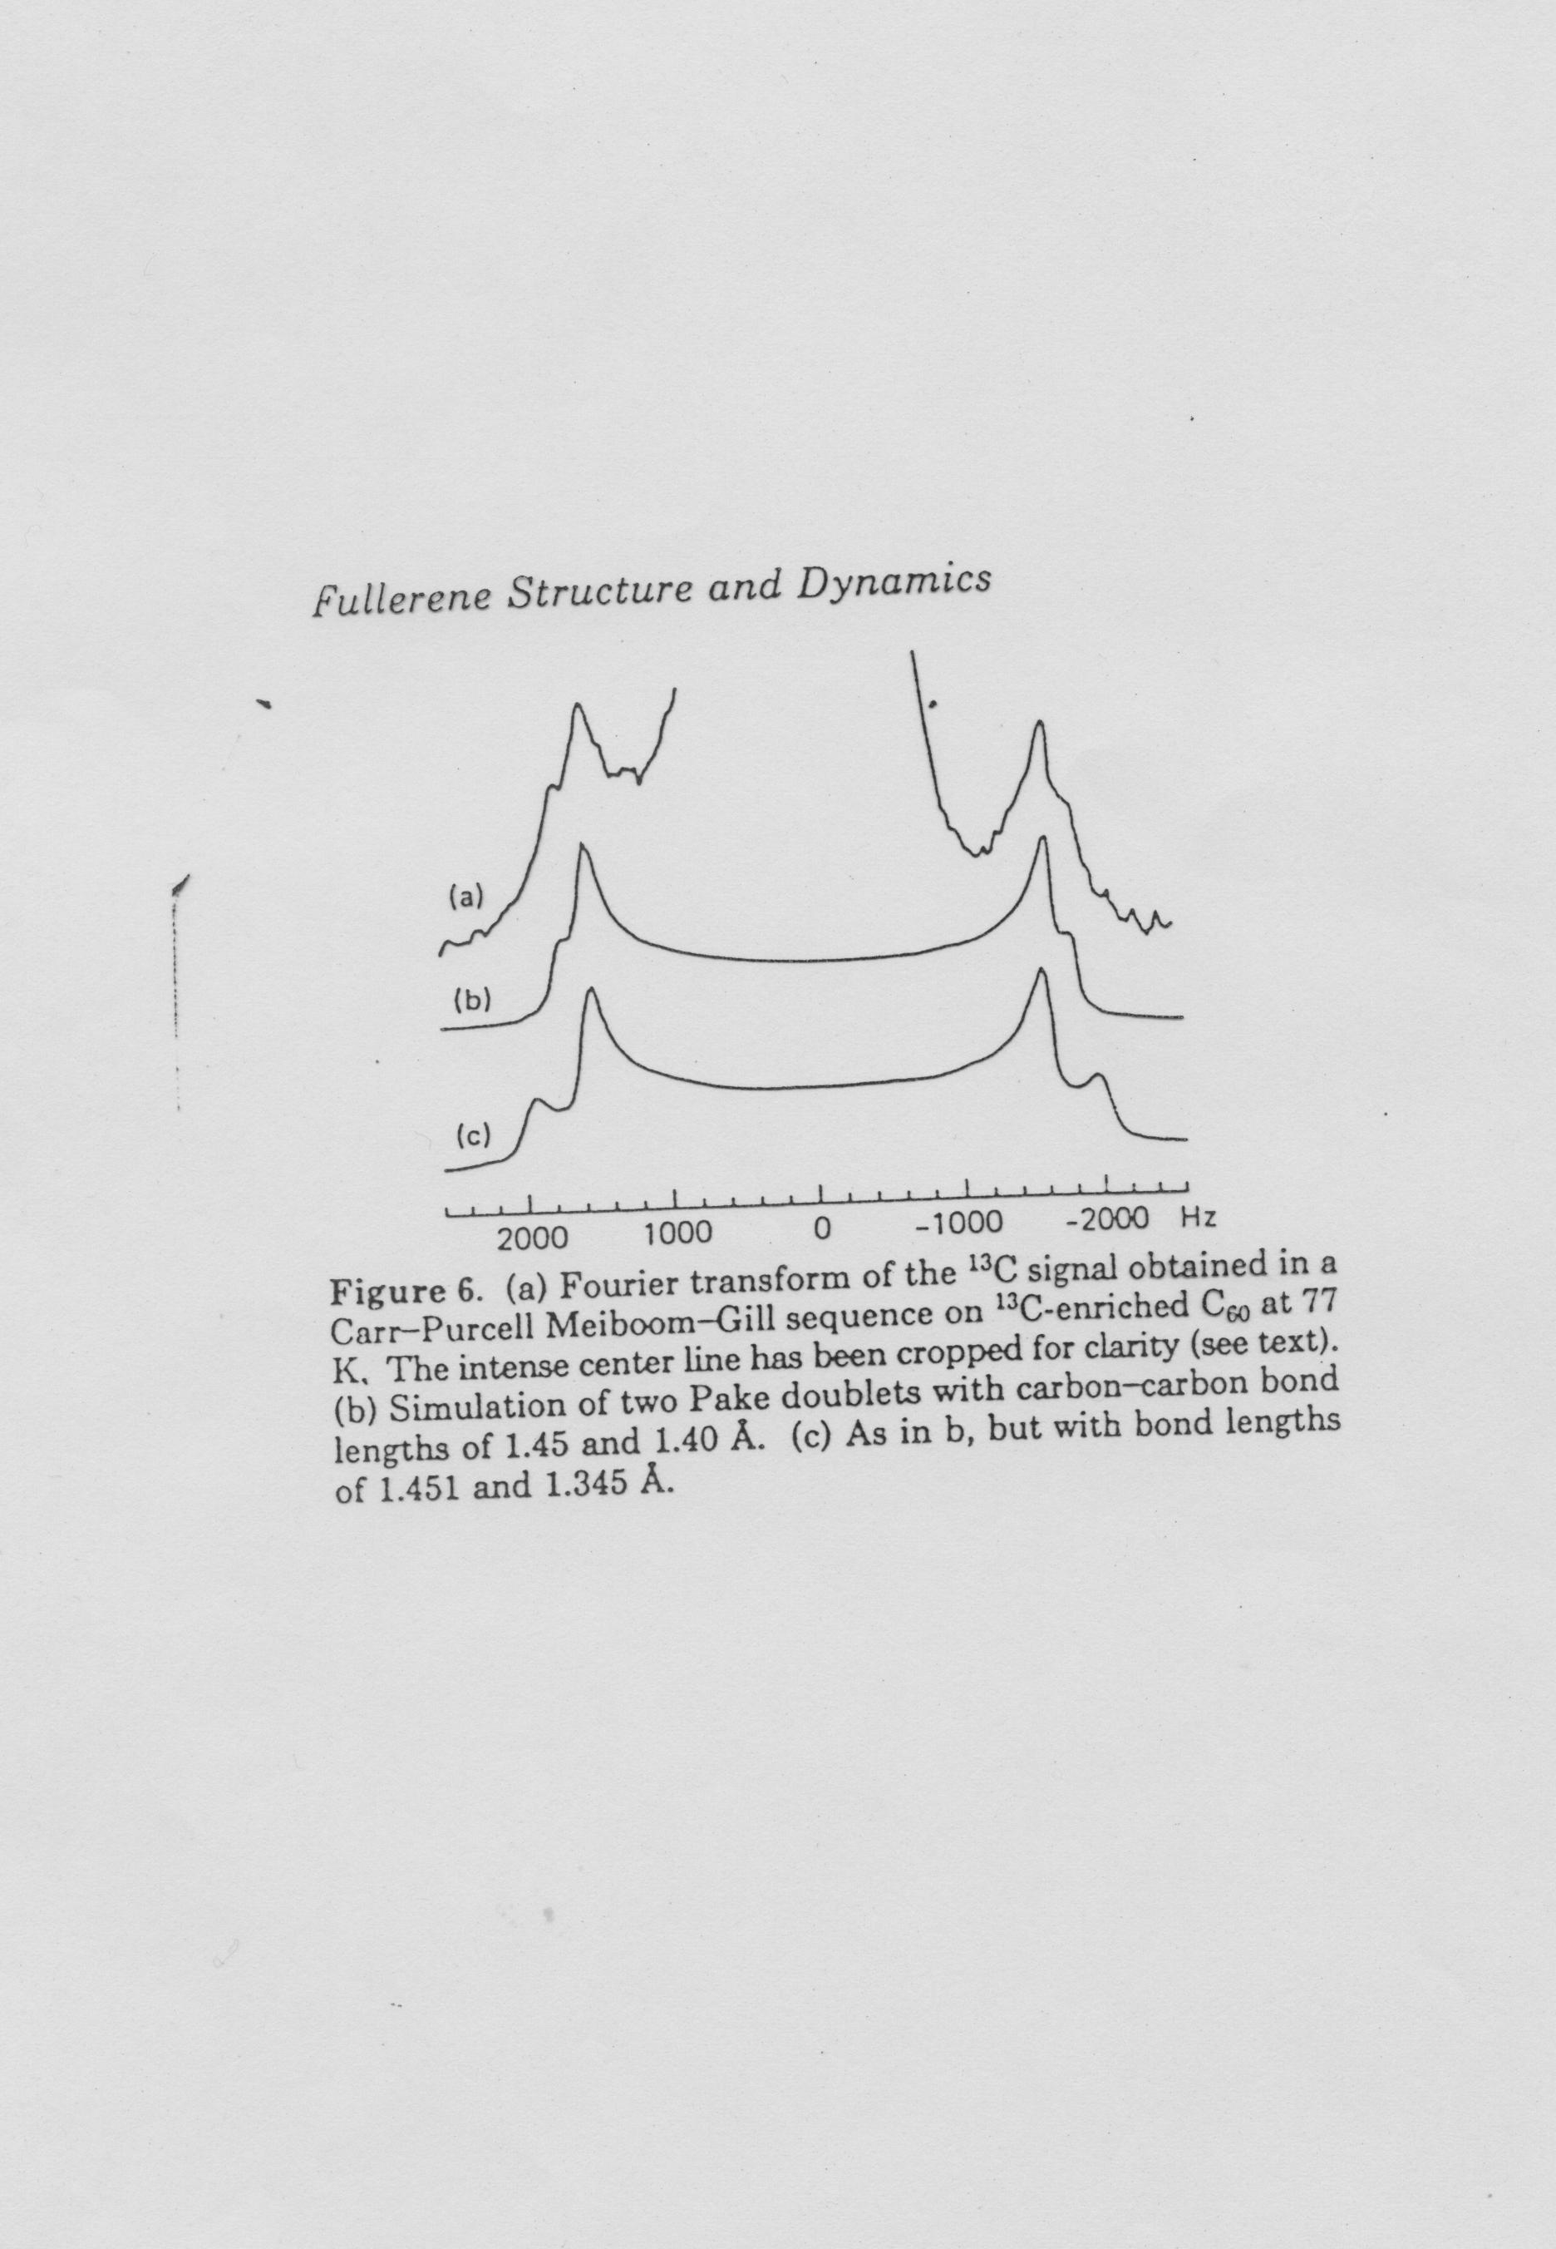

Slide 6
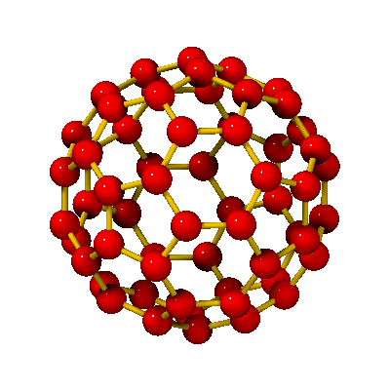
C₆₀
r₆₆
r₅₆
r₆₆ ≈ 140 pm
r₅₆ ≈ 145 pm
d ≈ 0,7 nm

Slide 7
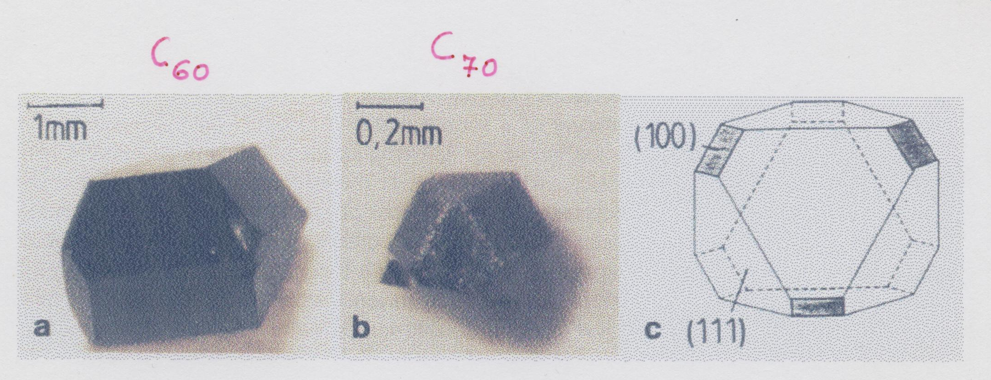

Slide 8
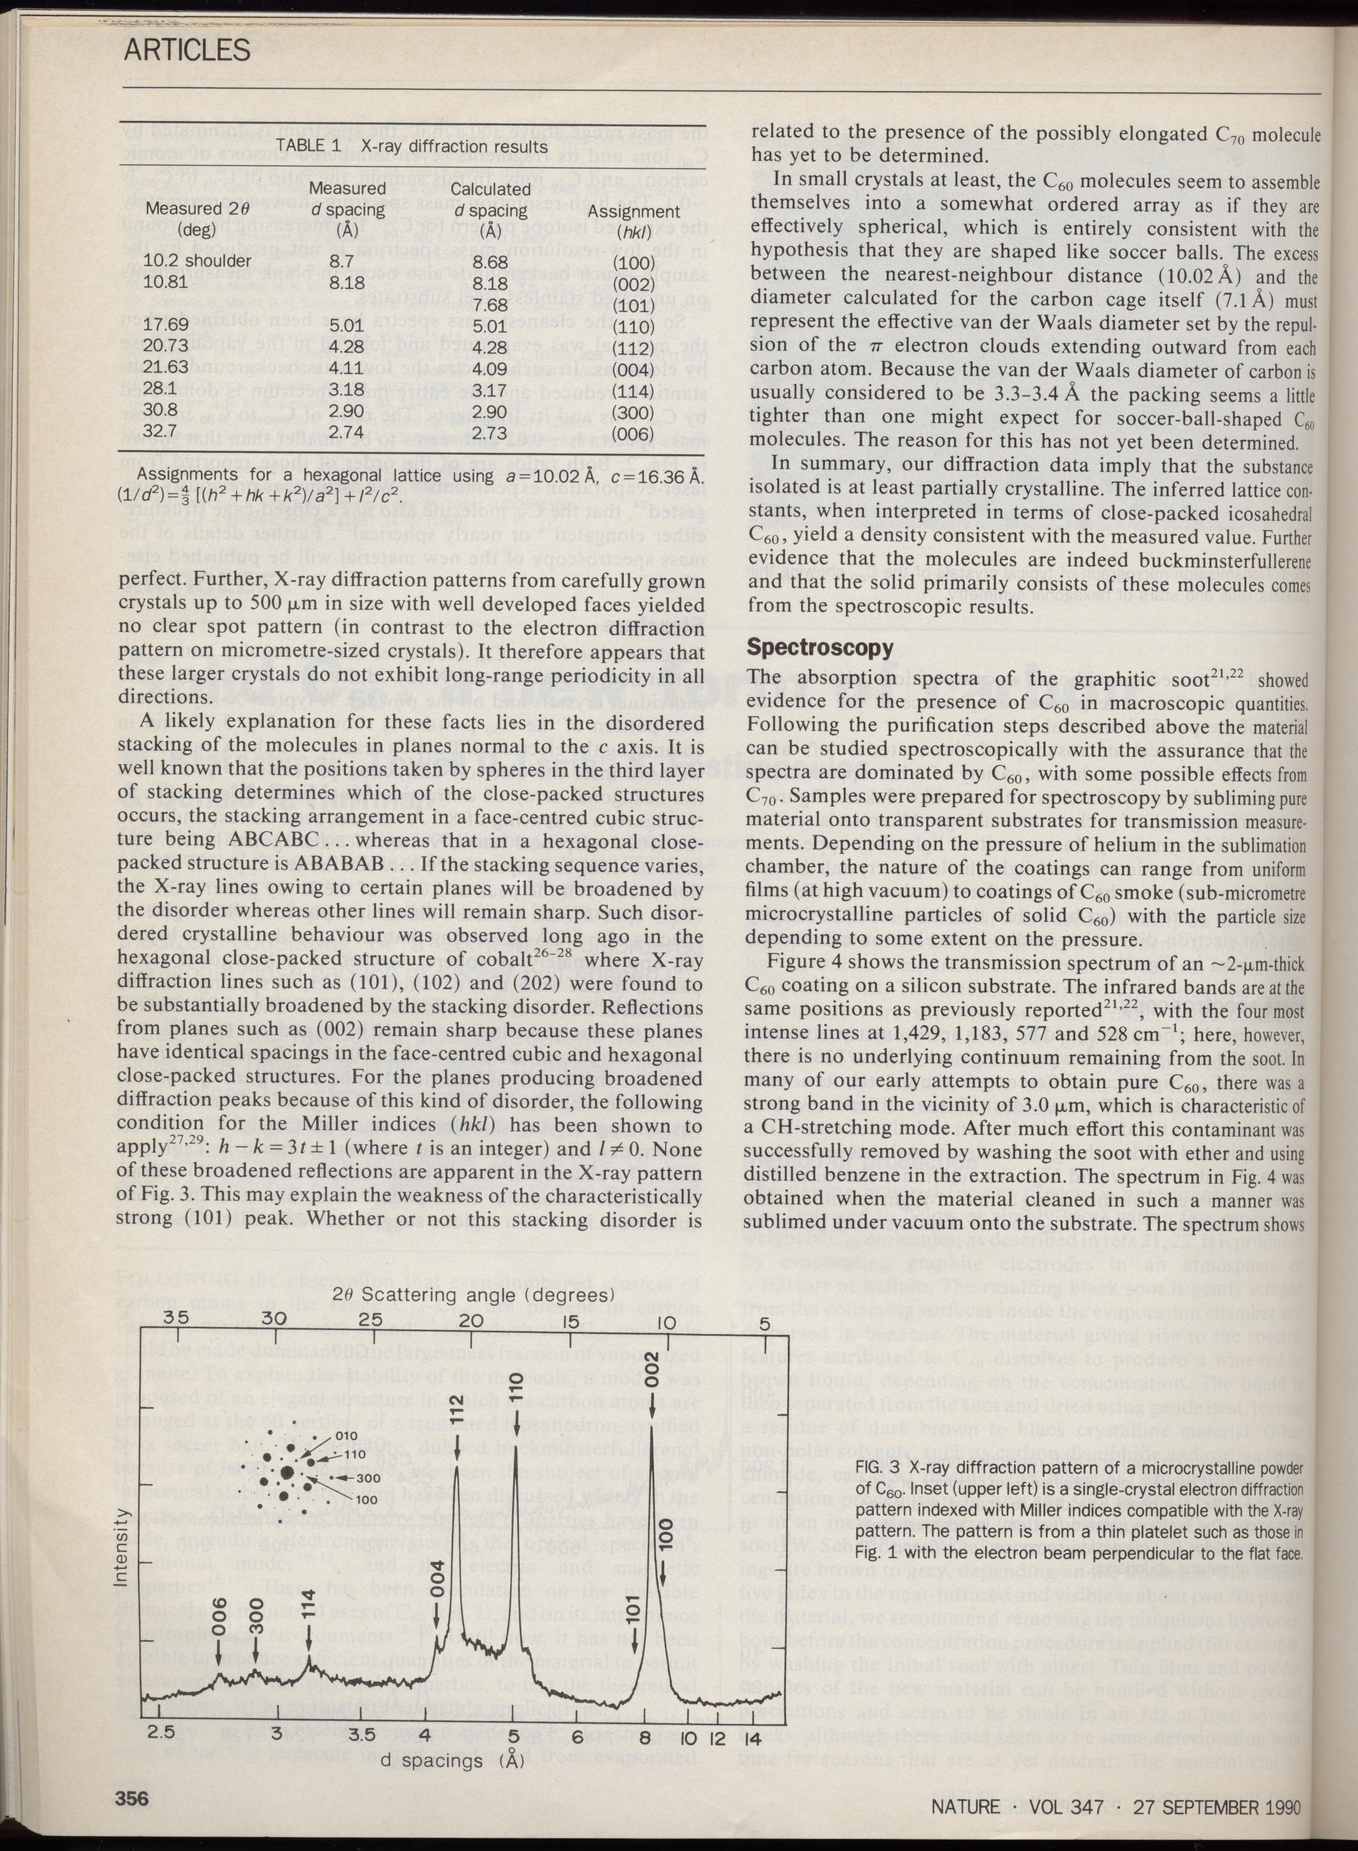

Slide 9
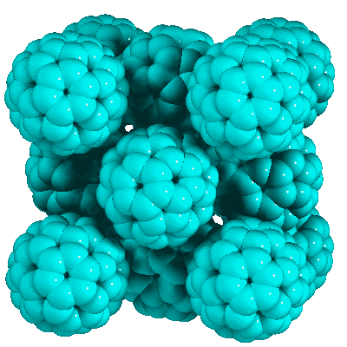
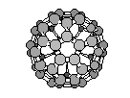
C₆₀ face centered cubic structure (fullerit)
d_{cc} ≈1 nm
d ≈0,7 nm
(T_{room})
a≈1,4 nm

Slide 10
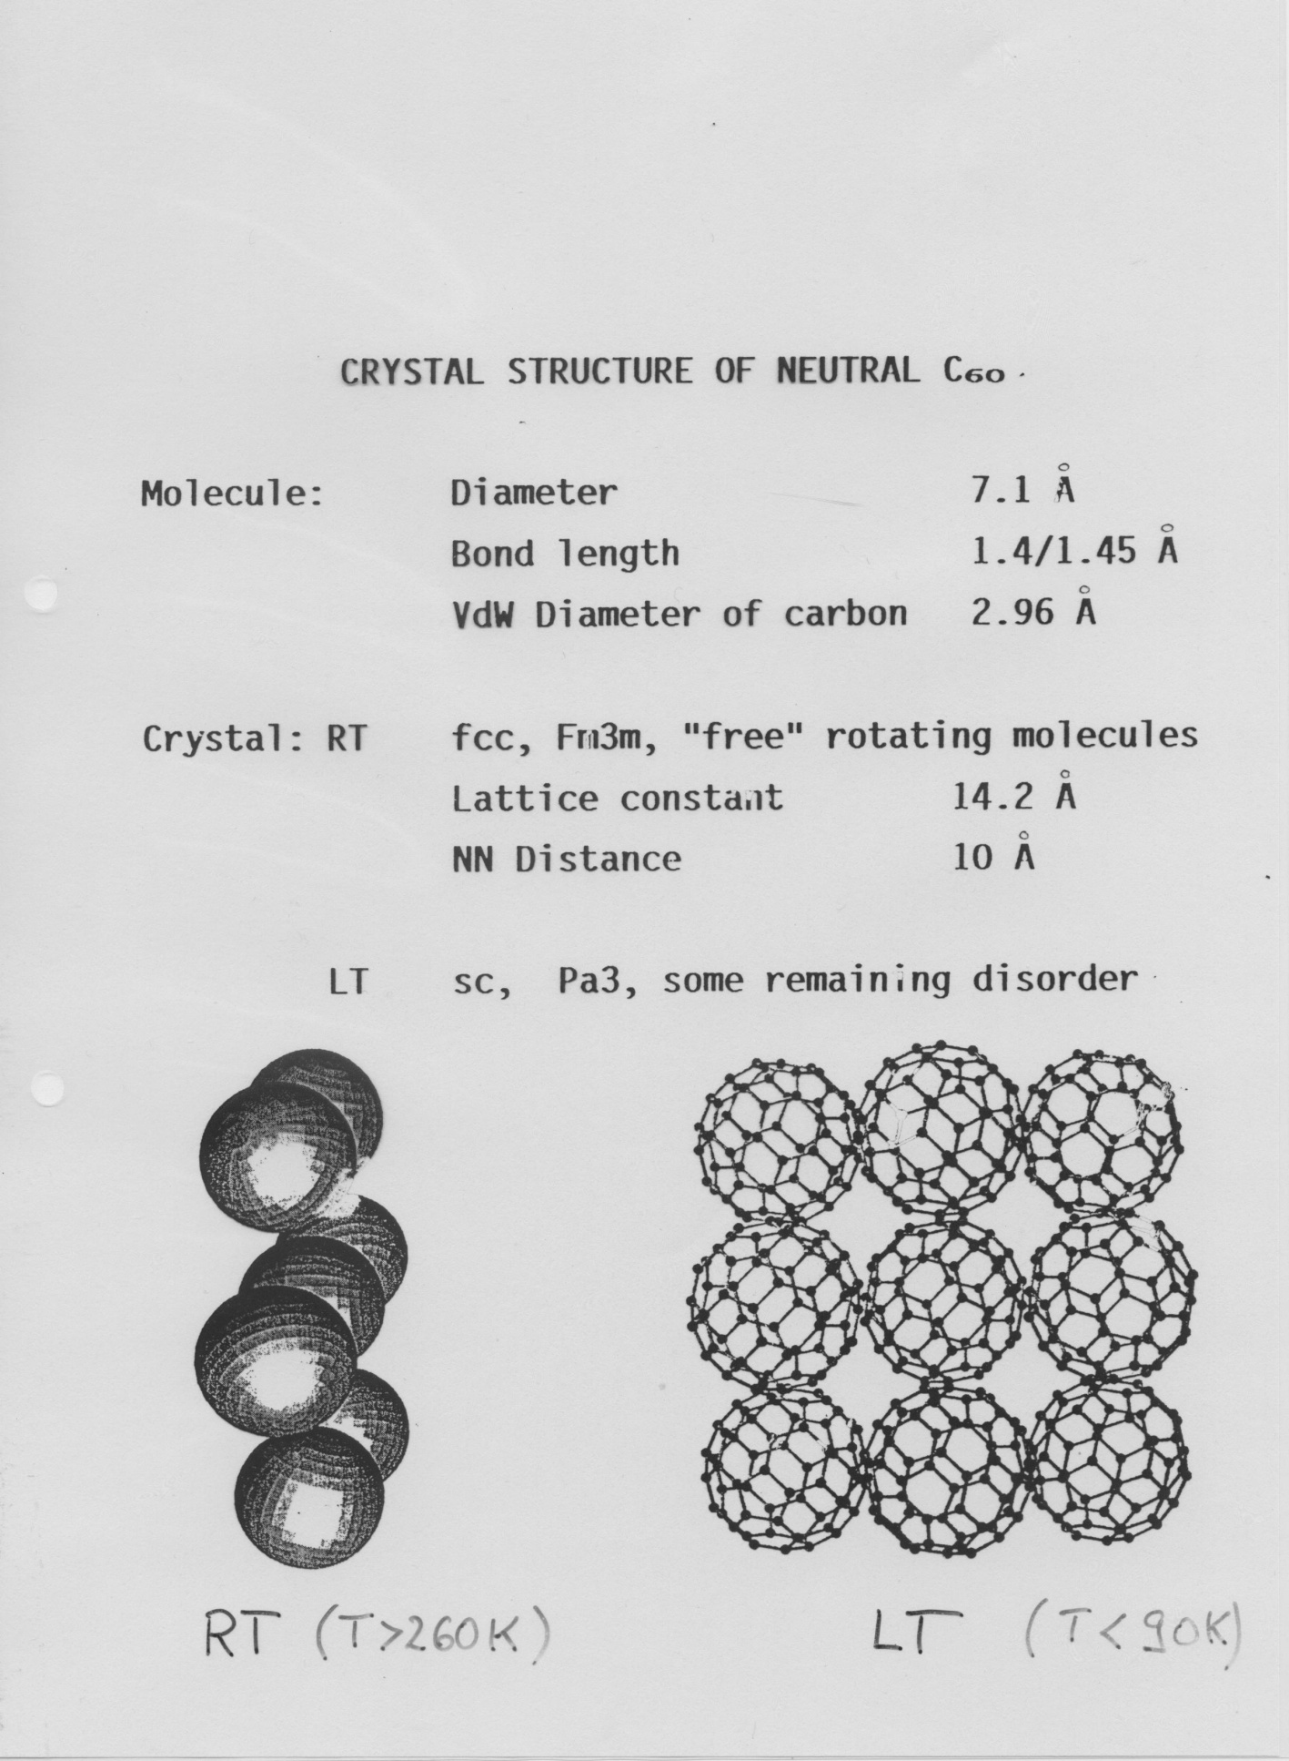

Slide 11
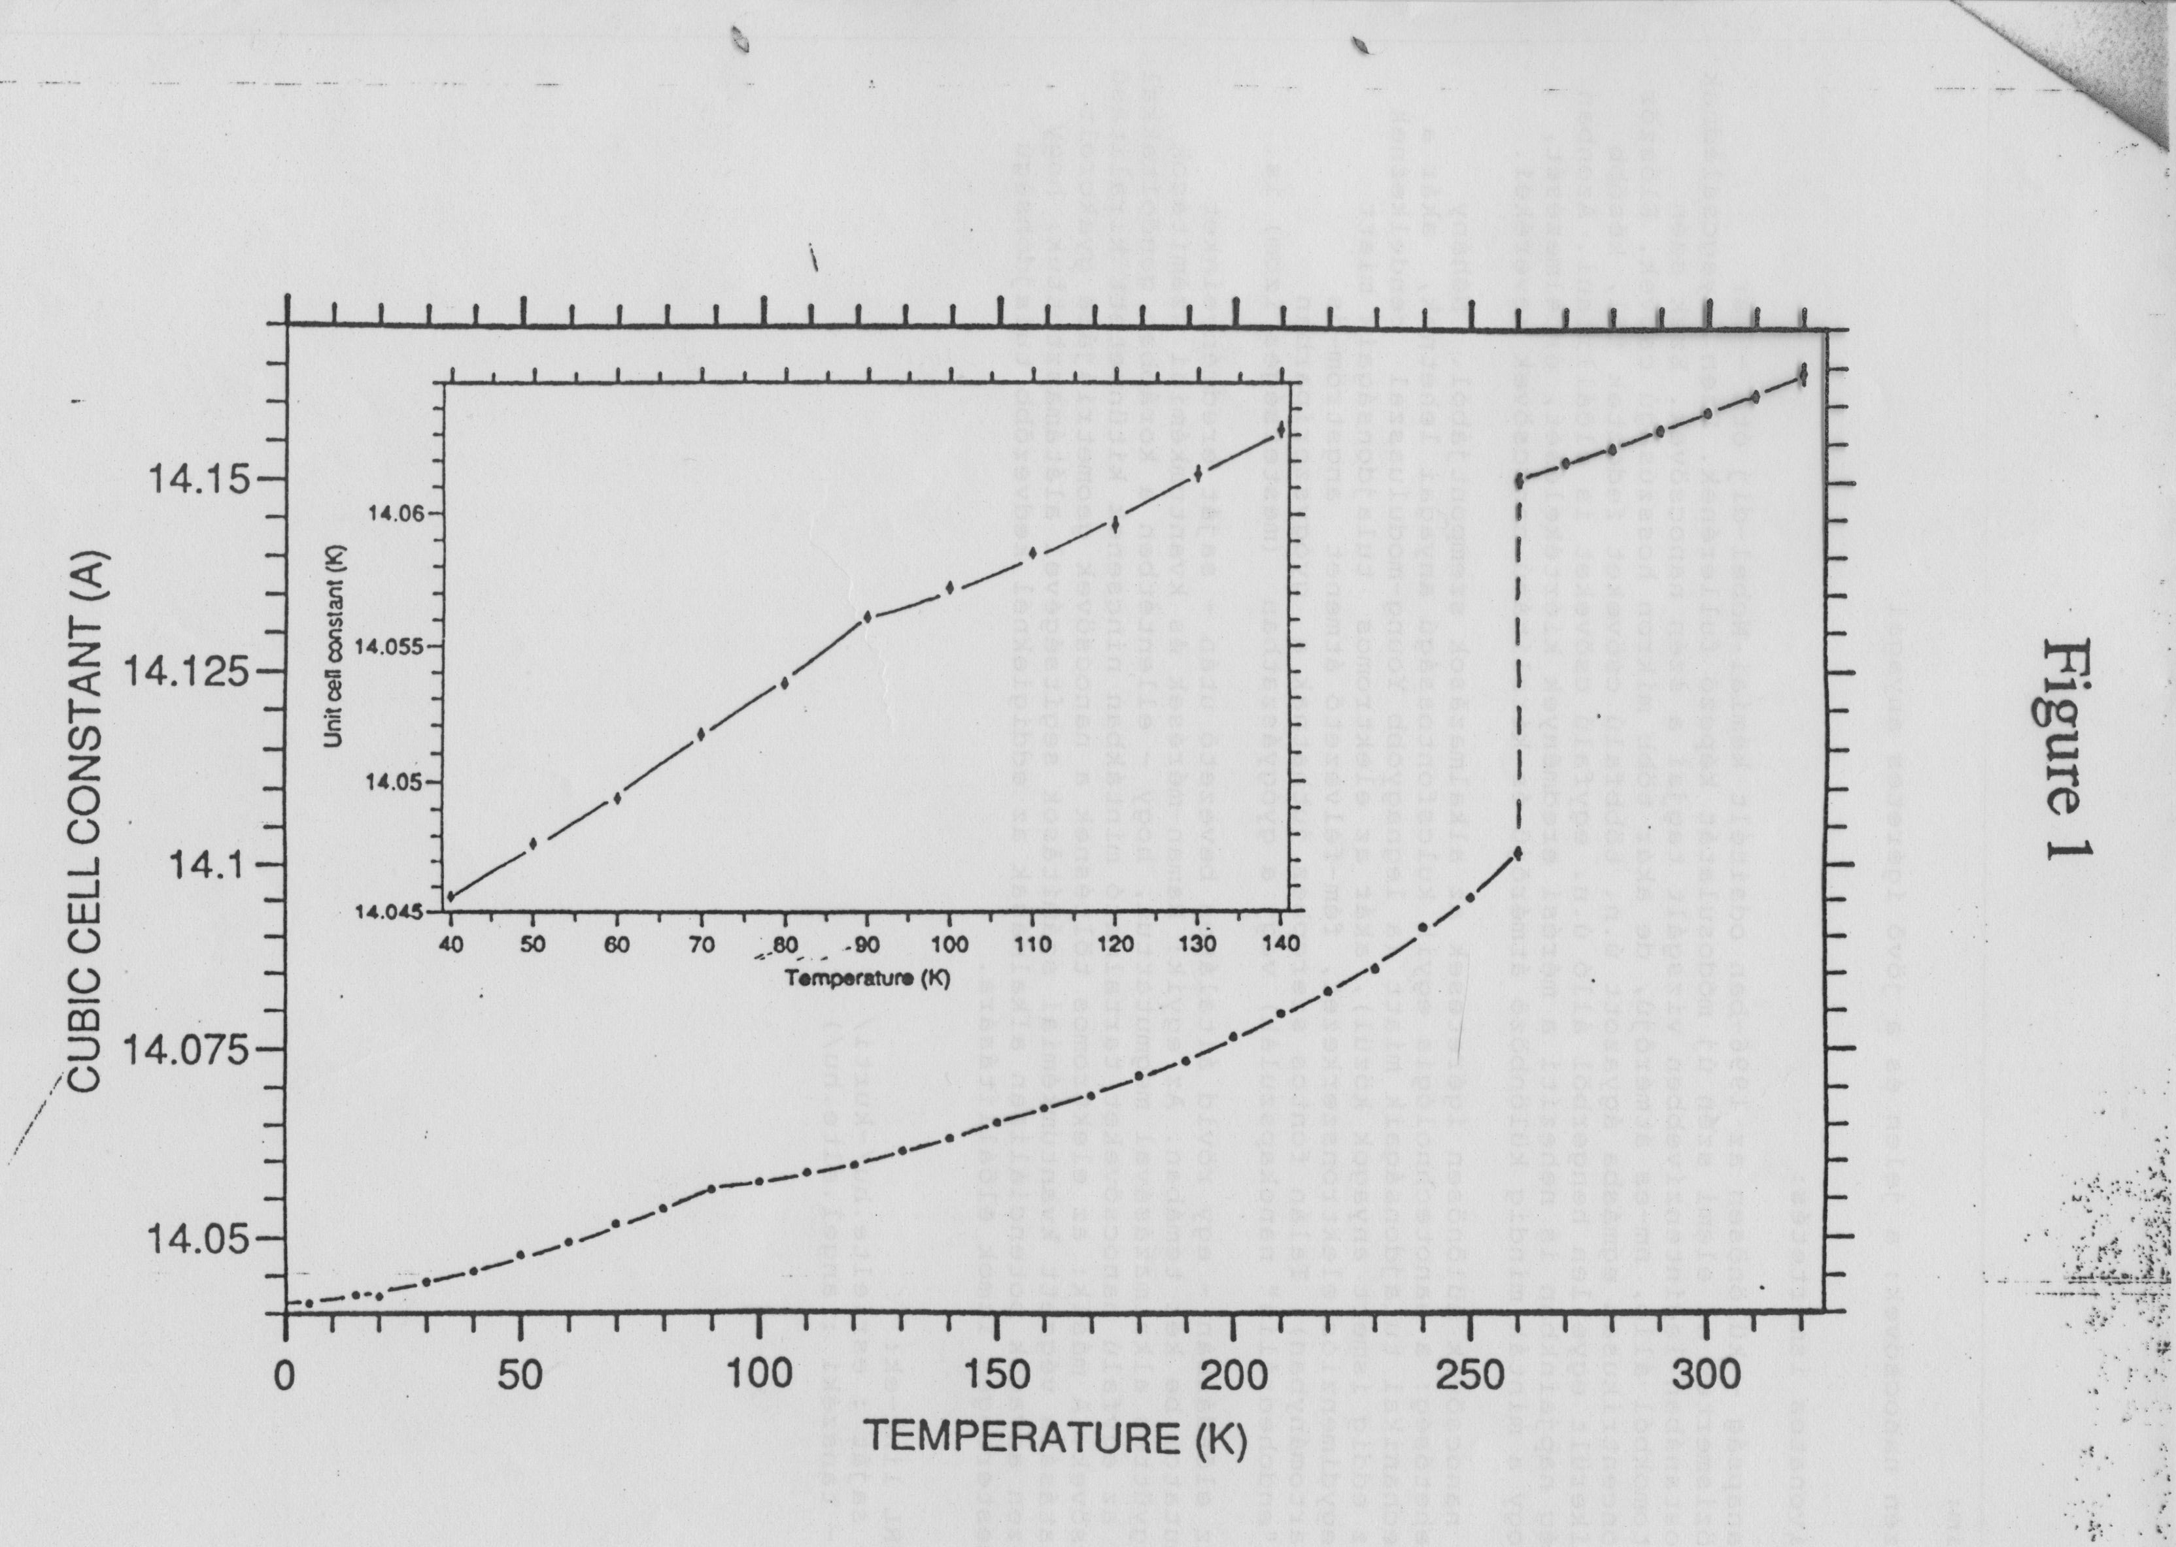
NEUTRON DIFFRACTION

Slide 12
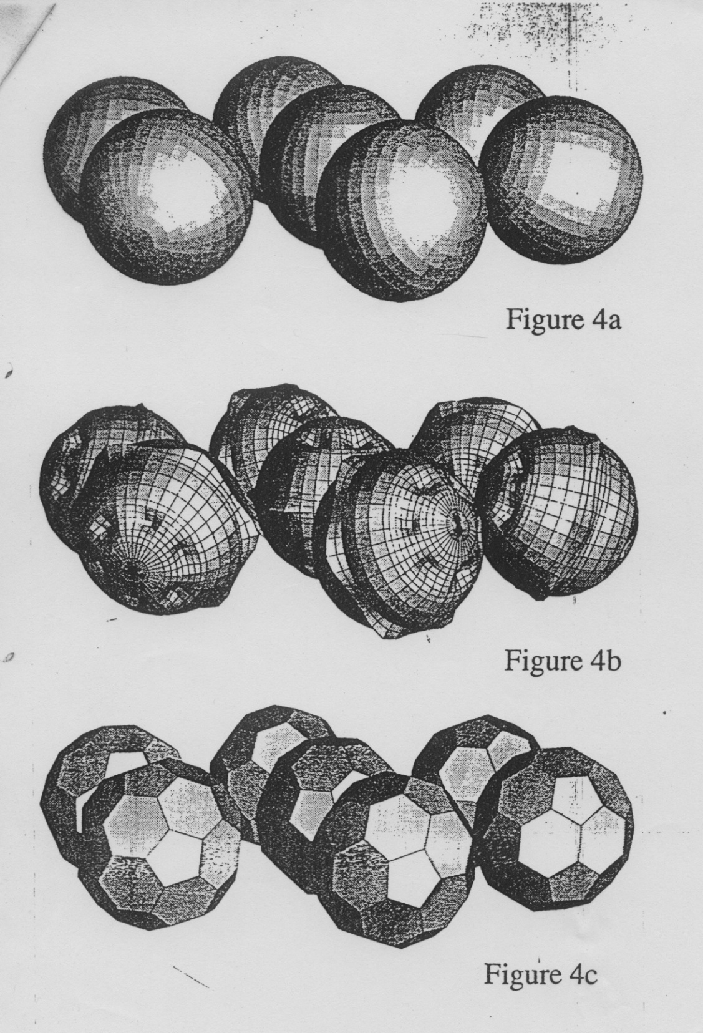
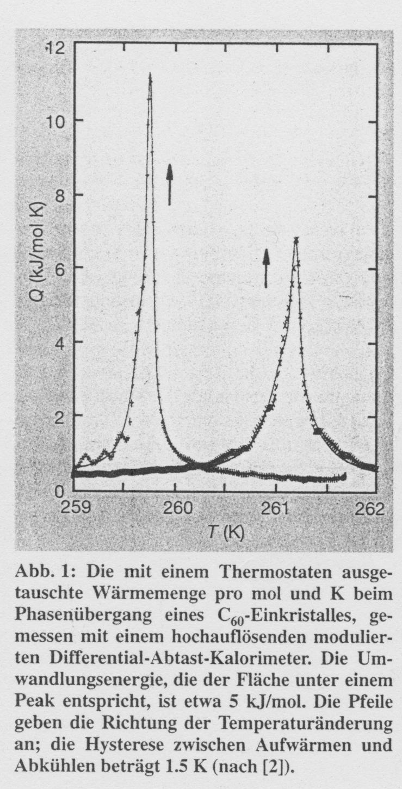
>260 K
< 90 K

Slide 13
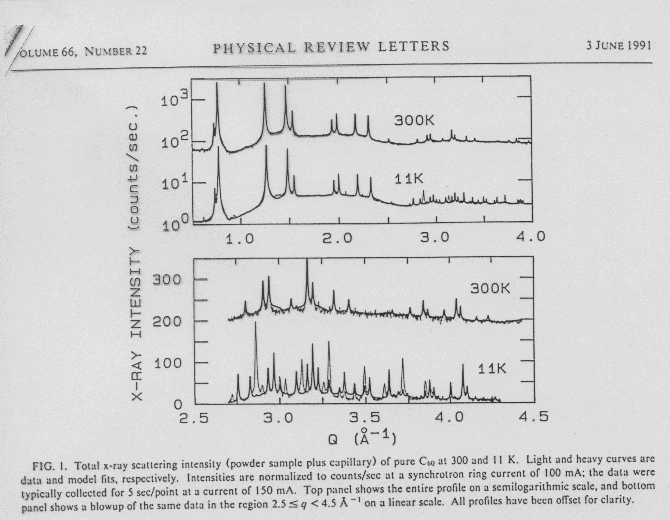

Slide 14
