Slide 1
CARBON NANOSTRUCTURES (FULLERENES, CARBON NANOTUBES, GRAPHENE)
lecture for physics and chemistry students
(2019. summer semester – 18. March)
Prof. Jenő Kürti
ELTE Department of Biological Physics
e-mail: kurti@virag.elte.hu www: regivirag.elte.hu/kurti

Slide 2
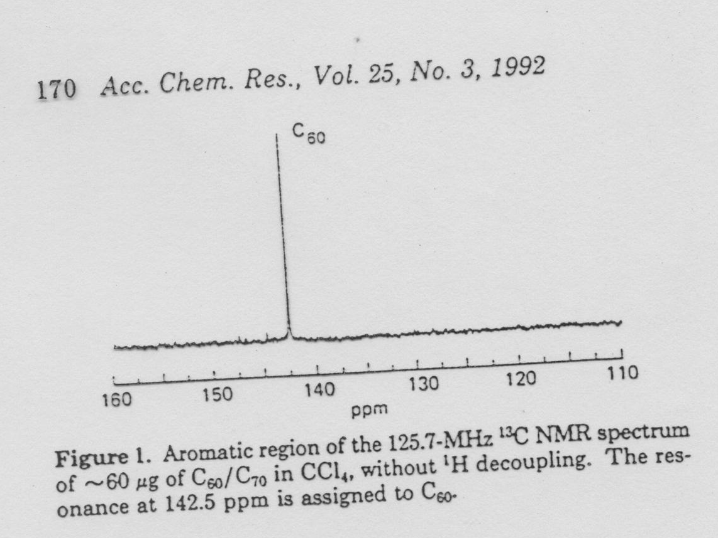

Slide 3
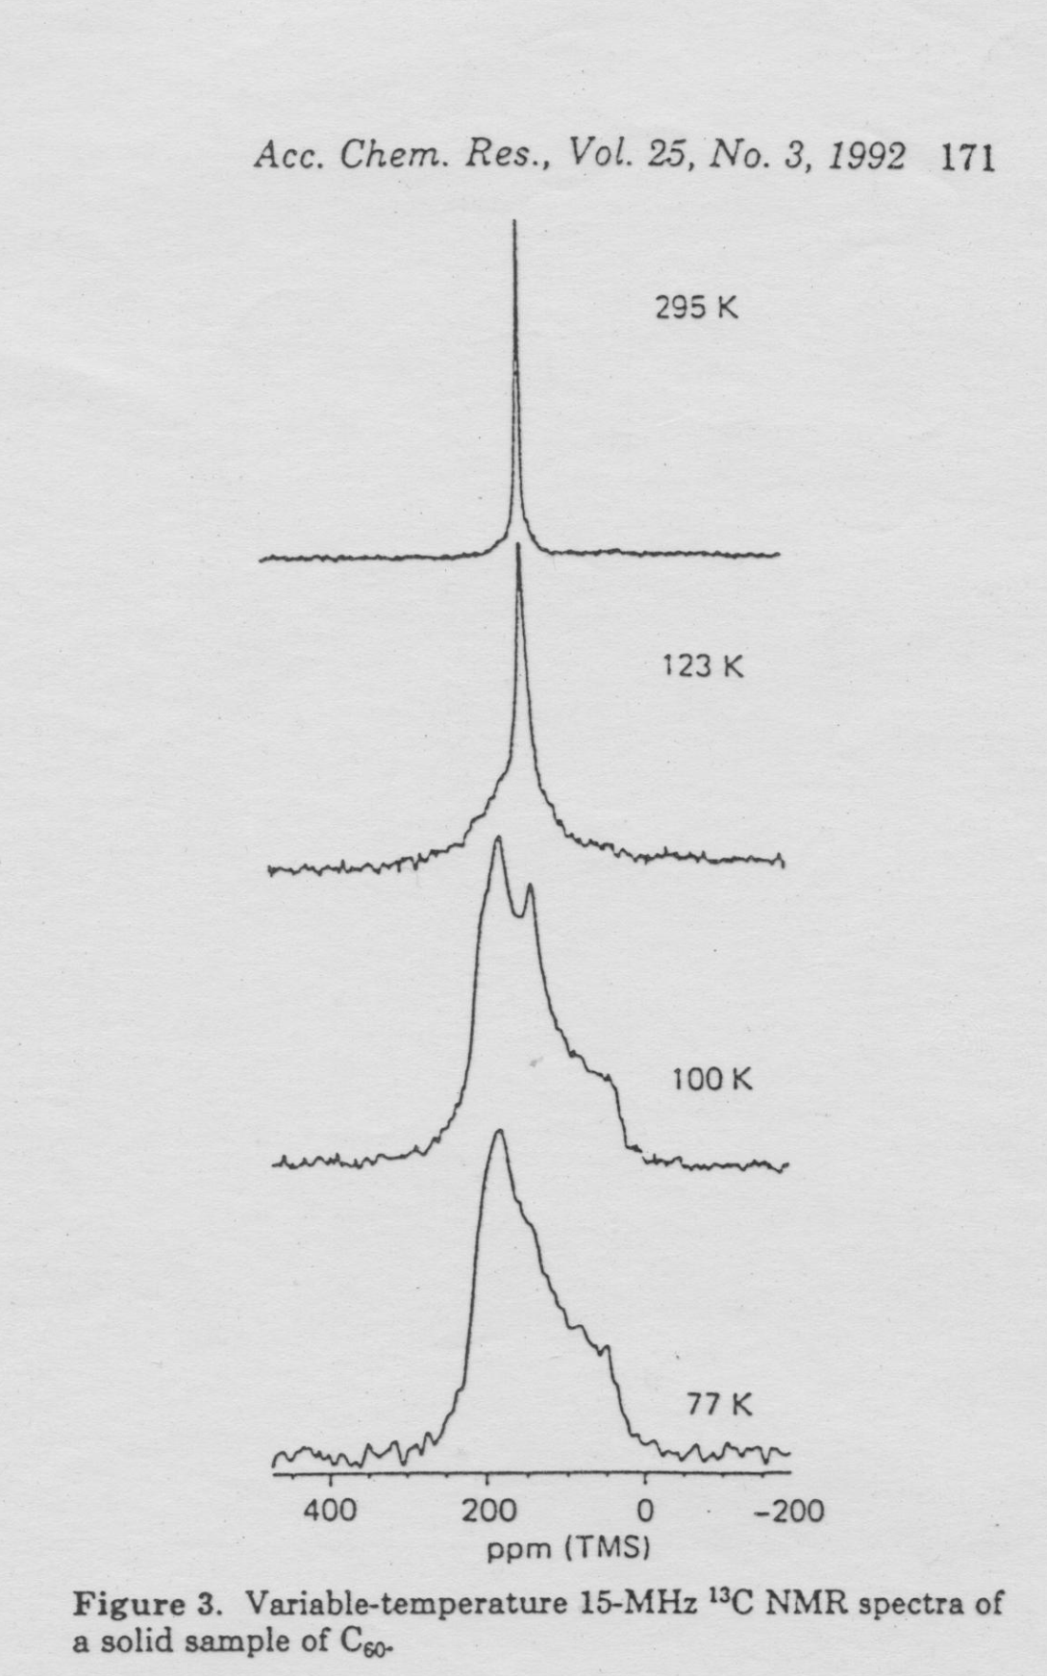

Slide 4
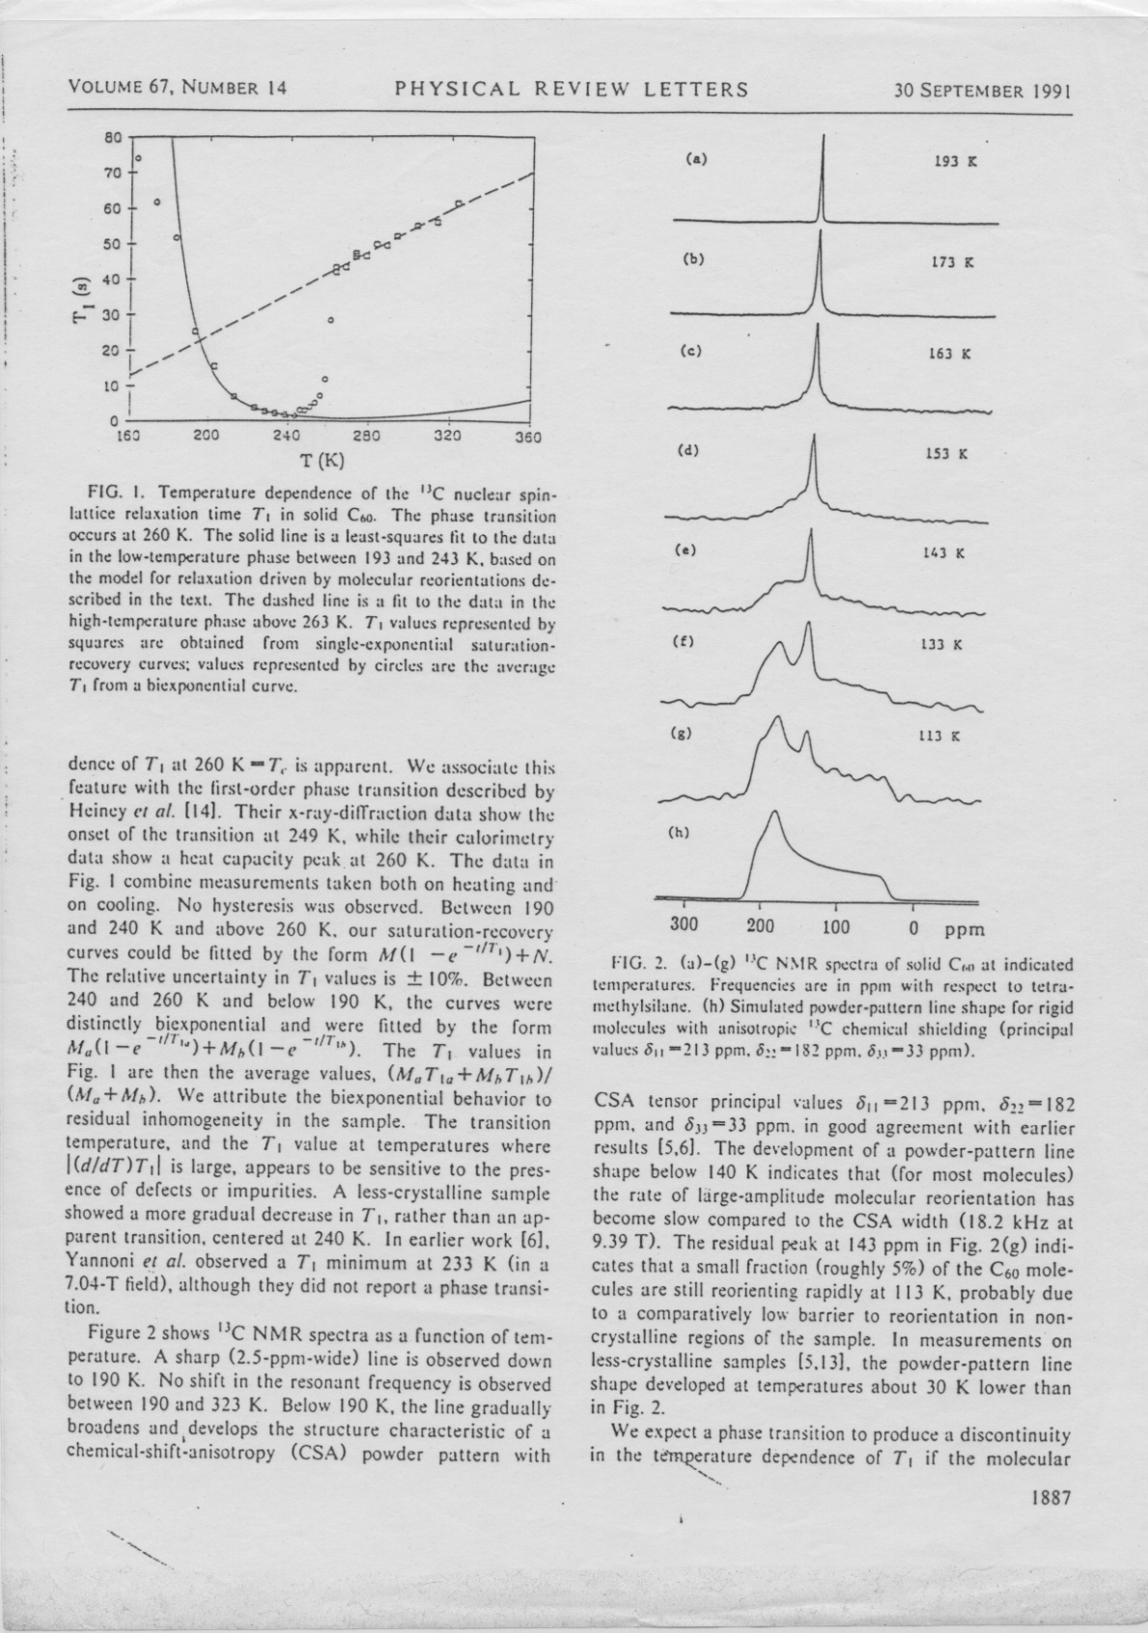

Slide 5
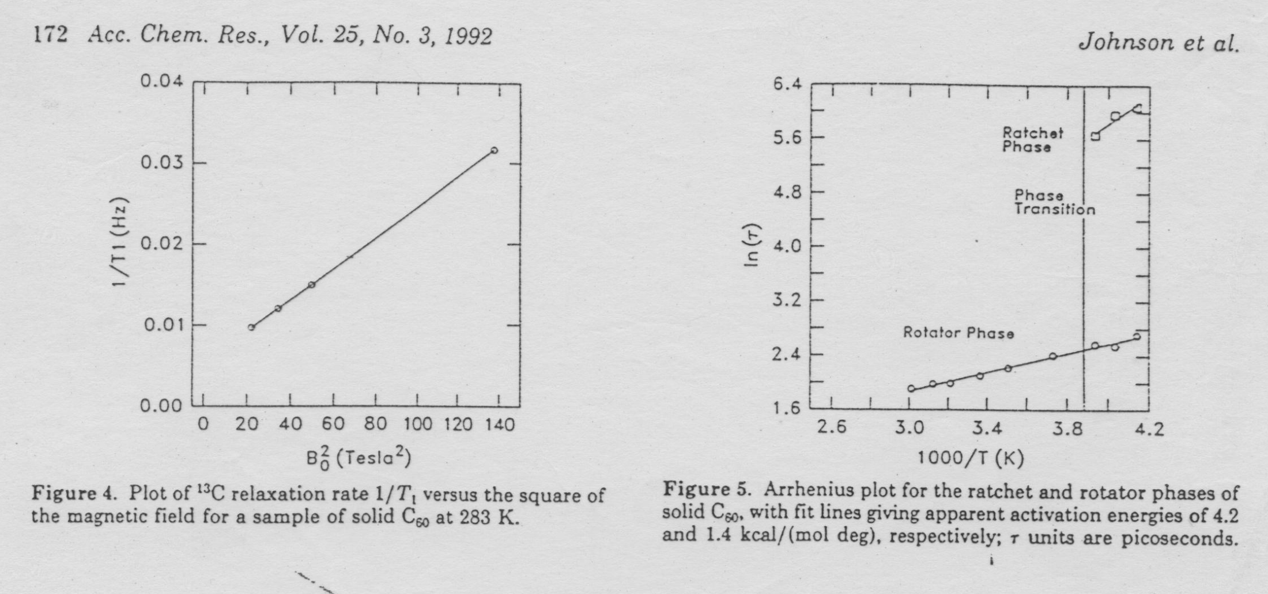
solid: τ=9.2 ps
gas: τ=3.1 ps
liquid: τ=15.5 ps

Slide 6
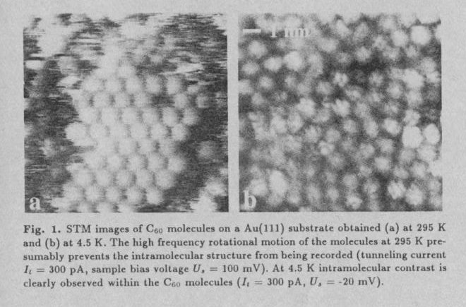

Slide 7
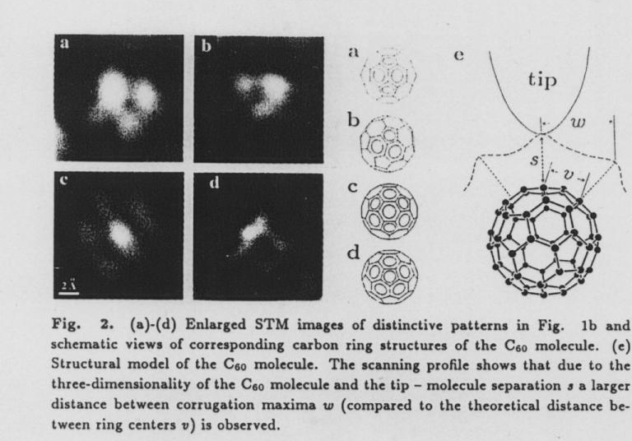

Slide 8
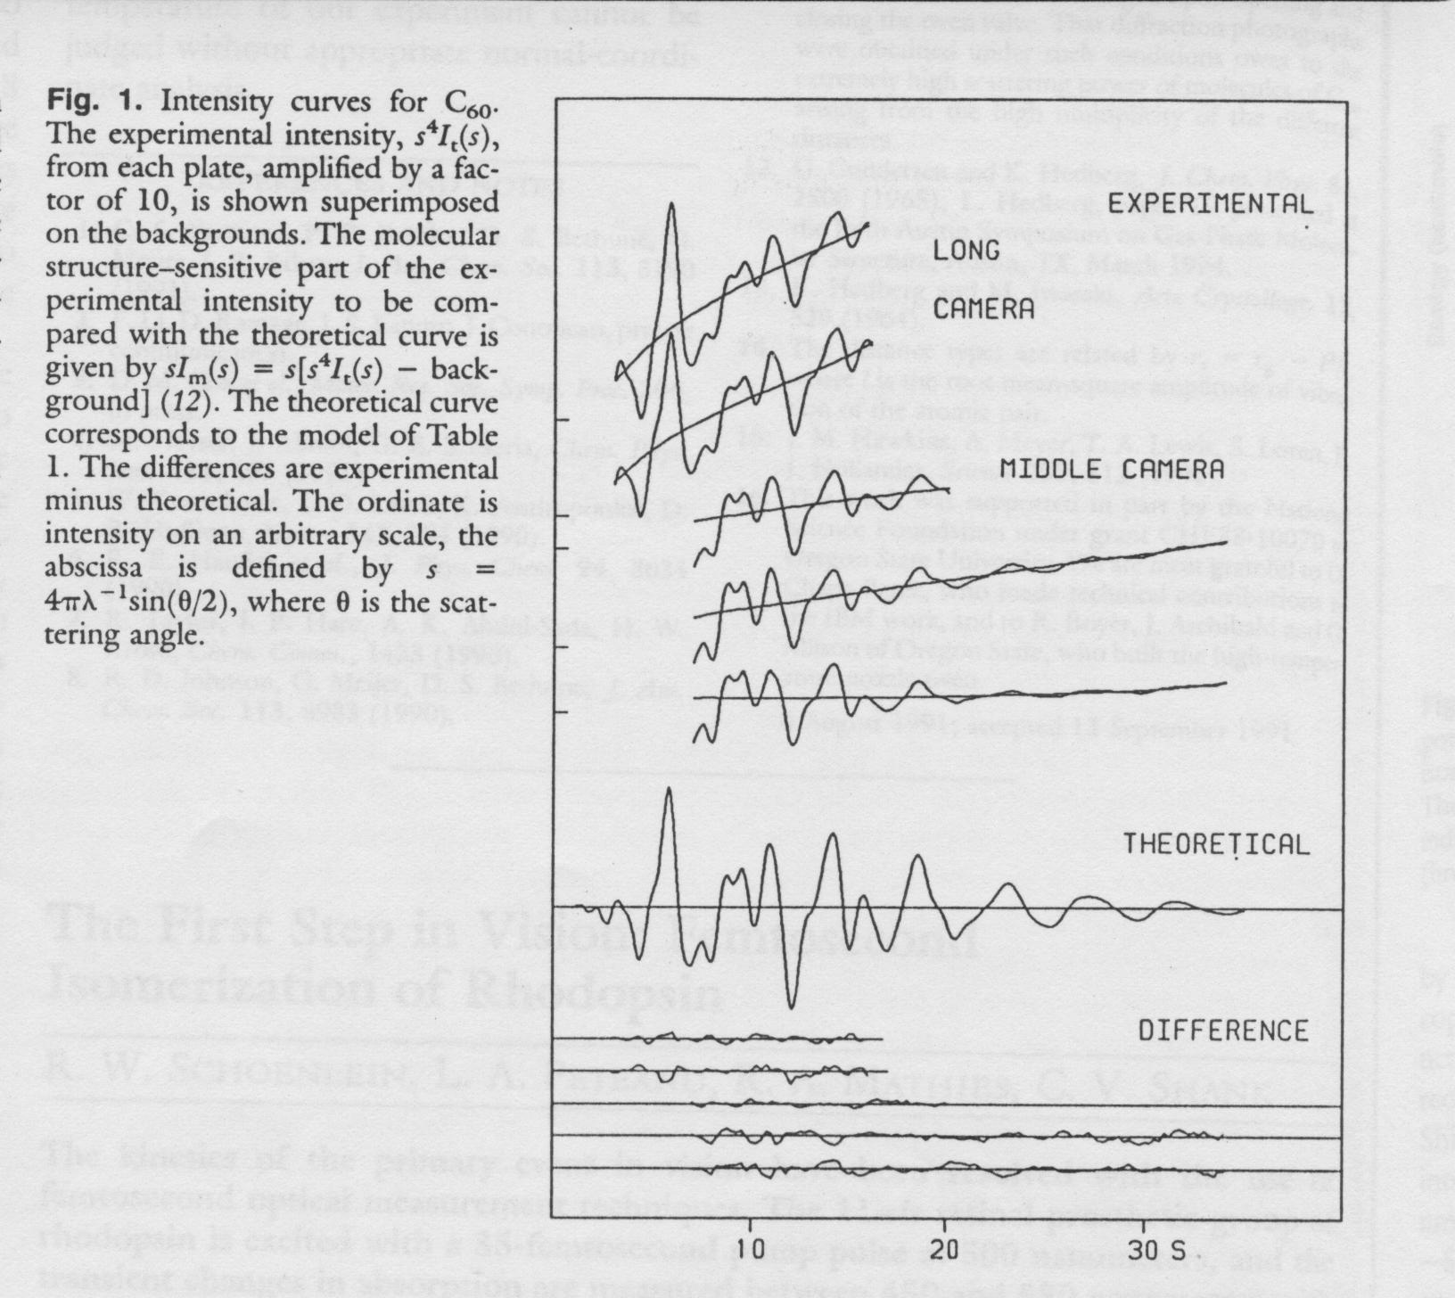
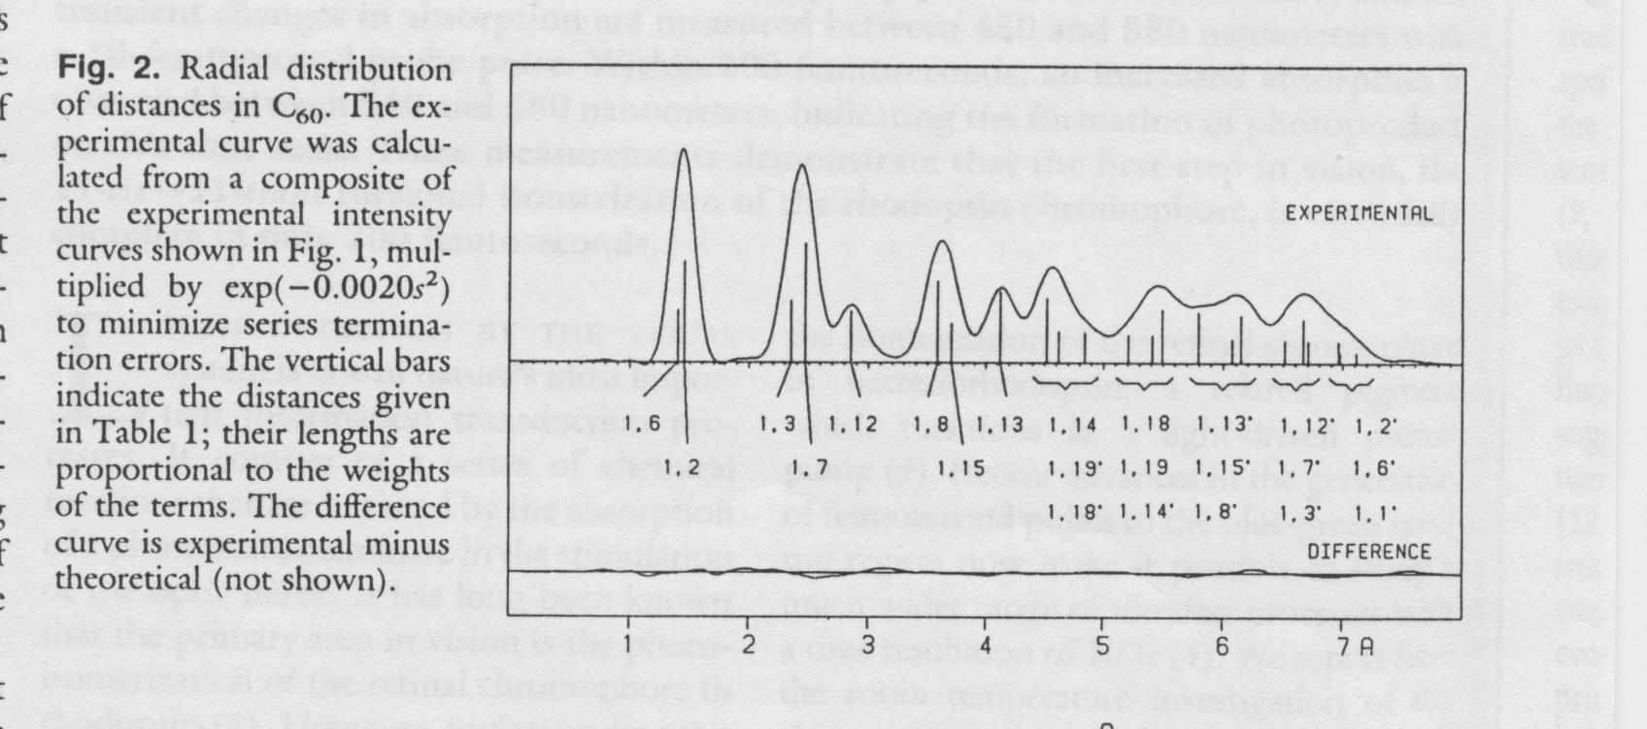
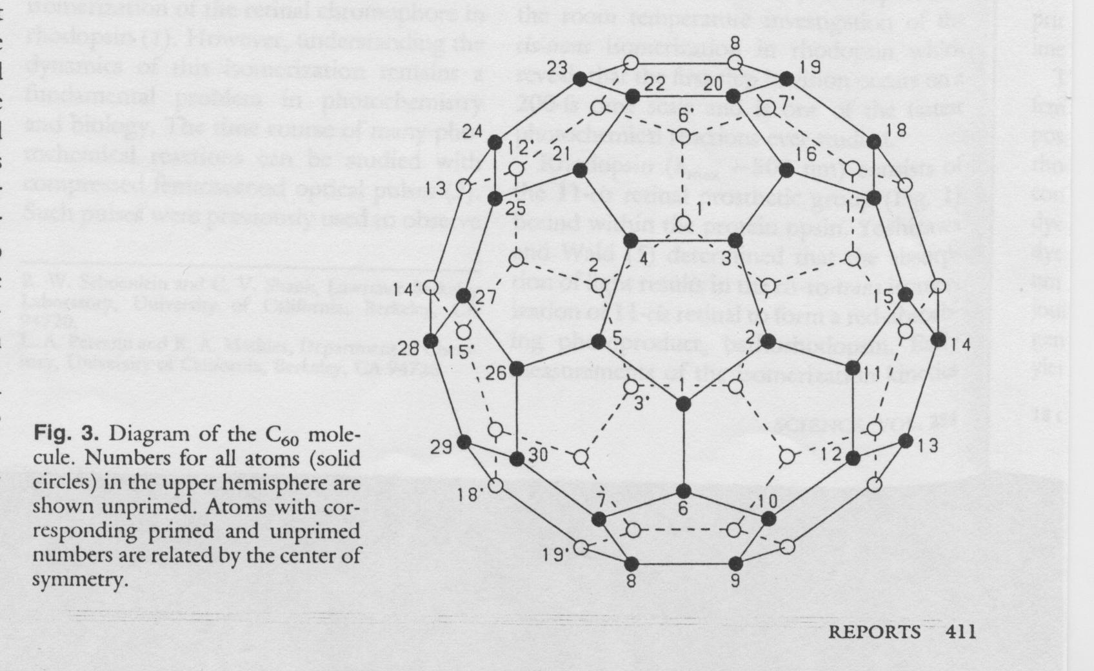

Slide 9
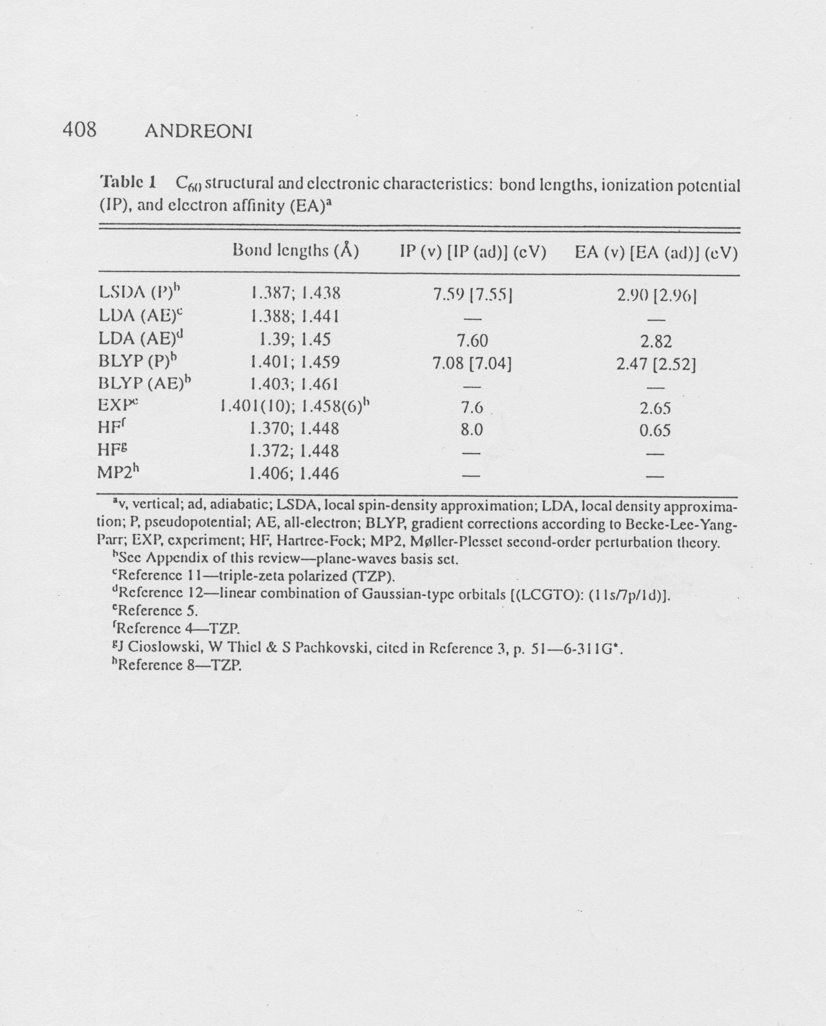
elektron diffraction (gas) 1.401(10) / 1.458 (6)
NMR (liquid) 1.40 (2) / 1.45 (2)
X-ray (110 K) 1.355(9) / 1.467(21)

Slide 11
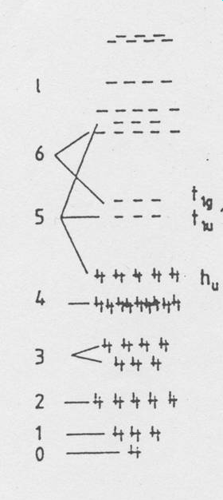

Slide 12
