Slide 1
CARBON NANOSTRUCTURES (FULLERENES, CARBON NANOTUBES, GRAPHENE)
lecture for physics and chemistry students
(2019. summer semester – 15. April)
Prof. Jenő Kürti
ELTE Department of Biological Physics
e-mail: kurti@virag.elte.hu www: regivirag.elte.hu/kurti

Slide 2
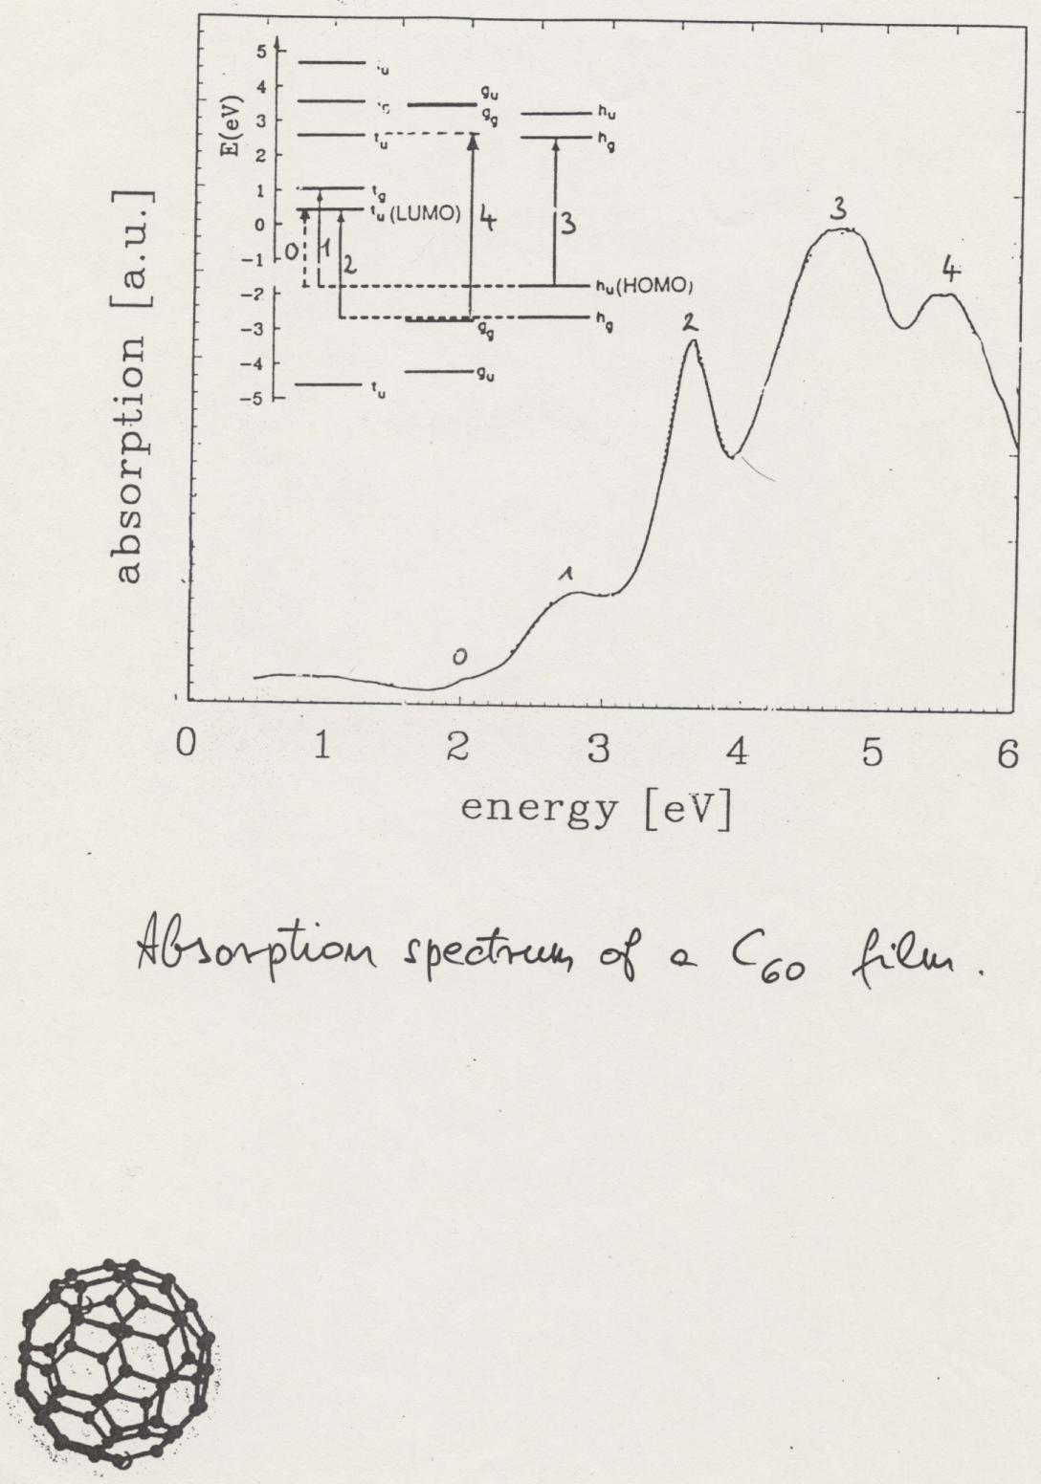

Slide 3
SUPPLEMENT
(dielectric formalism in optics)

Slide 4
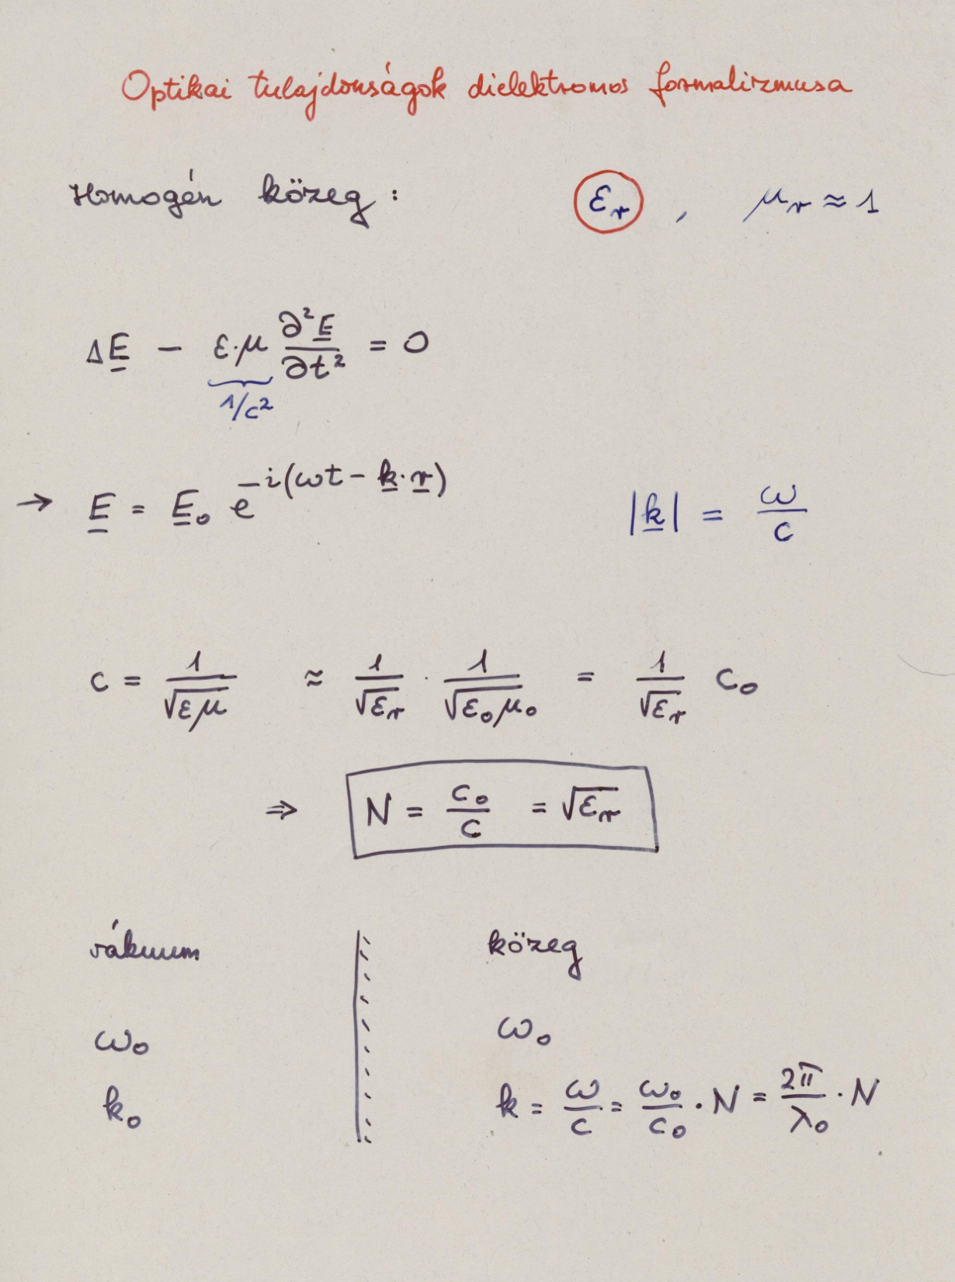

Slide 5
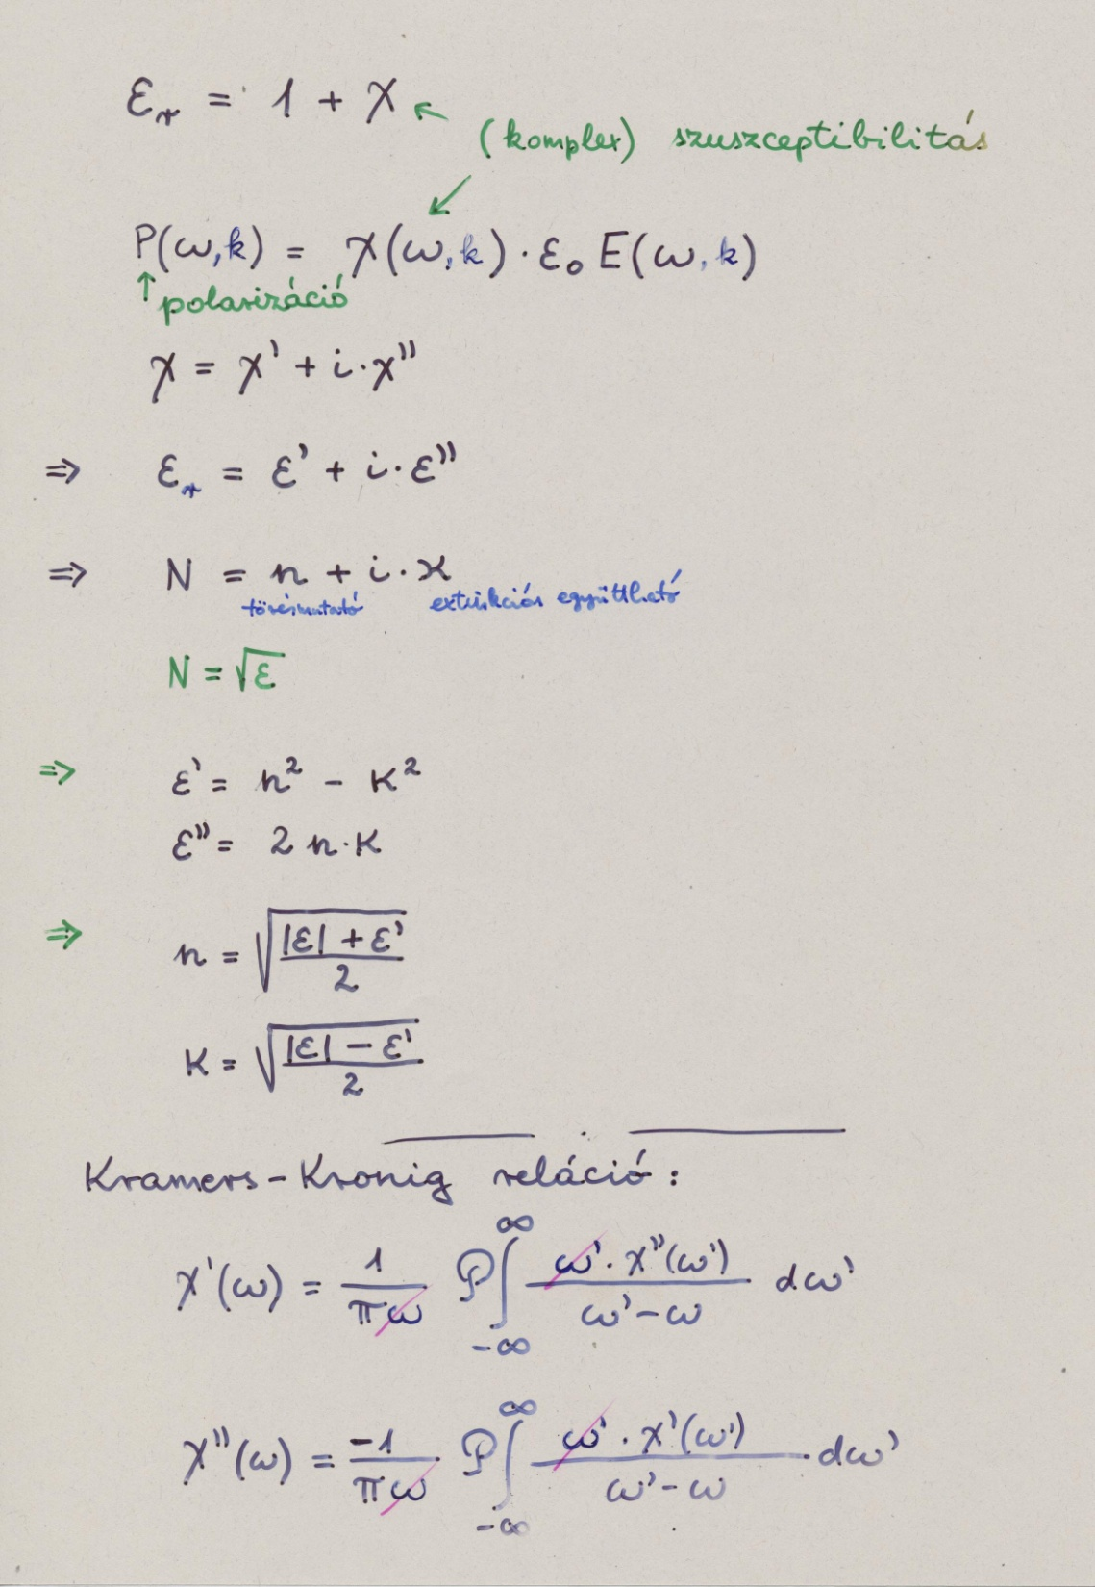

Slide 6
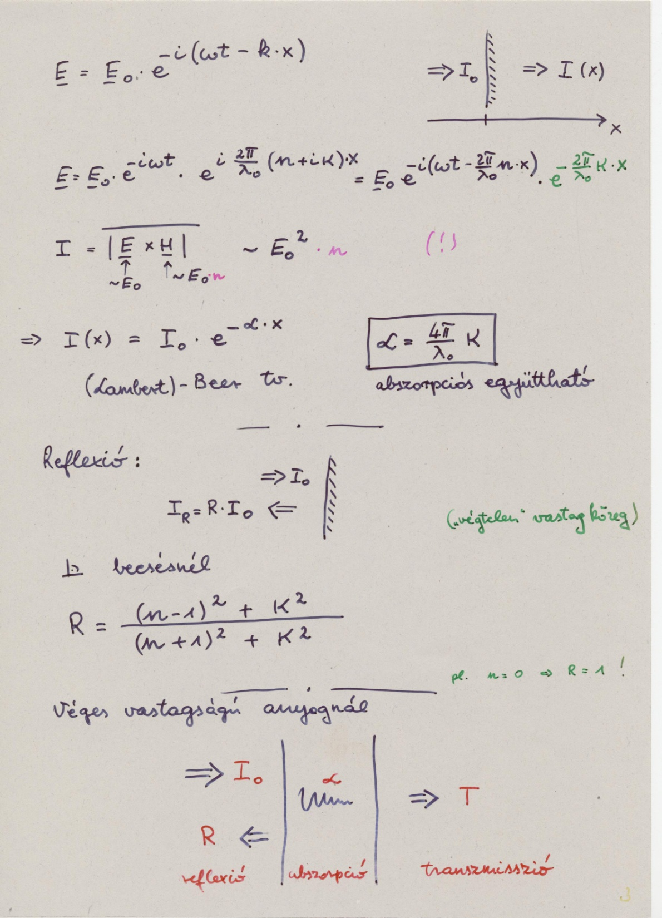

Slide 7
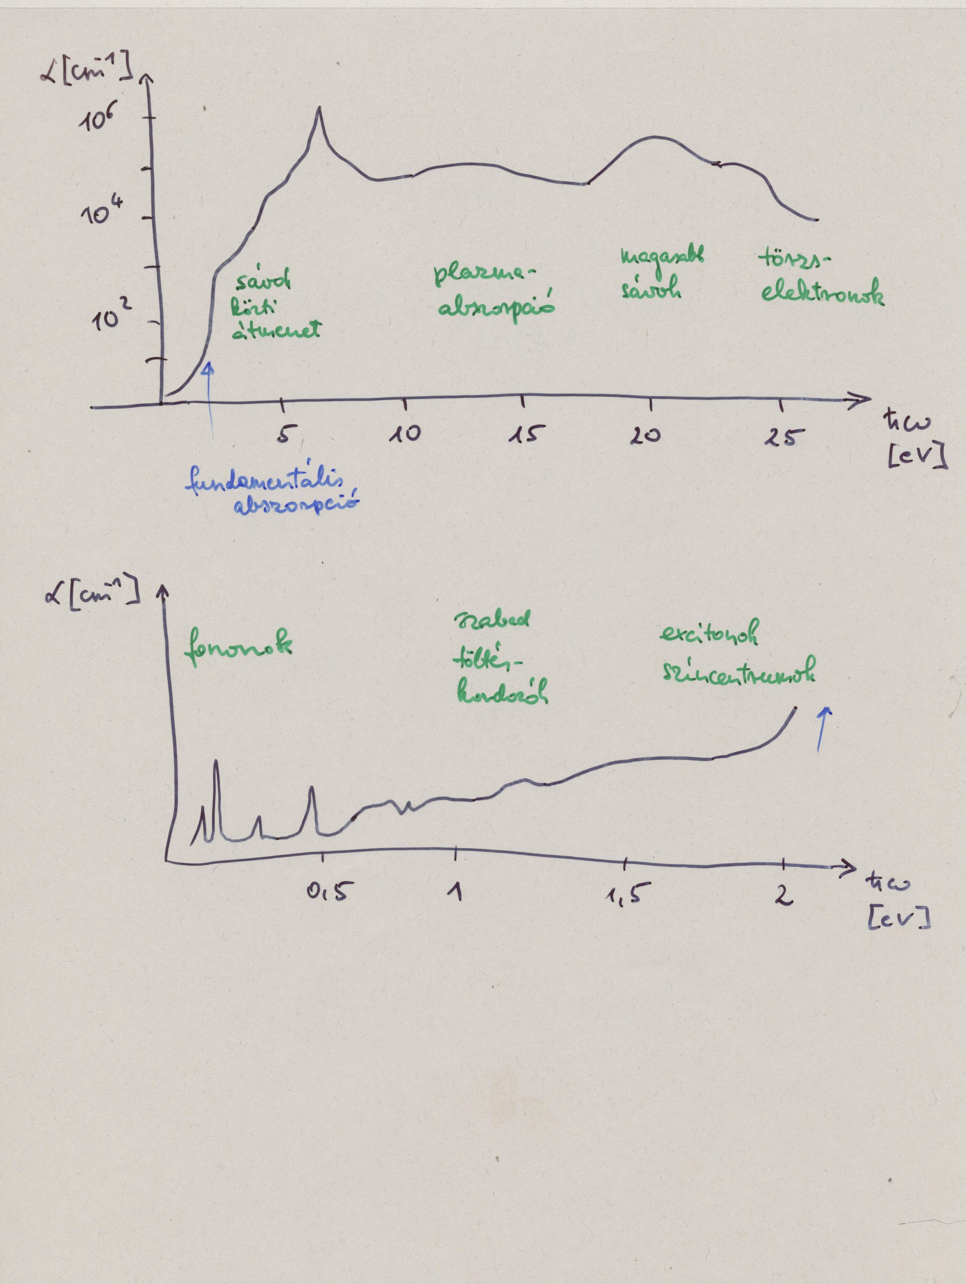

Slide 8
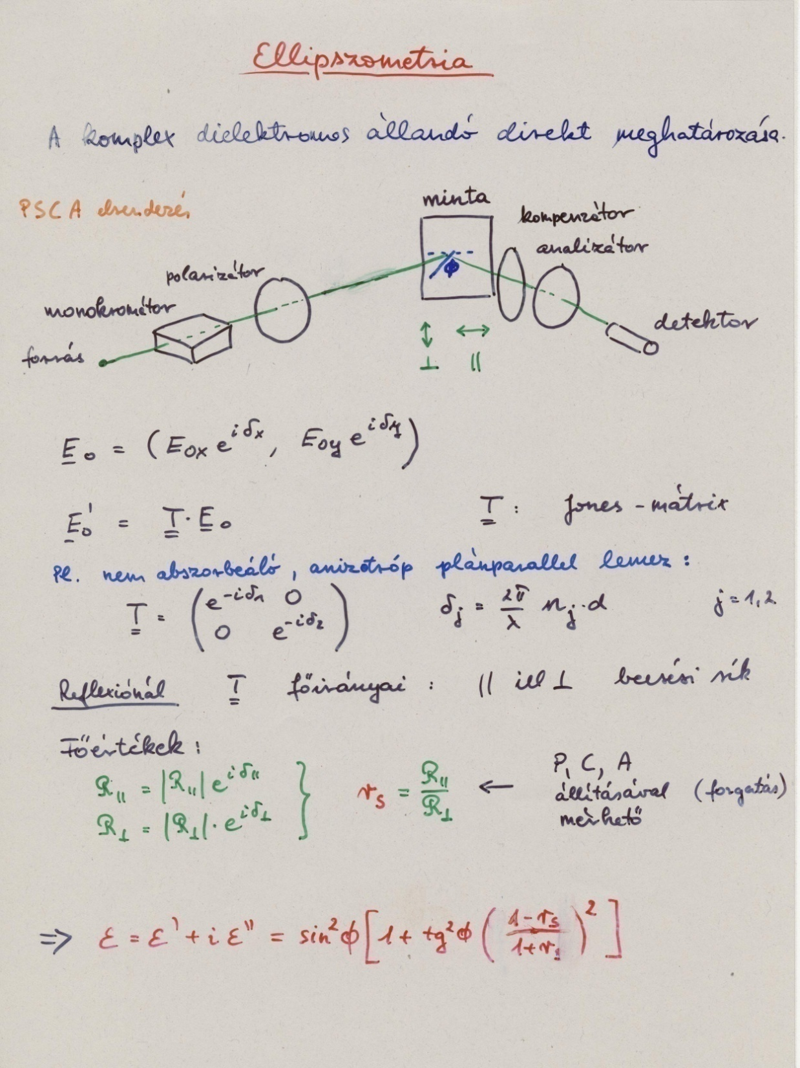

Slide 9
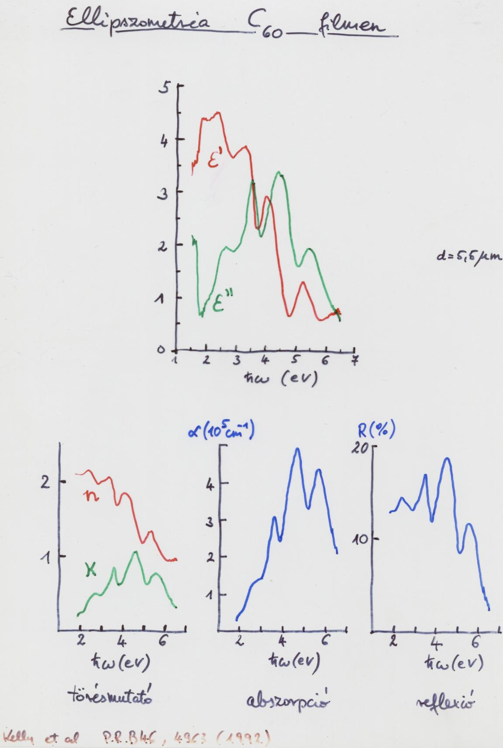

Slide 10
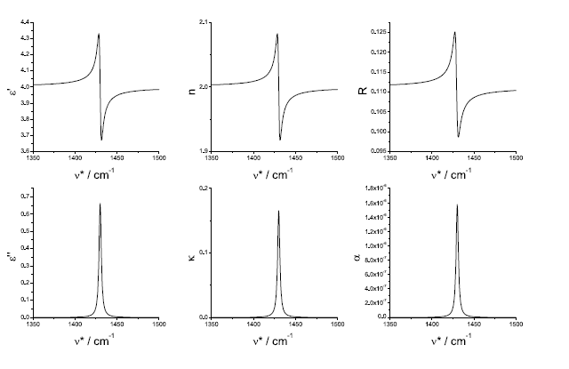
C₆₀

Slide 11
