Slide 1
CARBON NANOSTRUCTURES
(FULLERENES, CARBON NANOTUBES, GRAPHENE)
lecture for physics and chemistry students
(2019. summer semester – 29. April)
Prof. Jenő Kürti
ELTE Department of Biological Physics
e-mail: kurti@virag.elte.hu www: regivirag.elte.hu/kurti

Slide 2
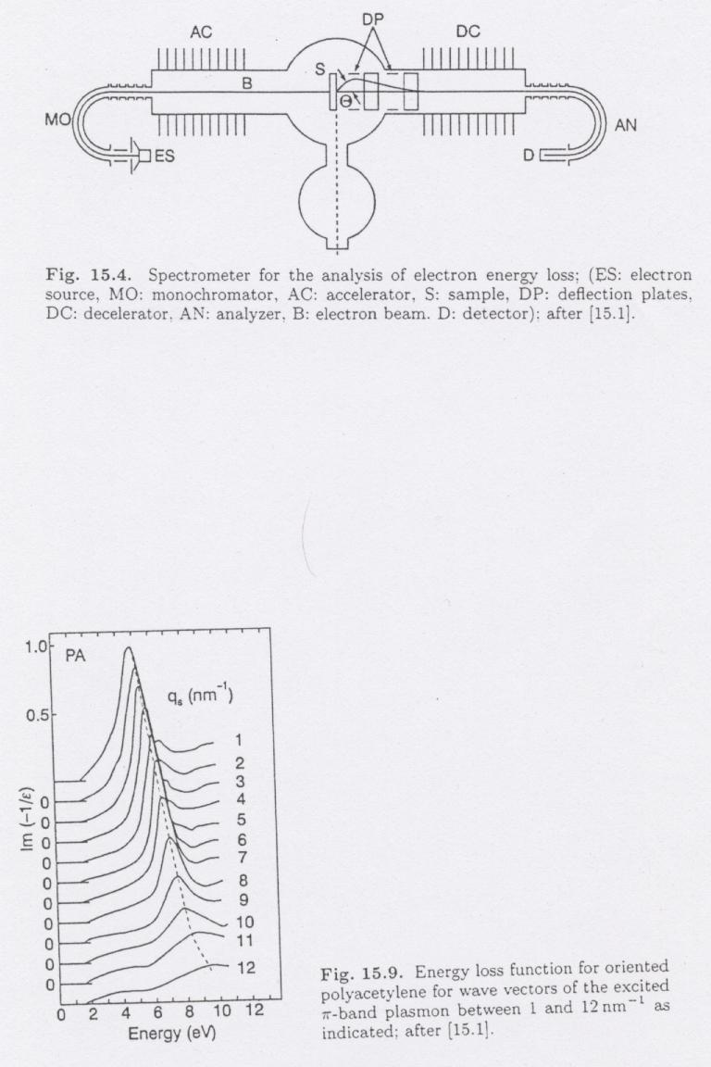
EELS
Im(-1/ε)

Slide 3
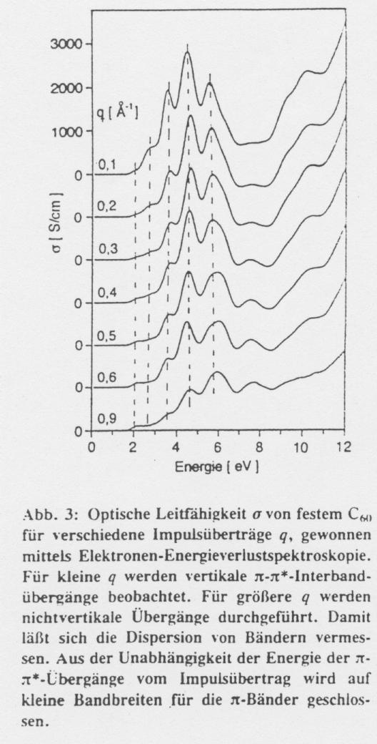
ω·Im(ε)
E_{primer} = 170 keV

Slide 4
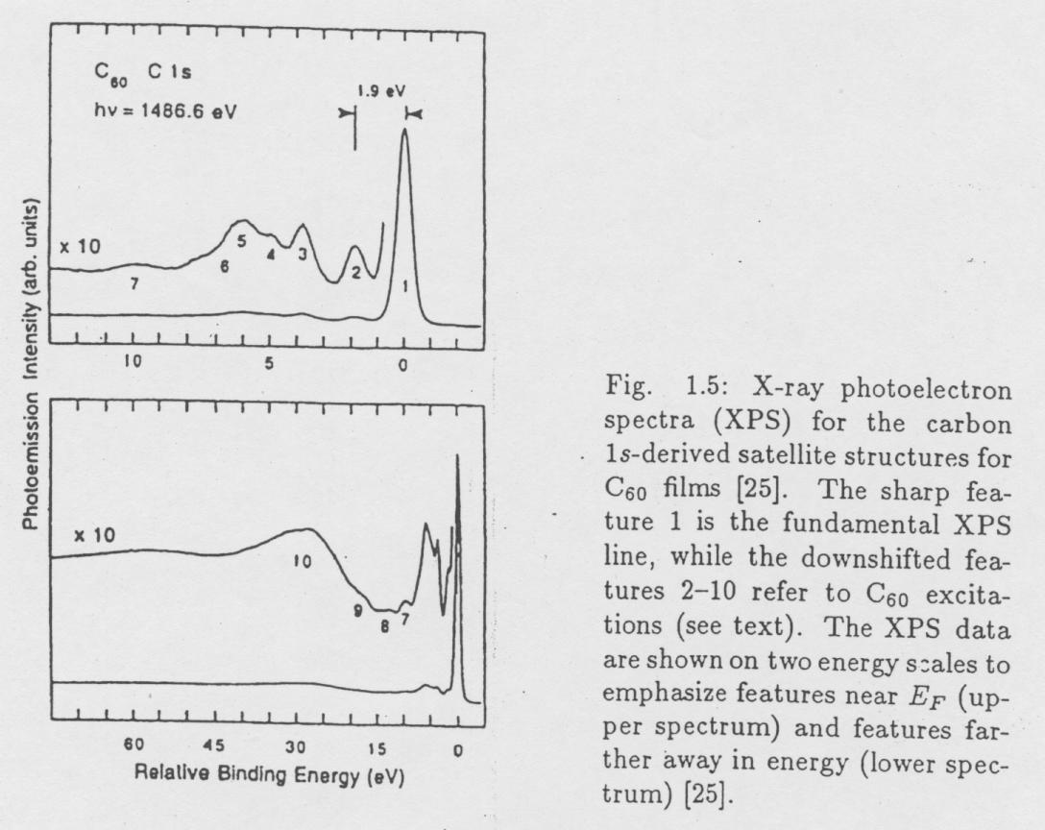
!
E_{b} = 285.0 eV

Slide 6
VIBRATIONS:
Raman- and infrared spectroscopy

Slide 7
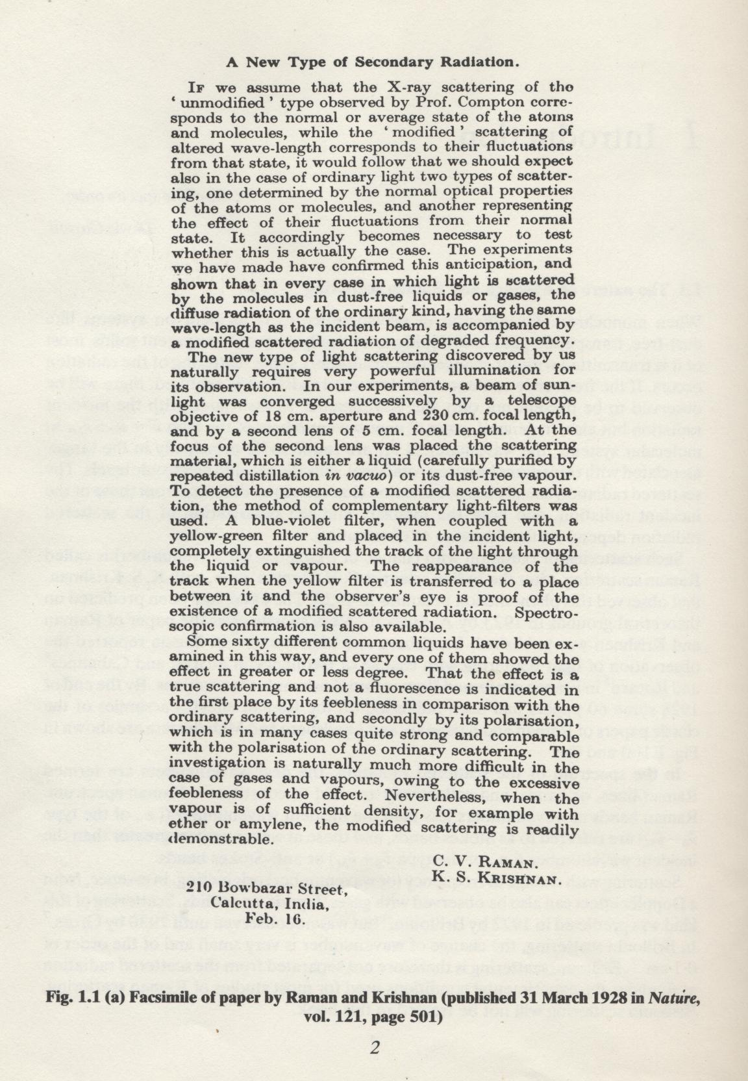
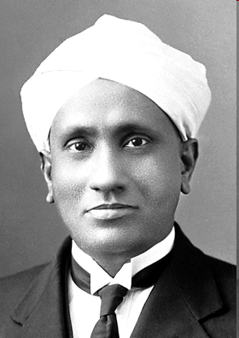
Sir Chandrasekhara Venkata Raman
(7 November 1888 – 21 November 1970)
The Nobel Prize in Physics 1930
"for his work on the scattering of light and for the discovery of the effect named after him".

Slide 8
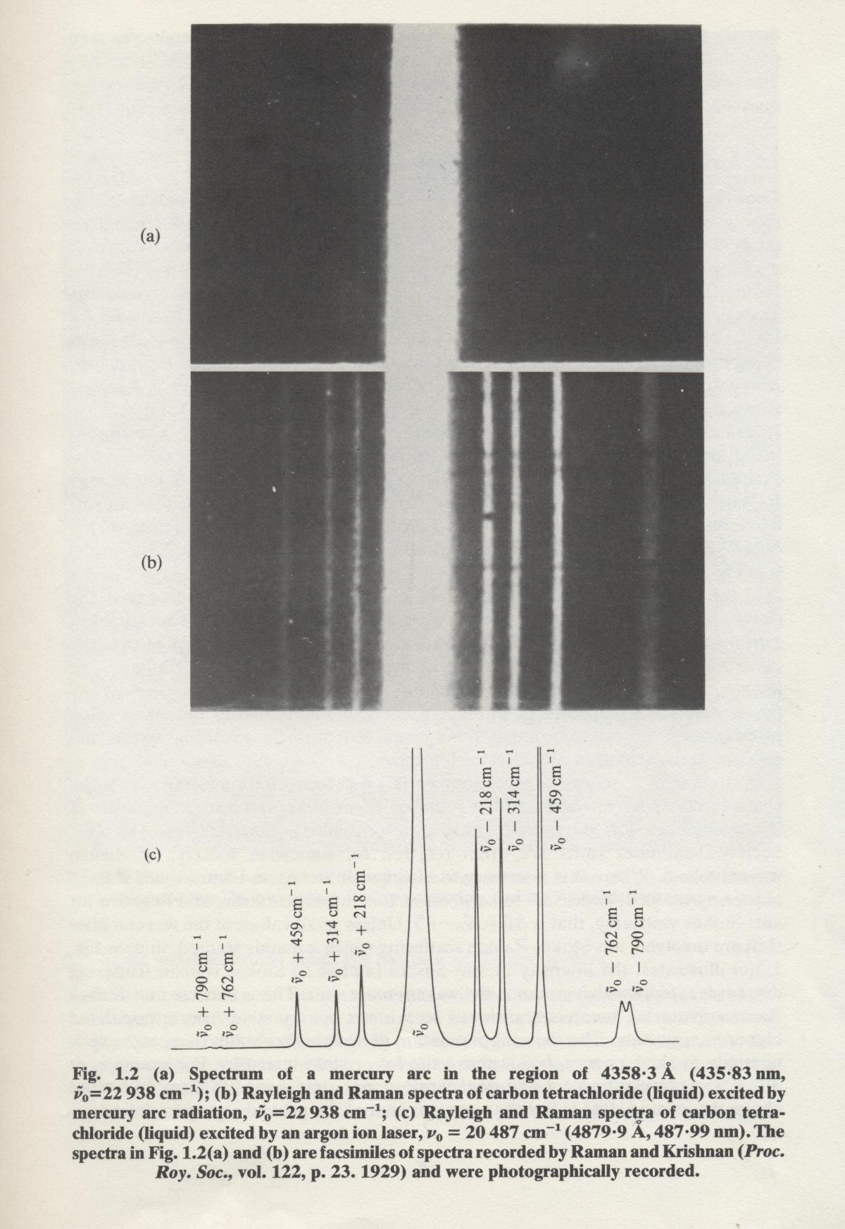
anti
-
Stokes
Stokes
D.A. Long: Raman spectroscopy
McGraw-Hill, 1977

Slide 9
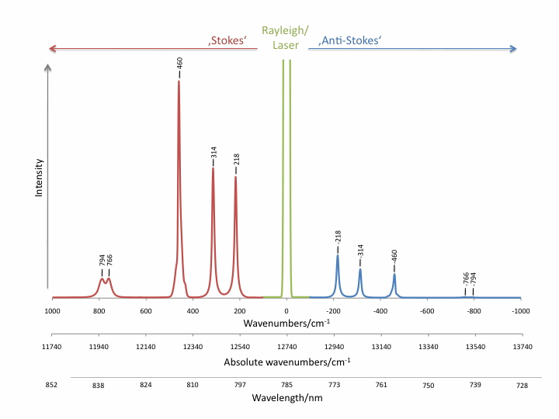
http://www.raman.de/htmlEN/basics/intensityEng.html

Slide 10
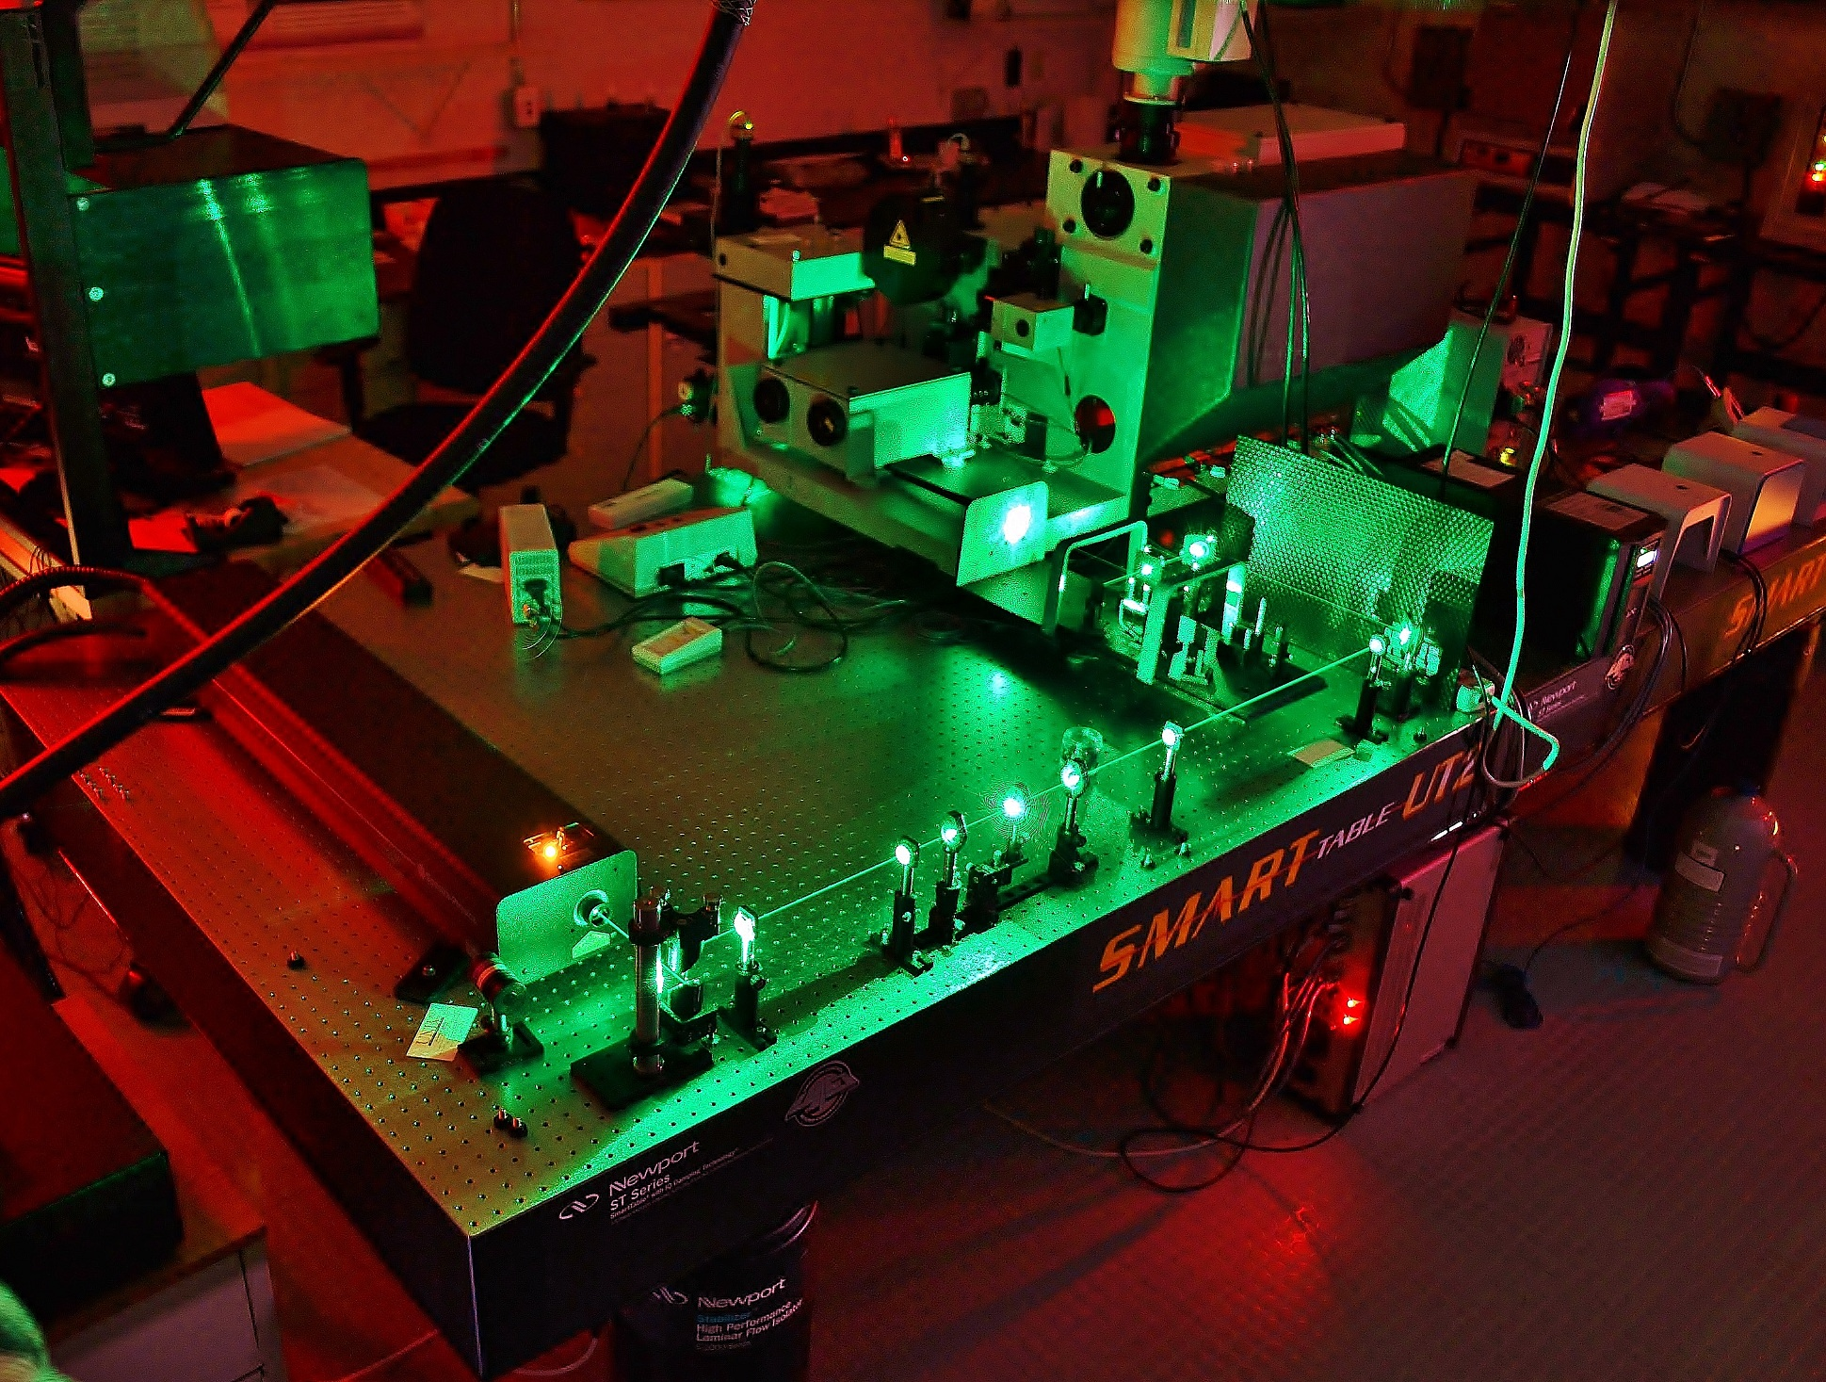
https://faculty.unlv.edu/klipinska/assets/Lab/RAMAN/

Slide 11
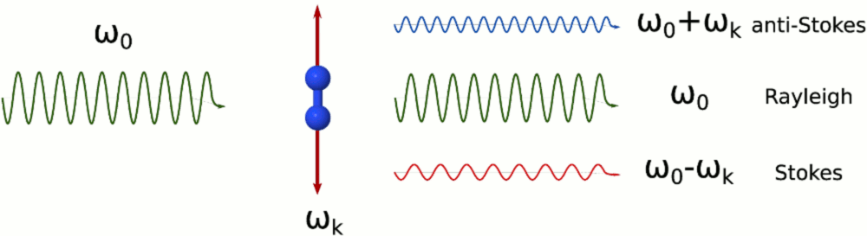
Inelastic light scattering: classical picture
induced
dipole
moment
k
0
0
0
k
0
k
polarizability
Rayleigh
anti-Stokes
Stokes
Raman

Slide 12
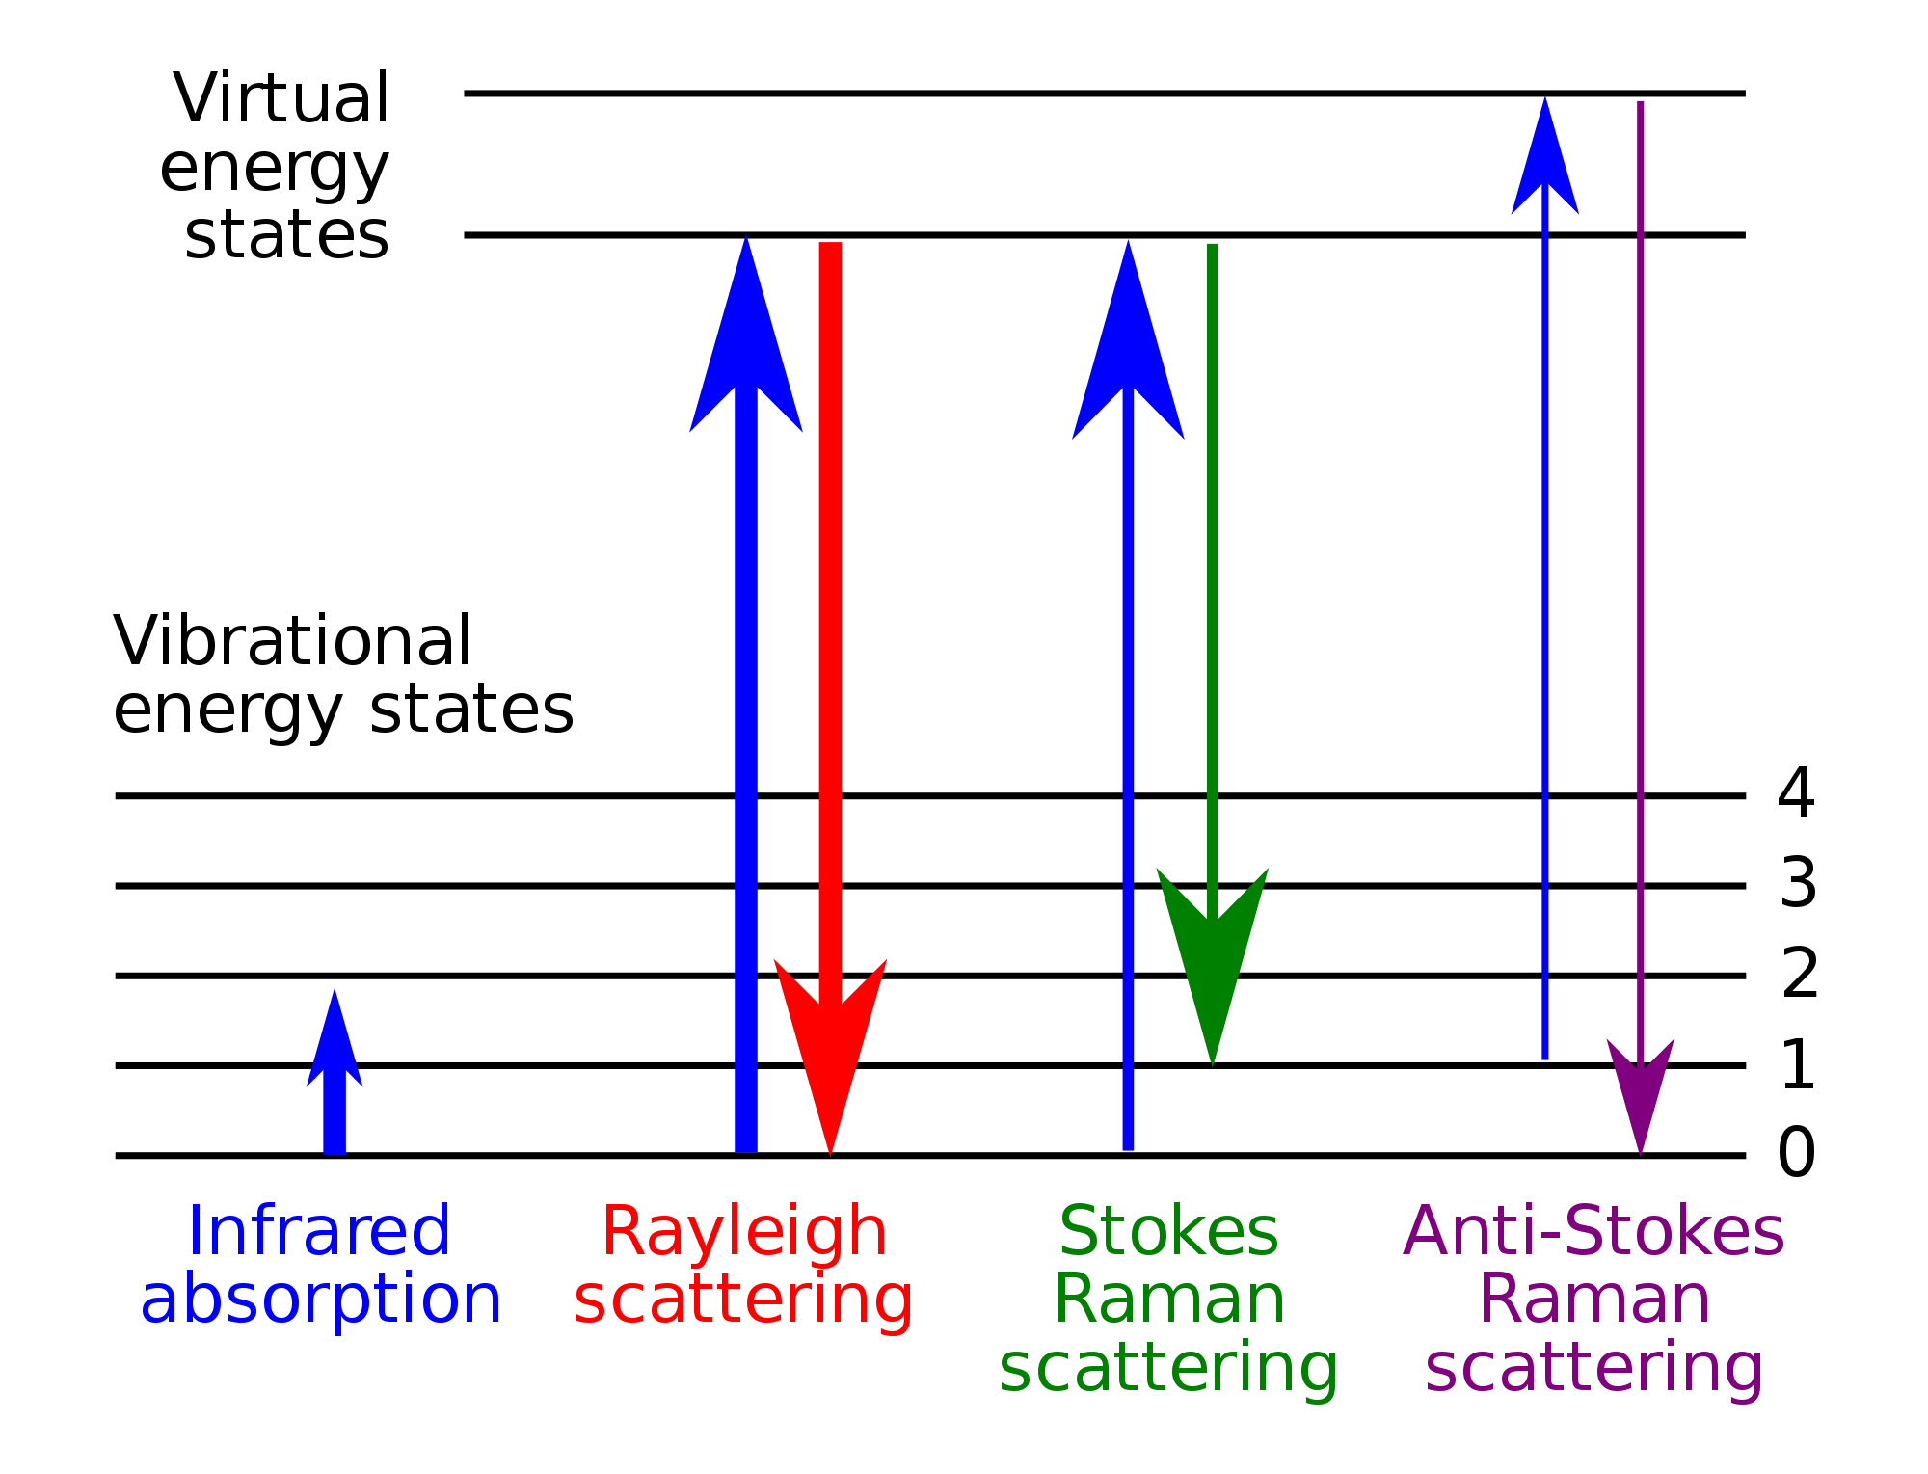
Inelastic light scattering: QM picture
ω₁
ω₂
ω₁
ω₂
ground state - -
ω (ħ=1)
ω₂ = ω₁ + ω
ω₂ = ω₁ – ω
wikipedia

Slide 13
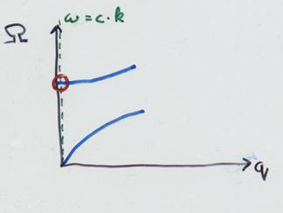
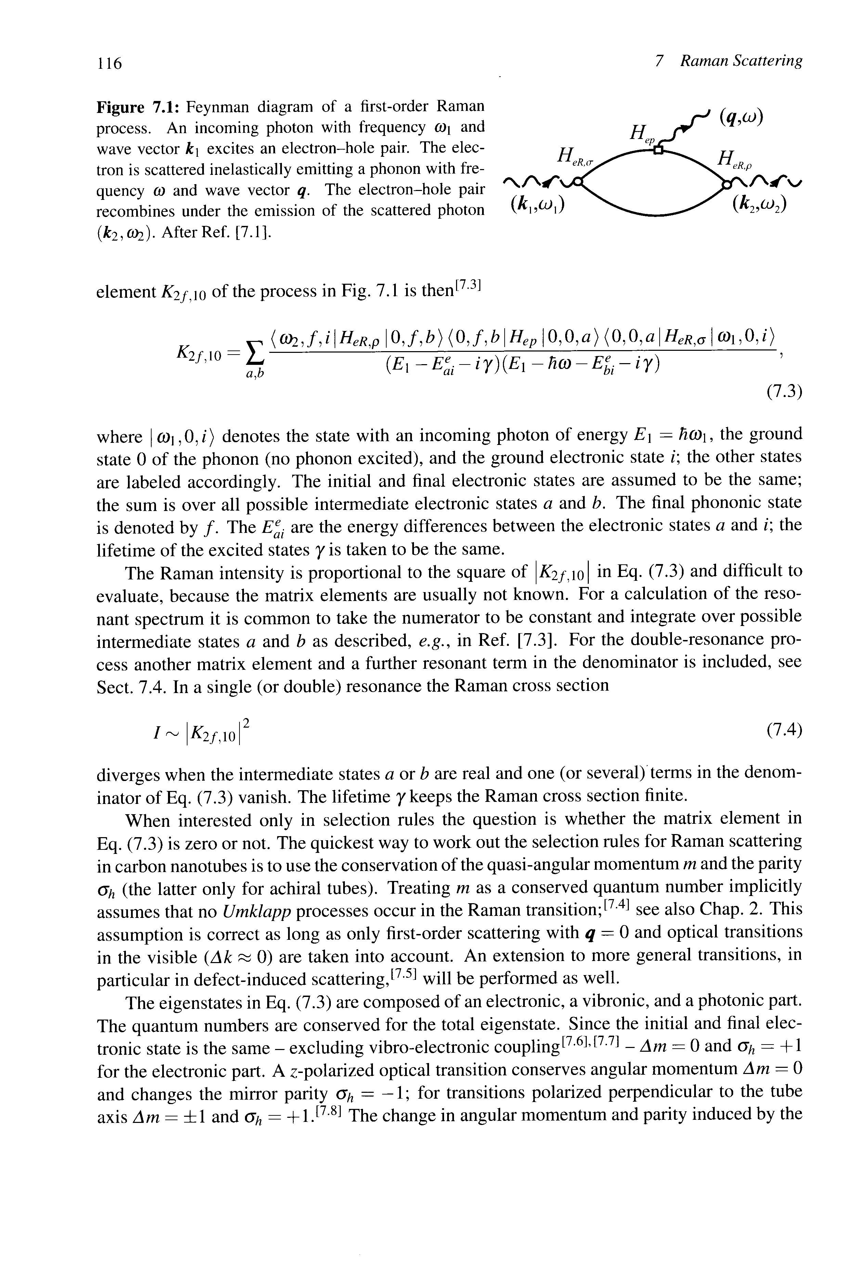
1st order Raman (Stokes)
phonon
q ≈ 0 (Γ–point)
ω₂ = ω₁ – ω
photon _{in}
photon _{out}
a
b
ω,
ω,
ω,
0
0

Slide 14
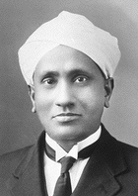
hν_{in}
hν_{out}
hν_{in}
hν_{out}
hν_{in}
hν_{out}
resonance Raman
(incoming)
C. V. Raman

