Slide 1
CARBON NANOSTRUCTURES (FULLERENES, CARBON NANOTUBES, GRAPHENE)
lecture for physics and chemistry students
(2019. summer semester – 06. May)
Prof. Jenő Kürti
ELTE Department of Biological Physics
e-mail: kurti@virag.elte.hu www: regivirag.elte.hu/kurti

Slide 2
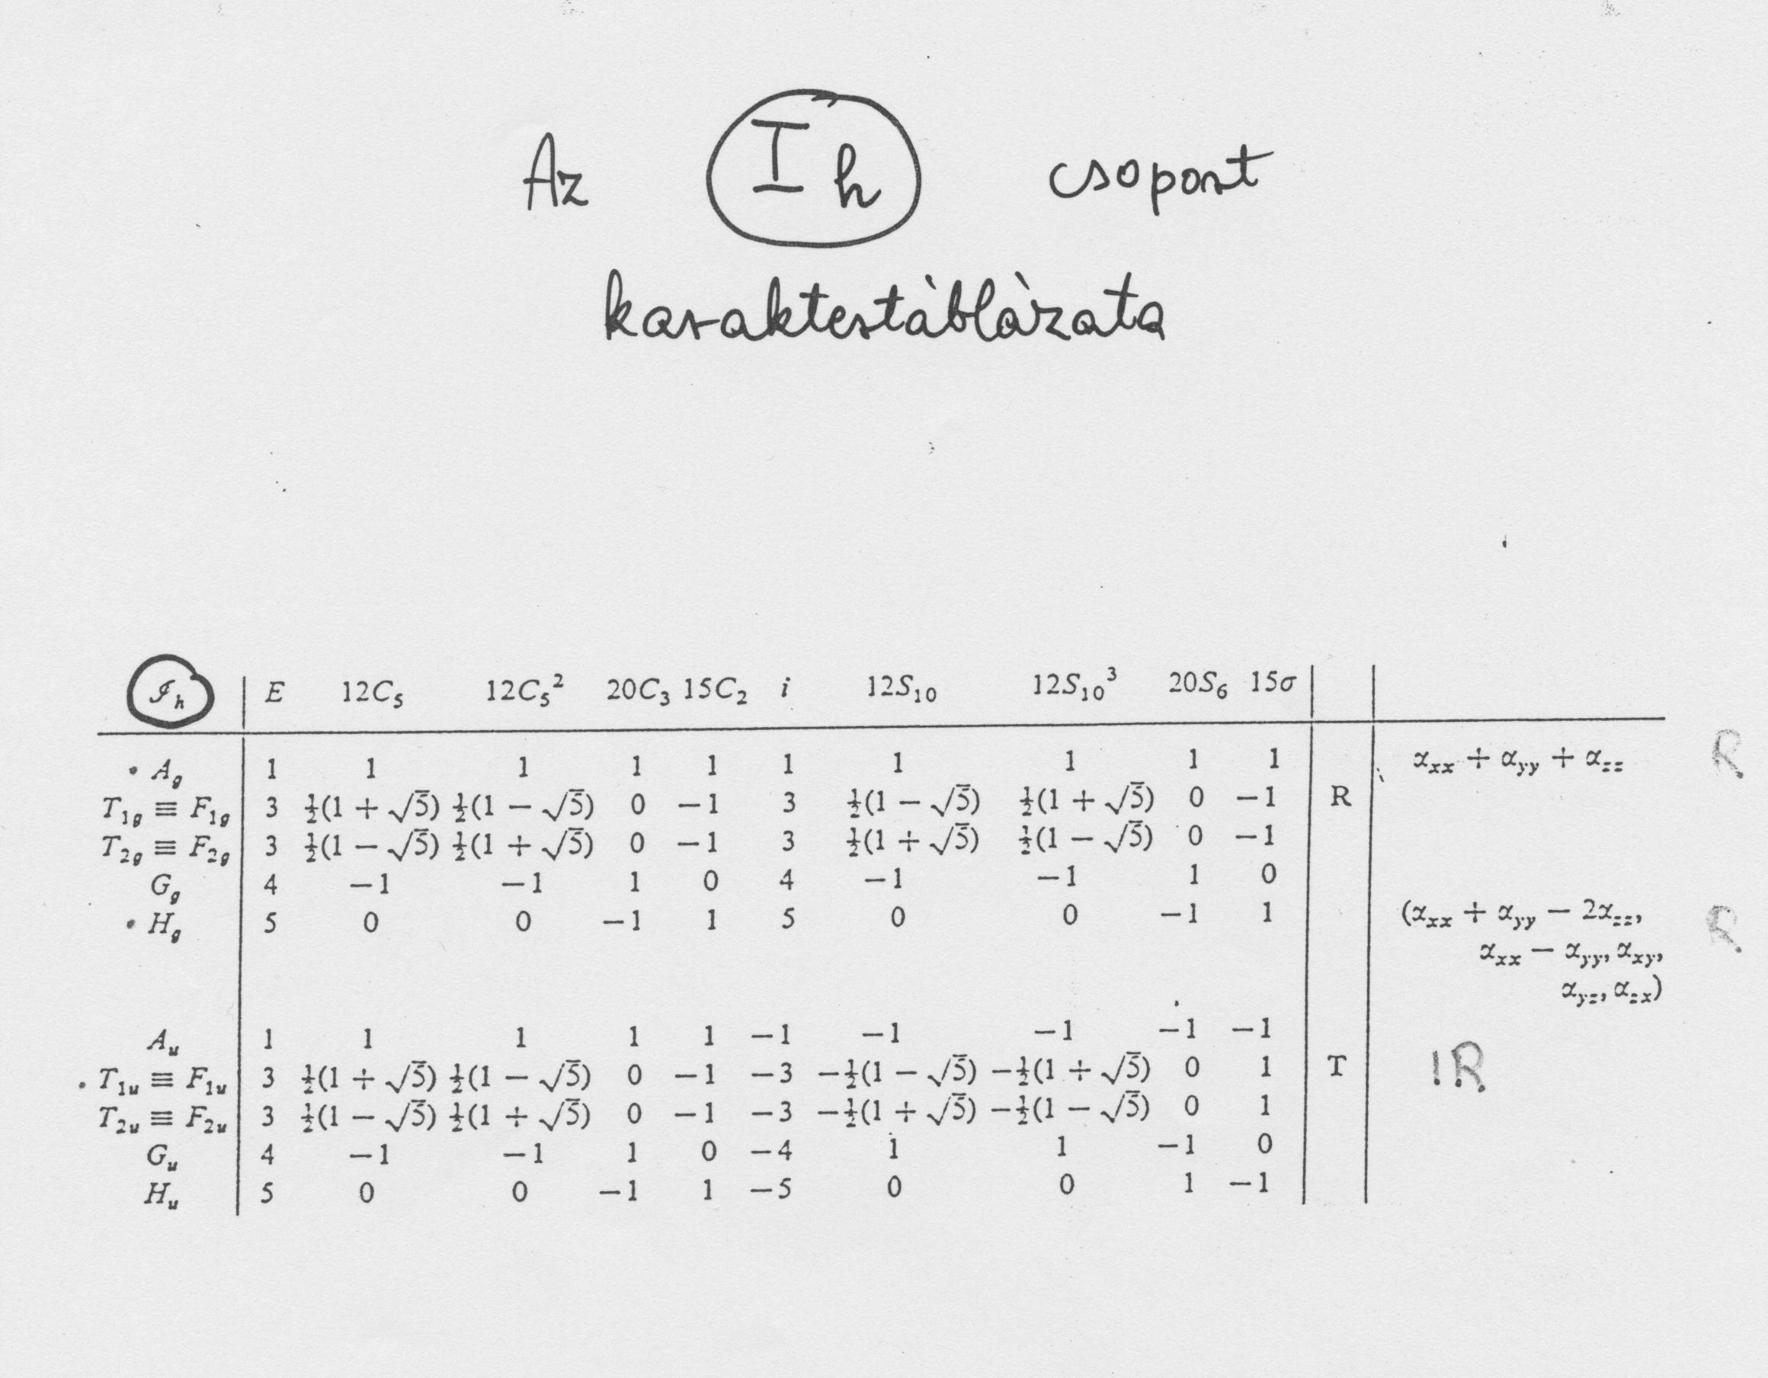
g = 120

Slide 3
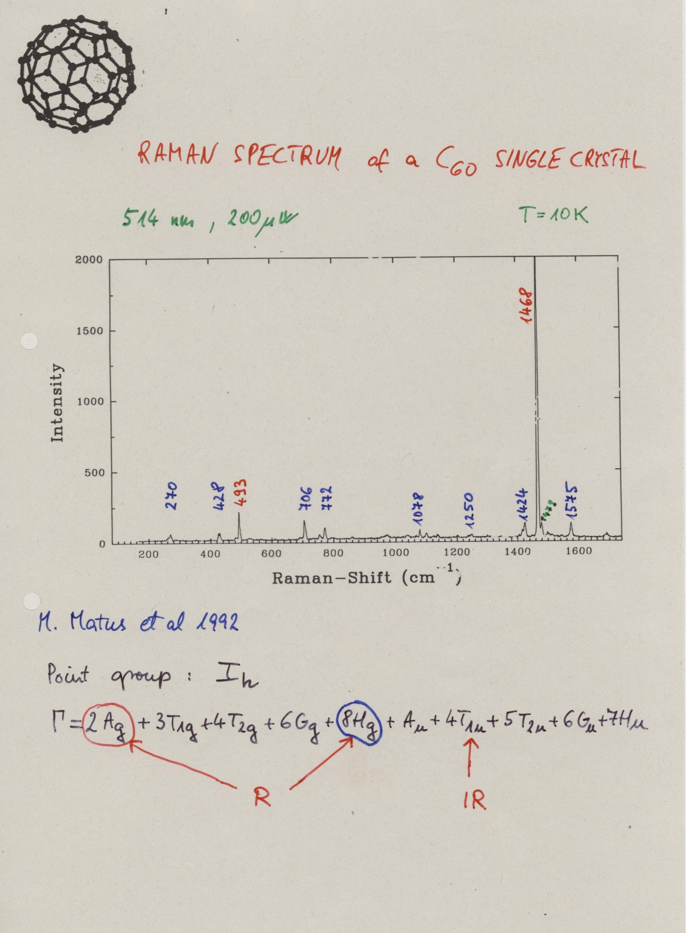

Slide 4
