Slide 1
CARBON NANOSTRUCTURES
(FULLERENES, CARBON NANOTUBES, GRAPHENE)
lecture for physics and chemistry students
(2020. summer semester – 17. February)
Prof. Jenő Kürti
ELTE Department of Biological Physics
e-mail: kurti@virag.elte.hu www: regivirag.elte.hu/kurti

Slide 2
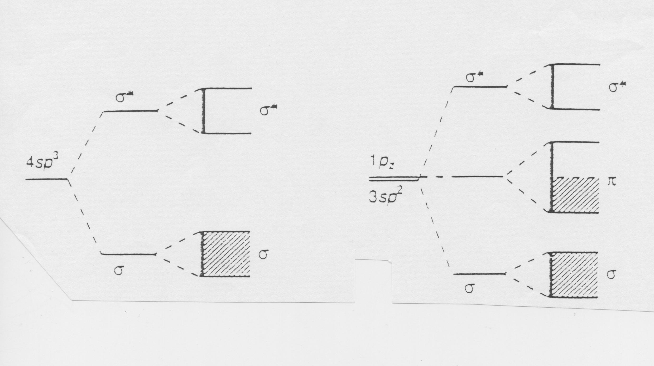
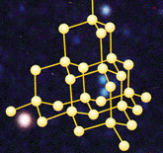
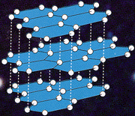
BAND STRUCTURE
-16 meV / carbon atom
≈5.4 eV
≈1.7 eV
diamond sp³ graphite sp²
d_{CC} ≅ 0,154 nm
d_{CC} ≅ 0,142 nm

Slide 3
E_{graphite} < E_{diamond}
E

Slide 4
E_{graphite} < E_{diamond} S_{graphite} > S_{diamond}
E – TS

Slide 5
E_{graphite} < E_{diamond} S_{graphite} > S_{diamond}
E – TS + pV
V_{graphite} > V_{diamond}

Slide 6
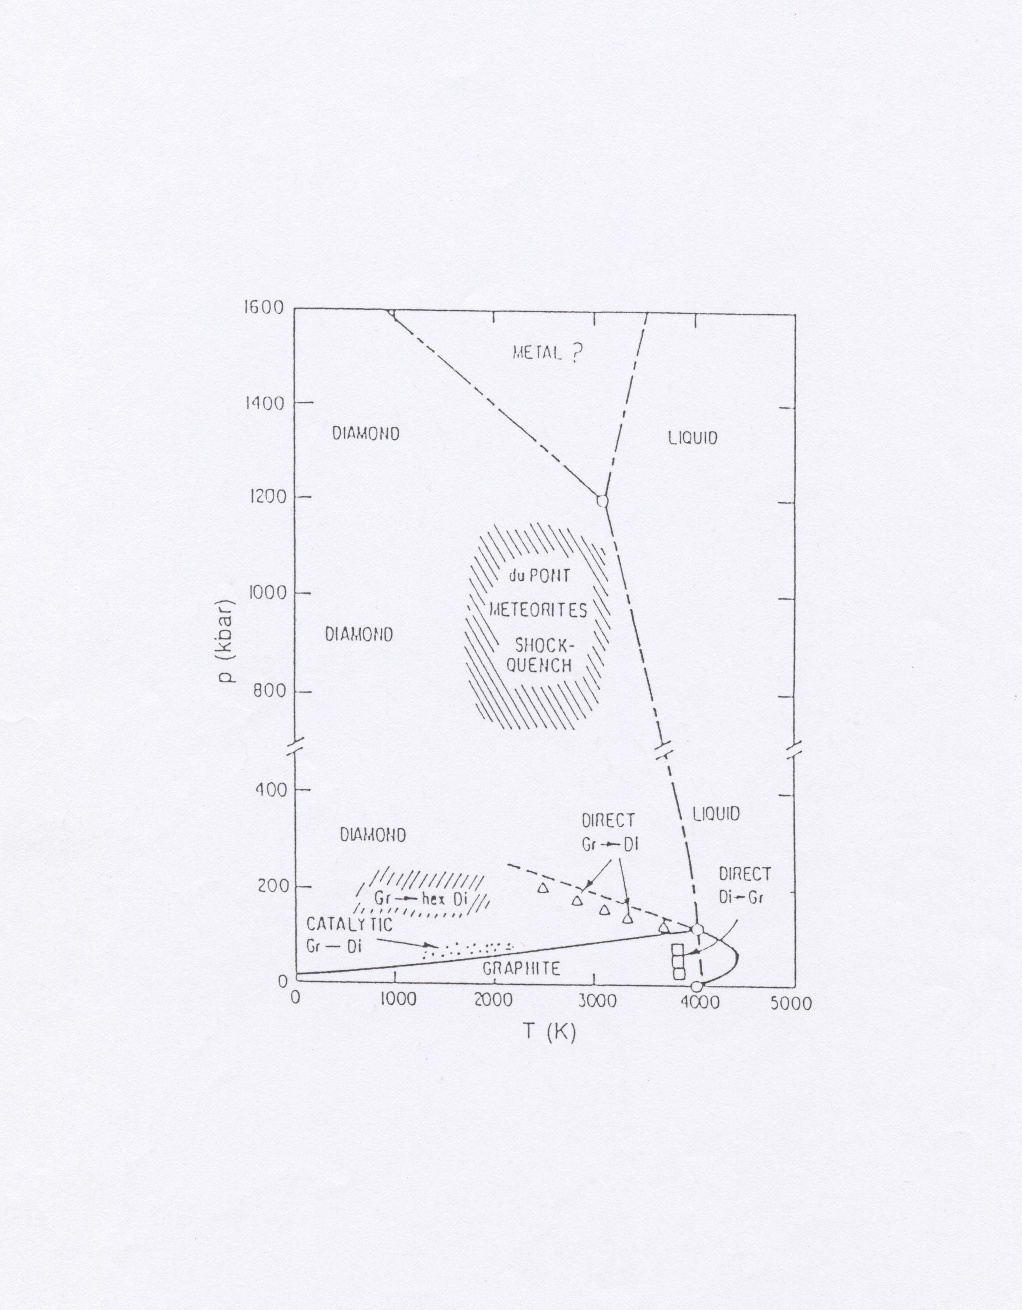

Slide 7
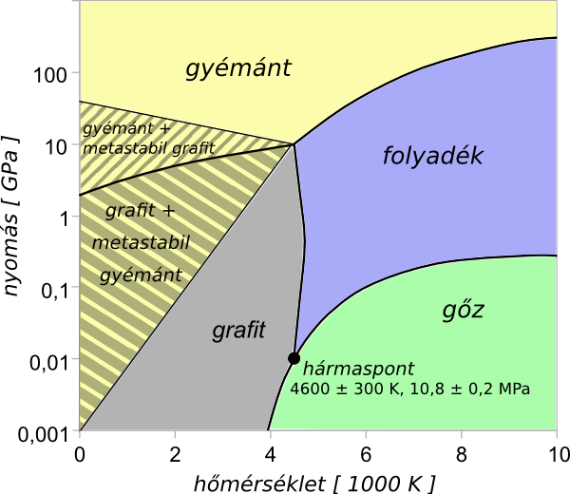

Slide 8
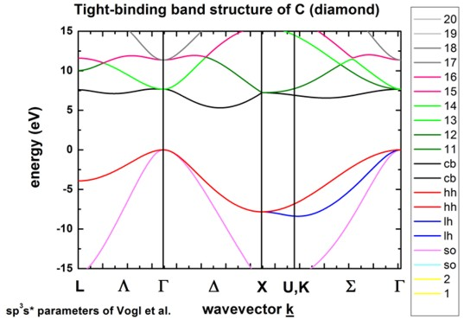
Downloaded from the internet

Slide 9
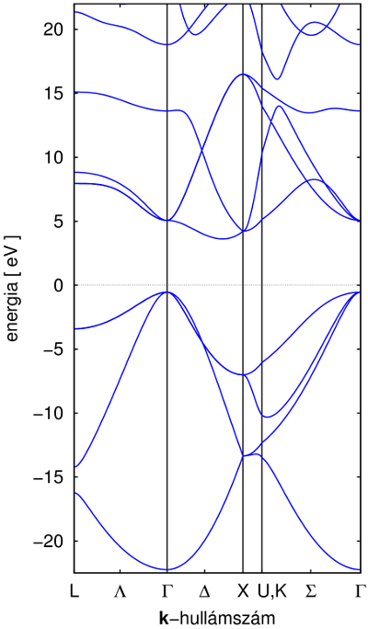
DFT band structure of diamond

Slide 10
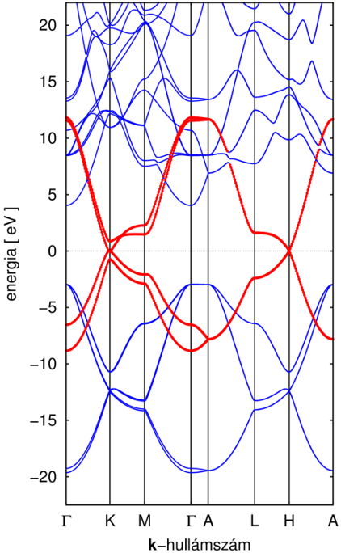
DFT band structure of graphite

Slide 11
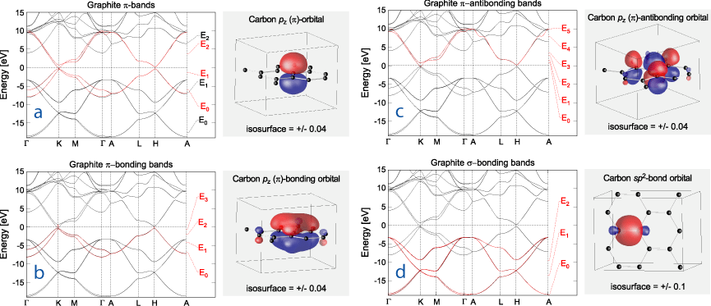
Downloaded from the internet

Slide 13
UNEXPECTED DISCOVERY in 1985
H.W.Kroto, J.R.Heath, S.C.O’Brien, R.F.Curl, R.E.Smalley,
„C₆₀: Buckminsterfullerene”, Nature 318, 162 (14 Nov. 1985)
NOBEL-PRIZE: in 1996

Slide 14
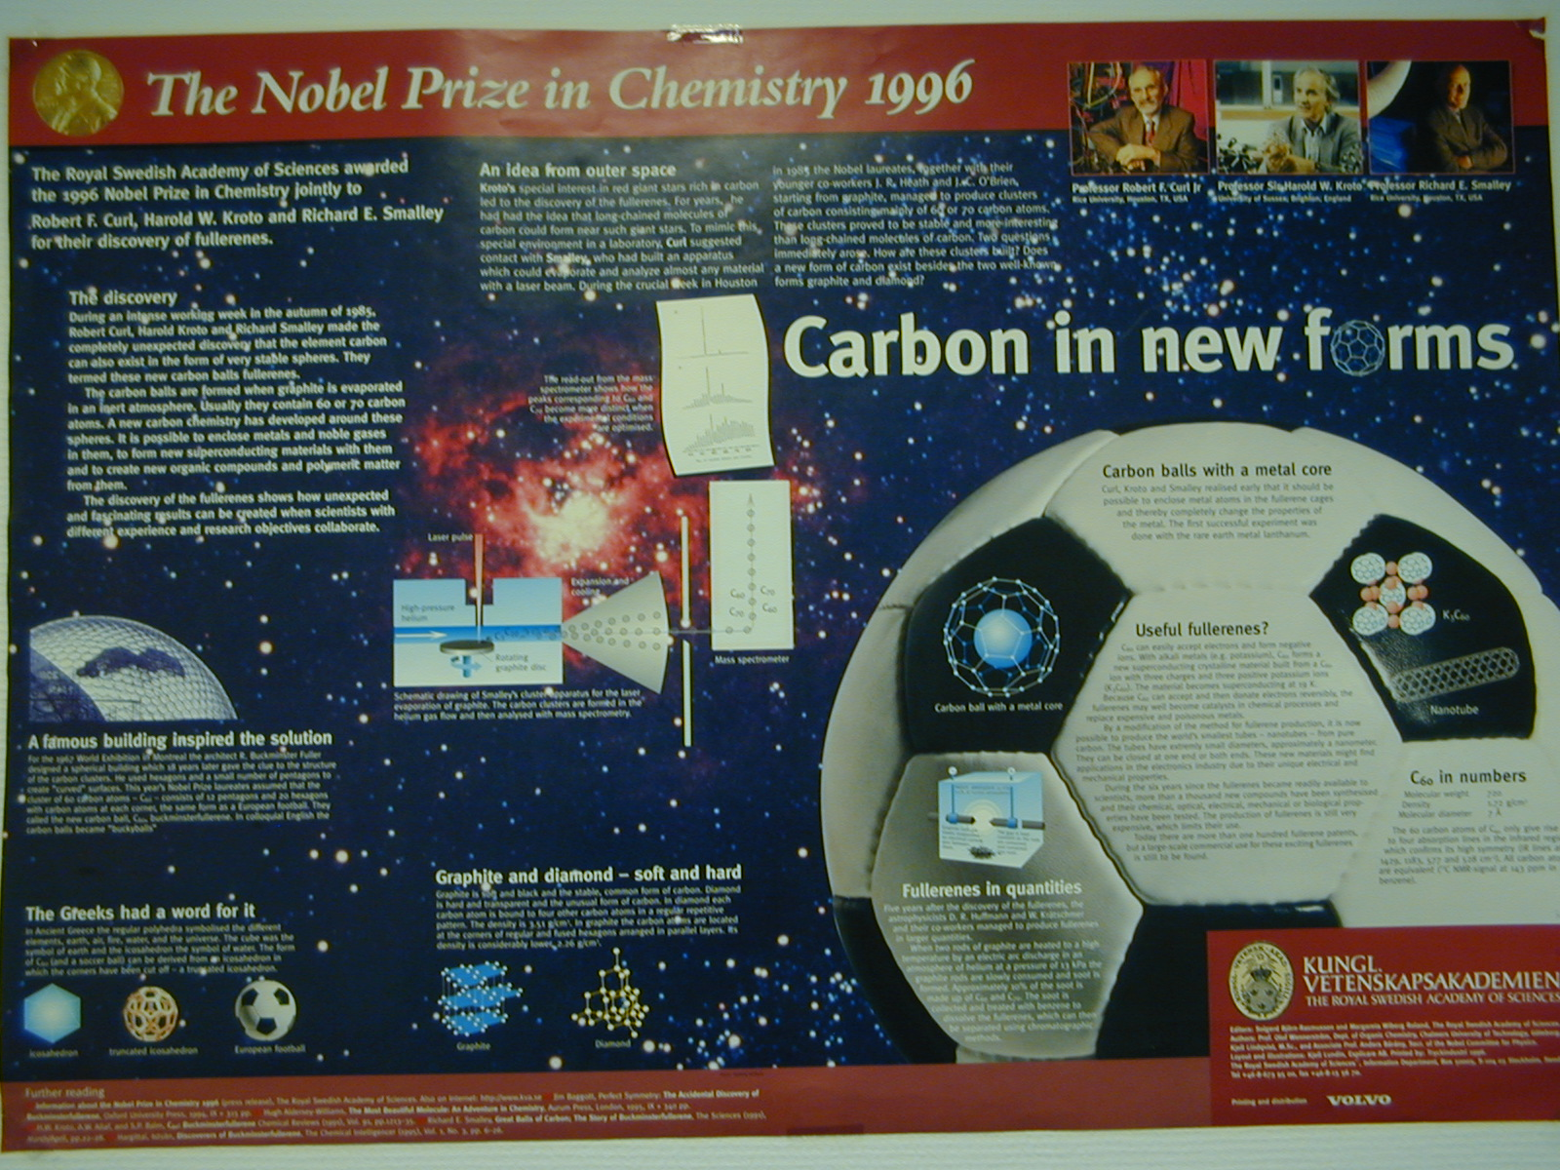
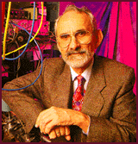
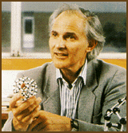
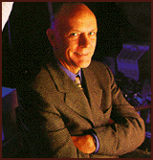

Slide 15
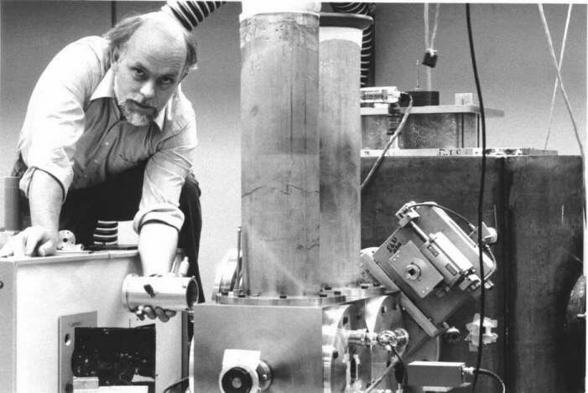

Slide 16
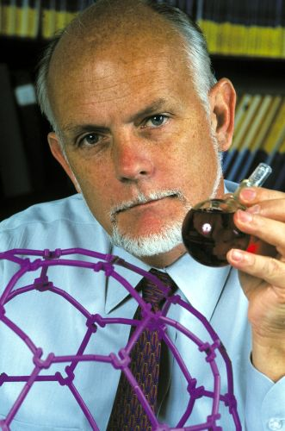
Richard E. Smalley (1943 – 2005)

Slide 17
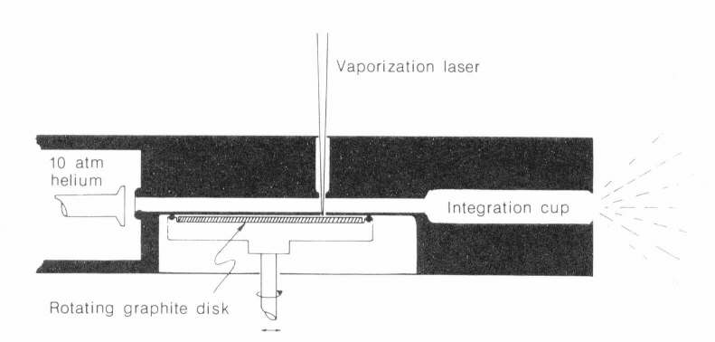

Slide 18
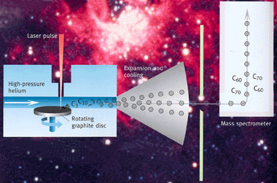

Slide 19
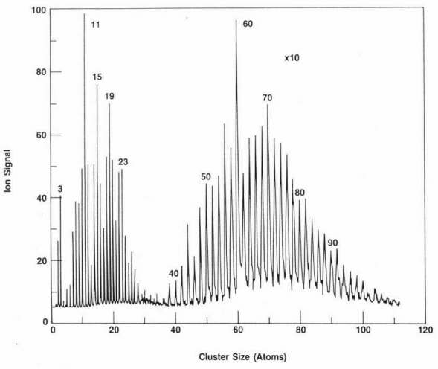
E.A.Rohlfing, D.M.Cox, A.Kaldor, J.Chem.Phys. 81, 3322 (1984)

Slide 20
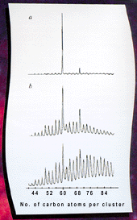
H.W.Kroto, J.R.Heath, S.C.O’Brien, R.F.Curl, R.E.Smalley,
„C₆₀: Buckminsterfullerene”, Nature 318, 162 (14 Nov. 1985)
E.A.Rohlfing, D.M.Cox, A.Kaldor, J.Chem.Phys. 81, 3322 (1984)

Slide 21
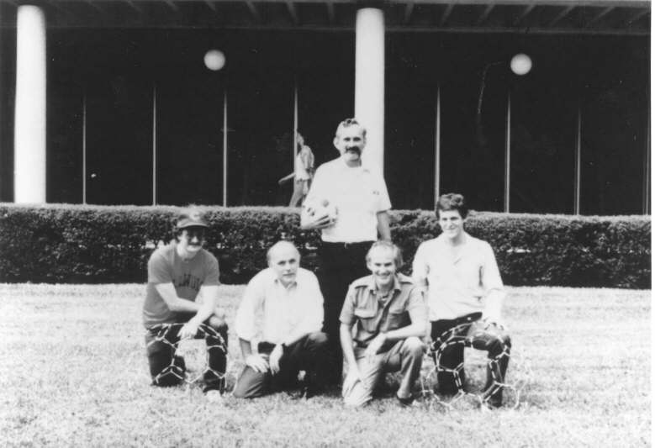

H.W.Kroto, J.R.Heath, S.C.O’Brien, R.F.Curl, R.E.Smalley,
„C₆₀: Buckminsterfullerene”, Nature 318, 162 (14 Nov. 1985)
Curl
O’Brien
Heath
Smalley Kroto

Slide 22

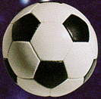

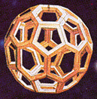
Icosahedron
Truncated Icosahedron

Slide 23
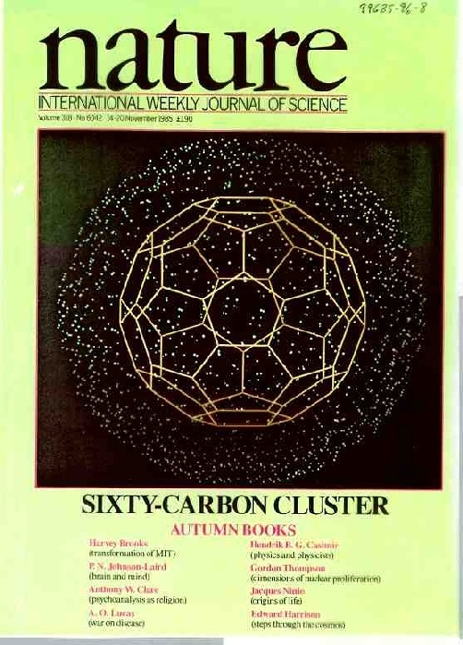

Slide 24
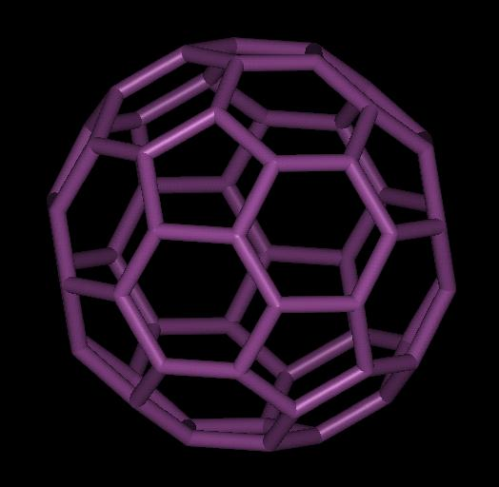
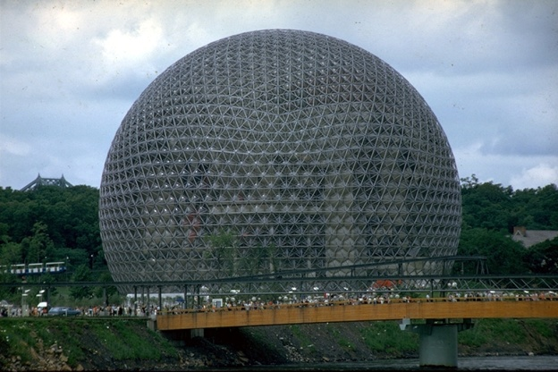
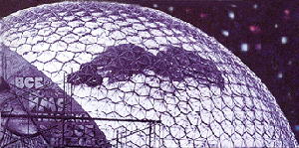
R. Buckminster Fuller
American architect (1895-1983)
e.g. „geodesic dome” Montreal world exposition 1967

Slide 25
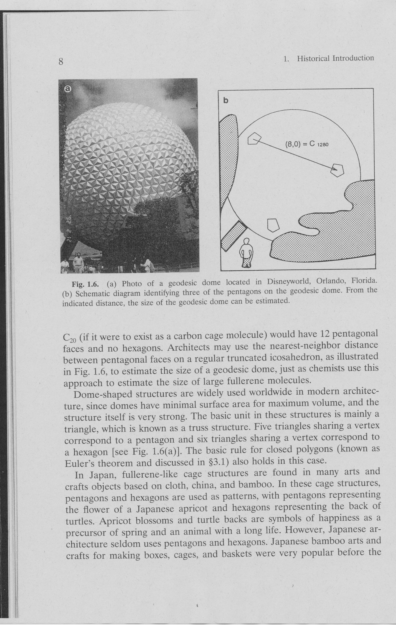

Slide 26
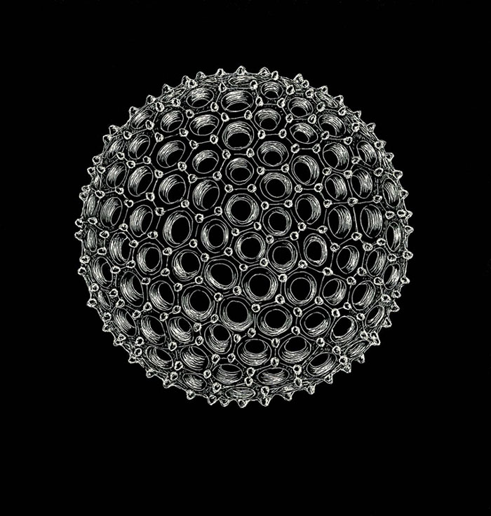
Si-containing skeleton of the radiolarian Aulonia hexagona

Slide 27
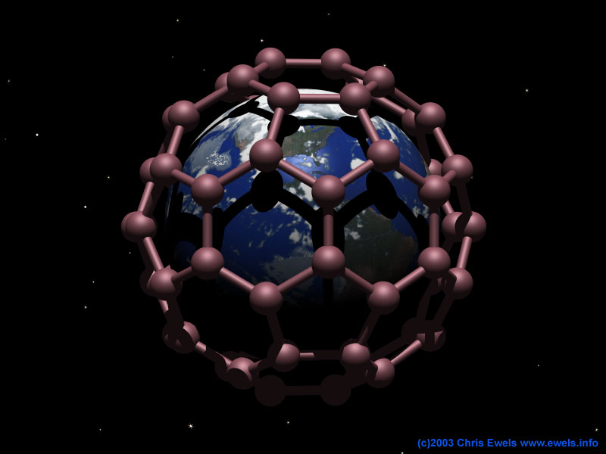
Notes:
http://www.nanotech-now.com/Art_Gallery/chris-ewels.htm
Dreams of Buckminster Fuller
"Buckminster Fuller, famous for his geodesic dome structures, once designed a dome large enough to cover mid-town Manhattan. Now his structures are reappearing in the chemistry of the nanoscale. So why not extrapolate a little?!"

Slide 28
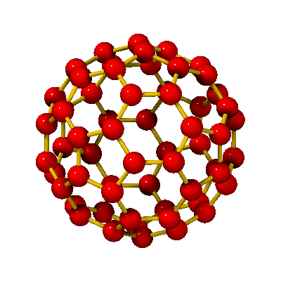
C₆₀
buckminsterfullerene
buckyball
(ballene
spherene
soccerene
carbosoccer ...)
d ≈ 0,7 nm

Slide 29
PRELUDE
PREHISTORY
…
ANTIQUE
– Babylon: „60”
– Greek:
Platon – 5 regular solids, including icosahedron
Archimedes – 13 archimedean solids, among which truncated icosahedron
Archimedes (287(?) - 212 B.C.)
Archimedes is believed to have conceived the thirteen "Archimedean solids", among which the truncated icosahedron is found.

Slide 30
MIDDLE AGES
– 1480, Piero della Francesca – first known art of a truncated icosahedron
– 1498 or 1509, drawing from Leonardo da Vinci of a truncated icosahedron in Luca Paciolis book
– ≈1500, art from Albrecht Dürer of an outstreched truncated icosahedron
– XVI. c., truncated icosahedron in renaissance paintings
– China, Ming dynasty (1368-1644), lions sculpt, with his paw on a truncated icosahedron
– Topkapi Sarayi, part of a truncated icosahedron above a gate
– Japán „kagome” (triangle-hexagon) structures with pentagon (heptagon) substitution
(fairy-lamp)

Slide 31
MIDDLE AGES
– 1480, Piero della Francesca – az első ismert rajz a csonkolt ikozaéderről
– 1498 vagy 1509, Leonardo da Vinci rajza csonkolt ikozaéderről Luca Pacioli könyvében
– ≈1500, Albrecht Dürer rajza egy kiterített csonkolt ikozaéderről
– XVI. sz., reneszánsz festményeken csonkolt ikozaéder
– Kína, Ming dinasztia (1368-1644), oroszlánszobor, mancsával csonkolt ikozaéderen
– Topkapi Sarayi, csonkolt ikozaéder részlet egy kapu fölött
– Japán „kagome” (háromszög-hatszög) szerkezetek ötszög (hétszög) helyettesítéssel
(lampion)

Slide 32
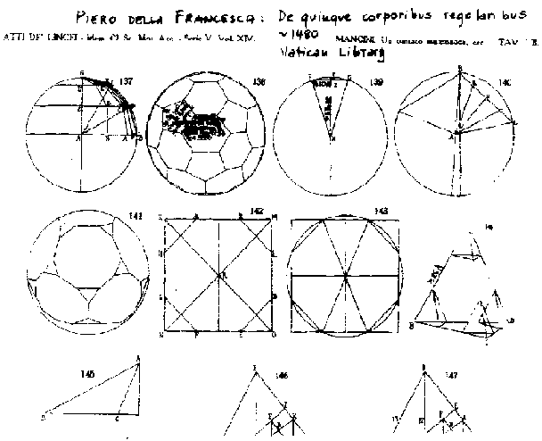
Piero della Francesca (1420-1492)
This is oldest known picture of a truncated icosahedron (the shape of C60. It is from the book Libellus de quinque corpibus regularibus ("On the Five Regular Bodies"), by the Italian renaissance painter and mathematician Piero della Francesca.

Slide 33
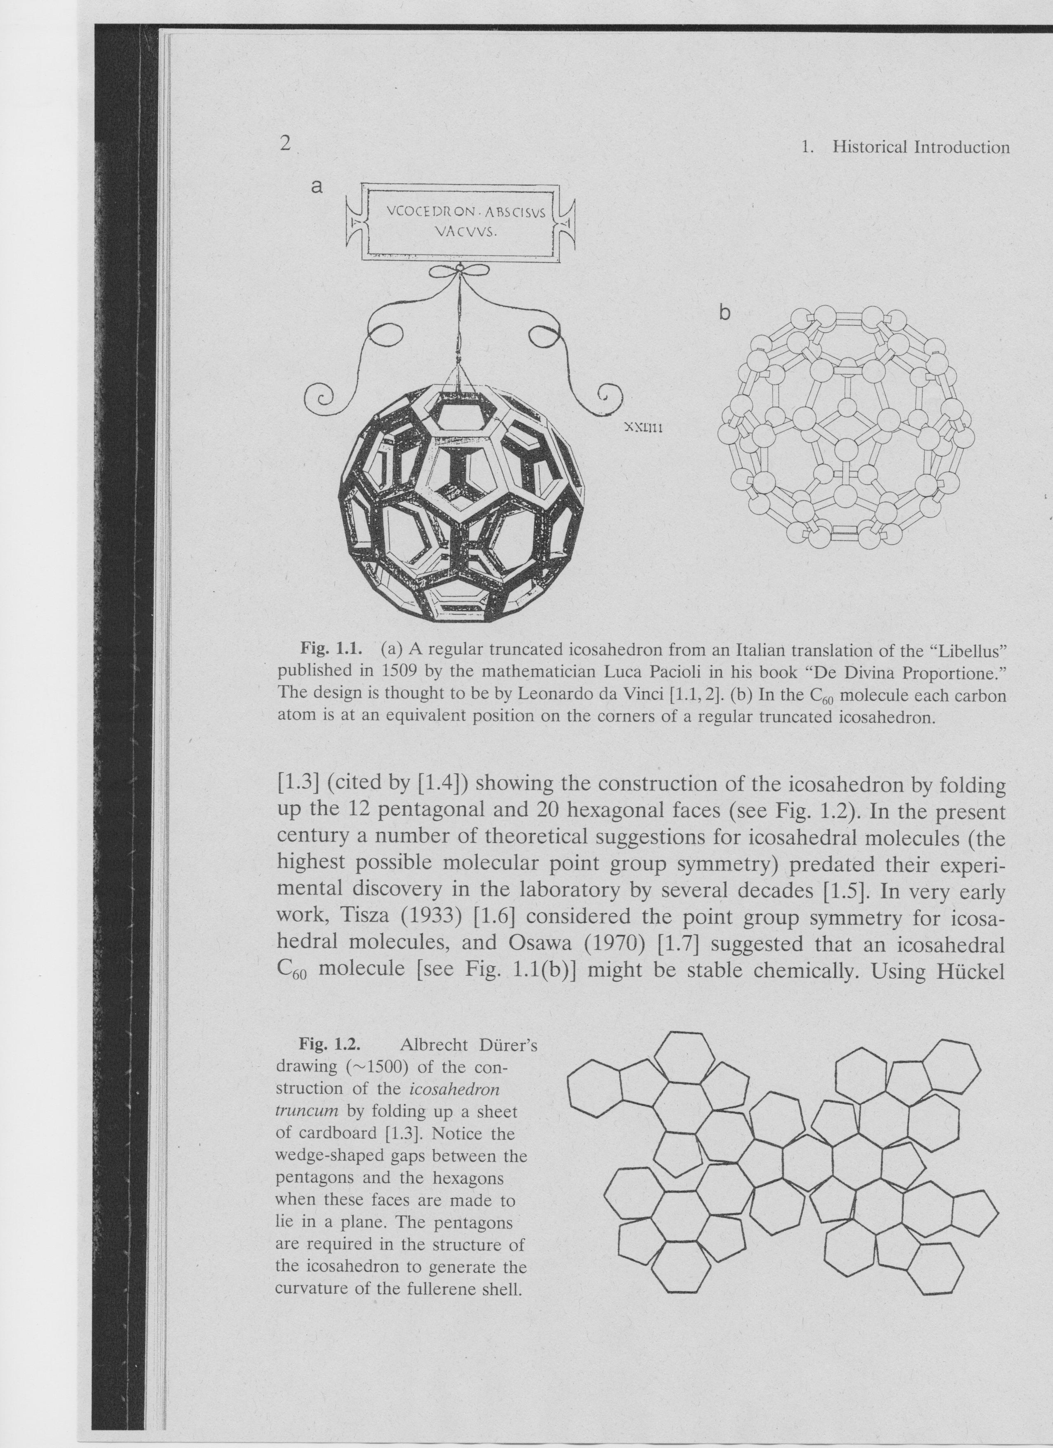

Slide 34
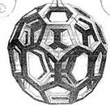
Leonardo da Vinci (1452-1519)
This rendition of the truncated icosahedron is from the book De Divina Proportione
("On Divine Proportion") by Fra' Luca Pacioli, published around 1498.
The drawing is ascribed to Leonardo da Vinci.
He seems to have invented this type of "skeleton model",
which lets us view both the outside and the inside of the polyhedron.
Johannes Kepler (1571-1630)
The concept of truncating a polyhedron was introduced by Johannes Kepler. Polyhedra were actually quite central to his research. In his work Prodromus Dissertationum Mathematicarum Continens Mysterium Cosmographicum ("The Cosmographic Mystery") he argued that the distances of the planets from the sun were determined by the Platonic solids.

Slide 36
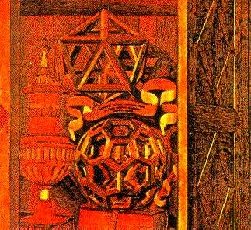
Fine Arts
An example of the appearance of the truncated icosahedron in art is shown in this picture from an Italian cathedral. At the top we see an icosahedron. It is bounded by twenty equilateral triangles. At each of the 12 vertices of the icosahedron, five of the triangles meet. Cutting off ('truncating') these vertices thus replaces each of them by a pentagonal face; it also converts each of the twenty former triangular faces into a hexagon. We can see the resulting truncated icosahedron at the bottom of the picture. This is the shape of the C60 molecule.

Slide 37
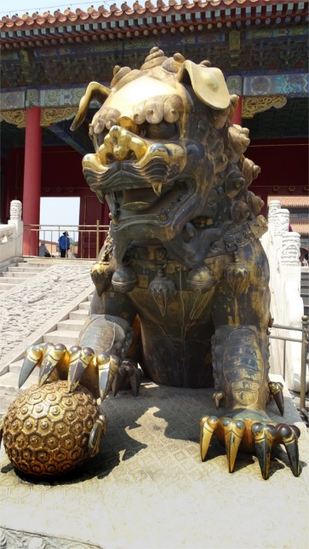

Slide 38
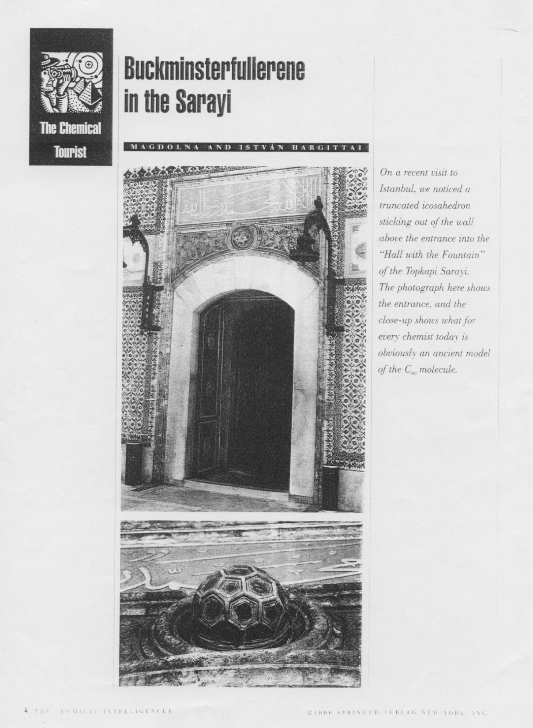

Slide 39
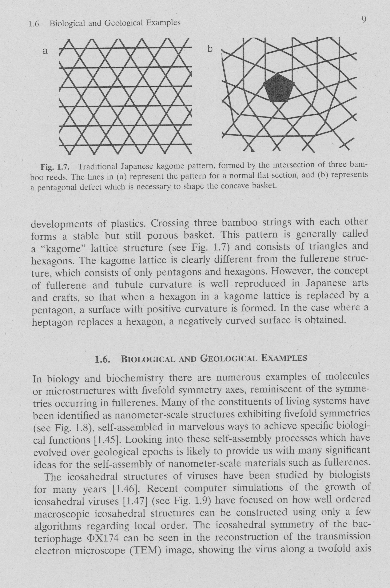

Slide 40
XX. century
– 1933, László Tisza icosahedral point group
– 1942, D.W. Thompson: carbon cage of 12 pentagons + any number of hexagons
– 1965, Schultz, from geometrical considerations: C₆₀H₆₀ – truncated icosahedron
– 1966, David Jones („Daedalus”), in New Scientist: football shaped carbon molecule from hexagons (intermediate density)
– Buckminster Fuller (1895-1983), geodesic buildings
– 1970, Eiji Osawa, Kagaku-ban (Yoshida): possibility of 3D aromatic structures → C₆₀
(– 1971, W.E. Barth és R.O. Lawton, synthesis of corannulene)
– 1973, D.A. Boc’var and G.E. Gal’pern, generalizatoin of ferrocene structure → C₂₀ (suggestion of Stankevic’: C₆₀)
– 1980, S. Iijima, with electron microscope: spherical carbon particles from carbon evaporated in vacuum
– 1981, R.A. Davidson, Hückel calculations on carbon clusters, also on C₆₀
– 1983, L.A. Paquette, C₂₀H₂₀ synthesis (dodecahedron)
– 1981-85, O. Chapman, tried to synthesize C₆₀ – without success
– 1985 september Kroto, Smalley, Curl, …
– 1985 október 9., A.D.J. Haymet, Hückel calculations on C₆₀

Slide 42
corannulene

