Slide 1
CARBON NANOSTRUCTURES (FULLERENES, CARBON NANOTUBES, GRAPHENE)
lecture for physics and chemistry students
(2020. summer semester – 02. March)
Prof. Jenő Kürti
ELTE Department of Biological Physics
e-mail: kurti@virag.elte.hu www: regivirag.elte.hu/kurti

Slide 2
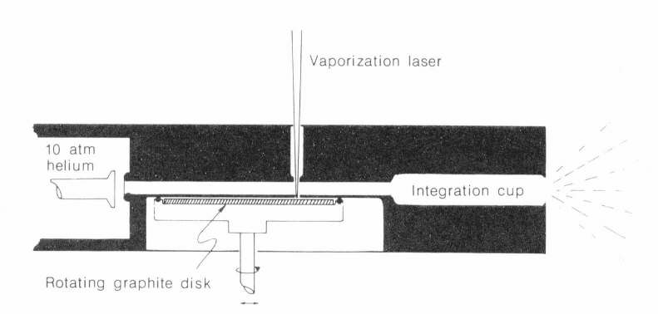
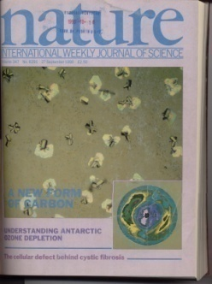
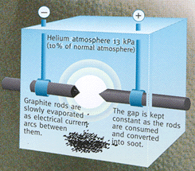
W.Krätschmer, L.D.Lamb, K.Fostiropoulos, D.R.Huffman, „Solid C₆₀: a new form of carbon”, Nature 347, 354 (1990)
C₆₀ in large quantities !

Slide 3
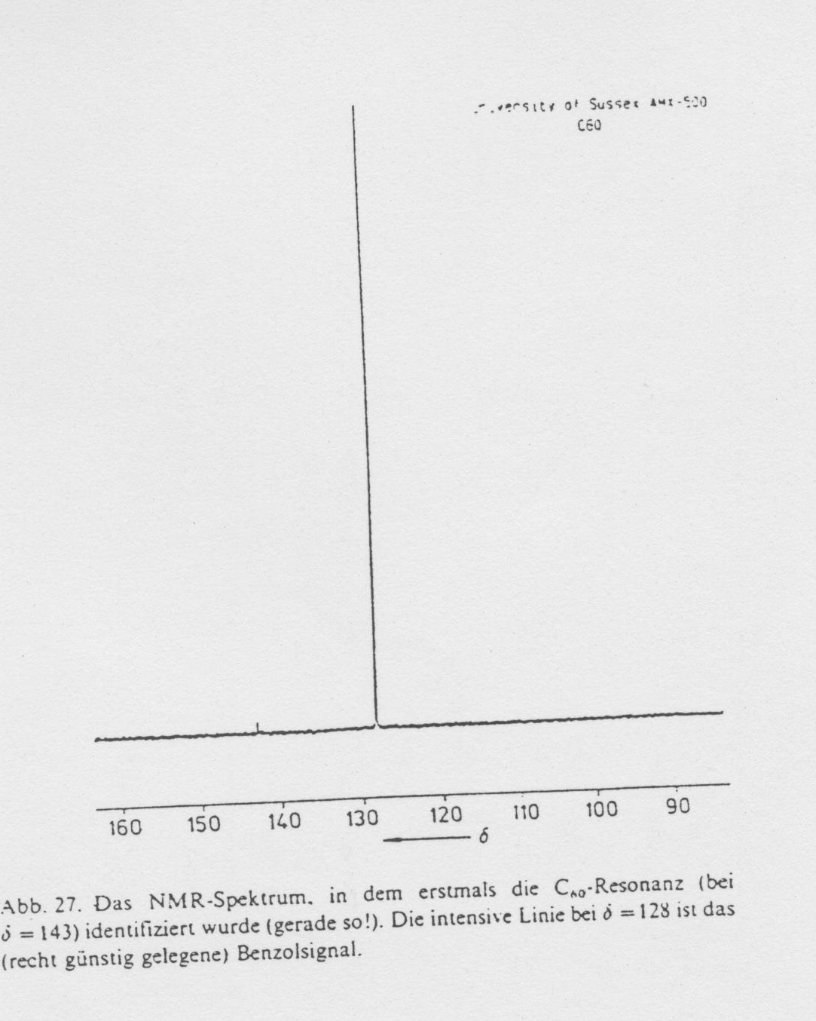

Slide 4
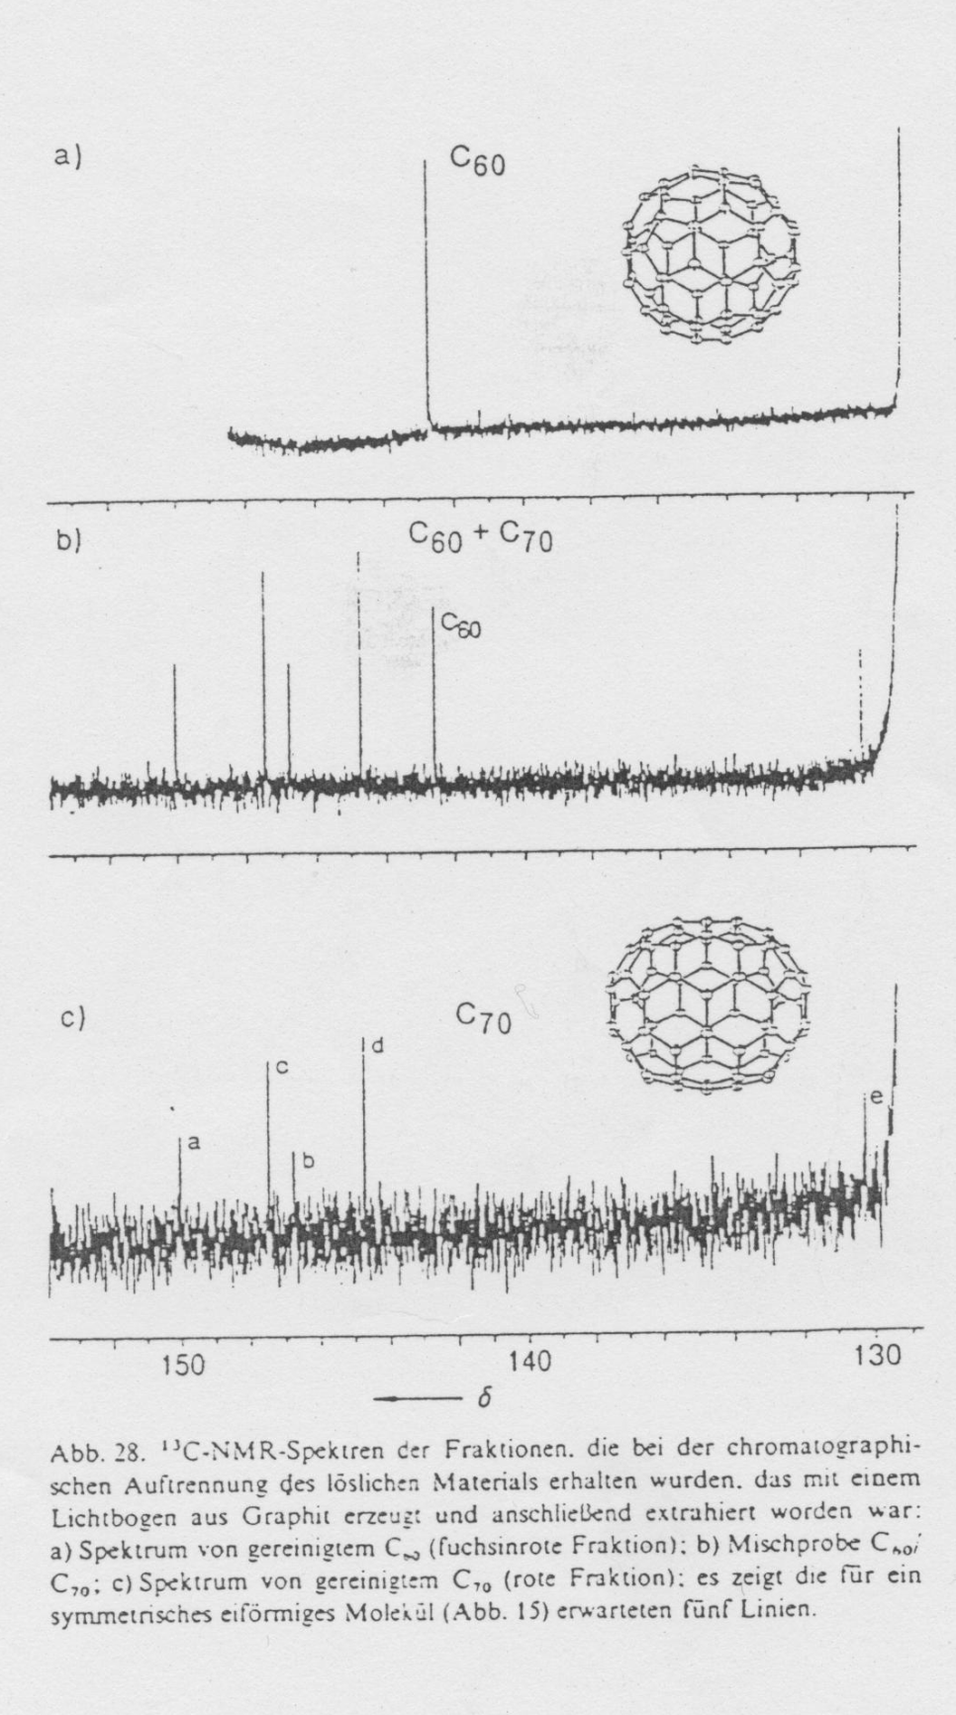
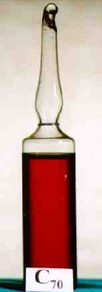

Slide 5
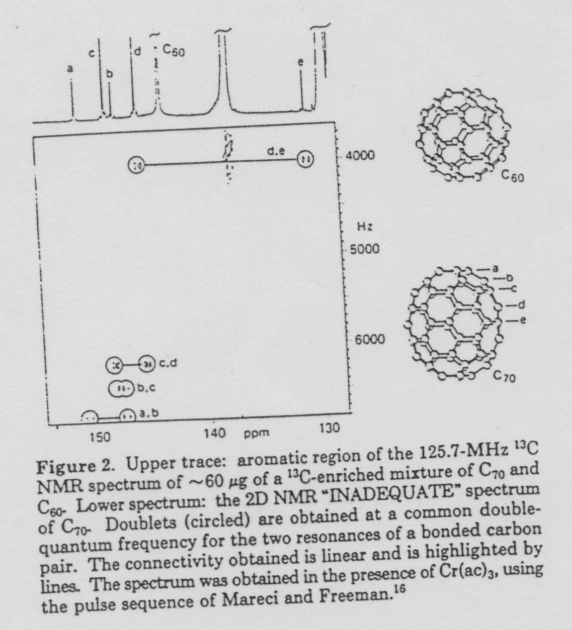

Slide 6
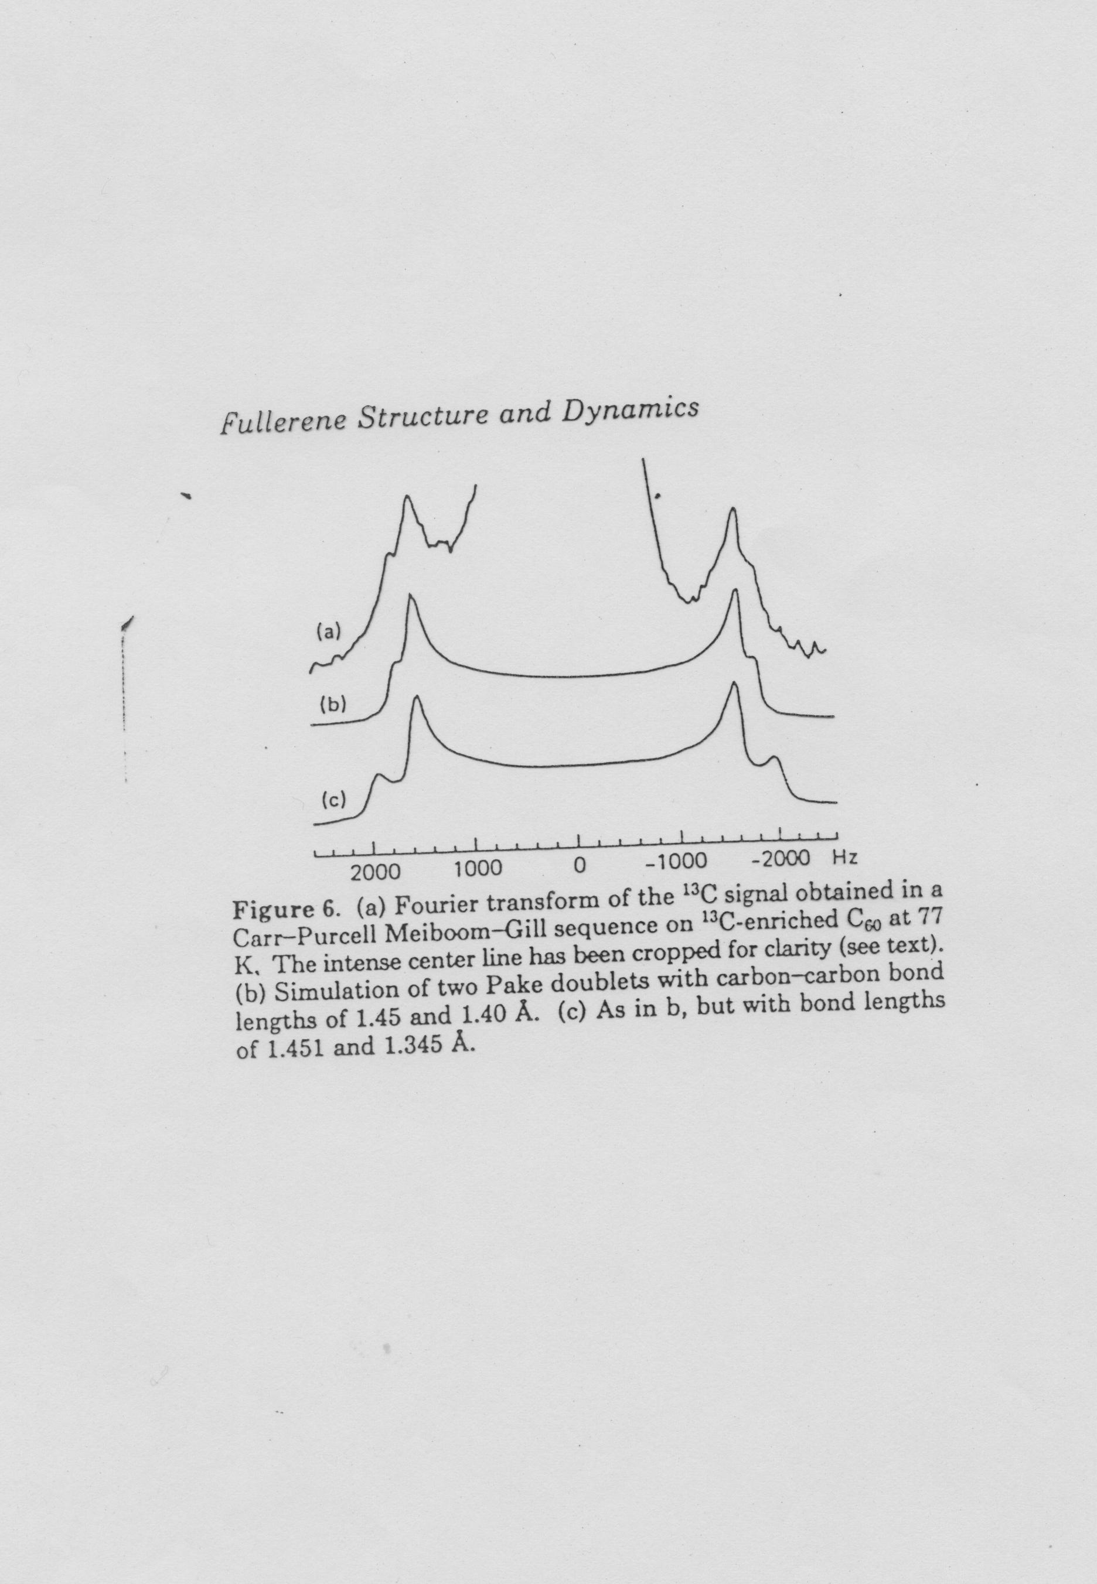

Slide 7
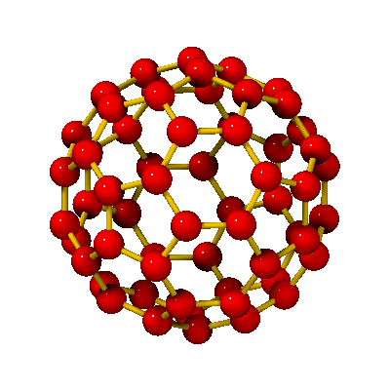
C₆₀
r₆₆
r₅₆
r₆₆ ≈ 140 pm
r₅₆ ≈ 145 pm
d ≈ 0,7 nm

Slide 8
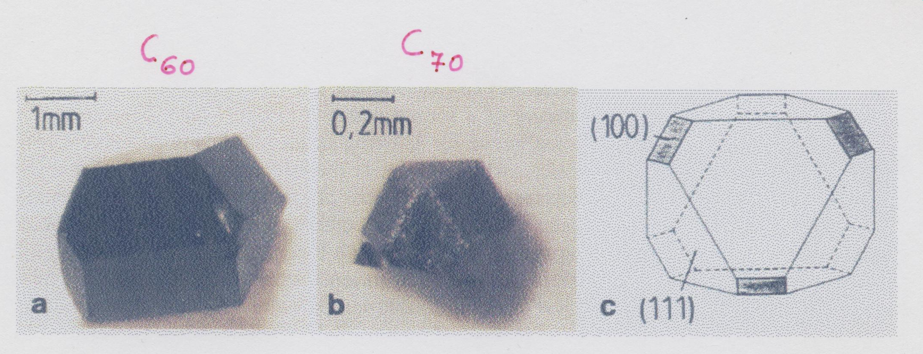

Slide 9
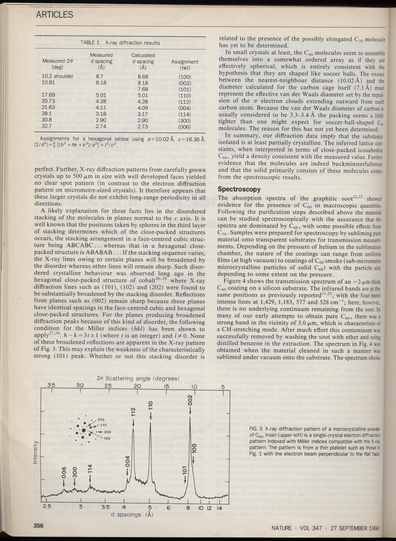

Slide 10
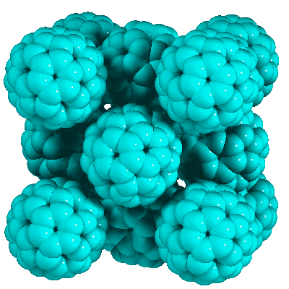
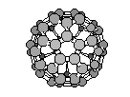
C₆₀ face centered cubic structure (fullerit)
d_{cc} ≈1 nm
d ≈0,7 nm
(T_{room})
a≈1,4 nm

Slide 11
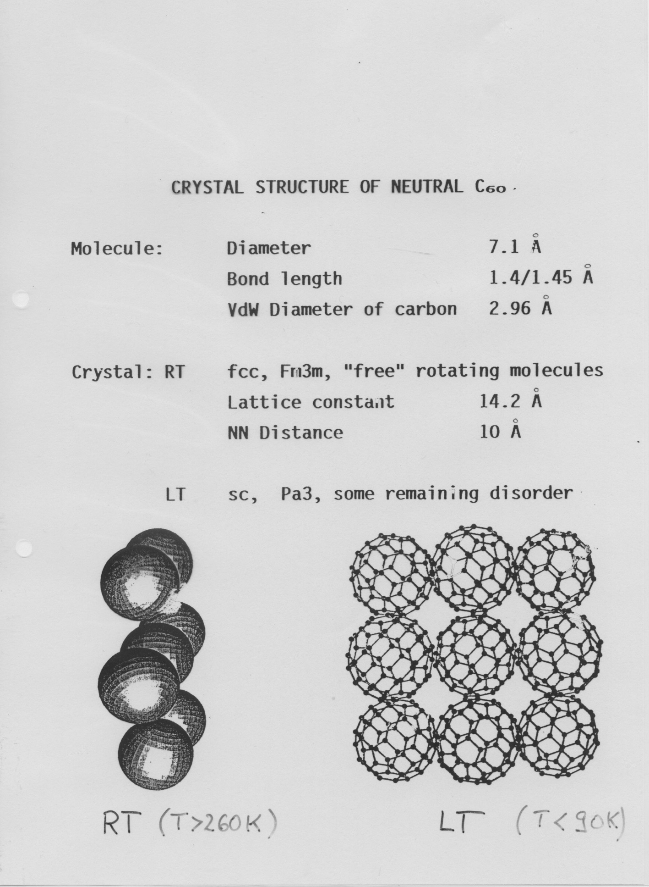

Slide 12
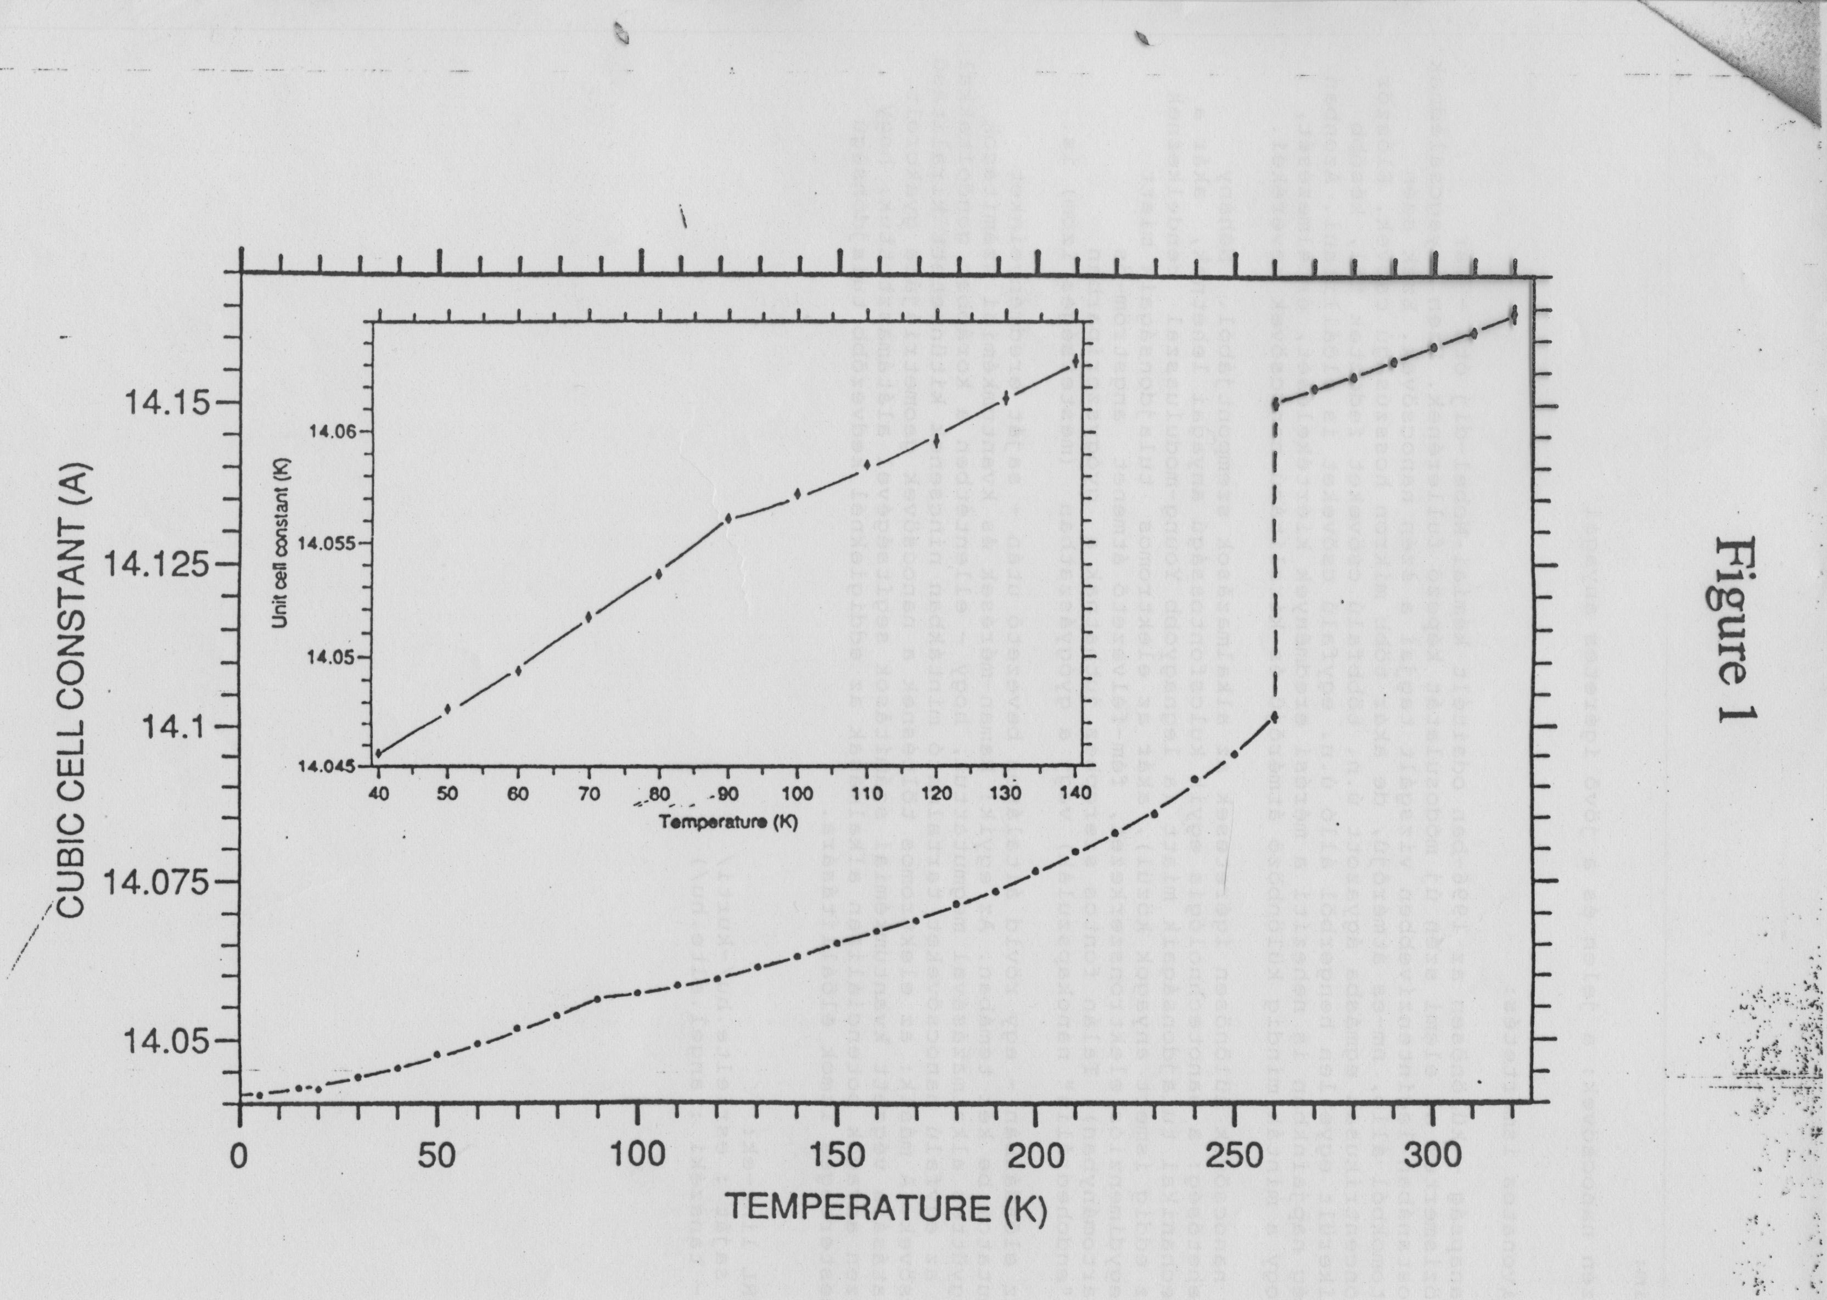
NEUTRON DIFFRACTION

Slide 13
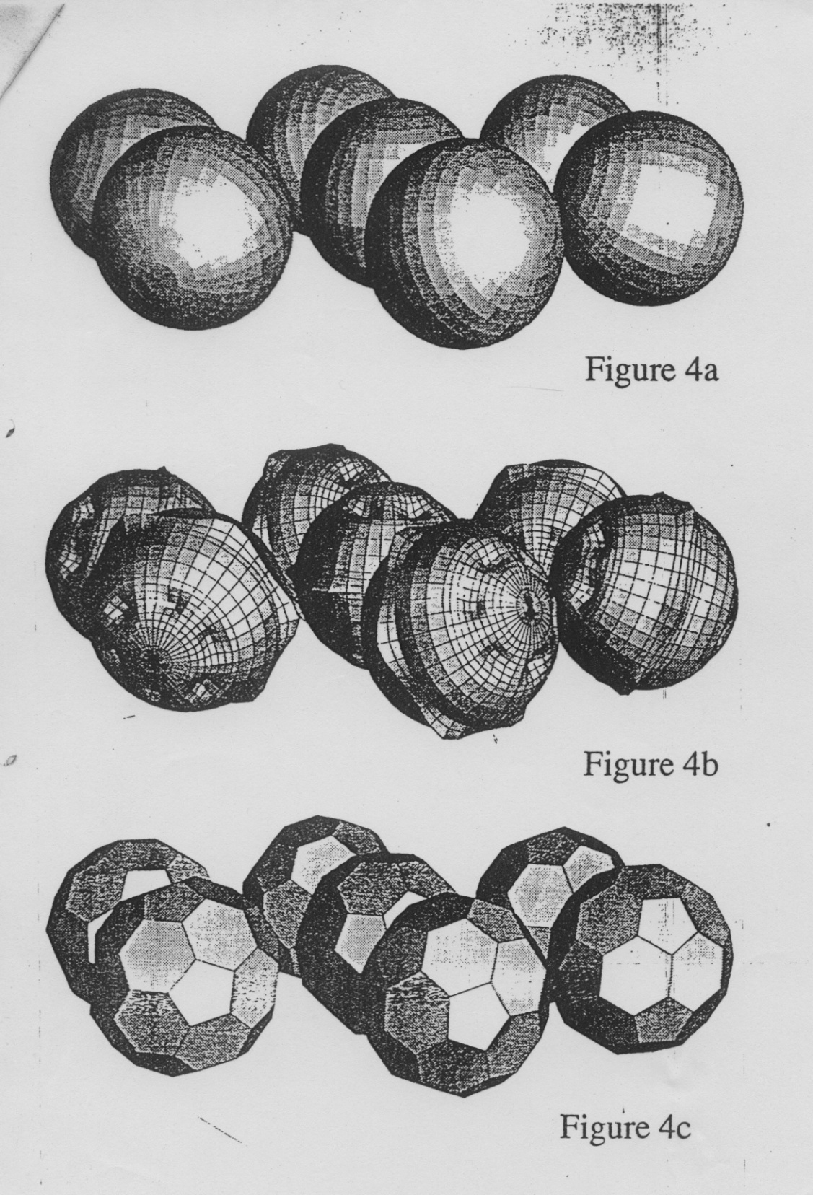
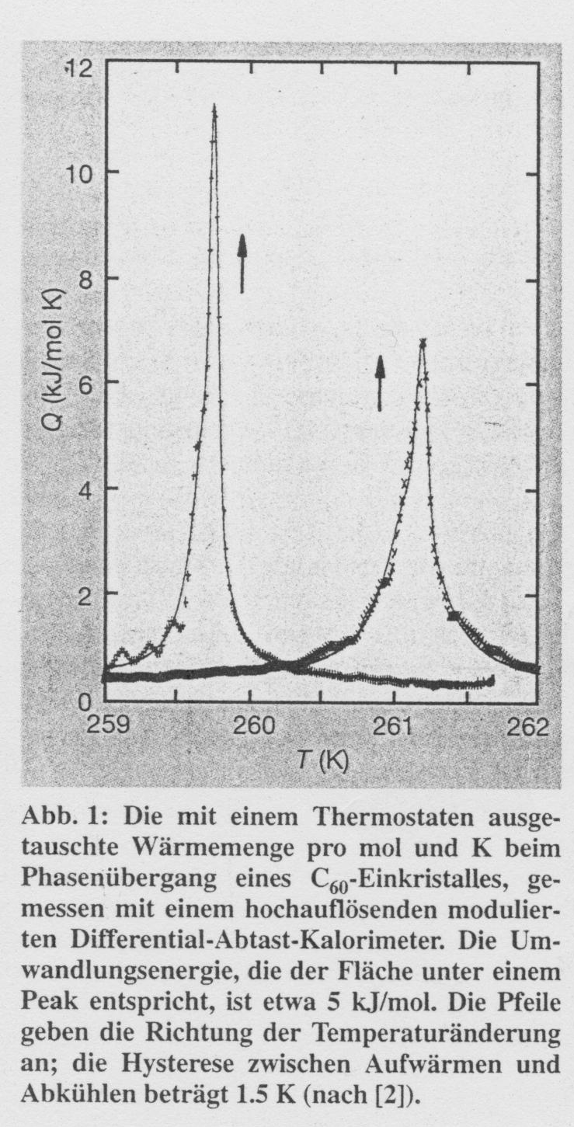
>260 K
< 90 K

