Slide 1
CARBON NANOSTRUCTURES
(FULLERENES, CARBON NANOTUBES, GRAPHENE)
lecture for physics and chemistry students
(2020. summer semester – 23. March)
Prof. Jenő Kürti
ELTE Department of Biological Physics
e-mail: kurti@virag.elte.hu www: regivirag.elte.hu/kurti

Slide 2

Symmetry analysis:
basics of group theory
and
representation theory
of finite point groups
There are many good books, recommended is e.g.
G. Burns: Introduction to Group Theory with Applications, Academic Press New York San Francisco London 1977 in Materials Science Series
and also wikipedia sites:
https://en.wikipedia.org/wiki/Group_(mathematics)
https://en.wikipedia.org/wiki/Group_representation
https://en.wikipedia.org/wiki/Character_theory
etc.

Slide 3
Definition of a Group
A group is a set, G, together with a binary operation („product”) which combines any two elements of the set.
The elements and the operation must satisfy the four group axioms:
Closure: For all elements A, B in G, the result of the operation, A ⋅ B, is also in G.
Associativity: For all A, B and C in G, (A ⋅ B) ⋅ C = A ⋅ (B ⋅ C).
Identity element: The set contains as one of its elements the identity E, such that E⋅A = A⋅E = A for all A.
Inverse element: For each A in G, there exists an element A⁻¹ in G, such that A ⋅ A⁻¹ = A⁻¹ ⋅ A = E.
A group is finite if the number of elements in the set, which is called the order of the group (g or h) is finite.

Slide 4
Molecular symmetry
Symmetry operations of a molecule (rotations, reflections, etc.) are operations which leave the molecule (namely the nuclei) in a state indistinguishable from the starting state. The symmetry operations form a group, where the binary operation (the „group product”) is the consecutive application of two symmetry operations. The identity element (unit element) leaves the molecule unchanged, which means non of the nuclei are moving. (It is necessary to include this trivial operation, without it we could not make use of the strong arsenal of group theory.) Inverse means performing the symmetry operation backwards. For a finite object (molecule) there is a point which remains fixed: the point where various rotational axes, mirror planes cross each other. Each molecule can be classified into one of the many possible point groups.
One has to distinguish symmetry elements from symmetry operations.

Slide 5
5 types of symmetry elements
E: identity (unity = Einheit in German)
C_{n}: n-fold rotational axis (or symmetry axis, or proper rotation axis)
a molecule can have more than one symmetry axis, the one with the highest n is called the principal axis
σ: mirror plane (or plane of symmetry)
σ_{h}: (horizontal) mirror plane perpendicular to the principal axis
σ_{v}: (vertical) mirror plane parallel with the principal axis (containing the principal axis)
σ_{d}: diagonal (or dihedral) mirror plane that bisects the angel between two C₂ axes perpendicular to the principal axis
S_{n}: n-fold rotation-reflection axis (or improper rotation axis)
rotation with simultaneous reflection, where the mirror plane is perpendicular to the rotation axis
i: inversion center (or center of symmetry)
Example: https://www.chemtube3d.com/symferrocenestaggeredd5d/ etc. …

Slide 6
Symmetry operations
Symmetry operations are associated with symmetry elements.
A symmetry element can have more than one operation associated with it.
For example, the C₄ axis is associated with
two C₄ rotations in opposite directions (±90°) and a C₂ ≡ C₄ ∙ C₄ ≡ C₄² rotation (180°).
C_{n}^{m} : m-times rotation with 360°/n around an n-fold rotational axis
S_{n}^{m} : m-times rotation-reflection with 360°/n around an n-fold rotation-reflection axis
(mirror plane is perpendicular to the rotation axis)
Since C₁ is equivalent to E, S₁ to σ and S₂ to i,
all symmetry operations can be classified as either proper or improper rotations.
For point groups we use the Schönflies notation.
There is a useful table of point groups with examples here:
https://en.wikipedia.org/wiki/Molecular_symmetry
The smallest point group is that of a molecule without any symmetry:
C₁ consisting of only one element, the identity (E).
The largest finite point group is the icosahedral group (I_{h}) with 120 elements.

Slide 7
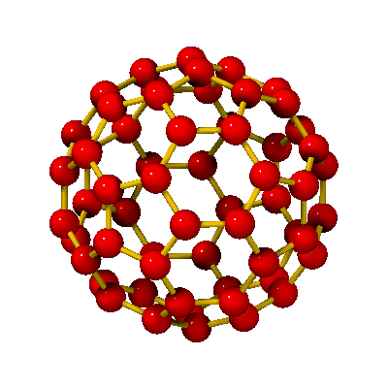
Icosahedral group
About the symmetry operations of C₆₀ look e.g. the website https://www2.fkf.mpg.de/andersen/fullerene/symmetry.html !
(Note, that the rotation with 60° is not a symmetry operation of C₆₀!)
The symmetry operations of the C₆₀ molecule form the icosahedral group (I_{h}) which is the largest finite point group: the total number of elements (symmetry operations) is 120. These 120 elements can be classified in 10 conjugacy classes: E + 12C₅ + 12C₅² + 20C₃ + 15C₂ + i + 12S₁₀ + 12S₁₀³ + 20S₆ + 15σ .
The general definition of conjugacy class is: two elements of the group A and B are conjugate (are in the same class) if there exists a symmetry operation F of the group such that B=F⁻¹AF (similarity transformation)
(Think of e.g. the symmetry operations of the Rubik cube ☺; for example: bring a rotation axis into the desired position, carry out the rotation around the axis and bring back the axis into the original position.)
Necessary condition for two symmetry operations are conjugated (are similar) is that the two operations must be of same kind (rotation with a given angle, reflection etc). But this might be not enough. Consider e.g. benzene: the 3 σ_{v} reflections (which bisect opposite atoms) and the 3 σ_{d} reflections (which bisect opposite bonds) form two different conjugacy classes.
The nontrivial classes contain proper rotations, improper rotations, reflections and the inversion. (see next slide)

Slide 8
Icosahedral group (cont.)
(symmetry operations, conjugacy classes)
Proper rotations:
C₆₀ molecule has three types of rotation axes: six 5-fold (C₅), ten 3-fold (C₃) and fifteen 2-fold (C₂) axes.
The associated symmetry operations, classified in separate conjugacy classes are the following.
Around 5-fold axes: with ±360°/5 (12C₅) and with ±2x360°/5 (12C₅²) Question: what about C₅³ , C₅⁴ and C₅⁵ ?
Around 3-fold axes: with ±360°/3 (20C₃) Question: what about C₃² ?
Around 2-fold axes: with 360°/2 (15C₂)
Improper rotations:
Rotation and mirroring together around 5-fold axes and around 3-fold axes (mirror plane perpendicular to the axis)
Around 5-fold axes: with ±360°/10 (12S₁₀) and with ±3x360°/10 (12S₁₀³) Question: what about S₁₀², S₁₀⁴, S₁₀⁵ …?
Around 3-fold axes: with ±360°/6 (20S₆) Question: what about S₆² , S₆³ , S₆⁴ , S₆⁵ ?
Reflections:
There are 15 mirror planes (which contain two opposite long bonds): 15σ
Inversion:
The molecule has a symmetry center in the middle
Homework: check and verify what is written above! Website https://www.chemtube3d.com/c60/ can help.

Slide 9
Matrix representation of
finite point groups
Symmetry operations of a molecule can be considered as linear transformations acting in some vector space, and as such can be represented by matrices. In practice, the two most important vector spaces are: a given set of (electronic) wave functions and a given set of displacement vectors (of nuclei). The former is used when we are interested in energy levels and the latter is used for treating vibrations. Each matrix is called a representative of the corresponding symmetry operation, and the complete set of matrices is called a matrix representation of the group.
These matrices themselves form a group where the group operation is the matrix multiplication. The representation of the symmetry operations by matrices is a structure-preserving mapping (homomorphism): if A and B are elements of the symmetry group G, and Γ(A) and Γ(B) are the representing matrices, then Γ(A ∙ B) = Γ(A) ∙ Γ(B), for any A and B.
For a given symmetry group there exist an infinite number of possible representations. When the matrices are n x n matrices, the dimension of the representation is n.
For a given vector space the numbers in the rows and columns of the representative matrices depend on the basis set which span the vector space and so the representation itself. By transforming the basis vectors with a transformation matrix S the representative matrices transform as well: Γ’(R) = S⁻¹ Γ(R) S (similarity transformation), where S is the same for all elements R of the symmetry group.

Slide 10
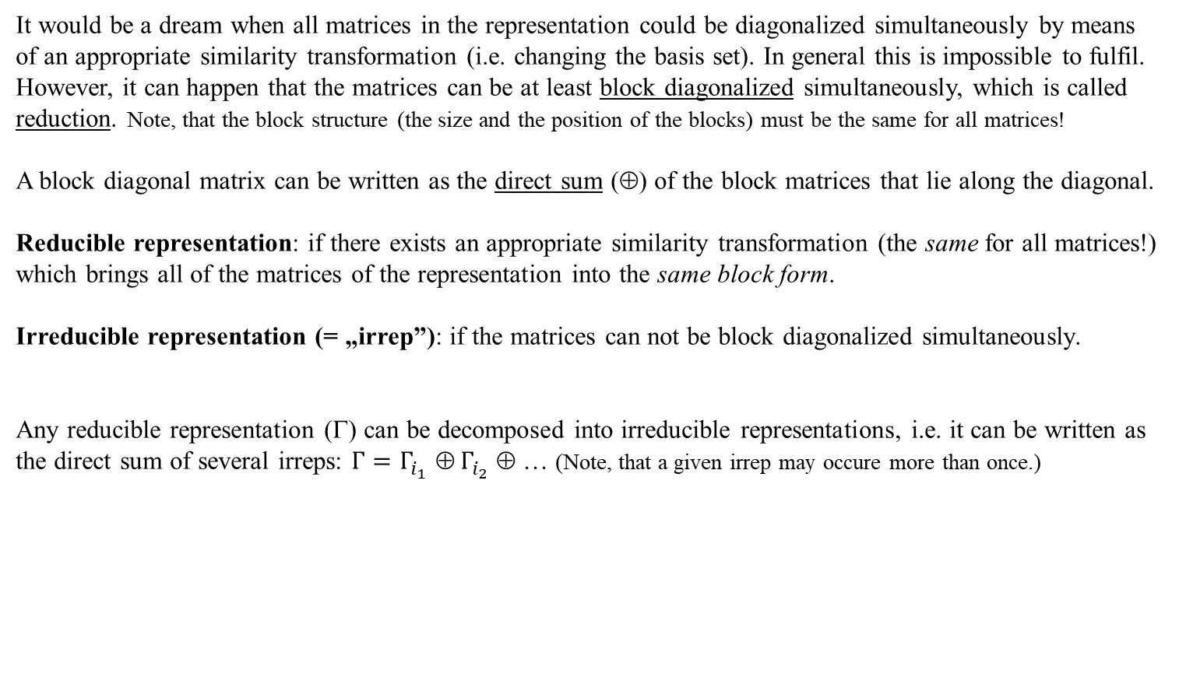
Reducible and irreducible representations
It would be a dream when all matrices in the representation could be diagonalized simultaneously by means of an appropriate similarity transformation (i.e. changing the basis set). In general this is impossible to fulfil. However, it can happen that the matrices can be at least block diagonalized simultaneously, which is called reduction. Note, that the block structure (the size and the position of the blocks) must be the same for all matrices!
A block diagonal matrix can be written as the direct sum (⊕) of the block matrices that lie along the diagonal.
Reducible representation: if there exists an appropriate similarity transformation (the same for all matrices!) which brings all of the matrices of the representation into the same block form.
Irreducible representation (= „irrep”): if the matrices can not be block diagonalized simultaneously.
Any reducible representation (Γ) can be decomposed into irreducible representations, i.e. it can be written as the direct sum of several irreps: $Γ=Γ_{i_{1}}$ ⊕${ Γ}_{i_{2}}$ ⊕ … (Note, that a given irrep may occure more than once.)

Slide 11
Will be continued …

