Slide 1
CARBON NANOSTRUCTURES
(FULLERENES, CARBON NANOTUBES, GRAPHENE)
lecture for physics and chemistry students
(2020. summer semester – 30. March)
Prof. Jenő Kürti
ELTE Department of Biological Physics
e-mail: kurti@virag.elte.hu www: regivirag.elte.hu/kurti

Slide 2

π-electron energy levels of C₆₀

Slide 3
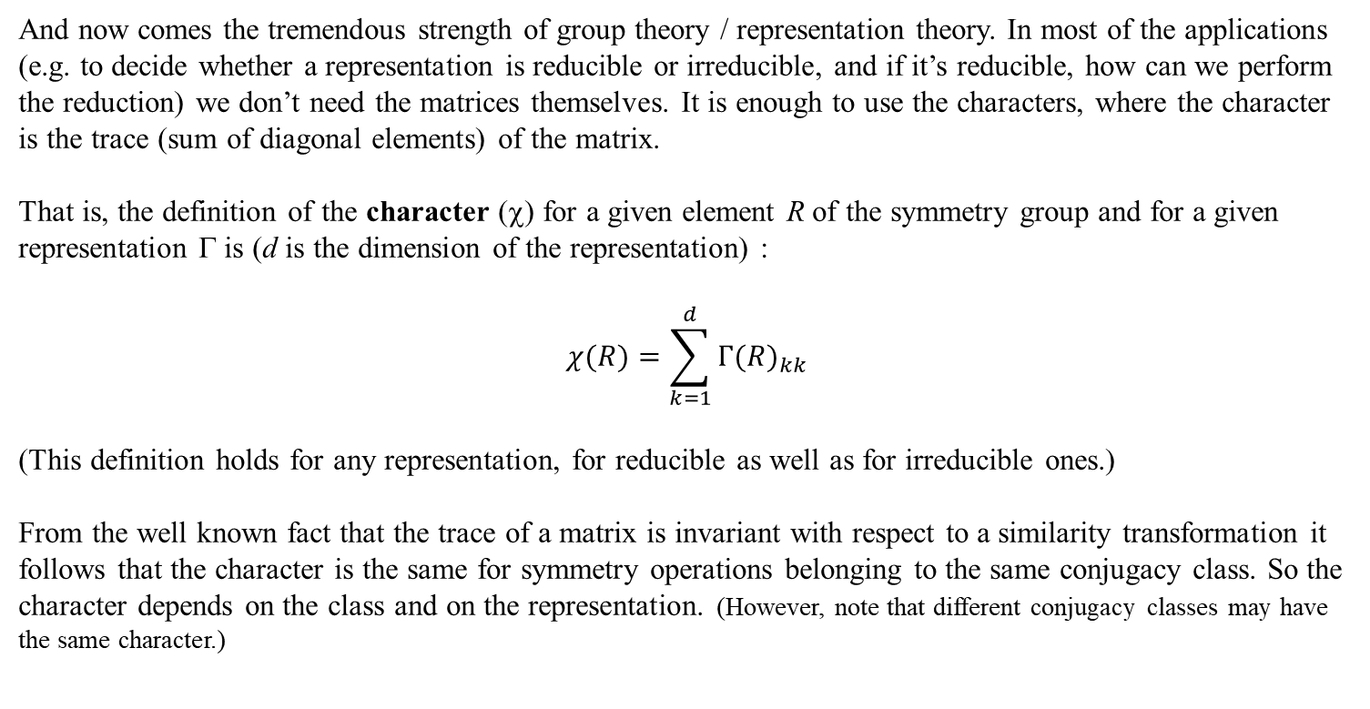
Characters
And now comes the tremendous strength of group theory / representation theory. In most of the applications (e.g. to decide whether a representation is reducible or irreducible, and if it’s reducible, how can we perform the reduction) we don’t need the matrices themselves. It is enough to use the characters, where the character is the trace (sum of diagonal elements) of the matrix.
That is, the definition of the character (χ) for a given element R of the symmetry group and for a given representation Γ is (d is the dimension of the representation) :
$$χ(R)=\sum_{k=1}^{d}{{Γ(R)}_{kk}}$$
(This definition holds for any representation, for reducible as well as for irreducible ones.)
From the well known fact that the trace of a matrix is invariant with respect to a similarity transformation it follows that the character is the same for symmetry operations belonging to the same conjugacy class. So the character depends on the class and on the representation. (However, note that different conjugacy classes may have the same character.)

Slide 4
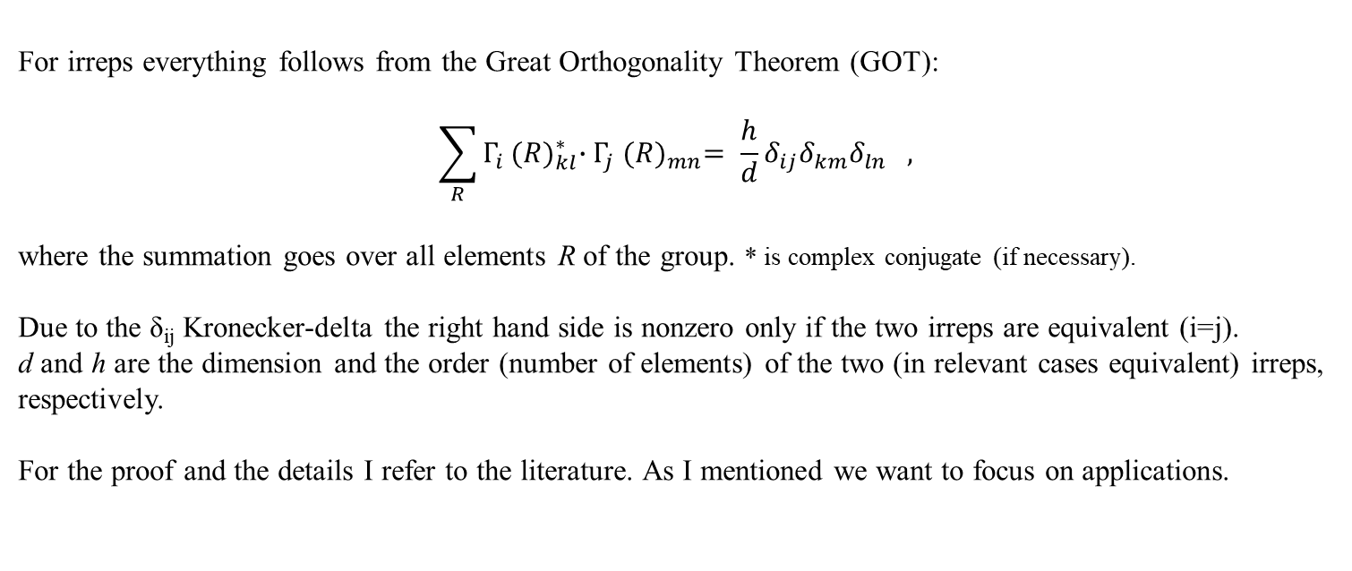
Great Orthogonality Theorem (GOT)
For irreps everything follows from the Great Orthogonality Theorem (GOT):
$$\sum_{R}^{ }{Γ_{i}}{(R)}_{kl}^{∗}{∙Γ}_{j}{(R)}_{mn}^{}= \frac{h}{d}δ_{ij}δ_{km}δ_{ln} ,$$
where the summation goes over all elements R of the group. * is complex conjugate (if necessary).
Due to the δ_{ij} Kronecker-delta the right hand side is nonzero only if the two irreps are equivalent (i=j).
d and h are the dimension and the order (number of elements) of the two (in relevant cases equivalent) irreps, respectively.
For the proof and the details I refer to the literature. As I mentioned we want to focus on applications.

Slide 5
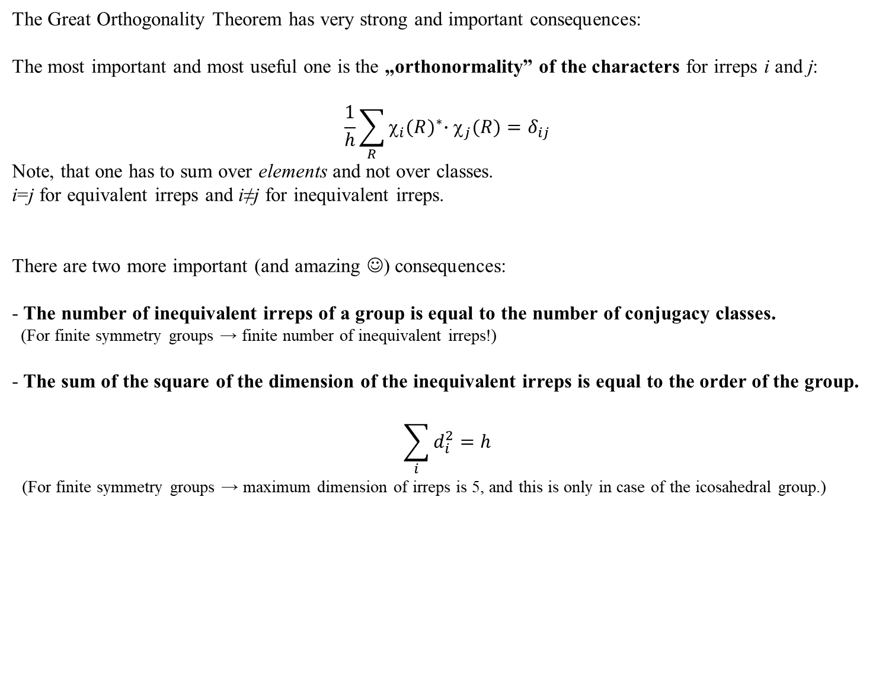
Consequences of GOT
The Great Orthogonality Theorem has very strong and important consequences:
The most important and most useful one is the „orthonormality” of the characters for irreps i and j:
$$\frac{1}{h}\sum_{R}^{ }{χ_{i}{(R)}^{∗}∙χ_{j}(R)}=δ_{ij}$$
Note, that one has to sum over elements and not over classes.
i=j for equivalent irreps and i≠j for inequivalent irreps.
There are two more important (and amazing ☺) consequences:
- The number of inequivalent irreps of a group is equal to the number of conjugacy classes.
(For finite symmetry groups → finite number of inequivalent irreps!)
- The sum of the square of the dimension of the inequivalent irreps is equal to the order of the group.
$$\sum_{i}{d_{i}^{2}}=h$$
(For finite symmetry groups → maximum dimension of irreps is 5, and this is only in case of the icosahedral group.)

Slide 6
Character tables
The character table of a symmetry group collects the characters of all inequivalent irreps for that group.
See the example for the icosahedral group (I_{h}) in the next slide.
The upper left corner contains the name of the symmetry group.
In the first row the conjugacy classes are listed, showing also the number of elements belonging to the class.
In the first place of this row there is always the identity element E which forms by itself a conjugacy class.
The first irrep is always the totally symmetric (or trivial) representation where all the characters are +1.
The totally symmetric irrep is labelled by A or A_{g} or A₁ (see later).
(If a function transforms according to the totally symmetric irrep = the function is invariant for all symmetry operations.)
General rules for the nomenclature of the irreps are:
- 1D irreps are labelled by A or B, depending on whether they are symmetric (character +1) or antisymmetric (character –1) under rotation about the principal axis. (There is no B irrep for I_{h}.)
- 2D, 3D, 4D and 5D irreps are labelled by E, T (or F), G and H, respectively.
If the symmetry group contains inversion, subscript g refers to even irreps (character of inversion is positive) and subscript u refers to odd irreps (character of inversion is negative). (compare e.g. A_{g} with A_{u})
To distinguish between different irreps with the same dimension subscript 1, 2 are used. (see e.g. T_{1g}, T_{2g})

Slide 7
Character table of I_{h} group
(h=120)
2z²-x²-y², xy,
yz, zx, x²-y²
+
Homework: please check for the I_{h} group the properties discussed before:
number of irreps, sum of the square of the dimensions of irreps; and most importantly the orthonormality of the characters!
(If you find a failure in the table, please write me!)
In the last columns there are linear and quadratic expressions in rows according to which irreps they transform.
These will be important later for infrared and Raman spectroscopy.
The linear expression can be a „true” (polar) vector like the (x,y,z) position vector, or a pseudo (axial) vector like the (R_{x},R_{y},R_{z}) angular velocity.

Slide 8
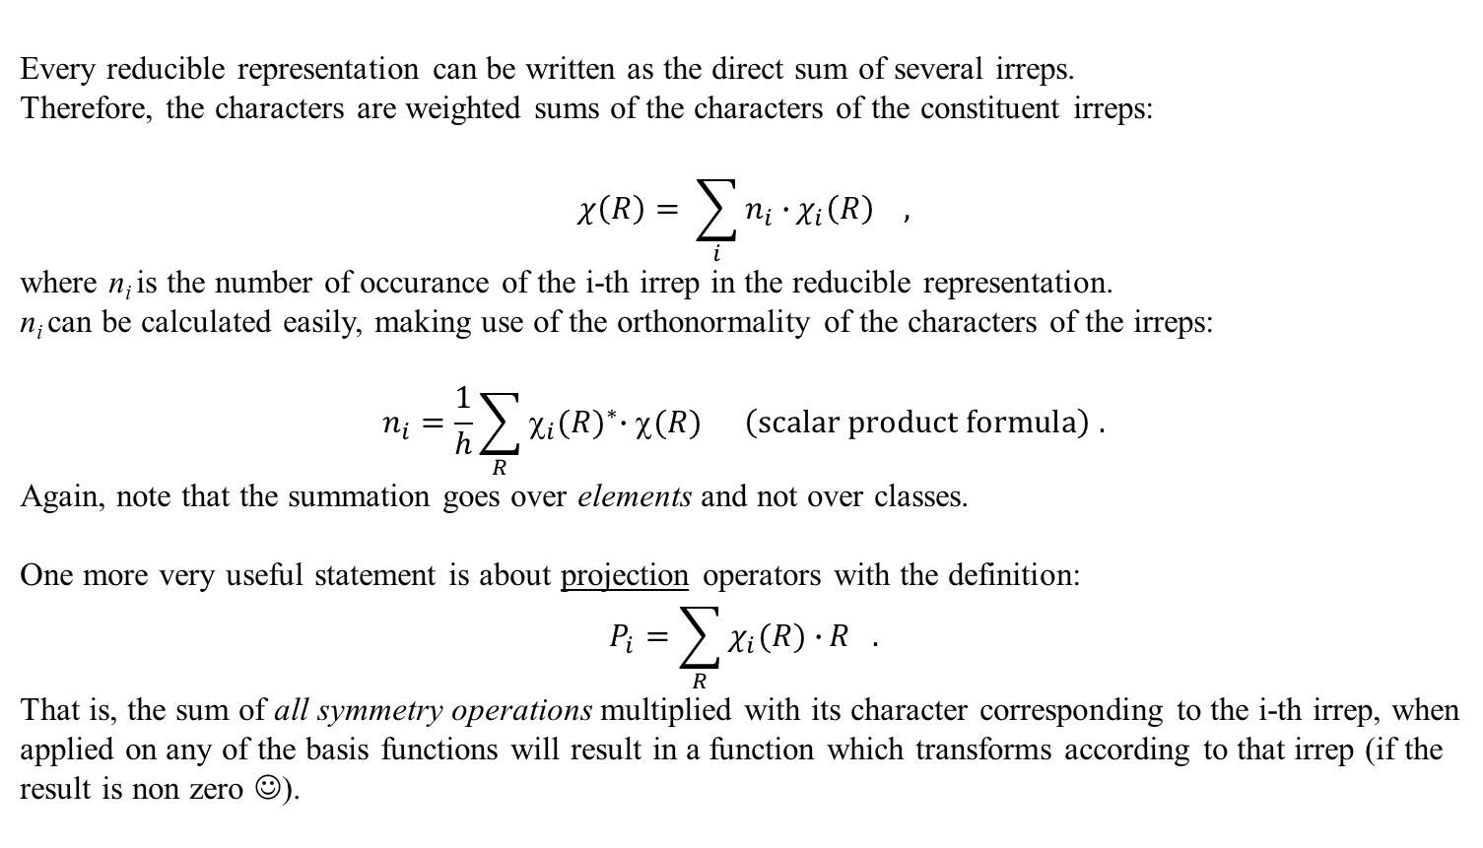
Reduction of a representation
Every reducible representation can be written as the direct sum of several irreps.
Therefore, the characters are weighted sums of the characters of the constituent irreps:
$$χ\left(R\right)= \sum_{i}{n_{i}∙}χ_{i}\left(R\right) ,$$
where n_{i} is the number of occurance of the i-th irrep in the reducible representation.
n_{i} can be calculated easily, making use of the orthonormality of the characters of the irreps:
$$n_{i}=\frac{1}{h}\sum_{R}^{ }{χ_{i}{(R)}^{∗}∙χ(R)} \left(\text{scalar} \text{product} \text{formula}\right) .$$
Again, note that the summation goes over elements and not over classes.
One more very useful statement is about projection operators with the definition:
$$P_{i}=\sum_{R}{χ_{i}(R)∙}R .$$
That is, the sum of all symmetry operations multiplied with its character corresponding to the i-th irrep, when applied on any of the basis functions will result in a function which transforms according to that irrep (if the result is non zero ☺).

Slide 9
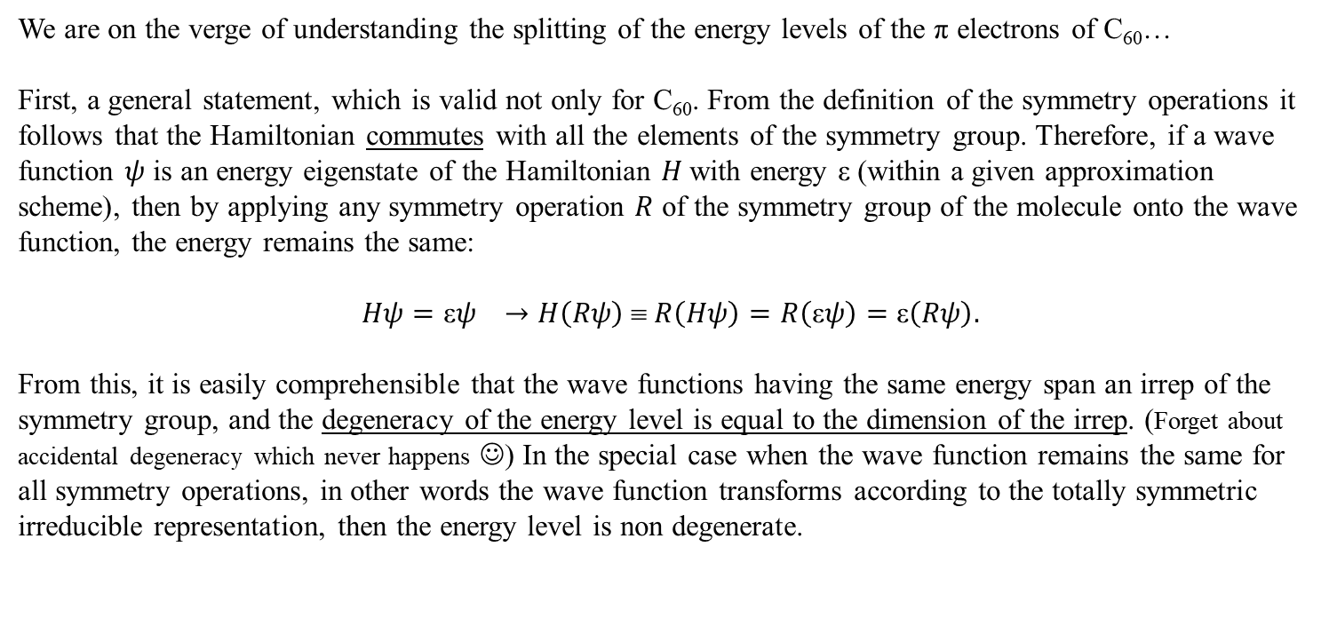
Degeneracy of energy levels
We are on the verge of understanding the splitting of the energy levels of the π electrons of C₆₀…
First, a general statement, which is valid not only for C₆₀. From the definition of the symmetry operations it follows that the Hamiltonian commutes with all the elements of the symmetry group. Therefore, if a wave function $ψ$ is an energy eigenstate of the Hamiltonian $H$with energy ε (within a given approximation scheme), then by applying any symmetry operation $R$ of the symmetry group of the molecule onto the wave function, the energy remains the same:
$$Hψ=\text{ε}ψ →H\left(Rψ\right) ≡ R\left(Hψ\right)=R\left(\text{ε}ψ\right)=\text{ε}\left(Rψ\right).$$
From this, it is easily comprehensible that the wave functions having the same energy span an irrep of the symmetry group, and the degeneracy of the energy level is equal to the dimension of the irrep. (Forget about accidental degeneracy which never happens ☺) In the special case when the wave function remains the same for all symmetry operations, in other words the wave function transforms according to the totally symmetric irreducible representation, then the energy level is non degenerate.
!

Slide 10
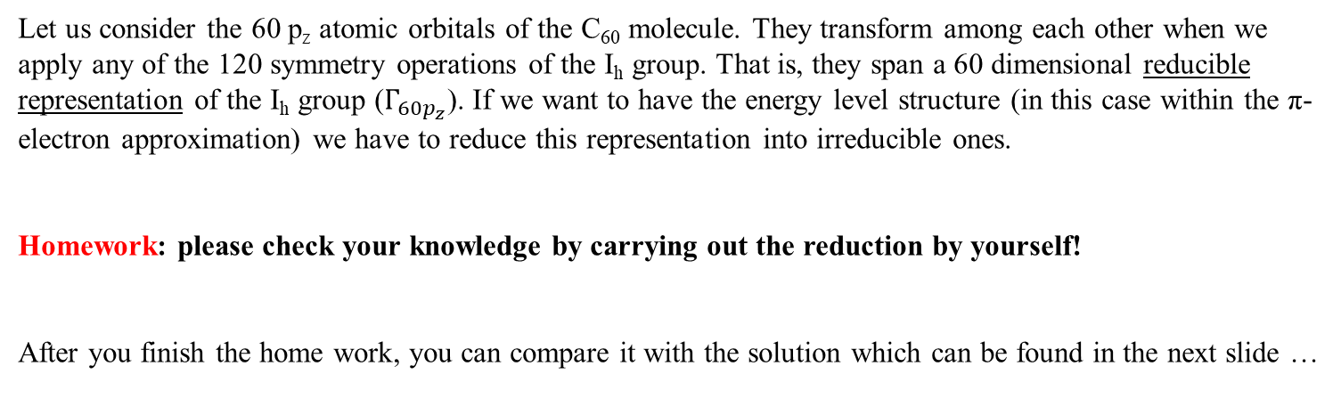
π-electron energy levels of C₆₀
(reduction of the 60dim representation)
Let us consider the 60 p_{z} atomic orbitals of the C₆₀ molecule. They transform among each other when we apply any of the 120 symmetry operations of the I_{h} group. That is, they span a 60 dimensional reducible representation of the I_{h} group ($Γ_{{60p}_{z}}$). If we want to have the energy level structure (in this case within the π-electron approximation) we have to reduce this representation into irreducible ones.
Homework: please check your knowledge by carrying out the reduction by yourself!
After you finish the home work, you can compare it with the solution which can be found in the next slide …

Slide 11
Sorry, the solution can be found in the next slide …

Slide 12
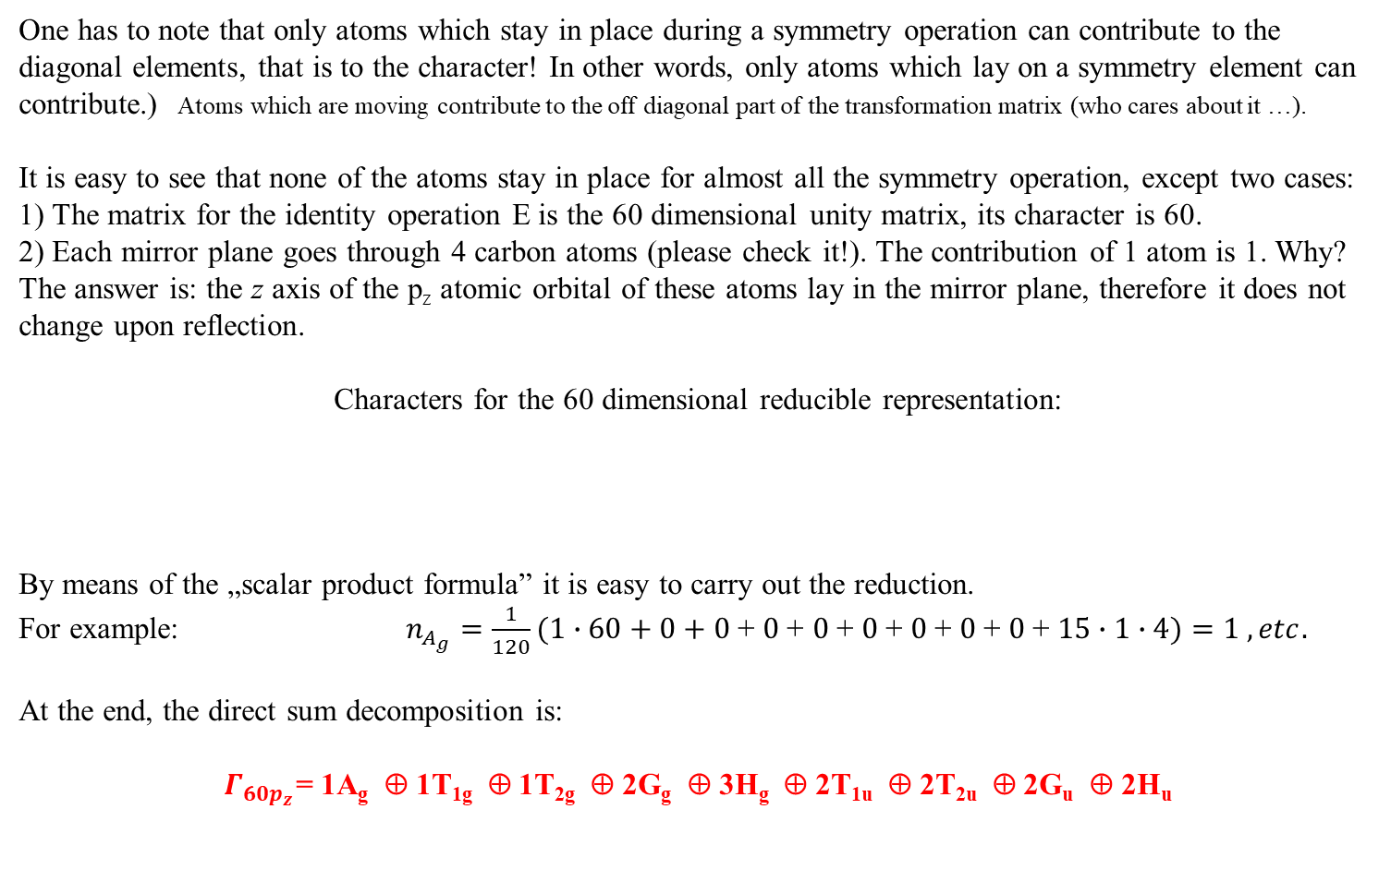
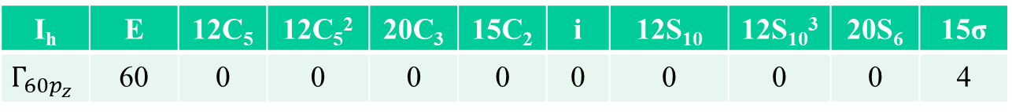
Solution
One has to note that only atoms which stay in place during a symmetry operation can contribute to the diagonal elements, that is to the character! In other words, only atoms which lay on a symmetry element can contribute.) Atoms which are moving contribute to the off diagonal part of the transformation matrix (who cares about it …).
It is easy to see that none of the atoms stay in place for almost all the symmetry operation, except two cases:
1) The matrix for the identity operation E is the 60 dimensional unity matrix, its character is 60.
2) Each mirror plane goes through 4 carbon atoms (please check it!). The contribution of 1 atom is 1. Why? The answer is: the z axis of the p_{z} atomic orbital of these atoms lay in the mirror plane, therefore it does not change upon reflection.
Characters for the 60 dimensional reducible representation:
By means of the „scalar product formula” it is easy to carry out the reduction.
For example: $n_{A_{g}}=\frac{1}{120}(1∙60+0+0$ + $0$+ $0$+ $0$+ $0$+ $0$+ $0$+ $15∙1∙4)=1 , etc.$
At the end, the direct sum decomposition is:
$Γ_{{60p}_{z}}$= 1A_{g} ⊕ 1T_{1g} ⊕ 1T_{2g} ⊕ 2G_{g} ⊕ 3H_{g} ⊕ 2T_{1u} ⊕ 2T_{2u} ⊕ 2G_{u} ⊕ 2H_{u}
I_{h} | E | 12C₅ | 12C₅² | 20C₃ | 15C₂ | i | 12S₁₀ | 12S₁₀³ | 20S₆ | 15σ
$$Γ_{{60p}_{z}}$$ | 60 | 0 | 0 | 0 | 0 | 0 | 0 | 0 | 0 | 4
!

Slide 13
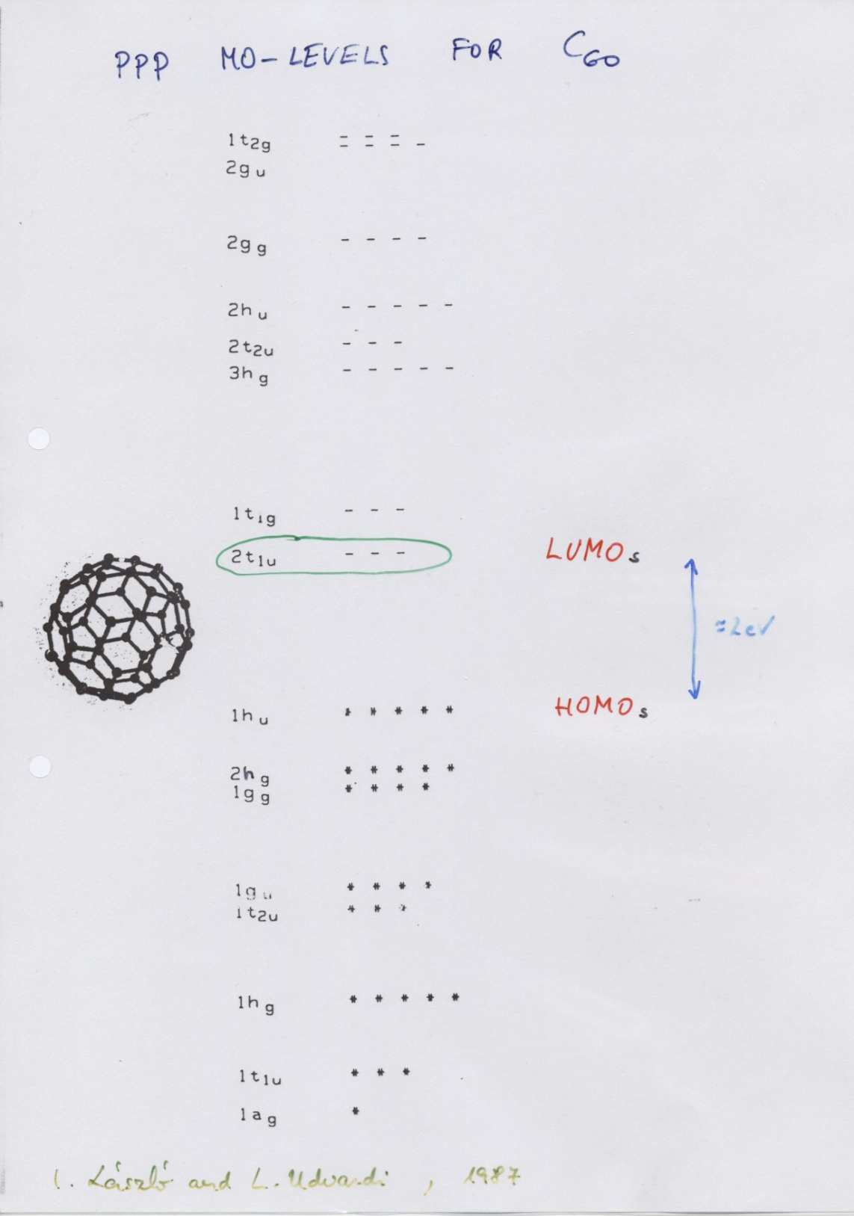
Homework:
compare the direct sum decomposition with the already known energy levels calculated by PPP method (see right side).
Comment1: for one-electron energy levels often the lowercase letters are used.
Comment2: symmetry analysis tells nothing about the numerical value of the energies, and nothing about the order of the energy levels.
However, by using the projection operators for the irreps, one can use qualitative arguments based on the „shape” of the molecular orbitals as expressed by linear combination of atomic orbitals (LCAO-MO).
For example the MO with a_{g} symmetry (totally symmetric MO) has the form where all atomic p_{z} orbitals have the same sign outside the cage (and the opposite, but again the same sign inside the cage). That is, there are no nodes between the atomic orbitals, therefore due to the well known qualitative argument, the MO with a_{g} symmetry should have the lowest energy, which is indeed the case.

Slide 15
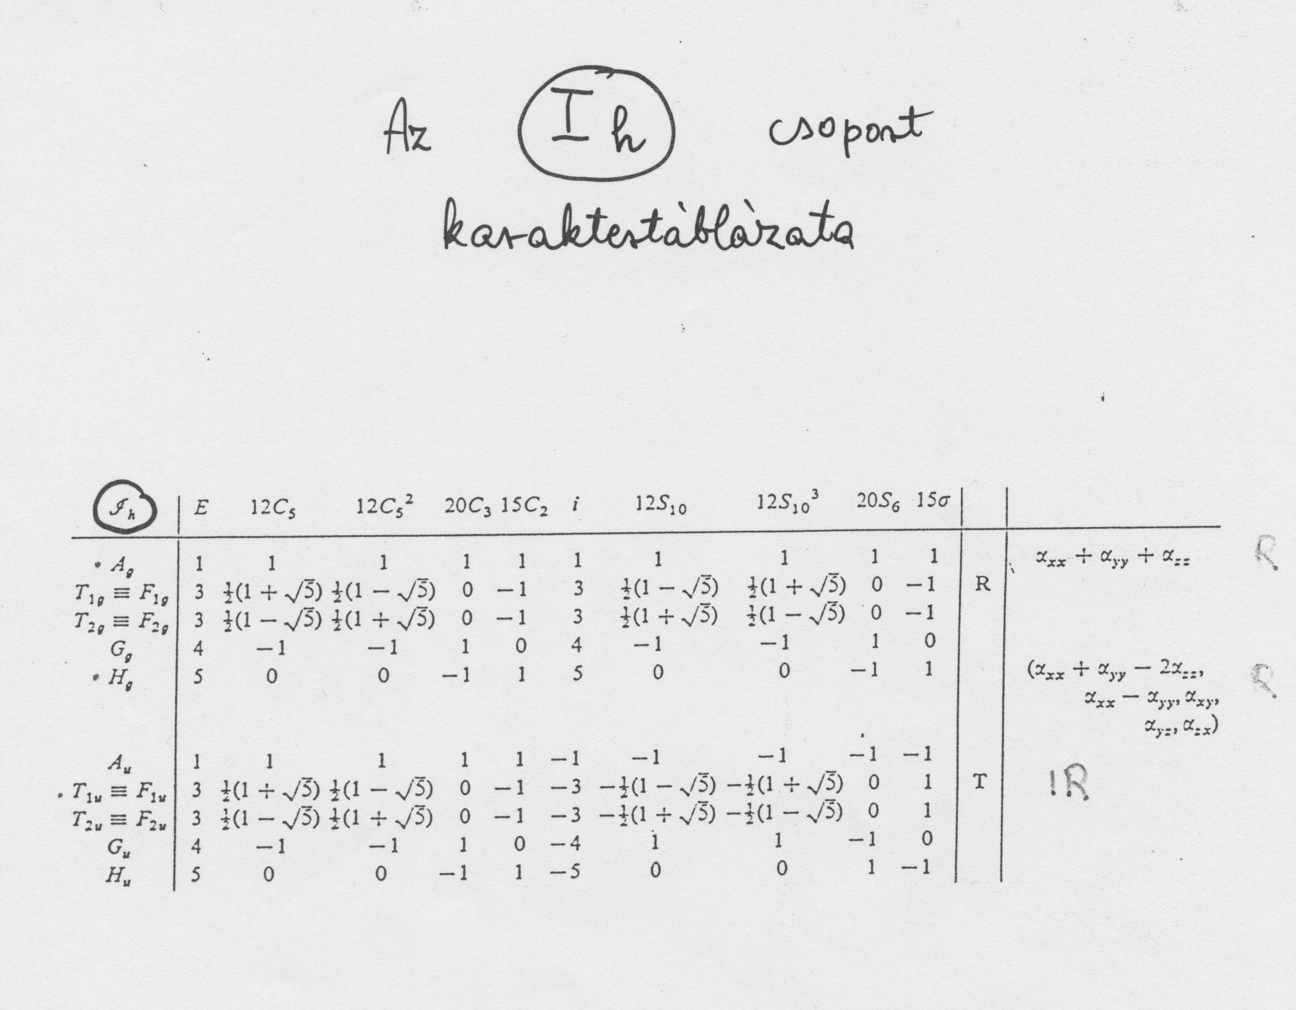
g = 120

