Slide 1
CARBON NANOSTRUCTURES (FULLERENES, CARBON NANOTUBES, GRAPHENE)
lecture for physics and chemistry students
(2020. summer semester – 06. April)
Prof. Jenő Kürti
ELTE Department of Biological Physics
e-mail: kurti@virag.elte.hu www: regivirag.elte.hu/kurti

Slide 2
Fullerenes:
band structure, optical properties

Slide 3
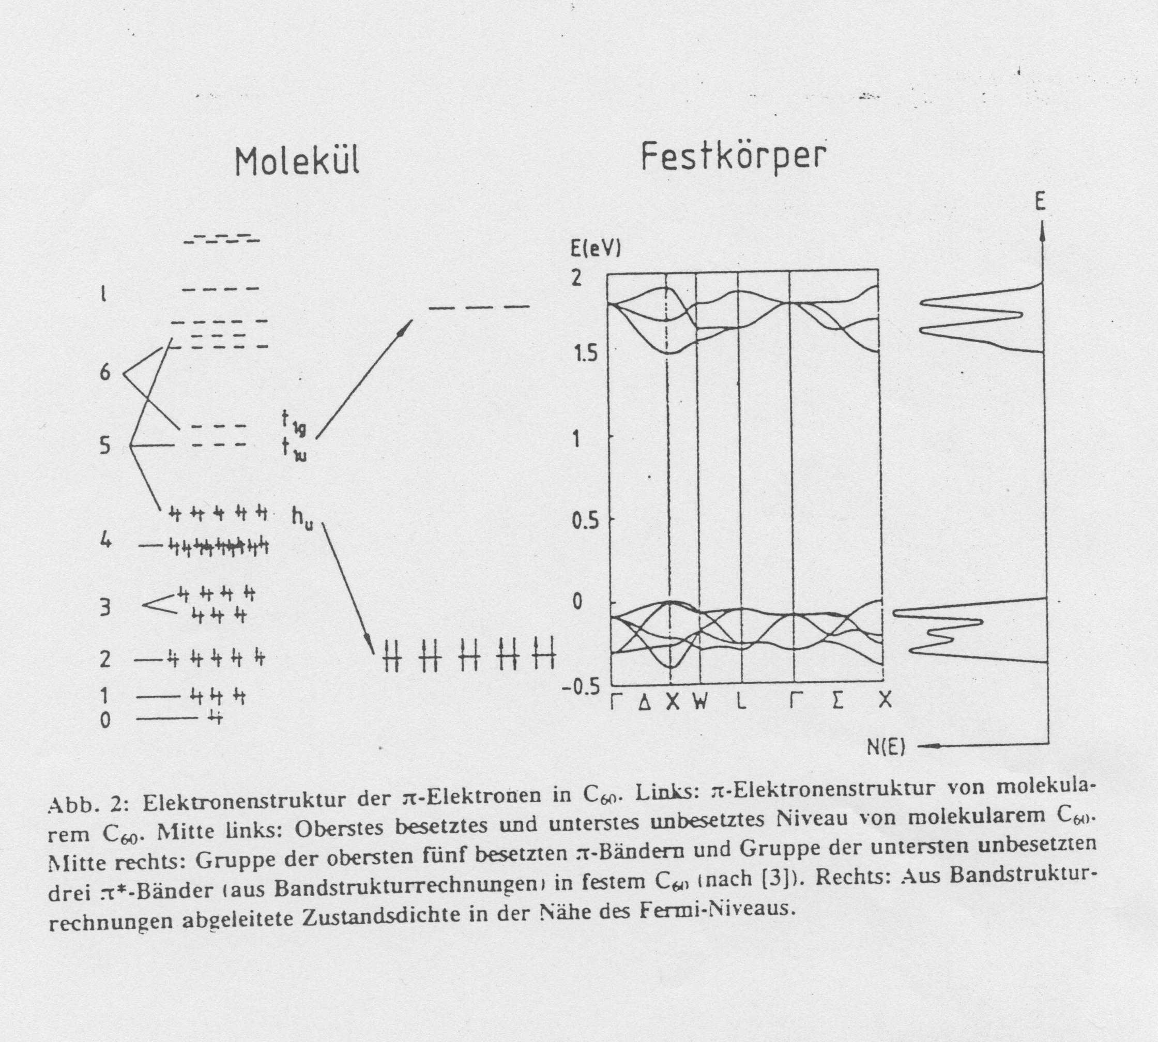
LUMO
DOS
HOMO

Slide 4
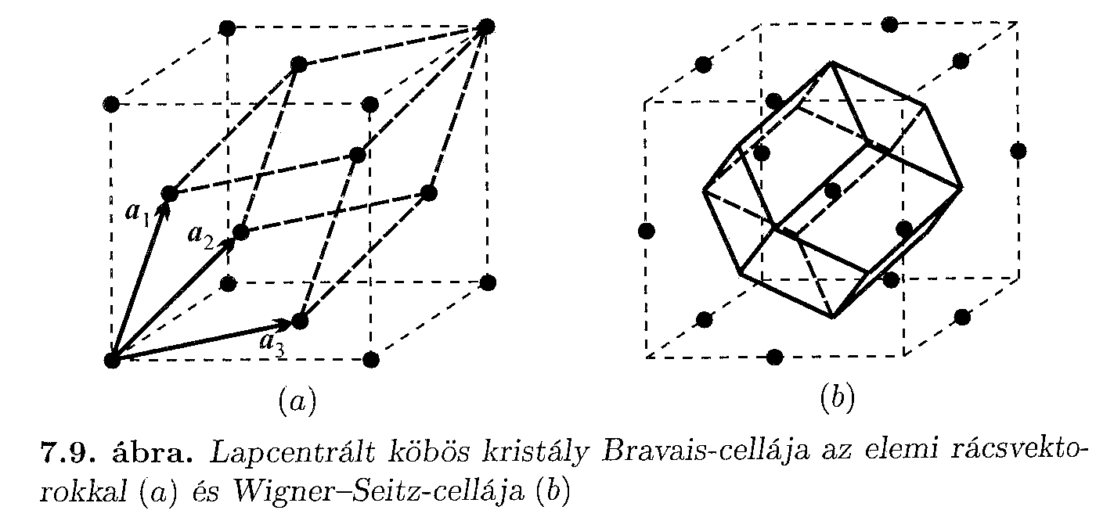
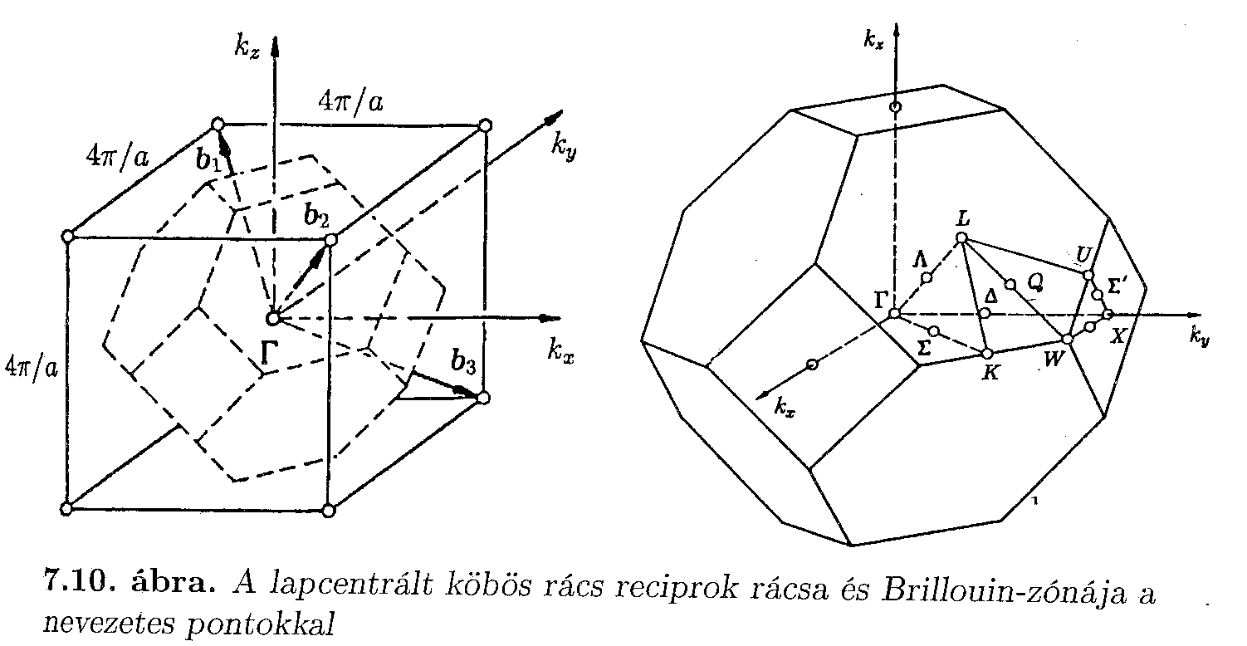
Bravais cell of face centered cubic (fcc) crystal with primitive vectors (a) and fcc Wigner-Seitz cell (b)
(see e.g. https://en.wikipedia.org/wiki/Wigner%E2%80%93Seitz_cell )
Reciprocal lattice of face centered cubic (fcc) lattice and its Brillouin zone with highly symmetric (critical) points
(see e.g. https://en.wikipedia.org/wiki/Brillouin_zone )
Jenő Sólyom: Fundamentals of the Physics of Solids I.

Slide 5
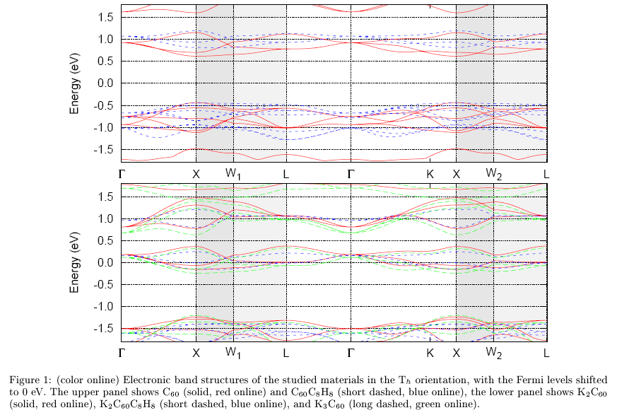
LUMO
HOMO

Slide 6
1
2

Slide 7
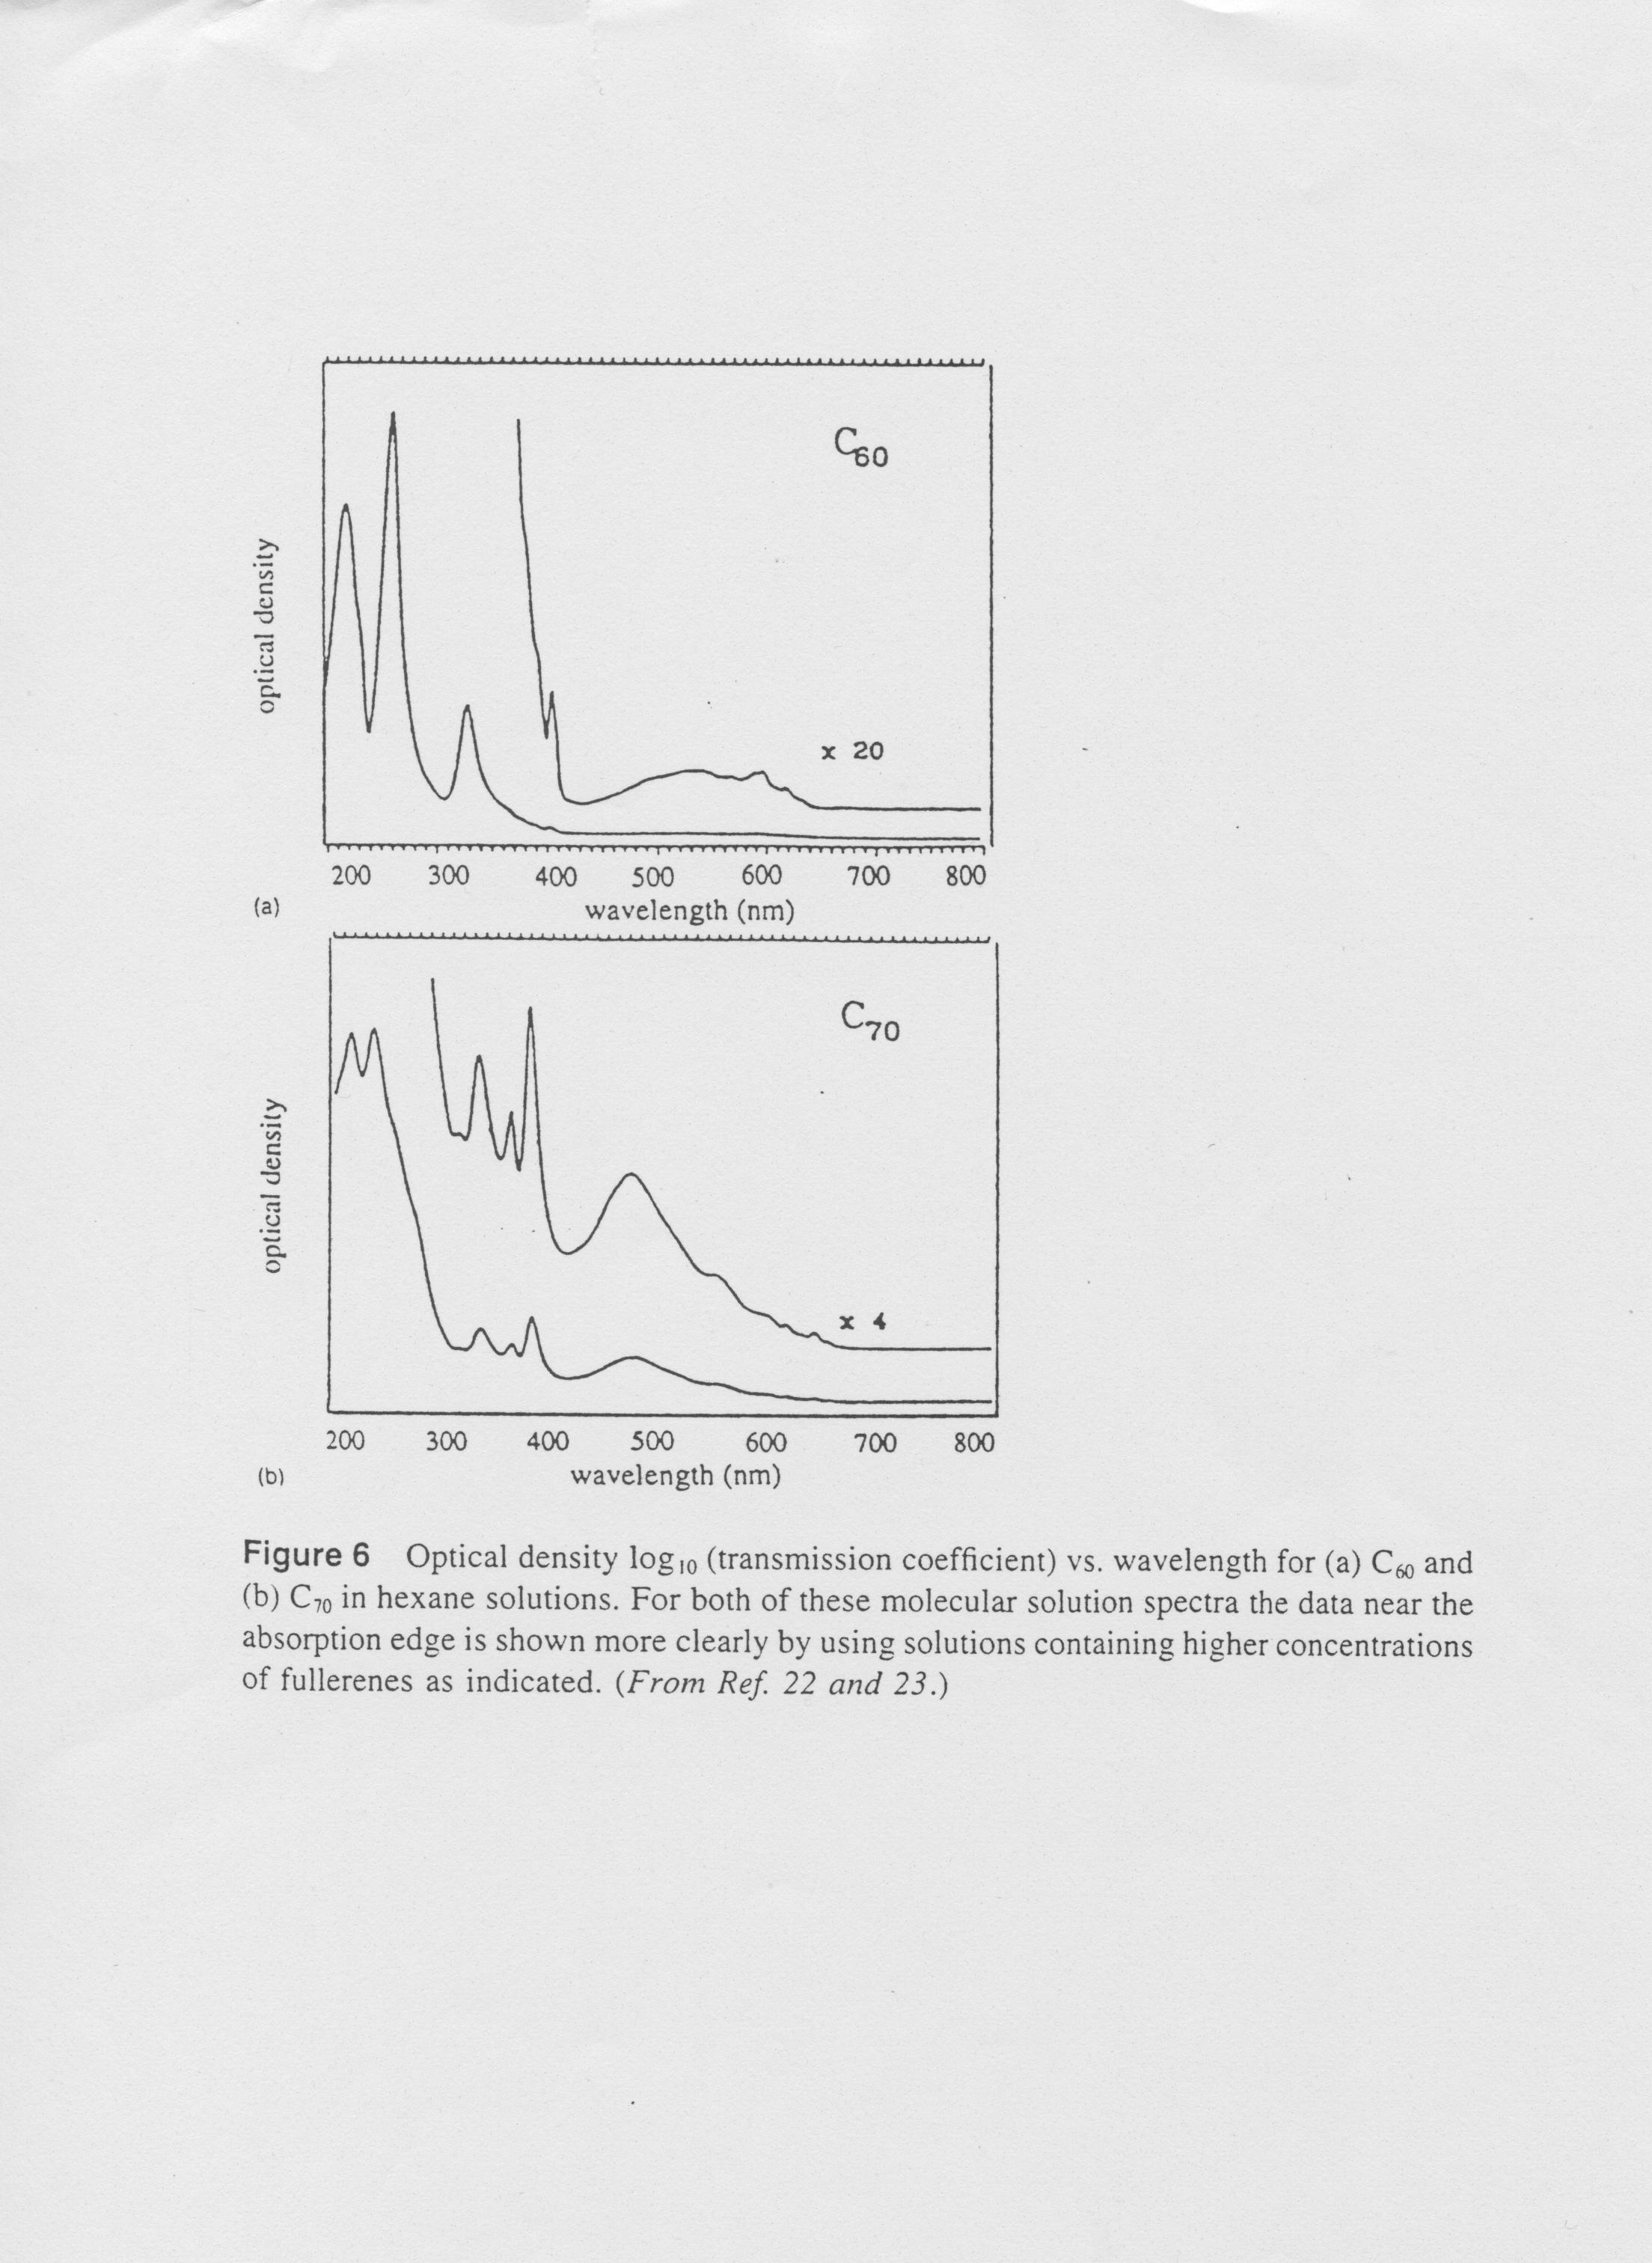
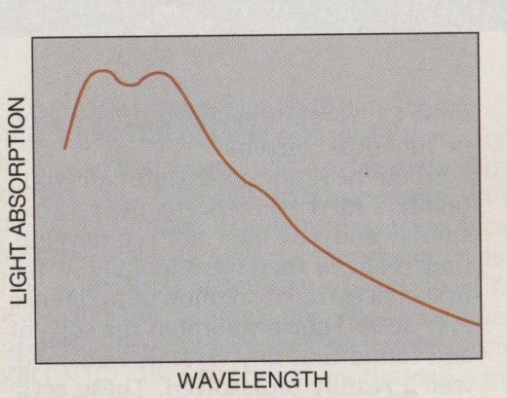
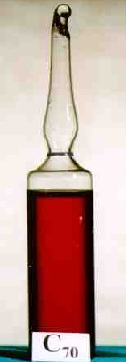
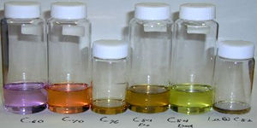
215 nm (5.8 eV)
270 nm (4.6 eV)
335 nm (3.7 eV)
440 nm – 640 nm
(2.8 eV – 1.9 eV)

Slide 8
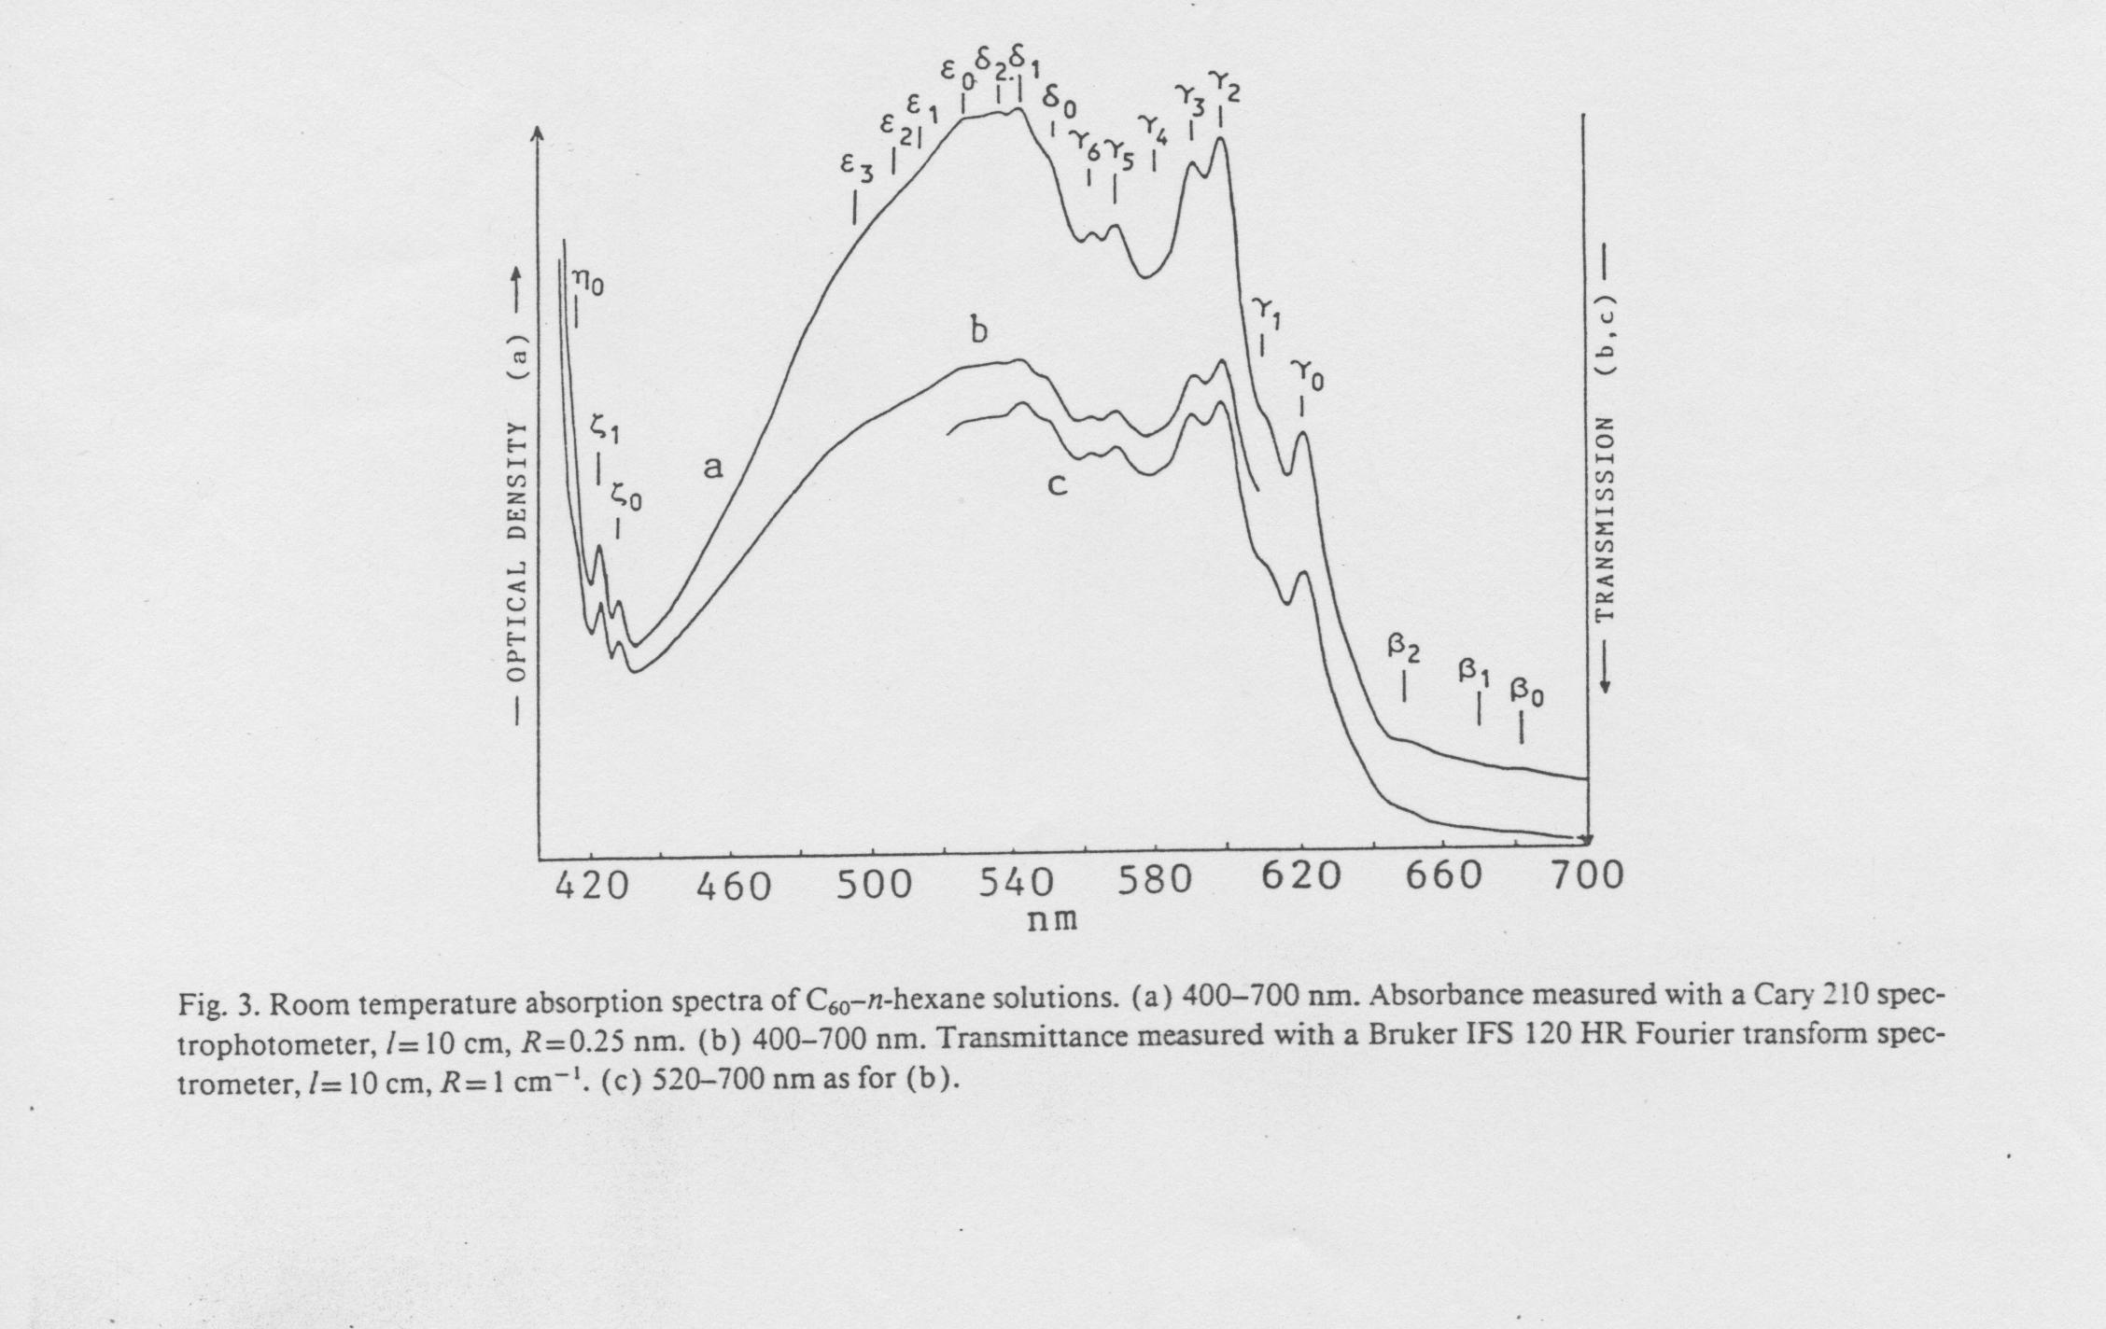

Slide 9
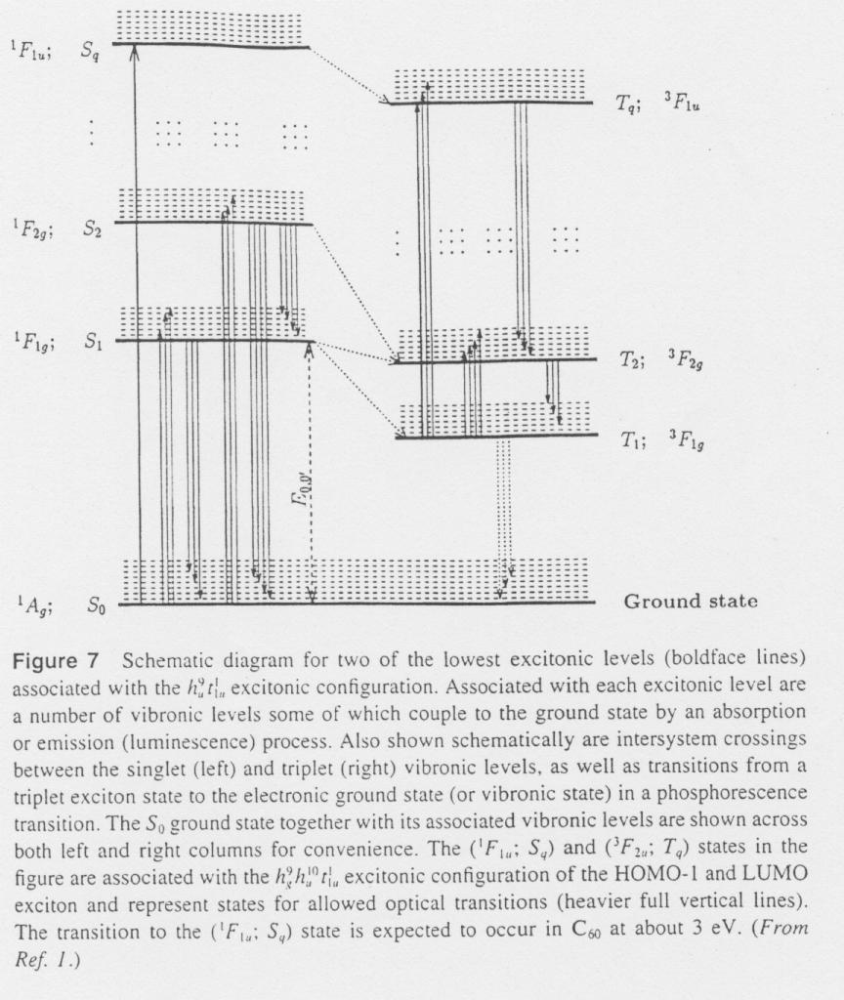

Slide 10
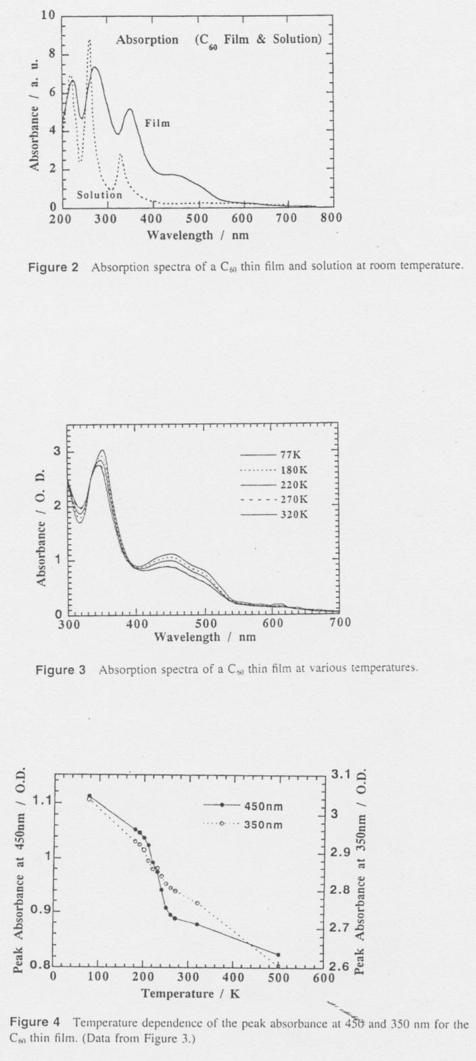

Slide 11
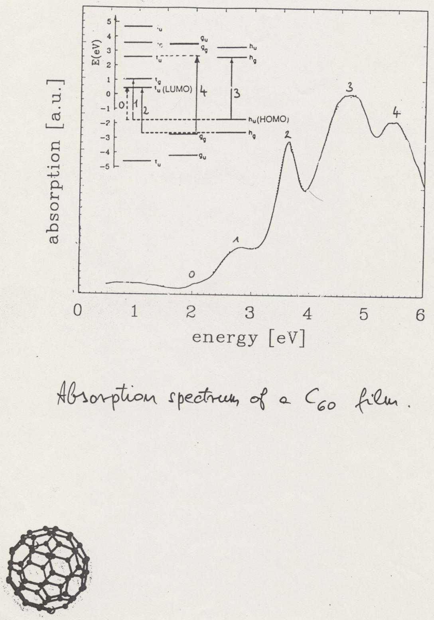

Slide 12
SUPPLEMENT
(dielectric formalism in optics)

Slide 13
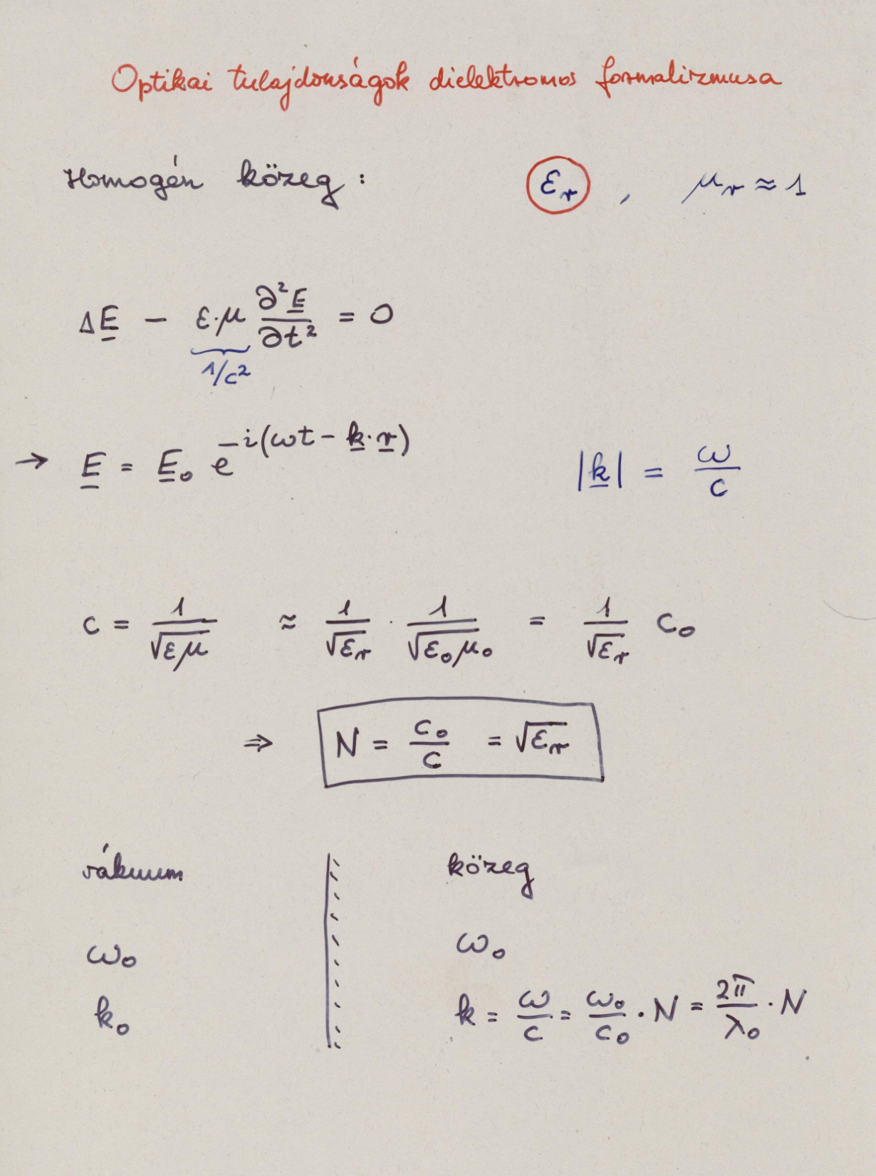

Slide 14
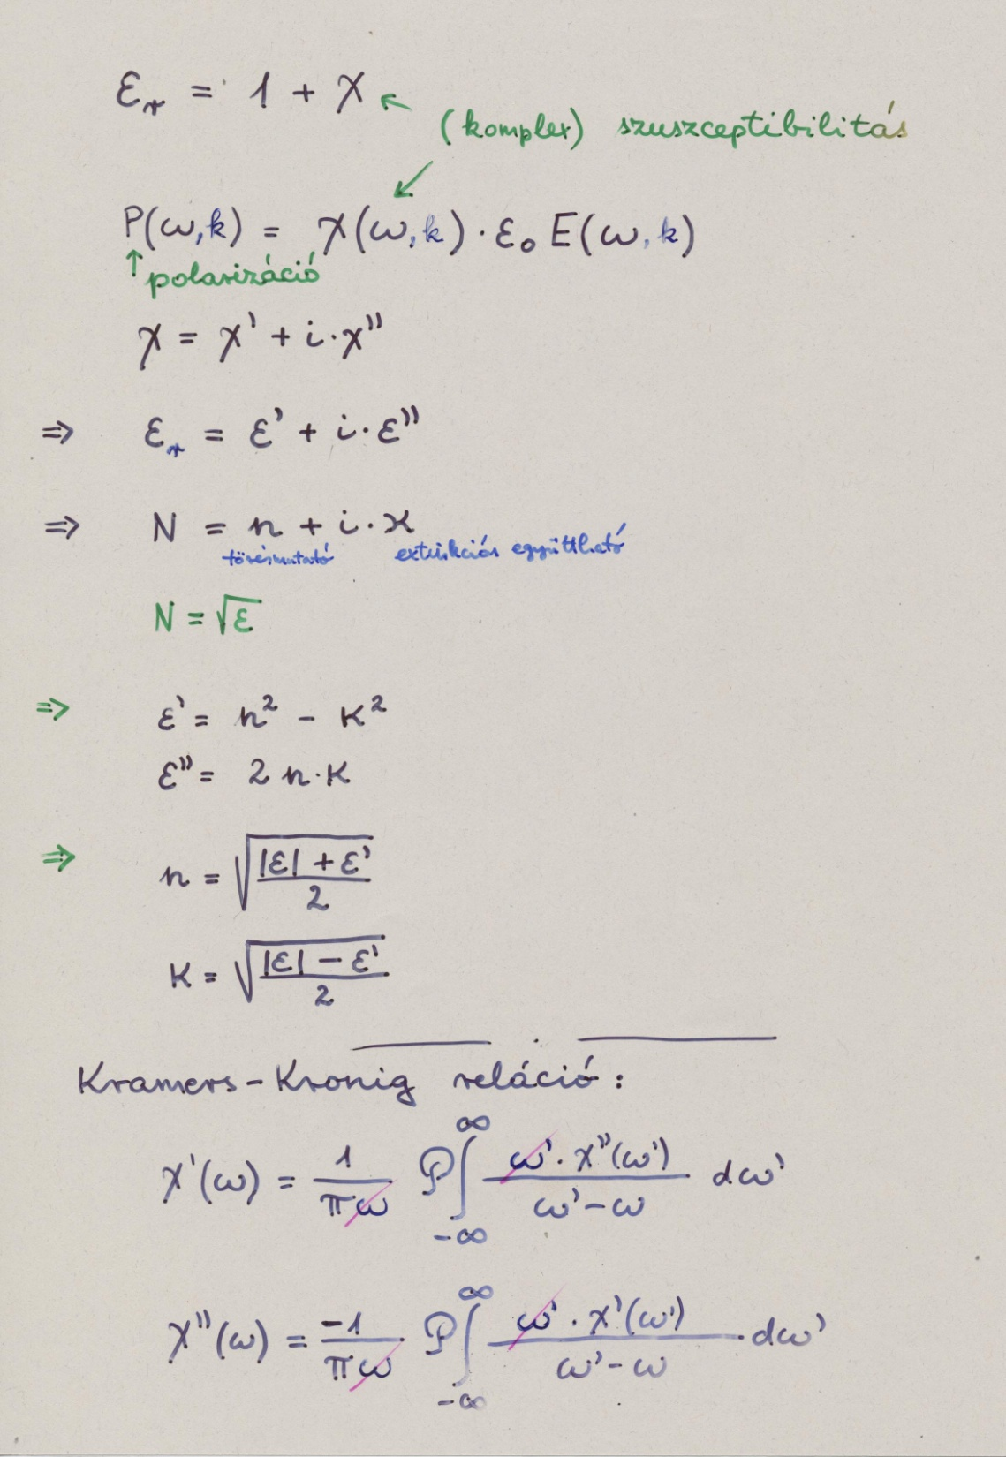

Slide 15
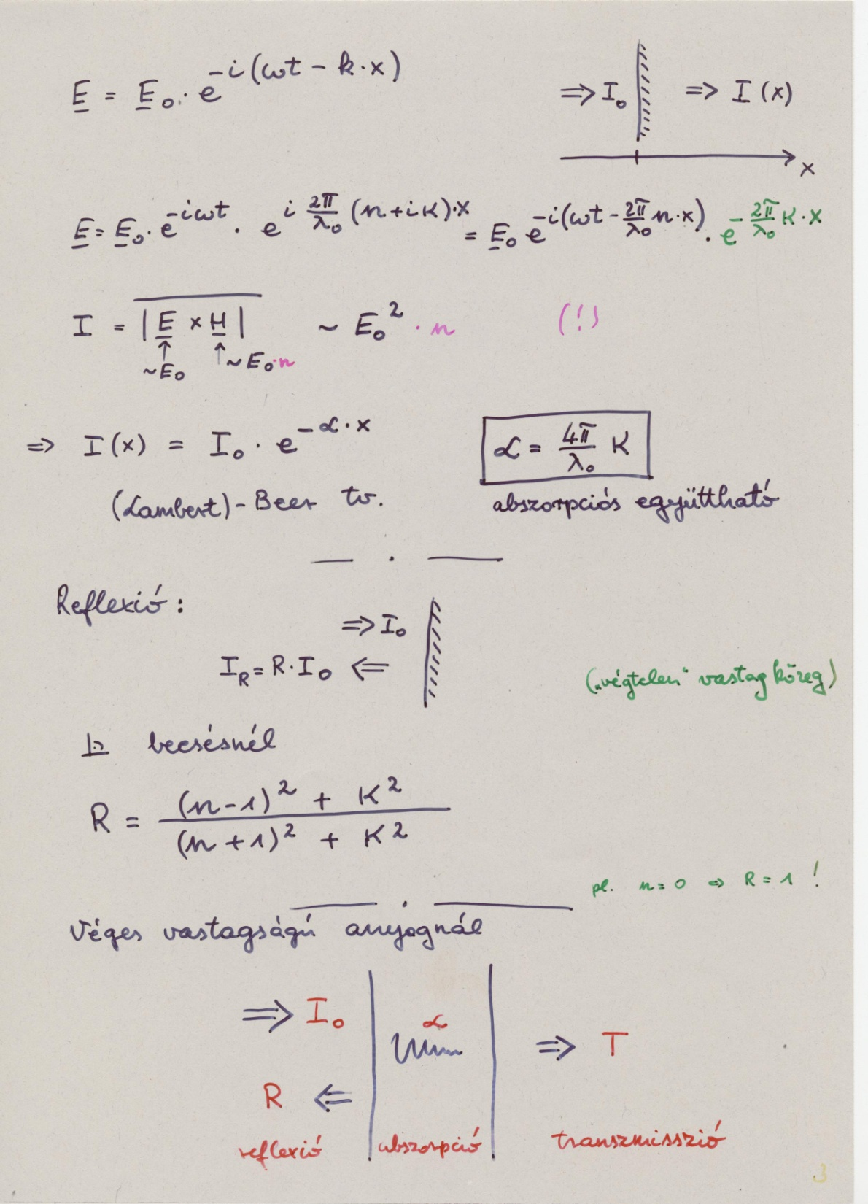

Slide 16
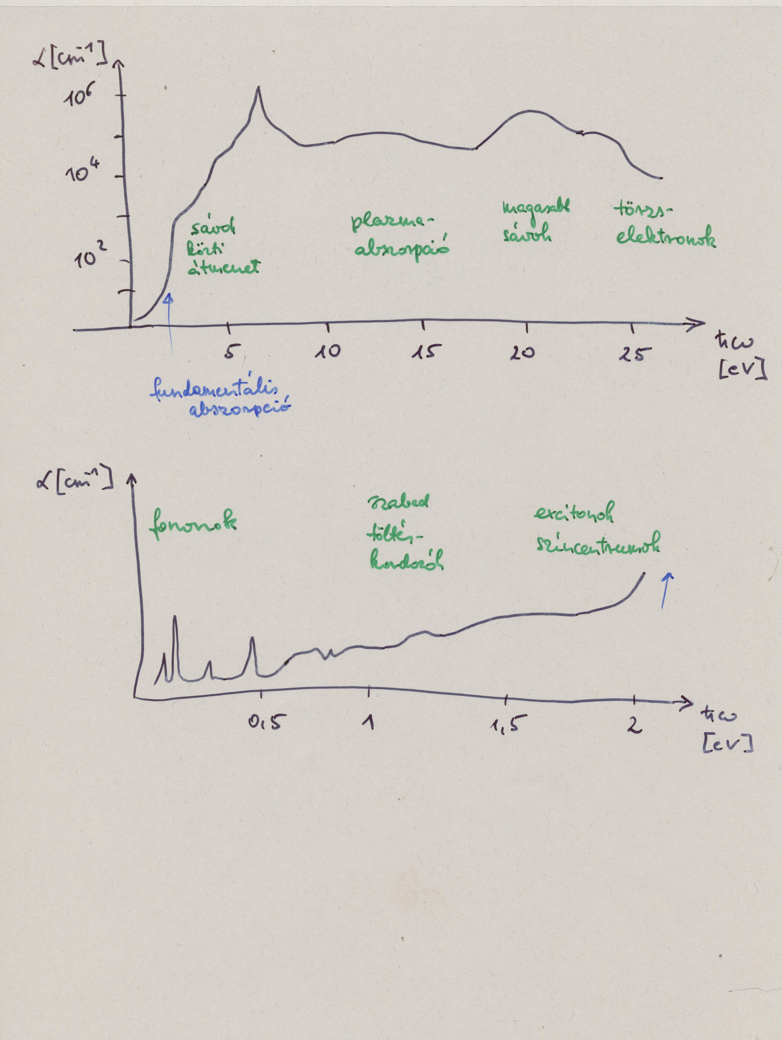

Slide 17
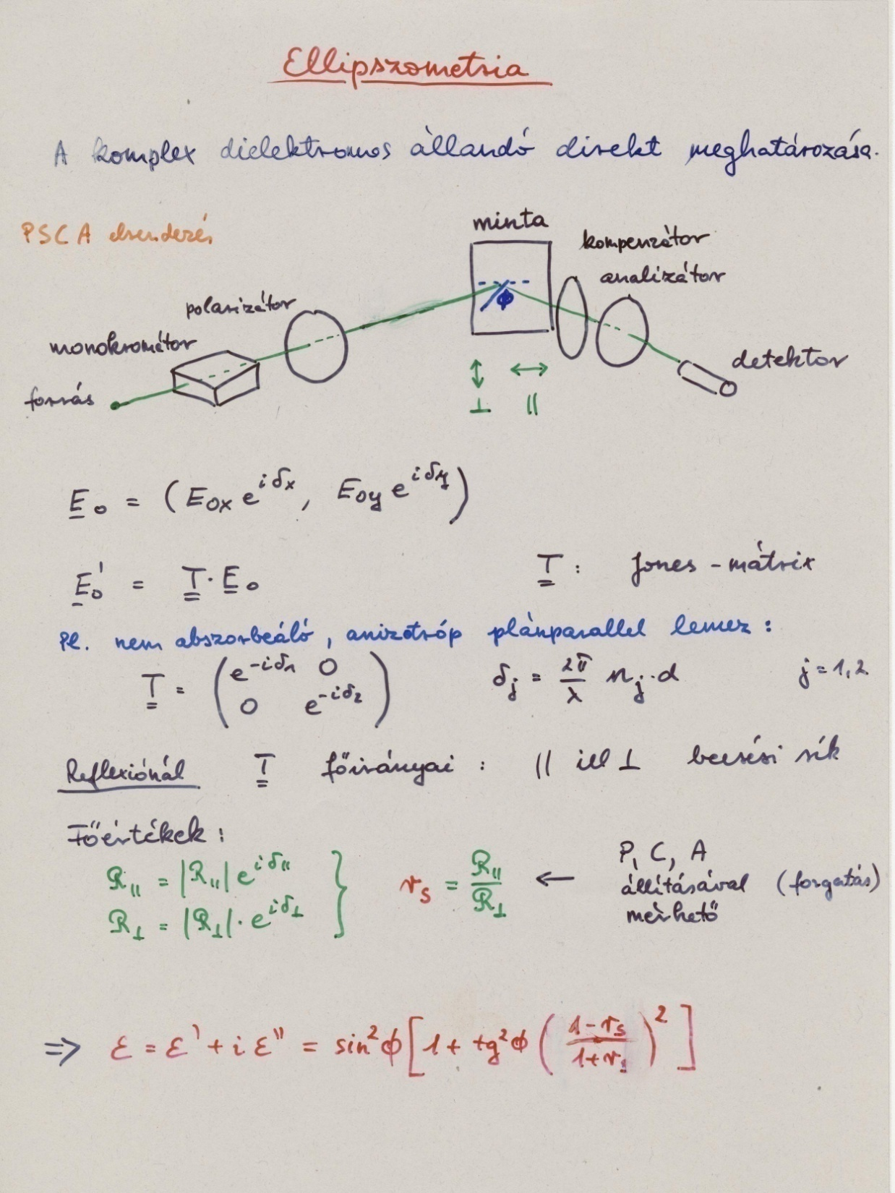

Slide 18
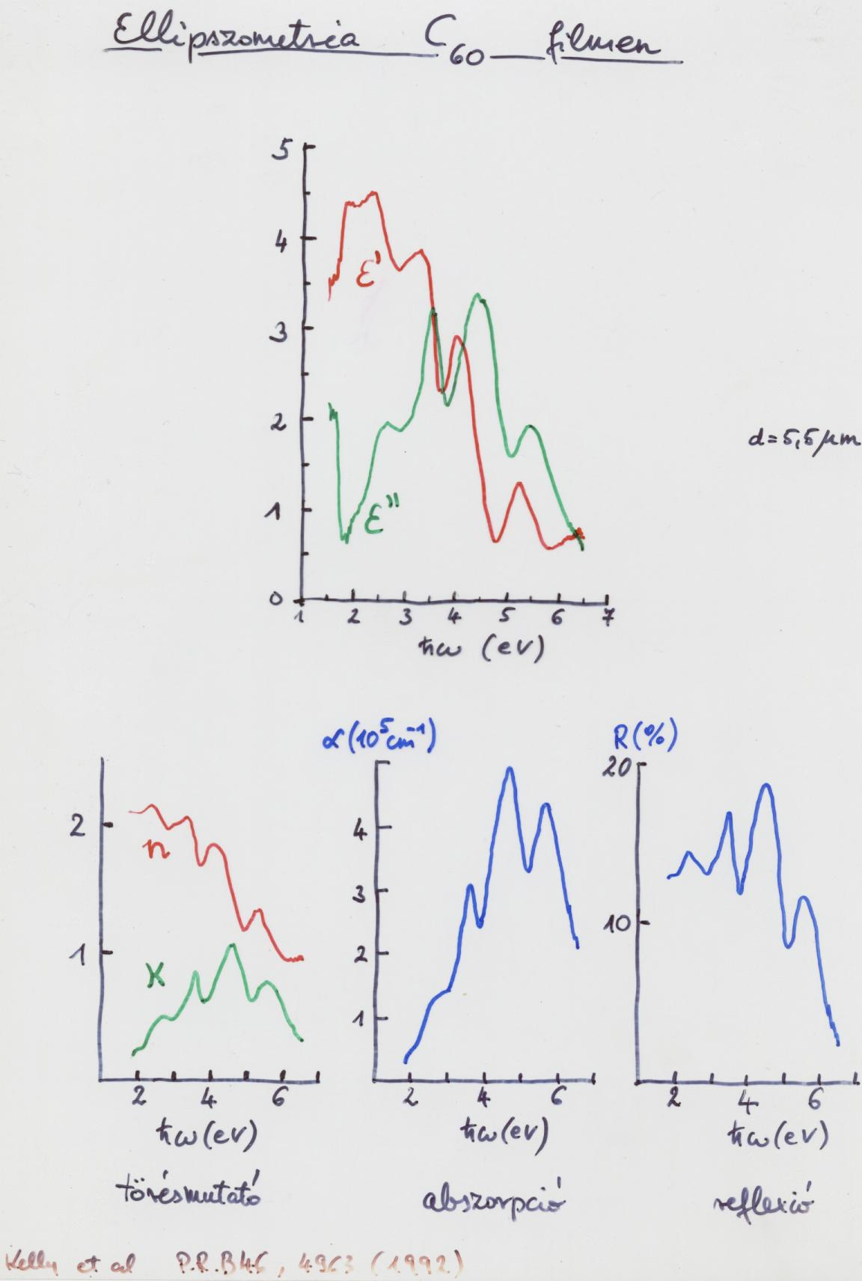

Slide 19
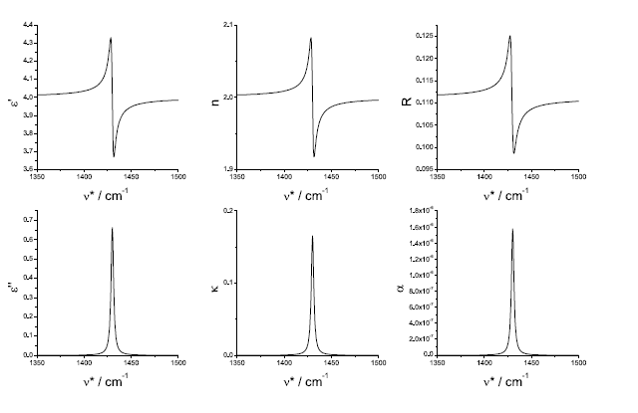
C₆₀

Slide 20
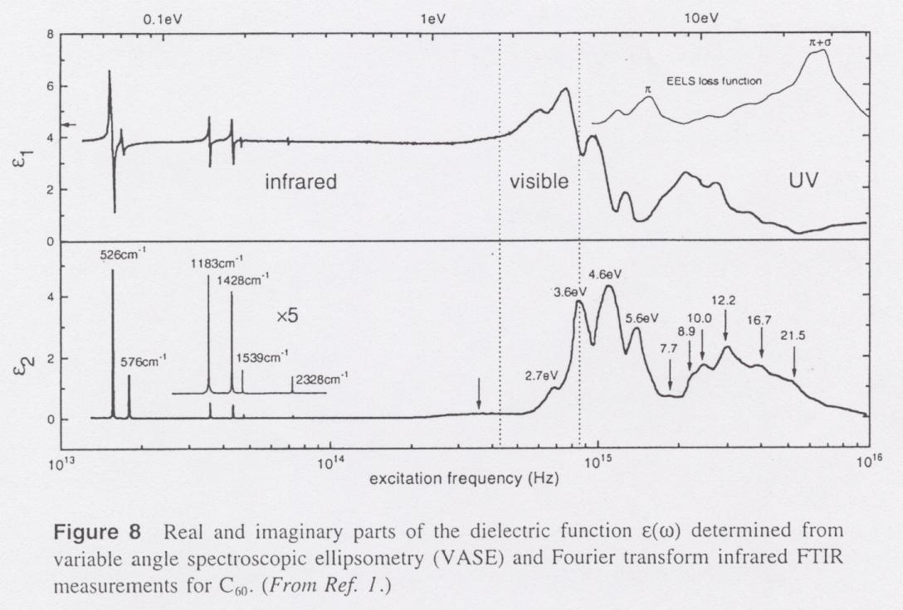

Slide 21
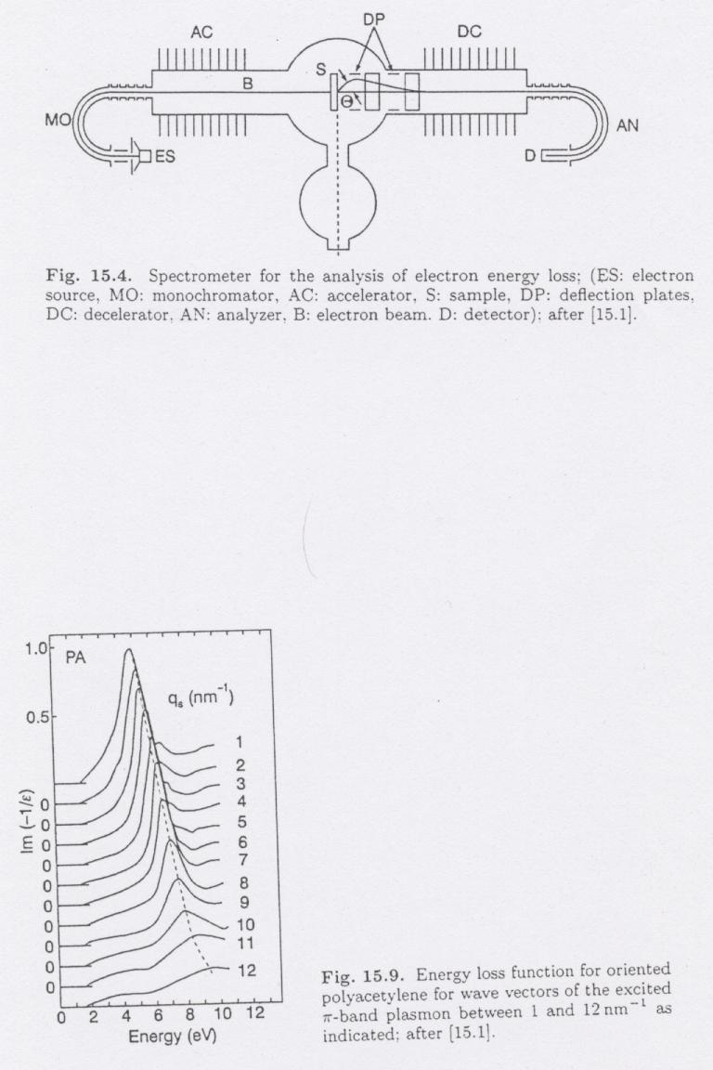
EELS
Im(-1/ε)

Slide 22
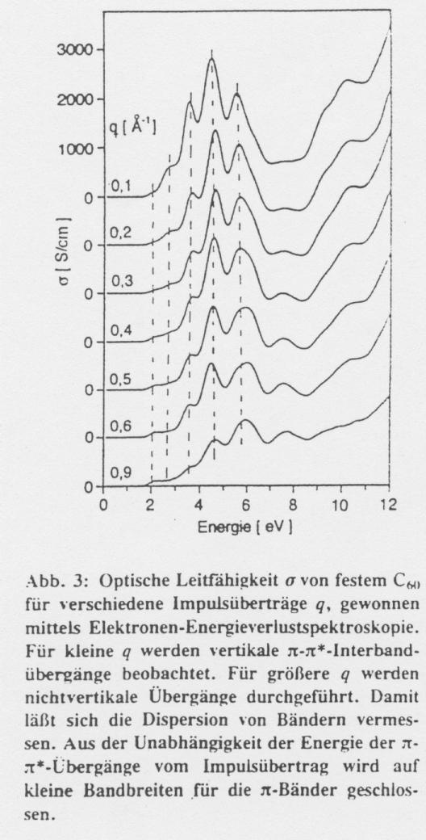
ω·Im(ε)
E_{primer} = 170 keV

Slide 23
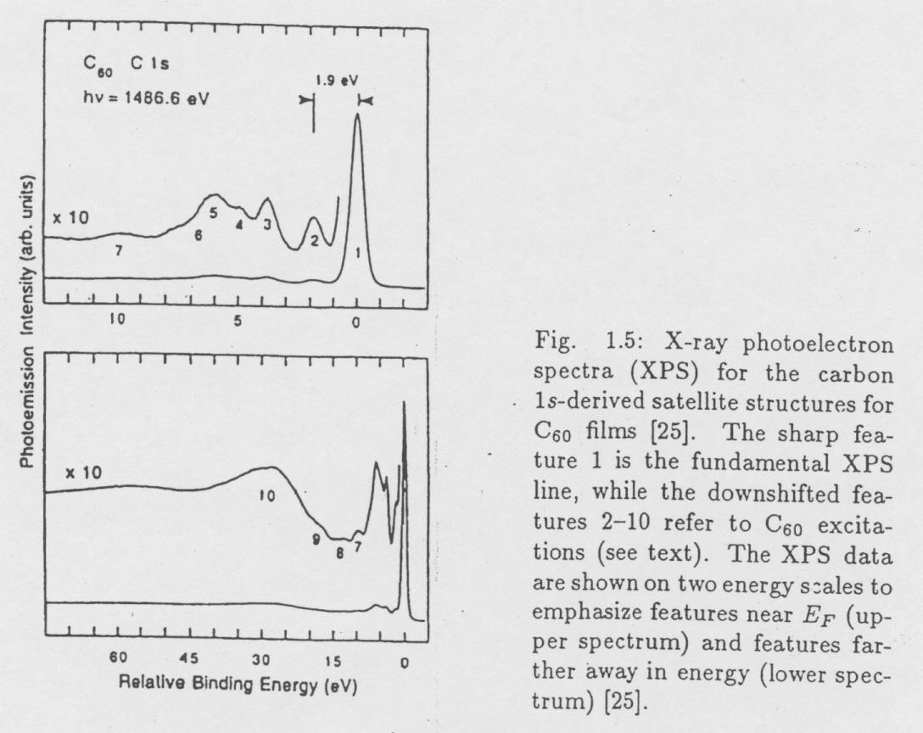
!
E_{b} = 285.0 eV

Slide 24
Sorry, the answer can be found in the next slide …

Slide 25
The selection rules are not the same for interactions with a photon and with an electron.

