Slide 1
CARBON NANOSTRUCTURES
(FULLERENES, CARBON NANOTUBES, GRAPHENE)
lecture for physics and chemistry students
(2020. summer semester – 20. April)
Prof. Jenő Kürti
ELTE Department of Biological Physics
e-mail: kurti@virag.elte.hu www: regivirag.elte.hu/kurti

Slide 2

VIBRATIONS:
Raman- and infrared spectroscopy

Slide 3
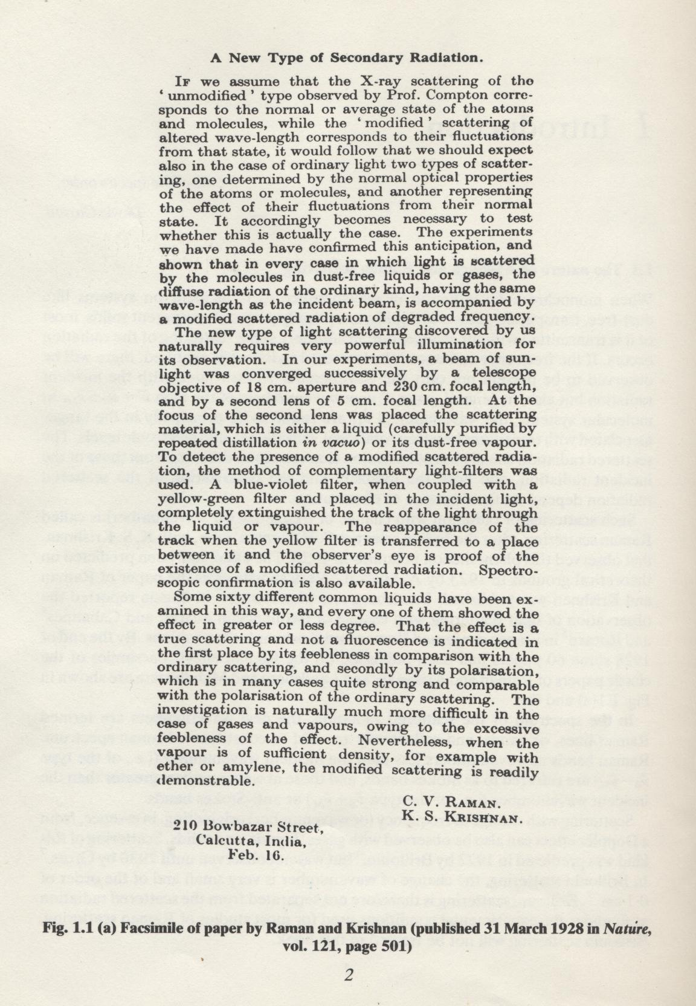
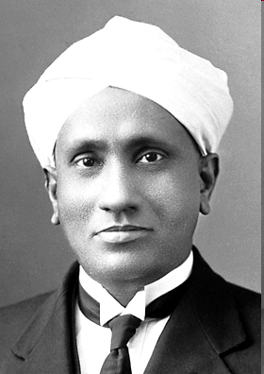
Sir Chandrasekhara Venkata Raman
(7 November 1888 – 21 November 1970)
The Nobel Prize in Physics 1930
"for his work on the scattering of light and for the discovery of the effect named after him".

Slide 4
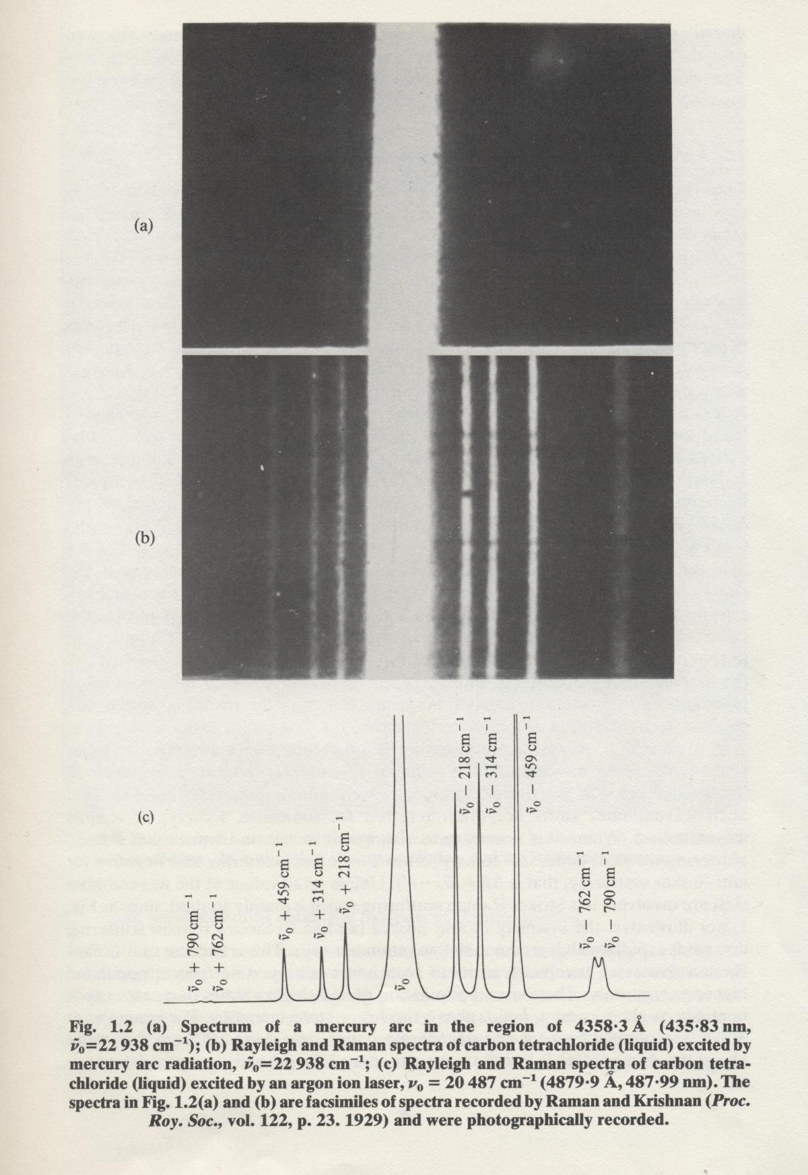
anti
-
Stokes
Stokes
D.A. Long: Raman spectroscopy
McGraw-Hill, 1977

Slide 5
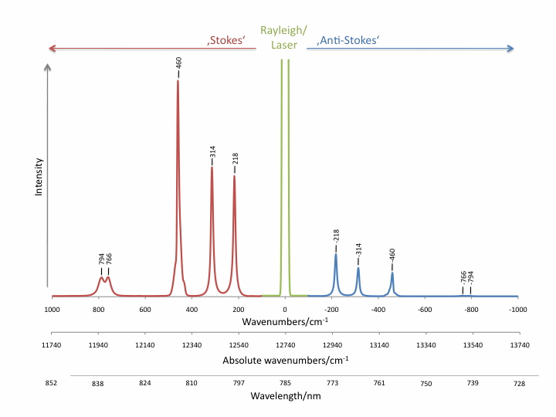
http://www.raman.de/htmlEN/basics/intensityEng.html

Slide 6
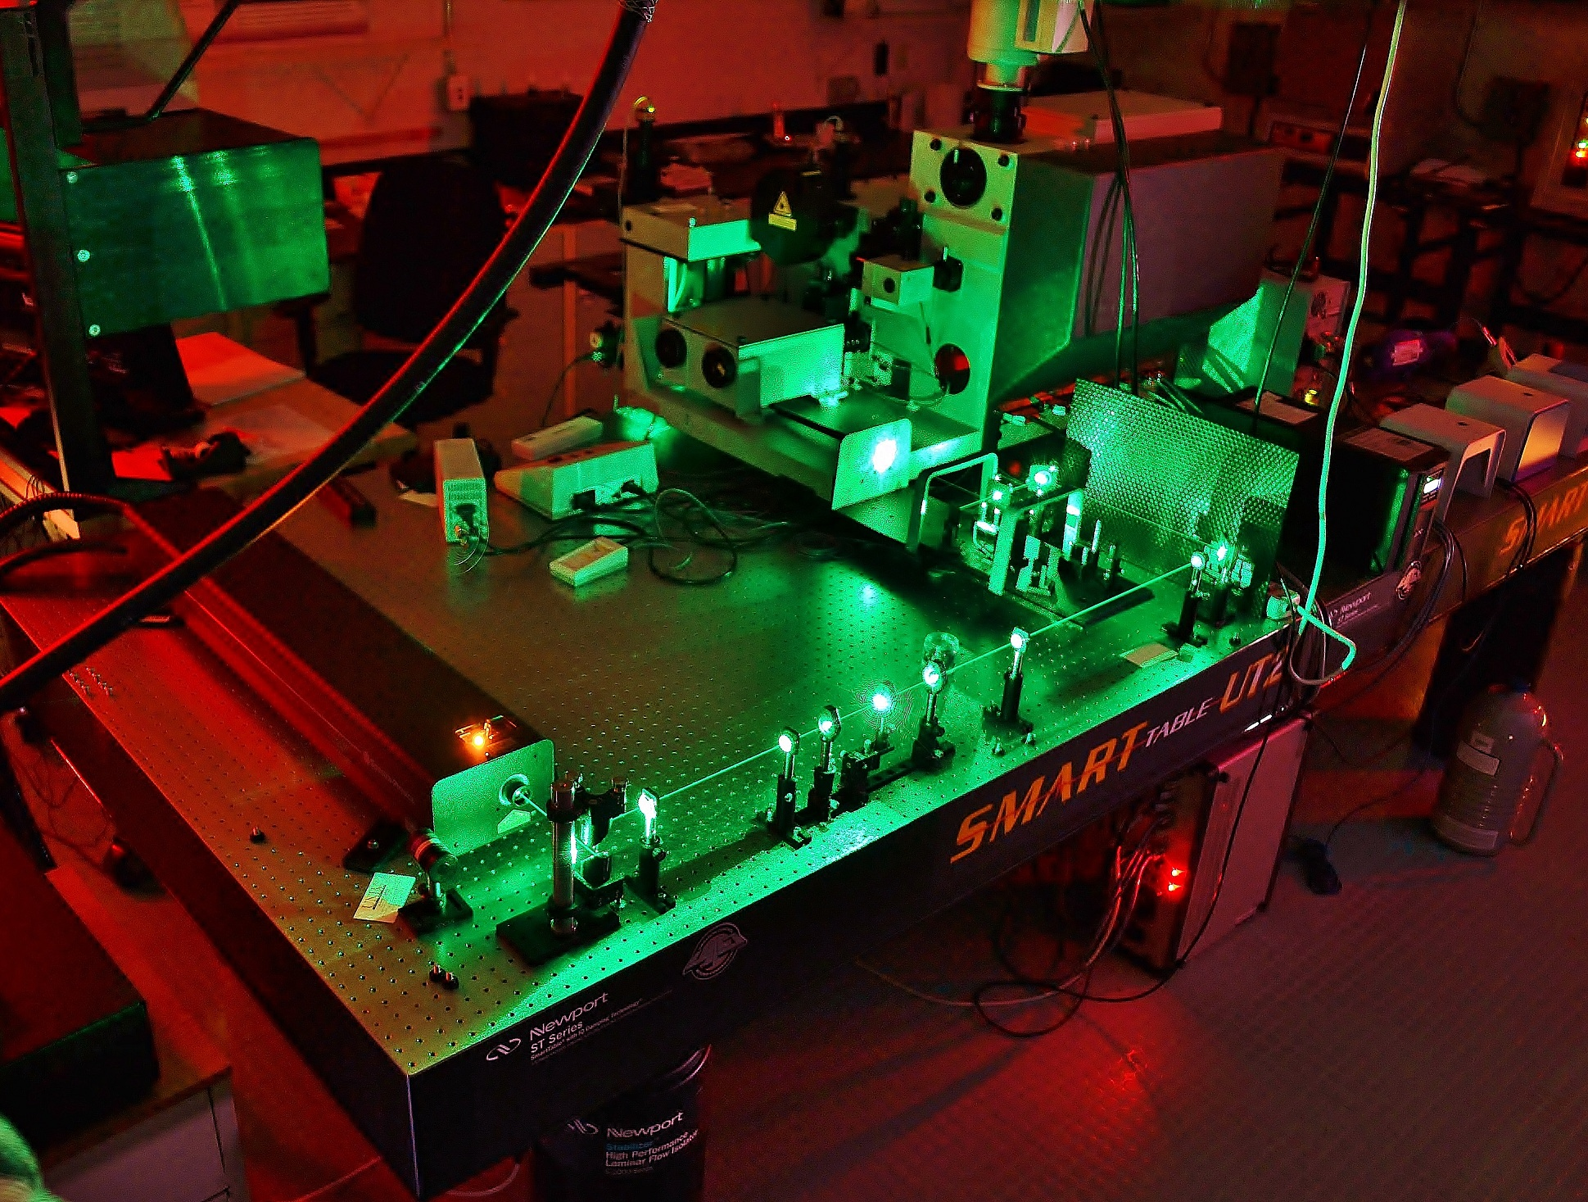
https://faculty.unlv.edu/klipinska/assets/Lab/RAMAN/

Slide 7
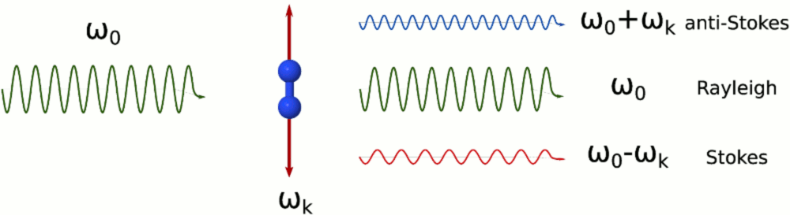
Inelastic light scattering: classical picture
induced
dipole
moment
k
0
0
0
k
0
k
polarizability
Rayleigh
anti-Stokes
Stokes
Raman

Slide 8
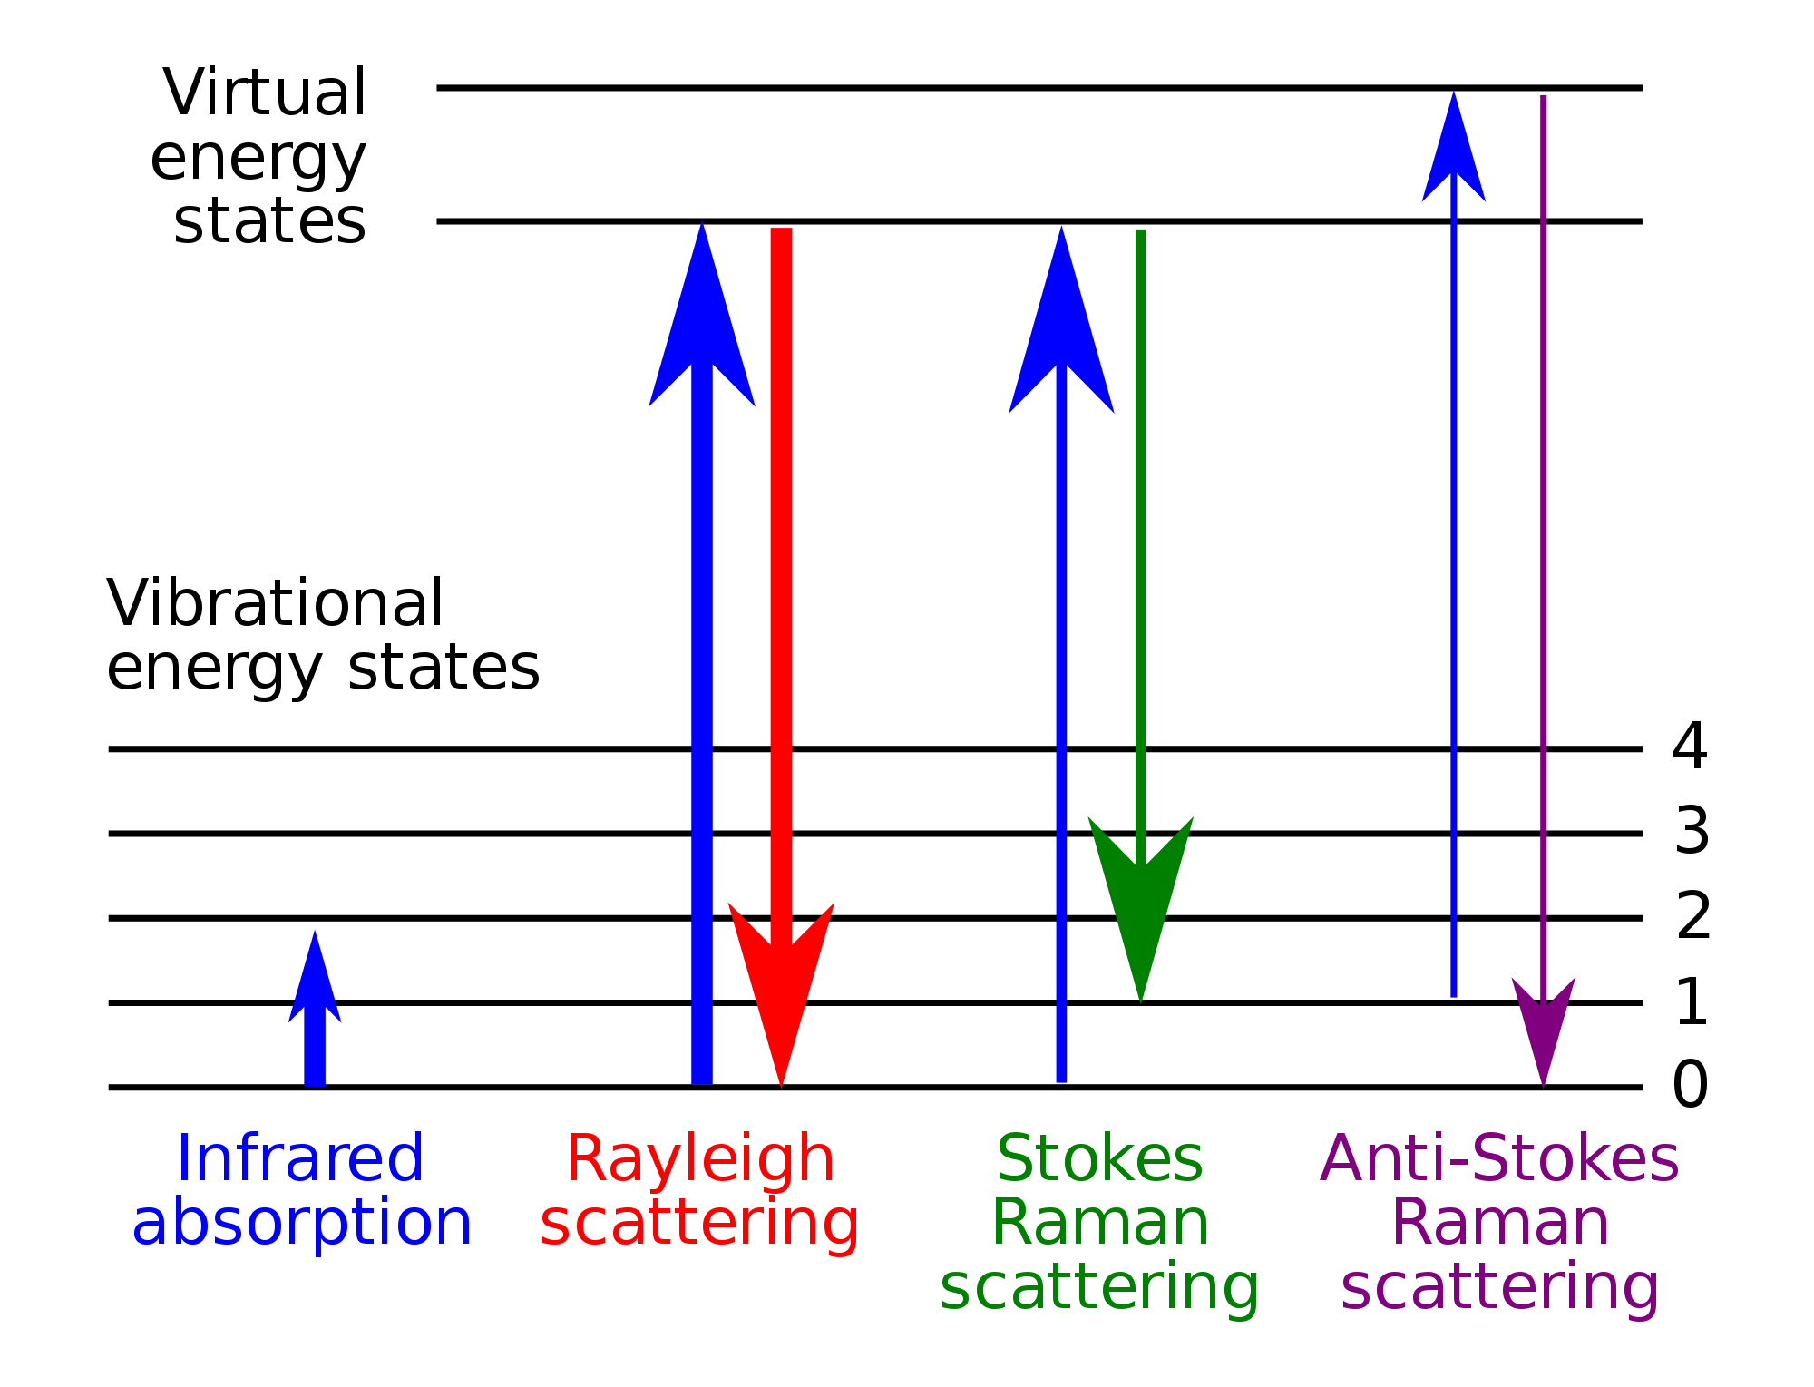
Inelastic light scattering: QM picture
ω₁
ω₂
ω₁
ω₂
ground state - -
ω (ħ=1)
ω₂ = ω₁ + ω
ω₂ = ω₁ – ω
wikipedia

Slide 9
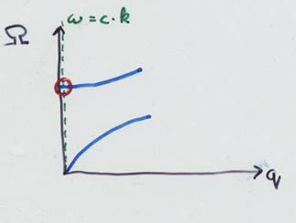
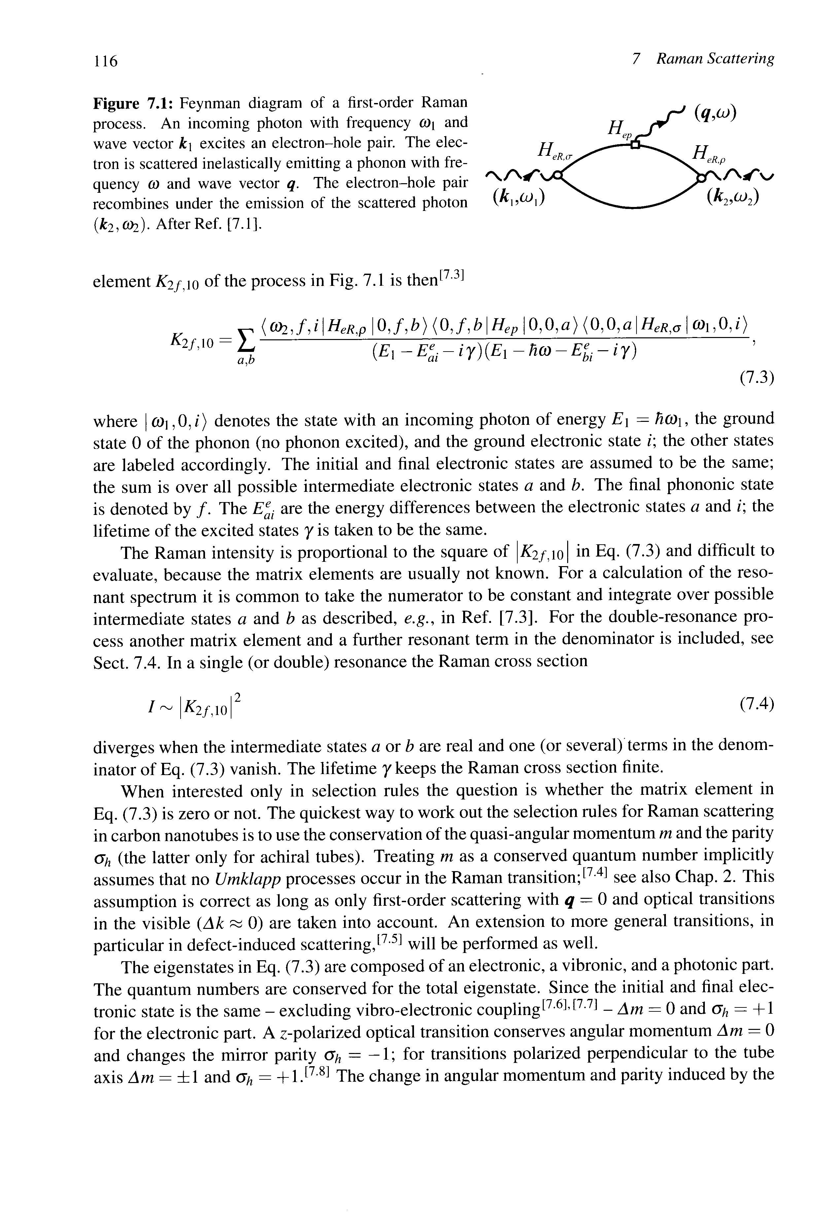
1st order Raman (Stokes)
phonon
q ≈ 0 (Γ–point)
ω₂ = ω₁ – ω
photon _{in}
photon _{out}
a
b
ω,
ω,
ω,
0
0

Slide 10
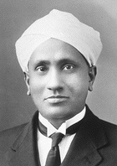
hν_{in}
hν_{out}
hν_{in}
hν_{out}
hν_{in}
hν_{out}
resonance Raman
(incoming)
C. V. Raman

Slide 11
Vibrational modes of C₆₀ molecule
Degree of freedom: 60 x 3 = 180
Translation: 3
Rotation: 3
Number of vibrational modes: 180 – 6 = 174
Question: how can we categorize these 174 normal modes?
An arbitrary (small) distortion of the C₆₀ molecule can be described by 60 (short) displacement vectors: one for each atom. These displacement vectors form a 180 dimensional representation of the icosahedral group. Of course, this is a reducible representation.
Homework:
Reduce this 180 dimensional representation into direct sum of irreducible representations.
Use the character table of the icosahedral group in the next slide. We are familiar with it already.
You can compare your solution with that, given after the character table.

Slide 12
Character table of I_{h} group
(h=120)
2z²-x²-y², xy,
yz, zx, x²-y²
+

Slide 13
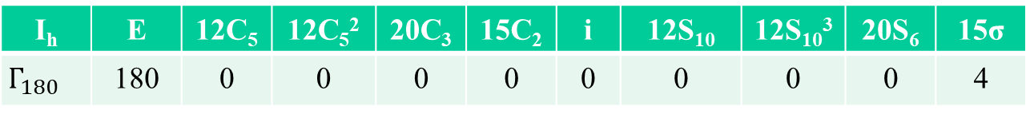
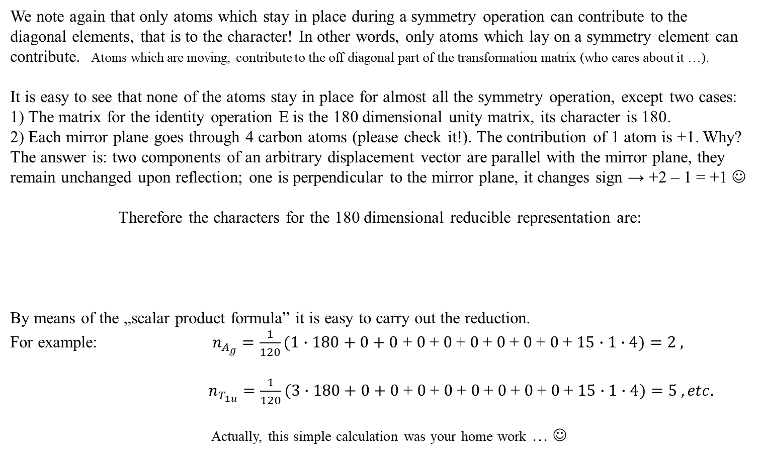
Solution
We note again that only atoms which stay in place during a symmetry operation can contribute to the diagonal elements, that is to the character! In other words, only atoms which lay on a symmetry element can contribute. Atoms which are moving, contribute to the off diagonal part of the transformation matrix (who cares about it …).
It is easy to see that none of the atoms stay in place for almost all the symmetry operation, except two cases:
1) The matrix for the identity operation E is the 180 dimensional unity matrix, its character is 180.
2) Each mirror plane goes through 4 carbon atoms (please check it!). The contribution of 1 atom is +1. Why? The answer is: two components of an arbitrary displacement vector are parallel with the mirror plane, they remain unchanged upon reflection; one is perpendicular to the mirror plane, it changes sign → +2 – 1 = +1 ☺
Therefore the characters for the 180 dimensional reducible representation are:
By means of the „scalar product formula” it is easy to carry out the reduction.
For example: $n_{A_{g}}=\frac{1}{120}(1∙180+0+0$ + $0$+ $0$+ $0$+ $0$+ $0$+ $0$+ $15∙1∙4)=2 ,$
$n_{T_{1u}}=\frac{1}{120}(3∙180+0+0$ + $0$+ $0$+ $0$+ $0$+ $0$+ $0$+ $15∙1∙4)=5 , etc.$
Actually, this simple calculation was your home work … ☺
I_{h} | E | 12C₅ | 12C₅² | 20C₃ | 15C₂ | i | 12S₁₀ | 12S₁₀³ | 20S₆ | 15σ
$$Γ_{{180}_{}}$$ | 180 | 0 | 0 | 0 | 0 | 0 | 0 | 0 | 0 | 4
!
!

Slide 14
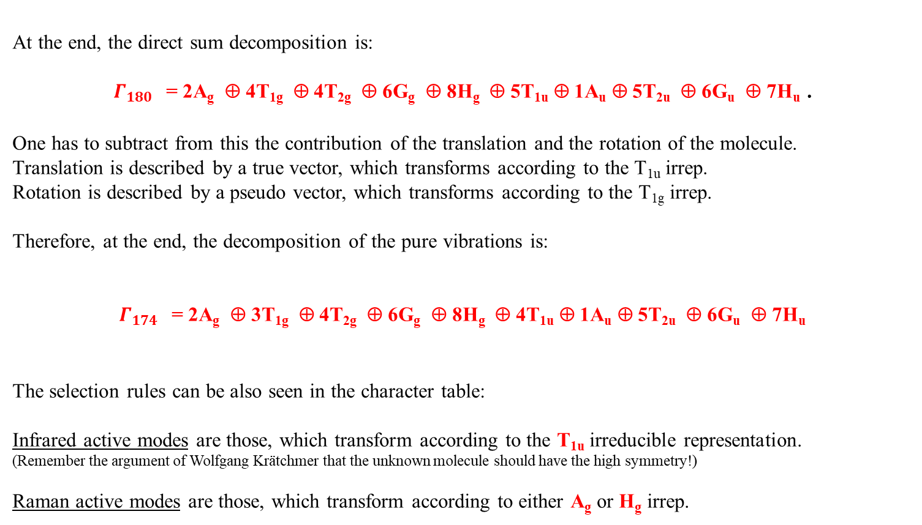
Solution (cont.)
At the end, the direct sum decomposition is:
$Γ_{{180}_{}}$= 2A_{g} ⊕ 4T_{1g} ⊕ 4T_{2g} ⊕ 6G_{g} ⊕ 8H_{g} ⊕ 5T_{1u} ⊕ 1A_{u} ⊕ 5T_{2u} ⊕ 6G_{u} ⊕ 7H_{u} .
One has to subtract from this the contribution of the translation and the rotation of the molecule.
Translation is described by a true vector, which transforms according to the T_{1u} irrep.
Rotation is described by a pseudo vector, which transforms according to the T_{1g} irrep.
Therefore, at the end, the decomposition of the pure vibrations is:
$Γ_{{174}_{}}$= 2A_{g} ⊕ 3T_{1g} ⊕ 4T_{2g} ⊕ 6G_{g} ⊕ 8H_{g} ⊕ 4T_{1u} ⊕ 1A_{u} ⊕ 5T_{2u} ⊕ 6G_{u} ⊕ 7H_{u}
The selection rules can be also seen in the character table:
Infrared active modes are those, which transform according to the T_{1u} irreducible representation.
(Remember the argument of Wolfgang Krätchmer that the unknown molecule should have the high symmetry!)
Raman active modes are those, which transform according to either A_{g} or H_{g} irrep.
R
R
IR

Slide 15
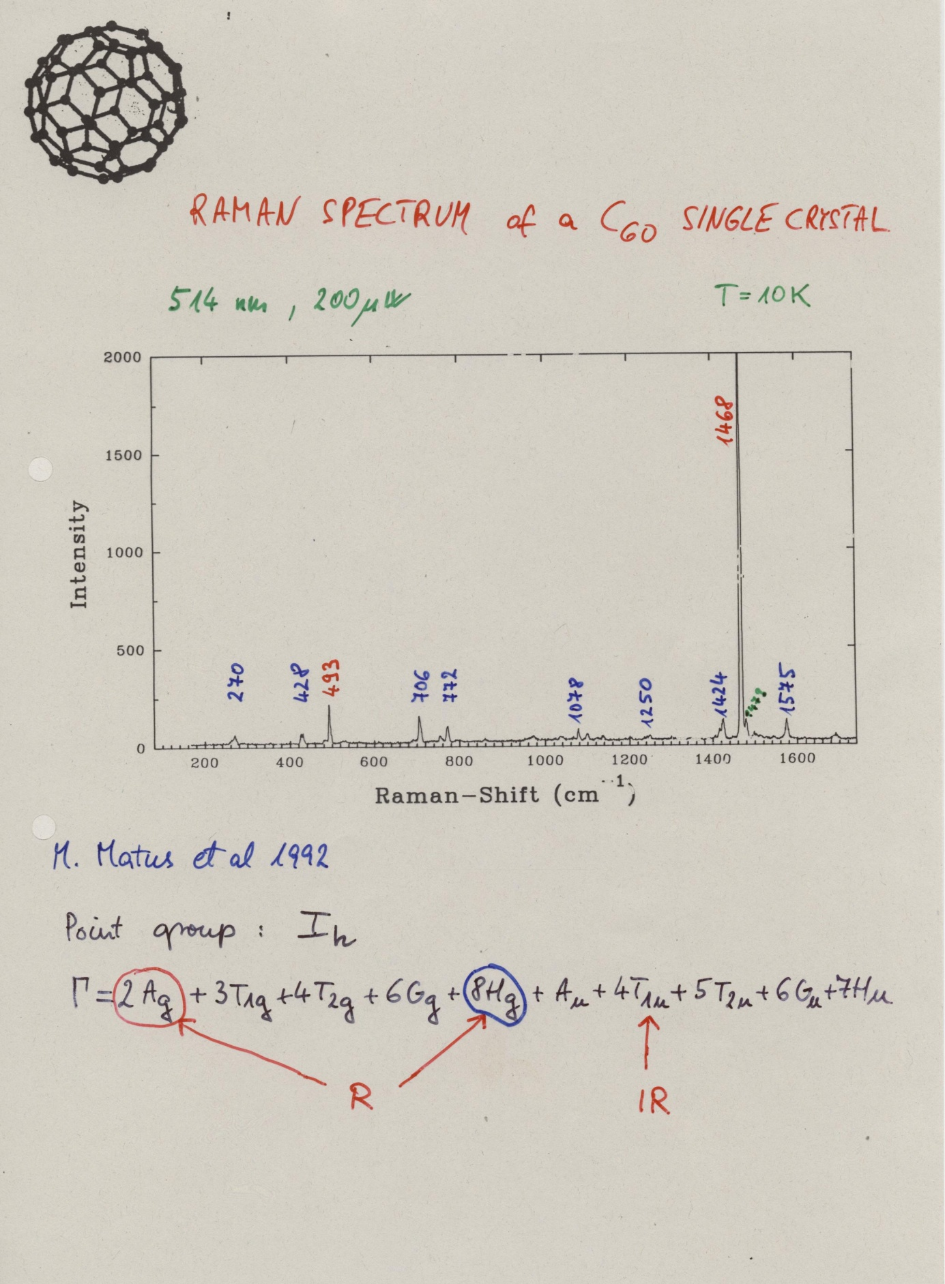

Slide 16
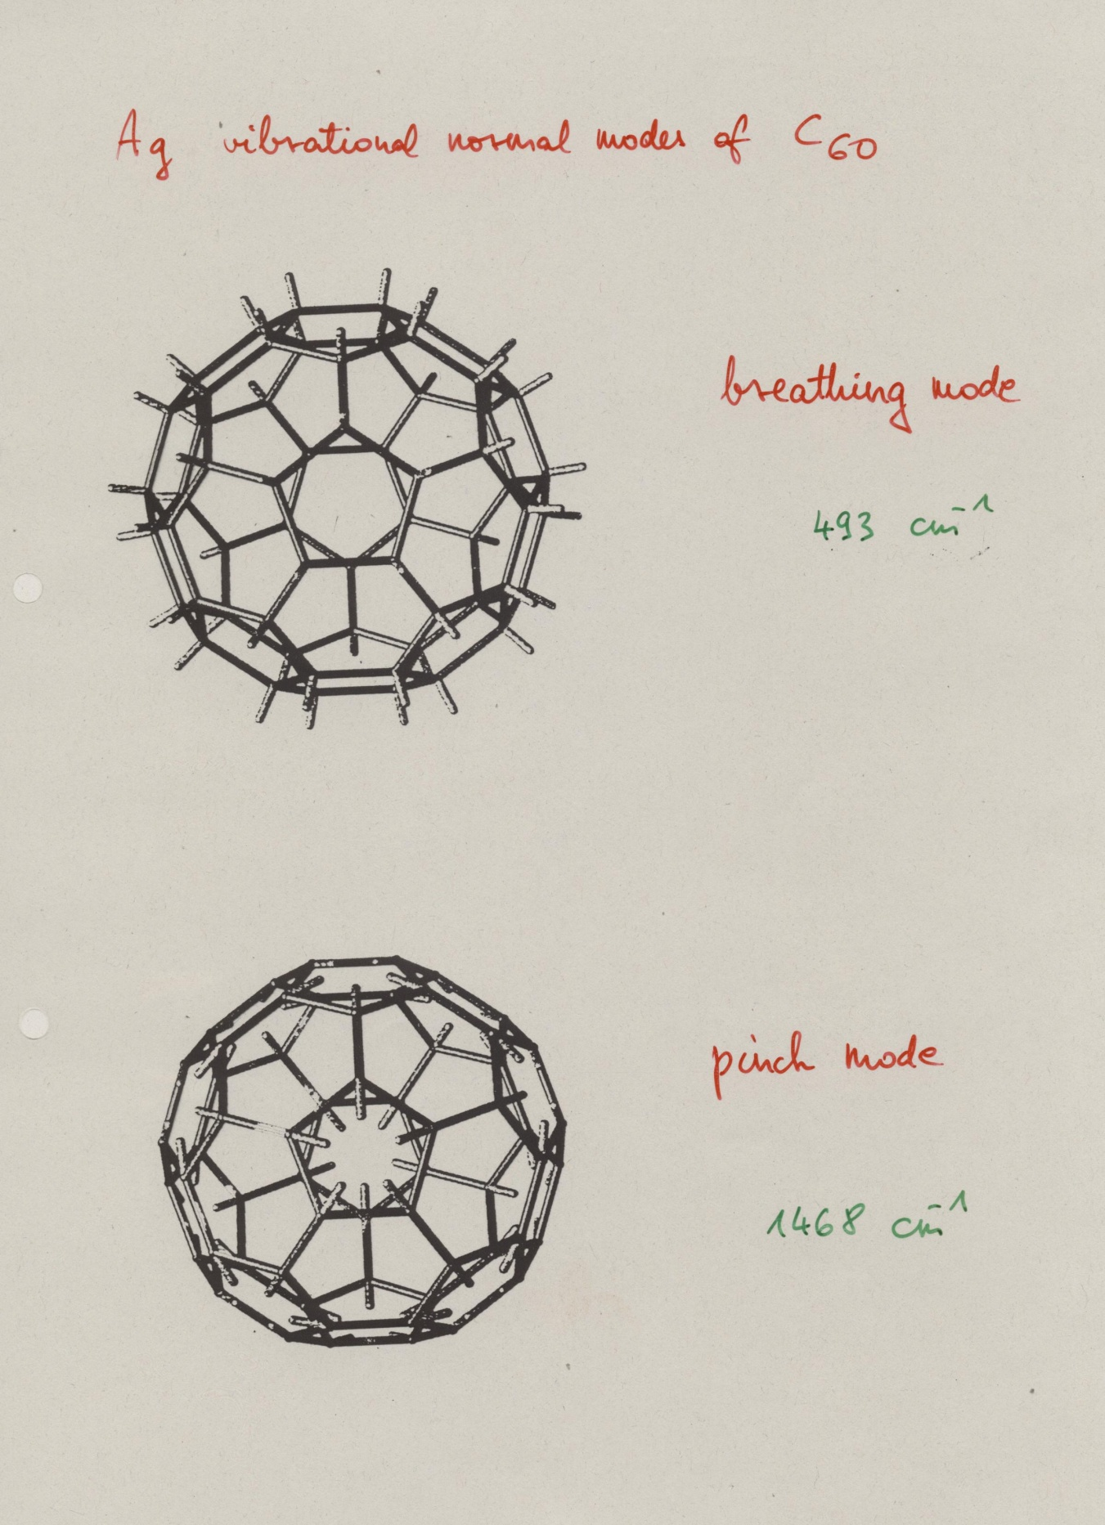

Slide 17
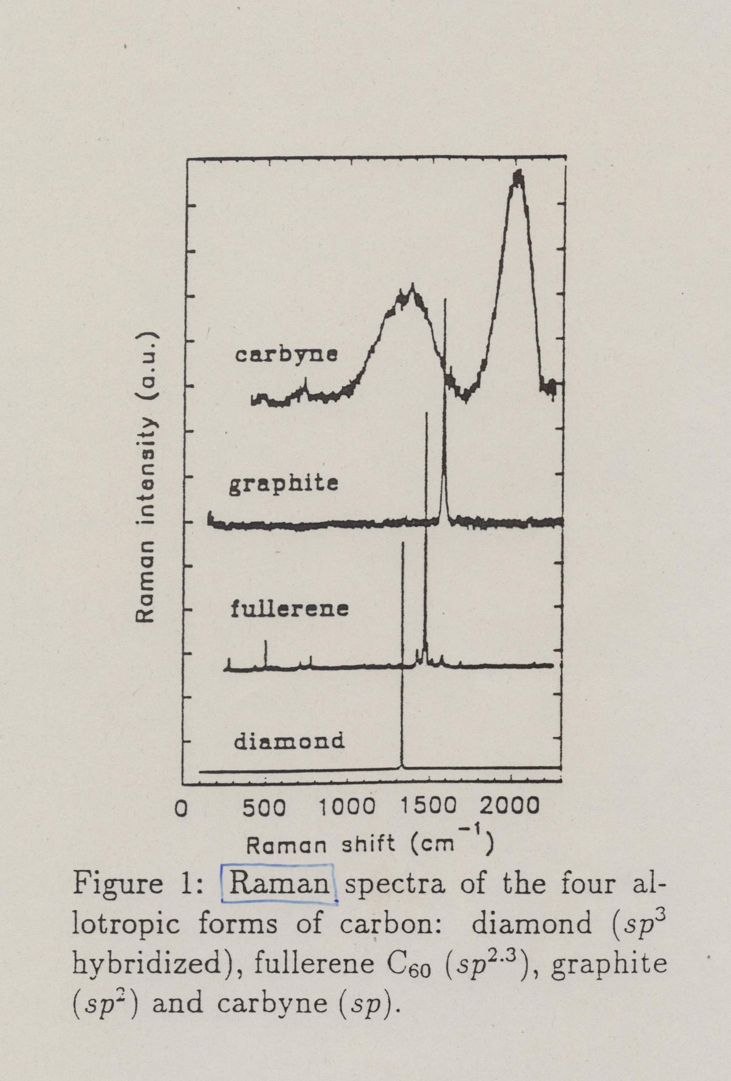

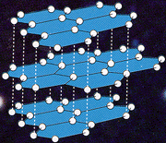
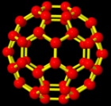
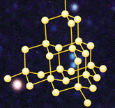
≈2000
sp¹
G
1580
sp²
1468
sp^{2.3}
1332
sp³
measured in Prof. Hans Kuzmany’s lab,
University of Vienna
Notes:
Effect of hybridization

Slide 18
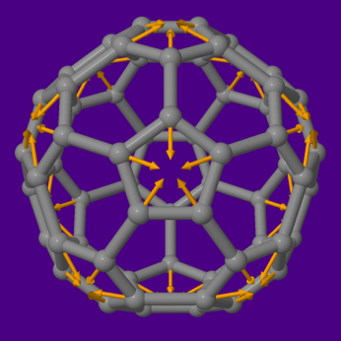
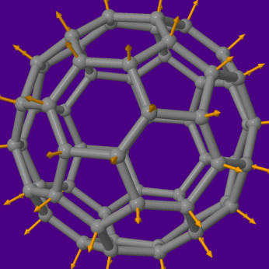

Slide 19
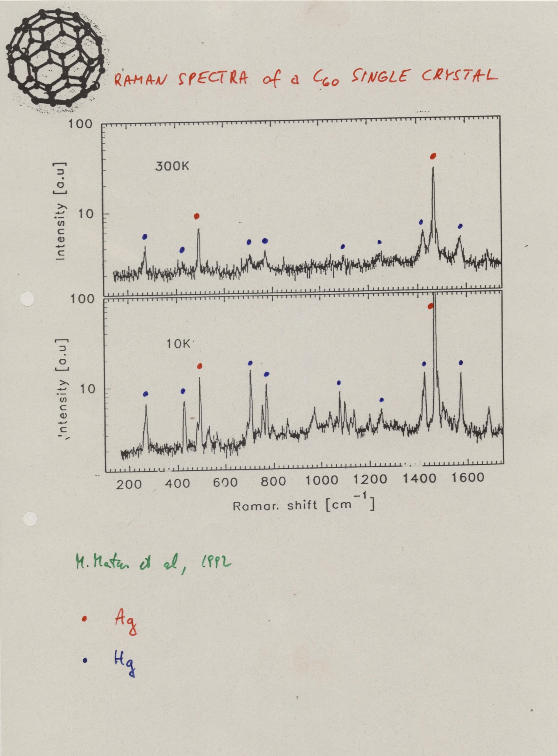

Slide 20
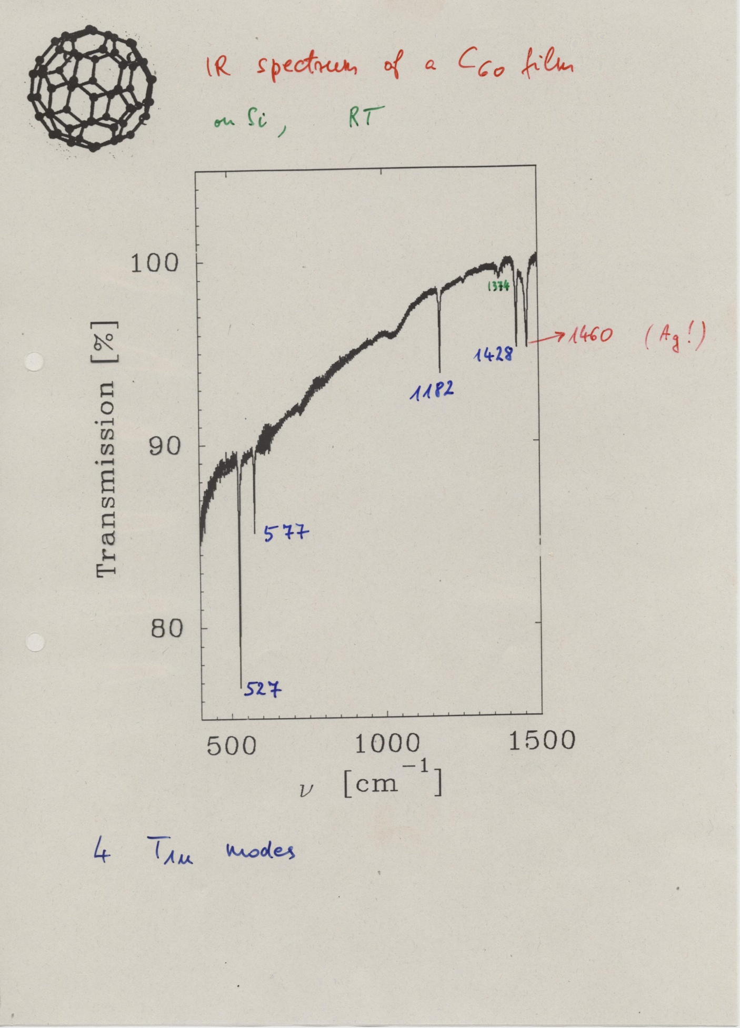

Slide 21
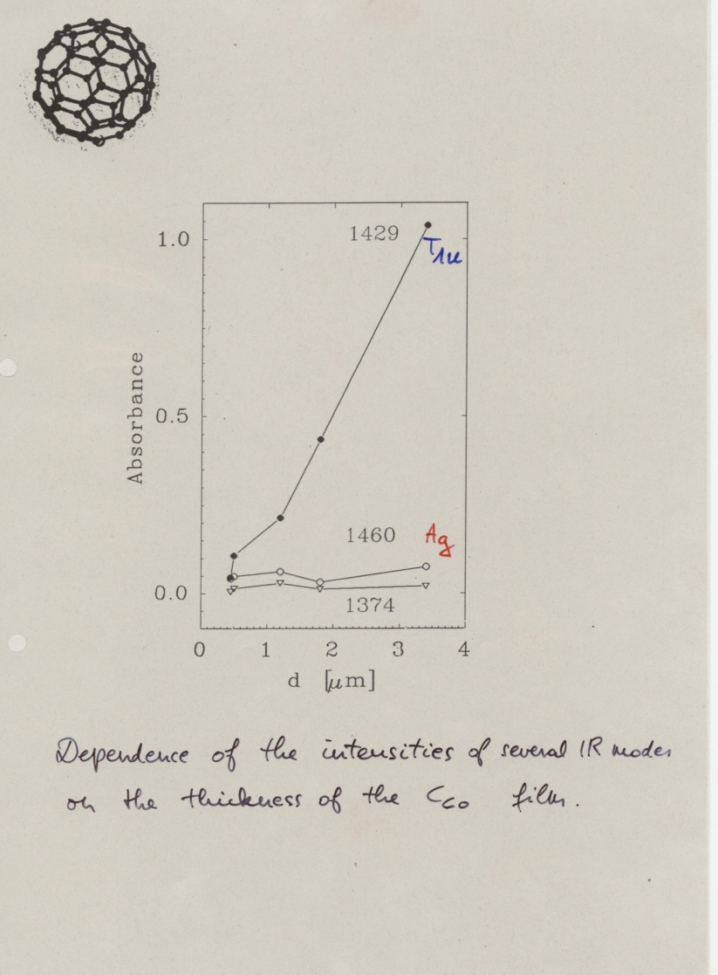

Slide 22
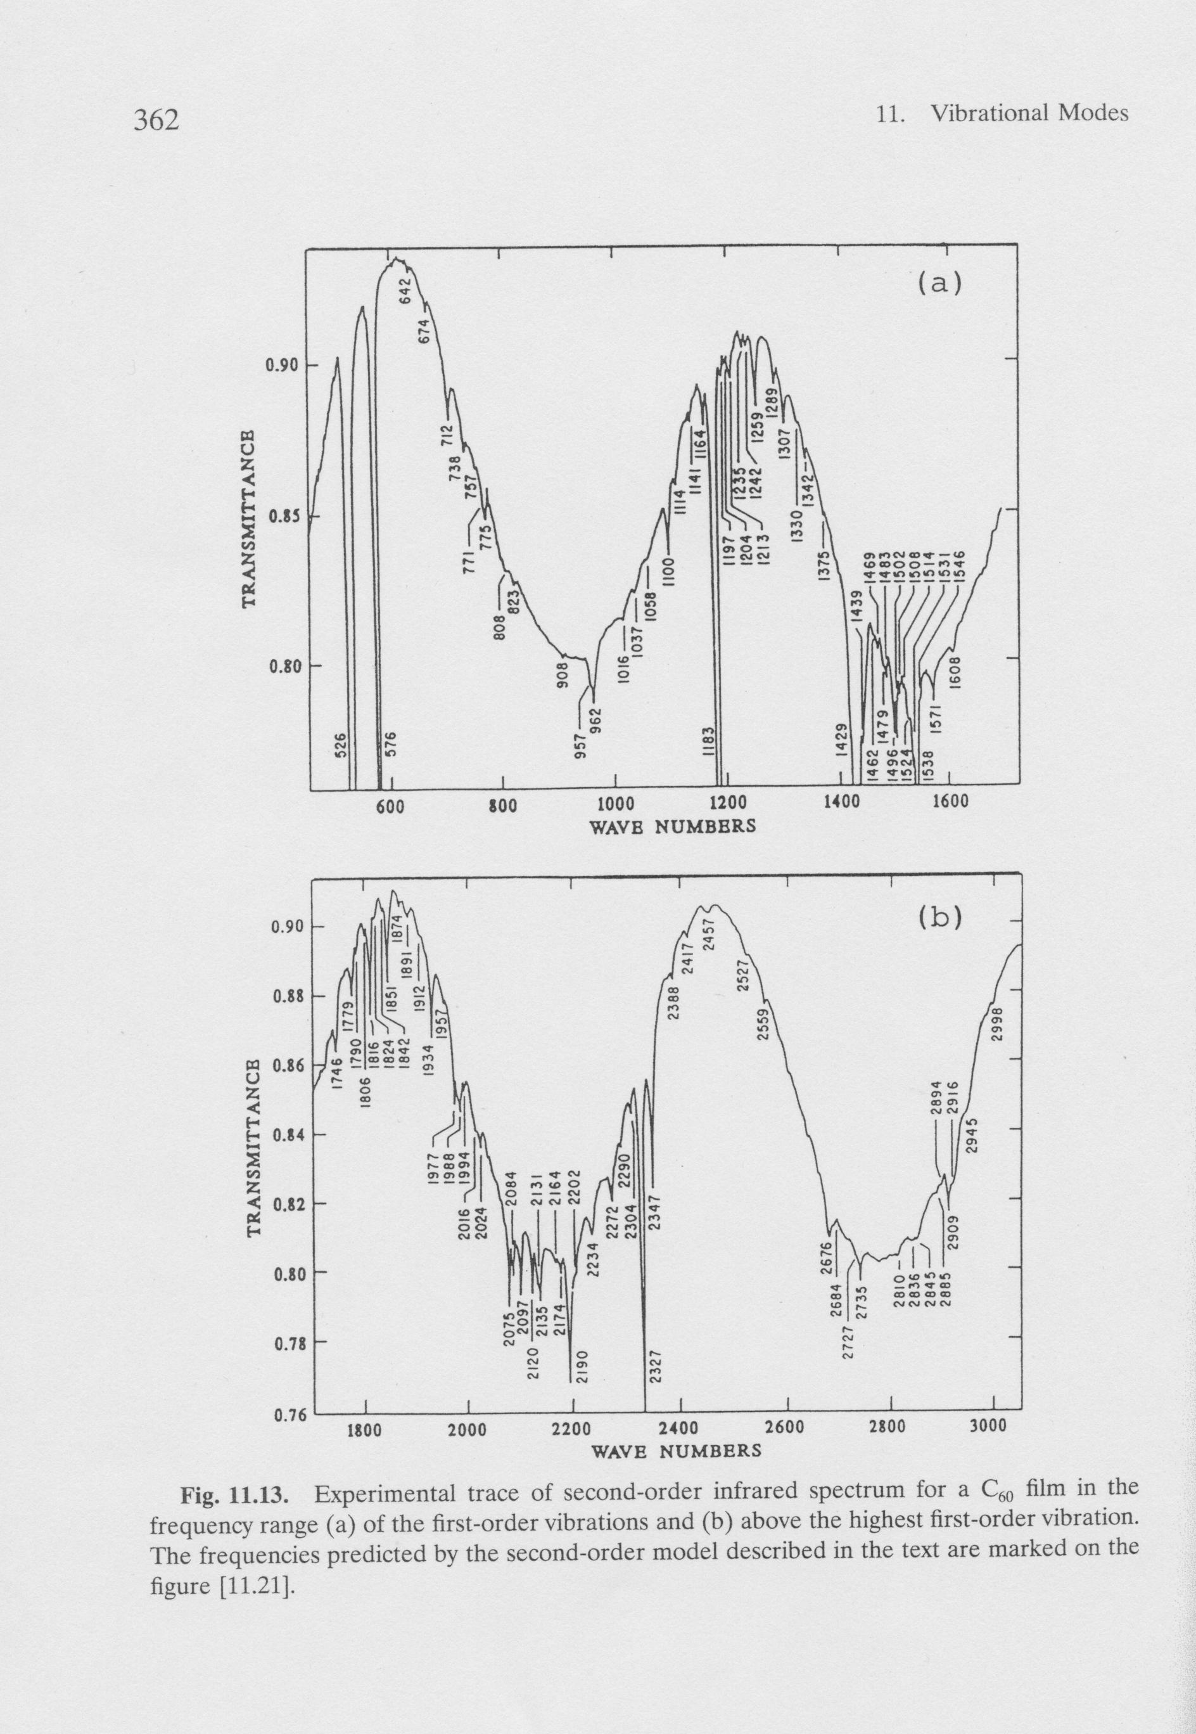
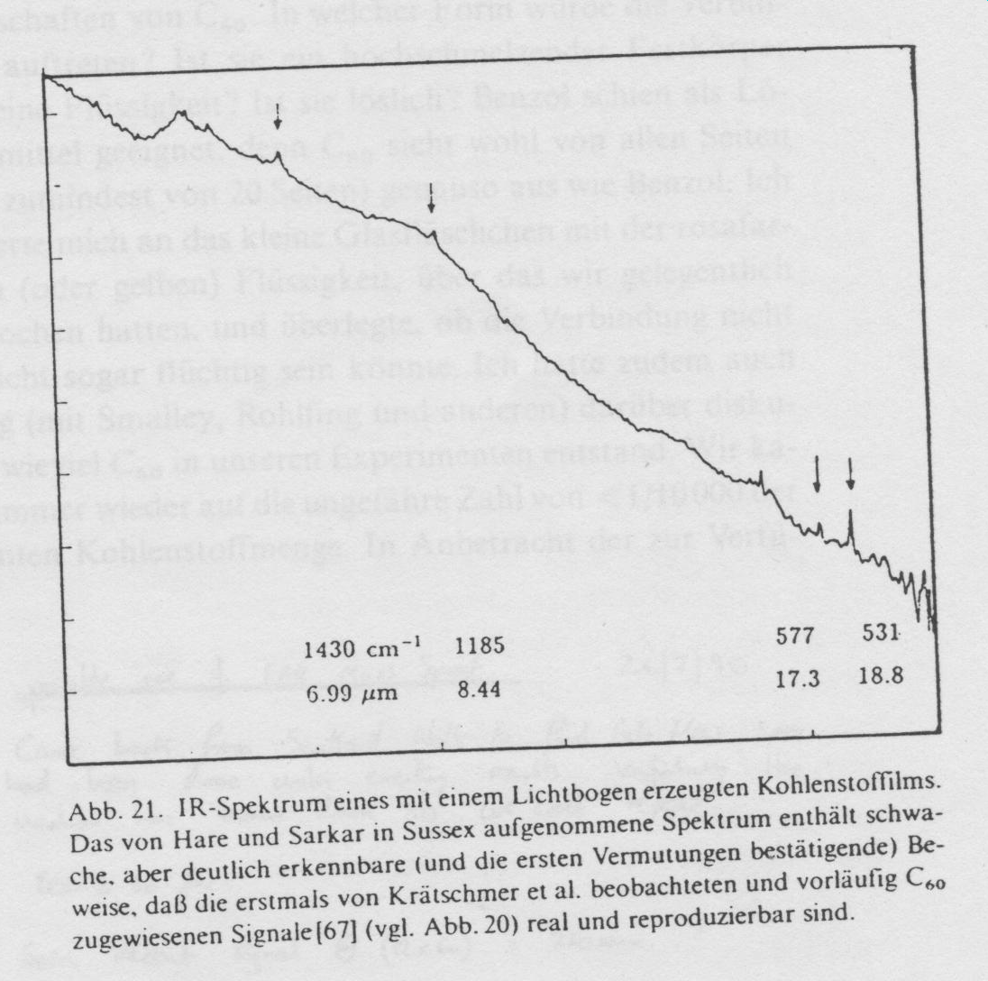
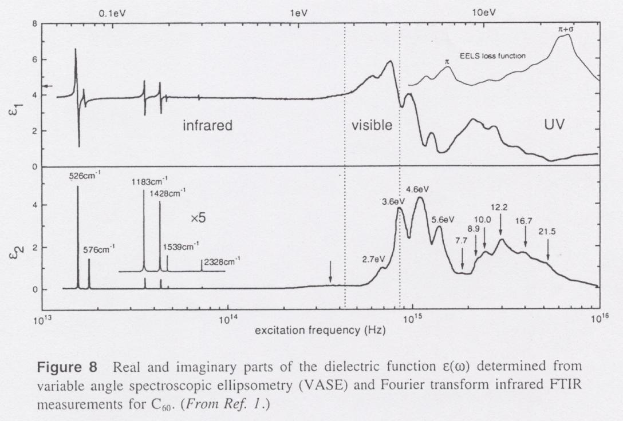

Slide 23
T_{1g} ⊗ T_{1u} = A_{u} + T_{1u} + H_{u}
but for example
G_{g} ⊗ T_{1u} = T_{2u} + G_{u} + H_{u}
In principle 380 combination modes !
>60

