Slide 1
CARBON NANOSTRUCTURES
(FULLERENES, CARBON NANOTUBES, GRAPHENE)
lecture for physics and chemistry students
(2020. summer semester – 27. April)
Prof. Jenő Kürti
ELTE Department of Biological Physics
e-mail: kurti@virag.elte.hu www: regivirag.elte.hu/kurti

Slide 2

Charged C₆₀

Slide 3
Cyclic voltammetry

Slide 4
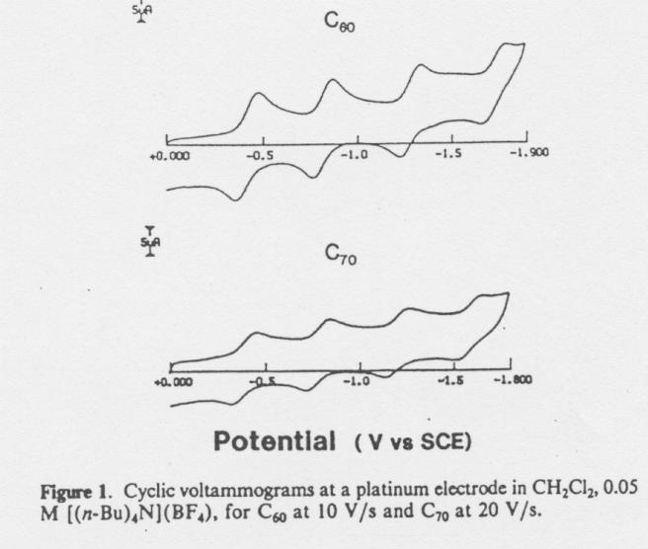
-4
-3
-2
-1

Slide 5
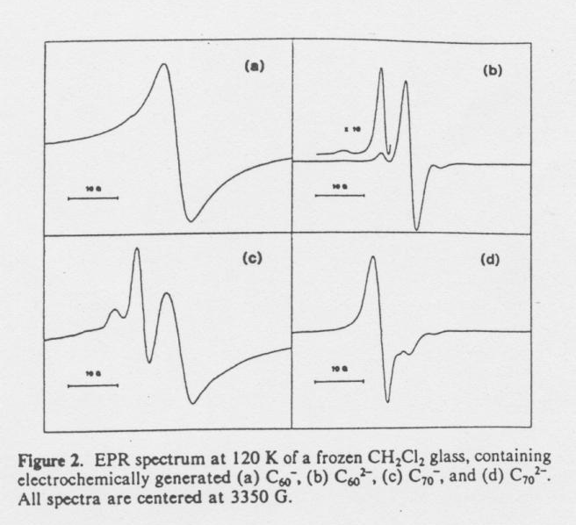

Slide 6
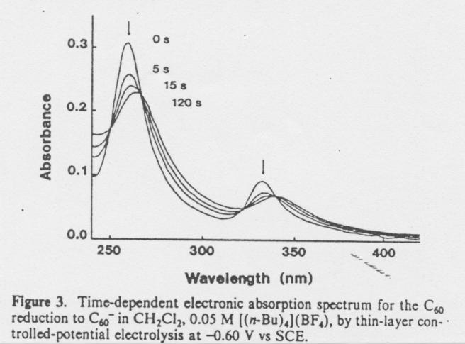

Slide 7
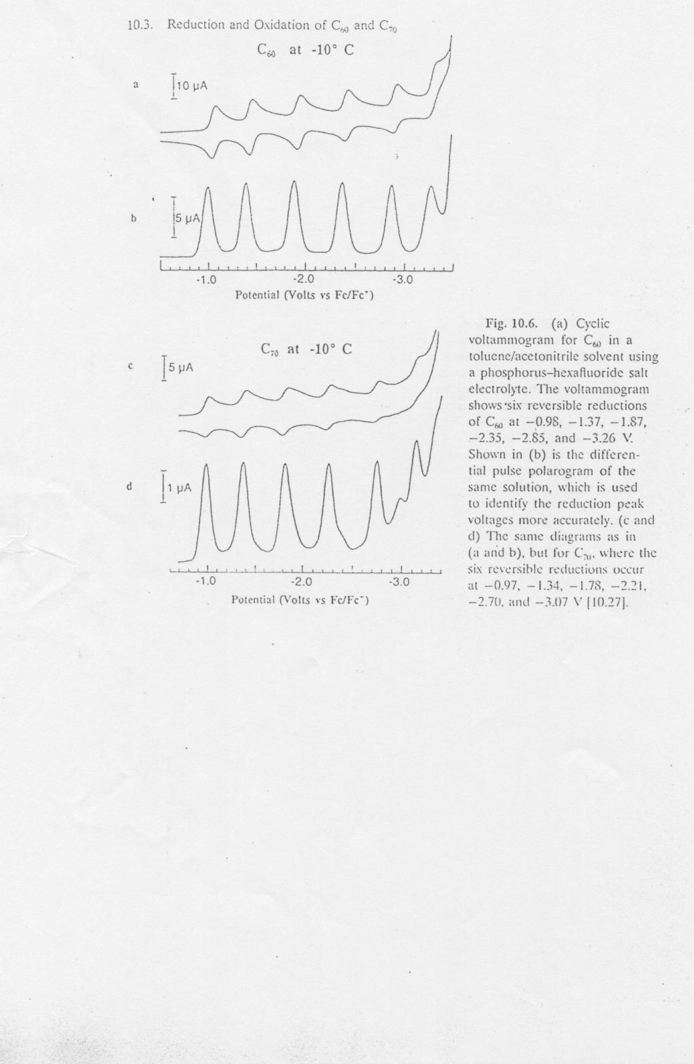

Slide 8
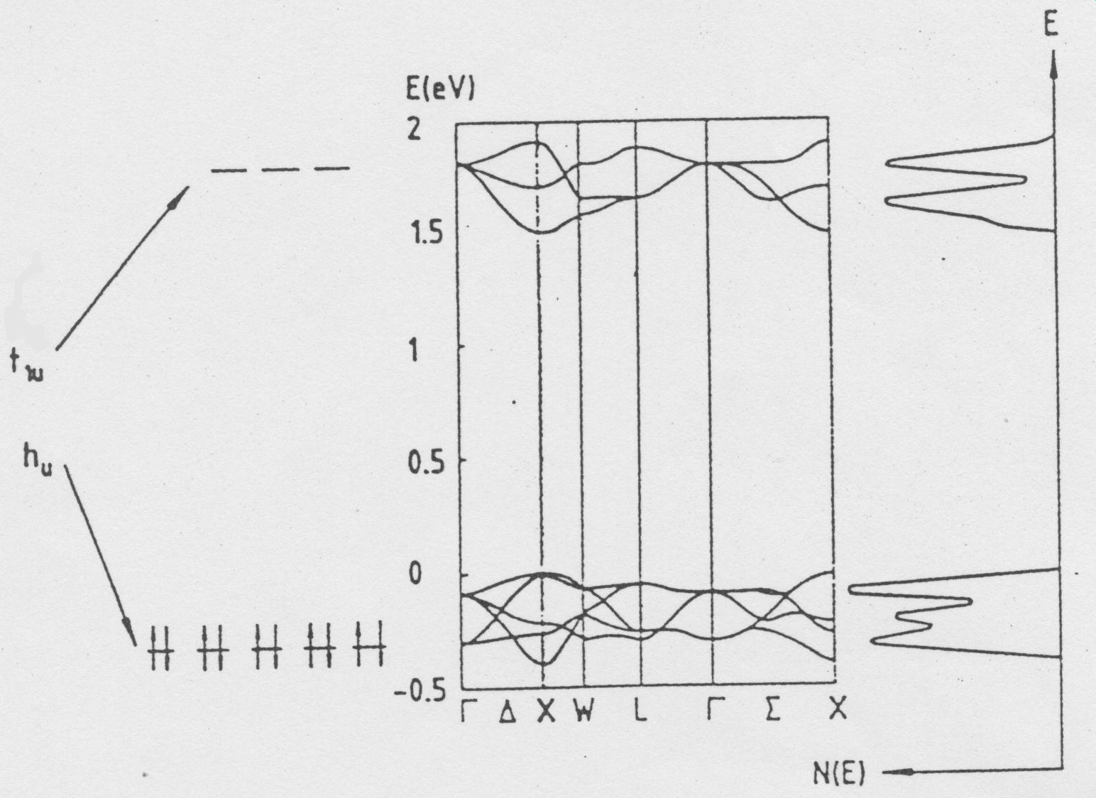
DOS

Slide 9
Doping

Slide 10
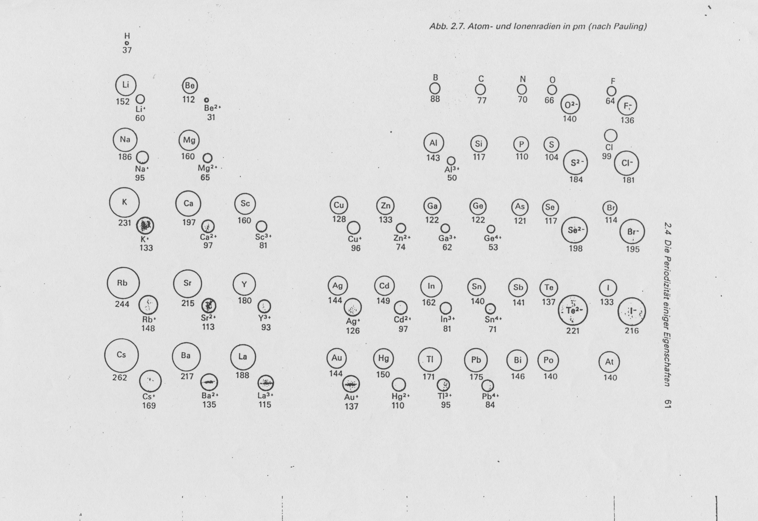

Slide 11
Voids in fcc crystal structure
o 1:1
t 2:1

Slide 12
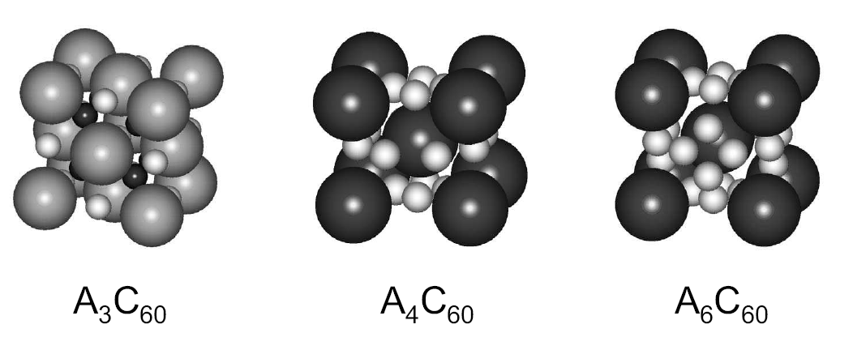
Examples of alkali fullerides
fcc
bct
bcc

Slide 13
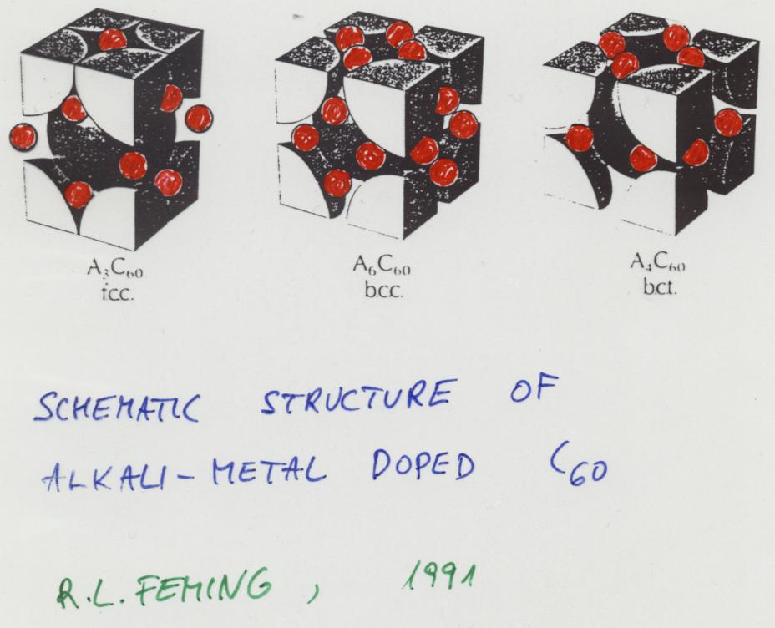

Slide 14
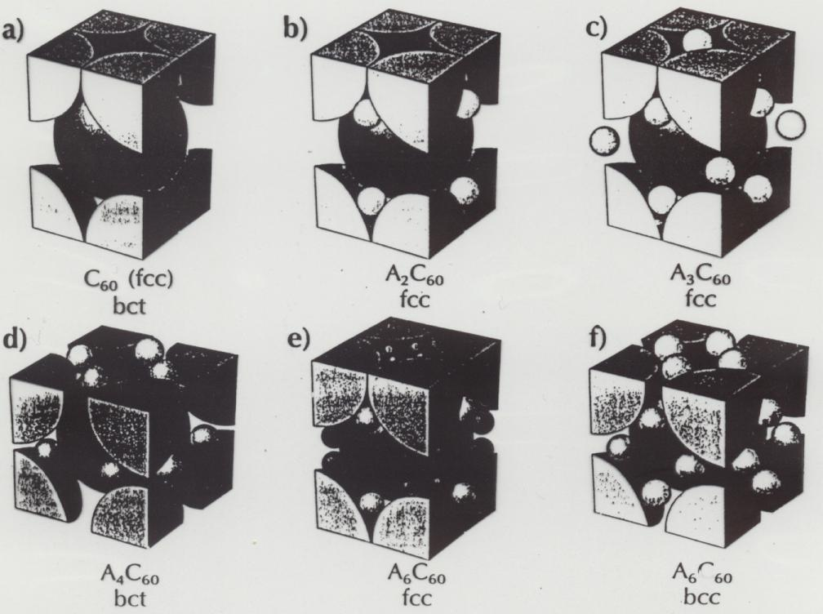

Slide 15
Spectroscopies during doping

Slide 16
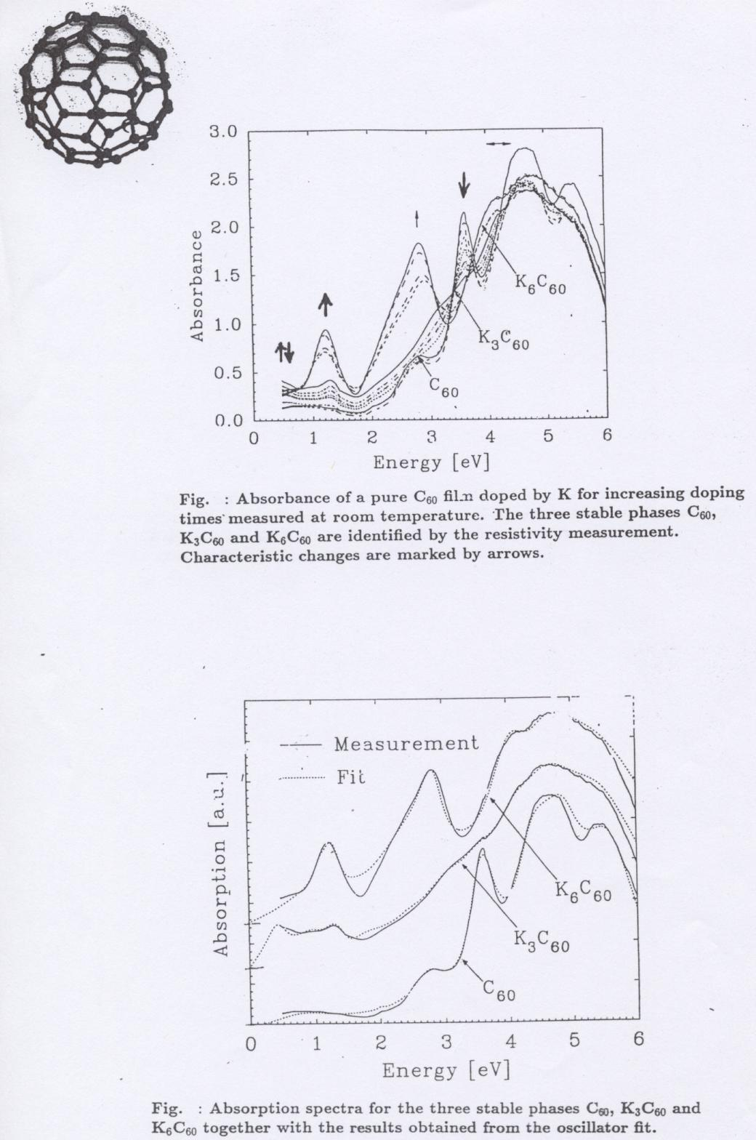

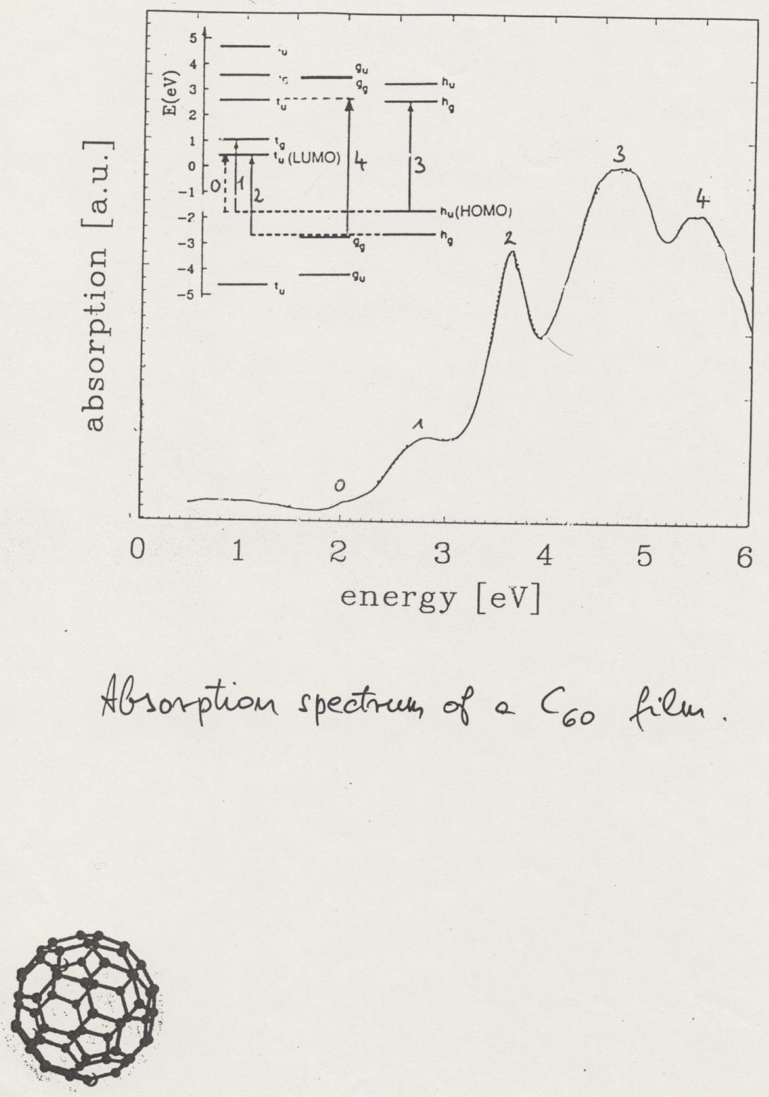
DOS

Slide 17
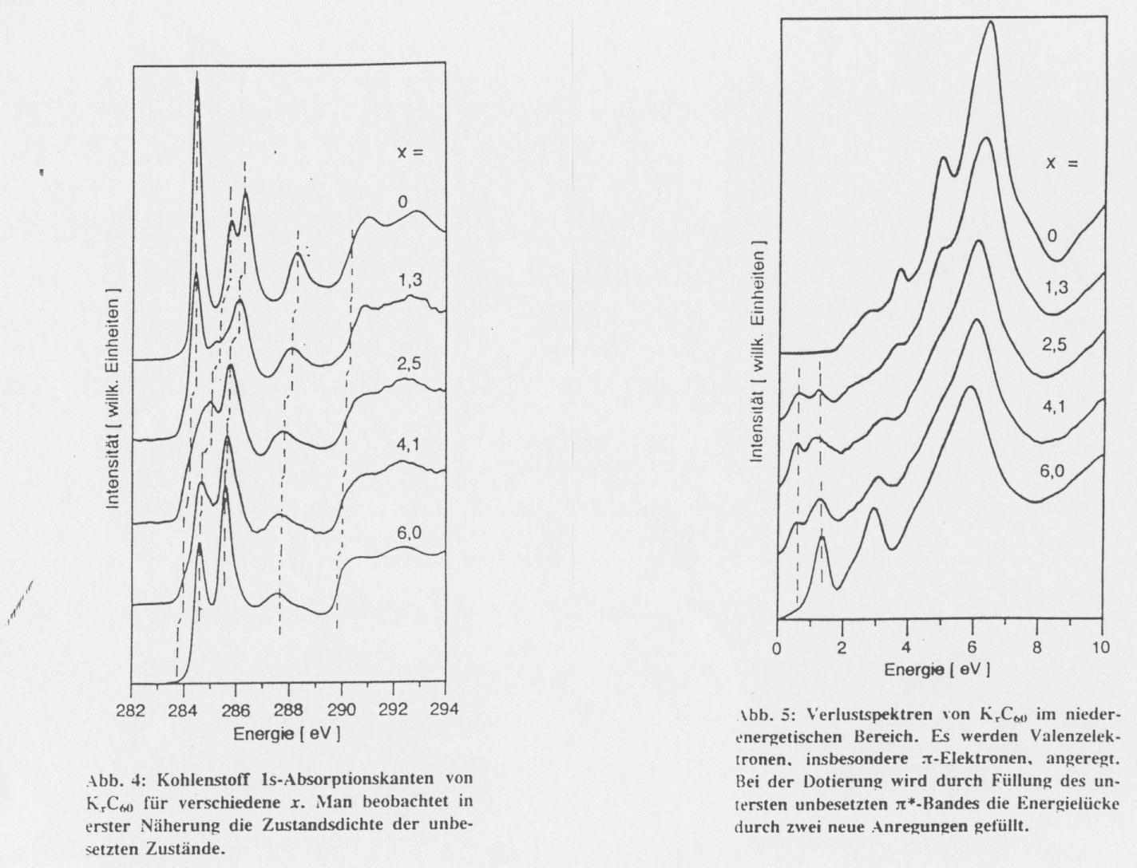
low energy EELS

Slide 18
high energy EELS

Slide 19
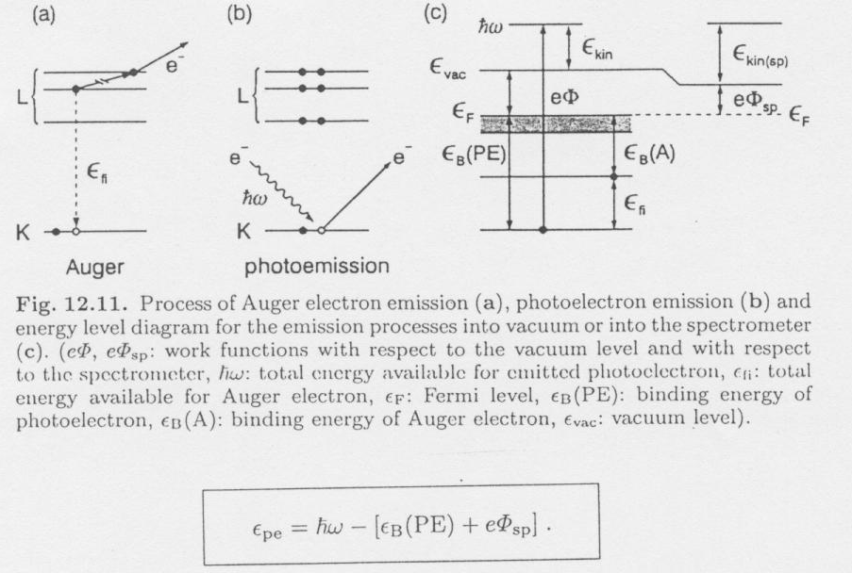

Slide 20
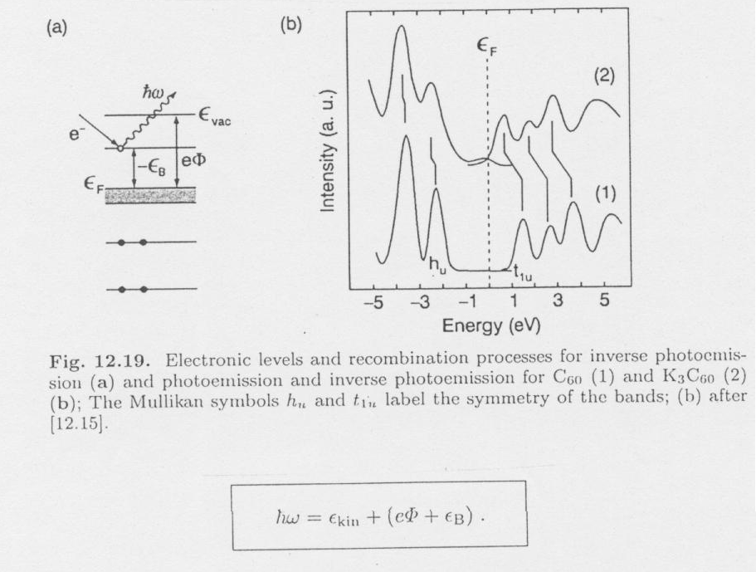

Slide 21
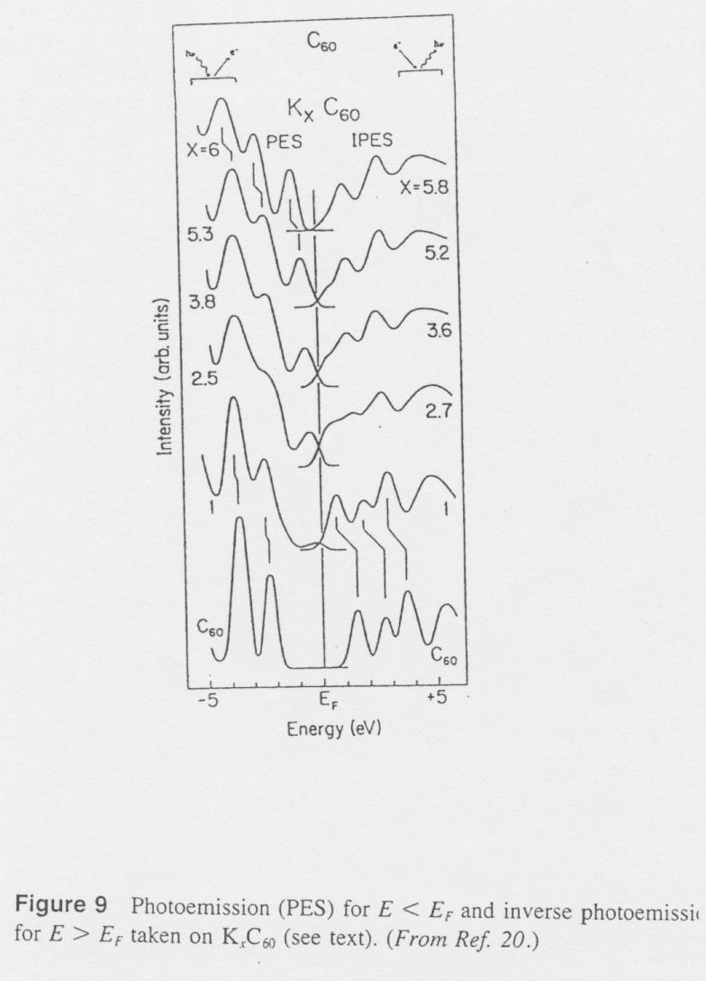

Slide 22
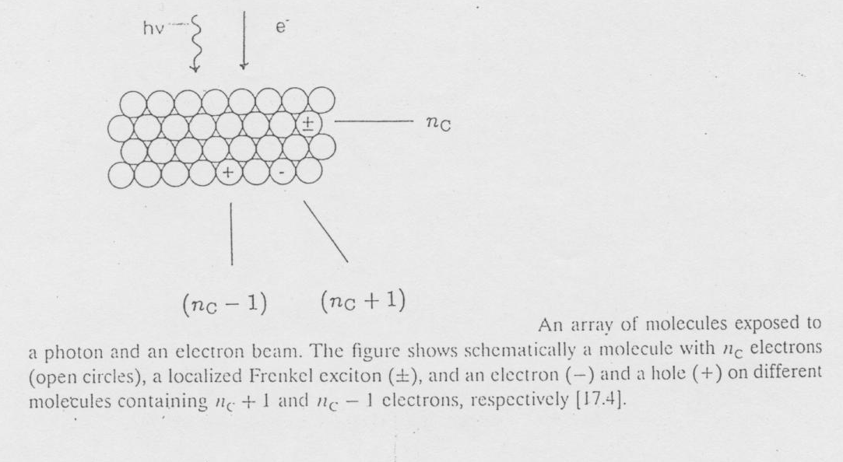

Slide 23
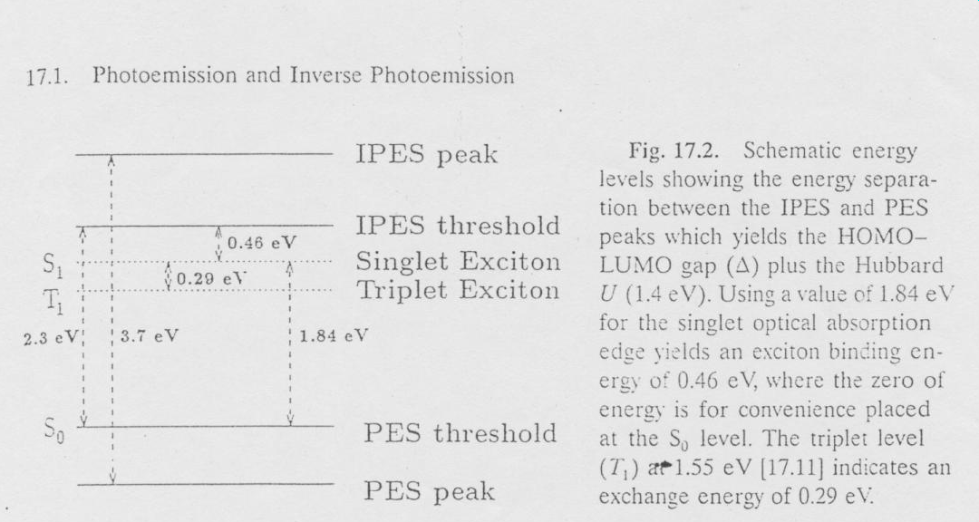

Slide 24
In situ Raman and IR spectroscopy during doping

Slide 25
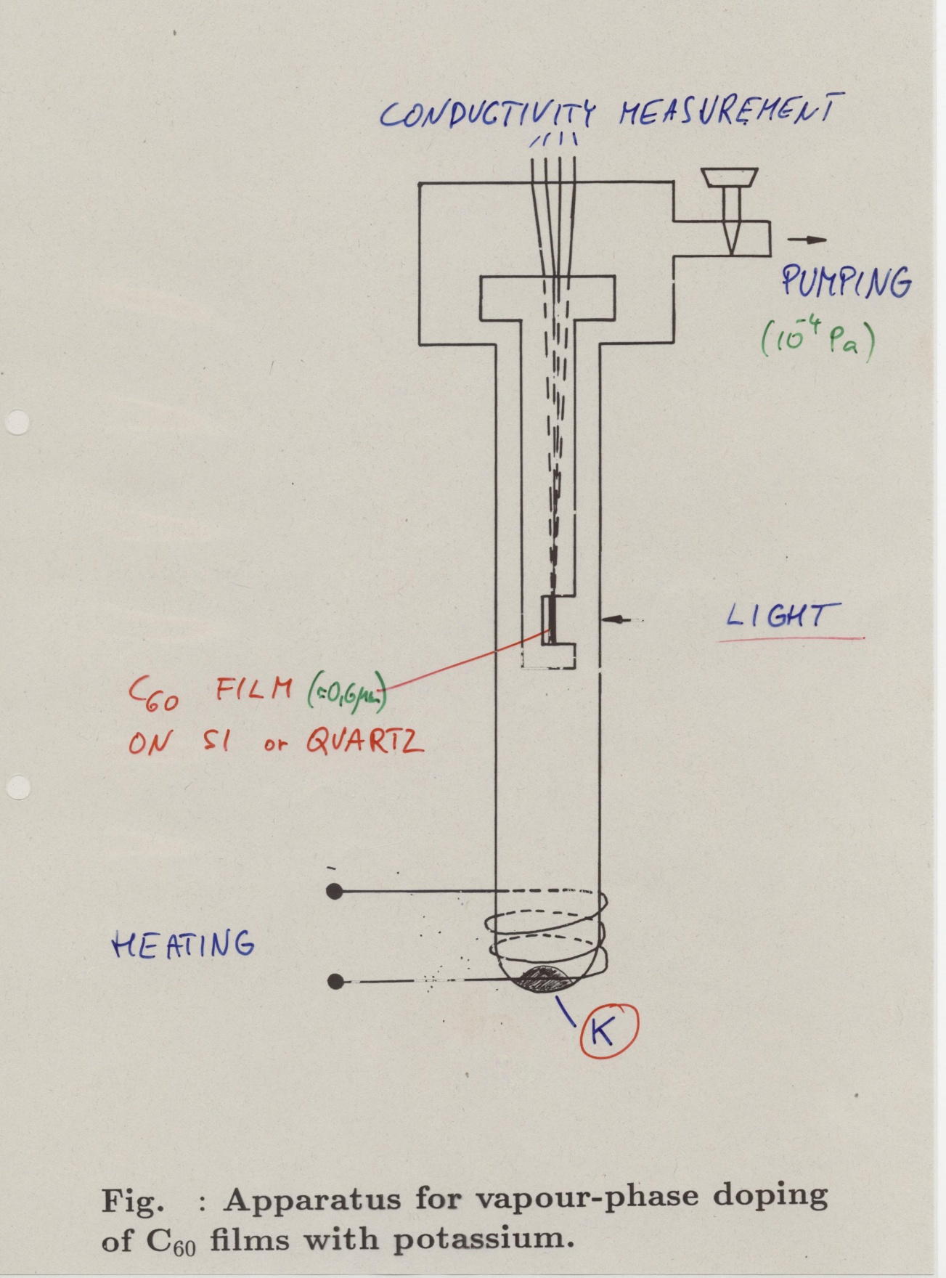

Slide 26
Raman

Slide 27
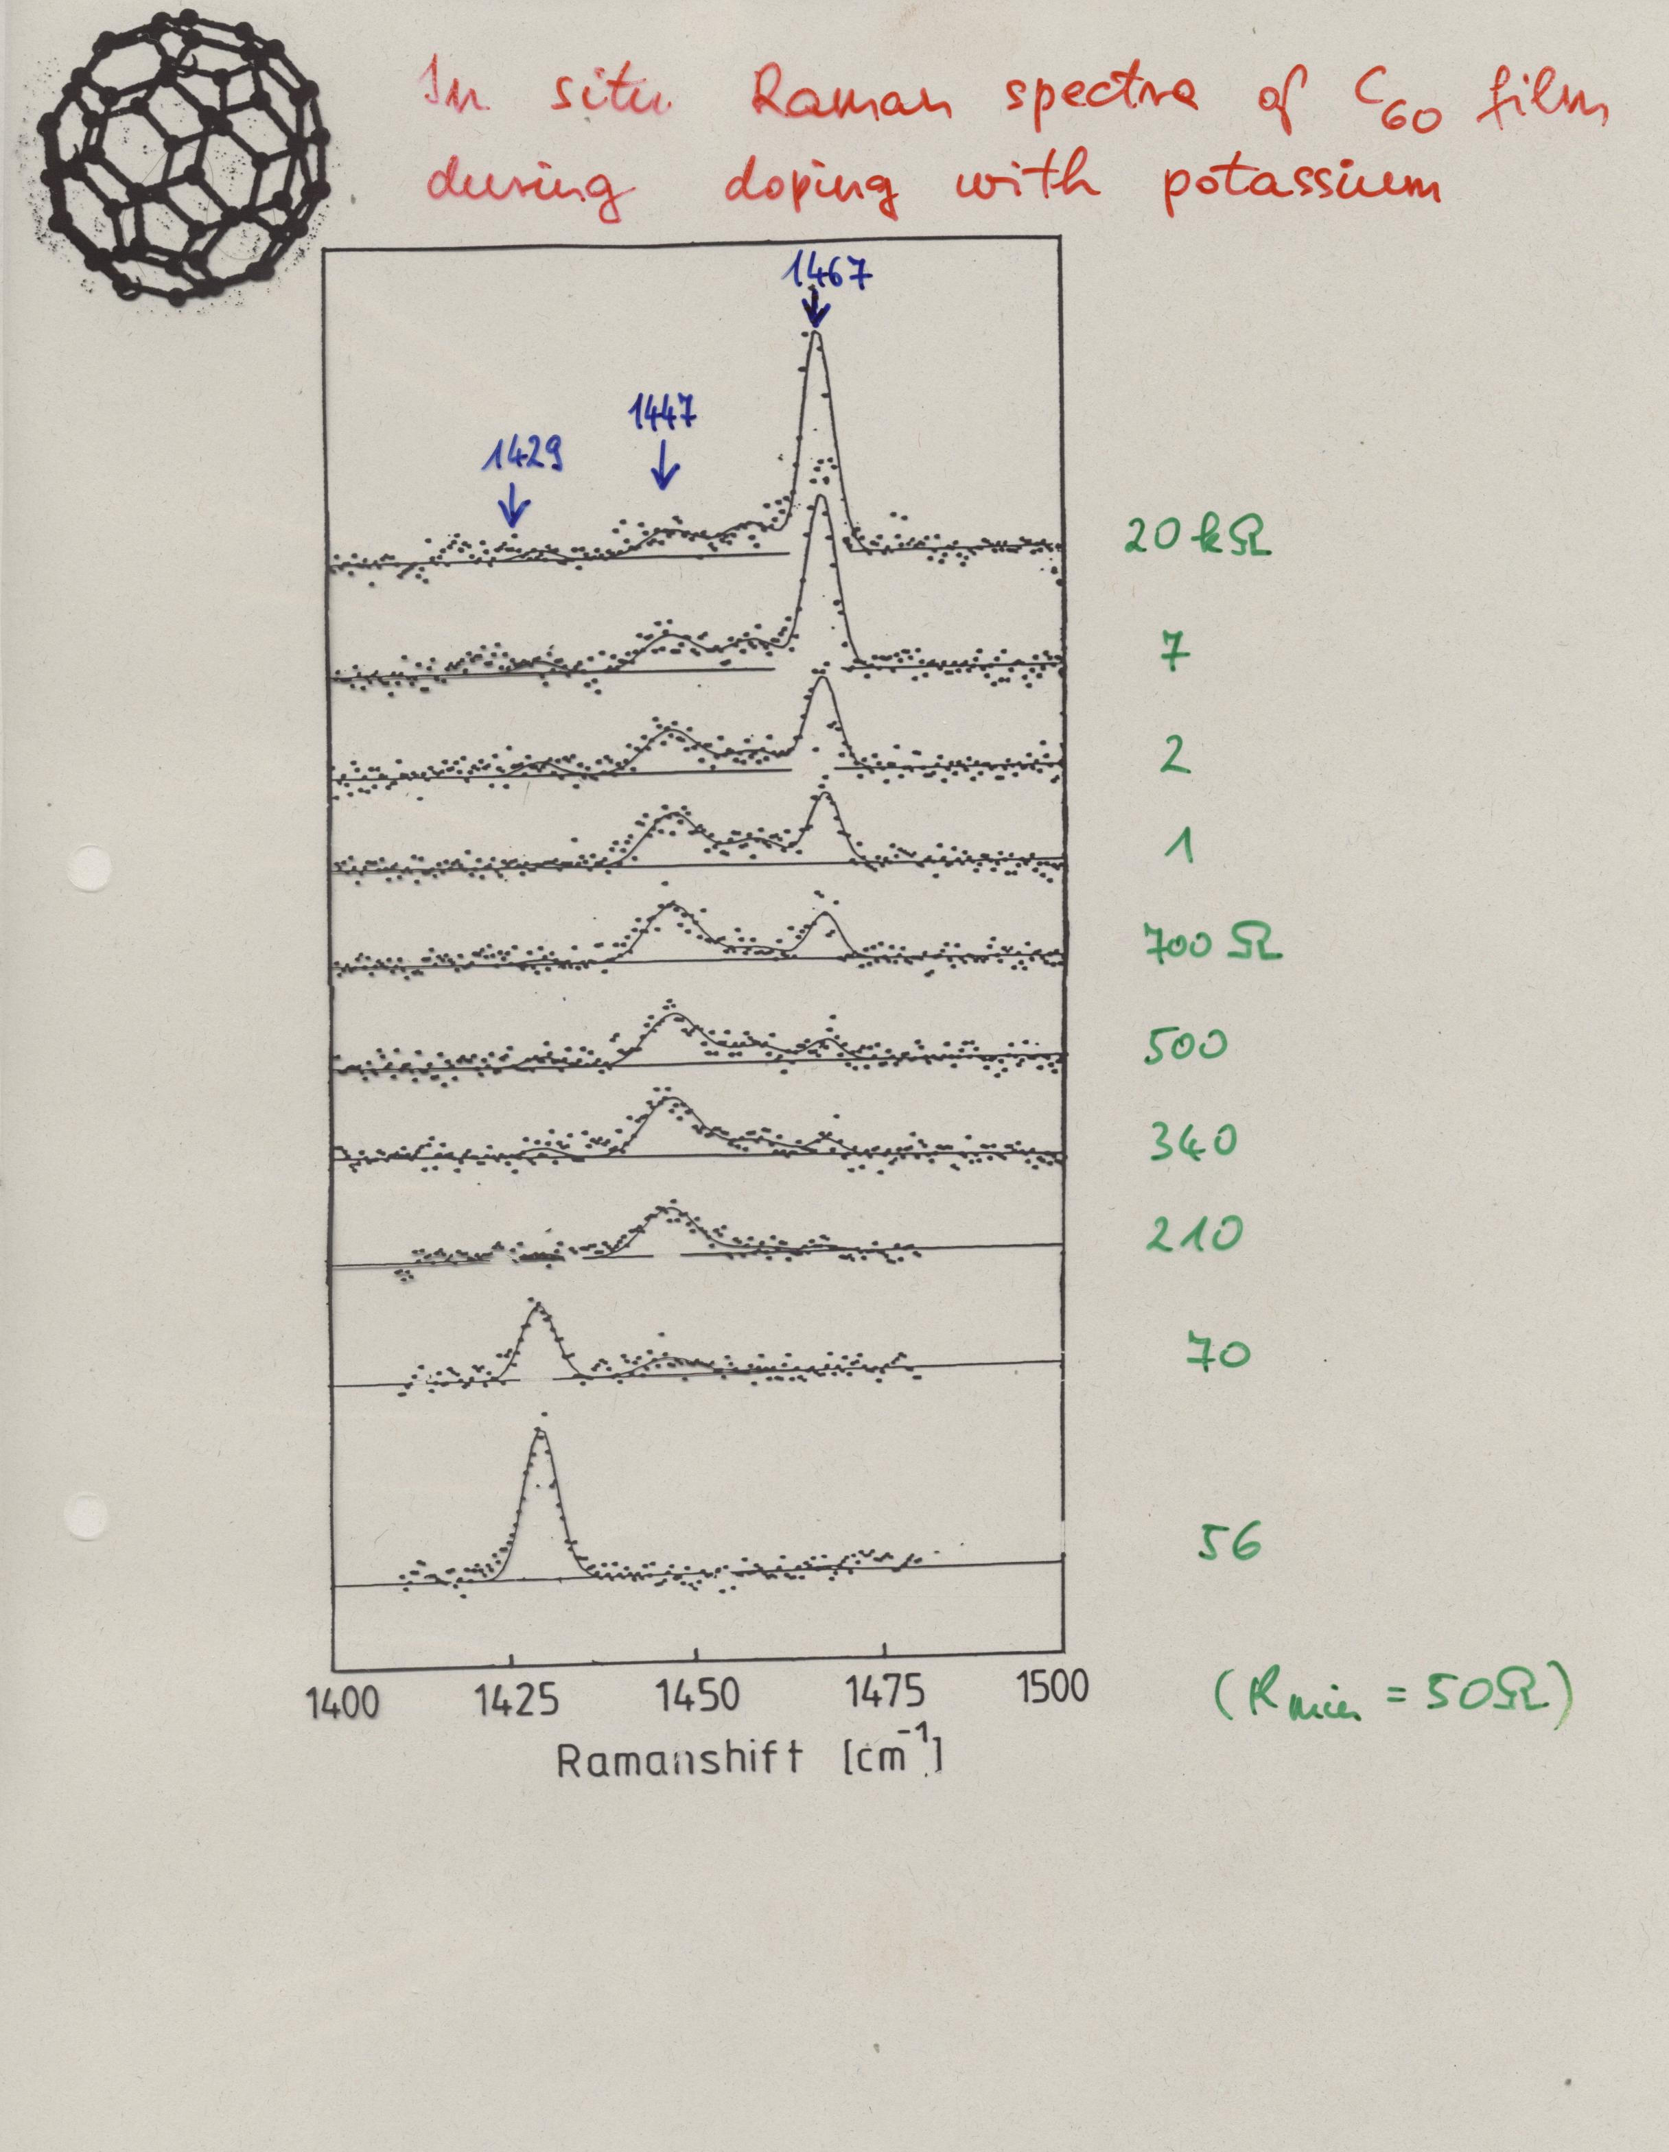

Slide 28
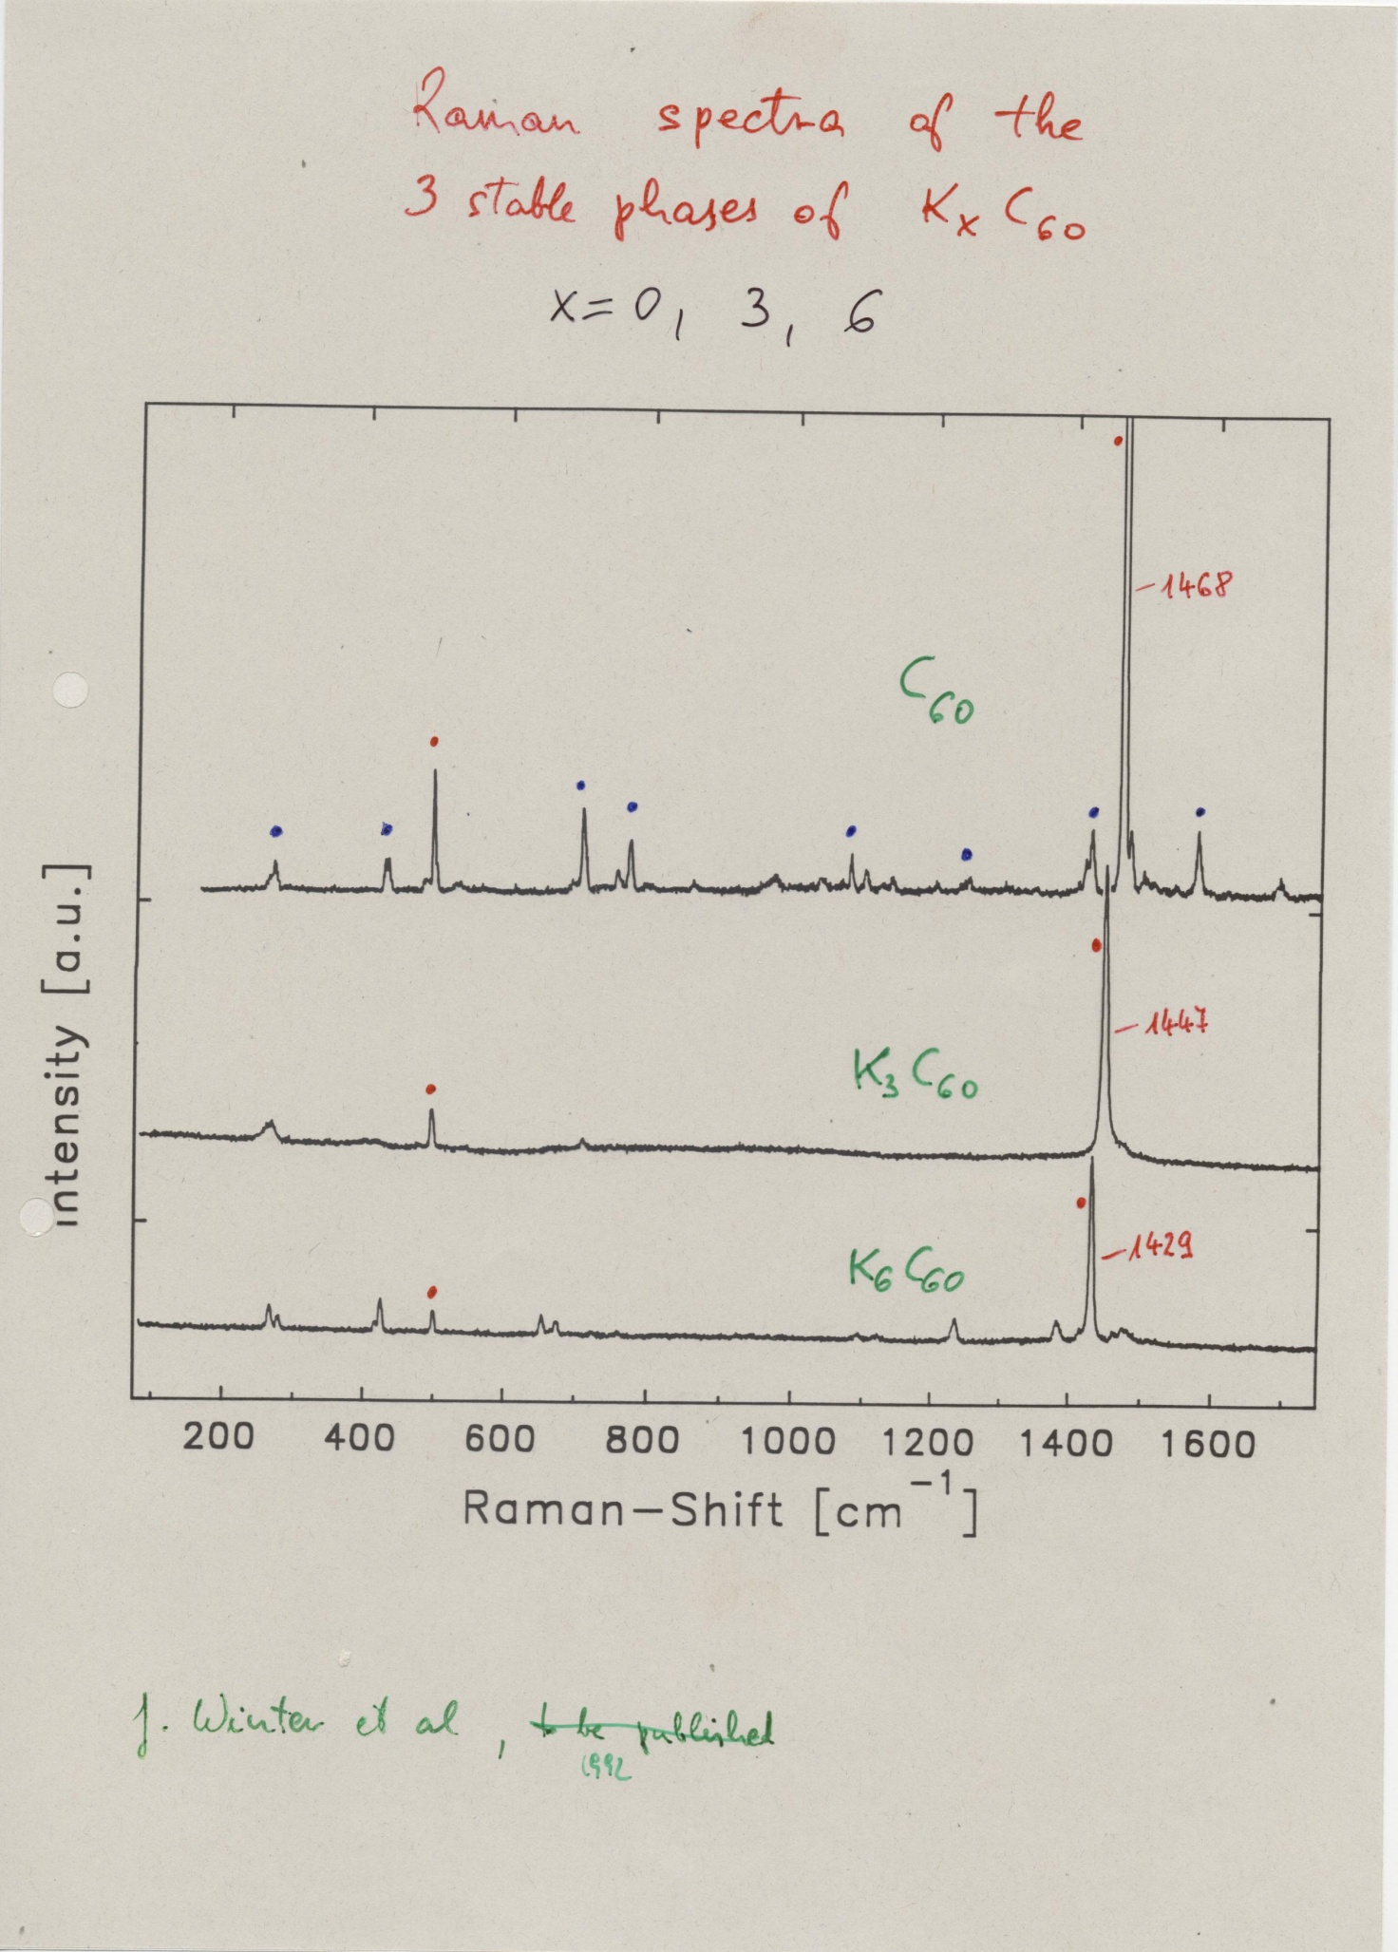
≈ 6-7 cm⁻¹ / electron

Slide 29
Infrared

Slide 30
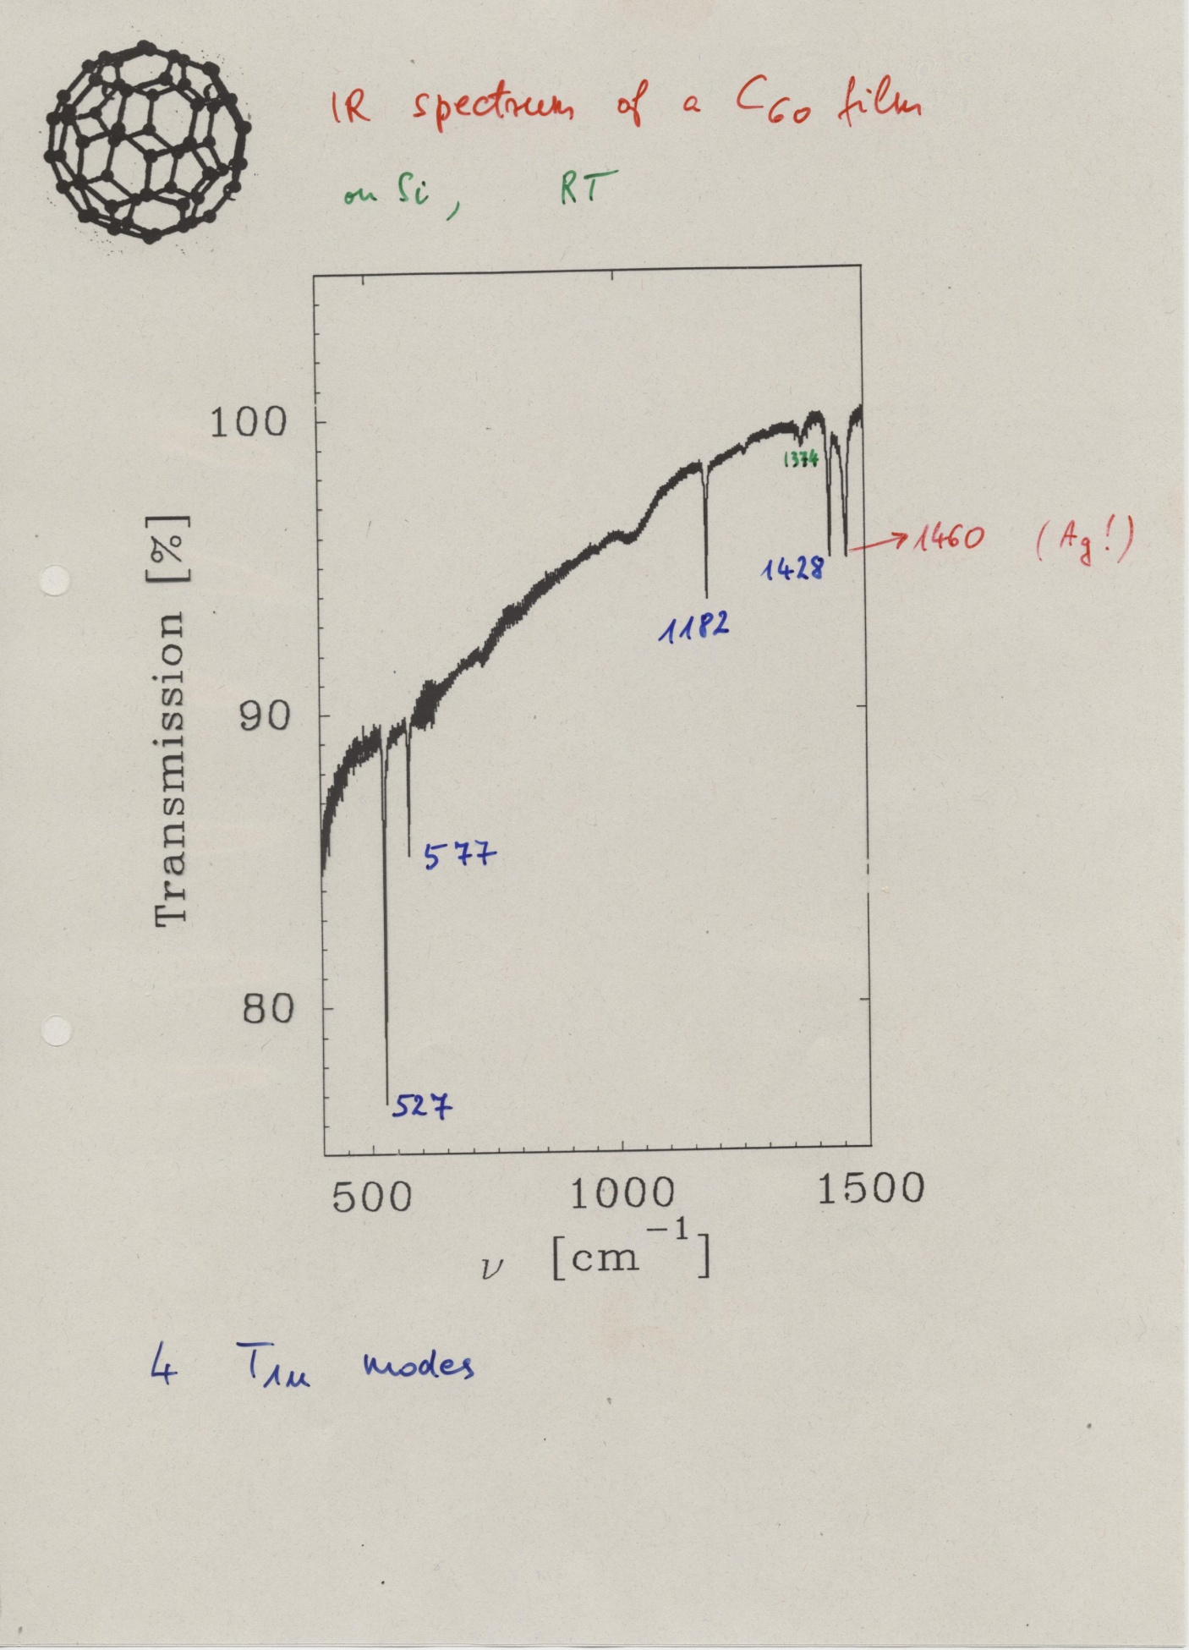
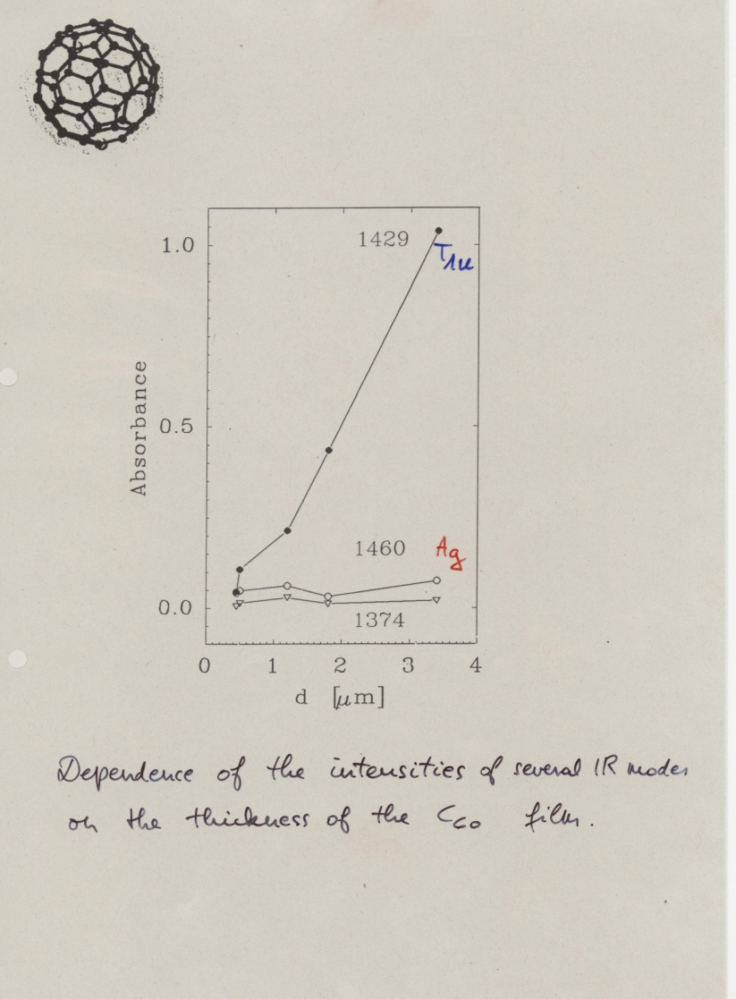

Slide 31
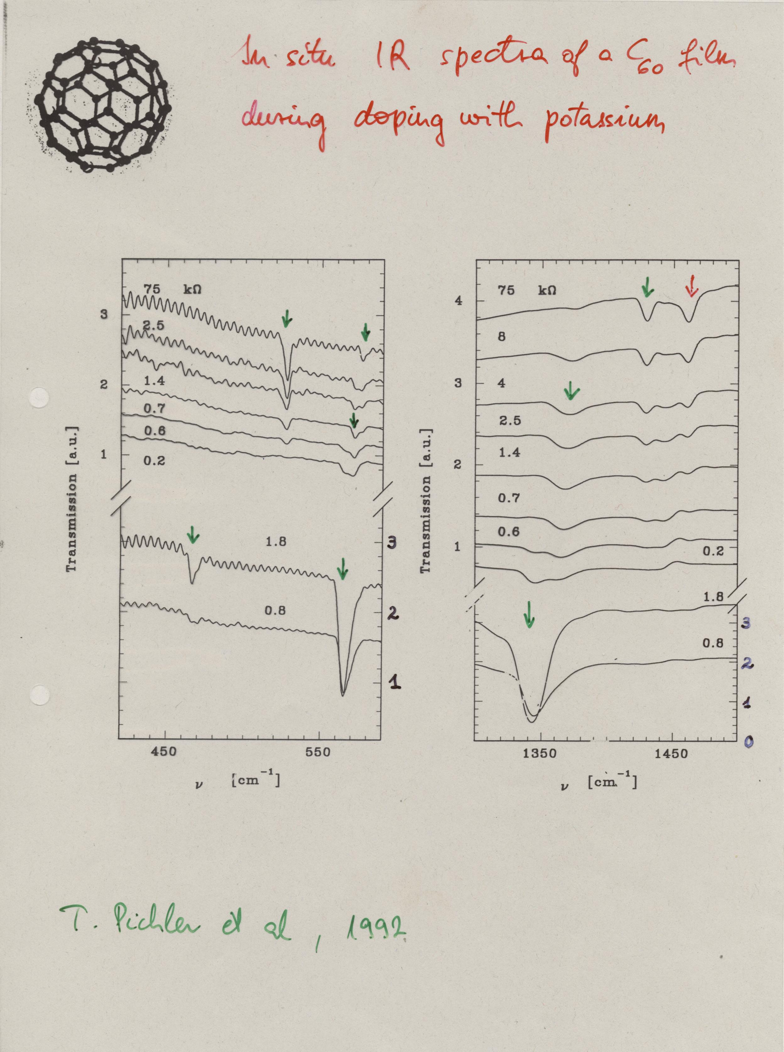

Slide 32
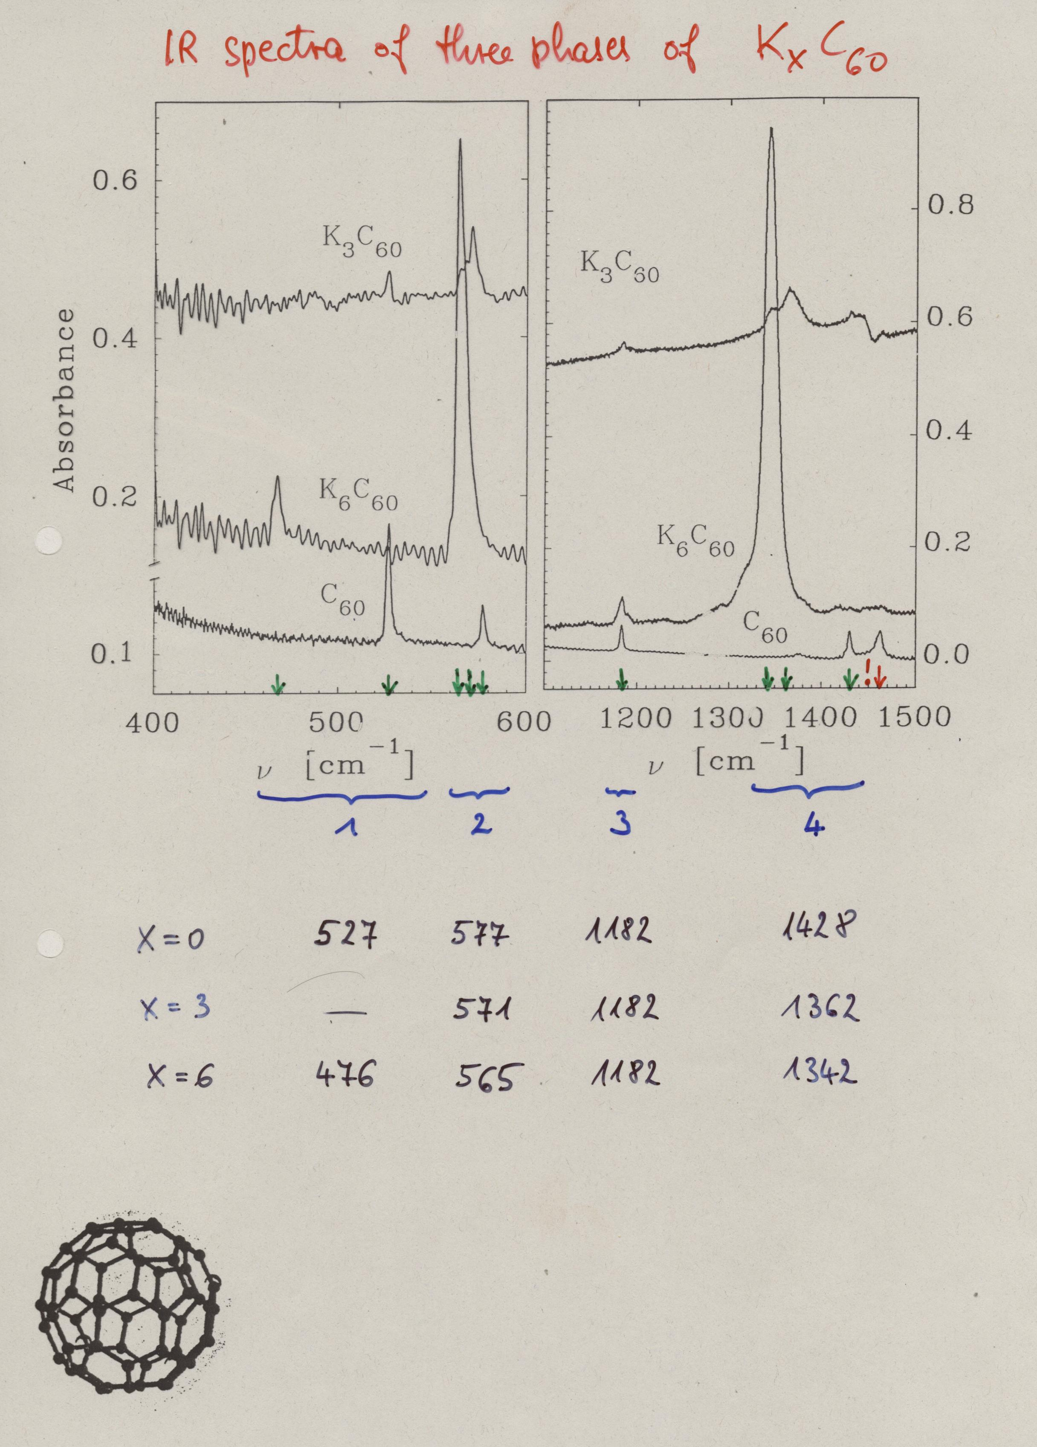

Slide 33
