Slide 1
CARBON NANOSTRUCTURES (FULLERENES, CARBON NANOTUBES, GRAPHENE)
lecture for physics and chemistry students
(2020. summer semester – 04. May)
Prof. Jenő Kürti
ELTE Department of Biological Physics
e-mail: kurti@virag.elte.hu www: regivirag.elte.hu/kurti

Slide 2
C₆₀ superconductivity

Slide 3
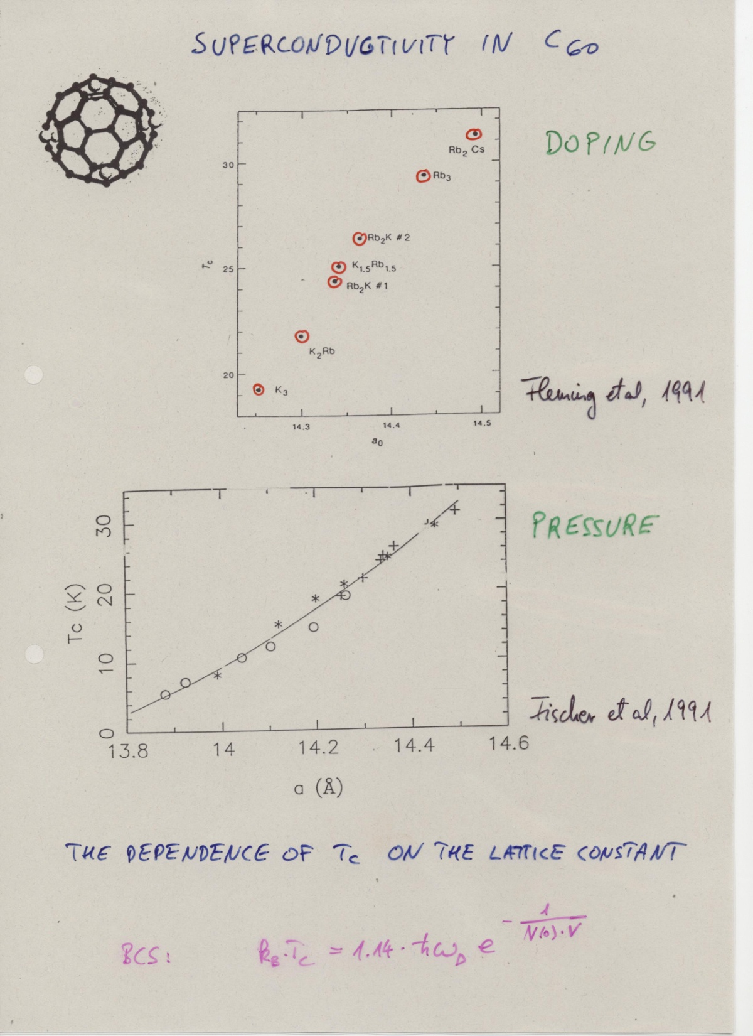

Slide 4
RbCs₂: 33K
1st:
2nd:

Slide 5
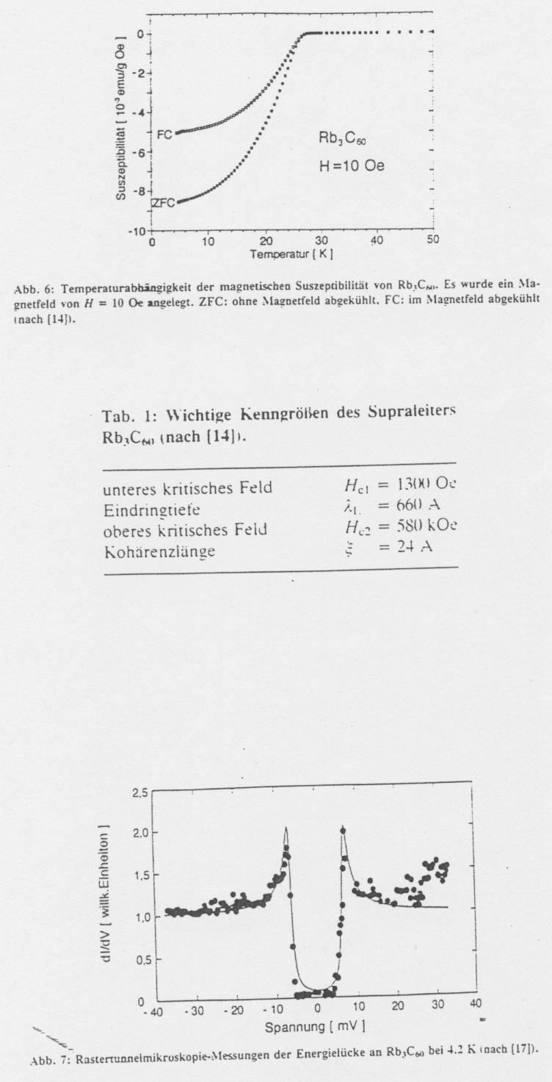
RbCs₂: 33K

Slide 6
C₆₀ polymers

Slide 7
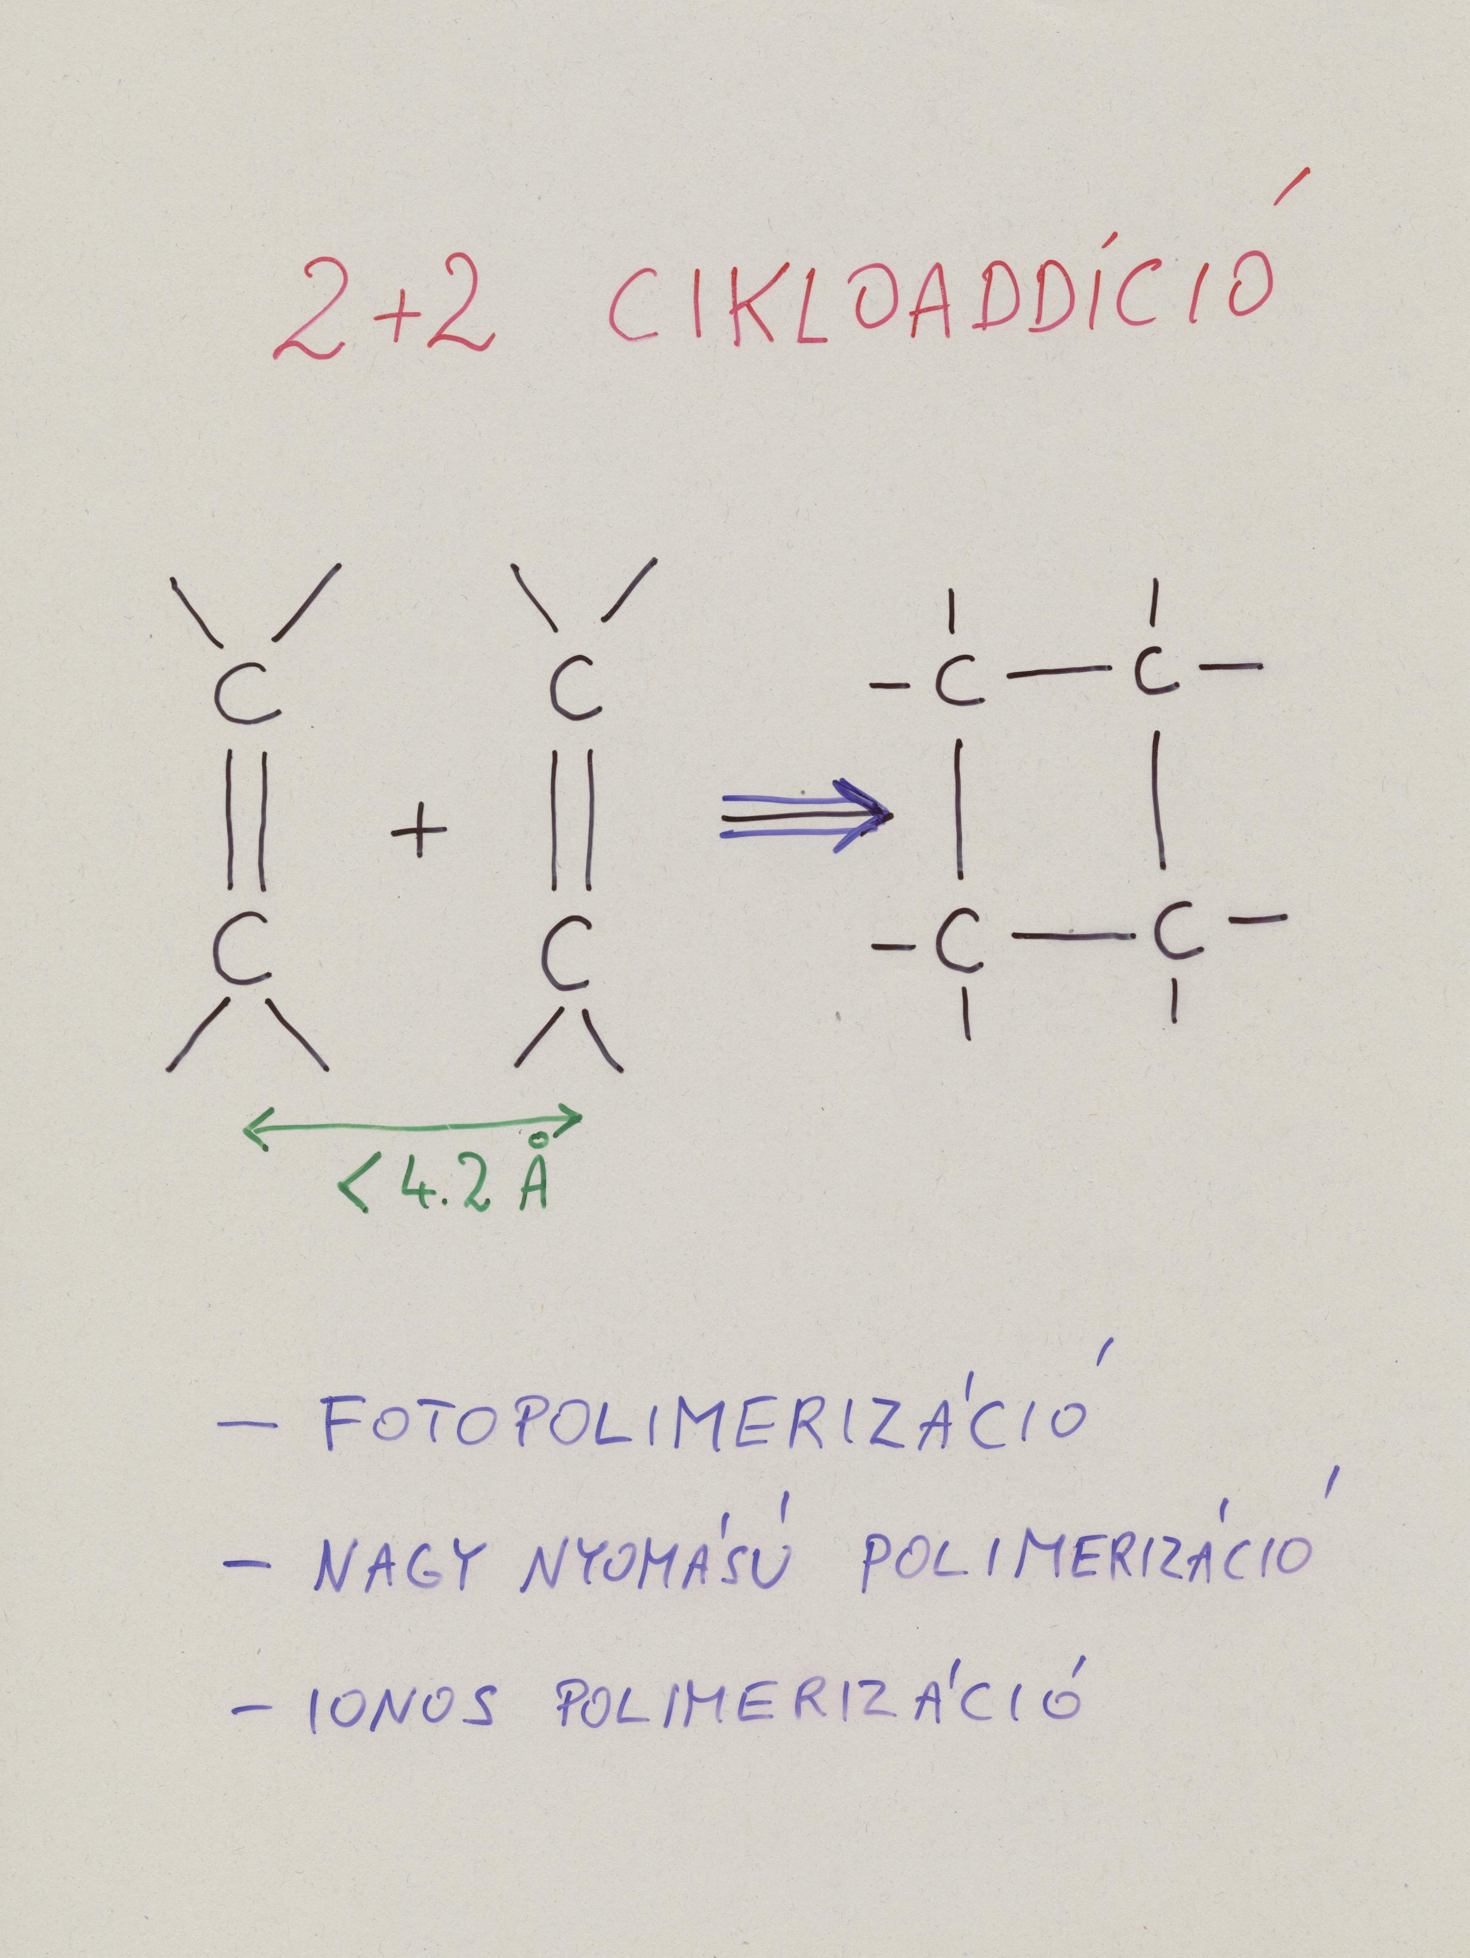
[2+2] cycloaddition
Woodward-Hoffmann rules
(4n, 4n+2 …)
Photopolymerization
Ionic polymerization
High pressure polymerization

Slide 8
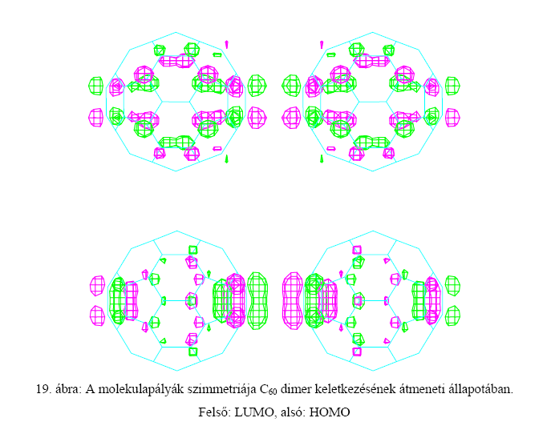
Symmetry of the molecular orbitals in the transient state during dimer formation.
Upper part: LUMO, lower part: HOMO
Kováts Éva PhD értekezés, 2006

Slide 9
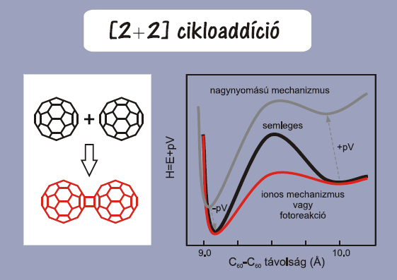
[2+2] cycloaddition
high pressure mechanism
neutral
ionic mechanism
or
photoreaction
C₆₀ – C₆₀ distance (Å)
Oszlányi Gábor MTA doktori, 2005

Slide 10
Photopolymerization

Slide 11
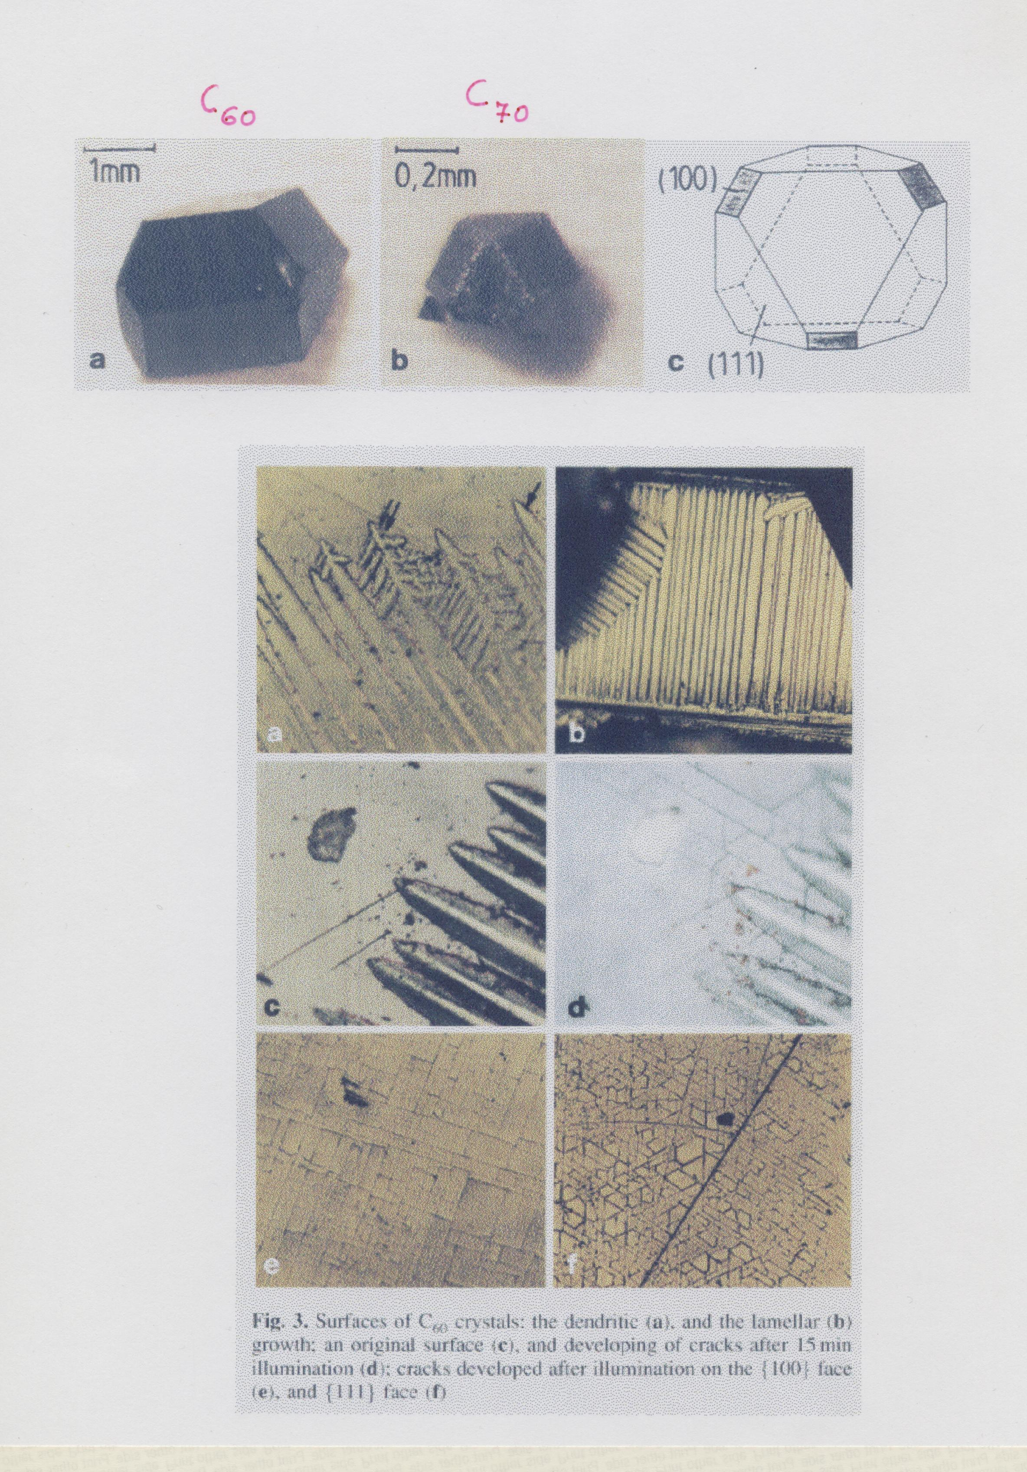

Slide 12
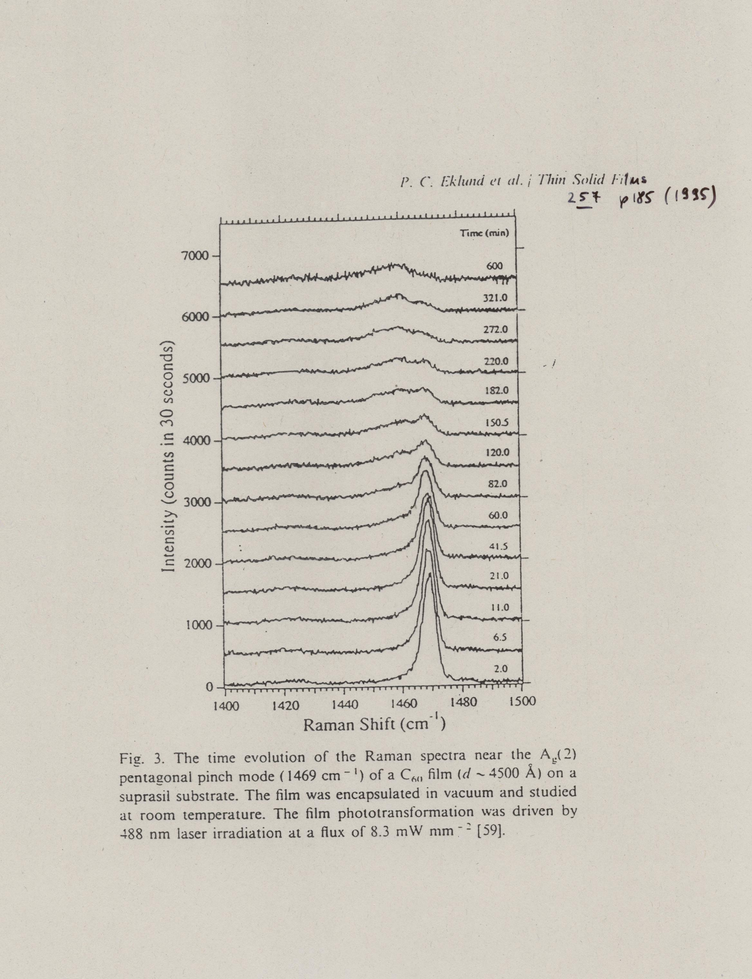

Slide 13
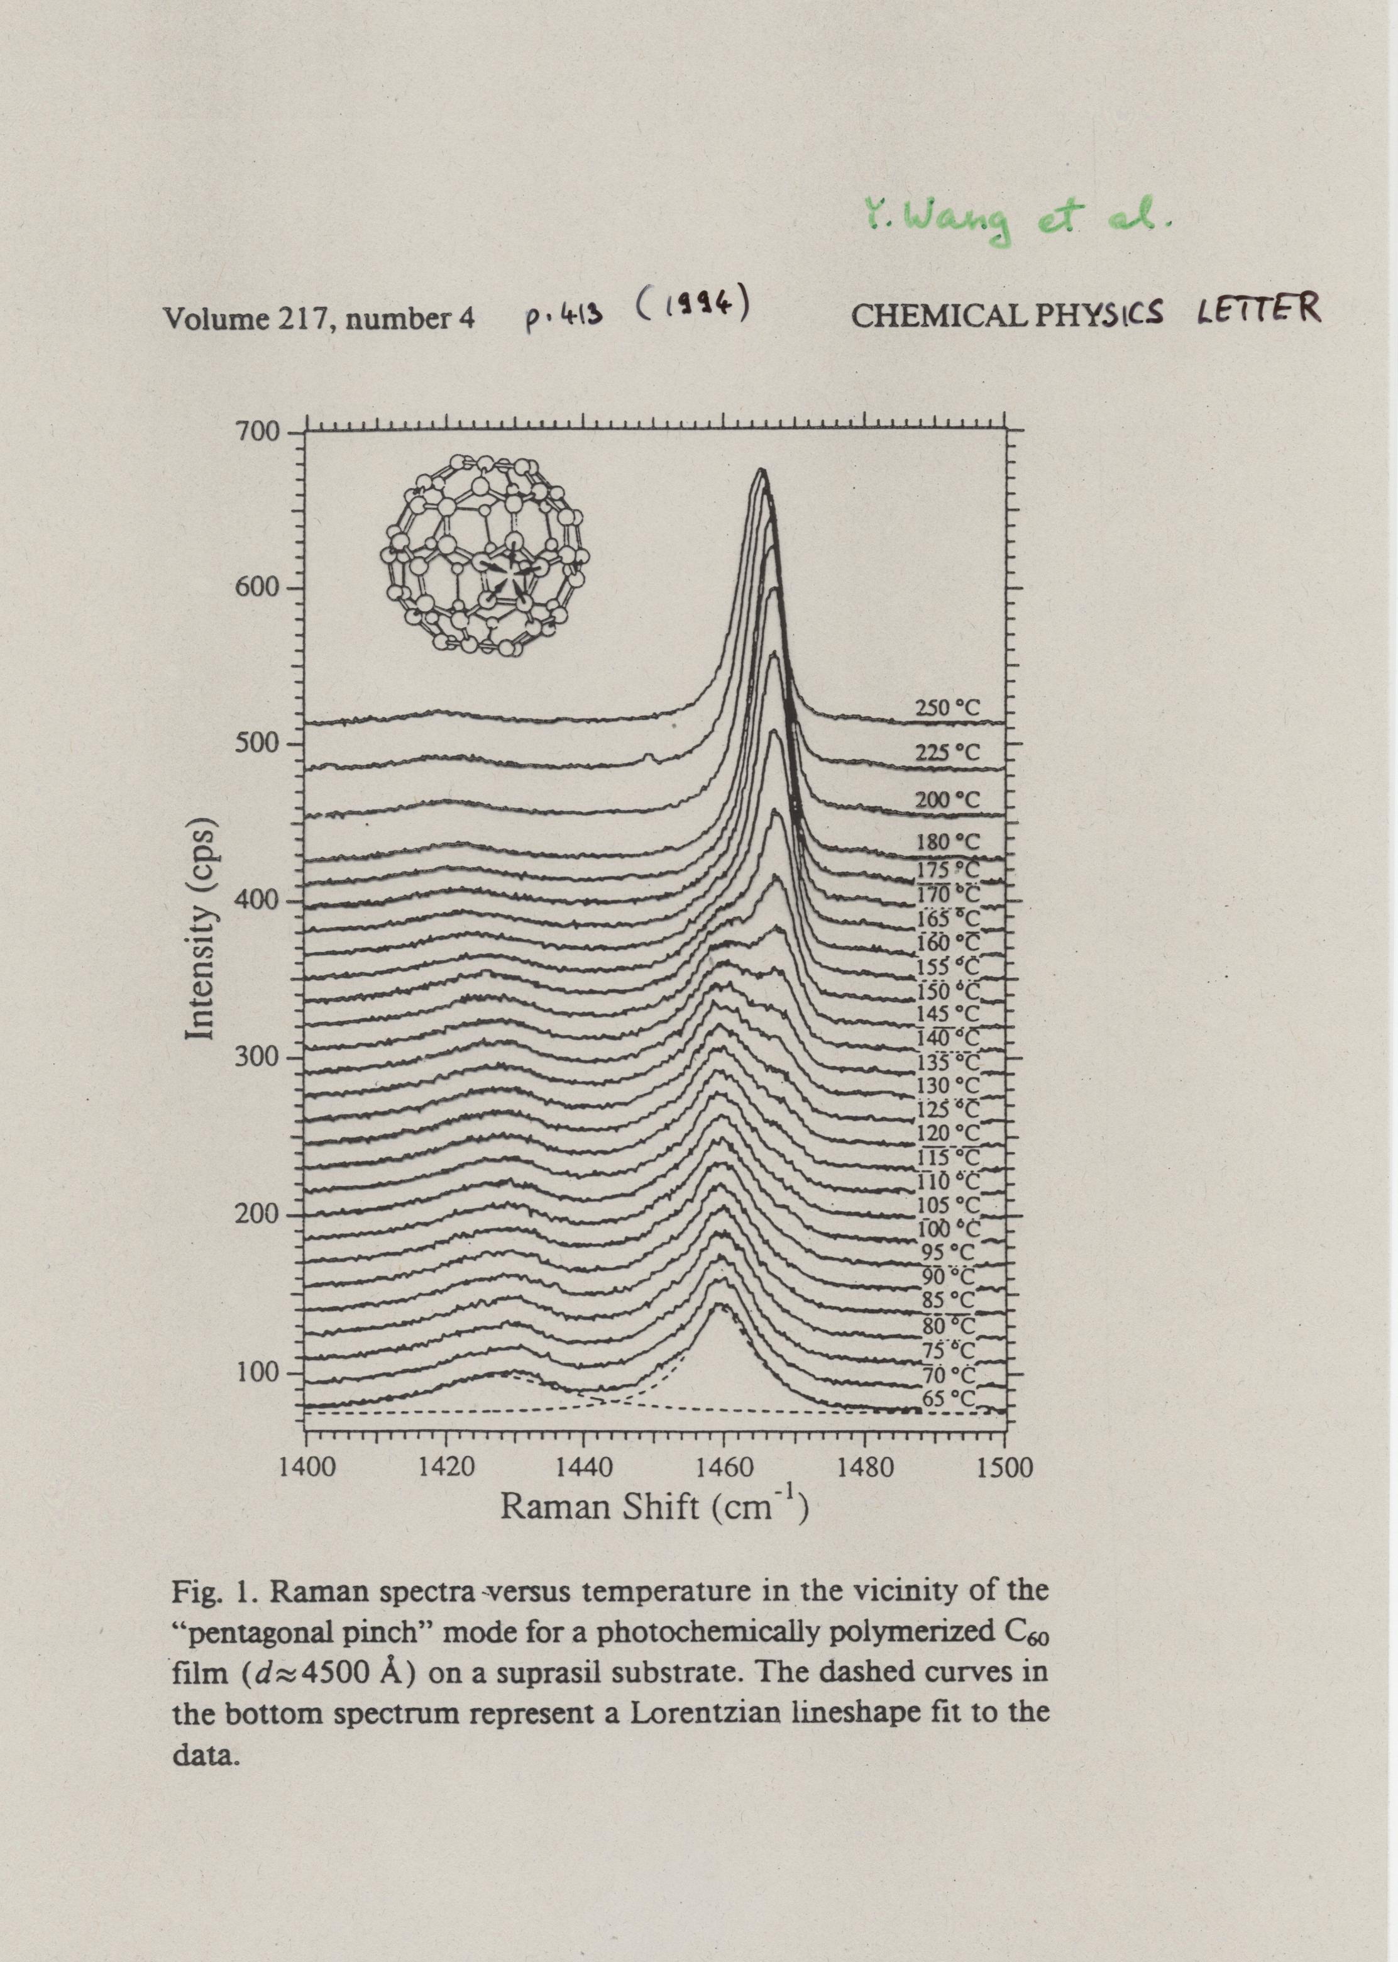

Slide 14
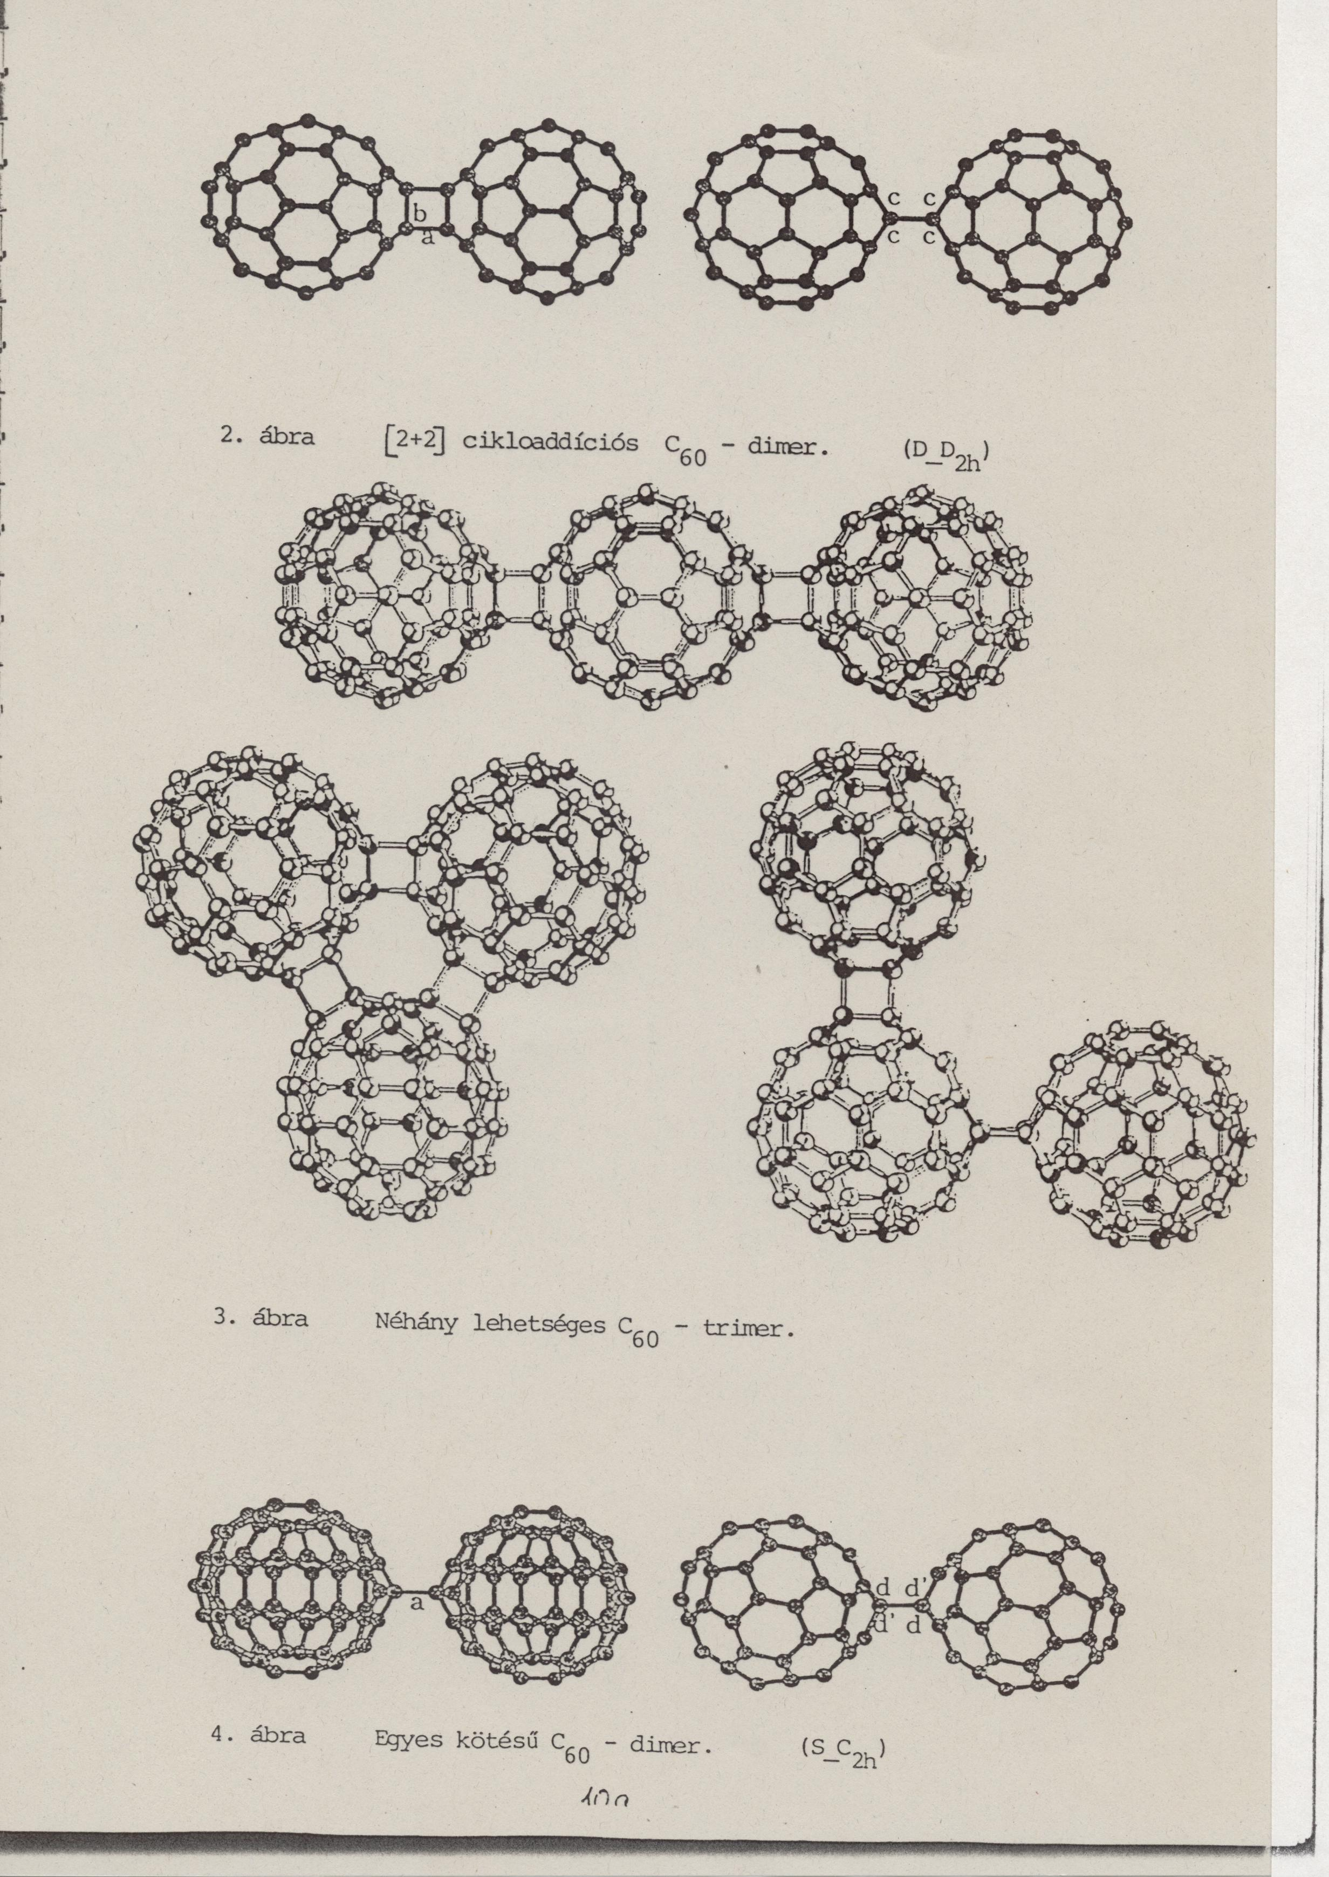
[2+2] cycloaddition C60 – dimer (D_D_{2h})
Several possible C60 – trimers

Slide 15
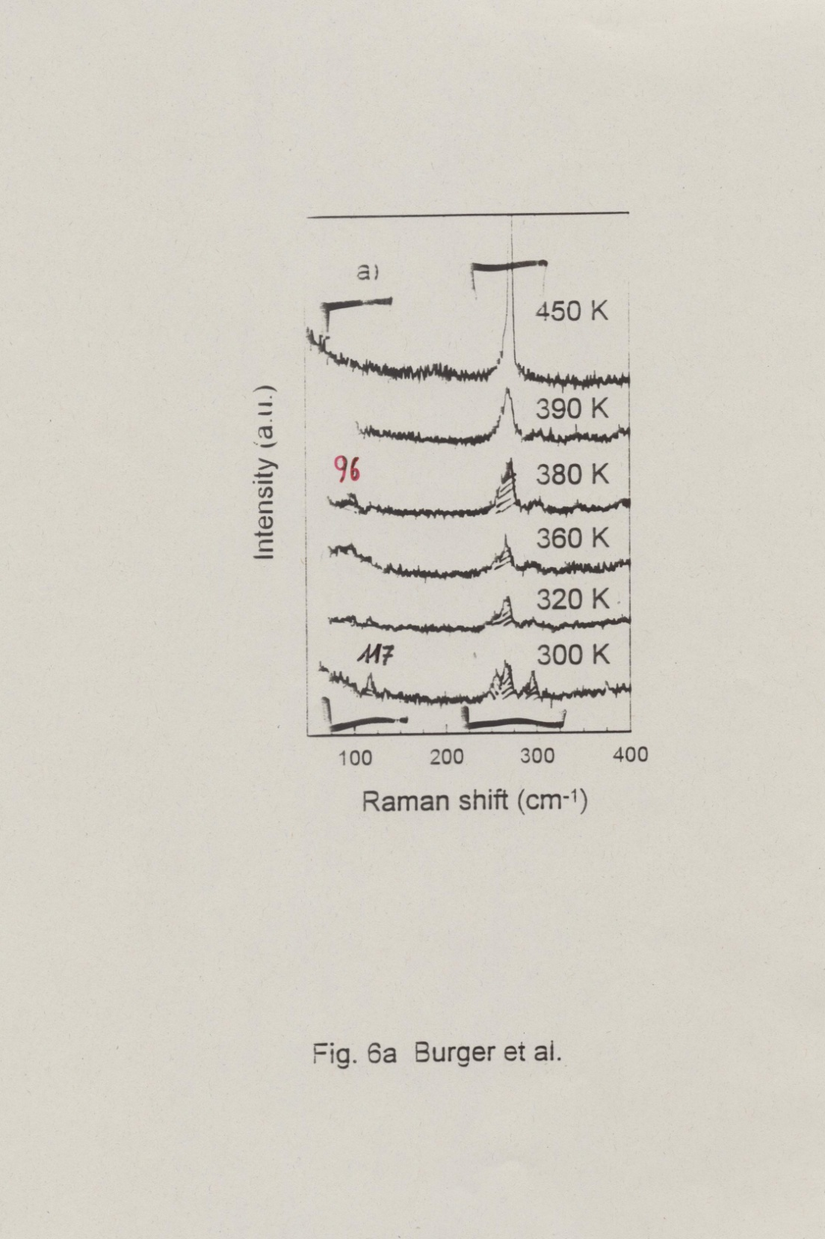
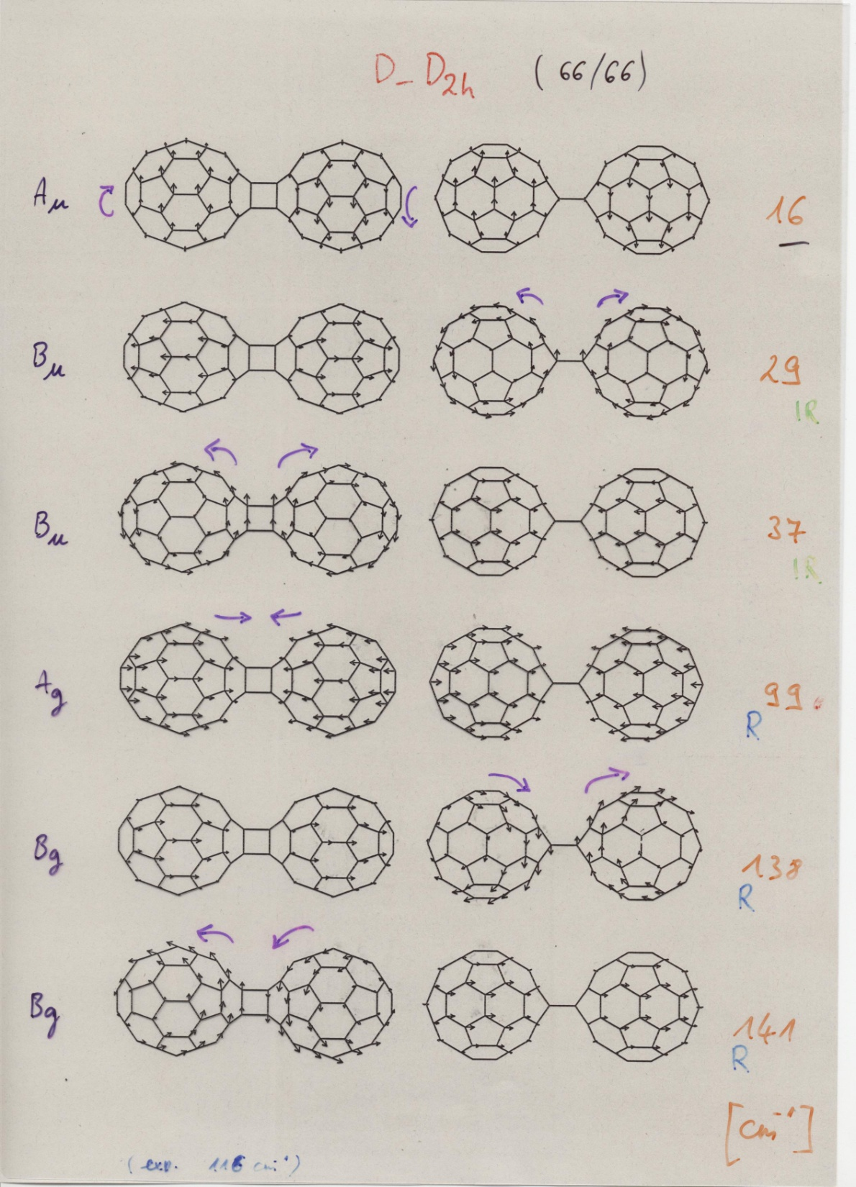
Number of vibrations for two independent C₆₀:
2 x (3 x 60 – 6) = 348
Number of vibrations for C₆₀ dimer:
(3 x 120 – 6) = 354
→ there are 6 extra vibrations
CAN YOU EXPLAIN WHY?
CAN YOU IDENTIFY THE SYMMETRY OF THEM?

Slide 16
Ionic polymerization

Slide 17
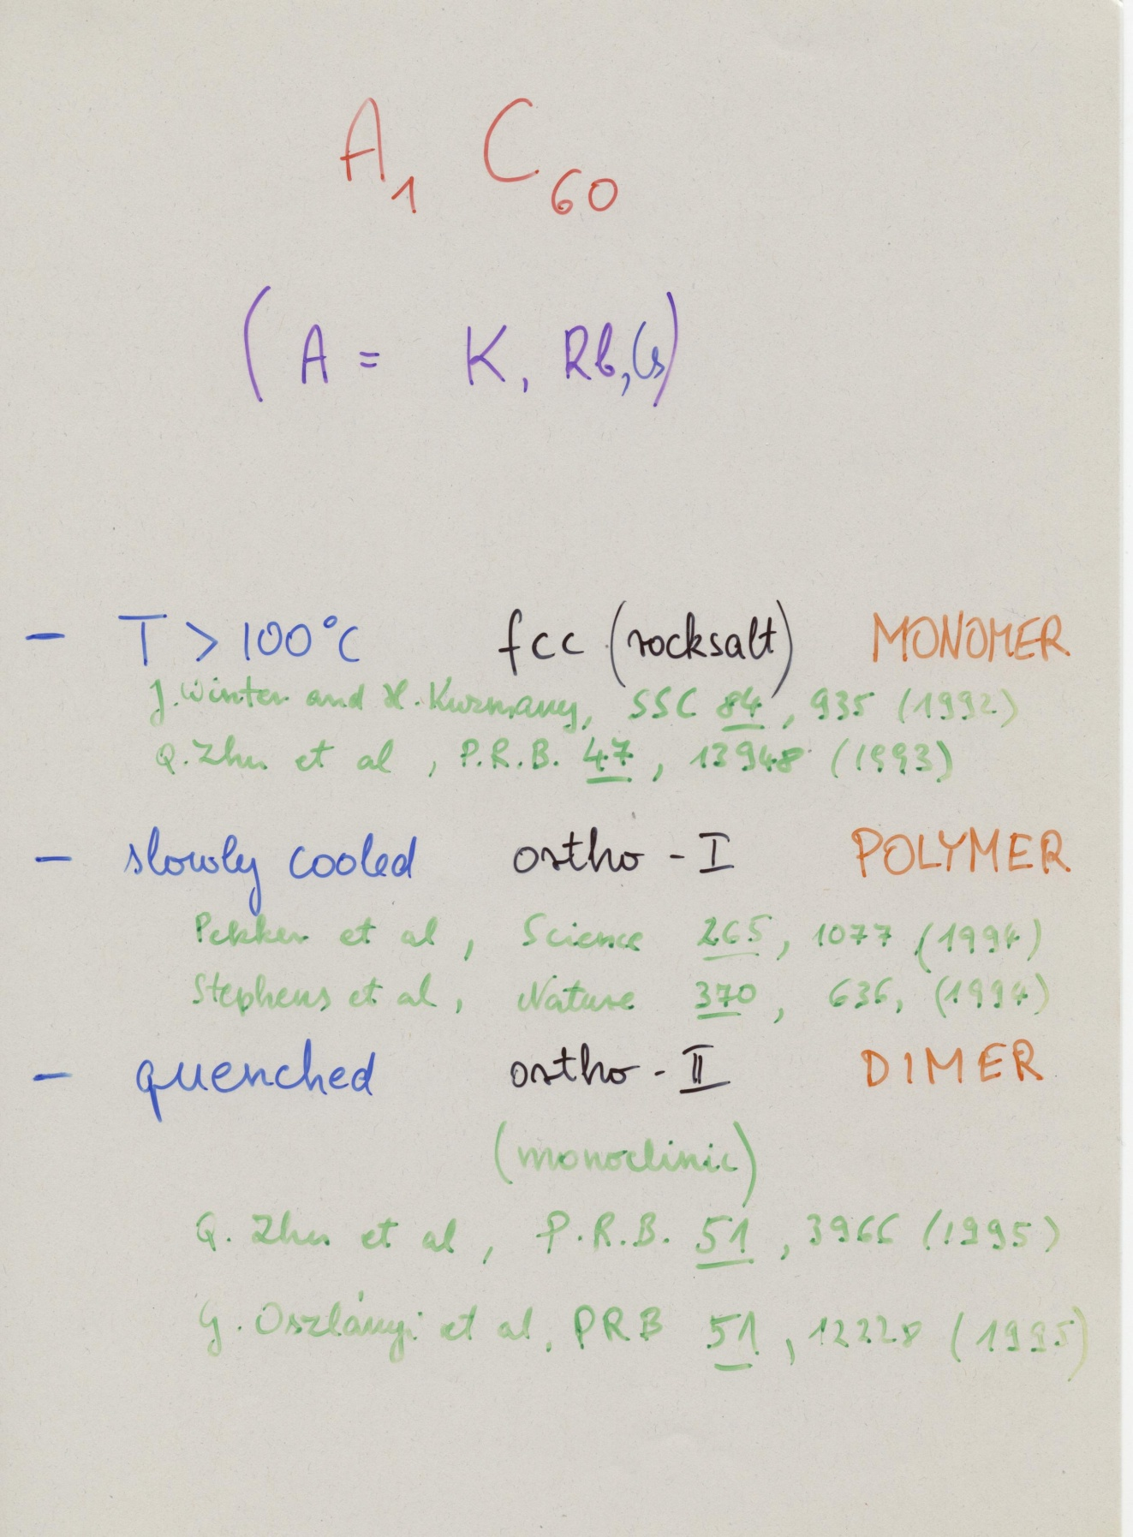

Slide 18
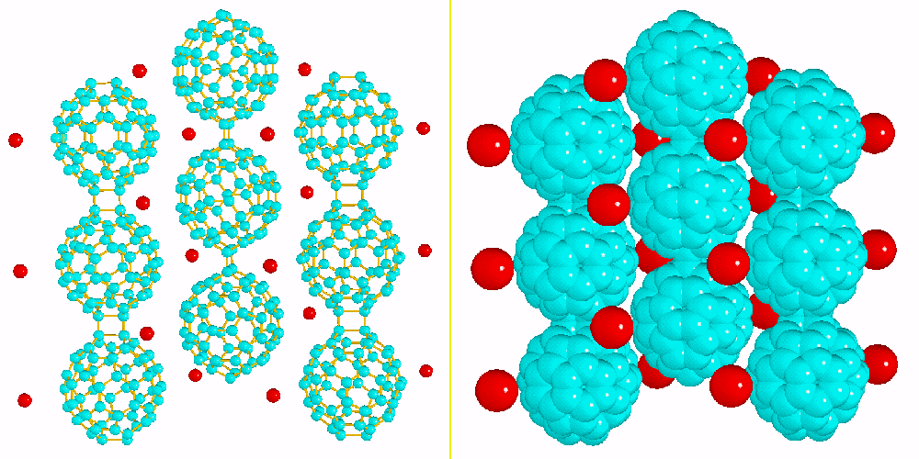
[2+2] cycloaddition
D_{2h}
C₆₀ ionic polymers
A₁C₆₀
9.14 Å
: A: alkali atom (Na, K, Rb, Cs)

Slide 19
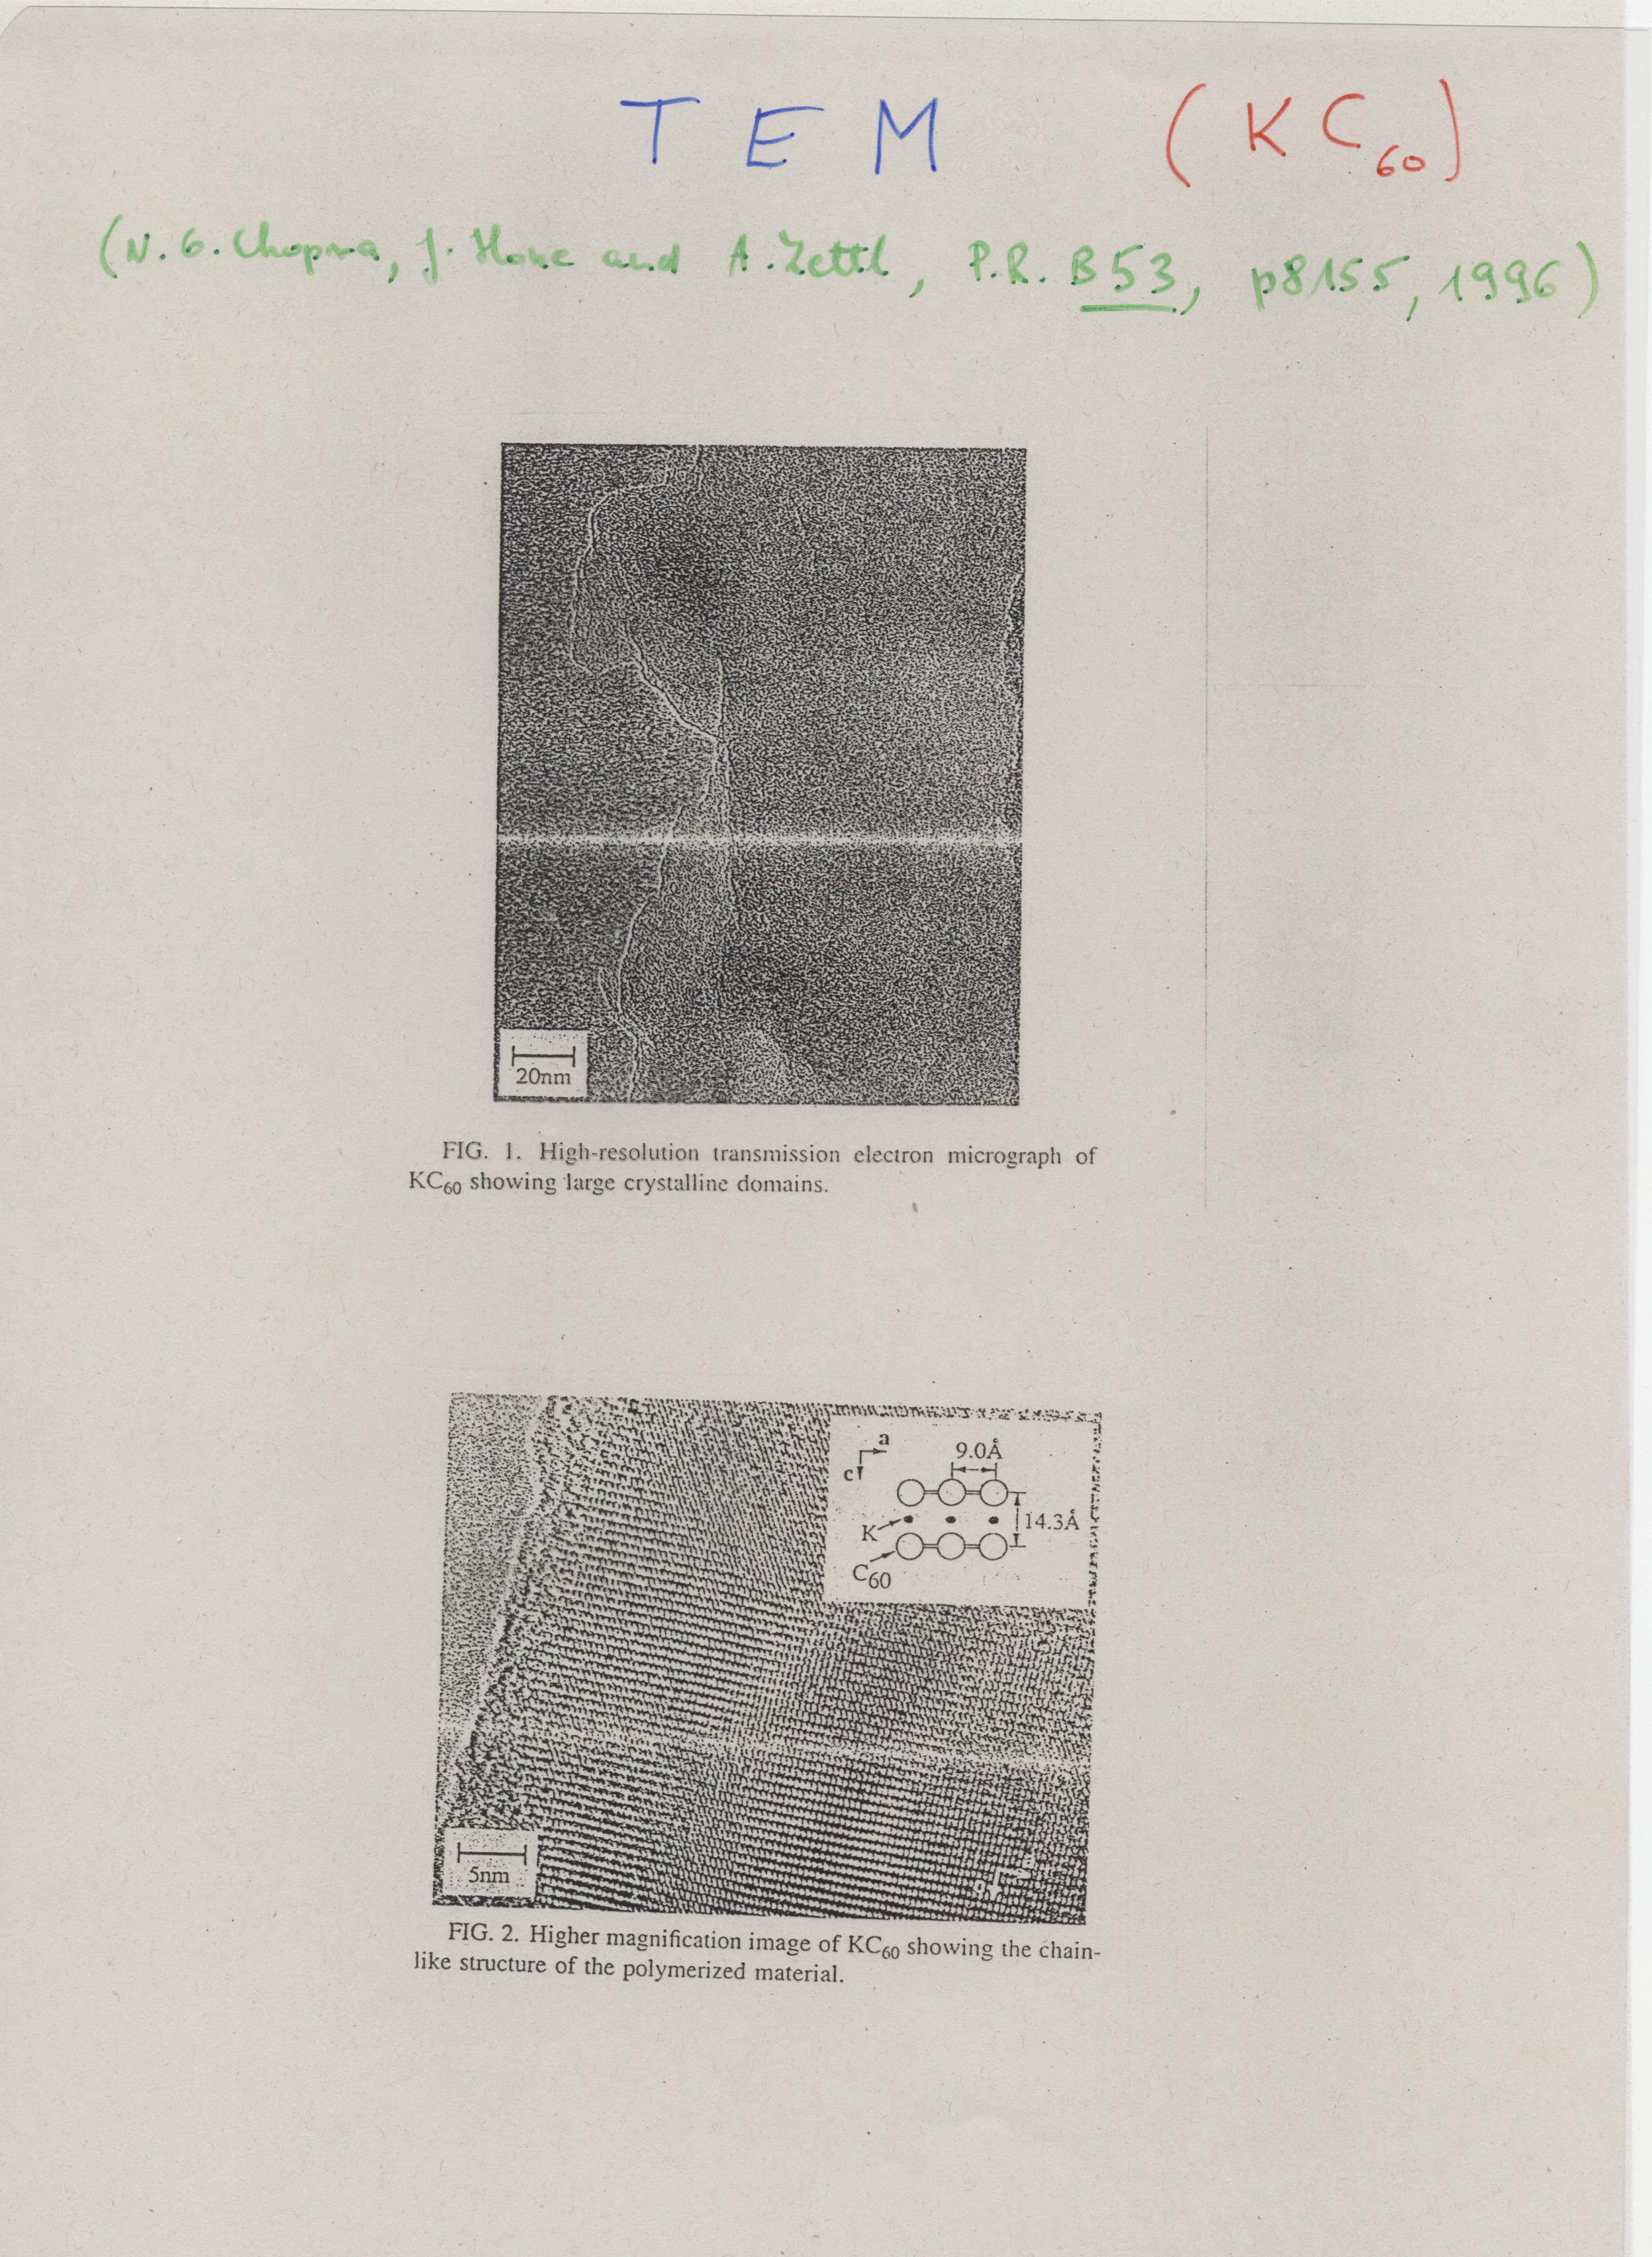

Slide 20
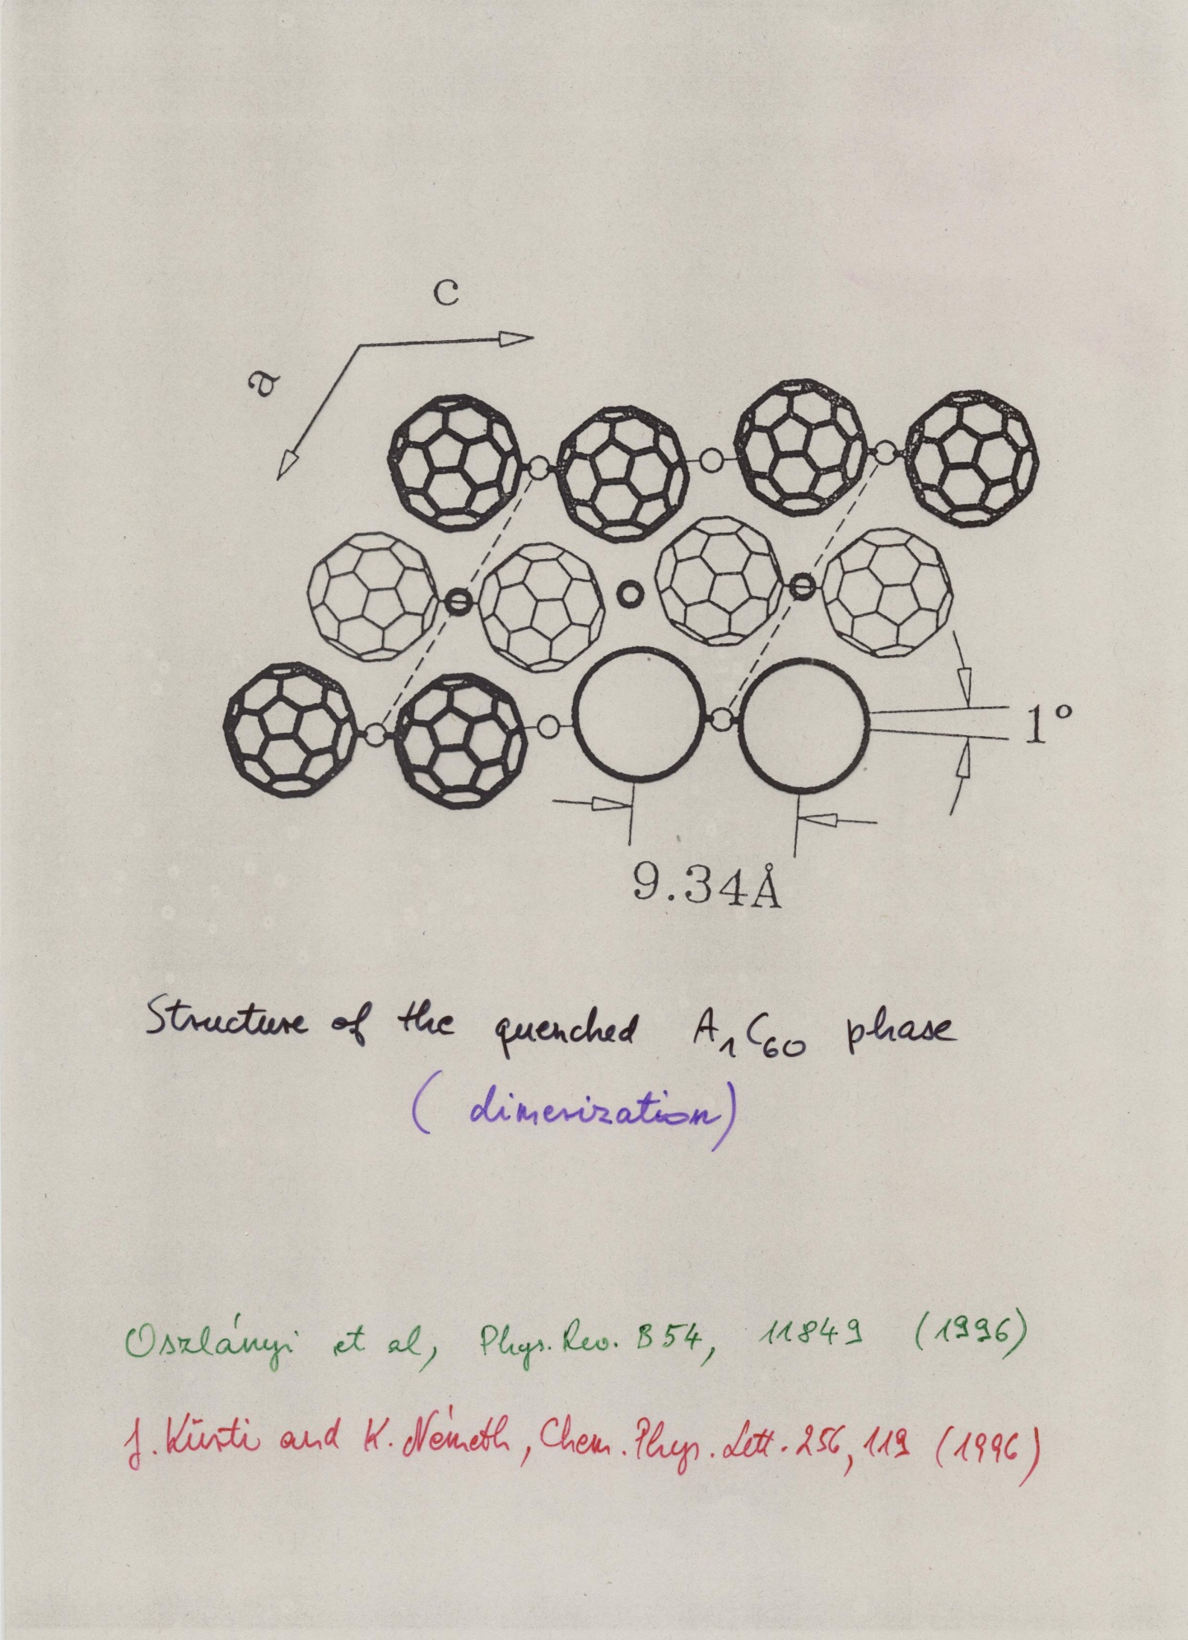

Slide 21
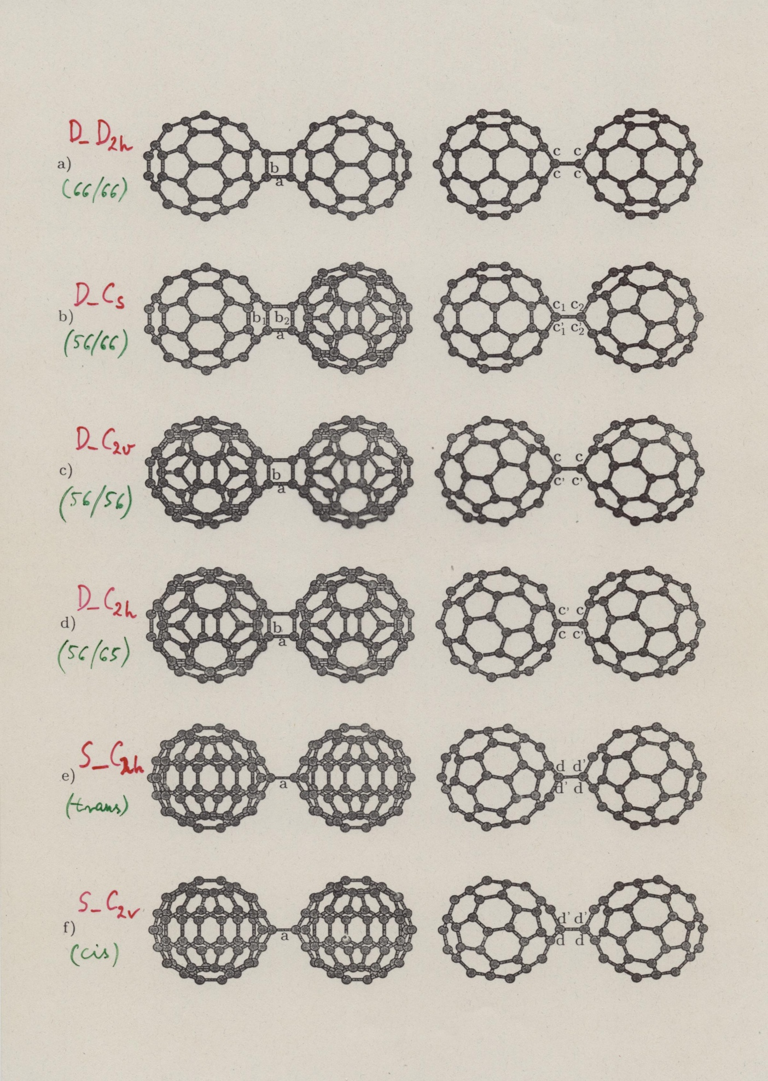

Slide 22
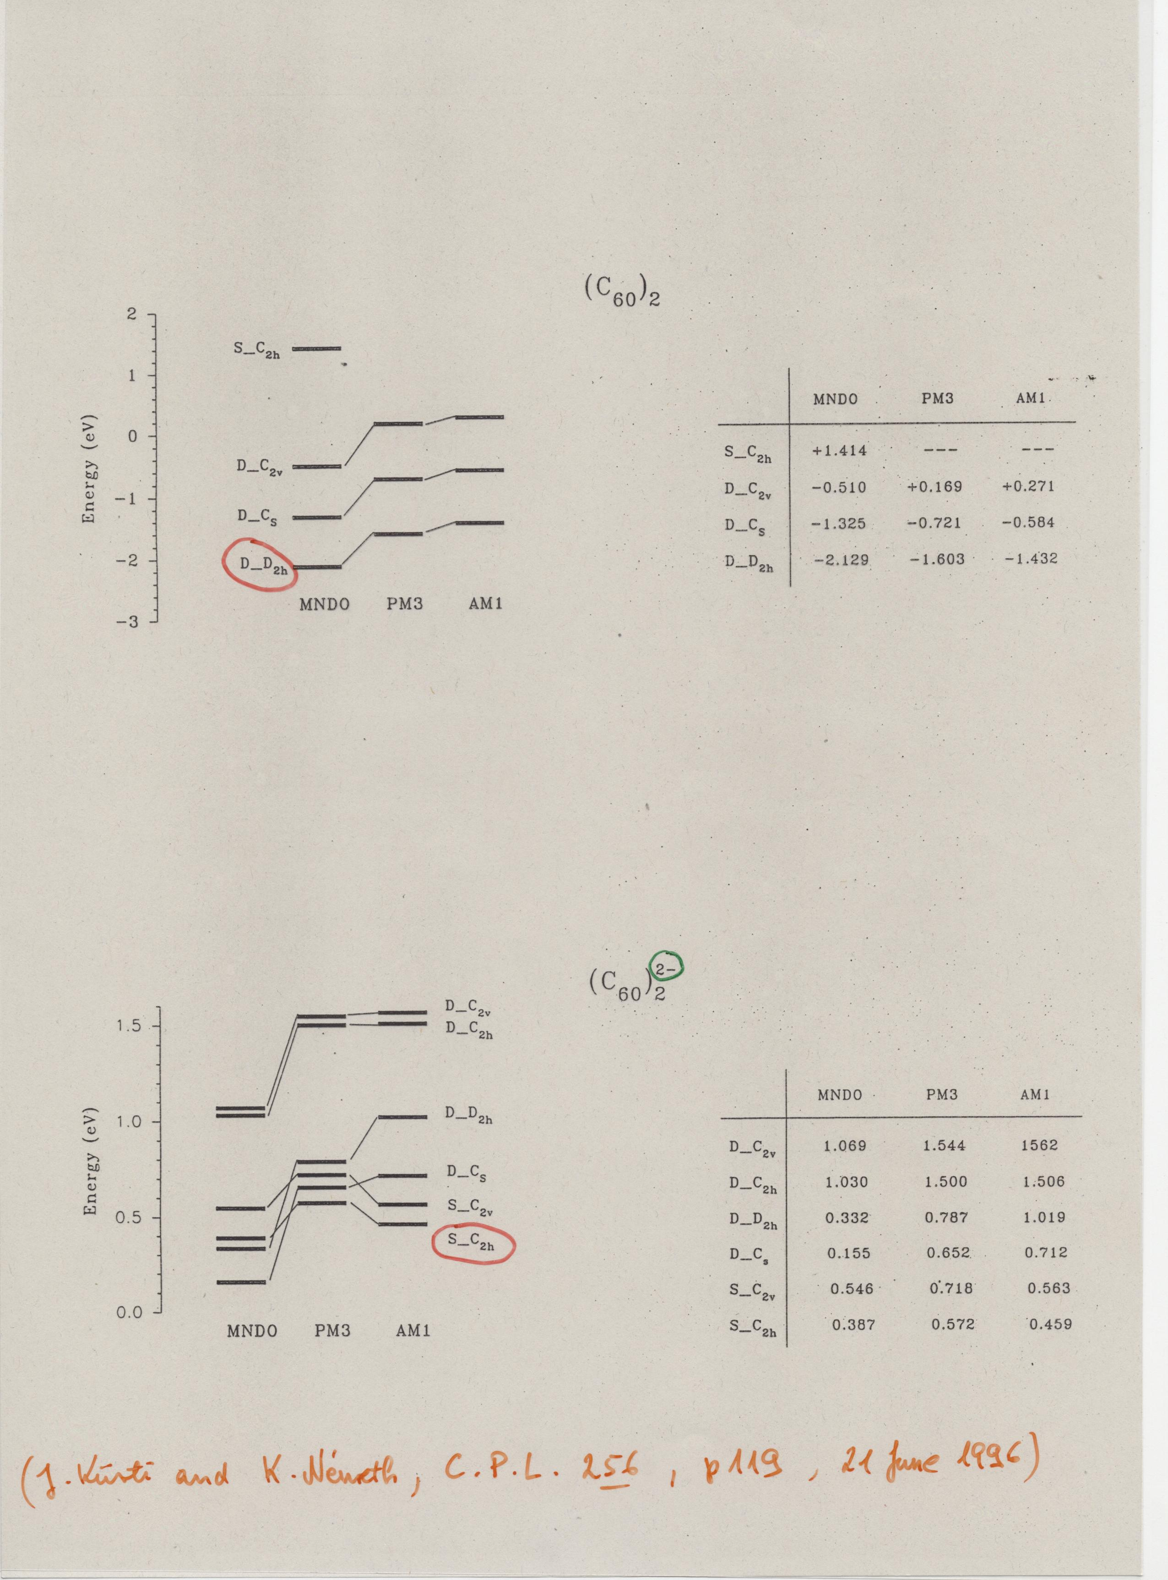

Slide 23
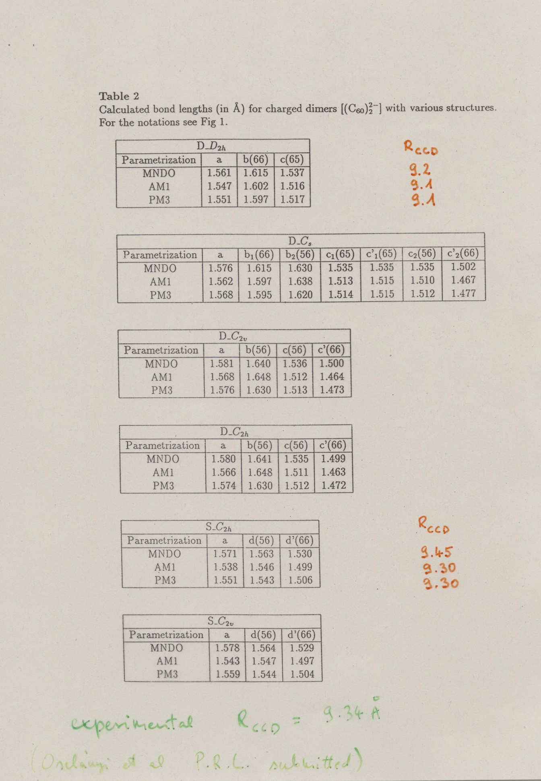

Slide 24
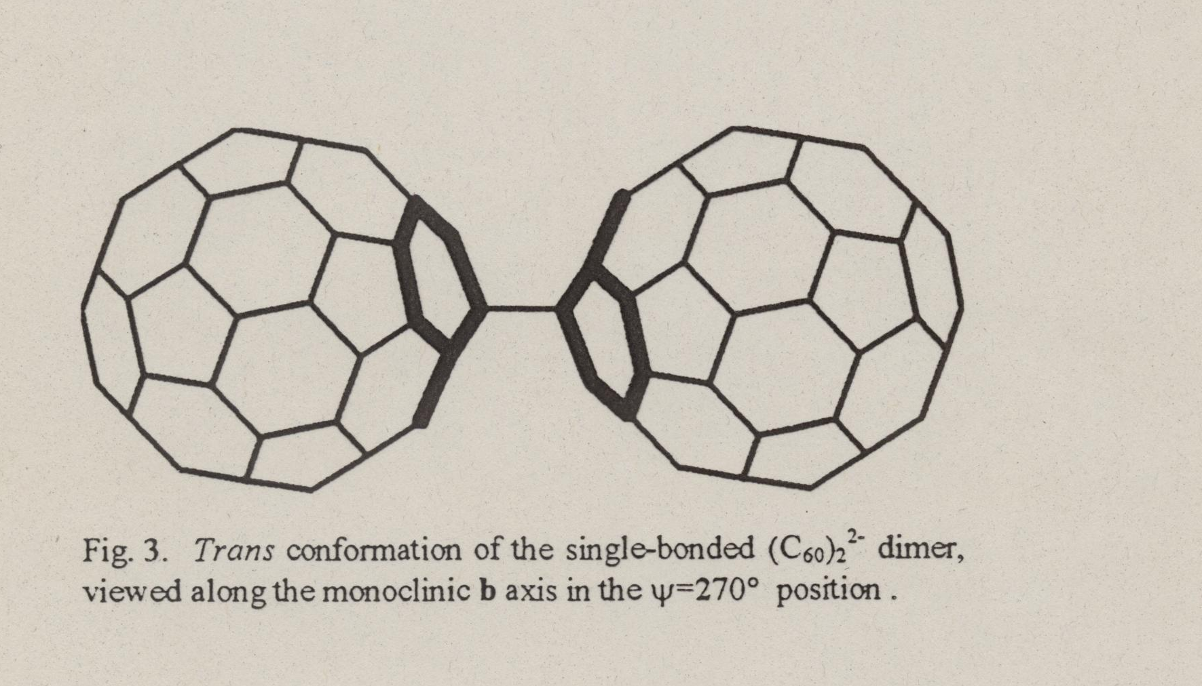

Slide 25
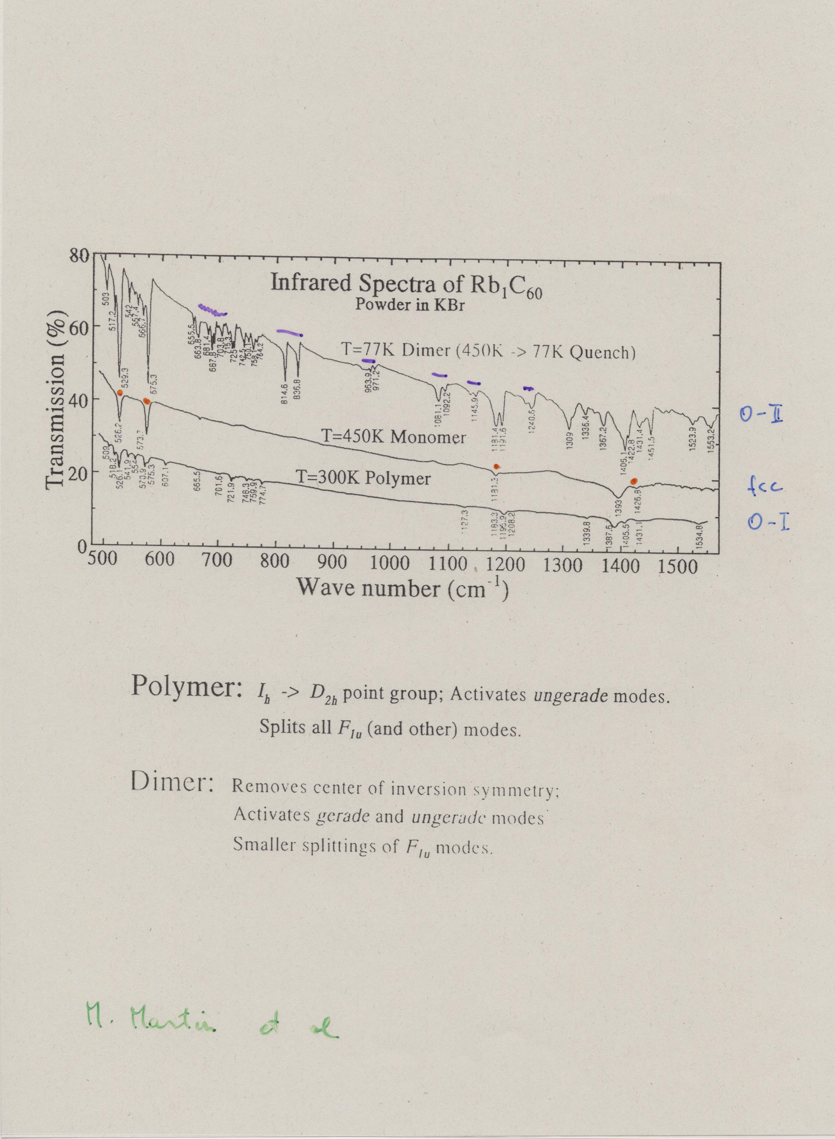

Slide 26
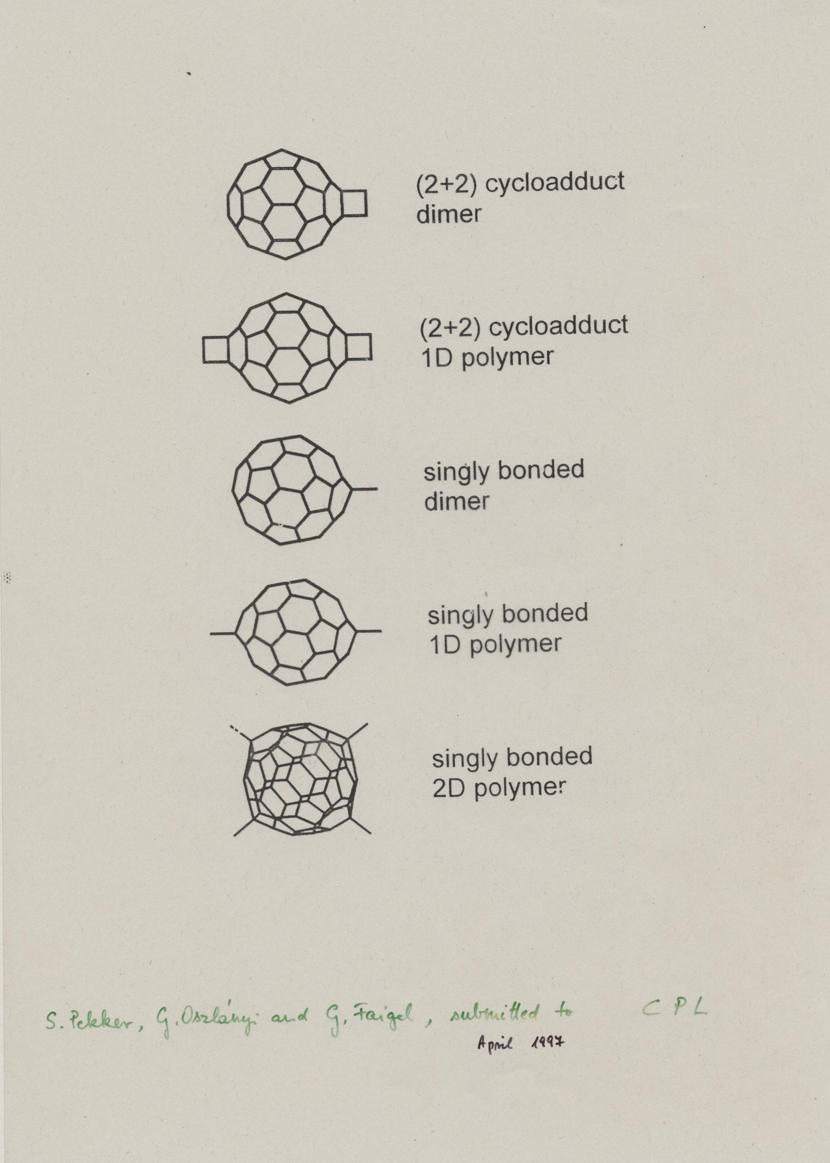
Pekker et al.

Slide 27
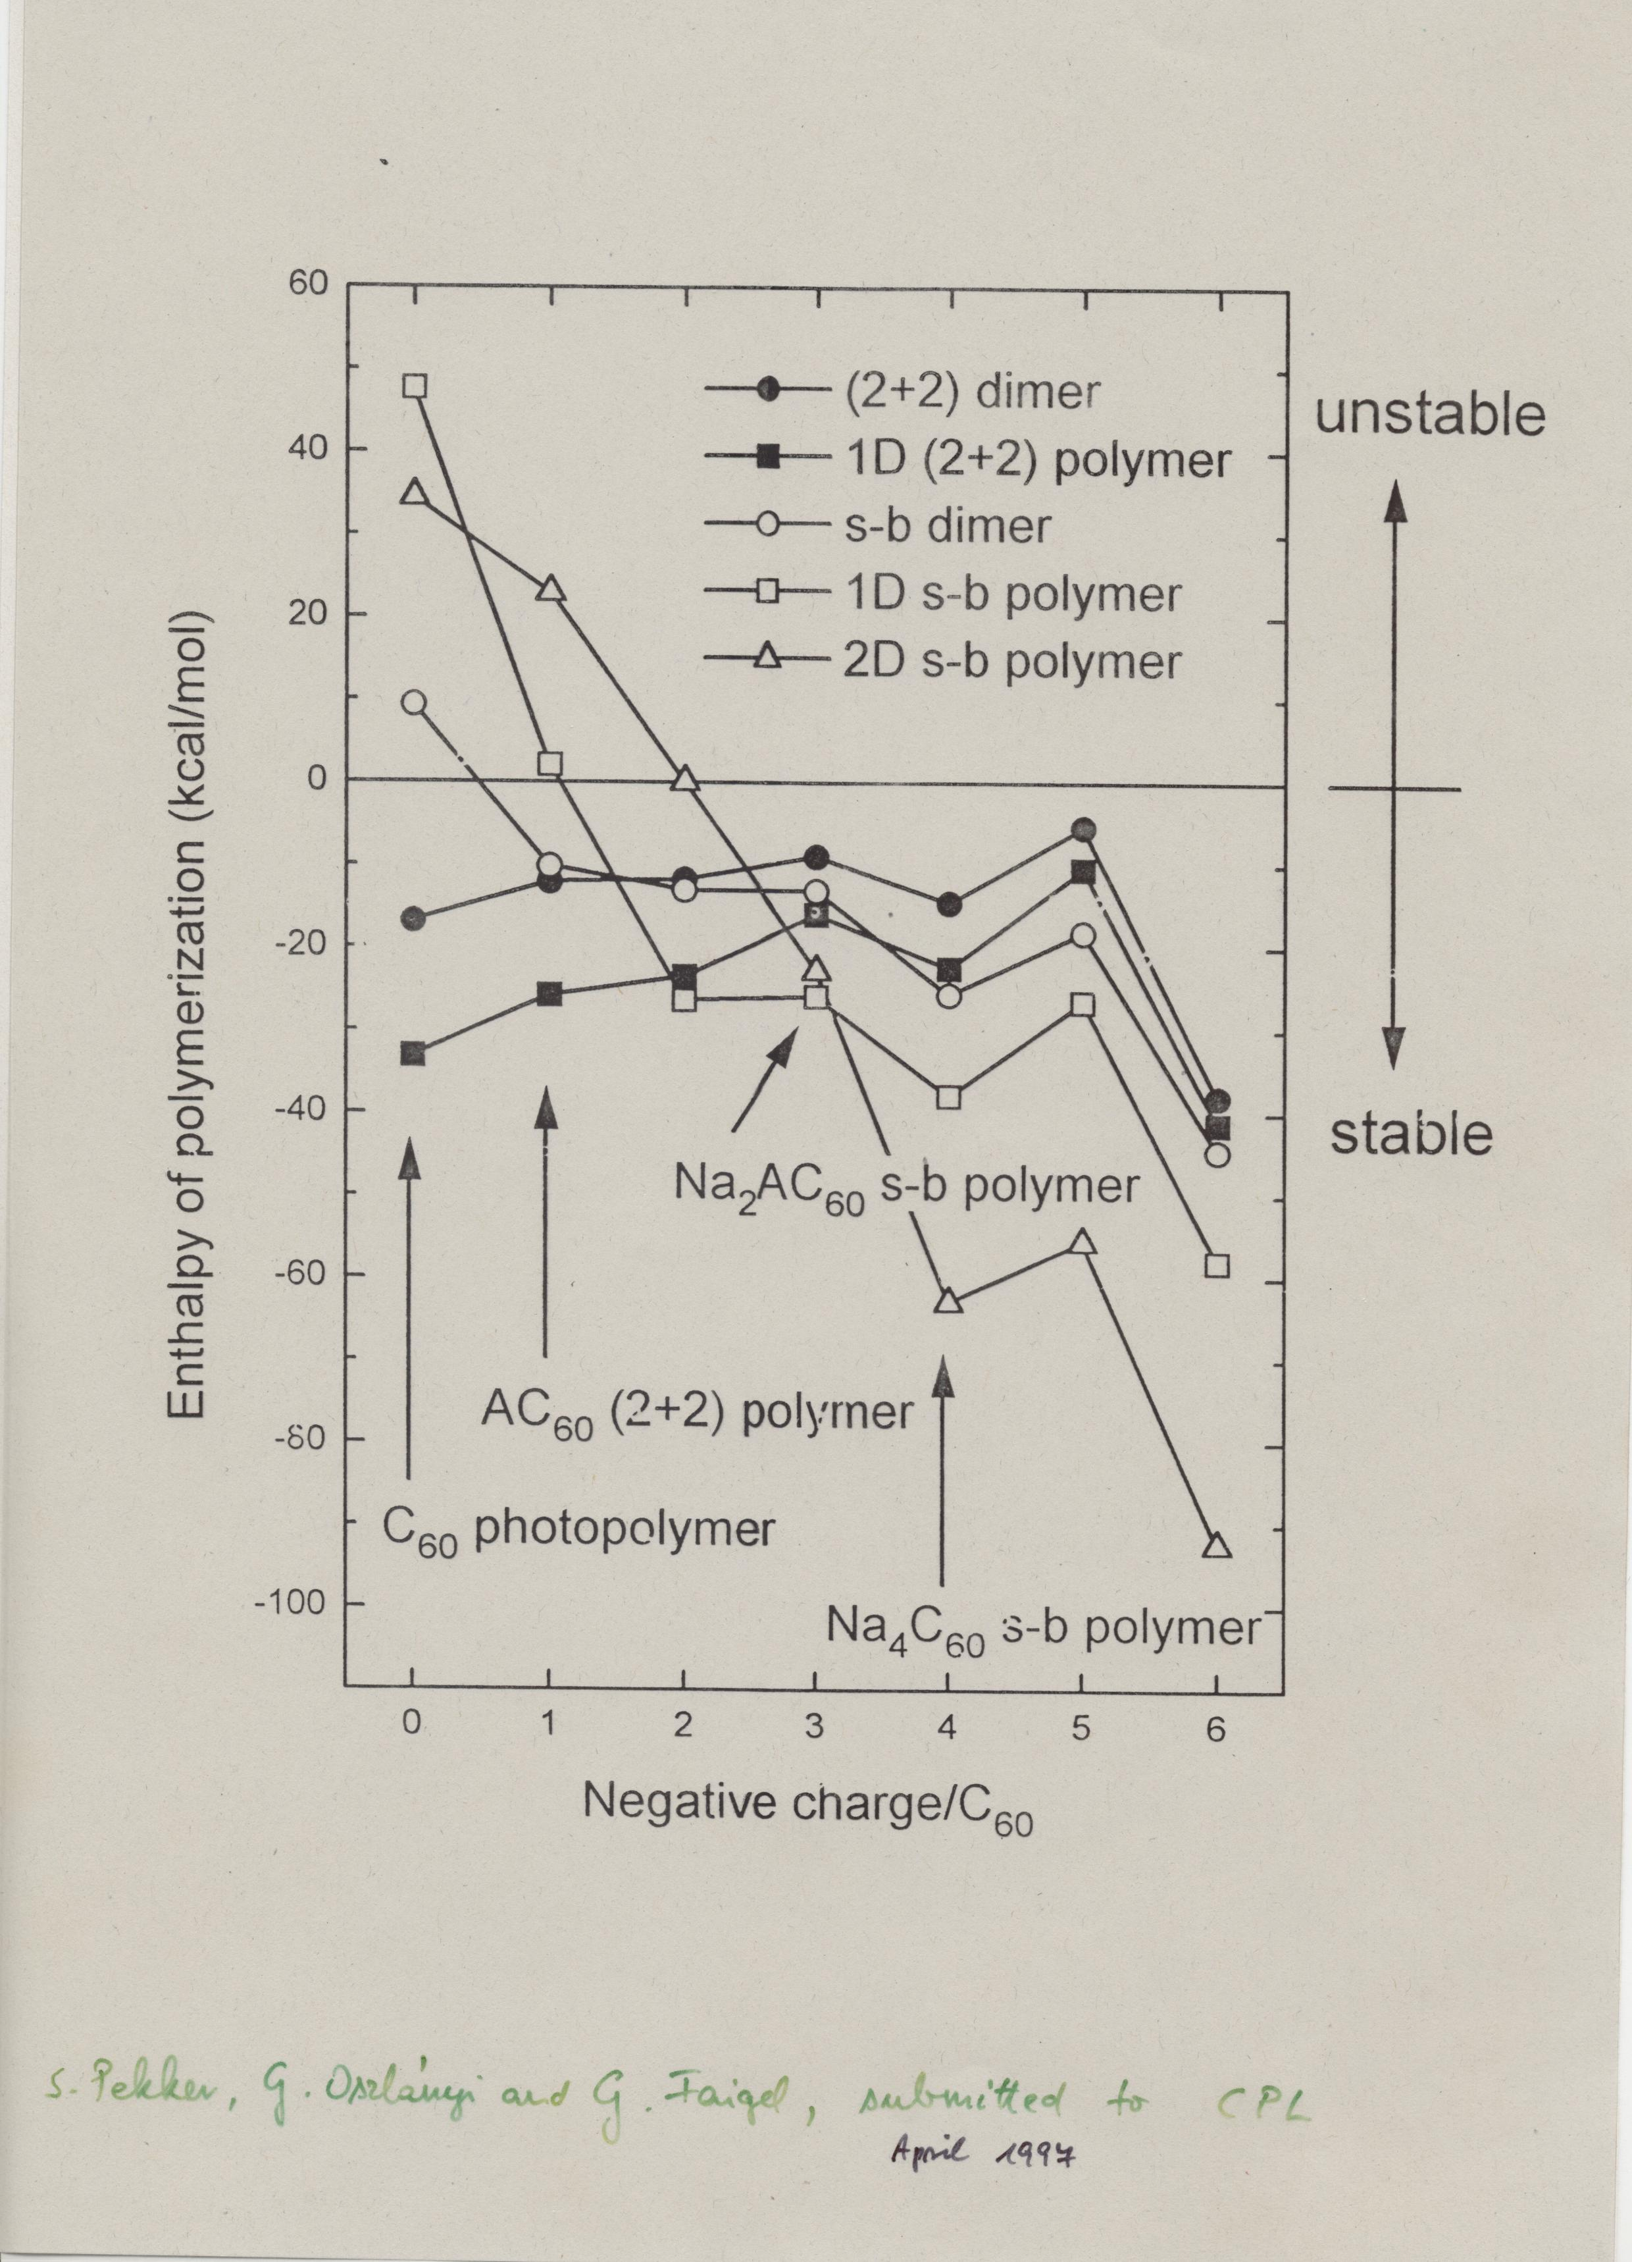
Pekker et al.

Slide 28
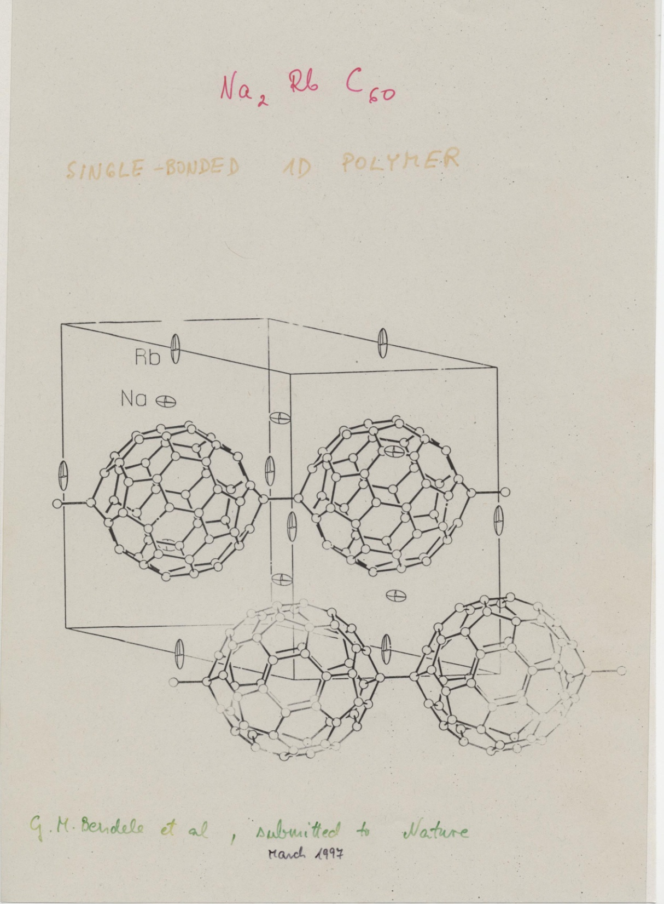
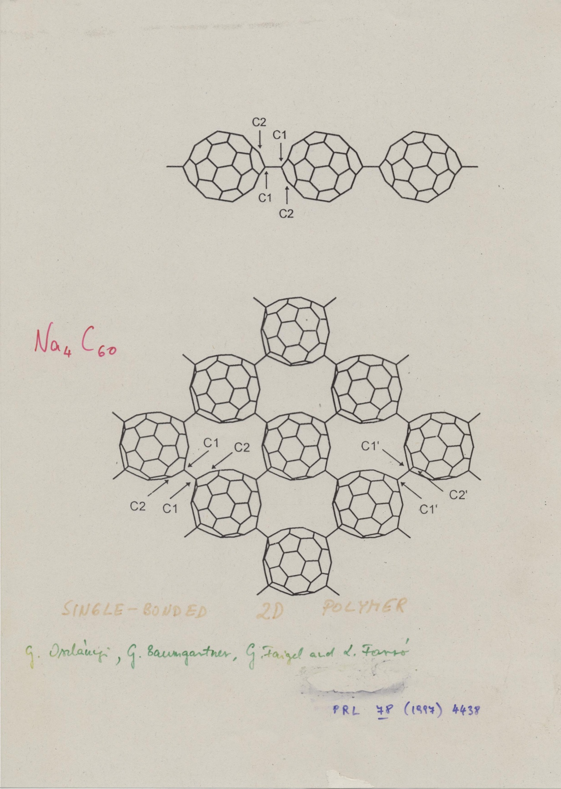

Slide 29
High pressure polymerization

Slide 30
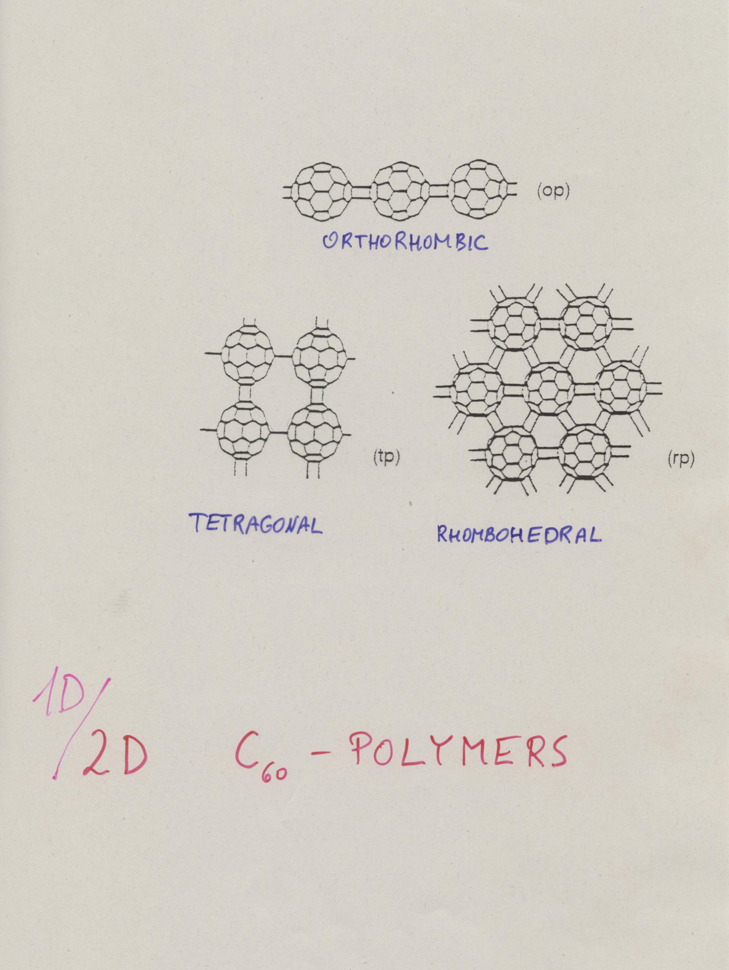
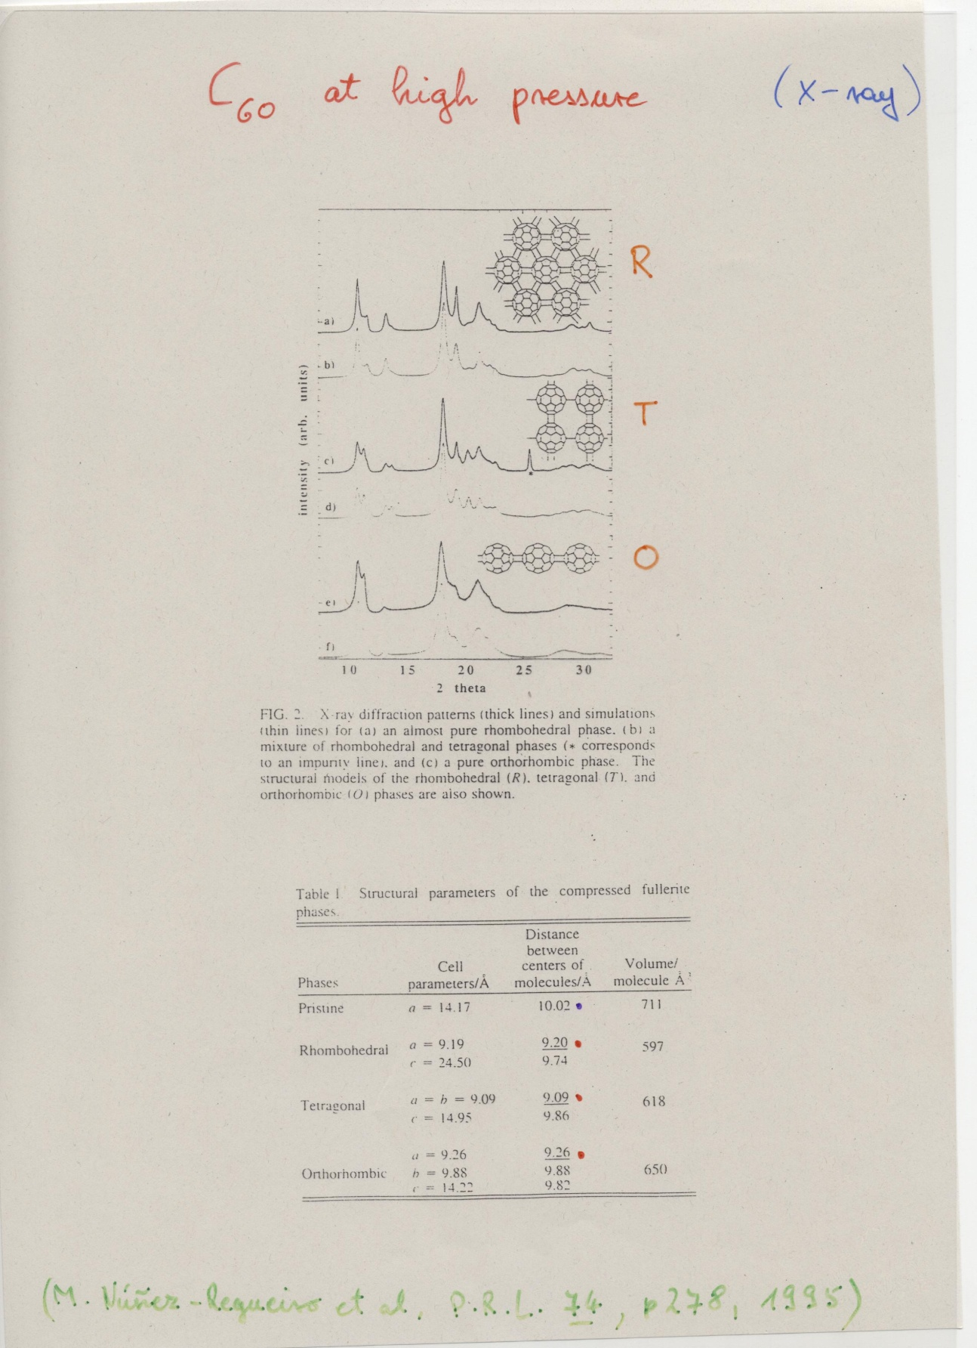
1D – 2D

Slide 31
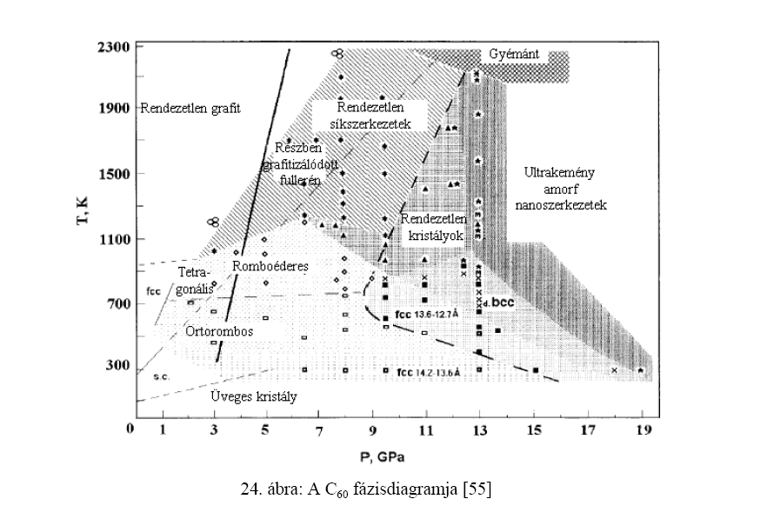
Kováts Éva PhD értekezés, 2006

Slide 32
C₆₀ – cubane

Slide 33
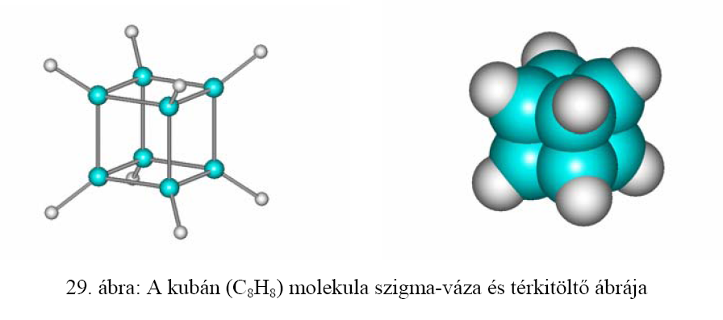
Cubane (C₈H₈)
sigma-skeleton space filling model
Kováts Éva PhD értekezés, 2006

Slide 34
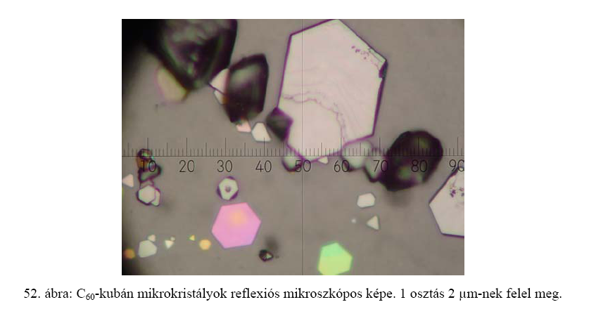
C₆₀–cubane microcrystals in reflection microscope. 1 division: 2μm.
Kováts Éva PhD értekezés, 2006

Slide 35
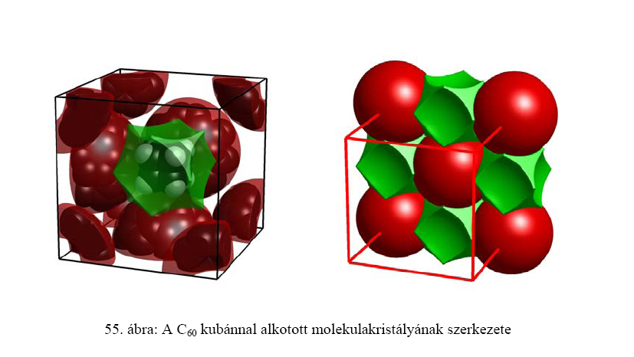
„rotor – stator” system
Structure of C60 – cubane molecular crystal
Kováts Éva PhD értekezés, 2006

Slide 36
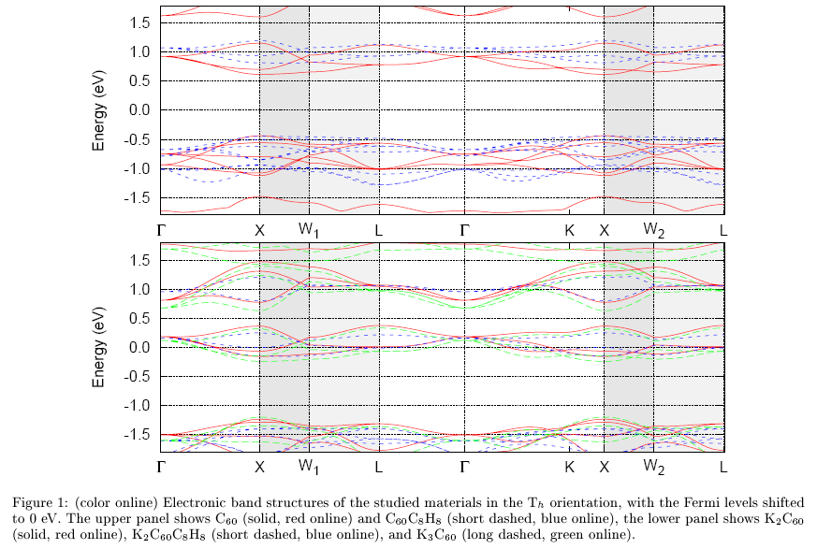

Slide 37
Endohedral fullerenes

Slide 38
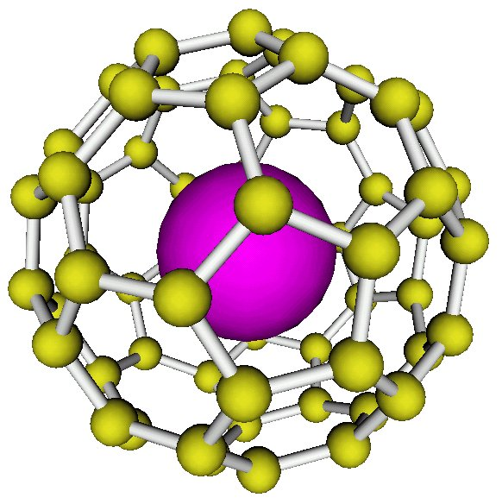
Endohedral fullerenes, e.g. N @ C₆₀

Slide 39
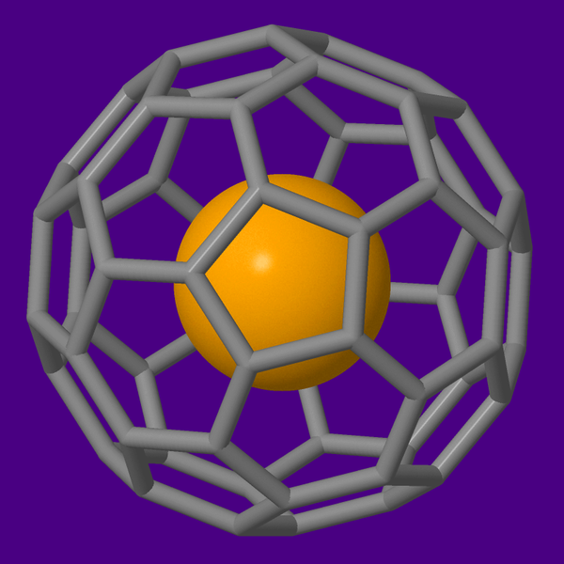
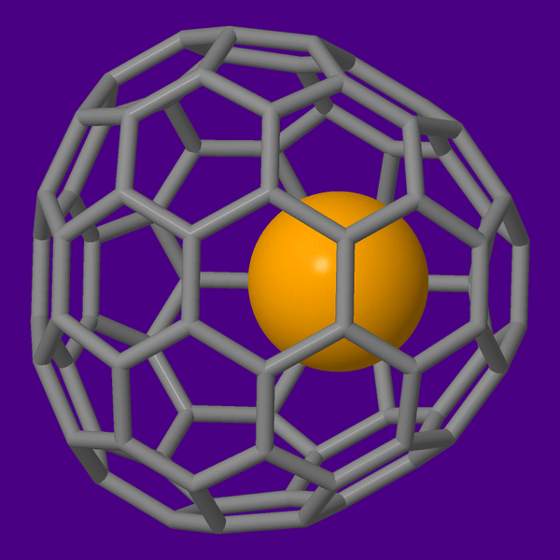
N @ C₆₀
Sc @ C₈₂

Slide 40
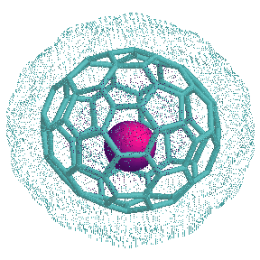
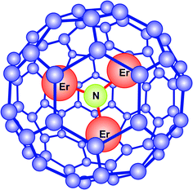
Sc @ C₈₂
Er₃N @ C₈₀

Slide 41
At the end two comments:
Fullerenes were discovered by chance, the motivation came from astrophysical – astrochemical ideas. It is interesting to mention, that more than two decades after the discovery of fullerenes it turned out that C₆₀ and C₇₀ can be indeed observed in the interstellar space. See e.g. Jan Cami et al., „Detection of C₆₀ and C₇₀ in a Young Planetary Nebula”, Science 329, pp 1180-1182 (2010).
An amazing experiment was done in 1999 at the University of Vienna: interference pattern was observed in a double slit arrangement with C60 molecules. Fullerene molecules are one of the largest objects for wich the particle – wave duality has been demonstrated. See e.g. M Arndt et al., „Wave-particle duality seen in carbon-60 molecules”, Nature 401, p680 (1999).

