Slide 1
MACROMOLECULES
lecture for physics, biophysics and chemistry students
2019. winter semester – 01. October
Jenő KÜRTI
Eötvös Loránd University
Institute of Physics
Department of Biological Physics
e-mail: kurti@virag.elte.hu www: regivirag.elte.hu/kurti

Slide 2
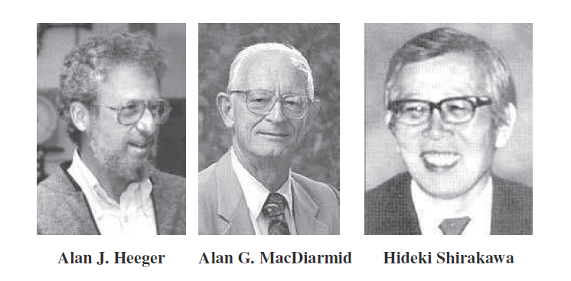
Nobel Prize in Chemistry, 2000
for the discovery of polyacetylene (1974)
(prototype of the family of conjugated polymers)
1936- 1927-2007 1936-

Slide 3
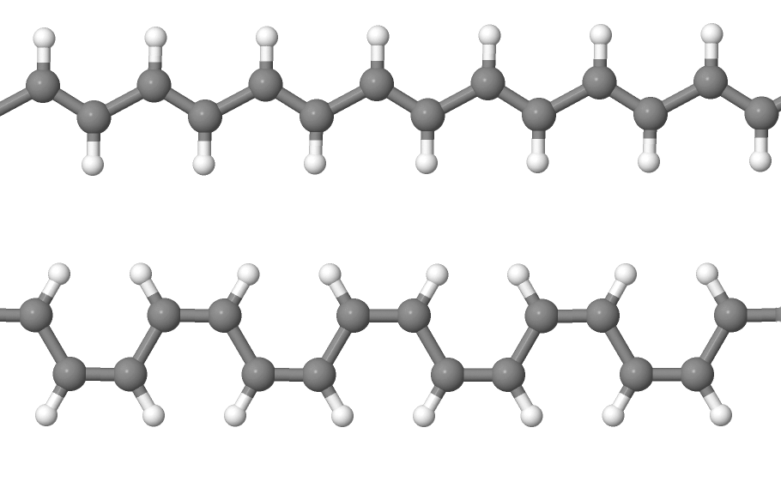
polyacetylene
trans (trans-transoid)
cis (cis-transoid)

Slide 4
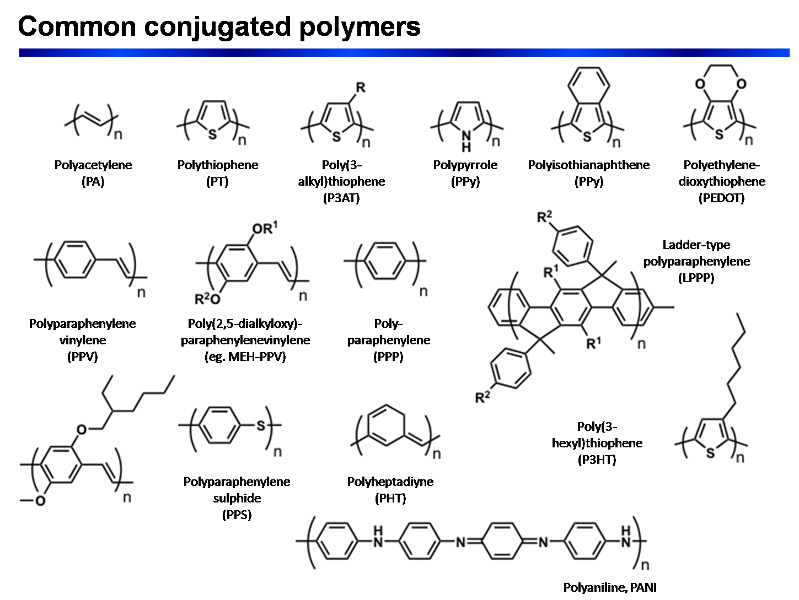
wikipedia

Slide 5
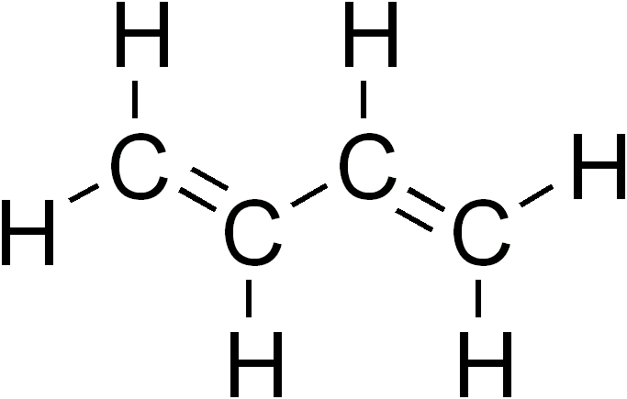
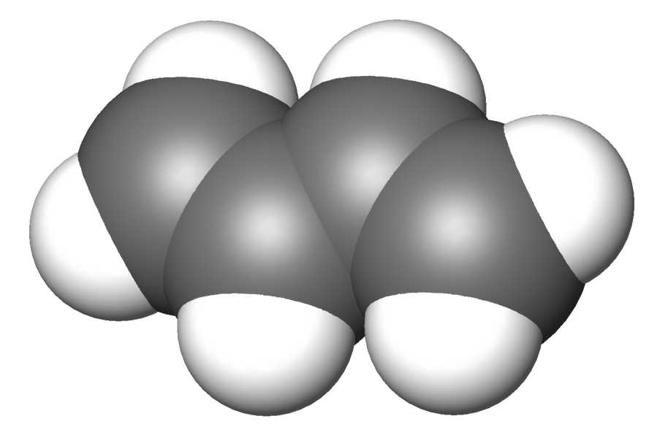
trans-butadiene
r₁
r₂
r₃

Slide 6
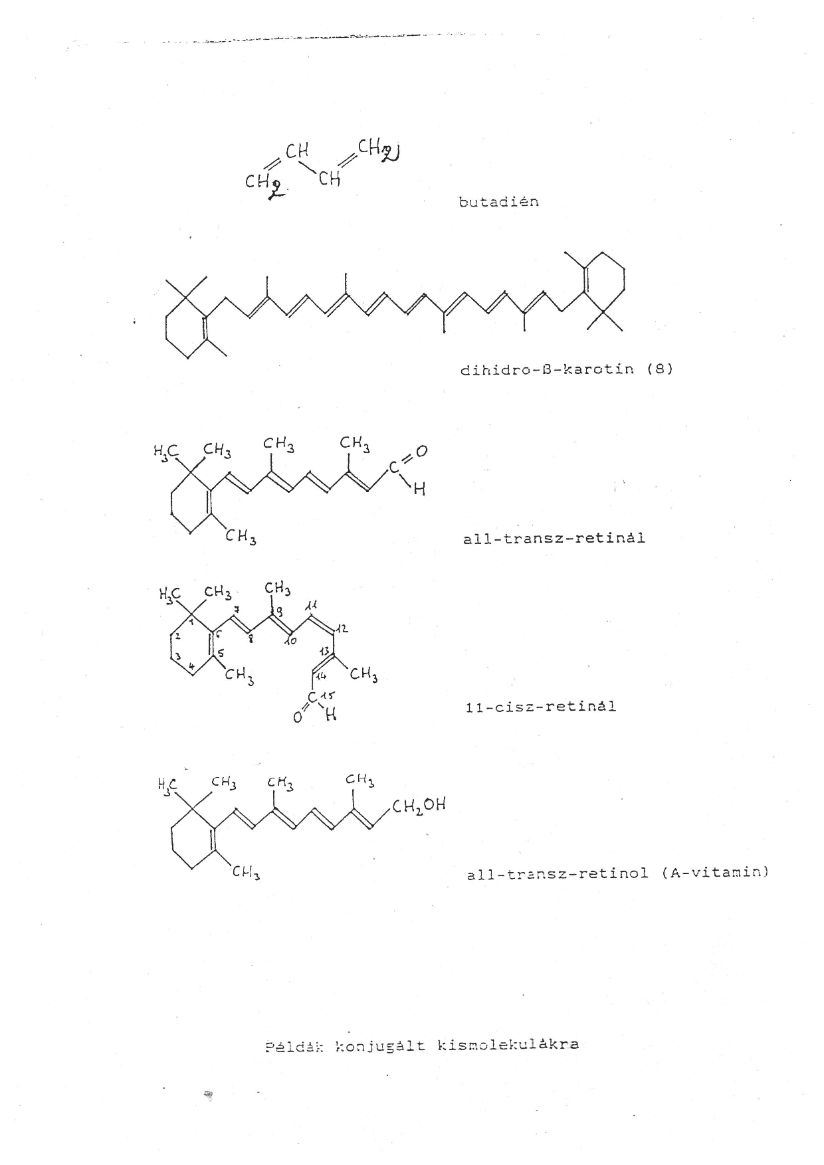

Slide 7
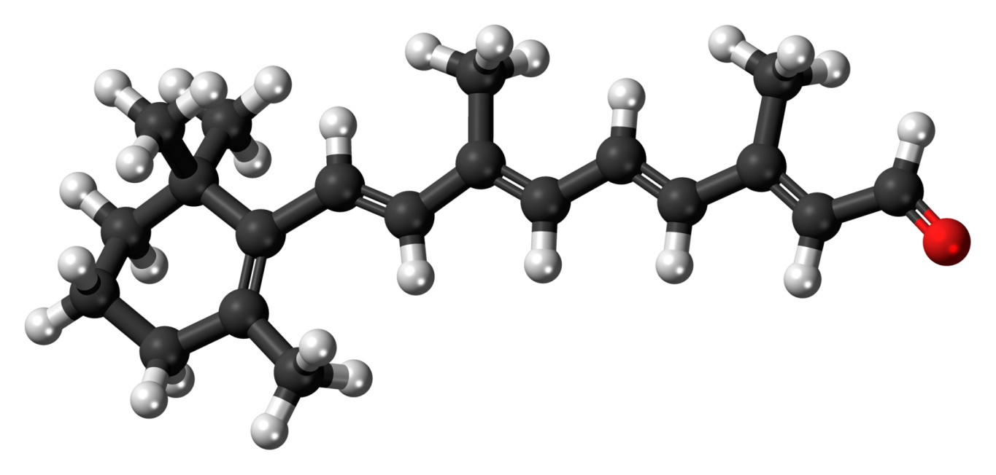
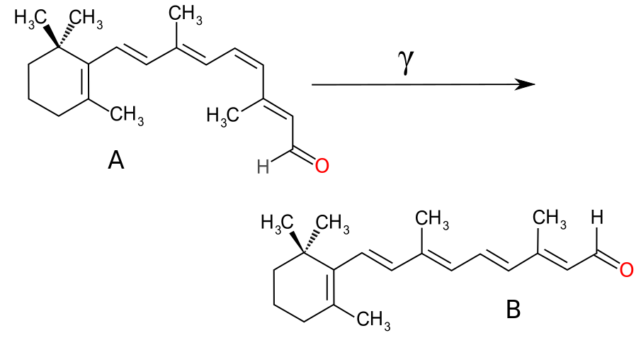
All-trans retinal (C₂₀H₂₈O)
Retinal: cis (A) – trans (B) transition

Slide 8
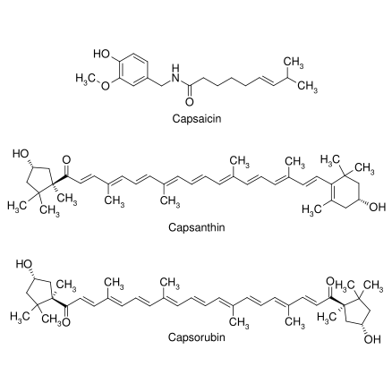
Paprika …

Slide 9
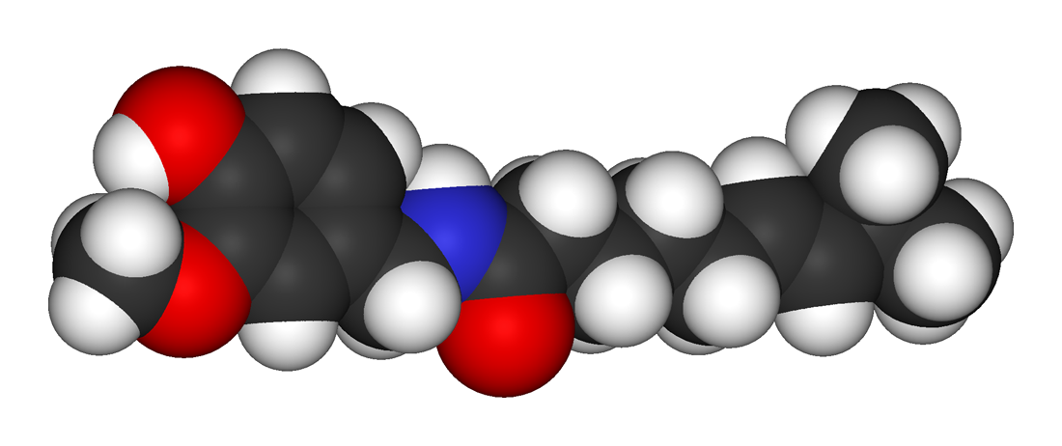
Capsaicin (C₁₈H₂₆O₃N)

Slide 10
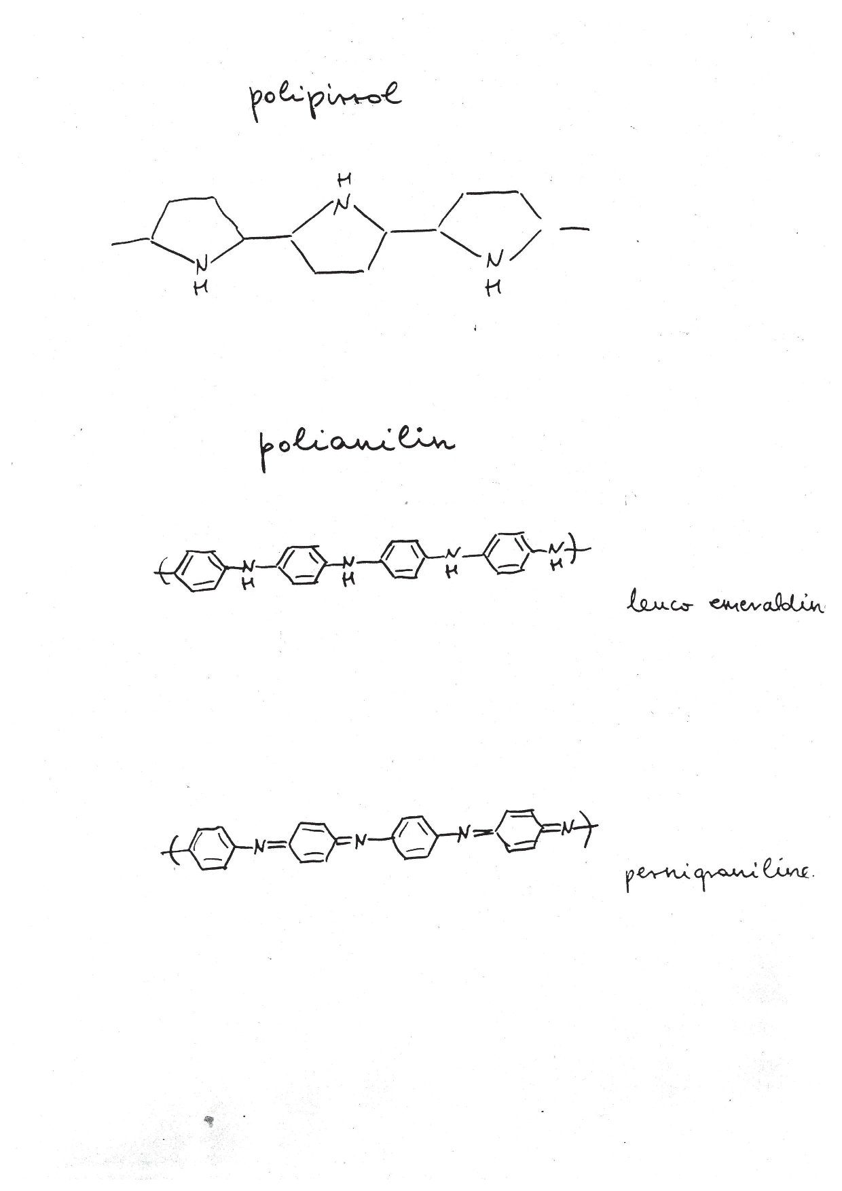

Slide 11
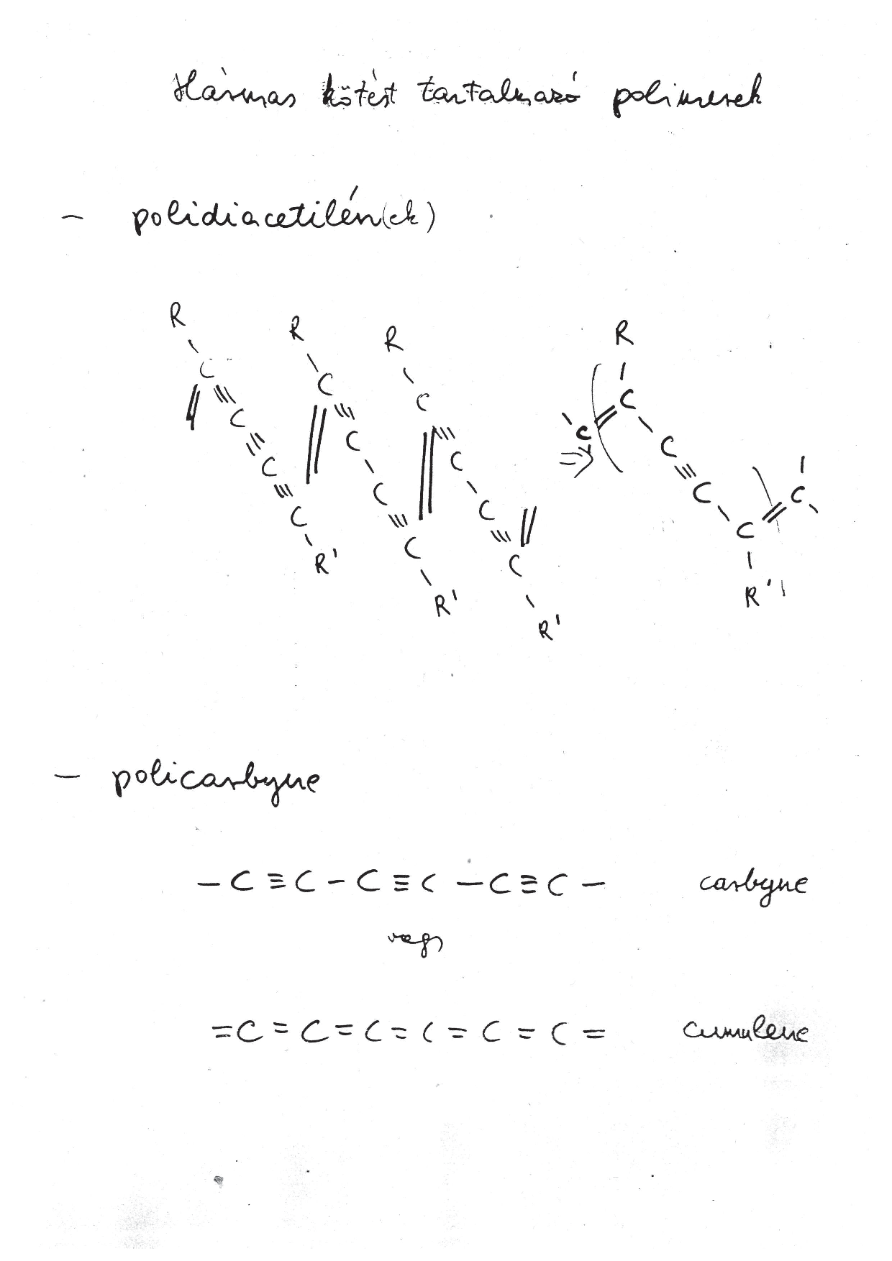

Slide 12
https://en.wikipedia.org/wiki/Polydiacetylenes

Slide 13
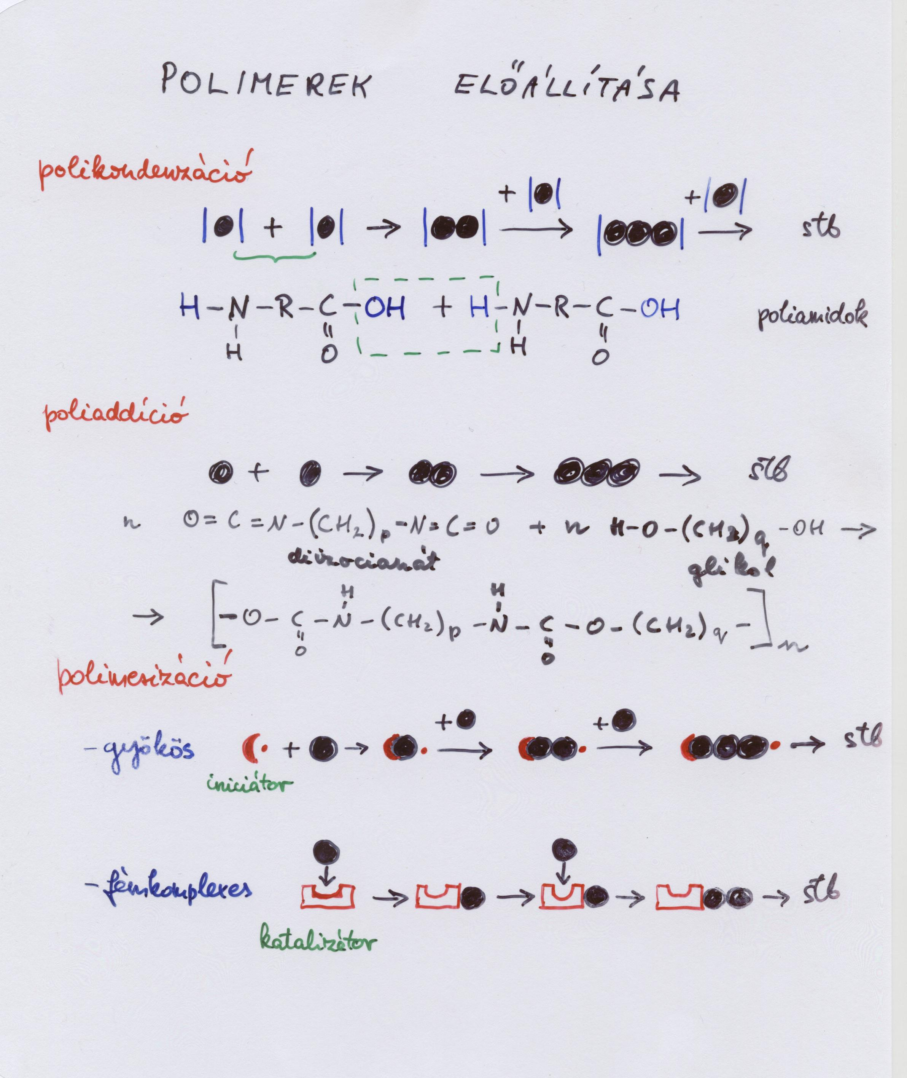

Slide 14
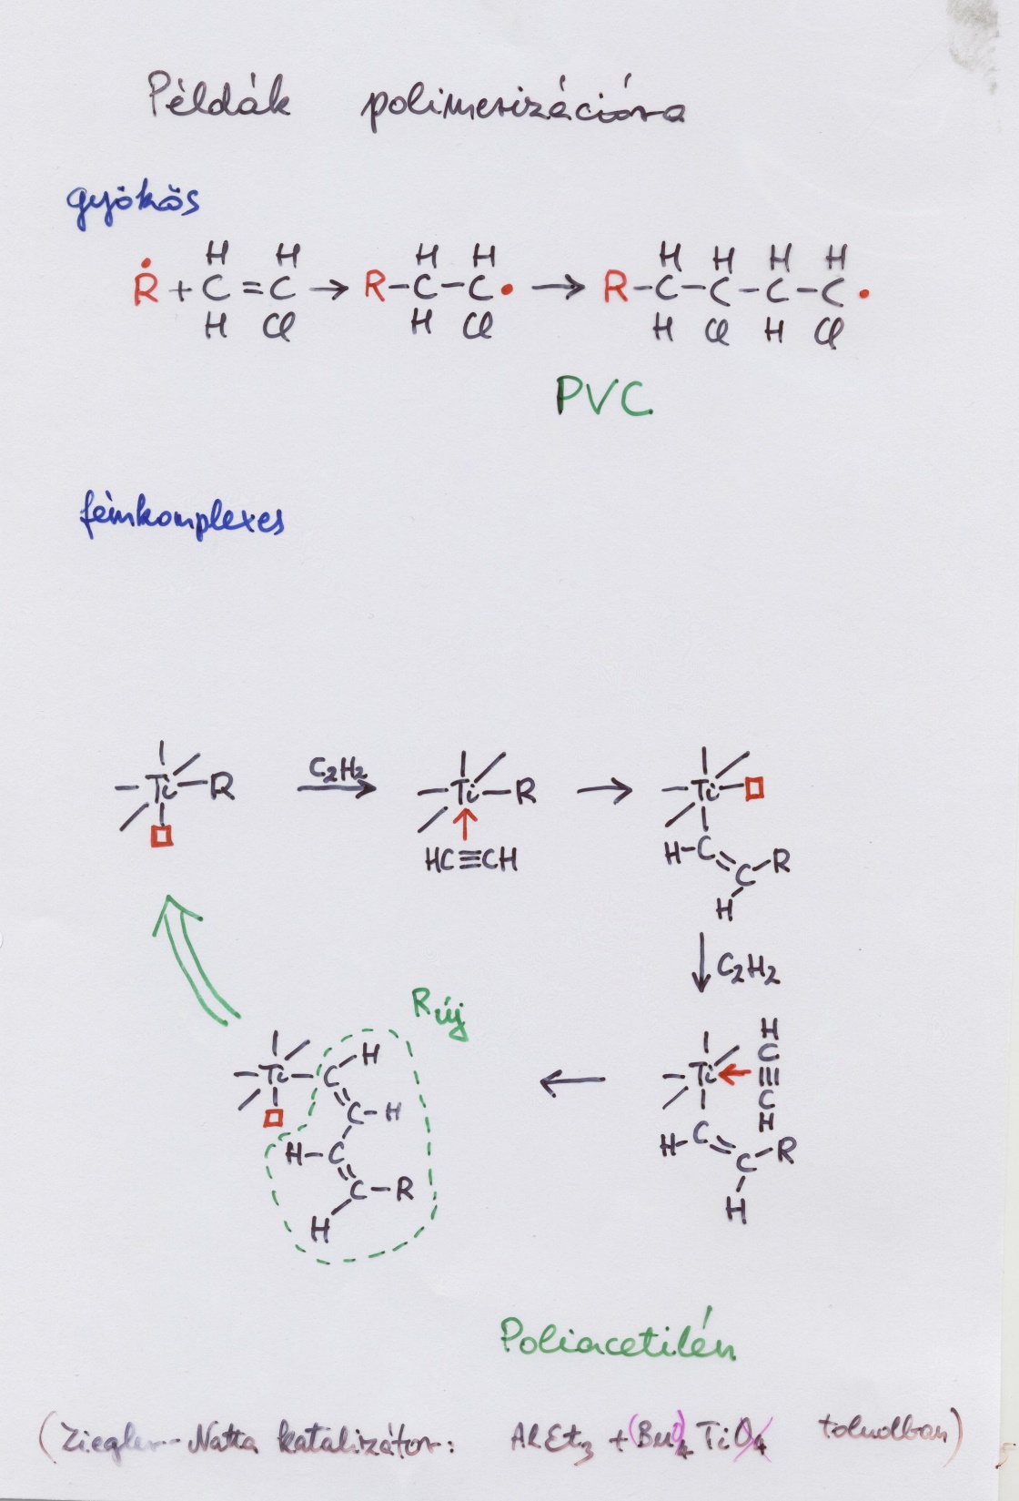

Slide 15
https://en.wikipedia.org/wiki/Ziegler%E2%80%93Natta_catalyst

Slide 16
SUPPLEMENT
(hybridization)

Slide 17
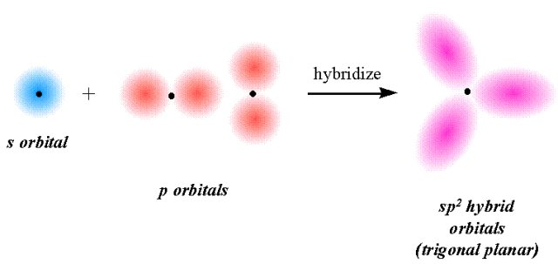
+
+
+
-
+
+
-
+
Downloaded from the internet

Slide 18
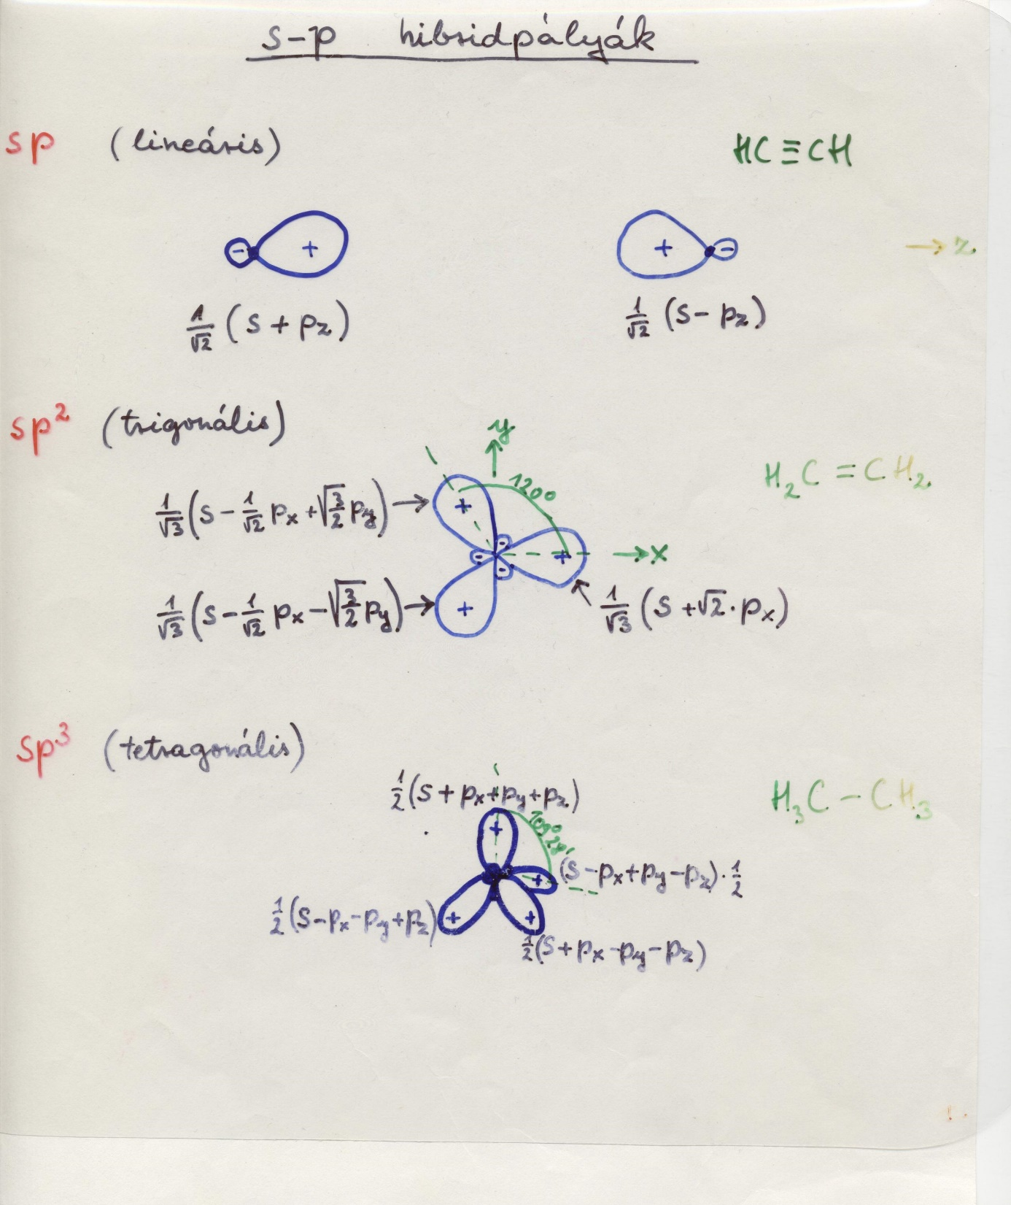

Slide 19
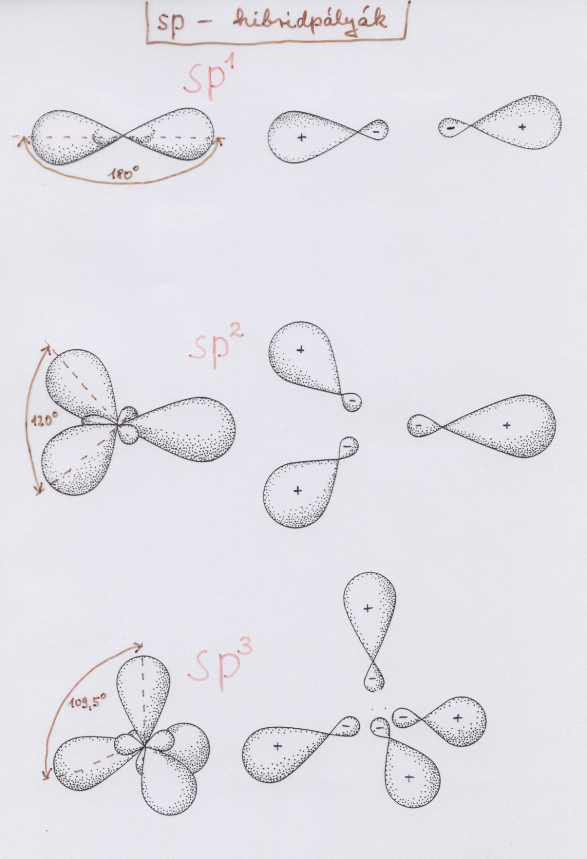

Slide 20
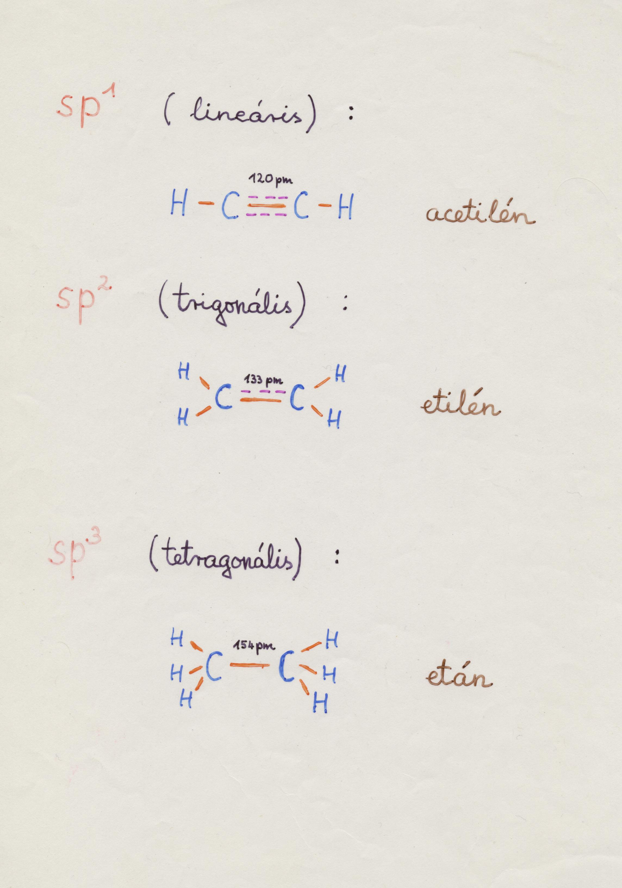

Slide 21
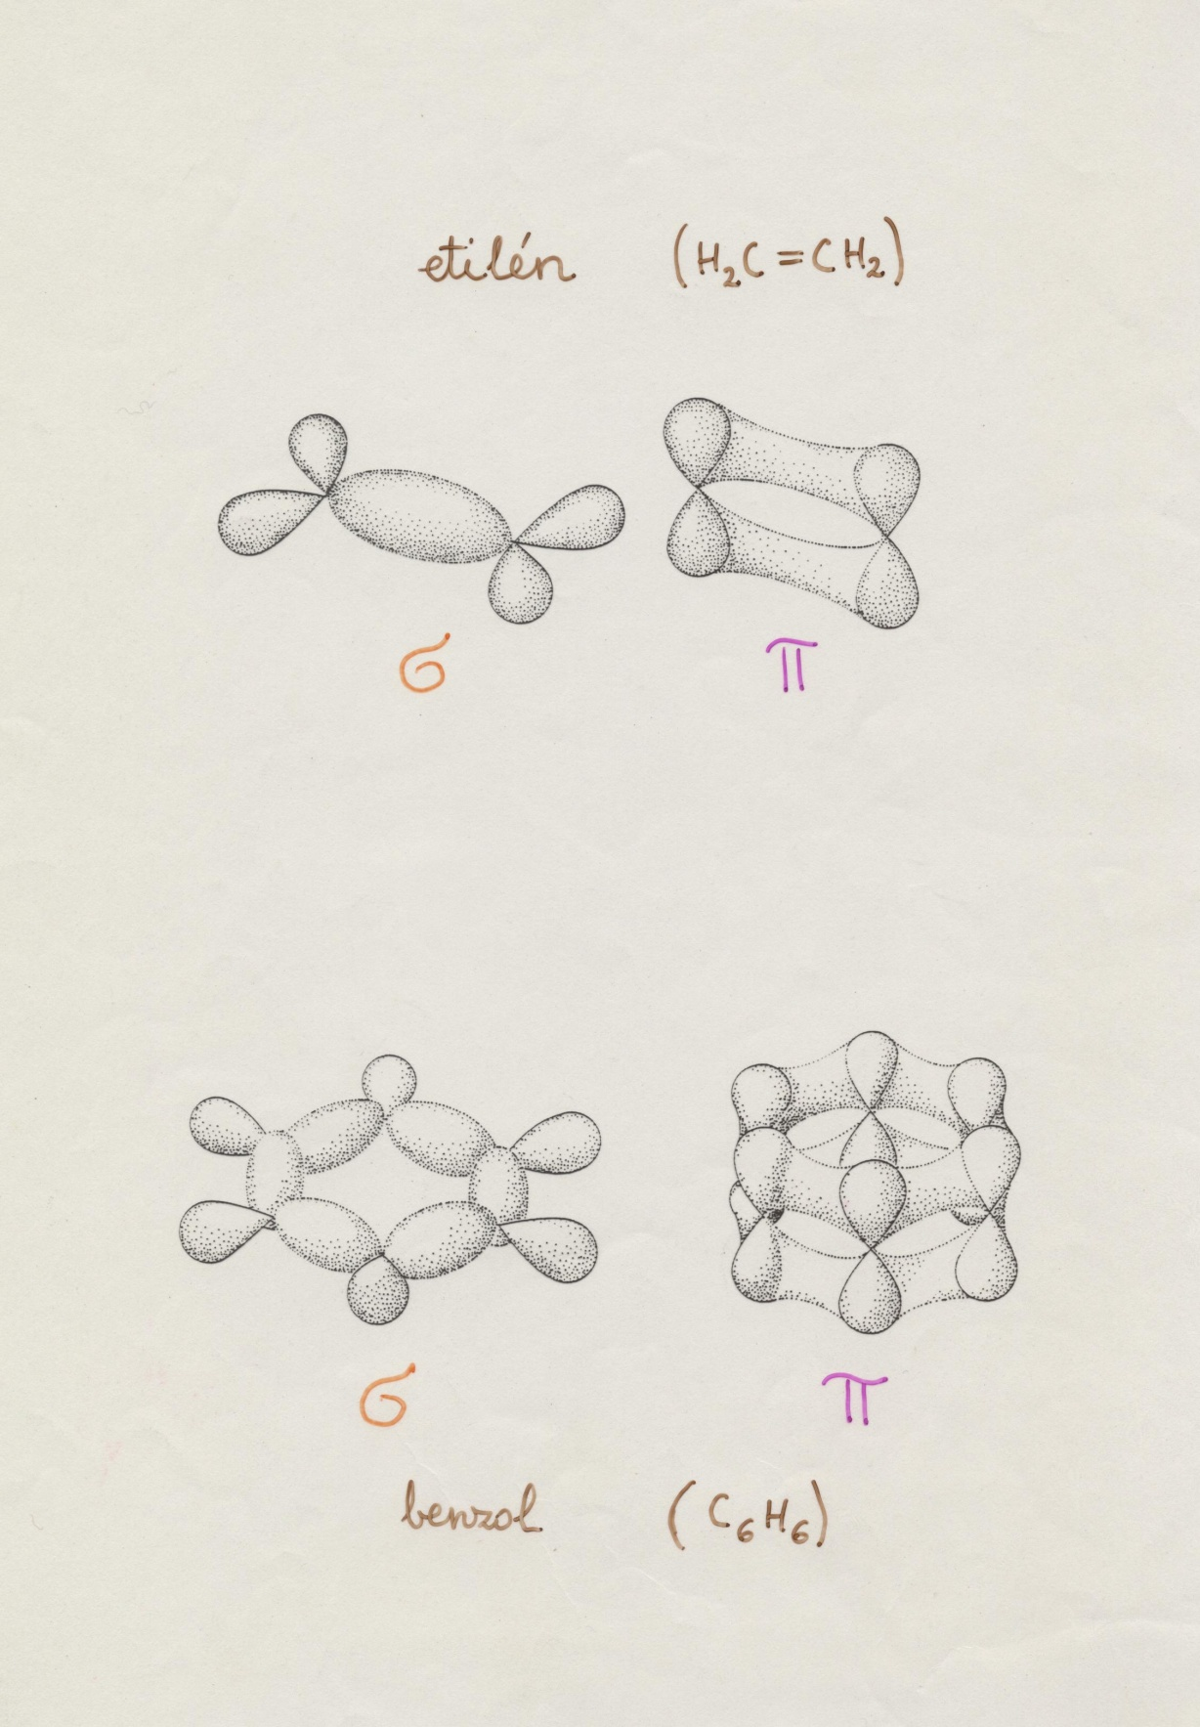
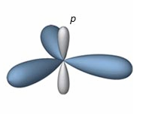
p_{z}
σ
sp²
σ
σ

Slide 22
