Slide 1
MACROMOLECULES
lecture for physics and biophysics students
2018. winter semester – 22. October
Jenő KÜRTI
Eötvös Loránd University
Institute of Physics
Department of Biological Physics
e-mail: kurti@virag.elte.hu www: regivirag.elte.hu/kurti

Slide 2
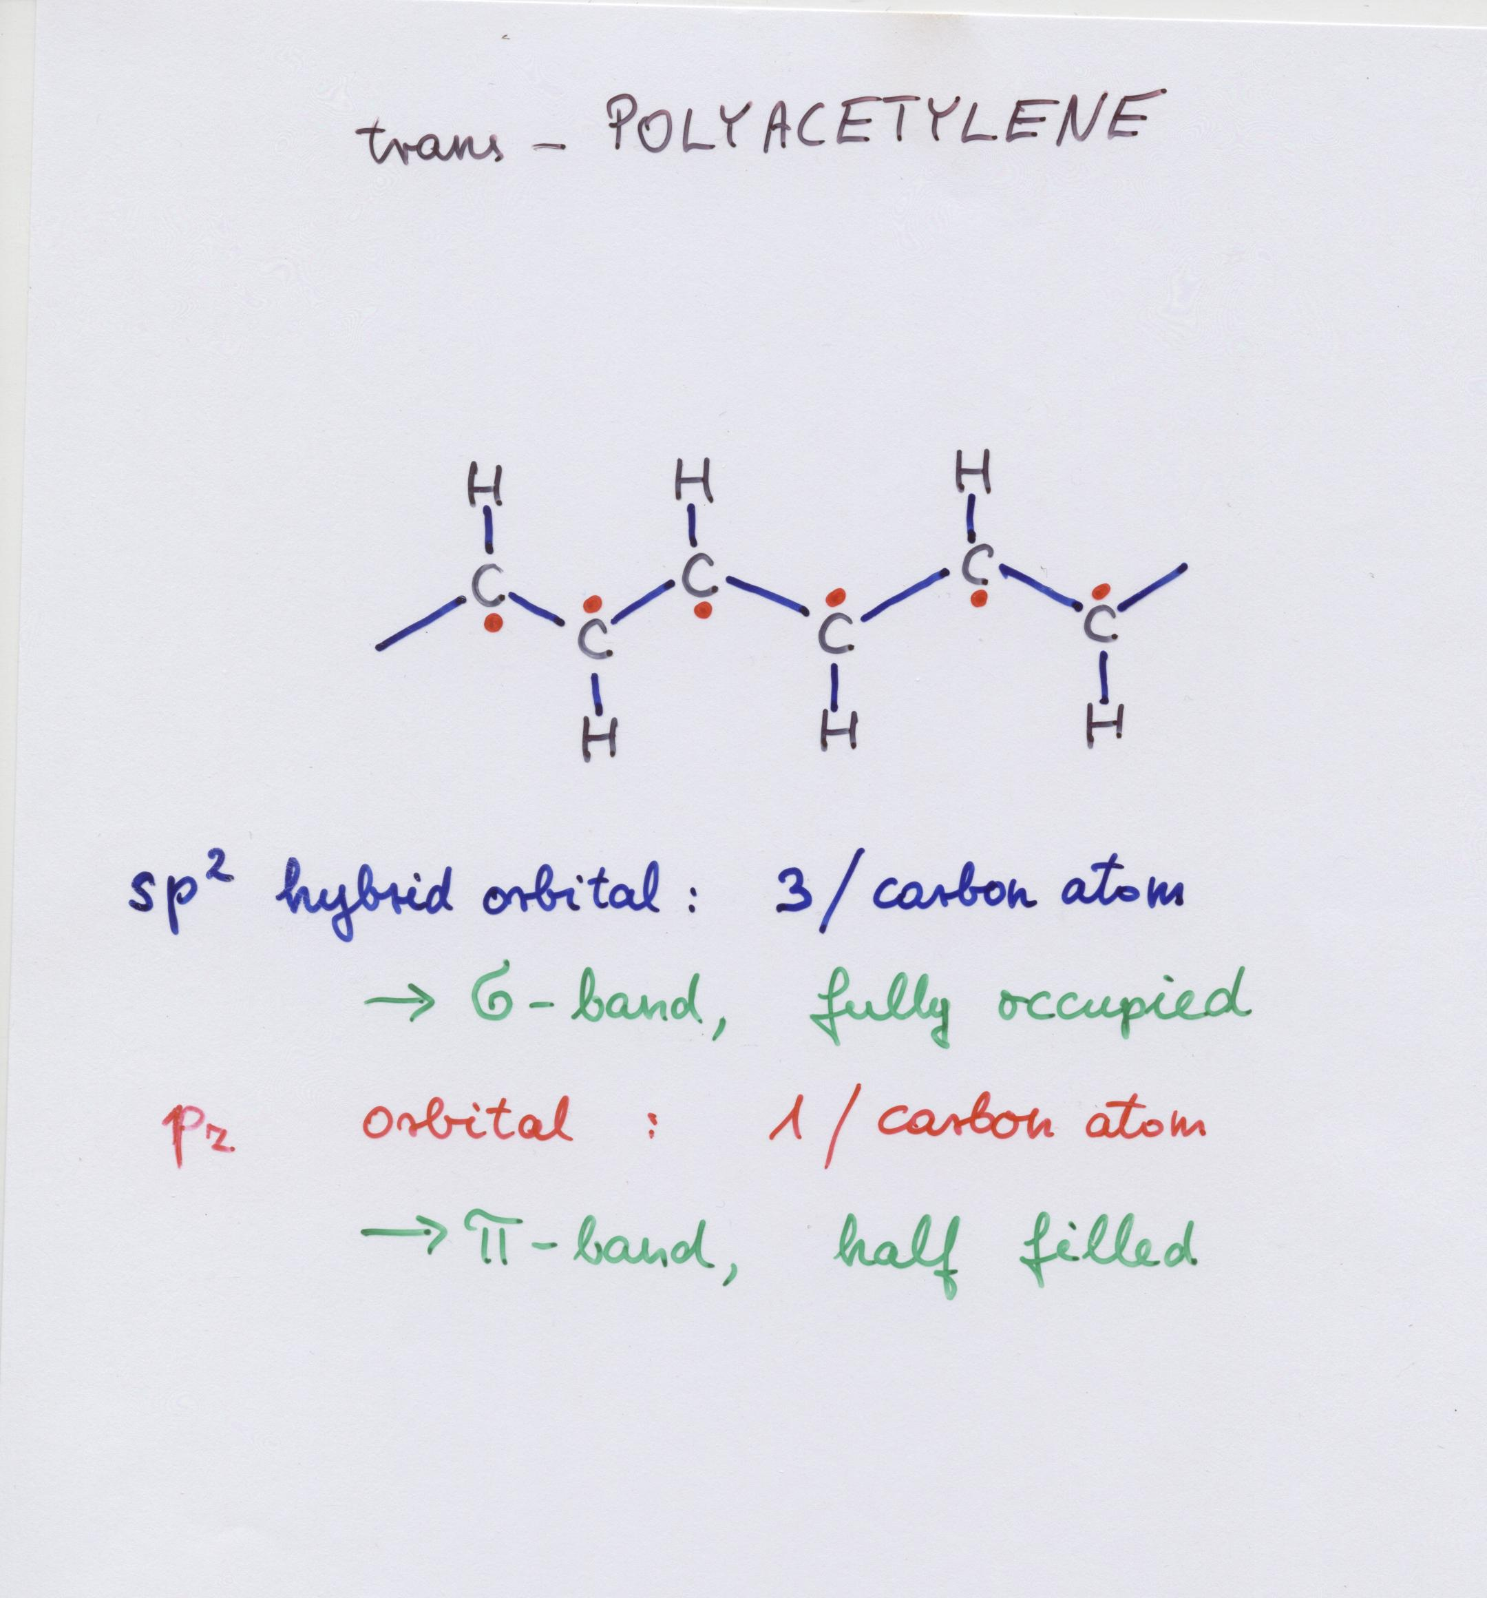

Slide 3
ELECTRONIC BAND STRUCTURE:
σ
π

Slide 5
Bond Length Alternation: BLA _{i} = |r_{i+1} – r_{i}|
r_{i+1}
r_{i}
physics student : BLA = 0

Slide 6
Bond Length Alternation: BLA _{i} = |r_{i+1} – r_{i}|
r_{i+1}
r_{i}
physics student : BLA = 0
chemistry student : BLA = R₁ – R₂ ≈ 21 pm

Slide 7
finite oligomer: chain end effects

Slide 8
finite oligomer: chain end effects

Slide 9
finite oligomer: chain end effects

Slide 10
infinite polymer: ???

Slide 11
Simple minded figure for molecular orbitals …

Slide 12
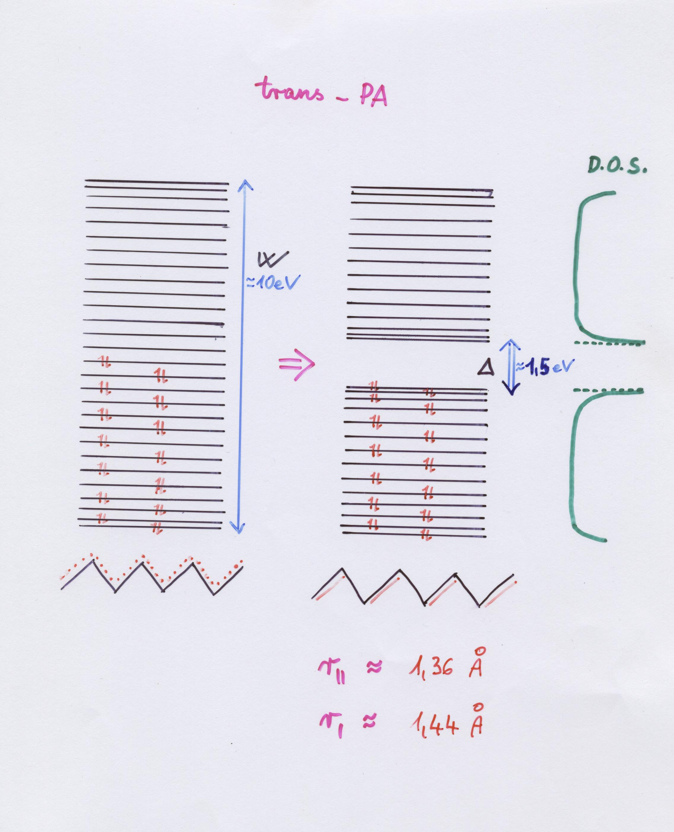

Slide 13
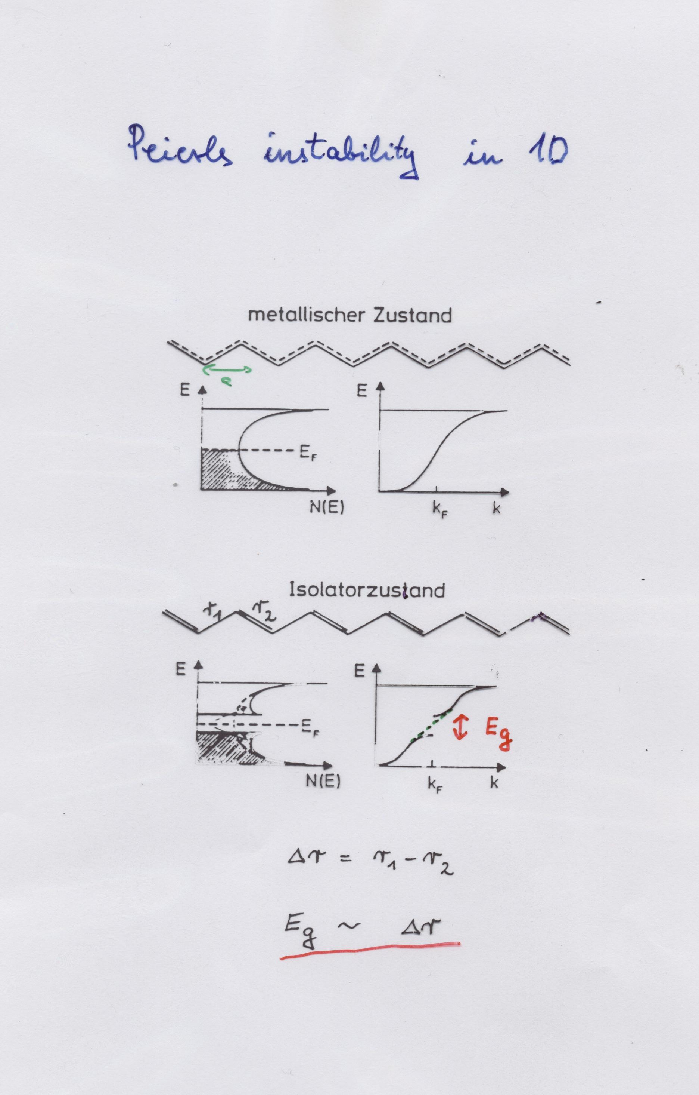

Slide 14
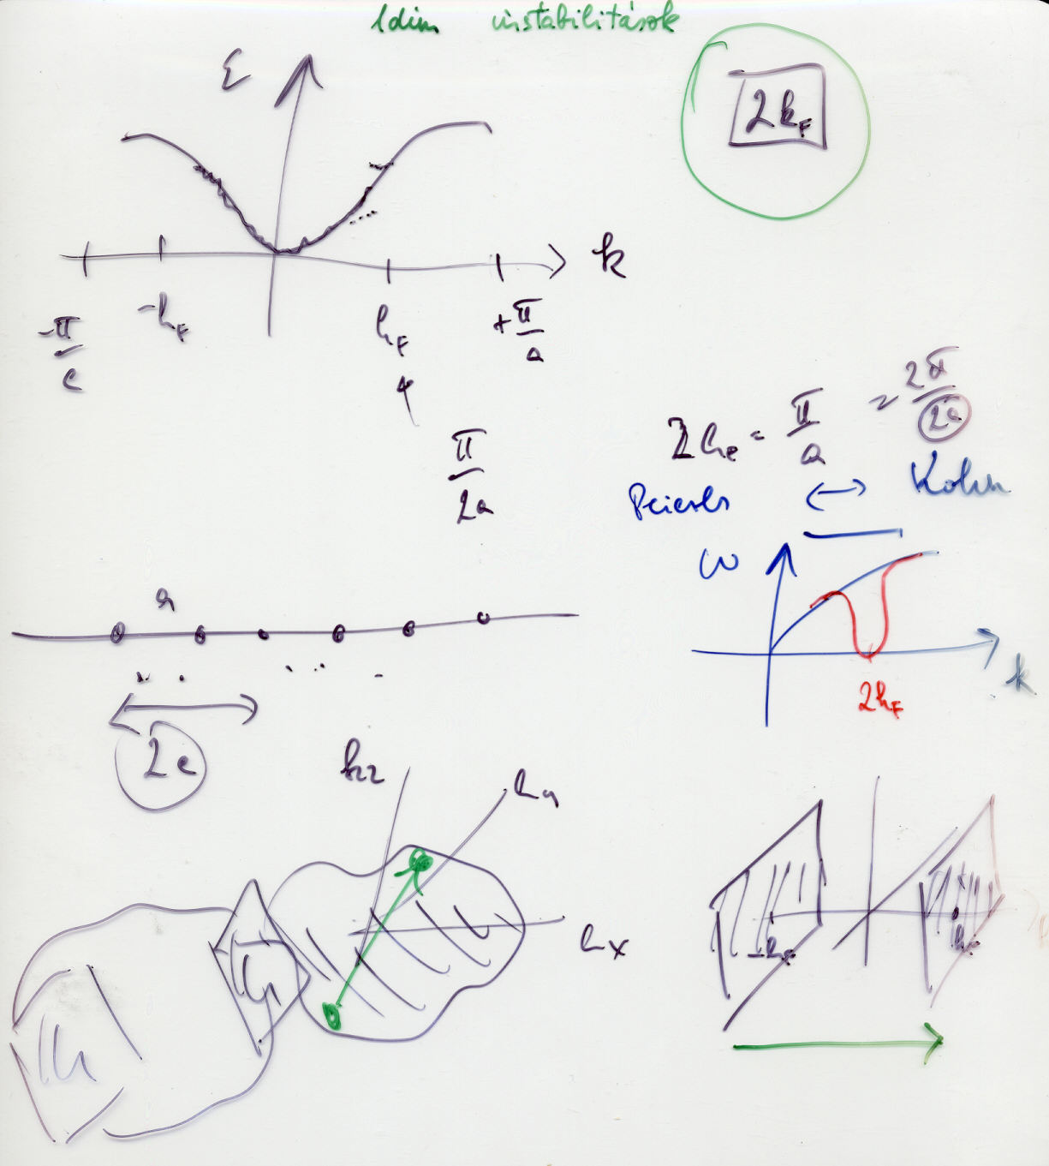

Slide 15
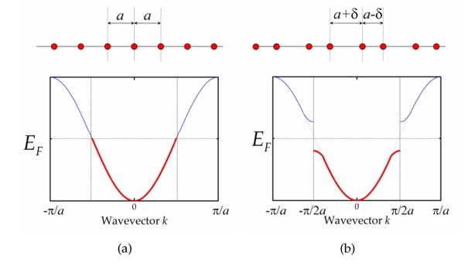
2k_{F}
Peierls instability
(https://www.utwente.nl/tnw/pin/onderzoek/physical_properties_of_low-dimensional_systems/physical_properties_of_low-dimensional_systems-8.png)

Slide 16
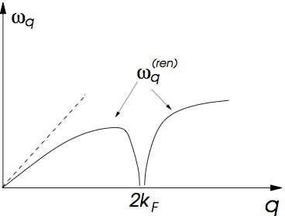
Kohn anomaly
http://www.itp.phys.ethz.ch/education/fs14/sst/slides/Peierls.pdf)

Slide 17
Bond Length Alternation: BLA _{i} = |r_{i+1} – r_{i}|
r_{i+1}
r_{i}
physics student (not well educated): BLA = 0 ☹
chemistry student (average) : BLA = R₁ – R₂ ≈ 21 pm K
physics student (well educated): 0 ≤ BLA ≈ 9 pm ≤ R₁ – R₂ J
Peierls-distortion

Slide 18
What do experiments tell us?

Slide 19
