Slide 1
MACROMOLECULES
lecture for physics and biophysics students
2019. winter semester – 5. November
Jenő KÜRTI
Eötvös Loránd University
Institute of Physics
Department of Biological Physics
e-mail: kurti@virag.elte.hu www: regivirag.elte.hu/kurti

Slide 2
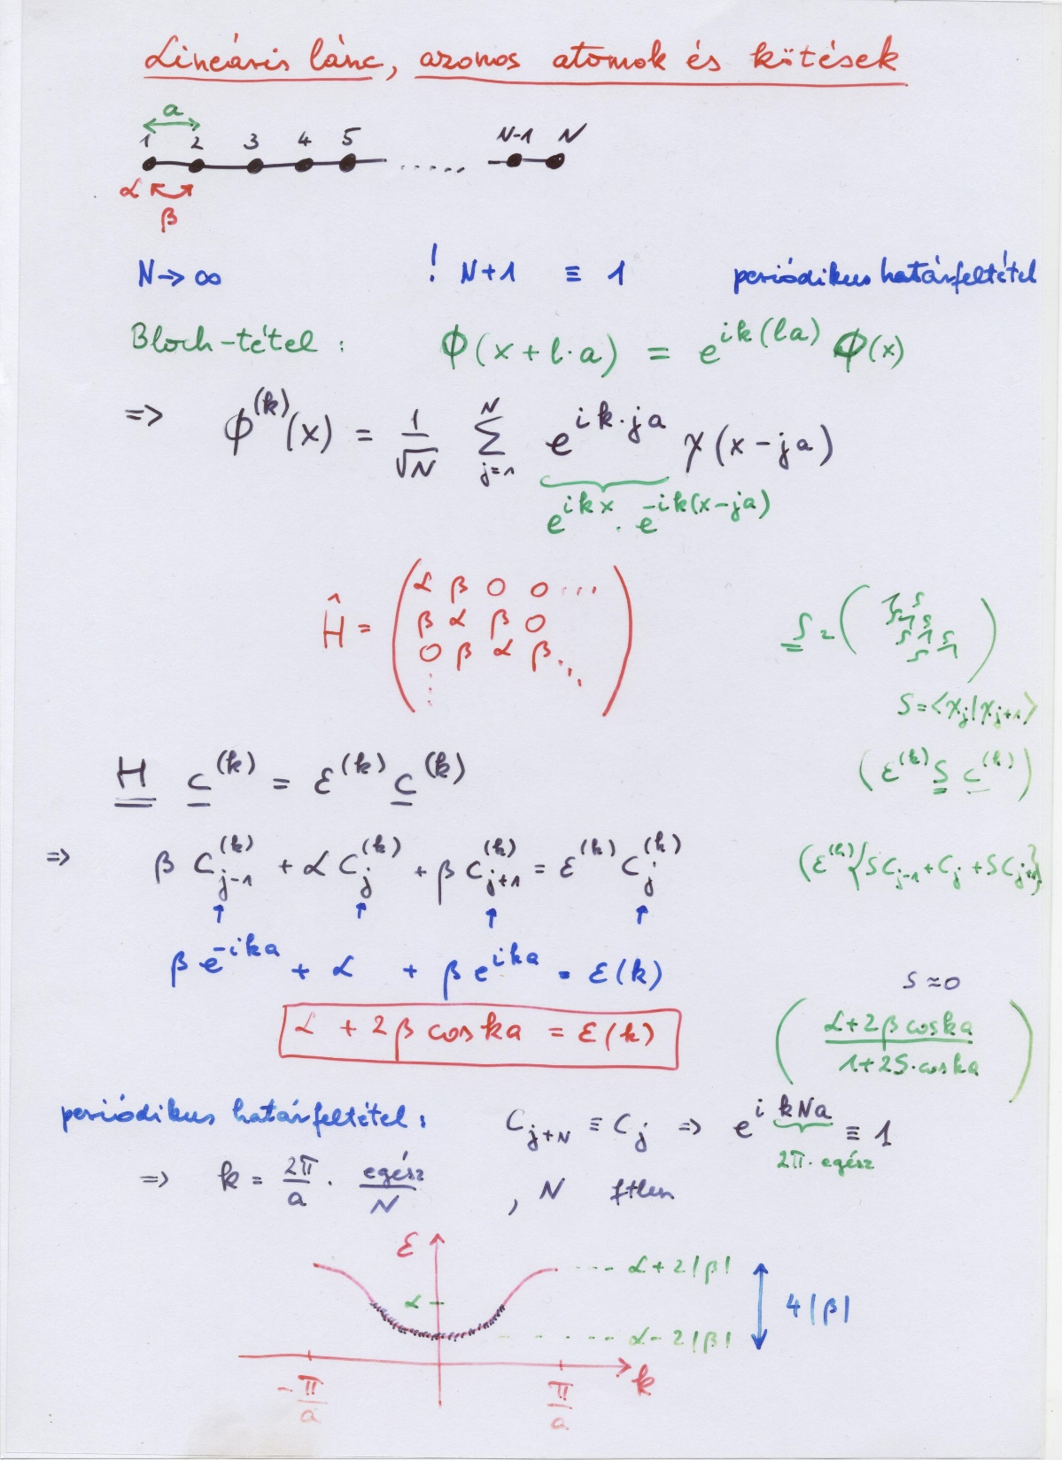

Slide 3
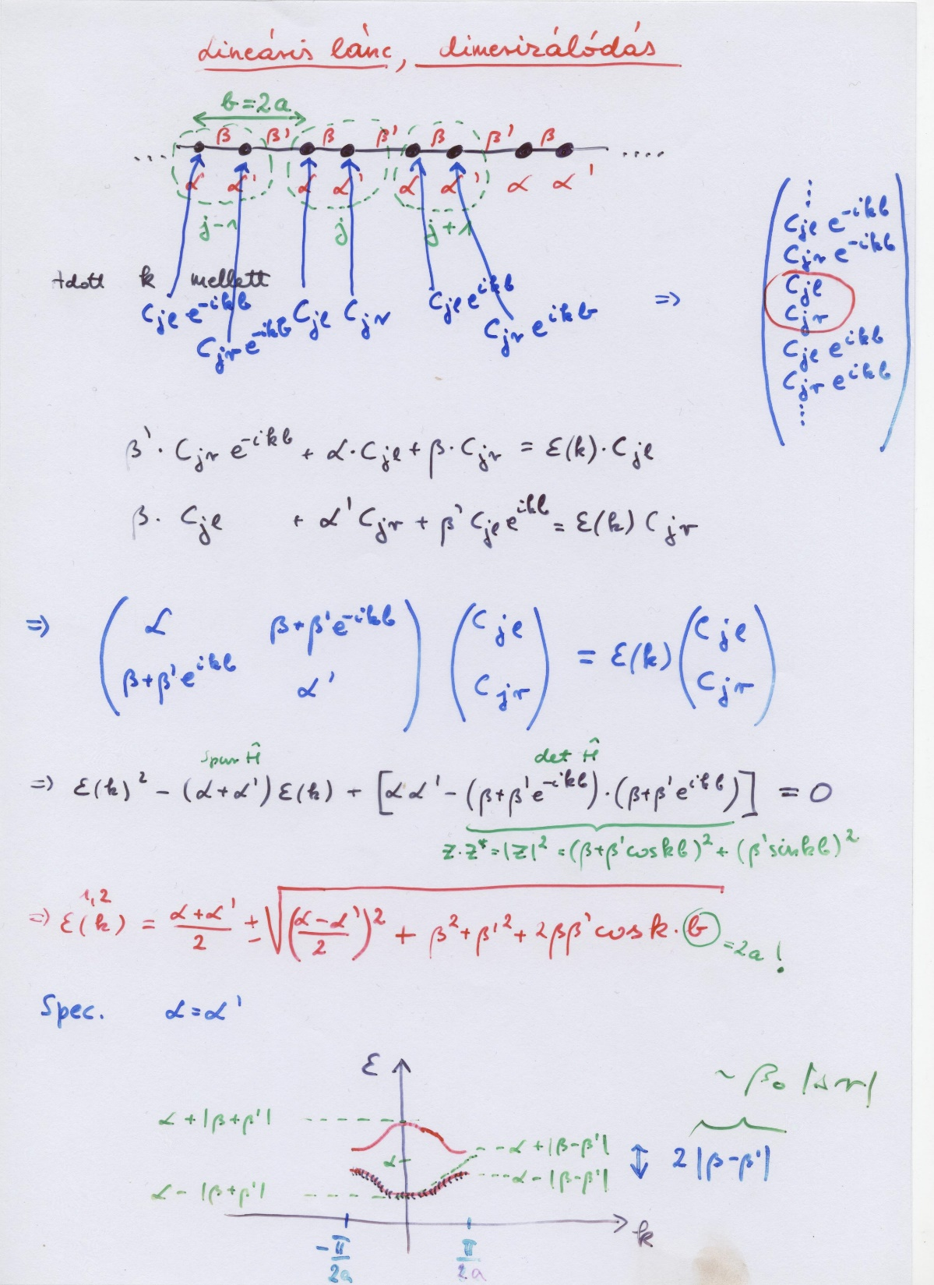

Slide 4
LHS model: Hückel theory with geometry (bond length) optimization
(Longuet-Higgins, Salem; 1959)

Slide 5
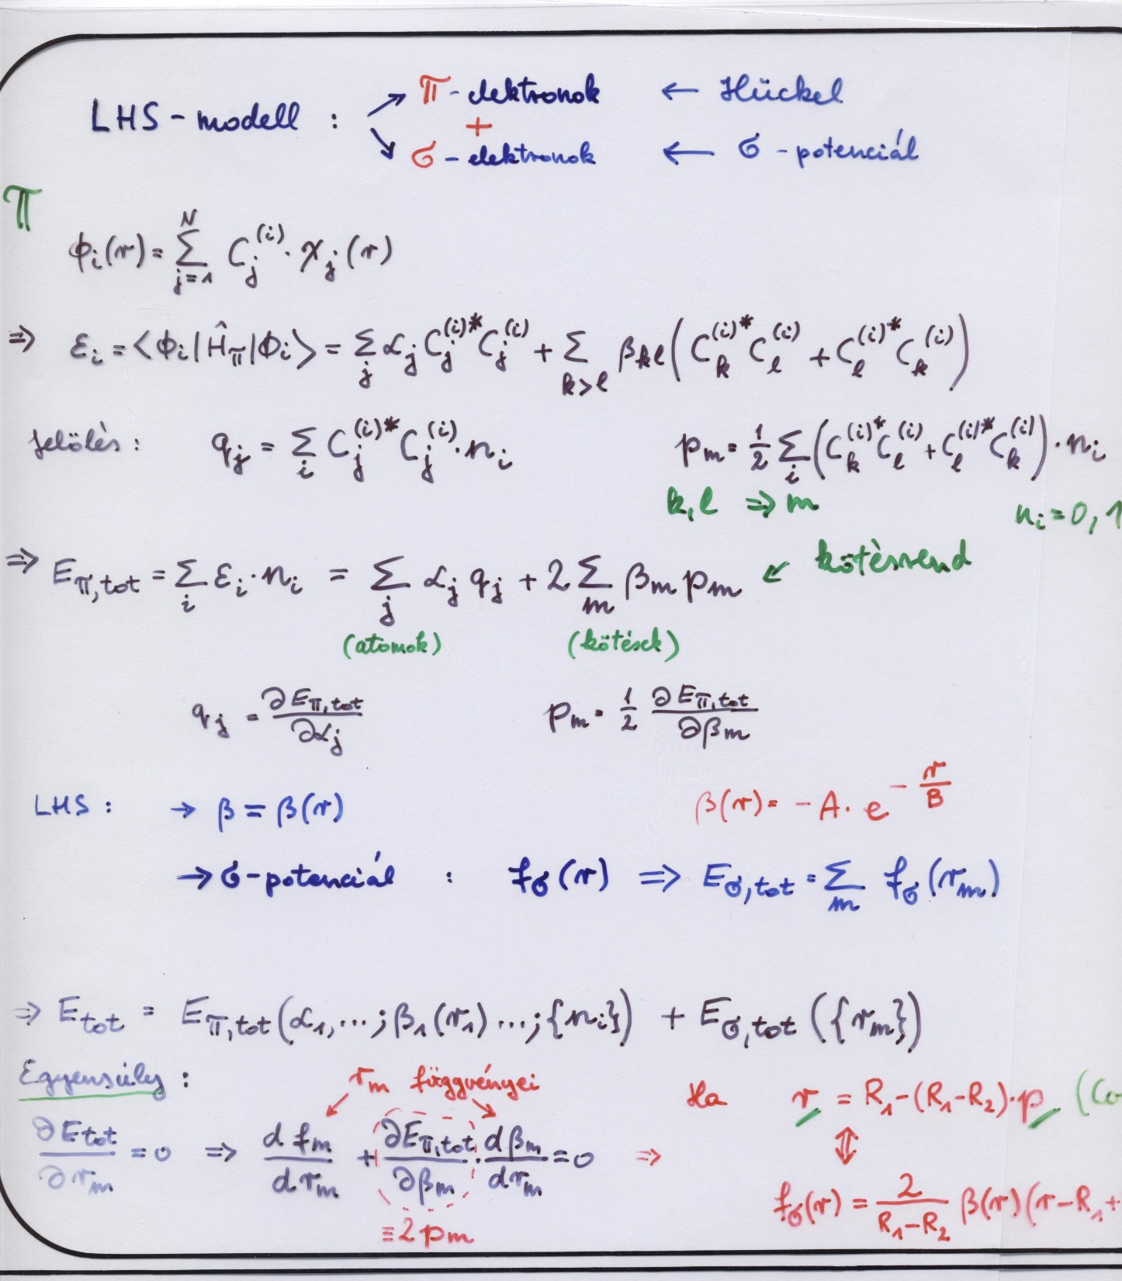
COULSON relation

Slide 6
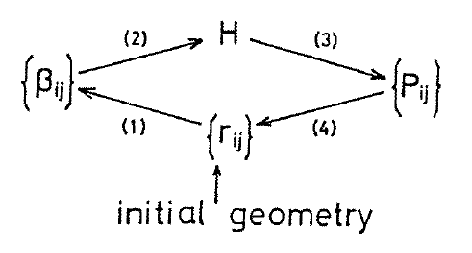
LHS model: Hückel theory with geometry (bond length) optimization
(Longuet-Higgins, Salem; 1959)
p_{m} (mobile) bond order:
MO - LCAO
Coulson relation

Slide 7
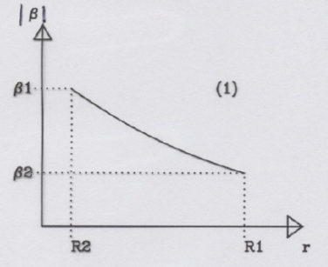
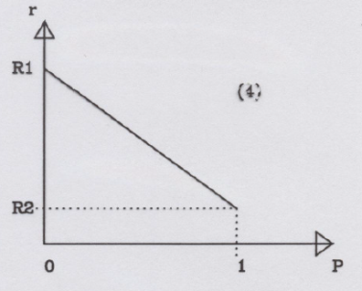
LHS model: Hückel theory with geometry (bond length) optimization
(Longuet-Higgins, Salem; 1959)
p_{m} (mobile) bond order:
MO - LCAO
Coulson relation

Slide 8
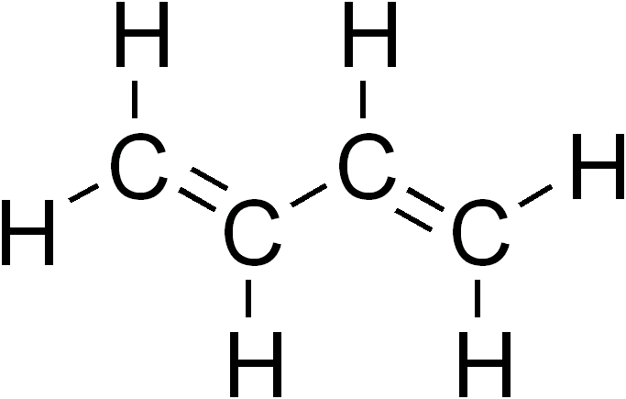
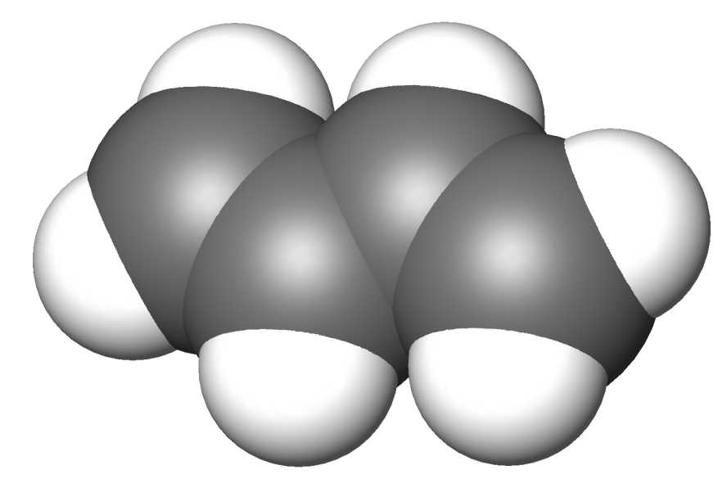
trans-butadiene
( C₄H₆ )
r₁
r₃
r₂

Slide 9
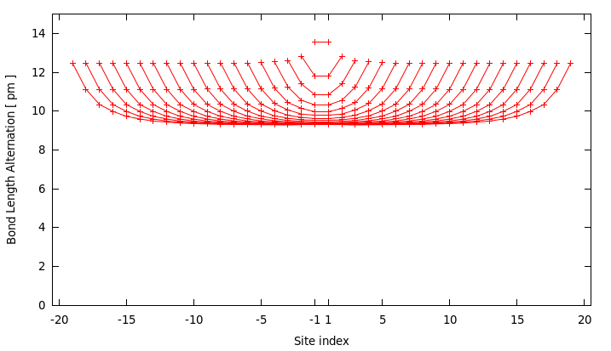
LHS results for BLA along C_{2n}H_{2n+2} chains
n=2
n=3
n=10

Slide 10
LHS results for BLA along C_{2n}H_{2n+2} chains
n=2
n=3

Slide 11
LHS results for BLA along C_{2n}H_{2n+2} chains
n=2
n=3
n=4

Slide 12
LHS results for BLA along C_{2n}H_{2n+2} chains
n=2
n=3
n=4
n=10
n=20
infinite limit: Peierls-distortion
BLA ≈9 pm

Slide 13
Bond Length Alternation: BLA _{i} = |r_{i+1} – r_{i}|
r_{i+1}
r_{i}
physics student (not well educated): BLA = 0 ☹
chemistry student (average) : BLA = R₁ – R₂ ≈ 21 pm K
physics student (well educated): 0 ≤ BLA ≈ 9 pm ≤ R₁ – R₂ J
Peierls-distortion

Slide 14
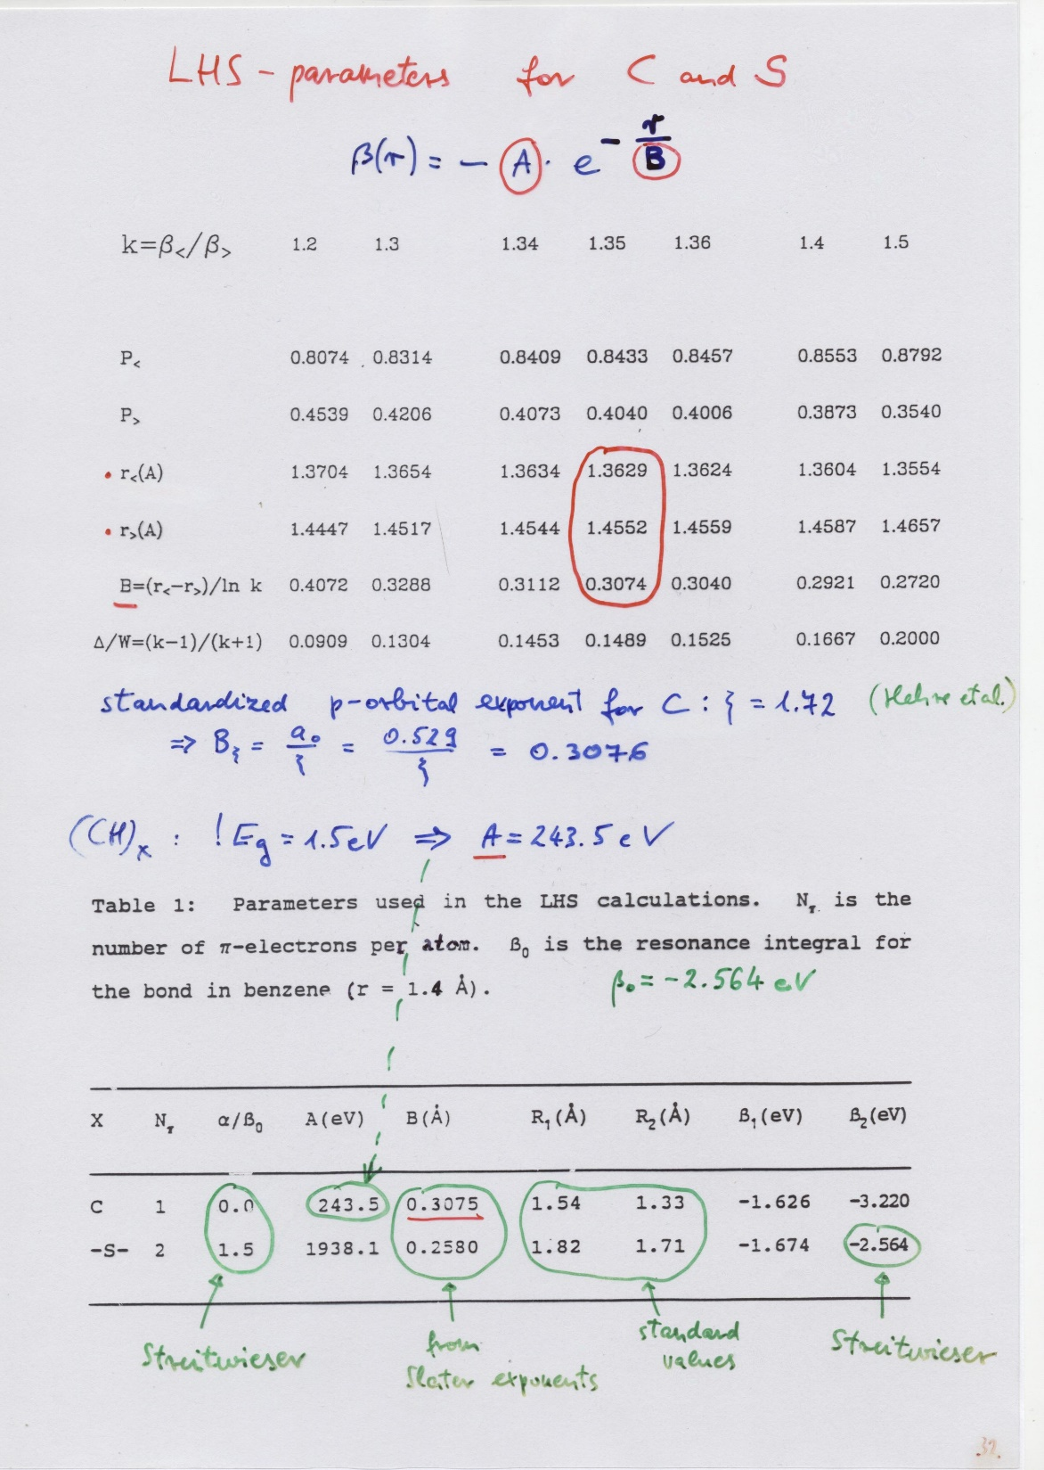

Slide 15
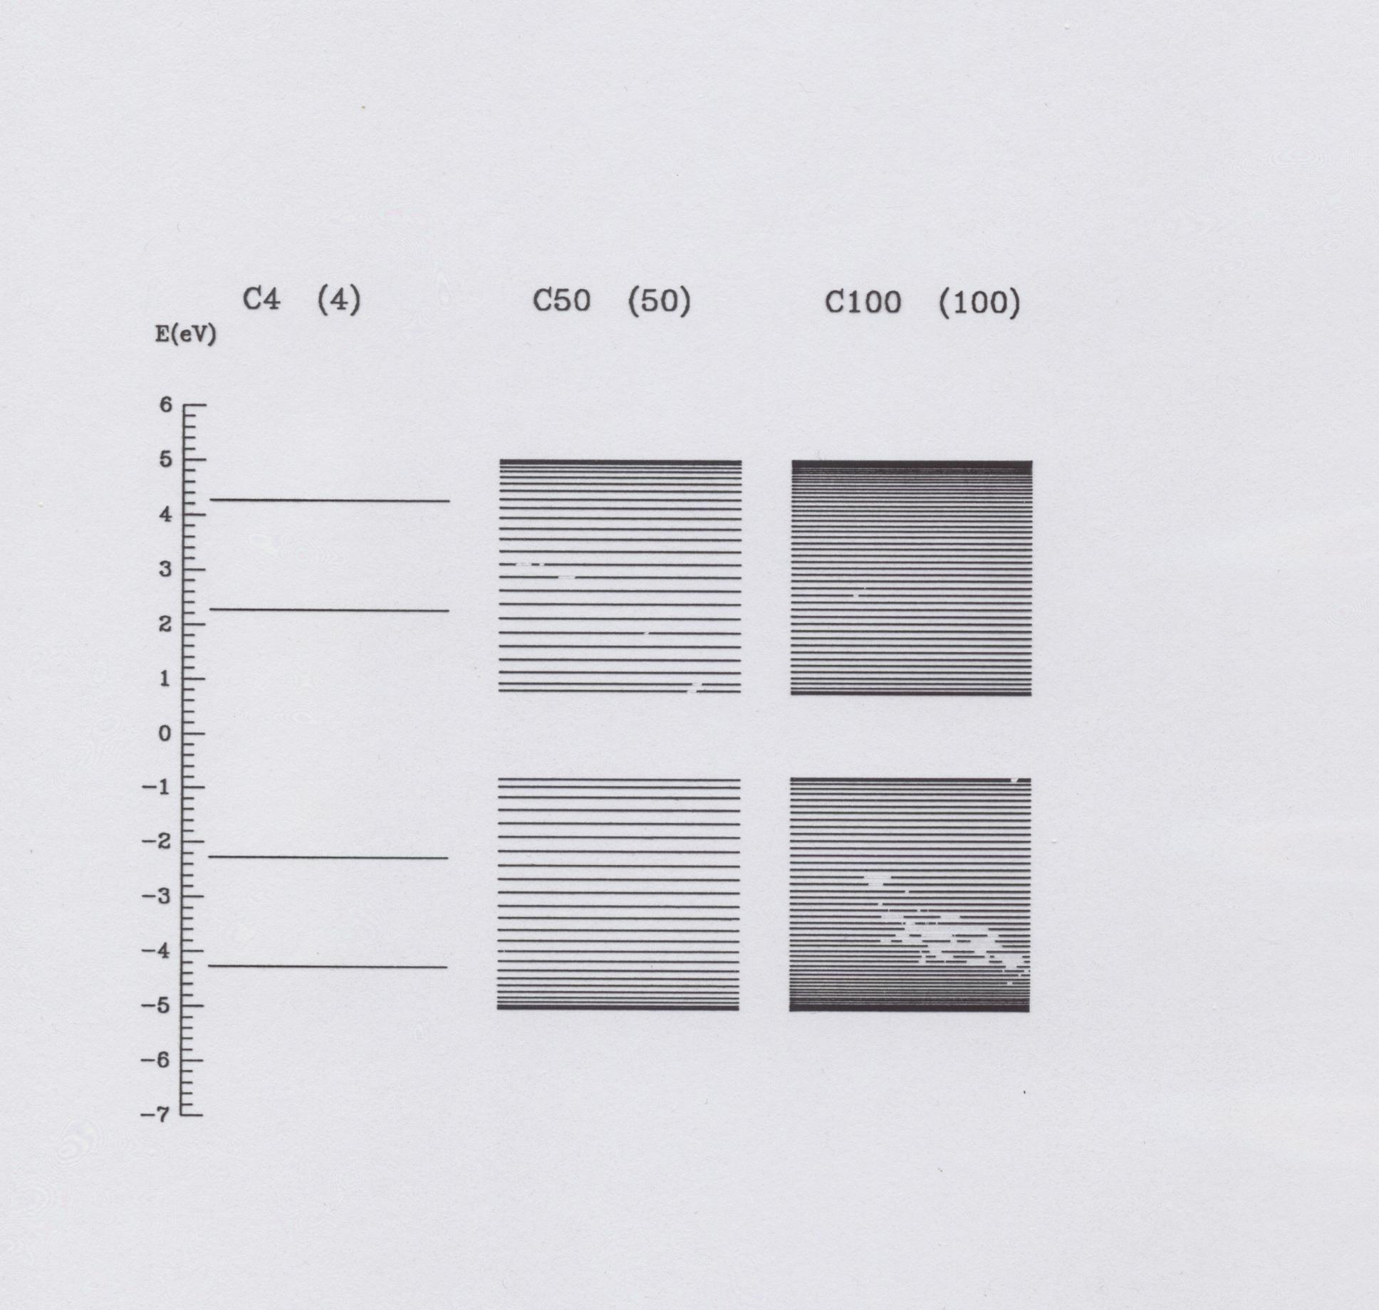

Slide 16
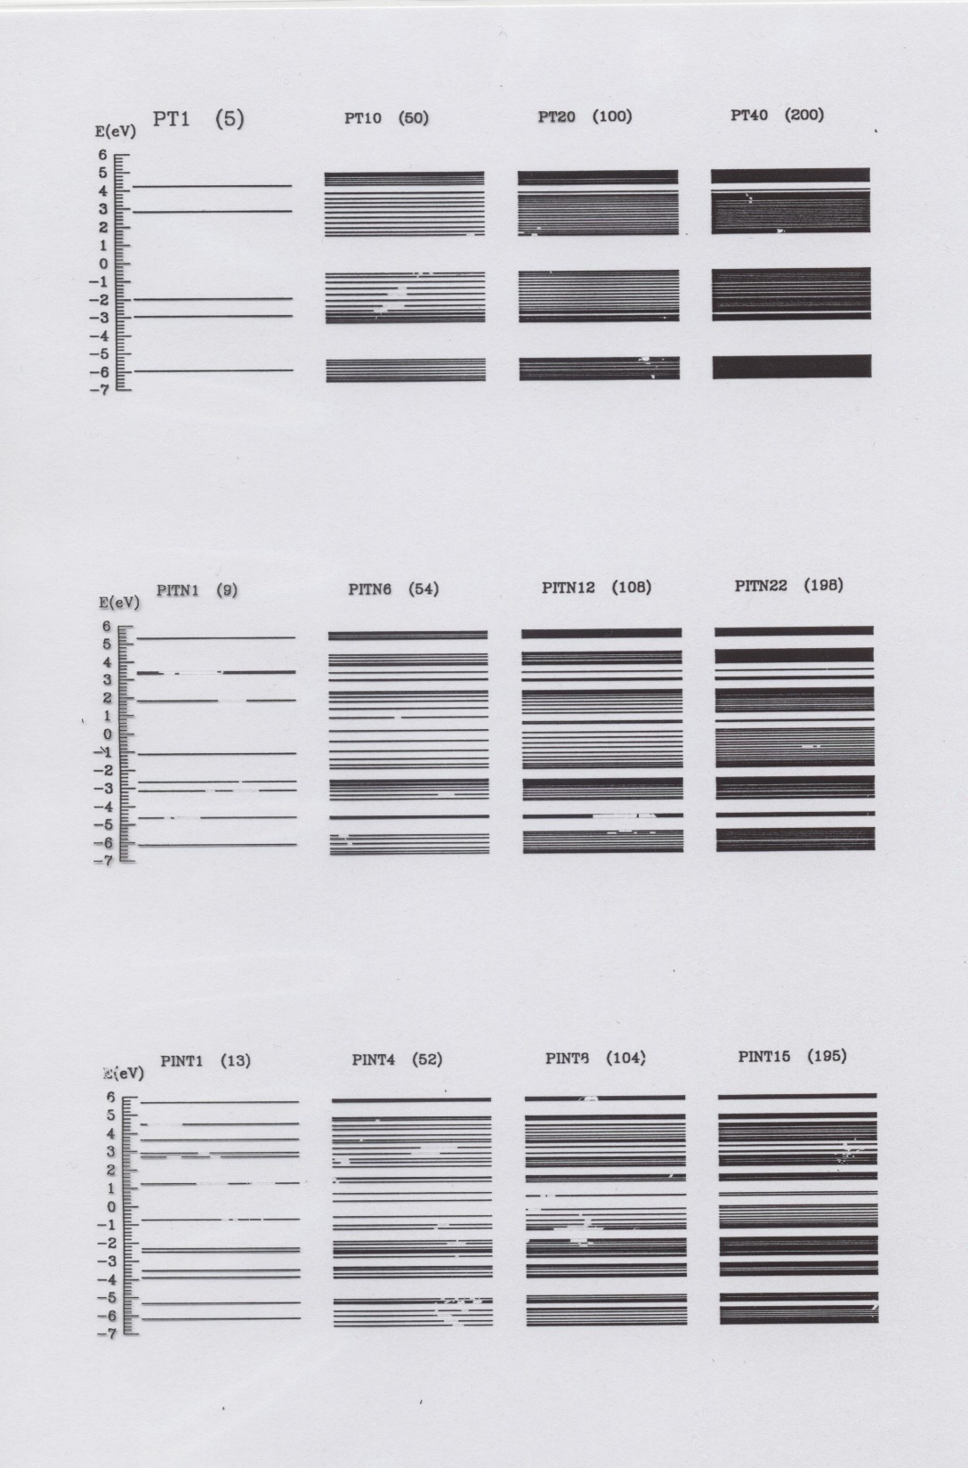

Slide 17
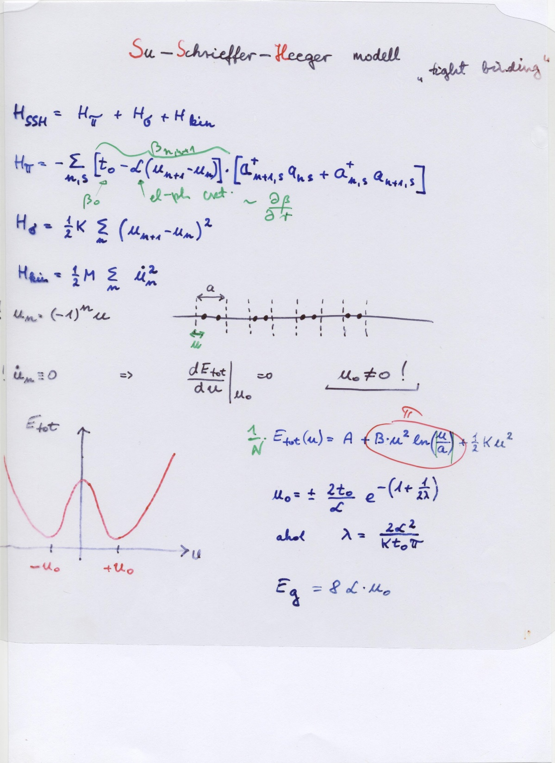

Slide 18
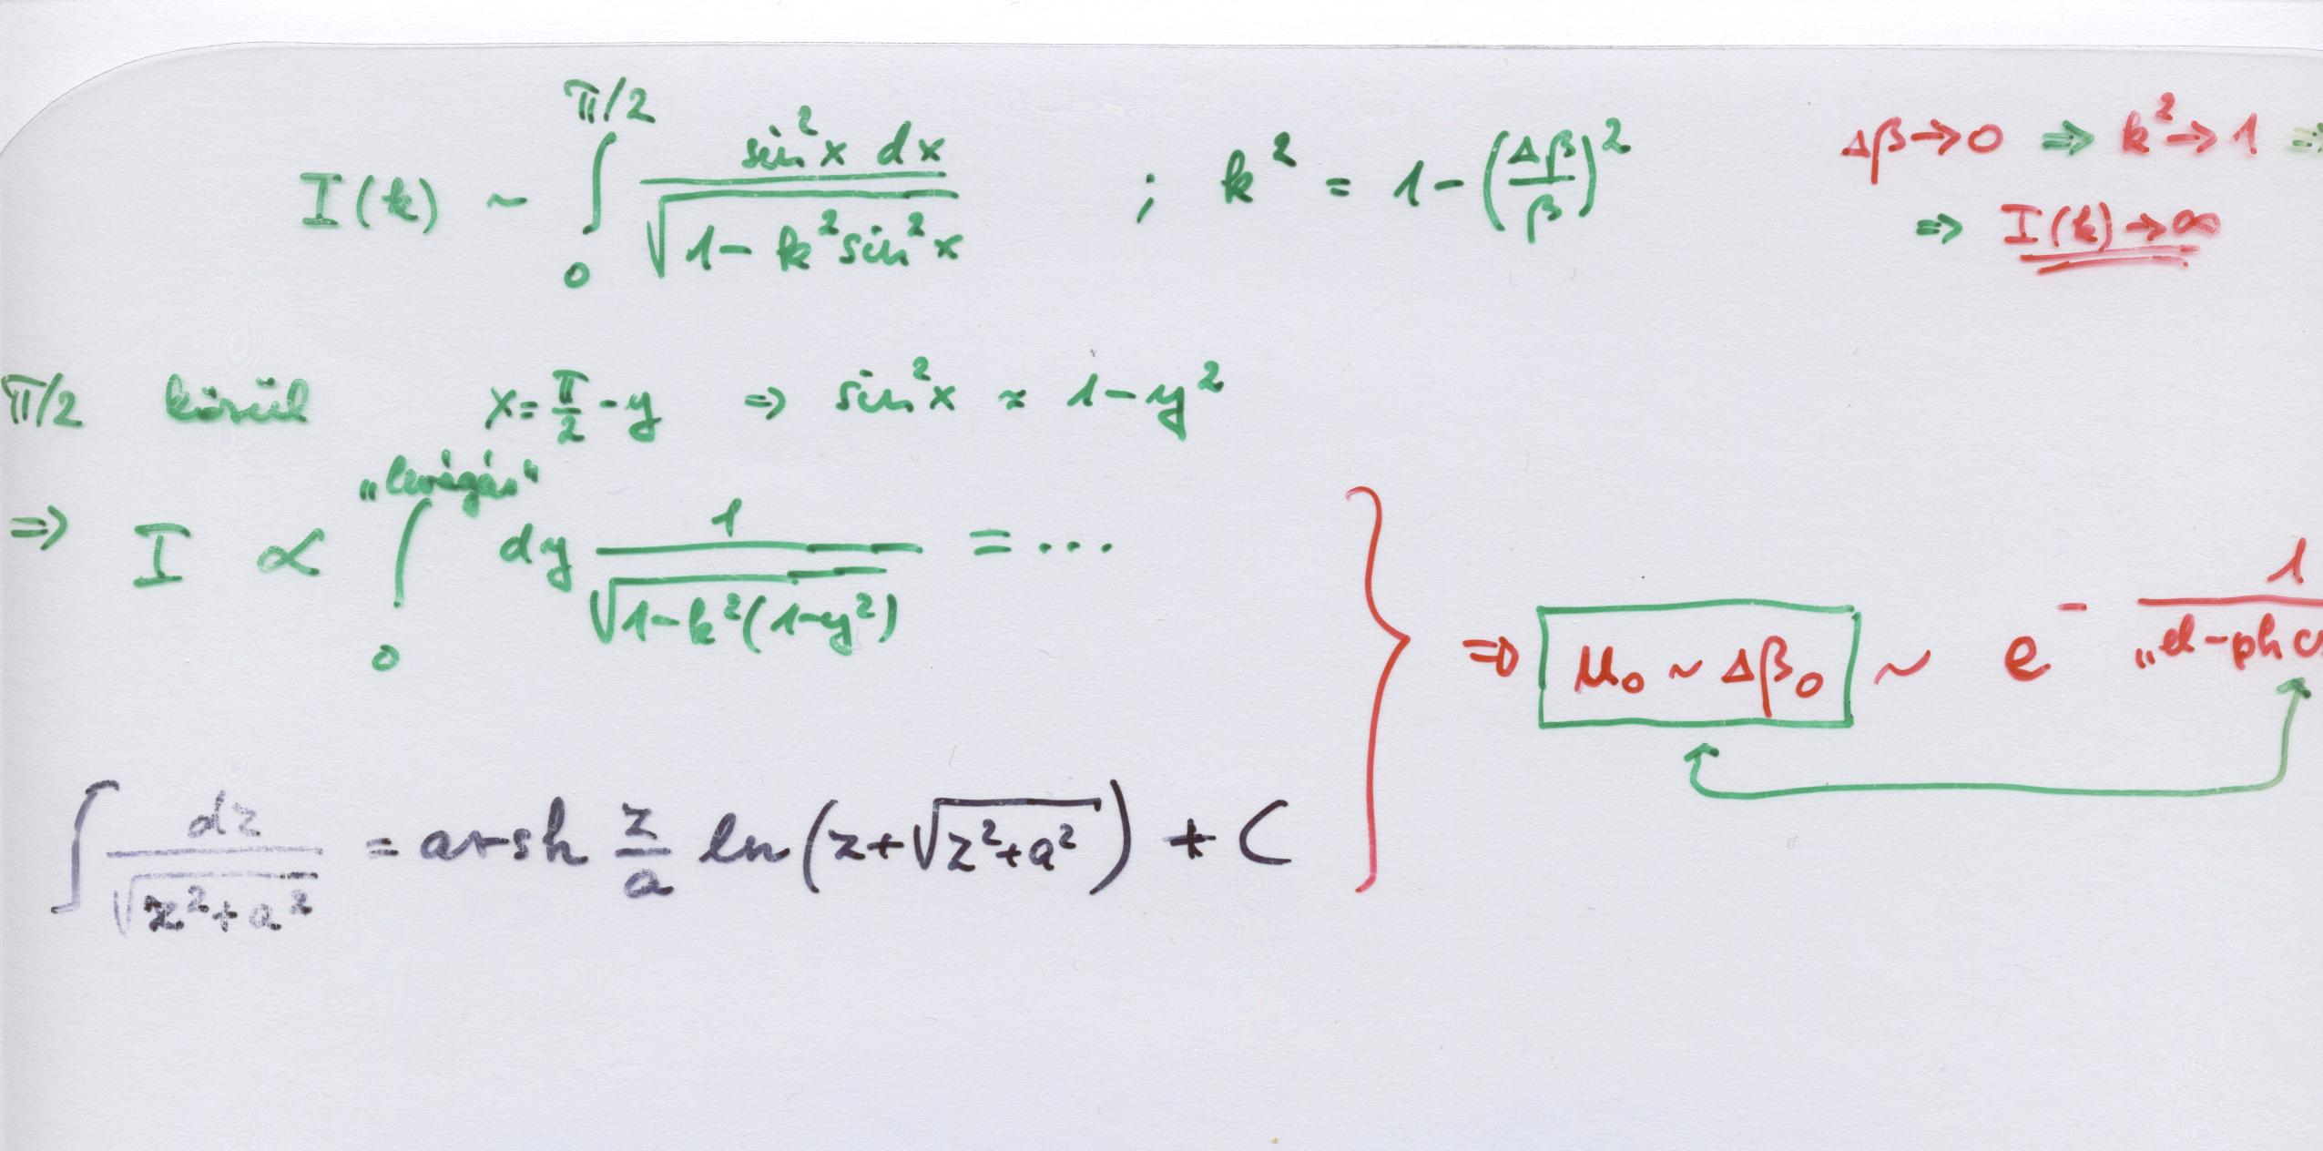

Slide 19
