Slide 1
MACROMOLECULES
lecture for physics and biophysics students
2018. winter semester – 12. November
Jenő KÜRTI
Eötvös Loránd University
Institute of Physics
Department of Biological Physics
e-mail: kurti@virag.elte.hu www: regivirag.elte.hu/kurti

Slide 2
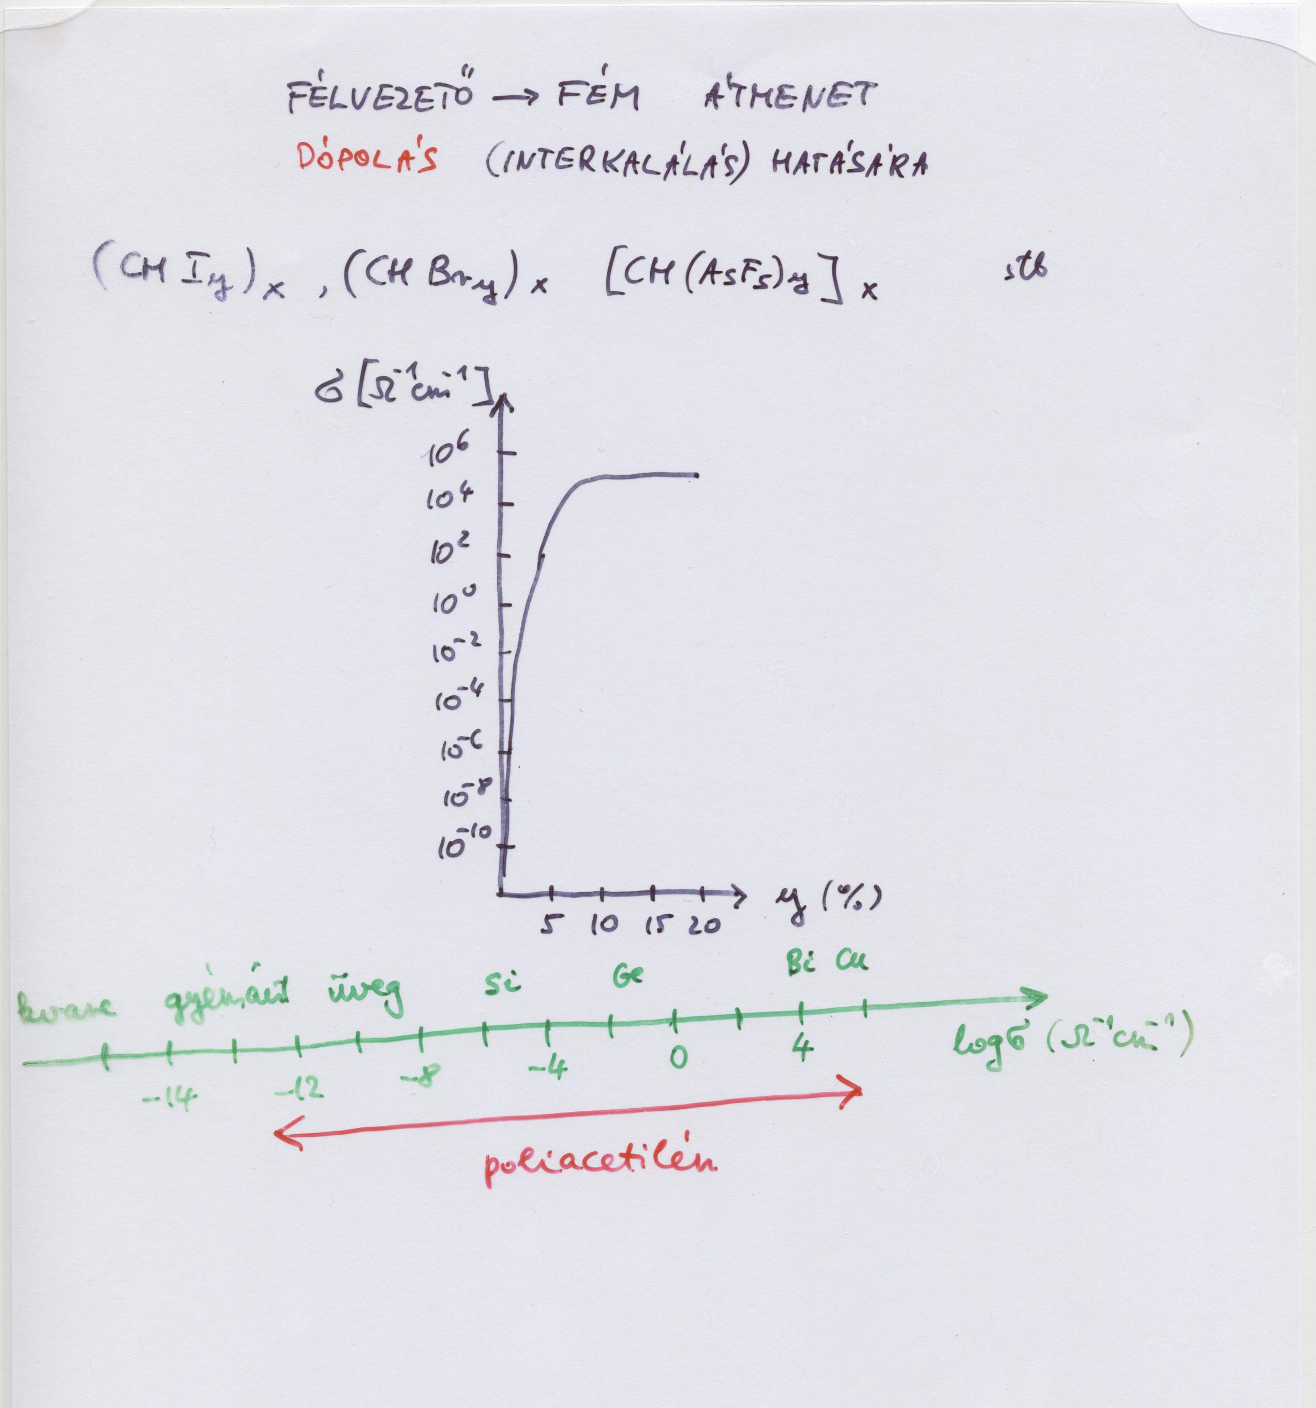

Slide 3
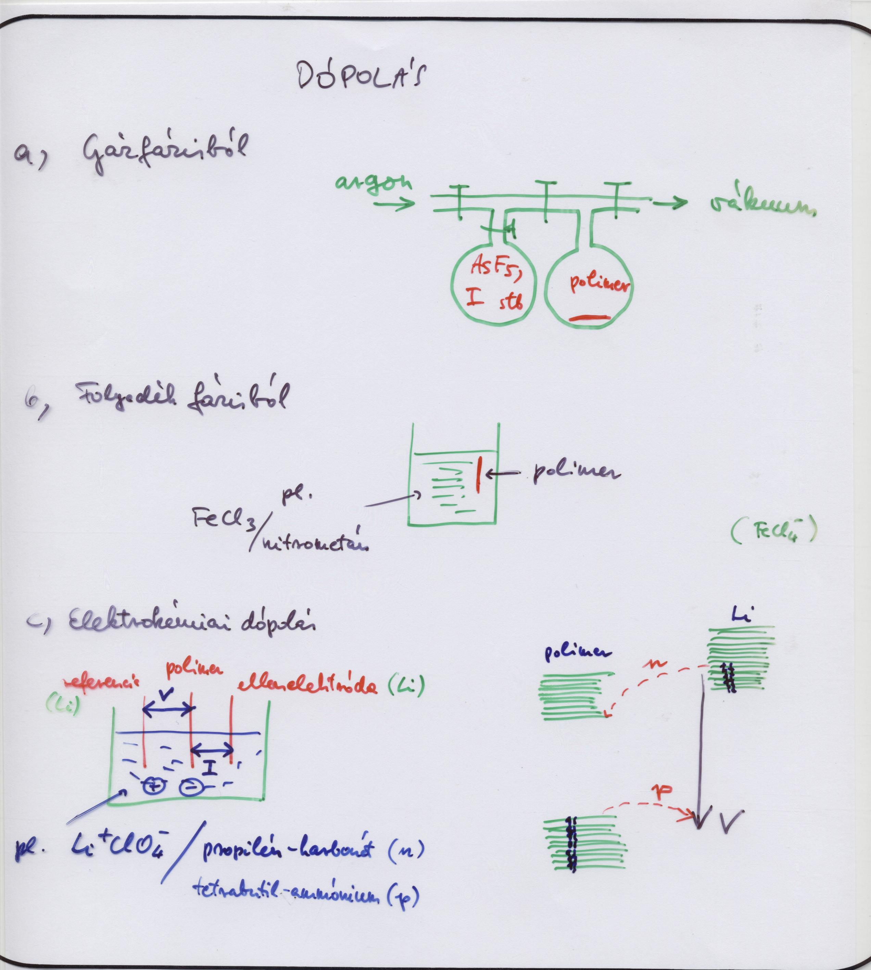

Slide 4
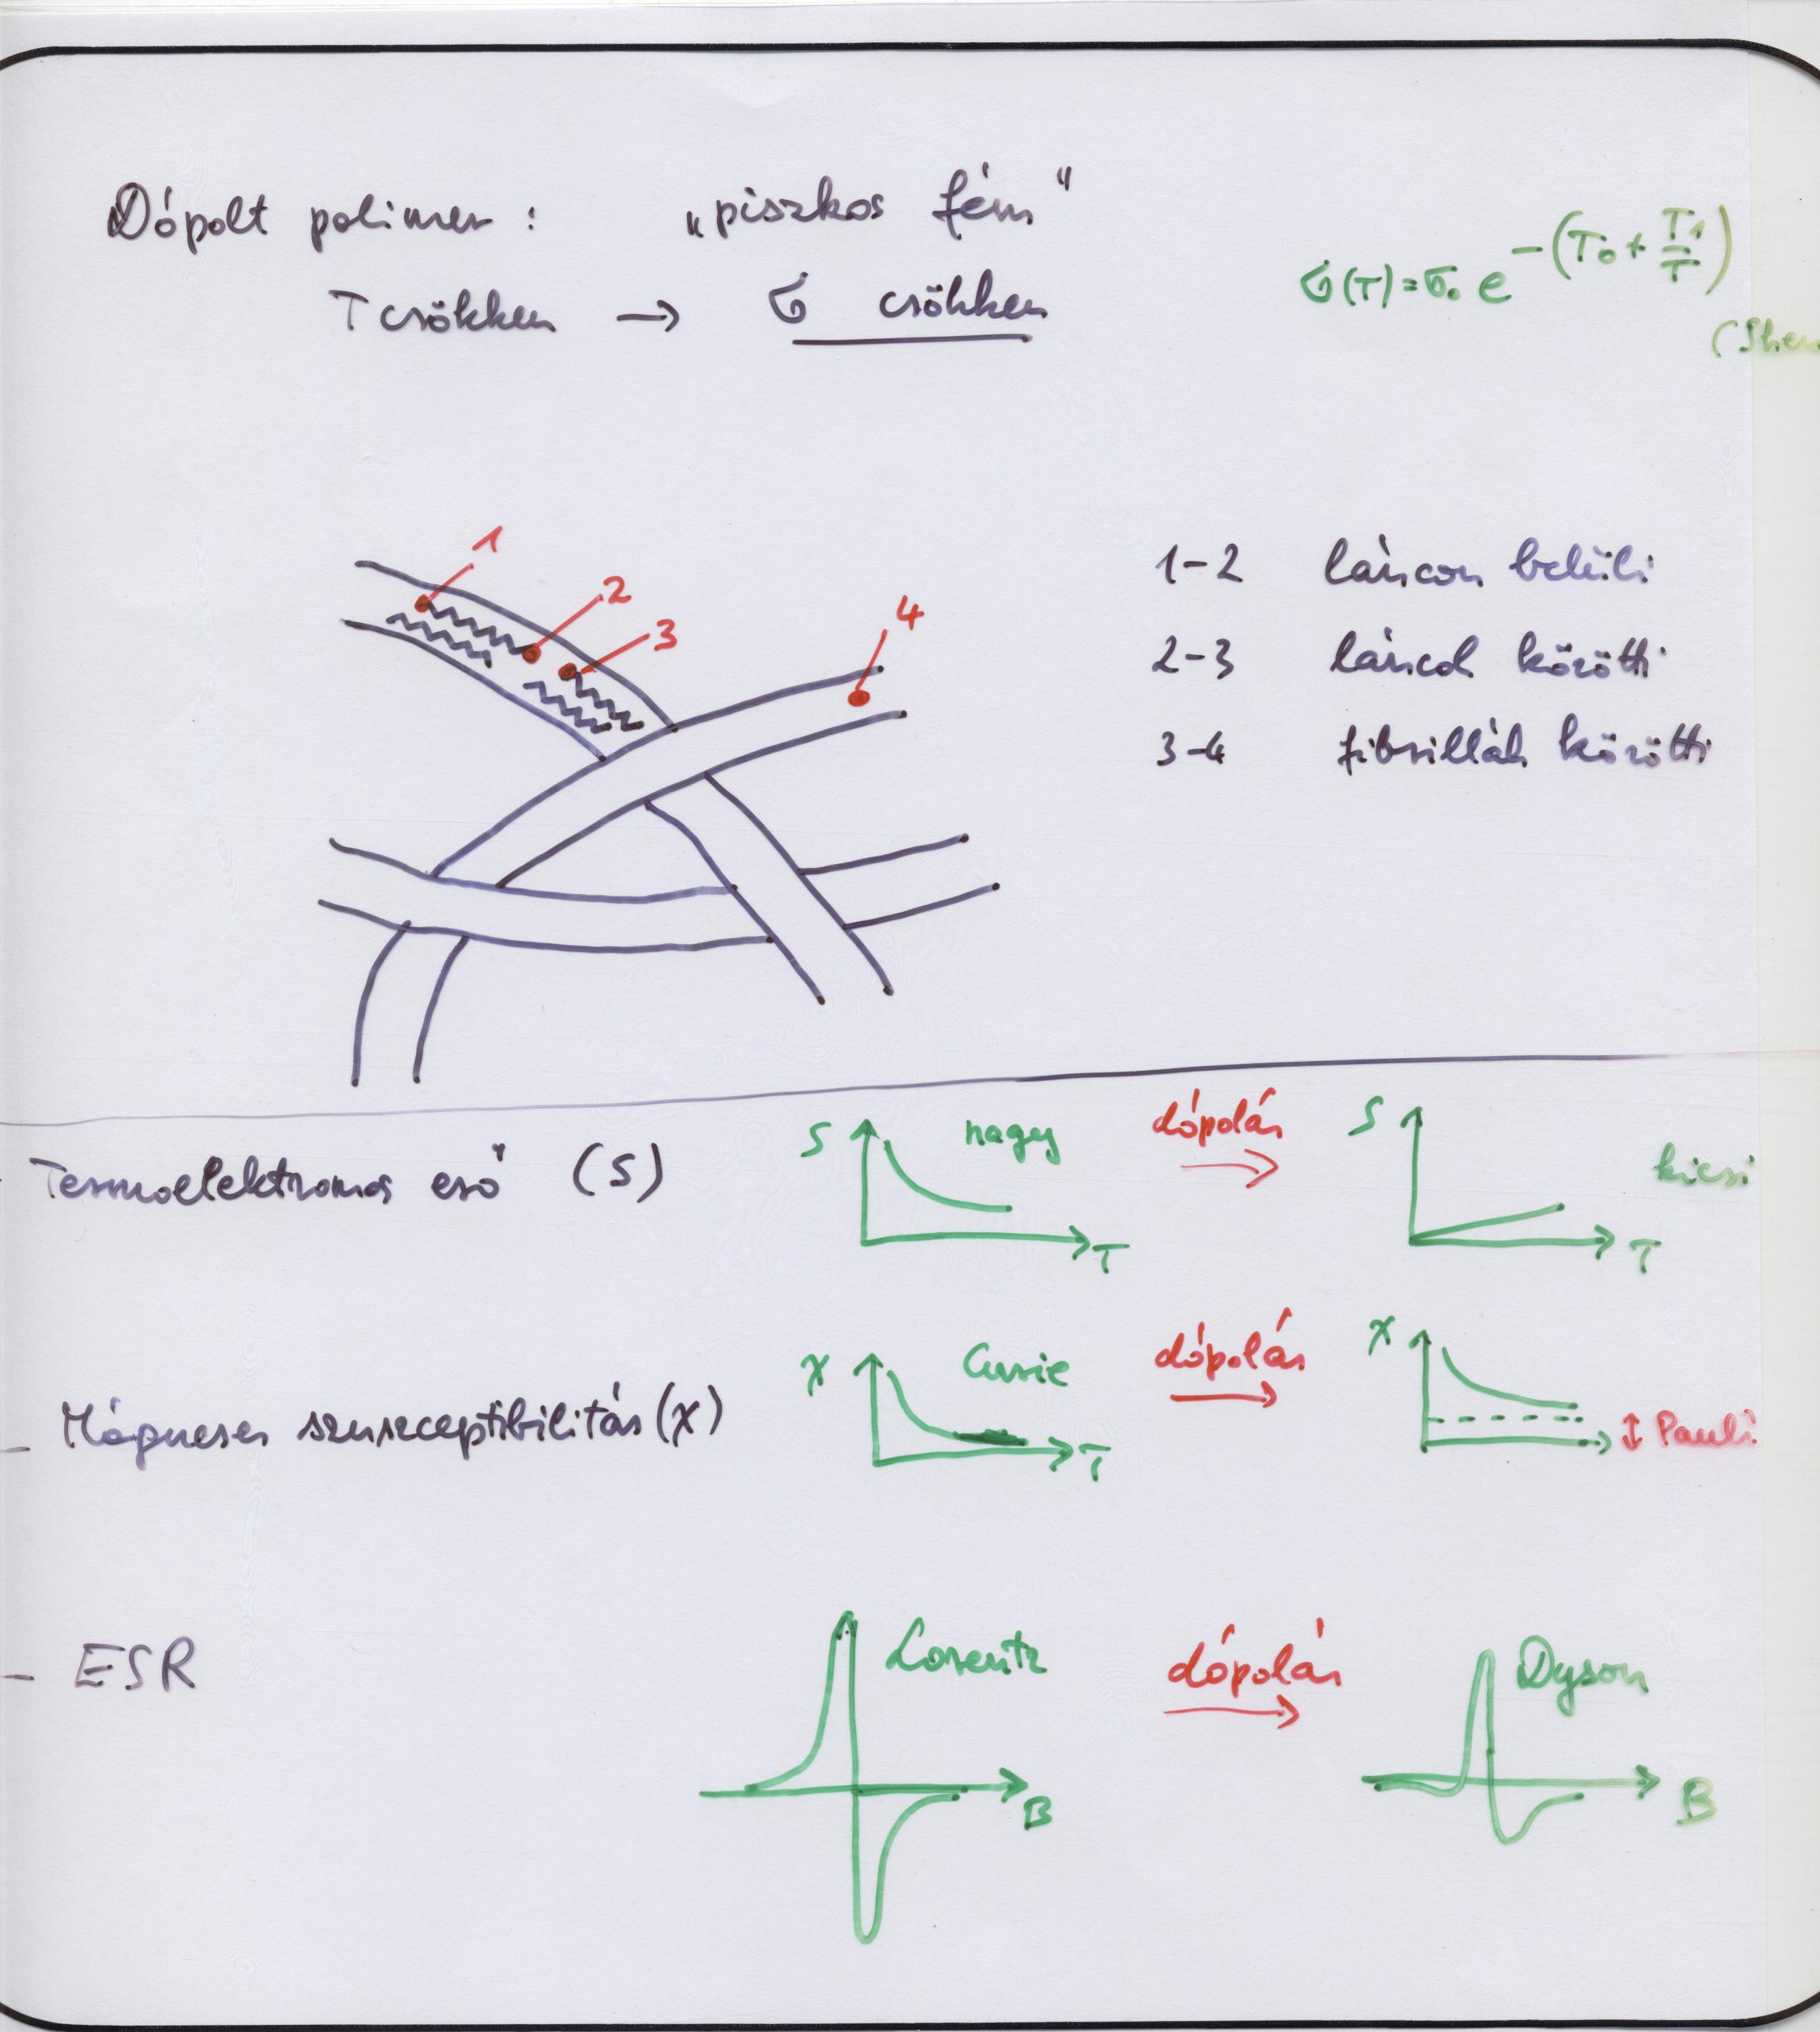

Slide 5
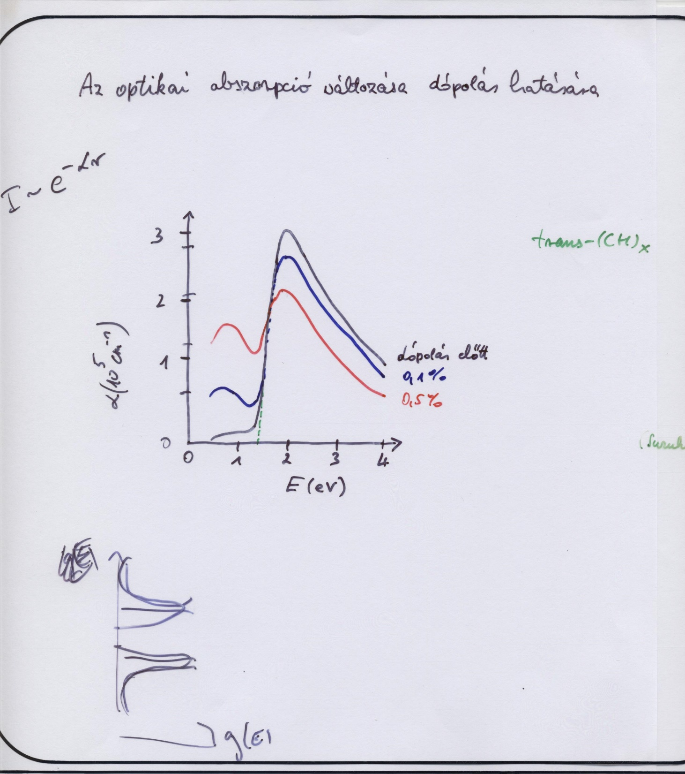

Slide 6
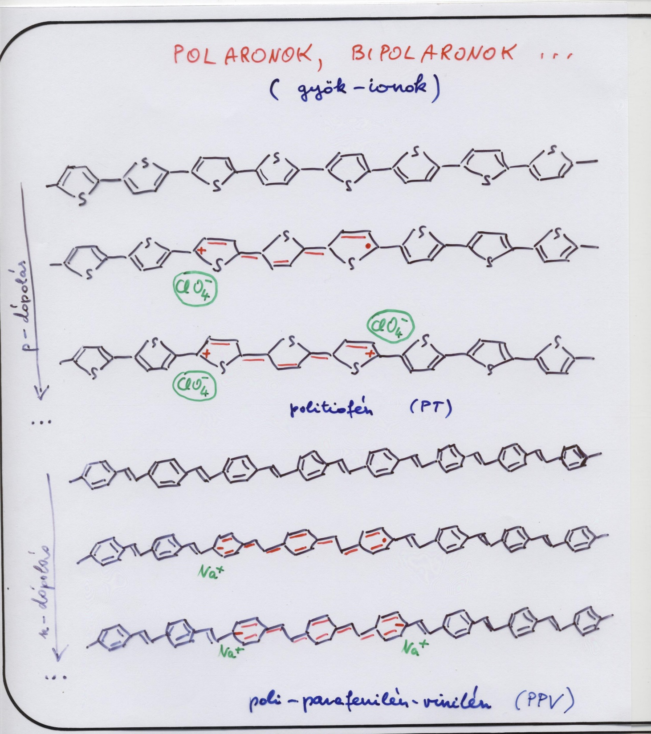

Slide 7
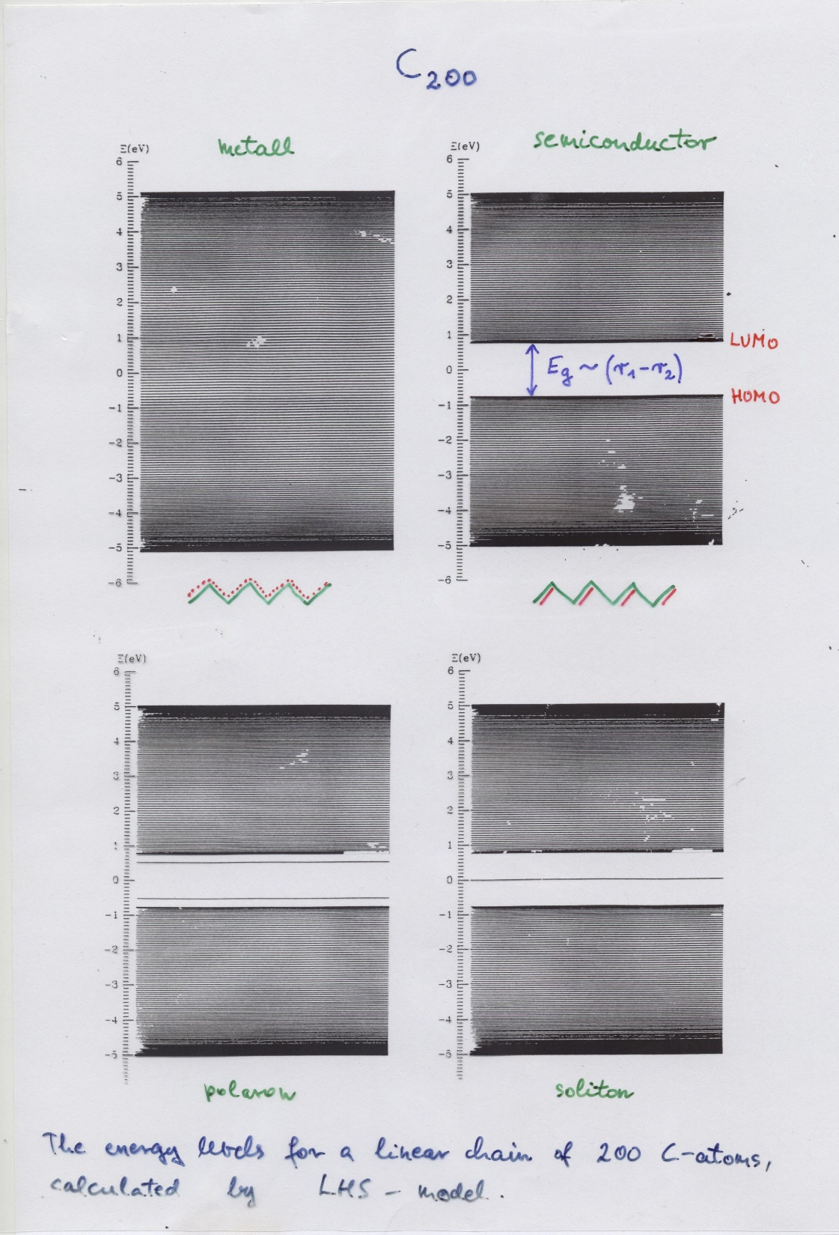

Slide 8
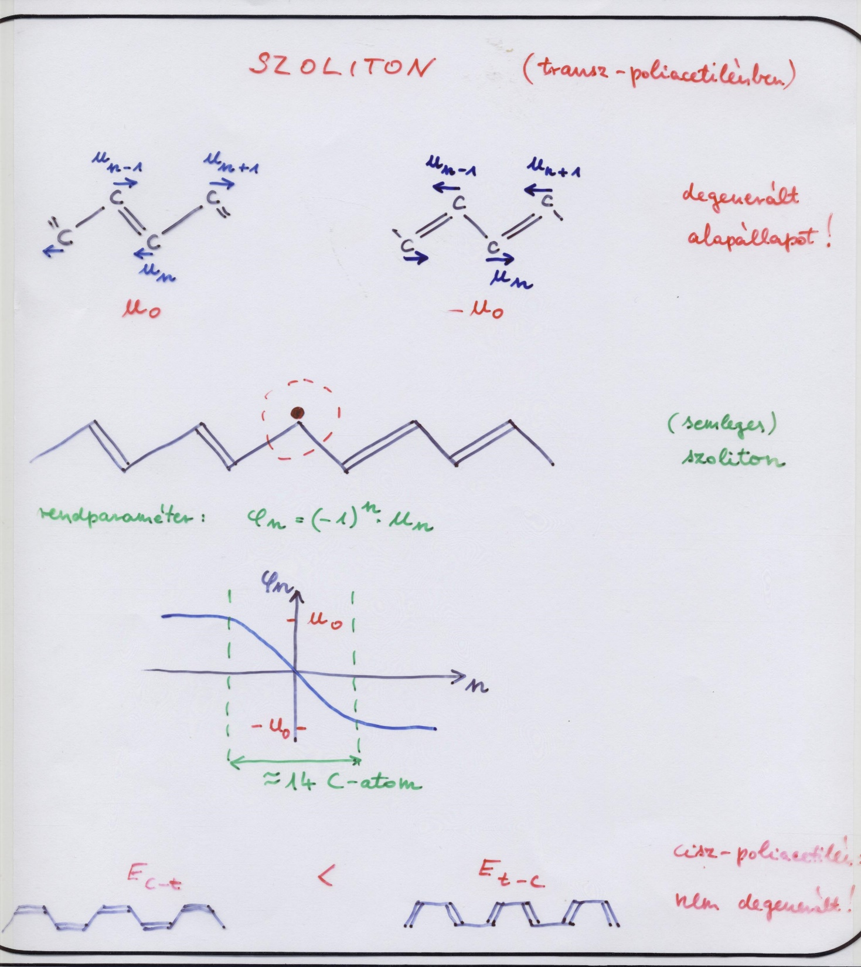

Slide 9
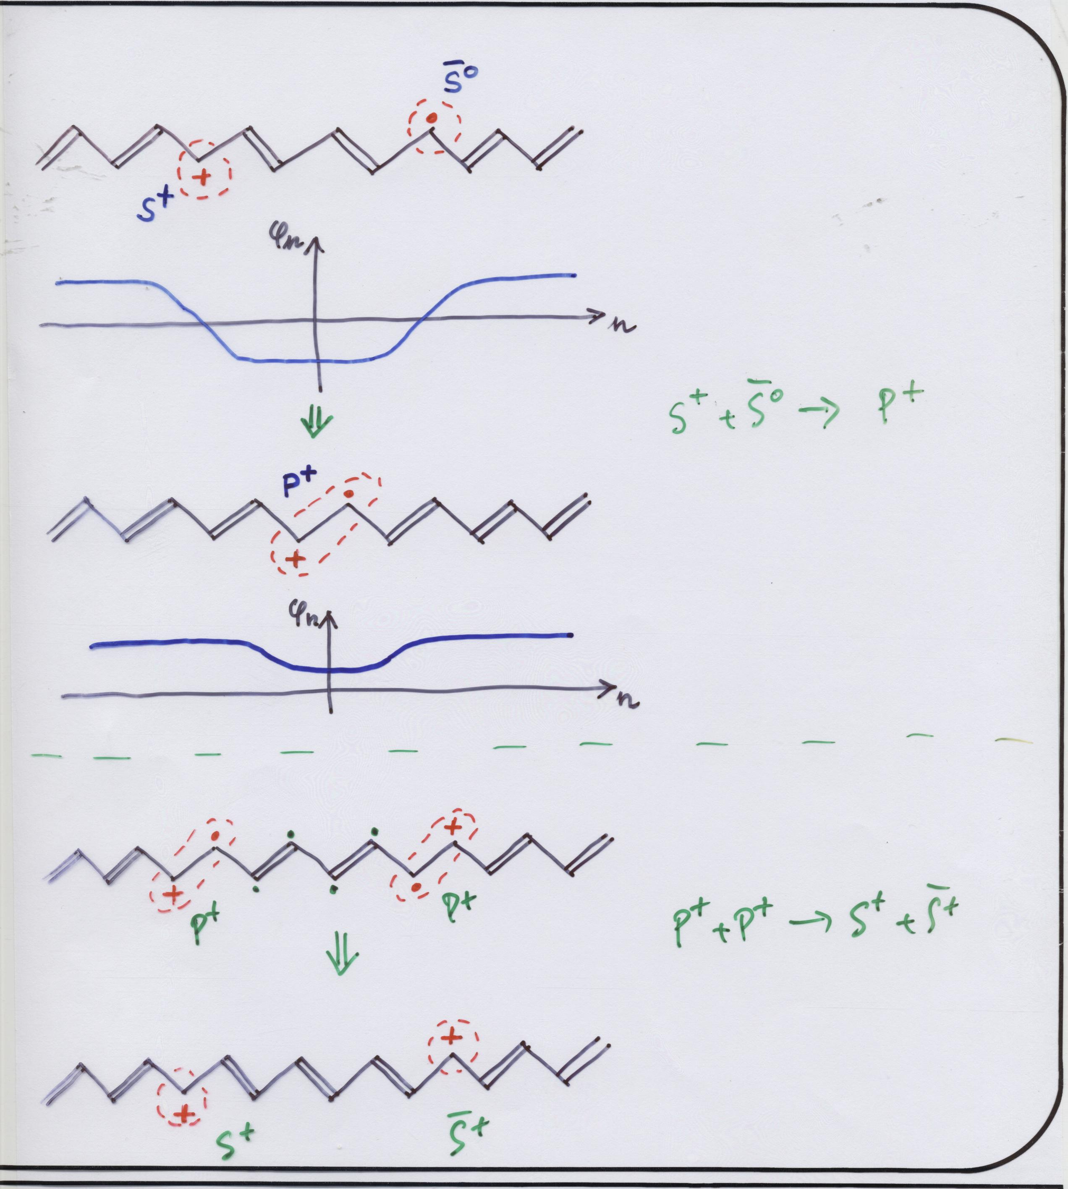

Slide 10
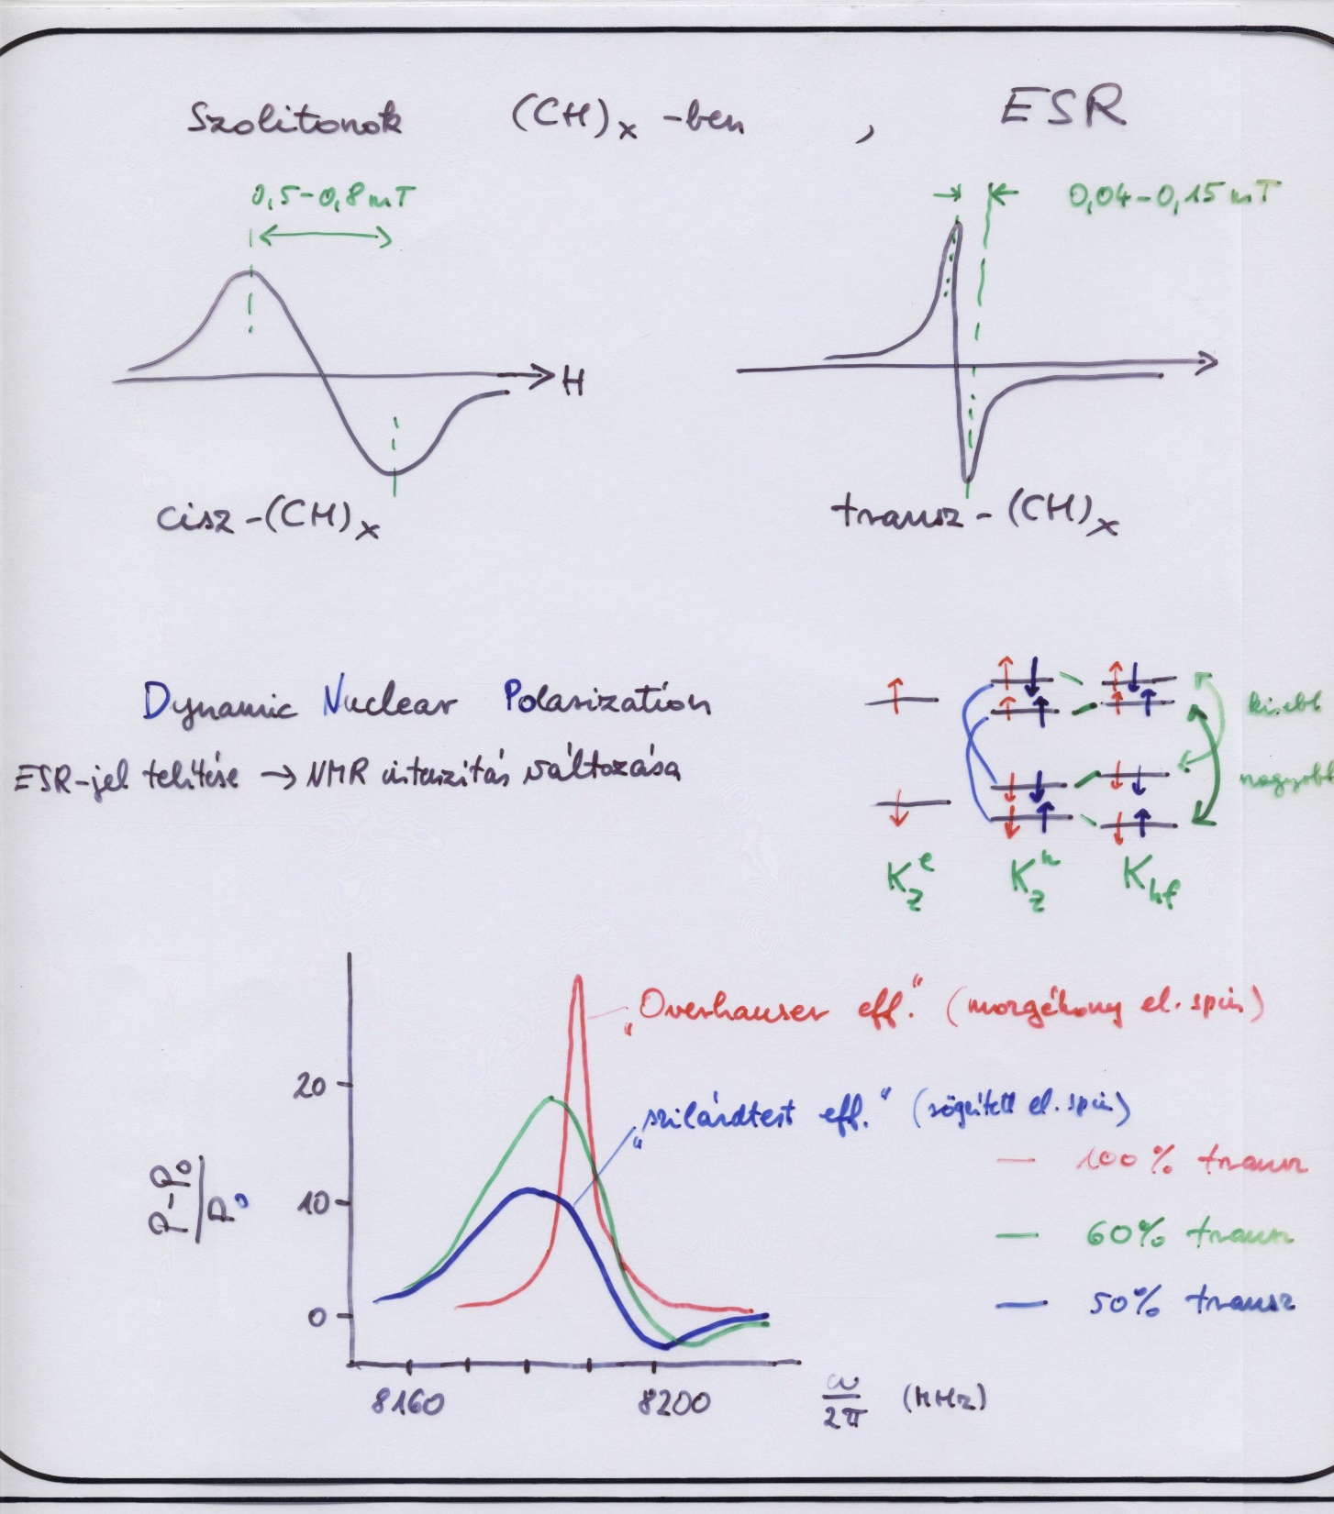

Slide 11
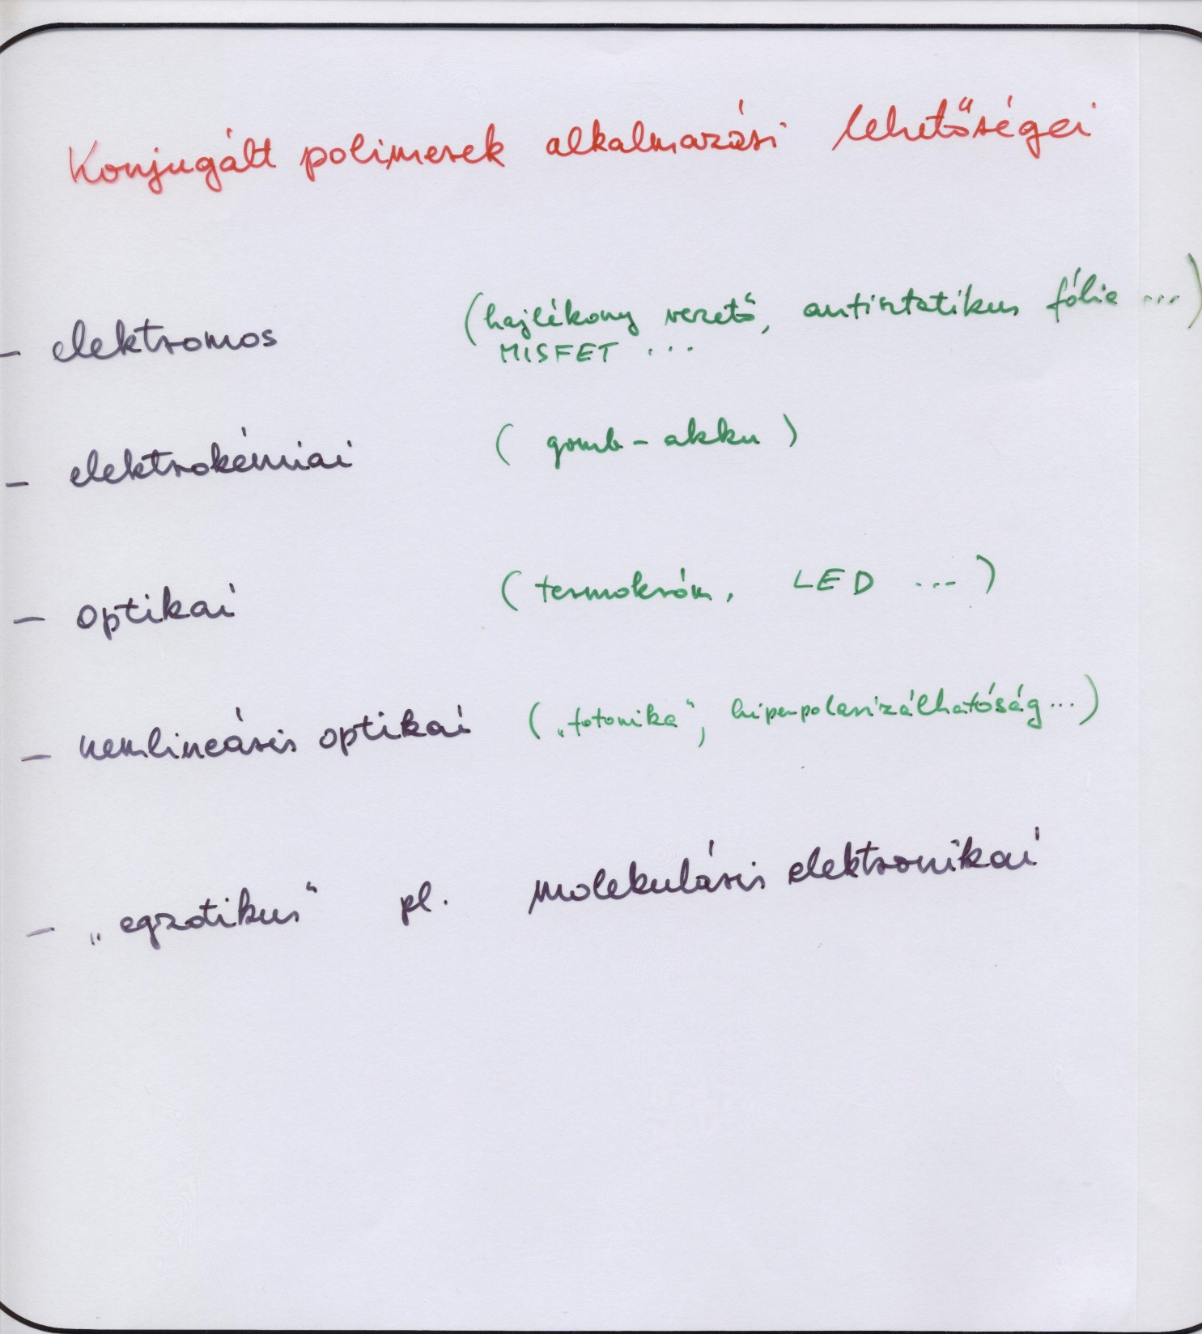

Slide 12
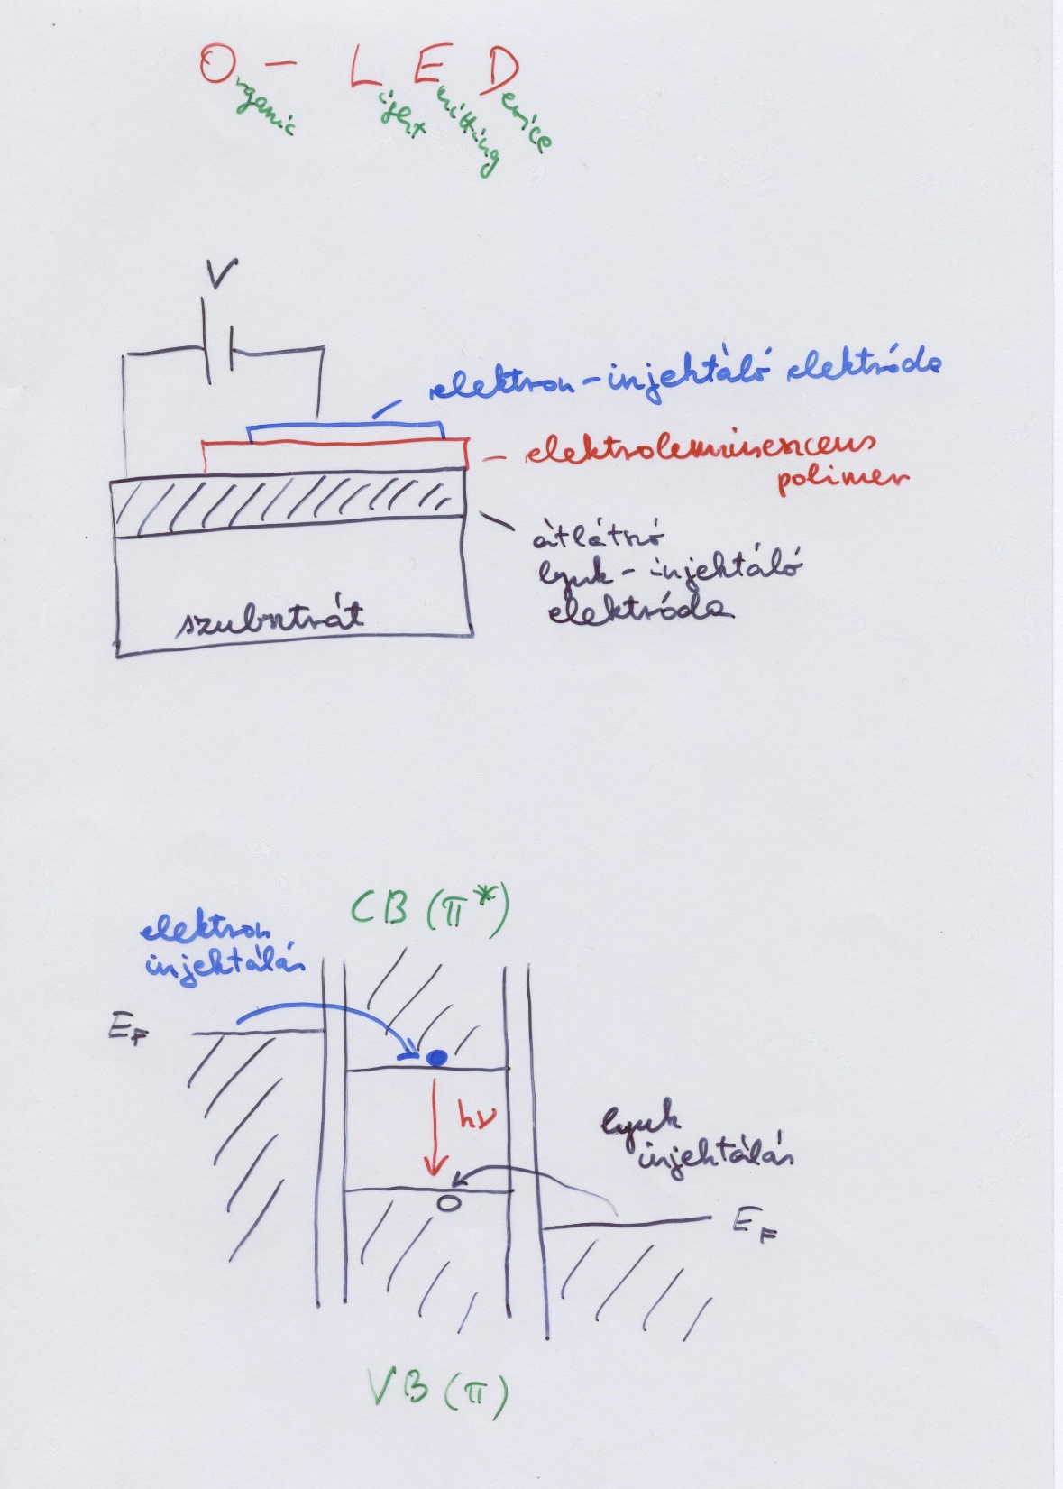

Slide 13
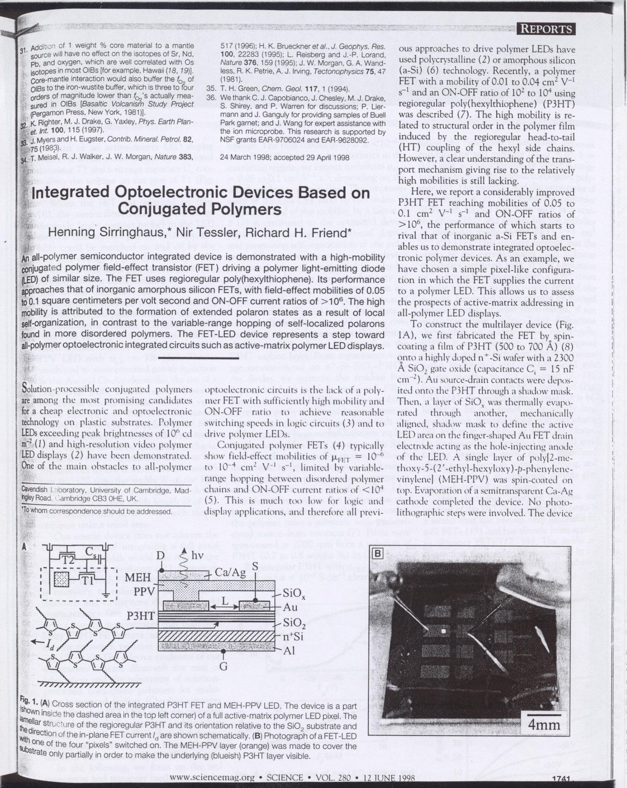

Slide 14
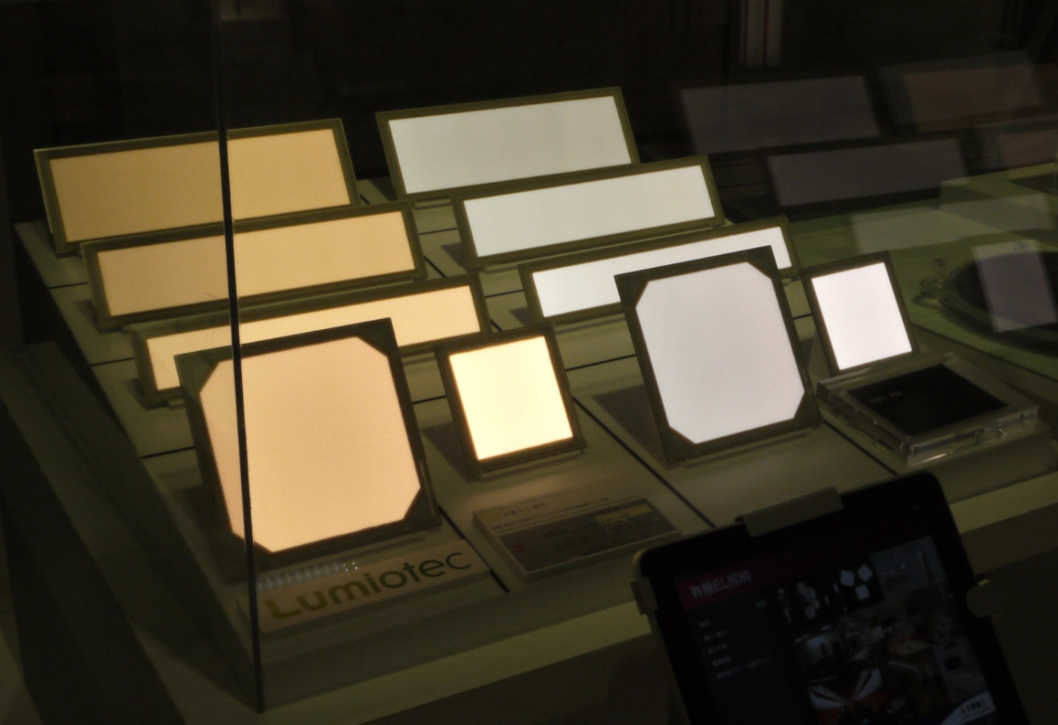
Prototype OLED lighting panels
from Wikipedia

Slide 15
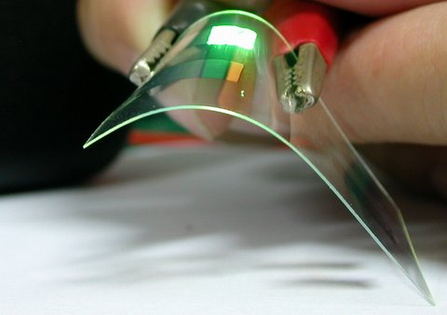
Demonstration of a flexible OLED device
from Wikipedia

Slide 16
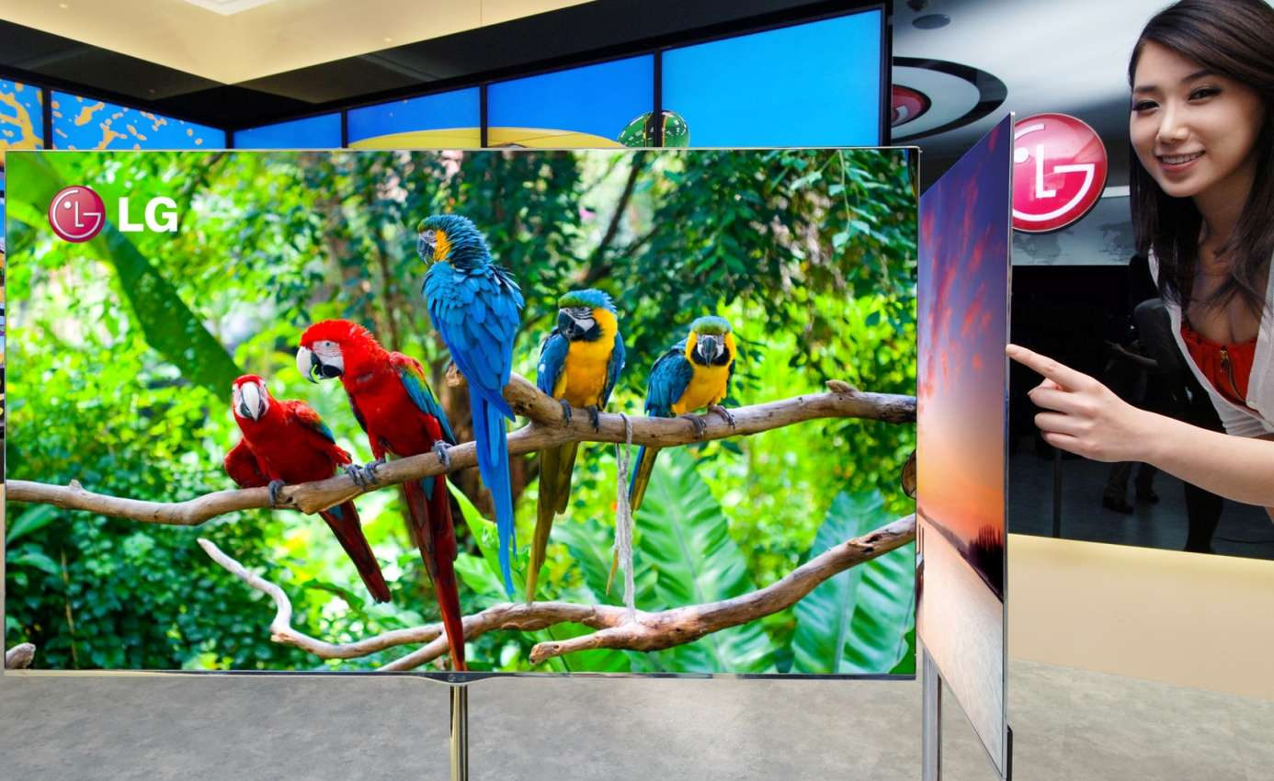
LG OLED TV
from Wikipedia

Slide 17
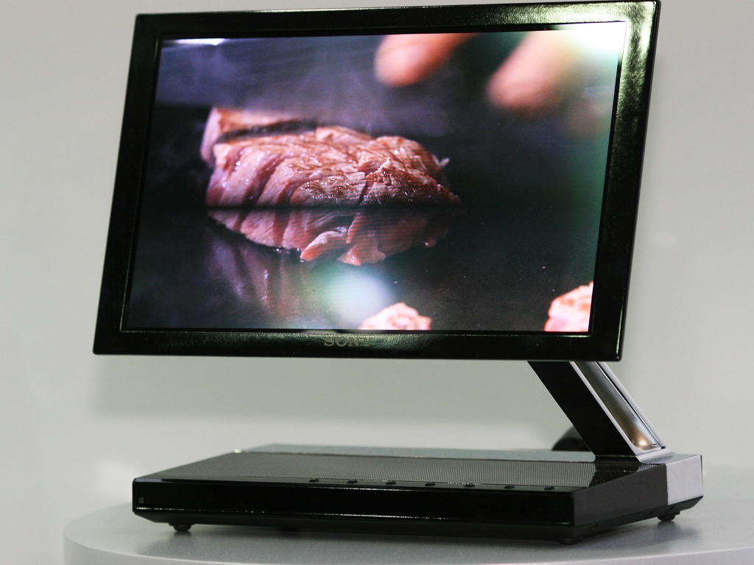
Sony XEL-1, the world's first OLED TV
from Wikipedia

Slide 18
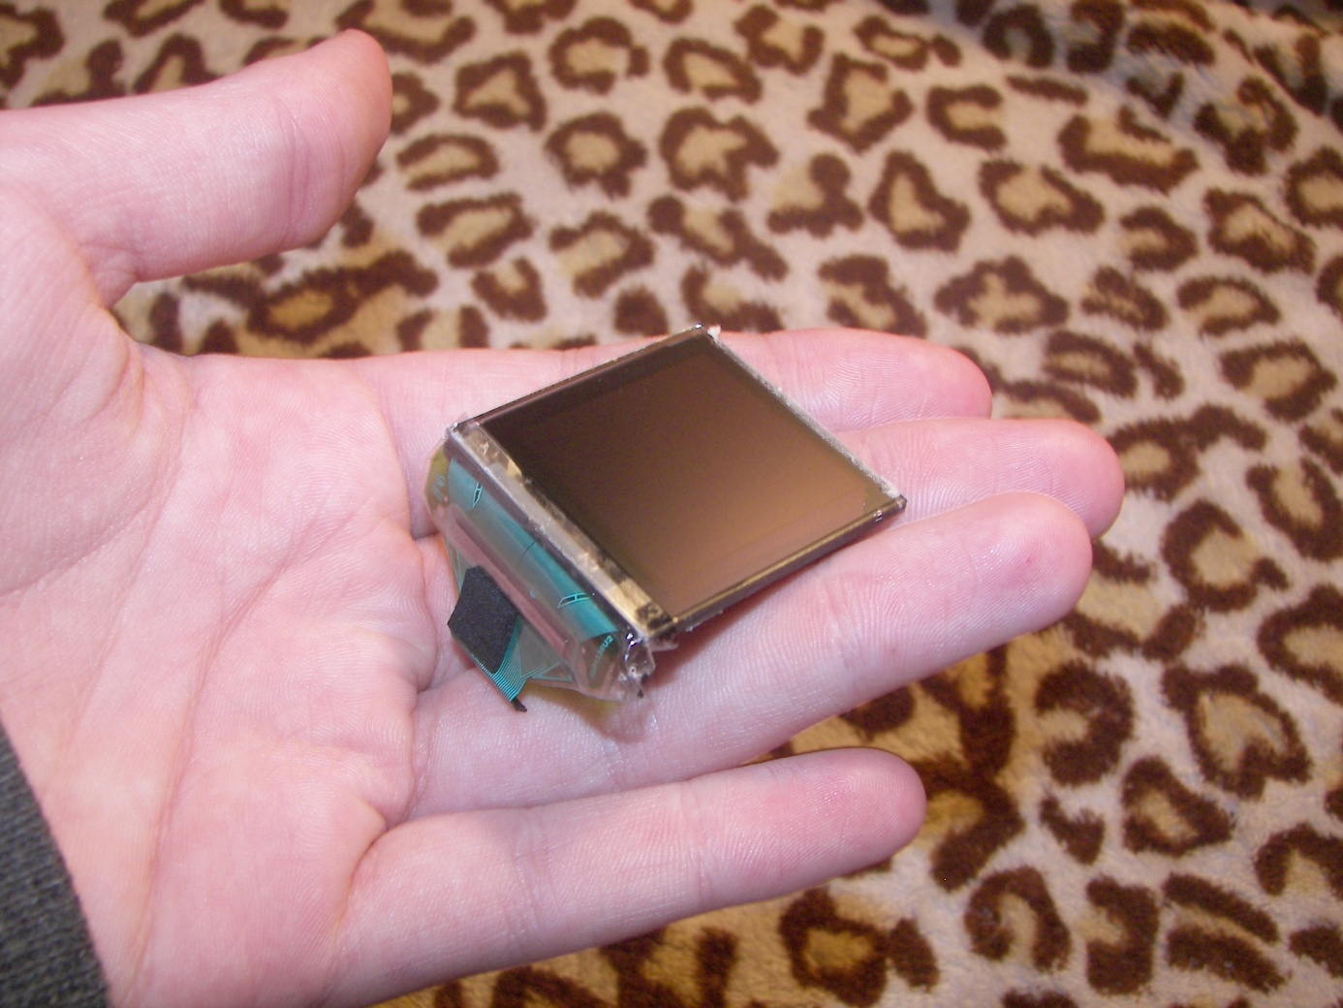
3.8 cm (1.5 in) OLED display from a Creative ZEN V media player
from Wikipedia

Slide 19
Demonstration of a 4.1" prototype OLED flexible display from Sony
from Wikipedia

